Slide 1


Automatic Key Term Extraction and Summarization from Spoken Course Lectures
課程錄音之自動關鍵用語擷取及摘要
Speaker: Yun-Nung Chen 陳縕儂
Advisor: Prof. Lin-Shan Lee 李琳山
National Taiwan University
Notes:
Hello, everybody. I am Vivian Chen, coming from National Taiwan University.
Today I’m going to present my work about automatic key term extraction from spoken course lectures using branching entropy and prosodic/semantic features.

Slide 2


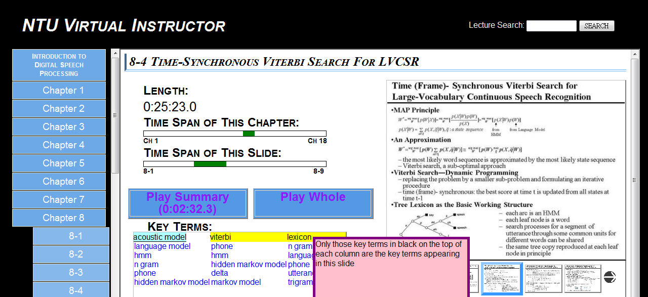
Introduction
Target: extract key terms and summaries from course lectures
Notes:
We can show some key terms related to acoustic model.
If the key term and acoustic model co-occurs in the same document, they are relevant, so that we can show them for users.

Slide 3
Introduction
Key Term
Summary
Indexing and retrieval
The relations between key terms and segments of documents
Efficiently understand the document
Related to document understanding and semantics from the document
Both are “Information Extraction”
Notes:
First I will define what is key term.
A key term is a term that has higher term frequency and includes core content.
There are two types of key terms.
One of them is phrase, we call it key phrase. For example, “language model” is a key phrase.
Another type is single word, we call it keyword, like “entropy”.
Then there are two advantages about key term extraction.
They can help us index and retrieve.
We also can construct the relationships between key terms and segment documents.
Here’s an example.

Slide 4
Automatic Key Term Extraction

Slide 5
Definition
Key Term
    Higher term frequency
    Core content
Two types
    Keyword
      Ex. “語音”
    Key phrase
      Ex. “語言 模型”
Notes:
First I will define what is key term.
A key term is a term that has higher term frequency and includes core content.
There are two types of key terms.
One of them is phrase, we call it key phrase. For example, “language model” is a key phrase.
Another type is single word, we call it keyword, like “entropy”.
Then there are two advantages about key term extraction.
They can help us index and retrieve.
We also can construct the relationships between key terms and segment documents.
Here’s an example.

Slide 6
Automatic Key Term Extraction
▼ Original spoken documents
Archive of spoken documents
Learning Methods
AdaBoost
Neural Network
ASR trans
ASR
Branching Entropy
Feature Extraction
speech signal
Notes:
Here’s the flow chart. Now there are a lot of spoken documents.

Slide 7
Automatic Key Term Extraction
Archive of spoken documents
Learning Methods
AdaBoost
Neural Network
ASR trans
ASR
Branching Entropy
Feature Extraction
speech signal
Notes:
First, with speech recognition system, we can get ASR transcriptions.

Slide 8
Automatic Key Term Extraction
Archive of spoken documents
Learning Methods
AdaBoost
Neural Network
ASR trans
ASR
Branching Entropy
Feature Extraction
speech signal
Notes:
The input of our work includes transcriptions and speech signals.

Slide 9
Automatic Key Term Extraction
Phrase Identification
Archive of spoken documents
Learning Methods
AdaBoost
Neural Network
ASR trans
ASR
Branching Entropy
Feature Extraction
speech signal
First using branching entropy to identify phrases
Notes:
The first part is to identify phrases. We propose branching entropy to finish this part.

Slide 10
Automatic Key Term Extraction
Phrase Identification
Key Term Extraction
Archive of spoken documents
Learning Methods
AdaBoost
Neural Network
ASR trans
ASR
Branching Entropy
Feature Extraction
speech signal
Key terms
entropy
acoustic model
:
Then using learning methods to extract key terms by some features
Notes:
Then we can enter key term extraction part.
We first extract some features to represent a candidate term, and use machine learning methods to decide the key terms.

Slide 11
Automatic Key Term Extraction
Phrase Identification
Key Term Extraction
Archive of spoken documents
Learning Methods
AdaBoost
Neural Network
ASR trans
ASR
Branching Entropy
Feature Extraction
speech signal
Key terms
entropy
acoustic model
:
Notes:
First we explain how to do phrase identification.

Slide 12
Branching Entropy
How to decide the boundary of a phrase?
is
represent
of
is
in
hidden Markov model
can
:
:
:
:
      Inside the phrase
Notes:
The target of this work is to decide the boundary of a phrase, but where’s the boundary?
We can observe some characteristics first.
Hidden is almost always followed by Markov.

Slide 13
Branching Entropy
How to decide the boundary of a phrase?
is
represent
of
is
in
hidden Markov model
can
:
:
:
:
      Inside the phrase
      Inside the phrase
Notes:
Similarly, hidden Markov is almost always followed by model,

Slide 14
Branching Entropy
How to decide the boundary of a phrase?
is
represent
of
is
in
hidden Markov model
can
:
:
:
:
boundary
      Inside the phrase
      Inside the phrase
      Boundary of the phrase
Define branching entropy to decide possible boundary
Notes:
But at this position, we find that hidden Markov model is followed by some different words.
The position is more likely to be boundary.
Then we define branching entropy by the concept.

Slide 15
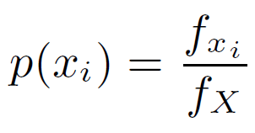
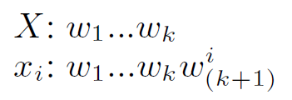
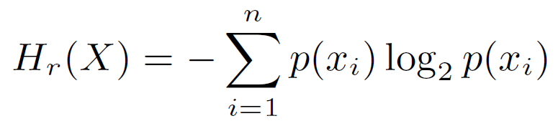
Branching Entropy
How to decide the boundary of a phrase?
is
represent
of
is
in
hidden Markov model
can
:
:
:
X
x_{i}
:
    Definition of Right Branching Entropy
    Probability of x_{i} given X
    Right branching entropy for X
Notes:
First, I will define what is right branching entropy.
We assume that X is hidden and x_i is the children of X, representing hidden Markov.
We define p of x_i to be the frequency of x_i over the frequency of X, which is probability of children x_i for X.
Then we define right branching entropy as this equation, H_r of X, which represents the entropy of X’s chidren.

Slide 16
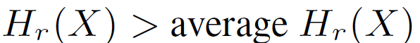
Branching Entropy
How to decide the boundary of a phrase?
is
represent
of
is
in
hidden Markov model
can
:
:
:
X
:
boundary
    Decision of Right Boundary
    Find the right boundary located between X and x_{i} where
Notes:
The idea is that the branching entropy at the boundary is higher.
So we can find the right boundary where branching entropy is higher like hidden Markov model.

Slide 17
Branching Entropy
How to decide the boundary of a phrase?
is
represent
of
is
in
hidden Markov model
can
:
:
:
:
Notes:
Similarly, left branching entropy has the same attribute.

Slide 18
Branching Entropy
How to decide the boundary of a phrase?
is
represent
of
is
in
hidden Markov model
can
:
:
:
:
Notes:
The approach called branching entropy is to find the boundaries of key phrases, but where’s the boundary.
The idea is that the word entropy at the boundary is higher.
There are four parts in this approach. We can present each part in detail.

Slide 19
Branching Entropy
How to decide the boundary of a phrase?
is
represent
of
is
in
hidden Markov model
can
:
:
:
:
boundary
Using PAT tree to implement
Notes:
The approach called branching entropy is to find the boundaries of key phrases, but where’s the boundary.
The idea is that the word entropy at the boundary is higher.
There are four parts in this approach. We can present each part in detail.

Slide 20
Automatic Key Term Extraction
Phrase Identification
Key Term Extraction
Archive of spoken documents
Learning Methods
AdaBoost
Neural Network
ASR trans
ASR
Branching Entropy
Feature Extraction
speech signal
Key terms
entropy
acoustic model
:
Extract prosodic, lexical, and semantic features for each candidate term
Notes:
With all candidate terms, including words and phrases, we can extract prosodic, lexical, semantic features for each term.

Slide 21
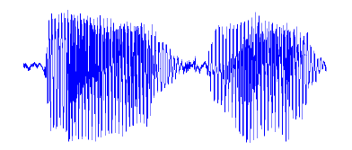
Feature Extraction
    Prosodic features
      For each candidate term appearing at the first time
Speaker tends to use longer duration to emphasize key terms
Feature Name | Feature Description
Duration (I – IV) | normalized duration (max, min, mean, range)
duration of phone “a” normalized by avg duration of phone “a”
using 4 values for duration of the term
Notes:
For each word, we also compute some prosodic features.
First, we believe that lecturer would use longer duration to emphasize key terms.
For the candidate term first appearing, we compute the duration for each phone in each candidate term.
Then we normalize the duration of specific phone by the average duration of this phone.
In this feature, we only use four values to represent this term.
We can compute maximum, minimum, mean and range over all phones in a single term to be the features.

Slide 22
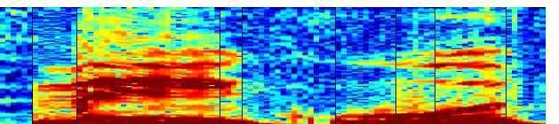
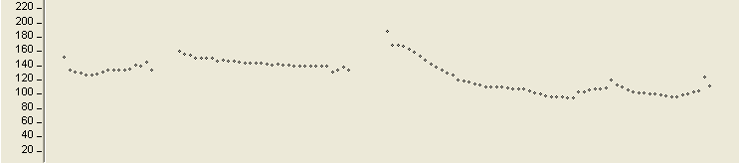
Feature Extraction
    Prosodic features
      For each candidate term appearing at the first time
Higher pitch may represent significant information
Feature Name | Feature Description
Duration (I – IV) | normalized duration (max, min, mean, range)
Notes:
We believe that higher pitch may represent important information.
So we can extract the pitch contour like this.

Slide 23
Feature Extraction
    Prosodic features
      For each candidate term appearing at the first time
Higher pitch may represent significant information
Feature Name | Feature Description
Duration (I – IV) | normalized duration (max, min, mean, range)
Pitch (I - IV) | F0 (max, min, mean, range)
Notes:
The method is like duration, but the segment unit is changed to single frame.
We also use these four values to represent the features.

Slide 24

Feature Extraction
    Prosodic features
      For each candidate term appearing at the first time
Higher energy emphasizes important information
Feature Name | Feature Description
Duration (I – IV) | normalized duration (max, min, mean, range)
Pitch (I - IV) | F0 (max, min, mean, range)
Notes:
Similarly, we think that higher energy may represent important information.
We also can extract energy for each frame in a candidate term.

Slide 25
Feature Extraction
    Prosodic features
      For each candidate term appearing at the first time
Higher energy emphasizes important information
Feature Name | Feature Description
Duration (I – IV) | normalized duration (max, min, mean, range)
Pitch (I - IV) | F0 (max, min, mean, range)
Energy (I - IV) | energy (max, min, mean, range)
Notes:
The features are like pitch. The first set of features is shown in this.

Slide 26
Feature Extraction
    Lexical features
Feature Name | Feature Description
TF | term frequency
IDF | inverse document frequency
TFIDF | tf * idf
PoS | the PoS tag
Using some well-known lexical features for each candidate term
Notes:
The second set of features is lexical features.
These features are well-known, which may indicate the importance of term.
We just use these features to represent each term.

Slide 27
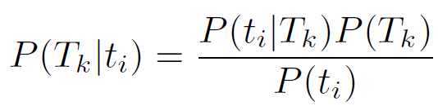
Feature Extraction
    Semantic features
      Probabilistic Latent Semantic Analysis (PLSA)
        Latent Topic Probability
Key terms tend to focus on limited topics
D_{i}: documents
T_{k}: latent topics
t_{j}: terms
Notes:
Third set of features is semantic features.
The assumption is that key terms tend to focus on limited topics.
We use PLSA to compute some semantic features.
We can get the probability of each topic given a candidate term.

Slide 28
Feature Extraction
    Semantic features
      Probabilistic Latent Semantic Analysis (PLSA)
        Latent Topic Probability
Key terms tend to focus on limited topics
non-key term
key term
Feature Name | Feature Description
LTP (I - III) | Latent Topic Probability (mean, variance, standard deviation)
describe a probability distribution
Notes:
Here are distributions of two terms.
Notice that the first term has similar probability for most topics, and it may be a function word, so that this candidate term may be non-key term.
In other one, the term focuses on less topics, so it is more likely to be key term.
In order to describe the distribution, for the distribution, we compute mean, variance and standard deviation to be the features of this term.

Slide 29

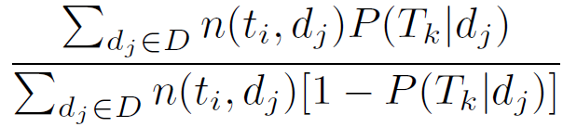
Feature Extraction
    Semantic features
      Probabilistic Latent Semantic Analysis (PLSA)
        Latent Topic Significance
      Within-topic to out-of-topic ratio
Key terms tend to focus on limited topics
non-key term
key term
within-topic freq.
out-of-topic freq.
Feature Name | Feature Description
LTP (I - III) | Latent Topic Probability (mean, variance, standard deviation)
Notes:
Similarly, we can compute latent topic significance, which is within-topic to out-of-topic ratio like this equation.
This is the significance of topic T_k in term t_i.
This one is within-topic frequency, where n of t_i and d_j is the number of t_i in document d_j, and this one is out-of-topic frequency.

Slide 30
Feature Extraction
    Semantic features
      Probabilistic Latent Semantic Analysis (PLSA)
        Latent Topic Significance
      Within-topic to out-of-topic ratio
Key terms tend to focus on limited topics
non-key term
key term
within-topic freq.
out-of-topic freq.
Feature Name | Feature Description
LTP (I - III) | Latent Topic Probability (mean, variance, standard deviation)
LTS (I - III) | Latent Topic Significance (mean, variance, standard deviation)
Notes:
Because the significance of key terms would focus on limited topics, we also compute this three values to represent a distribution.

Slide 31

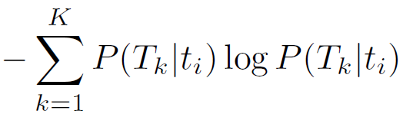
Feature Extraction
    Semantic features
      Probabilistic Latent Semantic Analysis (PLSA)
        Latent Topic Entropy
Key terms tend to focus on limited topics
non-key term
key term
Feature Name | Feature Description
LTP (I - III) | Latent Topic Probability (mean, variance, standard deviation)
LTS (I - III) | Latent Topic Significance (mean, variance, standard deviation)
Notes:
Then, we also can compute latent topic entropy.
Because this feature also can describe the difference between these two distributions.
Non-key term may have higher LTE, and key term would have lower one.

Slide 32
Feature Extraction
    Semantic features
      Probabilistic Latent Semantic Analysis (PLSA)
        Latent Topic Entropy
Key terms tend to focus on limited topics
non-key term
Higher LTE
key term
Lower LTE
Feature Name | Feature Description
LTP (I - III) | Latent Topic Probability (mean, variance, standard deviation)
LTS (I - III) | Latent Topic Significance (mean, variance, standard deviation)
LTE | term entropy for latent topic

Slide 33
Automatic Key Term Extraction
Phrase Identification
Key Term Extraction
Archive of spoken documents
Learning Methods
AdaBoost
Neural Network
ASR
ASR trans
Branching Entropy
Feature Extraction
speech signal
Key terms
entropy
acoustic model
:
Using supervised approaches to extract key terms
Notes:
Finally, we use some machine learning methods to extract key terms.

Slide 34
Learning Methods
    Adaptive Boosting (AdaBoost)
    Neural Network
Automatically adjust the weights of features to train a classifier
Notes:
We also use two supervised learning, adaptive boosting and neural network to automatically adjust the weights of features to produce a classifier.

Slide 35
Experiments
Automatic Key Term Extraction

Slide 36
Experiments
    Corpus
      NTU lecture corpus
        Mandarin Chinese embedded by English words
        Single speaker
        45.2 hours
    ASR System
      Bilingual AM with model adaptation [1]
      LM with adaptation using random forests [2]
Language | Mandarin | English | Overall
Char Acc (%) | 78.15 | 53.44 | 76.26
[1] Ching-Feng Yeh, “Bilingual Code-Mixed Acoustic Modeling by Unit Mapping and Model Recovery,” Master Thesis, 2011.
[2] Chao-Yu Huang, “Language Model Adaptation for Mandarin-English Code-Mixed Lectures Using Word Classes and Random Forests,” Master Thesis, 2011.
Notes:
Then we do some experiments to evaluate our approach.
The corpus is NTU lecture, which includes Mandarin Chinese and some English words, like this example.
This sentence is ~~, which means our solution is viterbi algorithm,
The lecture is from a single speaker, and total corpus is about 45 hours.

Slide 37
Experiments
    Reference Key Terms
      Annotations from 61 students who have taken the course
        If the an annotator labeled 150 key terms, he gave each of them a score of 1/150 , but 0 to others
        Rank the terms by the sum of all scores given by all annotators for each term
        Choose the top N terms form the list
          N is average number of key terms
        N = 154 key terms
        59 key phrases and 95 keywords
    Evaluation
      3-fold cross validation
Notes:
To evaluate our result, we need to generate reference key term list.
The reference key terms are from students’ annotations, and these students have taken the course.
Then we sort all terms and decide top N to be key terms.
N is the average numbers of key terms extracted by students, and N is 154.
The reference key term list includes 59 key phrases and 95 keywords.

Slide 38
Experiments
    Feature Effectiveness
      Neural network for keywords from ASR transcriptions
F-measure
56.55
48.15
42.86
35.63
20.78
Pr: Prosodic
Lx: Lexical
Sm: Semantic
Prosodic features and lexical features are additive
Three sets of features are all useful
Each set of these features alone gives F1 from 20% to 42%
Notes:
At this experiment, we are going to see feature effectiveness.
The results only include keywords, and it is from neural network using ASR transcriptions.
Row a, b, c perform F1 measure from 20% to 42%.
Then row d shows that prosodic and lexical features are additive.
Row e proves that adding semantic features can further improve the performance so that three sets of features are all useful.

Slide 39
Experiments
    Overall Performance (Keywords & Key Phrases)
F-measure
62.70
57.68
52.60
Baseline
23.44
N-Gram
TFIDF
Branching Entropy
TFIDF
Branching Entropy
AdaBoost
Branching Entropy
Neural Network
key phrase
keyword
Branching entropy performs well
Notes:
Finally, we show the overall performance for manual and ASR transcriptions.
These are baseline, conventional TFIDF without extracting phrases using branching entropy.
From the better performance, we can see that branching entropy is very useful.
This proves our assumption that the term with higher branching entropy is more likely to be key term.
And the best results are from supervised learning using neural network, achieving F1 measure of 67 and 62.

Slide 40
Experiments
    Overall Performance (Keywords & Key Phrases)
F-measure
67.31
62.39
62.70
55.84
57.68
52.60
Baseline
32.19
23.44
N-Gram
TFIDF
Branching Entropy
TFIDF
Branching Entropy
AdaBoost
Branching Entropy
Neural Network
key phrase
keyword
Supervised learning using neural network gives the best results
The performance of manual is slightly better than ASR
Notes:
Finally, we show the overall performance for manual and ASR transcriptions.
These are baseline, conventional TFIDF without extracting phrases using branching entropy.
From the better performance, we can see that branching entropy is very useful.
This proves our assumption that the term with higher branching entropy is more likely to be key term.
And the best results are from supervised learning using neural network, achieving F1 measure of 67 and 62.

Slide 41
Automatic Summarization

Slide 42

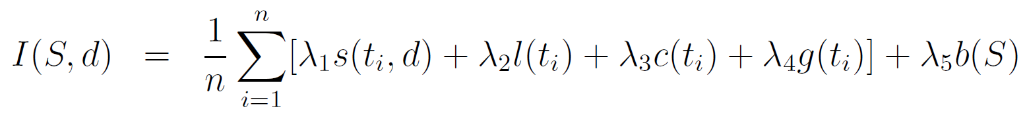
Introduction
    Extractive Summary
      Important sentences in the document
    Computing Importance of Sentences
        Statistical Measure, Linguistic Measure, Confidence Score, N-Gram Score, Grammatical Structure Score
    Ranking Sentences by Importance and Deciding Ratio of Summary
Proposed a better statistical measure of a term
Notes:
From the above experiments, the conclusion is that we proposed new approach to extract key terms efficiently.
The performance can be improved by two ideas, using branching entropy to extract key phrases and using three sets of features.

Slide 43
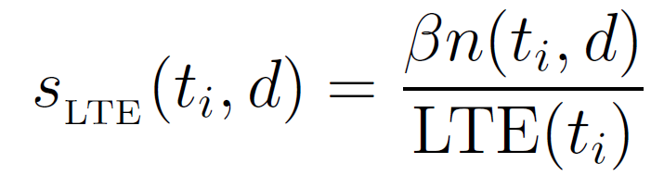
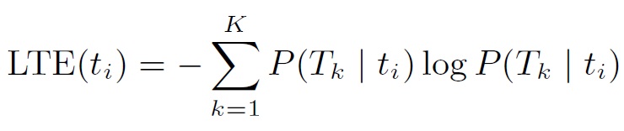
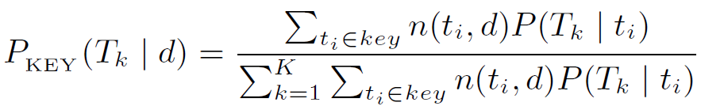
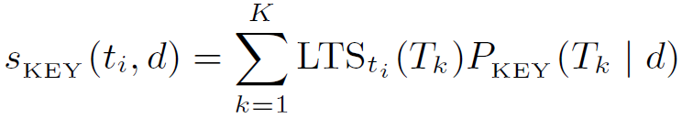
Statistical Measure of a Term
    LTE-Based Statistical Measure (Baseline)
    Key-Term-Based Statistical Measure
      Considering only key terms
      Weighted by LTS of the term
T_{k-1}
…
T_{k}
…
T_{k+1}
t_{i} ϵ key
t_{i} ϵ key
Key terms can represent core content of the document
Latent topic probability can be estimated more accurately
Notes:
From the above experiments, the conclusion is that we proposed new approach to extract key terms efficiently.
The performance can be improved by two ideas, using branching entropy to extract key phrases and using three sets of features.

Slide 44
Importance of the Sentence
    Original Importance
      LTE-based statistical measure
      Key-term-based statistical measure
    New Importance
      Considering original importance and similarity of other sentences
Sentences similar to more sentences should get higher importance
Notes:
From the above experiments, the conclusion is that we proposed new approach to extract key terms efficiently.
The performance can be improved by two ideas, using branching entropy to extract key phrases and using three sets of features.

Slide 45
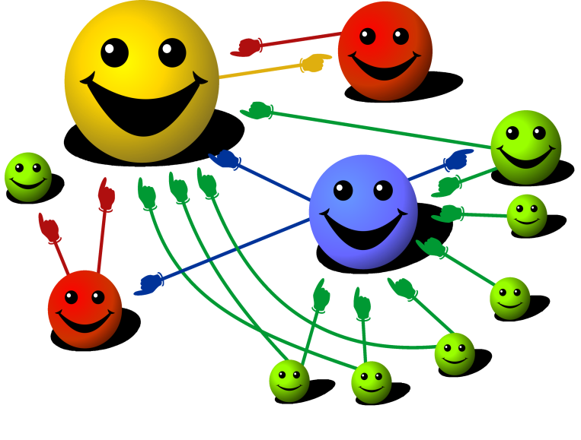
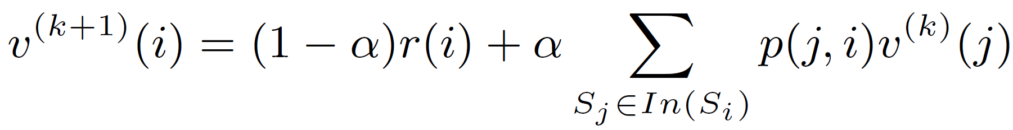
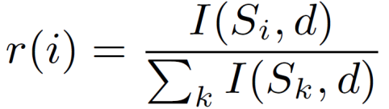
Random Walk on a Graph
    Idea
      Sentences similar to more important
      sentences should be more important
    Graph Construction
      Node: sentence in the document
      Edge: weighted by similarity between nodes
    Node Score
      Interpolating two scores
        Normalized original score of sentence S_{i}
        Scores propagated from neighbors according to edge weight p(j, i)
score of S_{i} in k-th iter.
Nodes connecting to more nodes with higher scores should get higher scores
Notes:
From the above experiments, the conclusion is that we proposed new approach to extract key terms efficiently.
The performance can be improved by two ideas, using branching entropy to extract key phrases and using three sets of features.

Slide 46
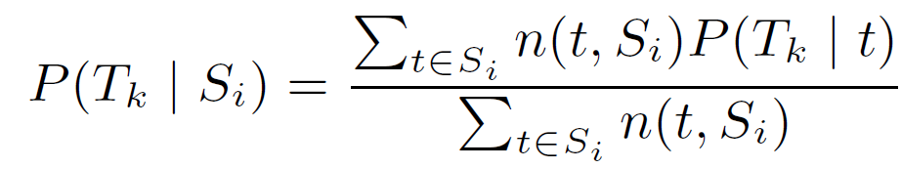
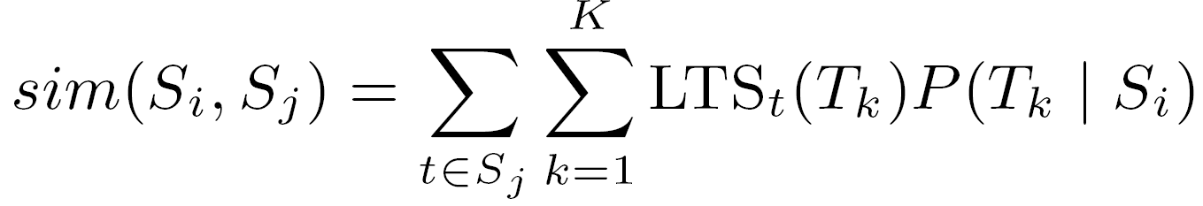
Random Walk on a Graph
    Topical Similarity between Sentences
      Edge weight sim(S_{i}, S_{j}): (sentence i → sentence j)
      Latent topic probability of the sentence
      Using Latent Topic Significance
S_{j}
t
LTS
T_{k-1}
…
T_{k}
…
T_{k+1}
S_{i}
t_{i}
t_{j}
t_{k}
Notes:
From the above experiments, the conclusion is that we proposed new approach to extract key terms efficiently.
The performance can be improved by two ideas, using branching entropy to extract key phrases and using three sets of features.

Slide 47
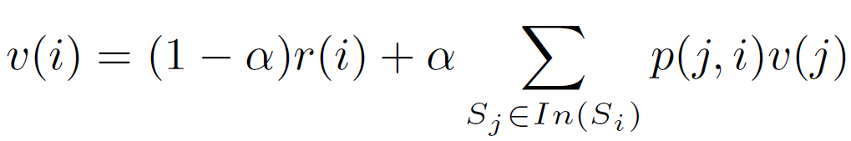
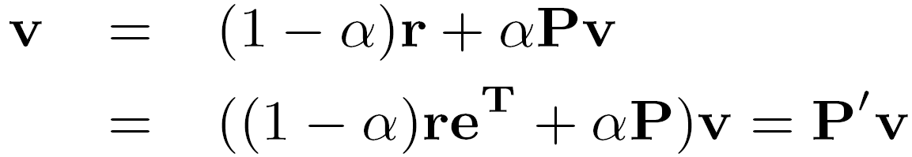
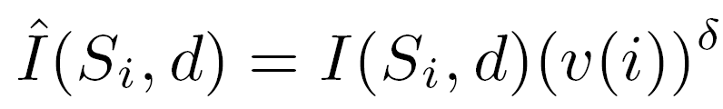
Random Walk on a Graph
    Scores of Sentences
      Converged equation
      Matrix form
      Solution
      dominate eigen vector of P’
    Integrated with Original Importance
Notes:
From the above experiments, the conclusion is that we proposed new approach to extract key terms efficiently.
The performance can be improved by two ideas, using branching entropy to extract key phrases and using three sets of features.

Slide 48
Experiments
Automatic Summarization

Slide 49
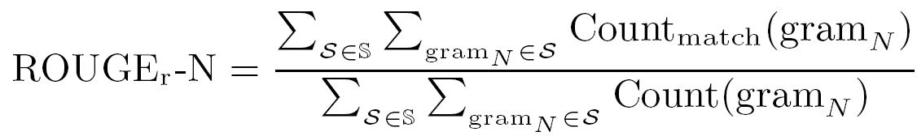
Experiments
    Same Corpus and ASR System
      NTU lecture corpus
    Reference Summaries
      Two human produced reference summaries for each document
        Ranking sentences from “the most important” to “of average importance”
    Evaluation Metric
      ROUGE-1, ROUGE-2, ROUGE-3
      ROUGE-L: Longest Common Subsequence (LCS)

Slide 50
Evaluation
ROUGE-1
ROUGE-2
ROUGE-3
ROUGE-L
ASR
LTE Key
Key-term-based statistical measure is helpful

Slide 51
Evaluation
ROUGE-1
ROUGE-2
ROUGE-3
ROUGE-L
ASR
LTE LTE + RW
Random walk can help the LTE-based statistical measure
ROUGE-1
ROUGE-2
ROUGE-3
ROUGE-L
ASR
Key Key + RW
Random walk can also help the key-term-based statistical measure
Topical similarity can compensate recognition errors

Slide 52
Evaluation
ROUGE-1
ROUGE-2
ROUGE-3
ROUGE-L
ASR
LTE LTE + RW Key Key + RW
Manual
Key-term-based statistical measure and random walk using topical similarity are useful for summarization

Slide 53
Conclusions

Slide 54
Conclusions
Automatic Key Term Extraction
Automatic Summarization
The performance can be improved by
  Identifying phrases by branching entropy
  Prosodic, lexical, and semantic features together
The performance can be improved by
  Key-term-based statistical measure
  Random walk with topical similarity
    Compensating recognition errors
    Giving higher scores to sentences topically similar to more important sentences
    Considering all sentences in the document
Notes:
From the above experiments, the conclusion is that we proposed new approach to extract key terms efficiently.
The performance can be improved by two ideas, using branching entropy to extract key phrases and using three sets of features.

Slide 55
Thanks for your attention! ☺
Q & A
Published Papers:
[1] Yun-Nung Chen, Yu Huang, Sheng-Yi Kong, and Lin-Shan Lee, “Automatic Key Term Extraction from Spoken Course Lectures Using Branching Entropy and Prosodic/Semantic Features,” in Proceedings of SLT, 2010.
[2] Yun-Nung Chen, Yu Huang, Ching-Feng Yeh, and Lin-Shan Lee, “Spoken Lecture Summarization by Random Walk over a Graph Constructed with Automatically Extracted Key Terms,” in Proceedings of InterSpeech, 2011.

