Slide 1

Minimum Routing Cost Spanning Trees
Kun-Mao Chao (趙坤茂)
Department of Computer Science and Information Engineering
National Taiwan University, Taiwan
E-mail: kmchao@csie.ntu.edu.tw
WWW: http://www.csie.ntu.edu.tw/~kmchao

Slide 2
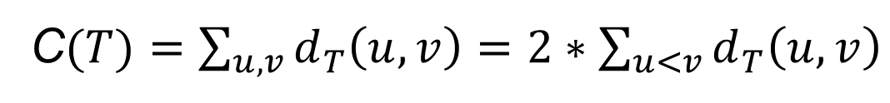
Minimum routing cost spanning trees
Given a graph, find a spanning tree with the minimum all-to-all distance
NP-hard
Note:
C$(T)=\sum_{u,v}{d_{T}\left(u,v\right)=2∗\sum_{u<v}{d_{T}\left(u,v\right)}}$

Slide 3

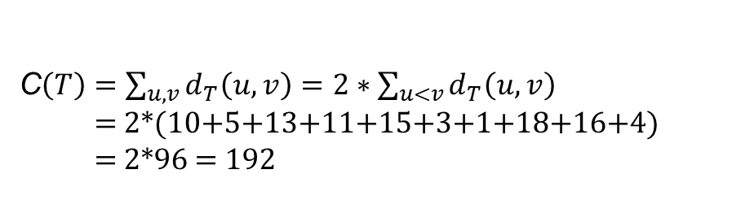
Routing cost C(T)=192
C$\left(T\right)=$ $\sum_{u,v}{d_{T}\left(u,v\right)=2∗\sum_{u<v}{d_{T}\left(u,v\right)}}$
= 2*(10+5+13+11+15+3+1+18+16+4)
= 2*96 = 192

Slide 4

Routing load l(T,e)

Slide 5
Routing cost C(T)=192

Slide 6
The impact of the topology

Slide 7
bound on routing load
x
n - x

Slide 8
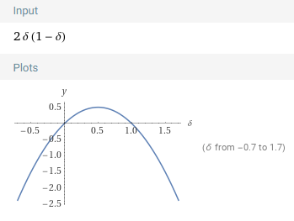
bound on routing load
>=δn
>=δn

Slide 9
Median
Let r be the median of graph G=(V,E,W), i.e., the vertex with the minimum total distance to all vertices.
In other words, r minimizes the function

Slide 10
A 2-approximation
A shortest-paths tree rooted at the median of a graph is a 2-approximation of an MRCT of the graph.
(Please refer to our discussions in class.)

Slide 11
Centroid

Slide 12
Some interesting vertices
Centroid
Median
Center (a vertex with the minimum eccentricity)
* a tree with positive edge weights, the median coincides with the centroid.
(If the median is not a centroid, then a neighbor of the median towards the centroid will have a smaller total distance to all vertices.)

Slide 13
1/2, 1/3, 1/4-separators

Slide 14
A δ-separator

Slide 15
A 15/8-approximation algorithm
Use a minimal 1/3-separator to estimate a lower of the routing cost of an MRCT
  There exists a path P which is a minimal 1/3-separator
The endpoints of P are useful in constructing a lower routing cost spanning tree

Slide 16
A 3/2-approximation algorithm
Besides the two endpoints of P, a centroid is used to lower the upper bound.

Slide 17
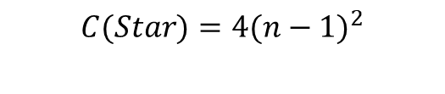
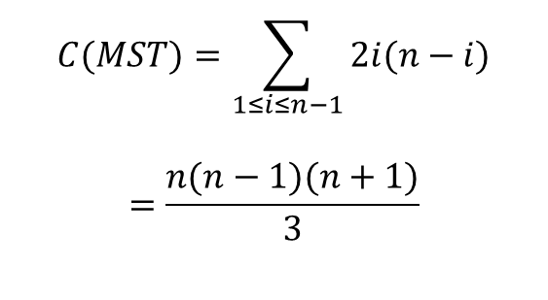
An MST with large routing cost
$$C(Star)=4(n−1)^{2}$$
$$C(MST)=\sum_{1≤i≤n−1}{2i(n−i)}$$
$$=\frac{n(n−1)(n+1)}{3}$$

Slide 18
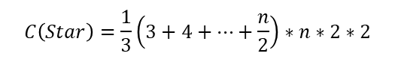
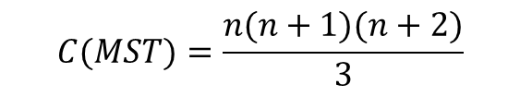
A smaller routing cost tree with much larger weight (n+1 vertices)
$$C(MST)=\frac{n(n+1)(n+2)}{3}$$
$$C\left(Star\right)=\frac{1}{3}\left(3+4+…+\frac{n}{2}\right)∗n∗2∗2$$
C(Star) is about one half of C(MST).
The total edge weight of the star is
Θ(n) times that of the MST.

