Slide 1
Shorter Labels for Routing in Trees
Pawel Gawrychowski, Wojciech Janczewski, Jakub Lopuszanski
R09942139 林宏信
R08946008 呂明修
F08945028 劉昕
D05945012 周裕人

Slide 2
Slide Overview
What is a Routing Labels Scheme?
About this Paper
Method 1 (Introduction)
Method 1 (Encoding Algorithm)
Encoding (Single Node Example)
Encoding (Two Nodes Example)
Encoding (Three Nodes Example)
Encoding (More Complex Example)
Method 1 (Decoding Algorithm)
Decoding (Three Nodes Example)
Decoding (More Complex Example)
Notes:
10行的Add懷疑是設

Slide 3
Slide Overview
Method 1 (Conclusion)
Final Structure of A Lable
Length of A Label
Method2
Classes & Groups
Final Structure of A Lable
Length of A Label
Method3
Final Structure and Length of A Lable
Conclusion
Notes:
10行的Add懷疑是設

Slide 4
What is a Routing Labels Scheme?
A routing labeling scheme will consist of
(Encode Part) A algorithm to assign a binary string (called label) to each node in a network, and assign port number from {1,...,d} for every edge outgoing from a node of degree d.
(Decode Part) A algorithm only use the label information to calculate the first edge on a shortest path from node A to node B in a network.

Slide 5
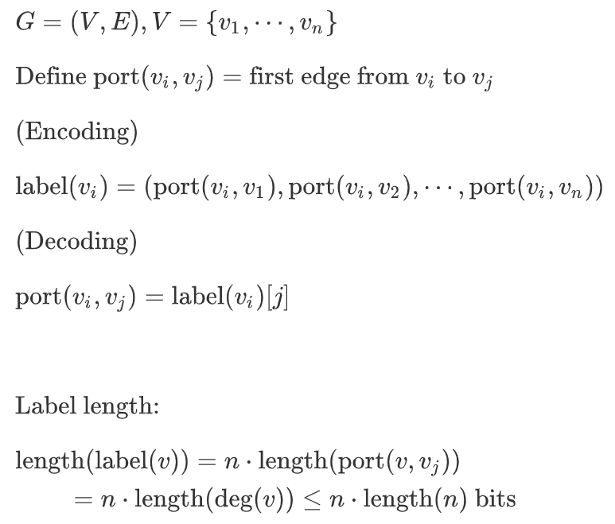
What is a Routing Labels Scheme?
A trivial example: (encode the full information)
In this case: The length of label is nlog(n).
Note: For each number in {1,...,n} we can use log(n) bit to store.
(binary encoding)
(log = log2 in this slide)

Slide 6
About this Paper
Shorter Labels for Routing in Trees is published on SODA (ACM-SIAM Symposium of Discrete Algorithms) 2021. (Top conference in discrete algorithms domain)
In this paper Shorter Labels for Routing in Trees The authors propose
An encoding method with label legnth logn + O((loglog(n))²).
A decoding method with polylogarithmic time. note: polylogarithmic time is better than polynomial time, it replaces the x by log(x).
(extending version) Label length logn + O((loglog(n)³) ) and constant decoding time.

Slide 7
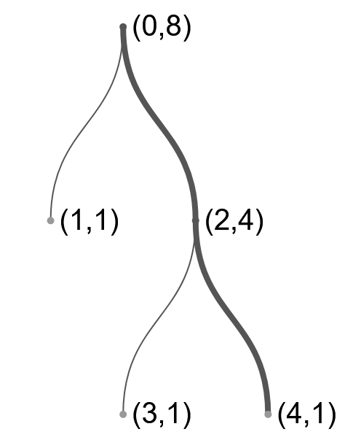
Method 1 (Introduction)
This method will assign each node u a pair of integers (start(u), bound(u)). As the figure shown on the right.
The start(u) can be viewed as an unique ID of a node.
The bound(u) can be viewed as roughly size of the subtree Tu. (The subtree rooted at u.)
Note: bound(u) will always be the power of 2.

Slide 8
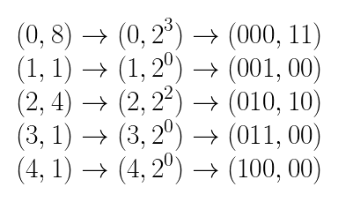
Method 1 (Introduction)
In this case, the label string of nodes may like
The binary string (called label) of the node (0,8) is (00011)2 node (1,1) is (00100)2

Slide 9
Method 1 (Introduction)
So far, we have know the binary string (called label) consist of a pair of (start(u), bound(u)).
Now, we see how to decode the label to get some information.
The basic idea is to view the label as an interval. The containment relation between intervals will instruct the first edge from node A to node B.
We will introduce the details later.

Slide 10
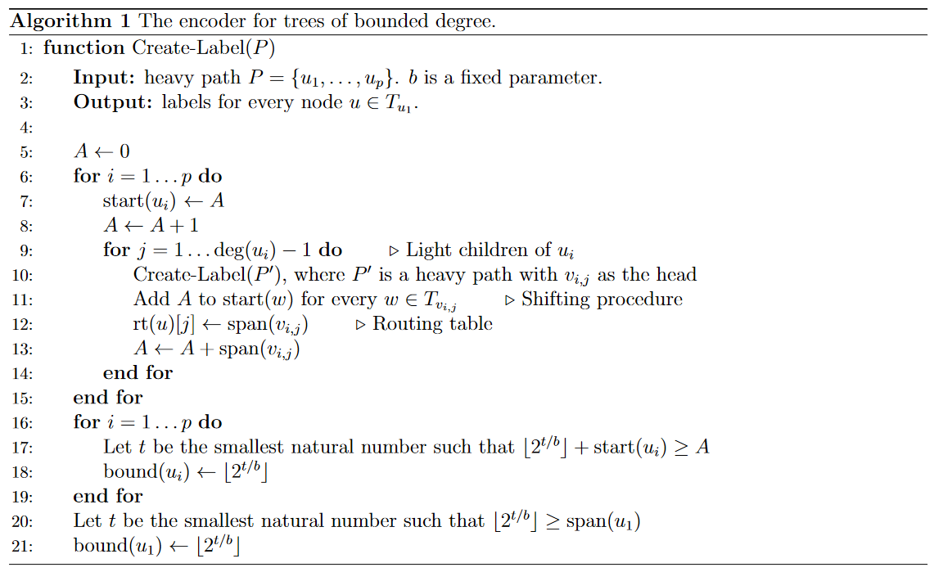
Method 1 (Encoding Algorithm)
Stage1: Compute node ID
Stage2: Compute node (substree) size

Slide 11
Encoding (Single Node Example)
P = {u1}, b=1
Run Stage1, start(u1) = 0, A=1
Run Stage2, bound(u1) = 1
Stage1: Compute node ID
Stage2: Compute node (substree) size

Slide 12
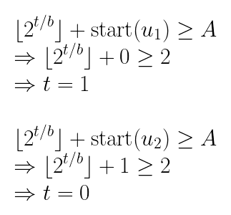
Encoding (Two Nodes Example)
Stage 2.1 (for loop)
P = {u1, u2} (top is u1) b=1
Run Stage1, start(u1) = 0, A=1 start(u2) = 0, A=2
Run Stage2, bound(u1) = 2,
bound(u2) = 1, bound(u1) = 2 (update again)
Generation process
Stage 2.2 (last 2 lines)

Slide 13
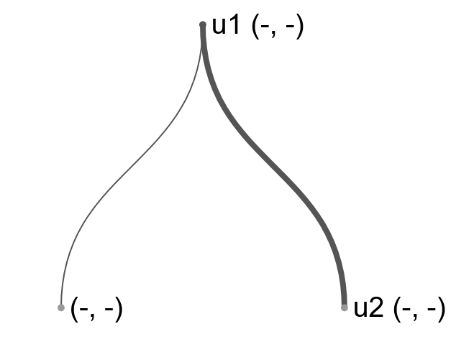
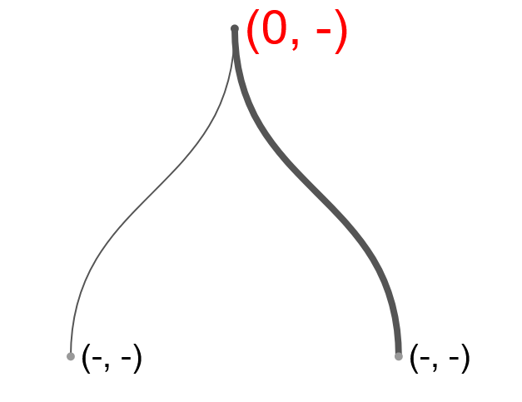
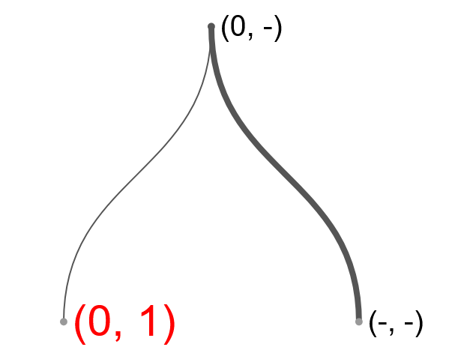
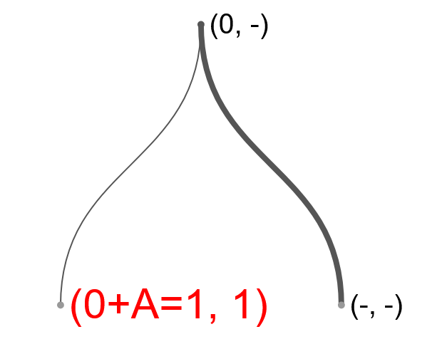
Encoding (Three Nodes Example)
P = {u1, u2} b=1
Run Stage1, start(u1) = 0, A=1 (fig.2)
Run recursion, (single node case)
start(ux) = 0
bound(ux) = 1 (fig.3)
Add A to each node of Tux (fig.4) Update A=2
1
2
3
4

Slide 14
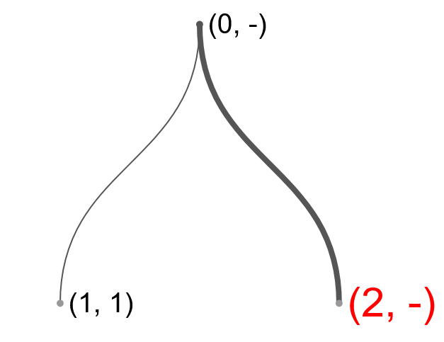
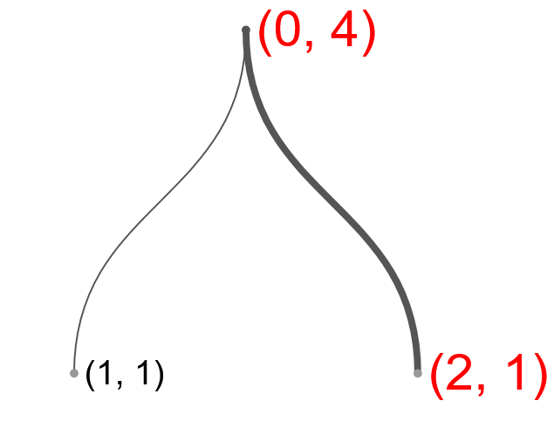
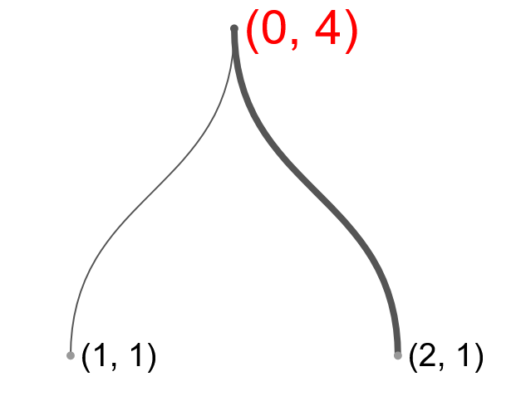
Encoding (Three Nodes Example)
Run Stage1, start(u2) = 2, A=3 (fig.5)
Run Stage2, bound(u1) = 4,
bound(u2) = 1, (fig.6) bound(u1) = 4 (update again) (fig.7)
5
6
7

Slide 15
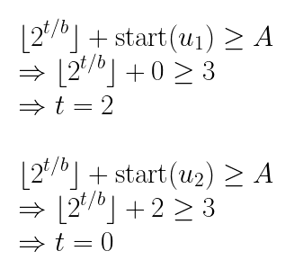
Encoding (Three Nodes Example)
Stage 2.1 (for loop)
7
Calculation details bound(u1) = 4,
bound(u2) = 1, (fig.6) bound(u1) = 4 (update again) (fig.7)
Stage 2.2 (last 2 lines)

Slide 16
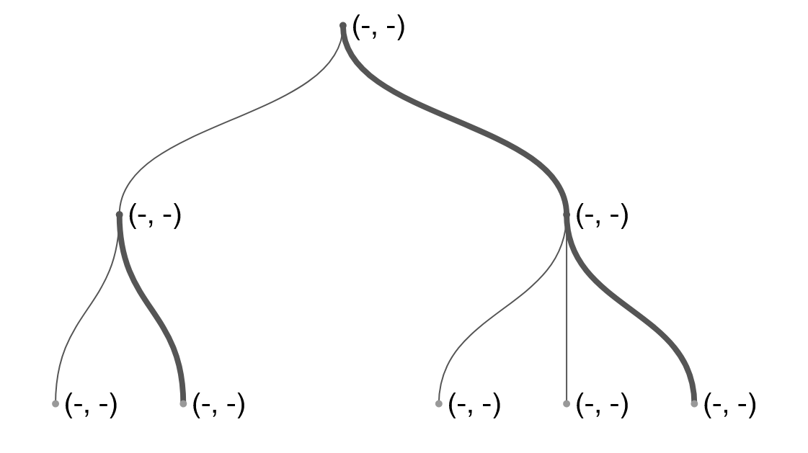
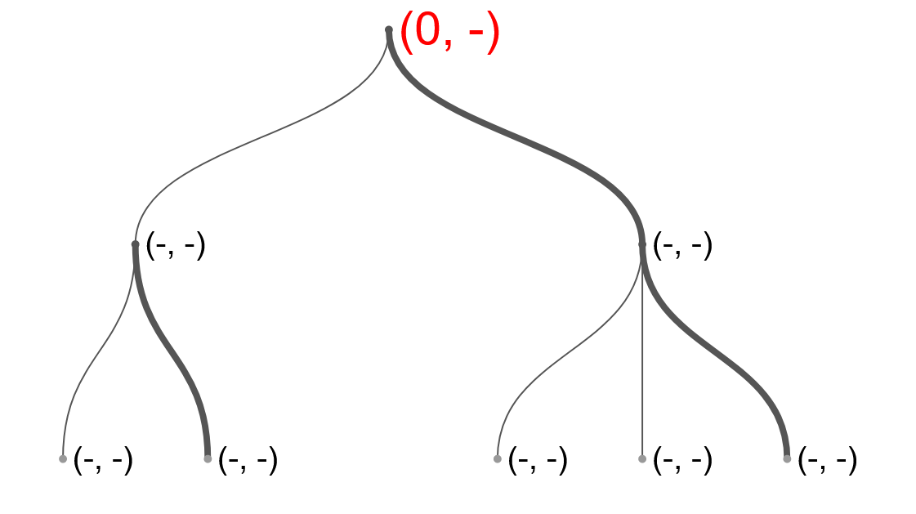
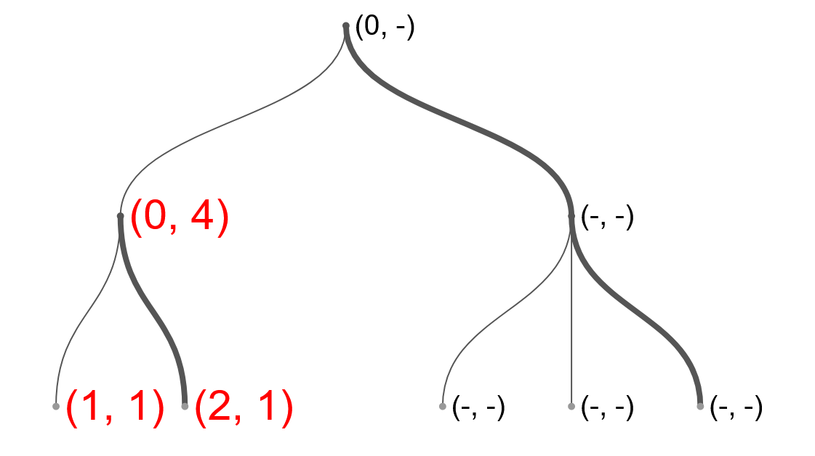
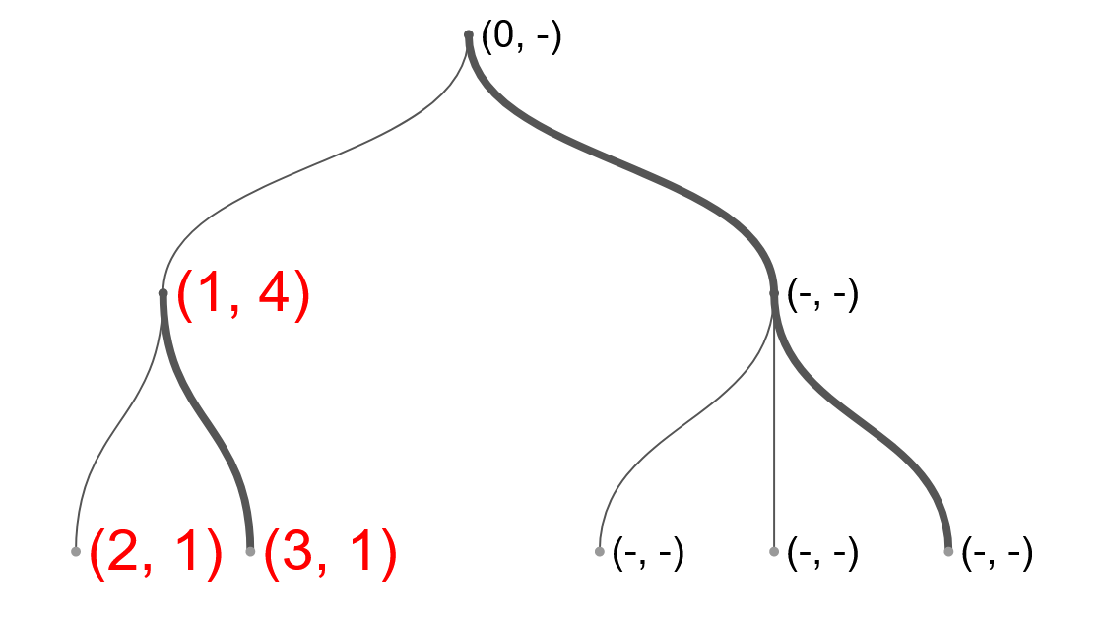
Encoding (More Complex Example)
1
2
3
4
Add A to the substree. Update A = 1+(5-1) = 5
Run recursion

Slide 17
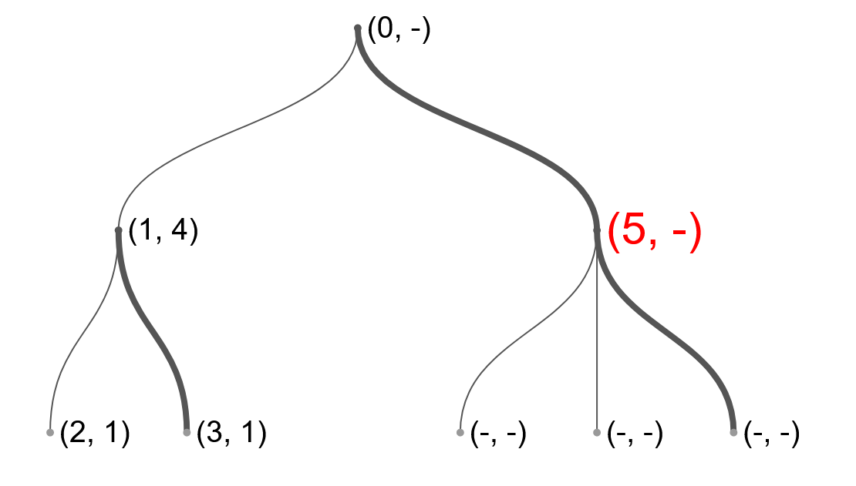
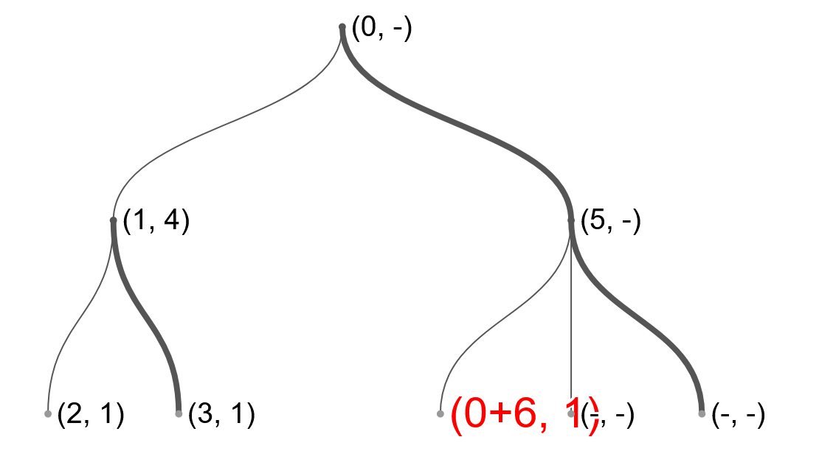
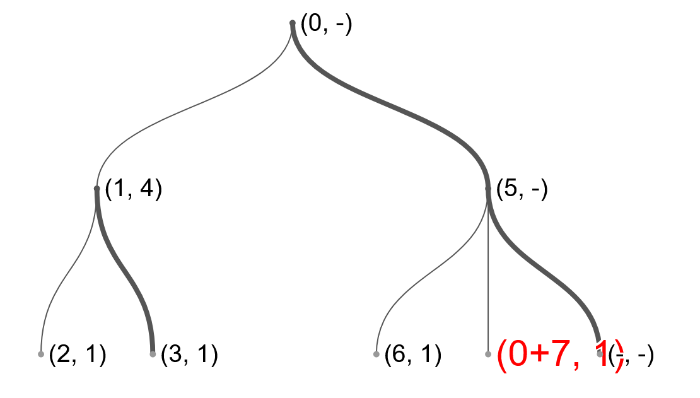
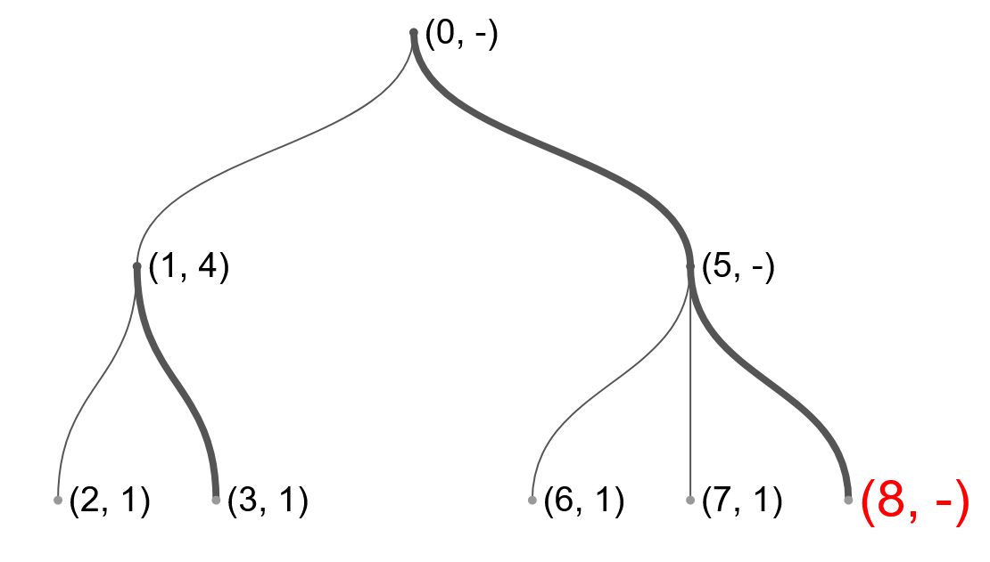
Encoding (More Complex Example)
5
6
7
8

Slide 18
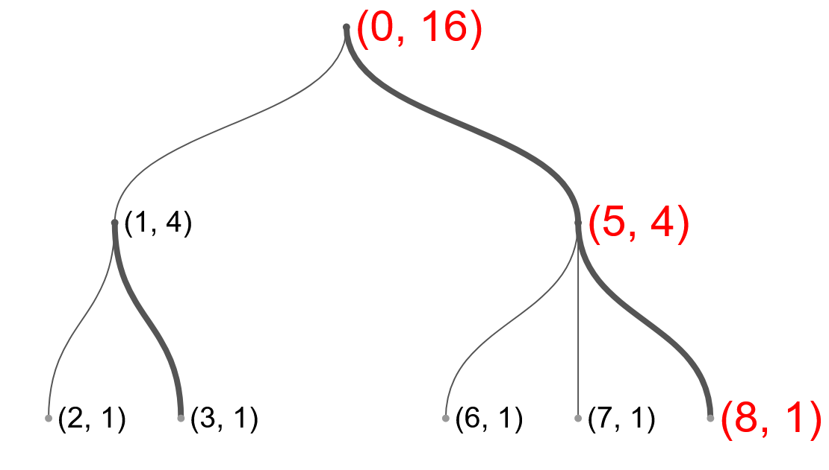
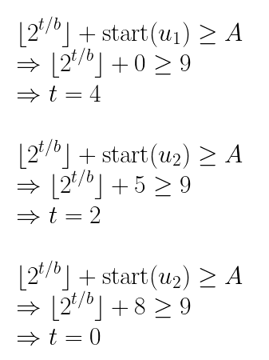
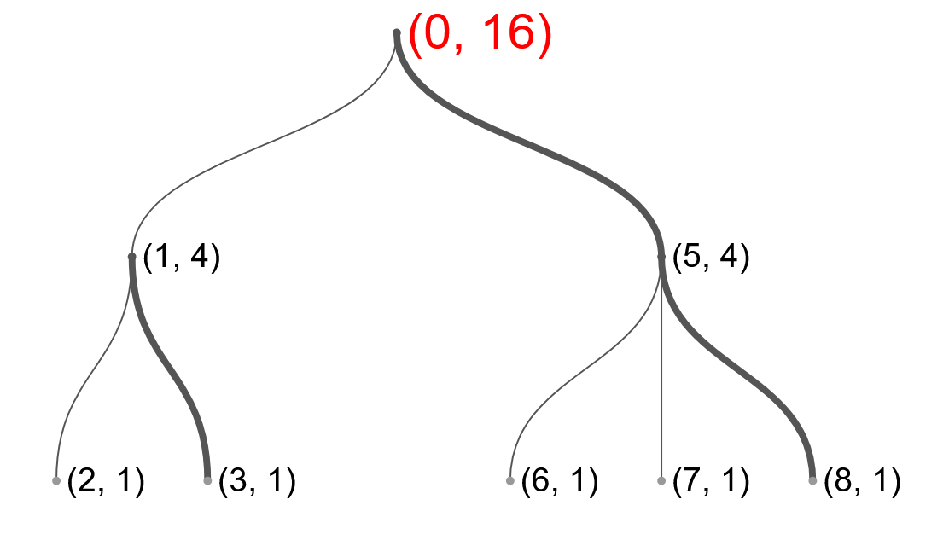
Encoding (More Complex Example)
Calculation details
bound(u1) = 16,
bound(u2) = 4,
bound(u3) = 1, bound(u1) = 16 (update again)
Stage 2.1 (for loop)
9
Stage 2
10
update u1 again
Stage 2.2 (last 2 lines)

Slide 19
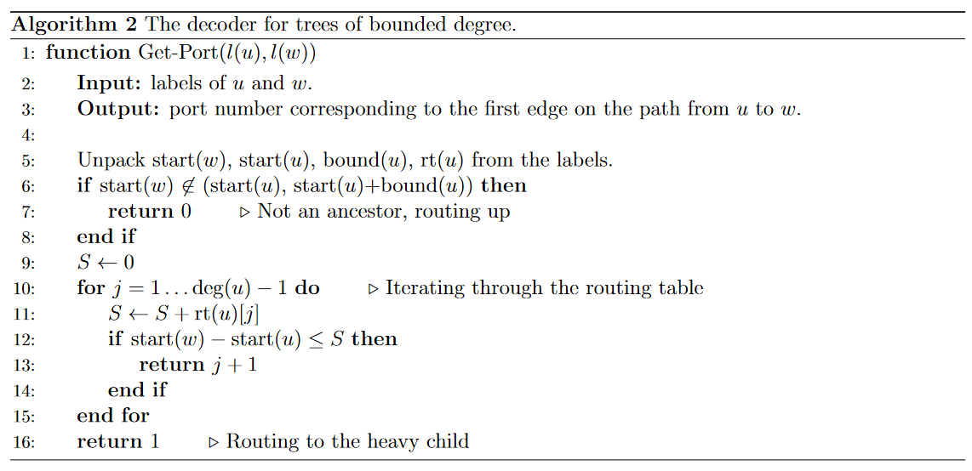
Method 1 (Decoding Algorithm)
edge to parent
edge to light node
edge to heavy node

Slide 20
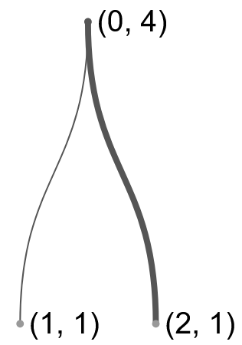
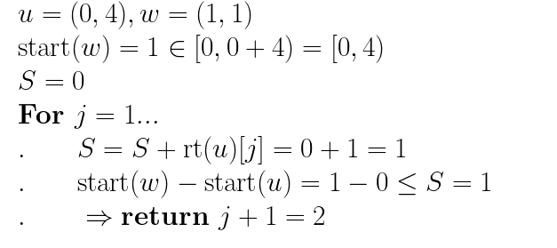
Decoding (Three Nodes Example)
The edge’s id to parent node: 0, to heavy node: 1, light node: 2,..... (increasing by node size)
case 1:
case 2:
edge to parent
edge to light node

Slide 21
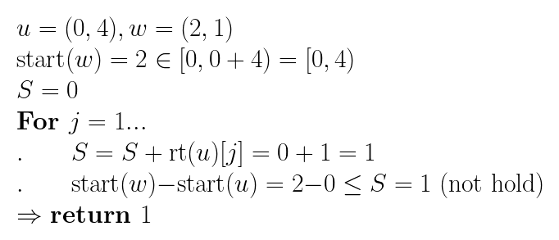
Decoding (Three Nodes Example)
case 3:
edge to heavy node

Slide 22
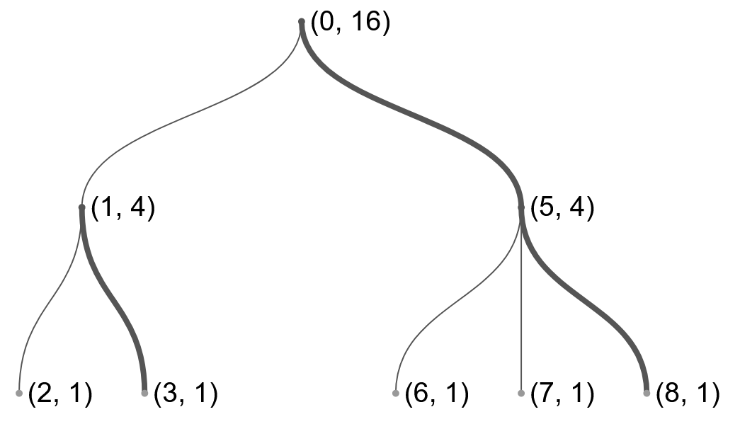
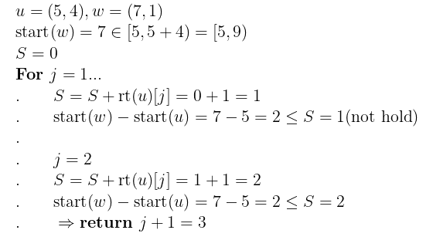
Decoding (More Complex Example)
case 1:
case 2:
edge to parent
edge to light node

Slide 23
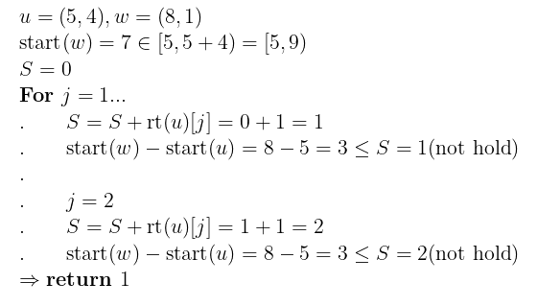
Decoding (More Complex Example)
case 3:
edge to heavy node

Slide 24
Final structure of a label
1.start(u).
2.bound(u)=[2^{t/b}] stored as t in binary.
3.small’(u).
4.routing table rt(u) storing the number of big children of every possible size.
5.level(u).

Slide 25
Length of a label

Slide 26
Method 2
First phase — segments assignment
Rounding in classes
Algorithm 3
Rounding in groups
Algorithm 4
Bound on the length of a segment
Second phase — creating labels
Algorithm 5

Slide 27
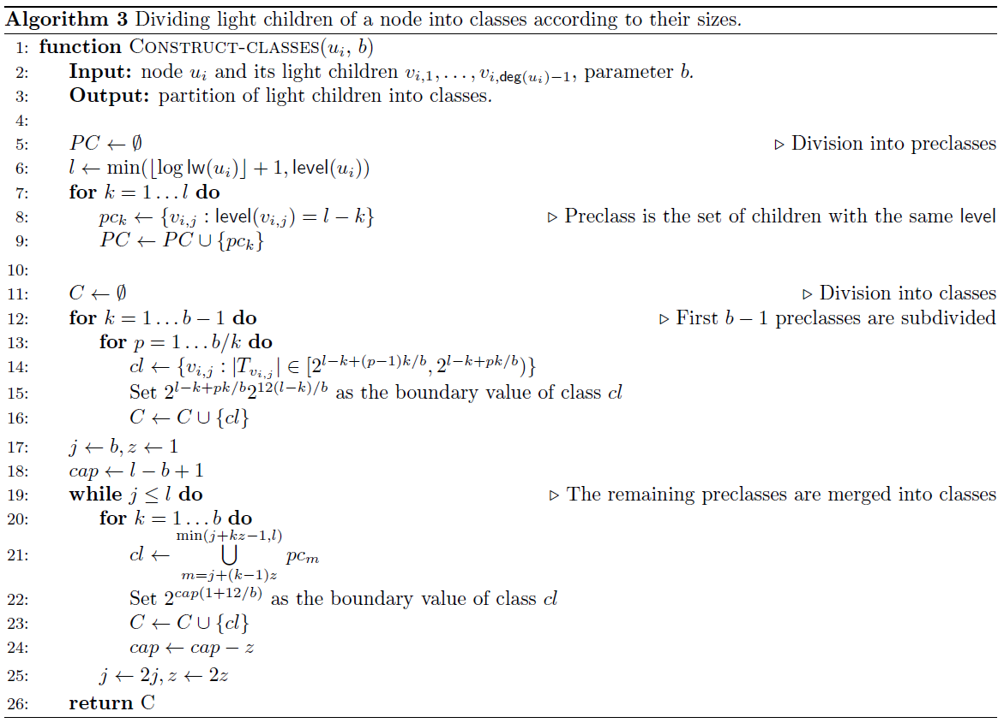
title
Notes:
l = log n 當成 size = level
size b-1 分割 因為太大
b 2b -1 的preclass 直接丟進來
2b 4b-1 就兩兩合在一起 丟進來
4b 8b-1 就4個合在一起 丟進來 class
以此類推
....

Slide 28
Method 2 - divided into classes
given b, node n and light children
Do preclass according log(lw) and level
Cases for preclasses
1~b-1
subdivided into classes
b~2b-1
direct into classes
rb~2rb-1
seperately merge r into classes

Slide 29
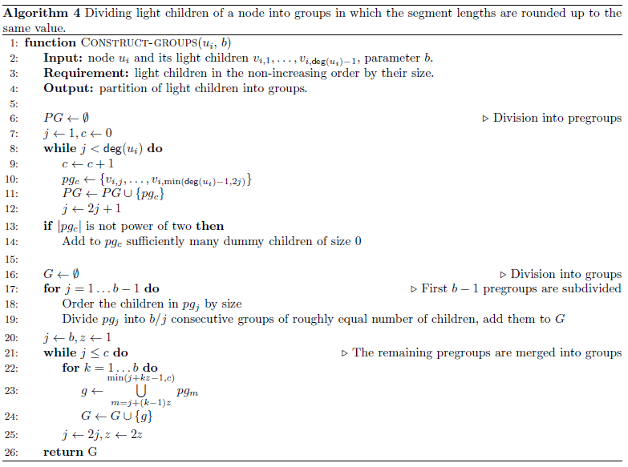
title
Notes:
Elements of the sequence will correspond to consecutive groups of children,
and their values to the set of boundary values defined by the classes.
Thus, these values correspond to the rounded sizes of reserved segments in groups.
To achieve the stated goal, we define pregroups and groups, similarly to preclasses and classes.
**sl(u1) the length of the reserved segment for u1 being the head of its heavy path.

Slide 30
Method 2 - divided into groups
similar as classes
no boundray value
just use the sorted order

Slide 31
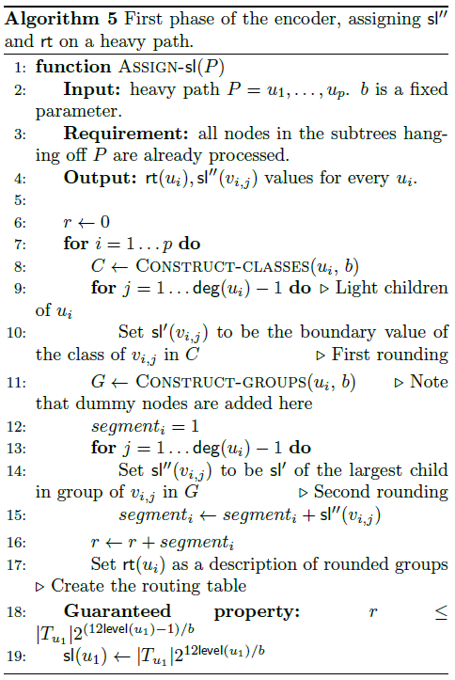
title
Notes:
rounging sl'(u1), when we ensure there is only a small set of possible values for sizes of the children’s segments.
rounding to sl''(u1) happens, when we gather children in groups and make the segment size of everyone in a group equal.
sl’ 從boundy value rounding來的
v1 v2 v3 v4 …
boundy value :Bi
v1 v2 , v1 B1, B2
second rounding , v1 v2 : B1.(sl’’)
v3 v4 v5 v6 : B3 B4 B5
second rouding , v3 v4 v5 v6 : B3. (sl’’)
2 4 8 16 ...做group
最後拿到sl’’ 類似前面的span

Slide 32
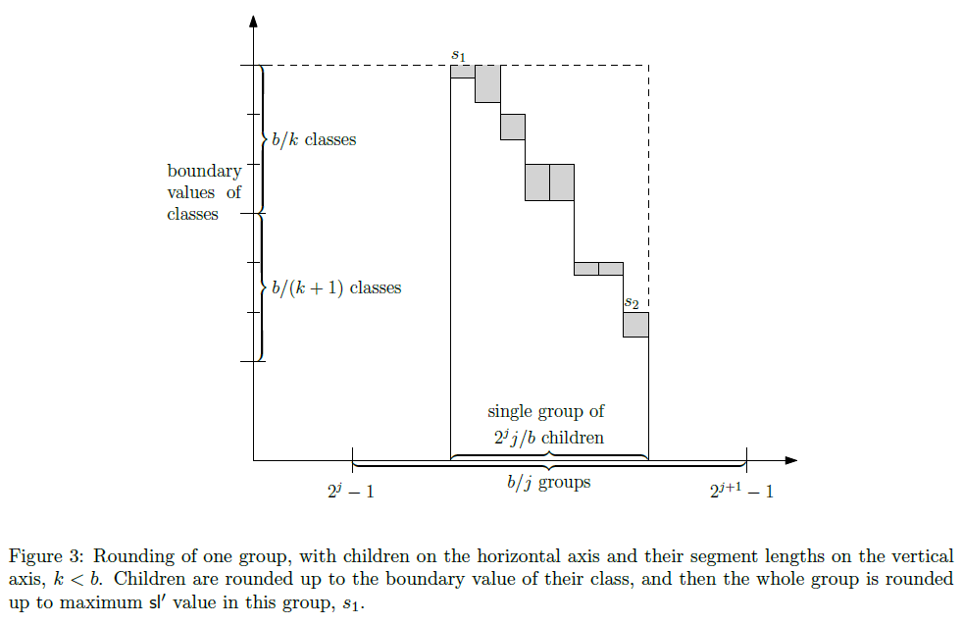
Notes:
2 4 8 16 方式進行大到小的分群(group)
[ 2^j -1 , 2^(j+1) -1]
2^j+1 -1 - ( 2^j+1 -1) = 2^j *(2-1) = 2^j
rank j : size 為 2^j的 group

Slide 33
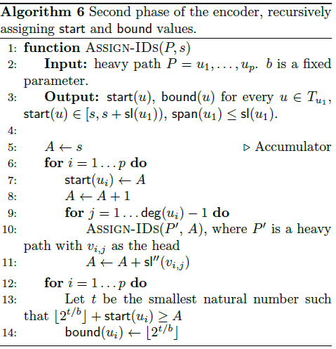
Notes:
等同演算法二 只是將sl’’視為span即可完成tree的編碼
但A值會透過ASSIGN-IDs進行值得傳遞

Slide 34
Final structure of a label
1.start(u).
2.bound(u)=[2^{t/b}] stored as t.
3.an encoding of rt(u).
4.log lw(u).
5.level(u).
6. log(deg(u)-1).

Slide 35
Length of a label

Slide 36
Method 3
The idea is that if the binary expansion of start(u) happens to have some trailing zeroes, then we can save some bits by removing these trailing zeroes, assuming that we are additionally storing their number. Thus, we add O(log log n) bits to every label, but then are able to substantially shorten some of them.
Add O(log log n) bits to every label, but then are able to substantially shorten some of them.
The saved space can be used to store a relatively big routing table.

Slide 37
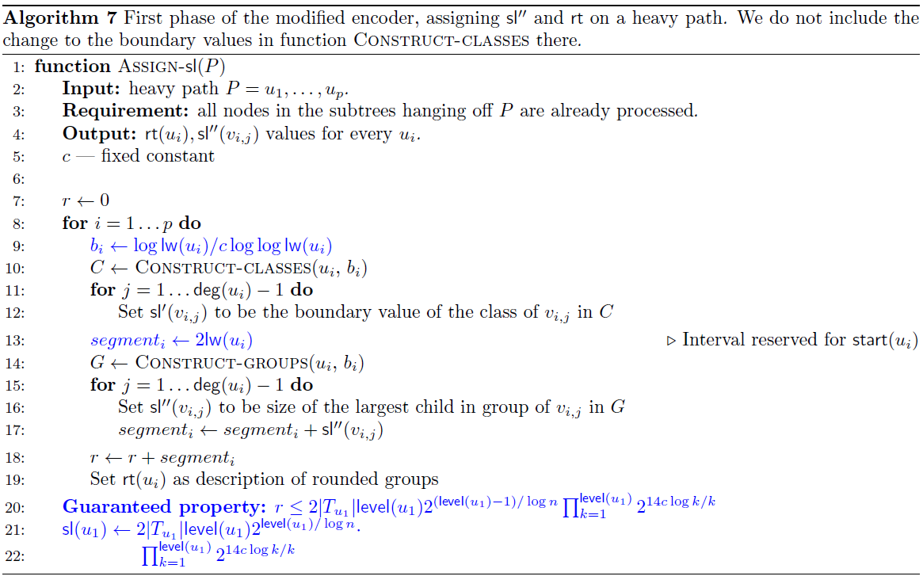
Notes:
c的作用 : [level(ui) - c, level (ui)] , given level = size
lw : sum of all light weight size
101000111100000
後面的 00000 : trailing zero
The idea is that if the binary expansion of start(u) happens to have l trailing zeroes, then we can save l bits by removing these trailing zeroes, assuming that
we are additionally storing their number. Thus, we add O(log log n) bits to every label, but then are able to substantially shorten some of them.
The saved space can be used to store a relatively big routing table.
size rank <= b-1 : big
size rank > b-1 : small

Slide 38
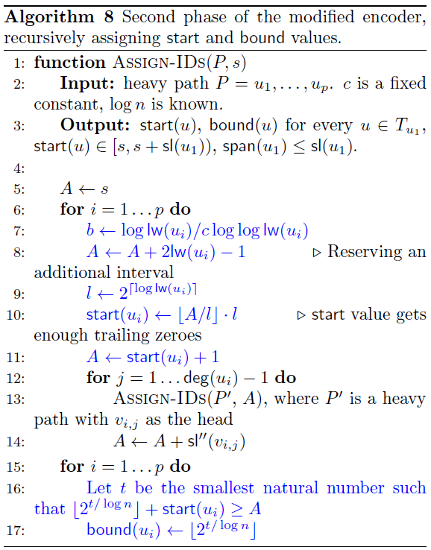
Notes:
Light weight assumption.
the encoder adds c + 1 artificial leaves to every node of the input tree. Then the assumption holds for every original node, but the encoder needs to handle these additional nodes.
In a heavy path decomposition, artificial nodes fall into two categories.
Ports lead-ing to the artificial children of a node u are deg(u) + 1, . . . , deg(u) + c'.

Slide 39
Final Structure and Length of A Label
Almost same as previous method
1.start(u) - but save zero seperately.
2.bound(u)=[2^{t/b}] stored as t.
3.an encoding of rt(u).
4.log lw(u) - but allows recovering b.
5.level(u).
6. log(deg(u)-1).

Slide 40
Conclusion
In this paper Shorter Labels for Routing in Trees The authors propose
An encoding method with label legnth logn +O((loglog(n))²).
A decoding method with polylogarithmic time. note: polylogarithmic time is better than polynomial time, it replaces the x by log(x).
Guess (no prove) the upper bound of the Designer-port routing problem.

