Slide 1
Maximum and Minimum Degree Conditions For Embedding Trees
Guido Besomi, Matías Pavez-Signé, and Maya Stein
SIAM J. Discrete Math., 34(4), 2108–2123. (16 pages)
Presenters: 穆大有，王柏元

Slide 2
outline
Problem definition
Proposed conjecture
Sketch on its proof
-> sharpness
-> correctness
Conclusion

Slide 3
Problem definition
Subgraph containment problem:
A
B
A contains B

Slide 4
Problem definition
Subgraph containment problem:
A
B
A contains B

Slide 5
Problem definition
Subgraph containment problem:
contains
contains
Minimum degree?
Maximum degree?
contains
Set of all k edges trees
What constraint?
a class of graph

Slide 6
Problem definition
Ex:
contains
$$δ\left(G\right)≥k$$
All $k$ edges tree

Slide 7
outline
Problem definition
Proposed conjecture
Sketch on its proof
-> sharpness
-> correctness

Slide 8
Proposed conjecture
Two conjectures
*
contains
$δ\left(G\right)≥\left\lfloor \frac{2k}{3}\right\rfloor$ and $Δ\left(G\right)≥k$
All $k$ edges tree
**
contains
$δ\left(G\right)≥\left\lfloor \frac{k}{2}\right\rfloor$ and $Δ\left(G\right)≥2k$
All $k$ edges tree
*F. Havet, B. Reed, M. Stein, and D. R. Wood, A variant of the Erd\H os--S\'os conjecture, J. Graph Theory, 94 (2020), pp. 131--158.
**G. Besomi, M. Pavez-Signe, and M. Stein, \' Degree conditions for embedding trees, SIAM J. Discrete Math., 33 (2019), pp. 1521--1555, https://doi.org/10.1137/18M1210861.

Slide 9
Proposed conjecture
Two conjectures
*
$δ\left(G\right)≥\left\lfloor \frac{2k}{3}\right\rfloor$ and $Δ\left(G\right)≥k$
decrease
increase
**
$δ\left(G\right)≥\left\lfloor \frac{k}{2}\right\rfloor$ and $Δ\left(G\right)≥2k$
*F. Havet, B. Reed, M. Stein, and D. R. Wood, A variant of the Erd\H os--S\'os conjecture, J. Graph Theory, 94 (2020), pp. 131--158.
**G. Besomi, M. Pavez-Signe, and M. Stein, \' Degree conditions for embedding trees, SIAM J. Discrete Math., 33 (2019), pp. 1521--1555, https://doi.org/10.1137/18M1210861.

Slide 10
Proposed conjecture
The proposed conjecture
0
$δ\left(G\right)≥\frac{k}{2}$ and $Δ\left(G\right)≥2k$
$$α$$
…
contains
All $k$ edges tree
~$\frac{1}{3}$
$δ\left(G\right)≥\frac{2k}{3}$ and $Δ\left(G\right)≥\frac{4k}{3}$

Slide 11
outline
Problem definition
Proposed conjecture
Sketch on its proof
-> sharpness
-> correctness

Slide 12
Sketch on its proof
Correctness and Sharpness
$δ\left(G\right)>(1+α)\frac{k}{2}$ and $Δ\left(G\right)>2\left(1−α\right)k$
$$δ$$
$$and$$
$$Δ$$
Above this line, contains
$δ\left(G\right)=(1+α)\frac{k}{2}$ and $Δ\left(G\right)=2\left(1−α\right)k$
correctness
Below this line, don’t contains
No matter how close
$δ\left(G\right)<(1+α)\frac{k}{2}$ and $Δ\left(G\right)<2\left(1−α\right)k$
sharpness

Slide 13
Sketch on its proof
Sharpness
$δ\left(G\right)>(1+\frac{1}{l}−γ)\frac{k}{2}$ $Δ\left(G\right)>2\left(1−\frac{1}{l}−γ\right)k$
$δ\left(G\right)>(1+α)\frac{k}{2}$ $Δ\left(G\right)>2\left(1−α\right)k$

Slide 14
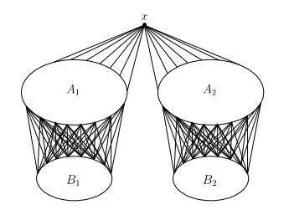
Sketch on its proof
Sharpness
Construct a graph that follows proposition 1.2
Then construct a tree that can’t fit into it.

Slide 15
Sketch on its proof
Correctness
Conjecture 1.1
An approximate version
Theorem 1.3
An weaken version excludes extremal case
Together with 1.4 proves 1.3
The case of
extremal graph
And Lemma 5.4
Theorem 1.4
proves
Lemma 4.2
from
from
G. Besomi, M. Pavez-Signe, and M. Stein, \' Degree conditions for embedding trees, SIAM J. Discrete Math., 33 (2019), pp. 1521--1555, https://doi.org/10.1137/18M1210861.

Slide 16
Sketch on its proof
Correctness
Conjecture 1.1
An approximate version
Theorem 1.3
An weaken version excludes extremal case
Together with 1.4 proves 1.3
The case of
extremal graph
And Lemma 5.4
Theorem 1.4
proves
Lemma 4.2
from
from
G. Besomi, M. Pavez-Signe, and M. Stein, \' Degree conditions for embedding trees, SIAM J. Discrete Math., 33 (2019), pp. 1521--1555, https://doi.org/10.1137/18M1210861.

Slide 17
Sketch on its proof
Correctness
$δ\left(G\right)≥\left(1+α\right)\frac{k}{2}$
and $Δ\left(G\right)≥2\left(1−α\right)k$
None
Each tree with k edges
vs
vs
vs
$δ\left(G\right)≥(1+δ)(1+α)\frac{k}{2}$
and $Δ\left(G\right)≥2(1+δ)\left(1−α\right)k$
$$Δ\left(T\right)≤k^{\frac{1}{67}}$$
$$n, k≥k_{0}$$

Slide 18
Sketch on its proof
Correctness
Conjecture 1.1
An approximate version
Theorem 1.3
An weaken version excludes extremal case
Together with 1.4 proves 1.3
The case of
extremal graph
And Lemma 5.4
Theorem 1.4
proves
Lemma 4.2
from
from
G. Besomi, M. Pavez-Signe, and M. Stein, \' Degree conditions for embedding trees, SIAM J. Discrete Math., 33 (2019), pp. 1521--1555, https://doi.org/10.1137/18M1210861.

Slide 19
Sketch on its proof
Correctness
$$δ\left(G\right)≥(1+δ)(1+α)\frac{k}{2}$$
$$Δ\left(G\right)≥2(1+δ)\left(1−α\right)k$$
vs
vs
$$δ\left(G\right)≥(1+δ)\frac{k}{2}$$
$$Δ\left(G\right)≥(1+δ)\frac{4k}{3}$$

Slide 20
Sketch on its proof
Correctness
Conjecture 1.1
An approximate version
Theorem 1.3
An weaken version excludes extremal case
Together with 1.4 proves 1.3
The case of
extremal graph
And Lemma 5.4
Theorem 1.4
proves
$\left(ε,η\right)$ – Reduced graph
Lemma 4.2
from
from
G. Besomi, M. Pavez-Signe, and M. Stein, \' Degree conditions for embedding trees, SIAM J. Discrete Math., 33 (2019), pp. 1521--1555, https://doi.org/10.1137/18M1210861.

Slide 21
Sketch on its proof
Correctness
$\left(ε,η\right)$ – Reduced graph
$\left(ε,η\right)$ – Regular partition
$\left(ε,η\right)$ – Regular

Slide 22
Sketch on its proof
Correctness $\left(ε,η\right)$ – Regular
…
…
…
…

Slide 23
Sketch on its proof
Correctness $\left(ε,η\right)$ – Regular partition

Slide 24
Sketch on its proof
Correctness $\left(ε,η\right)$ – Reduced graph

Slide 25
Sketch on its proof
Correctness $\left(ε,η\right)$ – Reduced graph

Slide 26
Sketch on its proof
Correctness
Conjecture 1.1
An approximate version
Theorem 1.3
An weaken version excludes extremal case
Together with 1.4 proves 1.3
The case of
extremal graph
And Lemma 5.4
Theorem 1.4
proves
Lemma 4.2
from
from
G. Besomi, M. Pavez-Signe, and M. Stein, \' Degree conditions for embedding trees, SIAM J. Discrete Math., 33 (2019), pp. 1521--1555, https://doi.org/10.1137/18M1210861.

Slide 27
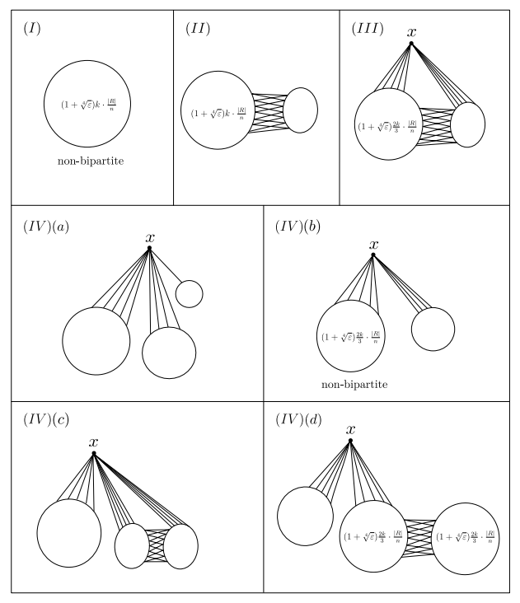
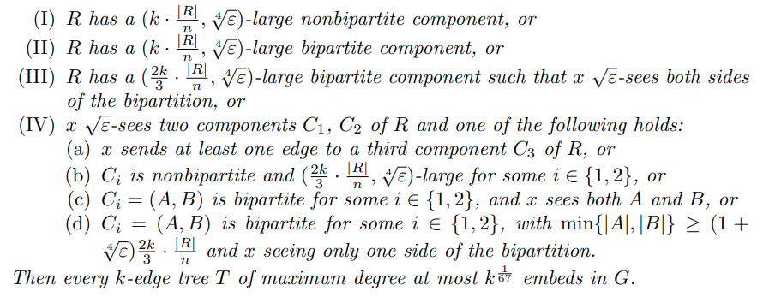
Sketch on its proof
Correctness

Slide 28
Sketch on its proof
Correctness

Slide 29
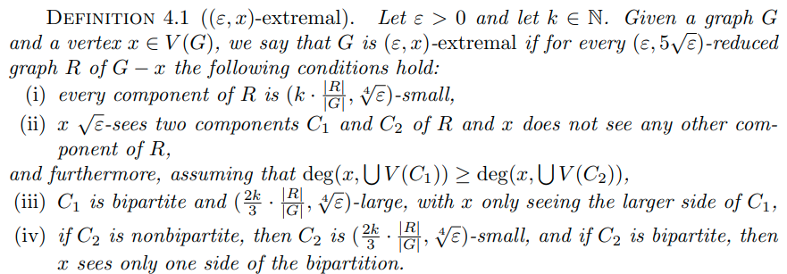
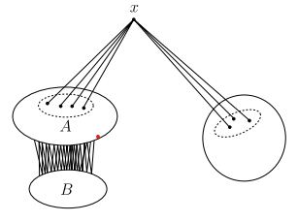
Sketch on its proof
Correctness

Slide 30
Sketch on its proof
Correctness
Conjecture 1.1
An approximate version
Theorem 1.3
An weaken version excludes extremal case
Together with 1.4 proves 1.3
The case of
extremal graph
And Lemma 5.4
Theorem 1.4
proves
Lemma 4.2
from
from
G. Besomi, M. Pavez-Signe, and M. Stein, \' Degree conditions for embedding trees, SIAM J. Discrete Math., 33 (2019), pp. 1521--1555, https://doi.org/10.1137/18M1210861.

Slide 31
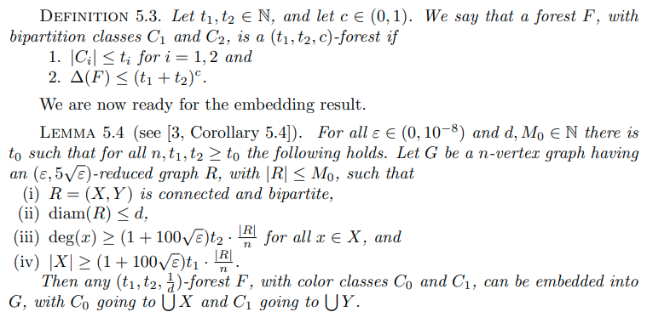
Sketch on its proof
Correctness

Slide 32
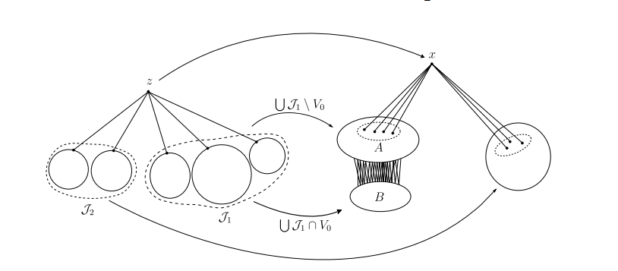
Sketch on its proof
Correctness

Slide 33
Sketch on its proof
Correctness
Conjecture 1.1
An approximate version
Theorem 1.3
An weaken version excludes extremal case
Together with 1.4 proves 1.3
The case of
extremal graph
And Lemma 5.4
Theorem 1.4
proves
Lemma 4.2
from
from
G. Besomi, M. Pavez-Signe, and M. Stein, \' Degree conditions for embedding trees, SIAM J. Discrete Math., 33 (2019), pp. 1521--1555, https://doi.org/10.1137/18M1210861.

Slide 34
outline
Problem definition
Proposed conjecture
Sketch on its proof
-> sharpness
-> correctness
Conclusion

Slide 35
Conclusion
Contribution
-> conjecture 1.1
-> proof of approximation version
Future work
-> generalize on $α$
-> improve 1/67

Slide 36
Thanks for your listening

Slide 37
Reference
Guido Besomi, Matías Pavez-Signé, and Maya Stein SIAM J. Discrete Math., 34(4), 2108–2123. (16 pages)

