Slide 1
Approximating Pathwidth for Graphs of Small Treewidth
Carla Groenland, Gwenaël Joret, Wojciech Nadara, Bartosz Walczak
SODA 2021: 1965-1976
D09945012 張 鈞
R08922128 林子欽
Notes:
GROENLAND, Carla, et al. Approximating pathwidth for graphs of small treewidth.
In: Proceedings of the 2021 ACM-SIAM Symposium on Discrete Algorithms (SODA).
Society for Industrial and Applied Mathematics, 2021. p. 1965-1976.

Slide 2
Outline
Introduction
Preliminaries and Tools
Proof of Theorem 1.1
Proof of Theorem 1.2
Tightness

Slide 3
Introduction

Slide 4
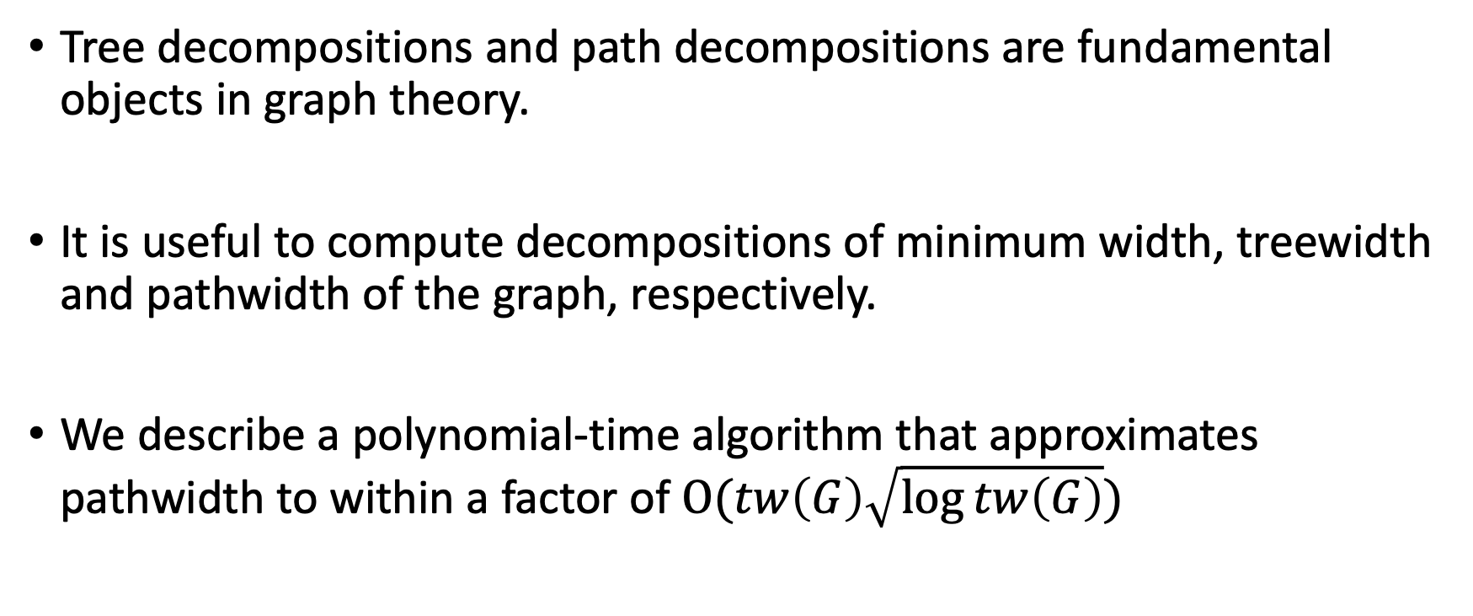
Introduction
Tree decompositions and path decompositions are fundamental objects in graph theory.
It is useful to compute decompositions of minimum width, treewidth and pathwidth of the graph, respectively.
We describe a polynomial-time algorithm that approximates pathwidth to within a factor of $Ο(tw\left(G\right)\sqrt{\log{tw\left(G\right)}})$

Slide 5
Treewidth – tw(G)
The treewidth of an undirected graph is an integer number which specifies, informally, how far the graph is from being a tree.
A tree decomposition of a graph G = (V, E) is a tree T, with nodes X₁, ..., X_{n}, where each X_{i} is a subset of V, satisfying the following properties:
  The union of all sets X_{i} equals V. That is, each graph vertex is contained in at least one tree node.
  If X_{i} and X_{j} both contain a vertex v, then all nodes X_{k} of T in the (unique) path between X_{i} and X_{j} contain v as well.
  For every edge (v, w) in the graph, there is a subset X_{i} that contains both v and w.
Notes:
https://en.wikipedia.org/wiki/Treewidth

Slide 6
Treewidth – tw(G)
A graph with eight vertices, and a tree decomposition of it onto a tree with six nodes.
Each graph edge connects two vertices that are listed together at some tree node.
Each graph vertex is listed at the nodes of a contiguous subtree of the tree.
Each tree node lists at most three vertices, so the width of this decomposition is two.
Ref: https://en.wikipedia.org/wiki/Treewidth#/media/File:Tree_decomposition.svg

Slide 7
Pathwidth – pw(G)
The path decomposition of a graph G is, informally, a representation of G as a "thickened" path graph, and the pathwidth of G is a number that measures how much the path was thickened to form G.
In the first of their famous series of papers on graph minors, Neil Robertson and Paul Seymour (1983) define a path-decomposition of a graph G to be a sequence of subsets X_{i} of vertices of G, with two properties:
  For each edge of G, there exists an i such that both endpoints of the edge belong to subset X_{i}
  For every three indices i ≤ j ≤ k, X_{i} ∩ X_{k} ⊆ X_{j}.
Notes:
https://en.wikipedia.org/wiki/Pathwidth

Slide 8
Pathwidth – pw(G)
An example graph G with pathwidth 2 and its path-decomposition of width 2.
The bottom portion of the image is the same graph and path-decomposition with color added for emphasis.
Ref: https://en.wikipedia.org/wiki/Pathwidth#/media/File:Pathwidth.JPG

Slide 9
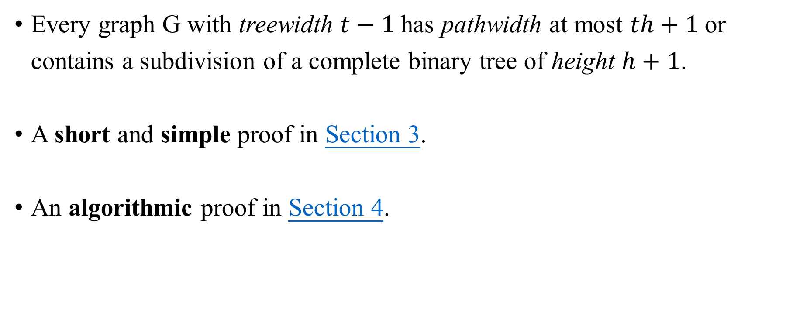
Theorem 1.1
Every graph G with treewidth $t−1$has pathwidth at most $th+1$or contains a subdivision of a complete binary tree of height $h+1$.
A short and simple proof in Section 3.
An algorithmic proof in Section 4.

Slide 10
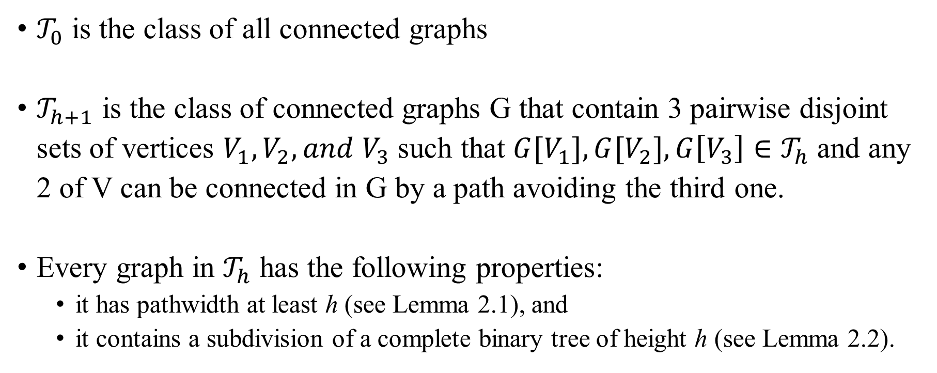

A sequence of classes of graph – ${(𝒯_{h})}_{h=0}^{∞}$
$𝒯_{0}$ is the class of all connected graphs
$𝒯_{h+1}$ is the class of connected graphs G that contain 3 pairwise disjoint sets of vertices $V_{1}, V_{2}, and V_{3}$ such that ${G[V}_{1}], {G[V}_{2}], G\left[V_{3}\right]∈𝒯_{h}$ and any 2 of V can be connected in G by a path avoiding the third one.
Every graph in $𝒯_{h}$ has the following properties:
  it has pathwidth at least h (see Lemma 2.1), and
  it contains a subdivision of a complete binary tree of height h (see Lemma 2.2).

Slide 11
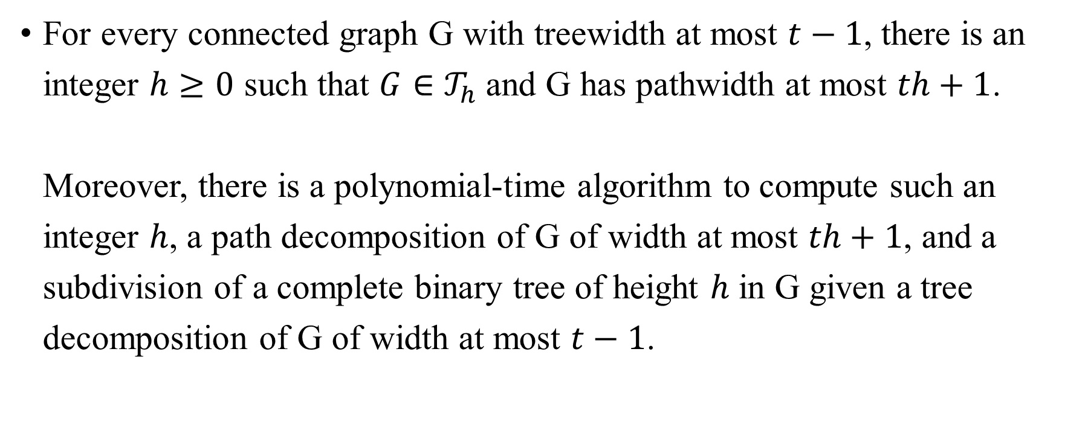
Theorem 1.2
For every connected graph G with treewidth at most $t−1$, there is an integer $h≥0$ such that $G∈𝒯_{h}$and G has pathwidth at most $th+1$.
Moreover, there is a polynomial-time algorithm to compute such an integer $h$, a path decomposition of G of width at most $th+1$, and a subdivision of a complete binary tree of height $h$ in G given a tree decomposition of G of width at most $t−1$.

Slide 12
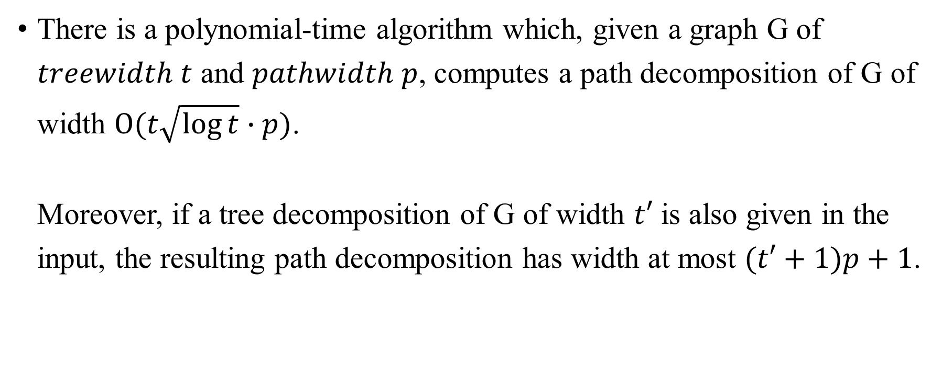
Corollary 1.3
There is a polynomial-time algorithm which, given a graph G of $treewidth t$ and $pathwidth p$, computes a path decomposition of G of width $Ο(t\sqrt{\log{t}}∙p)$.
Moreover, if a tree decomposition of G of width $t′$ is also given in the input, the resulting path decomposition has width at most $(t′+1)p+1$.

Slide 13
Preliminaries and Tools

Slide 14
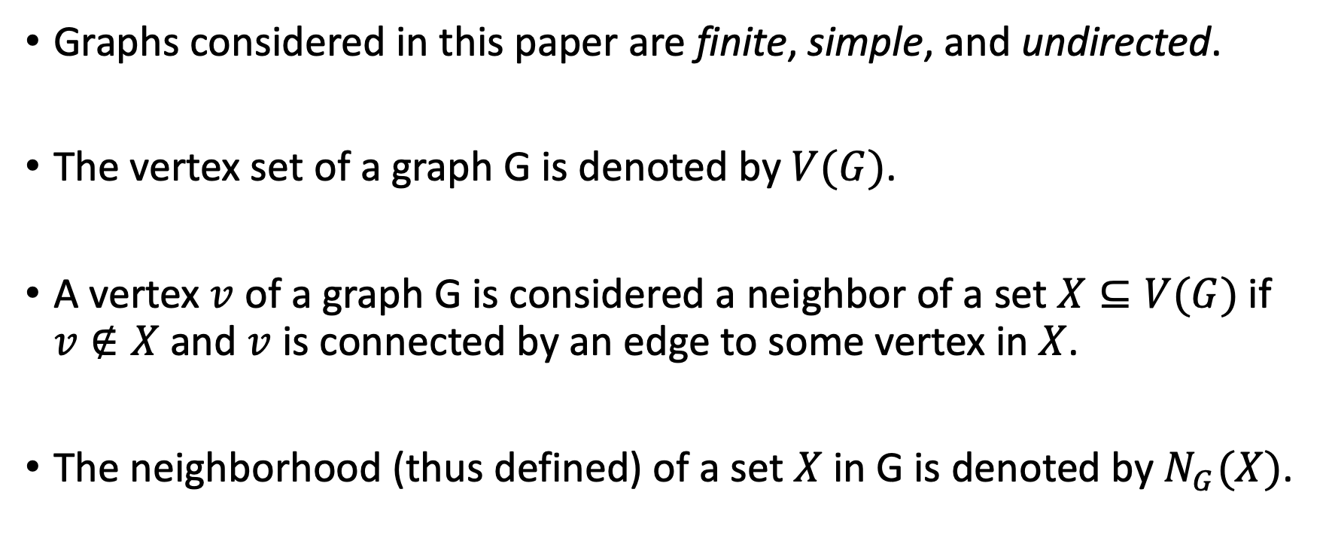
Basic Definitions – 1
Graphs considered in this paper are finite, simple, and undirected.
The vertex set of a graph G is denoted by $V(G)$.
A vertex $v$ of a graph G is considered a neighbor of a set $X⊆V(G)$if $v∉X$and $v$ is connected by an edge to some vertex in $X$.
The neighborhood (thus defined) of a set $X$ in G is denoted by $N_{G}(X)$.

Slide 15
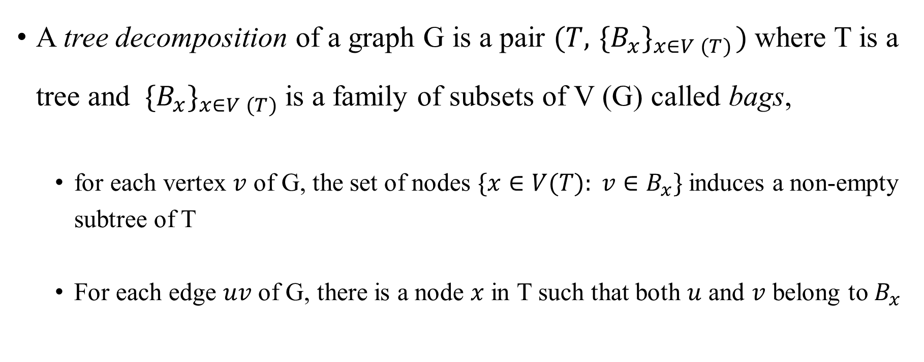
Basic Definitions – 2
A tree decomposition of a graph G is a pair $(T, { \{B_{x}\}}_{x∈V (T)})$where T is a tree and ${ \{B_{x}\}}_{x∈V (T)}$is a family of subsets of V (G) called bags,
  for each vertex $v$ of G, the set of nodes $\{x∈V(T): v∈B_{x}\}$induces a non-empty subtree of T
  For each edge $uv$ of G, there is a node $x$ in T such that both $u$ and $v$ belong to $B_{x}$

Slide 16
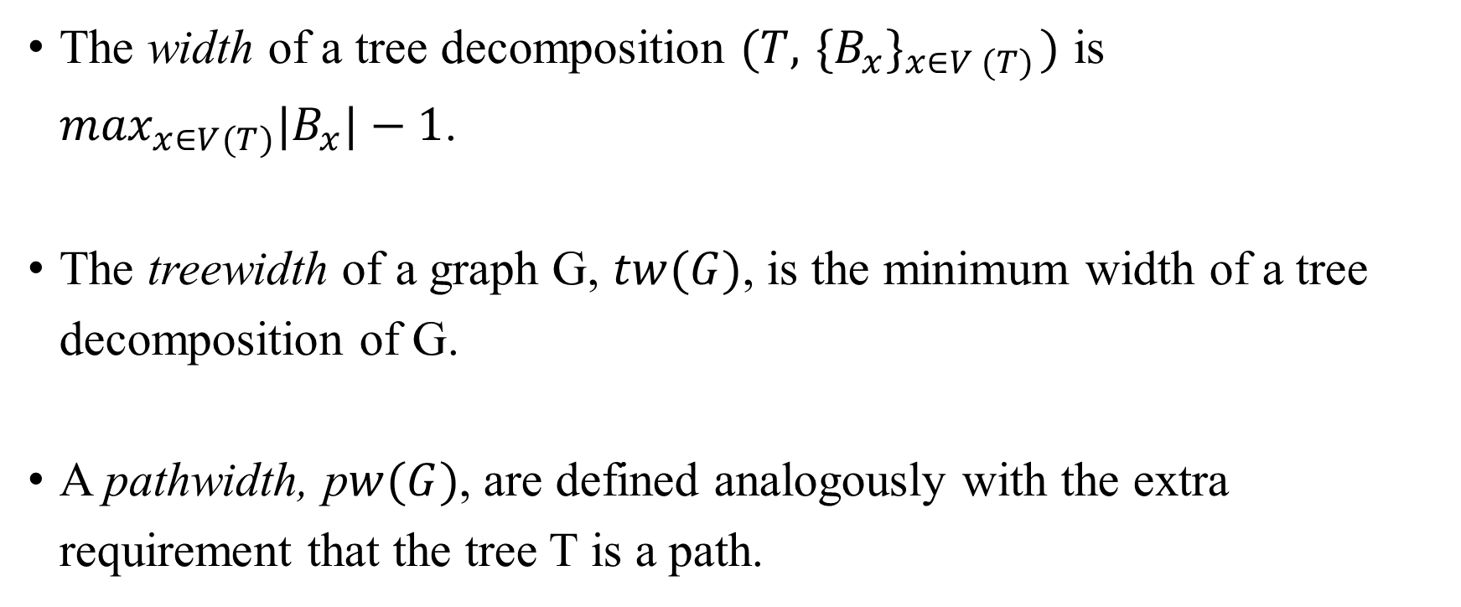
Basic Definitions – 3
The width of a tree decomposition $(T, { \{B_{x}\}}_{x∈V (T)})$ is $\max_{x∈V(T)}|B_{x}|−1$.
The treewidth of a graph G, $tw(G)$, is the minimum width of a tree decomposition of G.
A pathwidth, p$w(G)$, are defined analogously with the extra requirement that the tree T is a path.

Slide 17
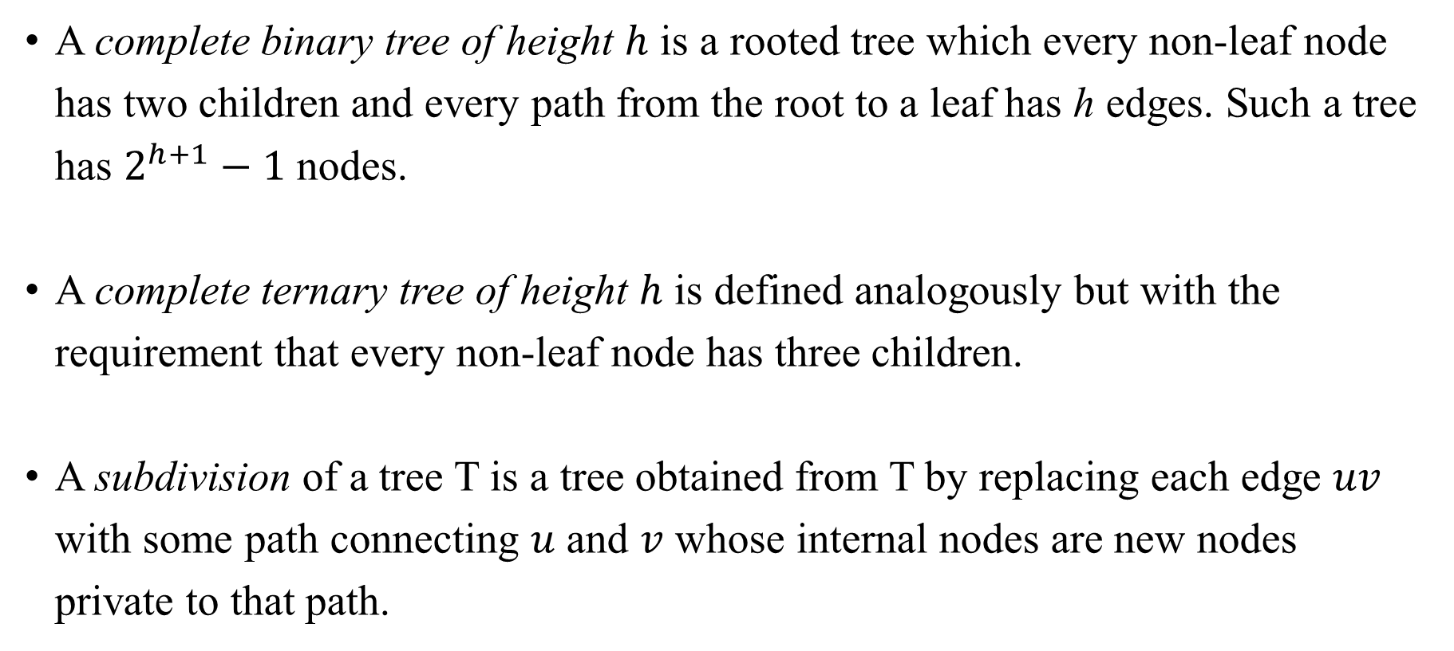
Basic Definitions – 4
A complete binary tree of height $h$ is a rooted tree which every non-leaf node has two children and every path from the root to a leaf has h edges. Such a tree has $2^{h+1}−1$ nodes.
A complete ternary tree of height $h$ is defined analogously but with the requirement that every non-leaf node has three children.
A subdivision of a tree T is a tree obtained from T by replacing each edge $uv$ with some path connecting $u$ and $v$ whose internal nodes are new nodes private to that path.

Slide 18
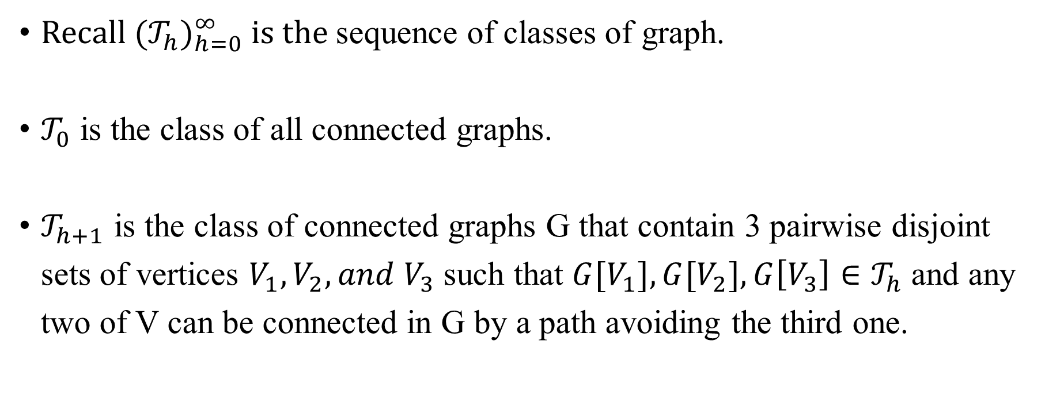
Witnesses for Large Pathwidth
Recall ${(𝒯_{h})}_{h=0}^{∞}$ is the sequence of classes of graph.
$𝒯_{0}$ is the class of all connected graphs.
$𝒯_{h+1}$ is the class of connected graphs G that contain 3 pairwise disjoint sets of vertices $V_{1}, V_{2}, and V_{3}$ such that ${G[V}_{1}], {G[V}_{2}], G\left[V_{3}\right]∈𝒯_{h}$ and any two of V can be connected in G by a path avoiding the third one.

Slide 19
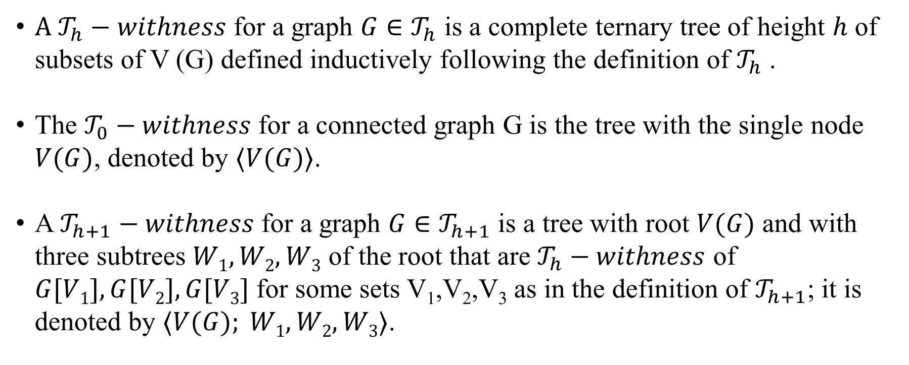
Witnesses for Large Pathwidth
A $𝒯_{h}−withness$ for a graph $G∈𝒯_{h}$ is a complete ternary tree of height $h$ of subsets of V (G) defined inductively following the definition of $𝒯_{h}$ .
The $𝒯_{0}−withness$ for a connected graph G is the tree with the single node $V(G)$, denoted by $⟨V(G)⟩$.
A $𝒯_{h+1}−withness$ for a graph $G∈𝒯_{h+1}$ is a tree with root $V(G)$ and with three subtrees $W1, W2, W3$ of the root that are $𝒯_{h}−withness$ of $G[V1],G[V2],G[V3]$for some sets V₁,V₂,V₃ as in the definition of $𝒯_{h+1}$; it is denoted by $⟨V(G); W1, W2, W3⟩$.

Slide 20
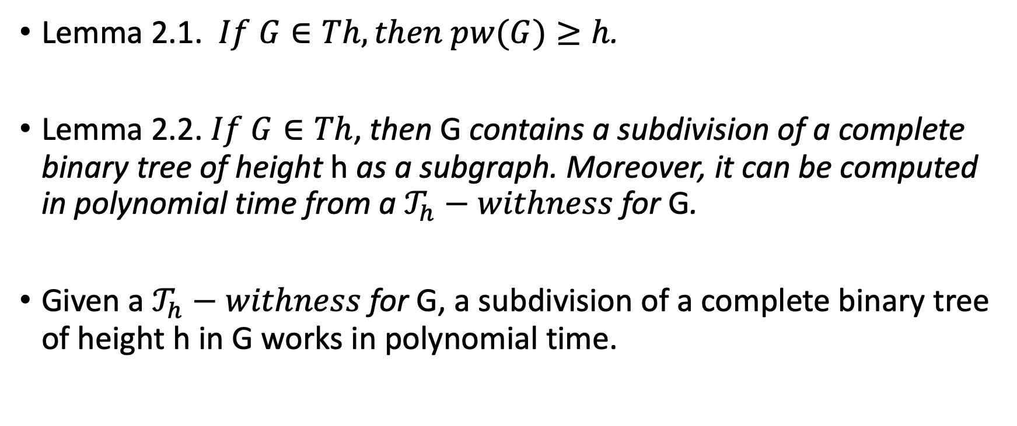
Witnesses for Large Pathwidth
Lemma 2.1. $If G∈Th, then pw(G)≥h$.
Lemma 2.2. $If G∈Th$, then G contains a subdivision of a complete binary tree of height h as a subgraph. Moreover, it can be computed in polynomial time from a $𝒯_{h}−withness$ for G.
Given a $𝒯_{h}−withness$ for G, a subdivision of a complete binary tree of height h in G works in polynomial time.

Slide 21
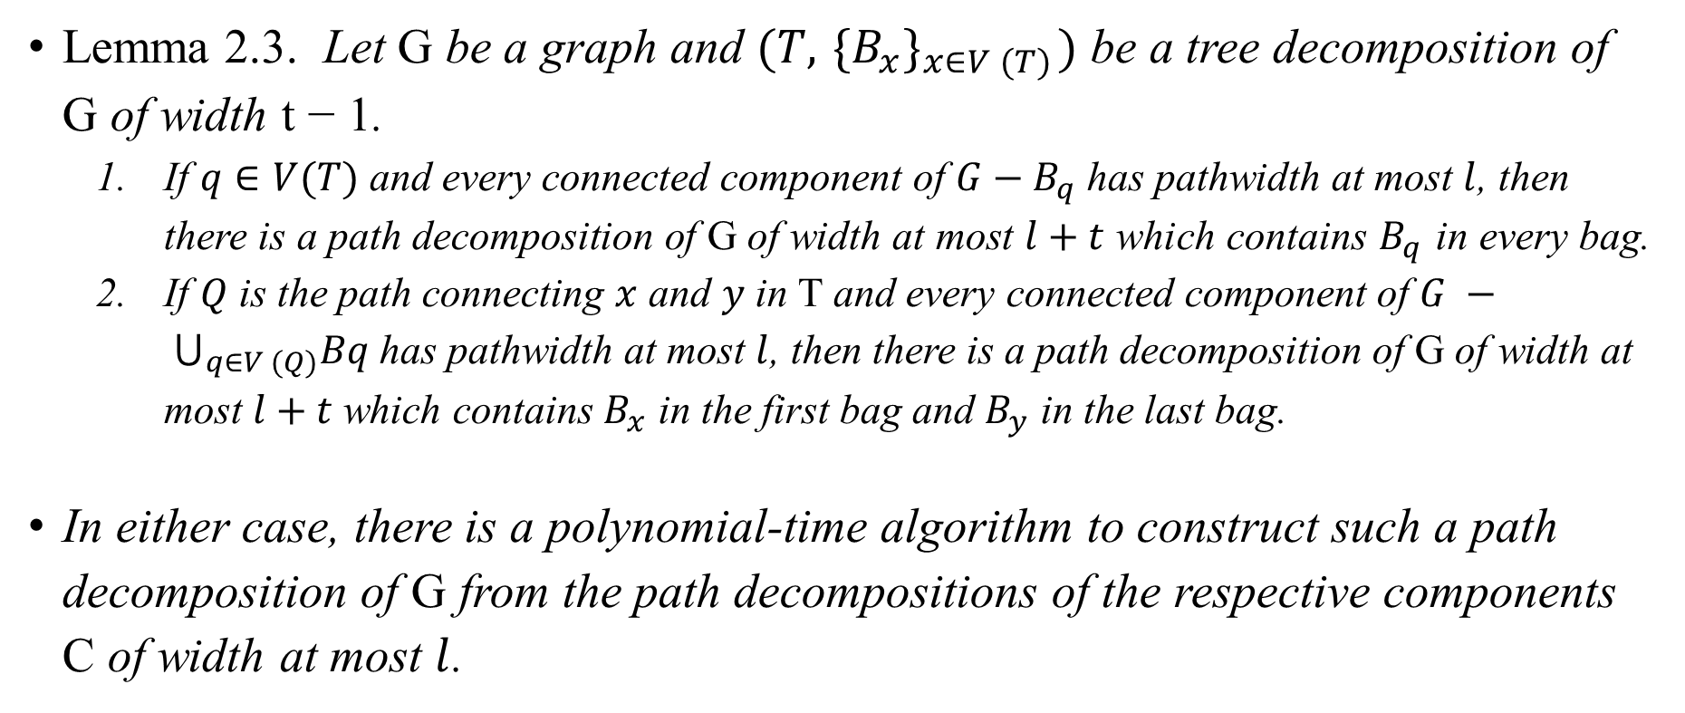
Combining Path Decompositions
Lemma 2.3. Let G be a graph and $(T, { \{B_{x}\}}_{x∈V (T)})$ be a tree decomposition of G of width t − 1.
  If $q∈V(T)$and every connected component of $G−B_{q}$has pathwidth at most $l$, then there is a path decomposition of G of width at most $l+t$which contains $B_{q}$ in every bag.
  If $Q$ is the path connecting $x$ and $y$ in T and every connected component of $G − ⋃_{q∈V (Q)}Bq$has pathwidth at most $l$, then there is a path decomposition of G of width at most $l+t$which contains $B_{x}$ in the first bag and $B_{y}$ in the last bag.
In either case, there is a polynomial-time algorithm to construct such a path decomposition of G from the path decompositions of the respective components C of width at most $l$.

Slide 22
Proof of Theorem 1.1

Slide 23
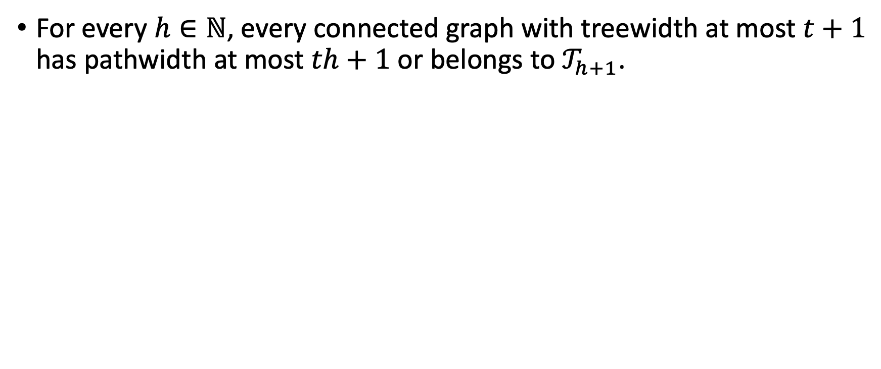
Theorem 3.1
For every $h∈ℕ$, every connected graph with treewidth at most $t+1$ has pathwidth at most $th+1$ or belongs to $𝒯_{h+1}$.

Slide 24

Proof
The statement is true for $h=0$, if a connected graph G has a cycle a vertex of degree at least 3, then $G∈𝒯_{1}$, and otherwise G is a path, so $pw(G)≤1$.

Slide 25
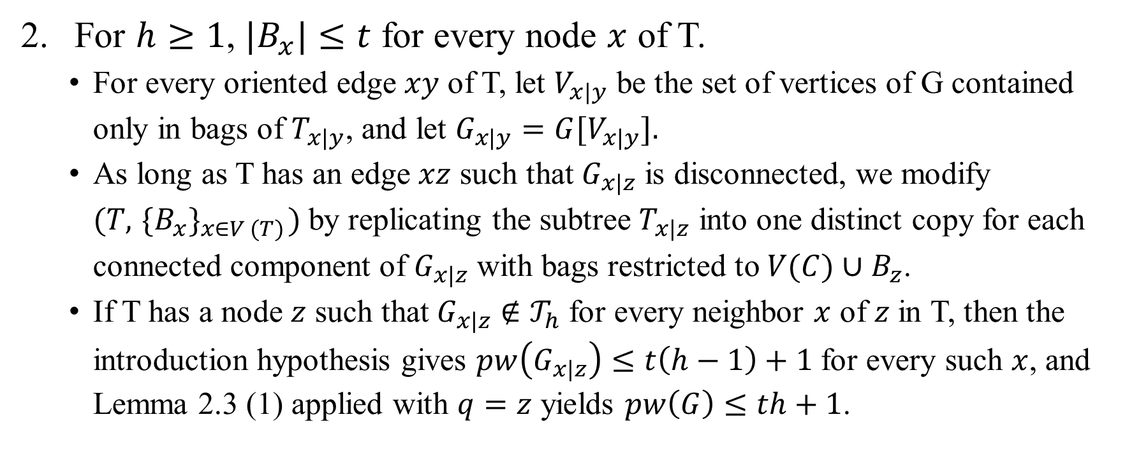
Proof
For $h≥1$, $|B_{x}|≤t$ for every node $x$ of T.
  For every oriented edge $xy$ of T, let $V_{x|y}$ be the set of vertices of G contained only in bags of $T_{x|y}$, and let $G_{x|y}={G[V}_{x|y}].$
  As long as T has an edge $xz$ such that $G_{x|z}$ is disconnected, we modify $(T, { \{B_{x}\}}_{x∈V (T)})$by replicating the subtree $T_{x|z}$ into one distinct copy for each connected component of $G_{x|z}$ with bags restricted to $V(C)∪B_{z}$.
  If T has a node $z$ such that $G_{x|z}∉𝒯_{h}$ for every neighbor $x$ of $z$ in T, then the introduction hypothesis gives $pw\left(G_{x|z}\right)≤t\left(h−1\right)+1$ for every such $x$, and Lemma 2.3 (1) applied with $q=z$ yields $pw\left(G\right)≤th+1$.

Slide 26
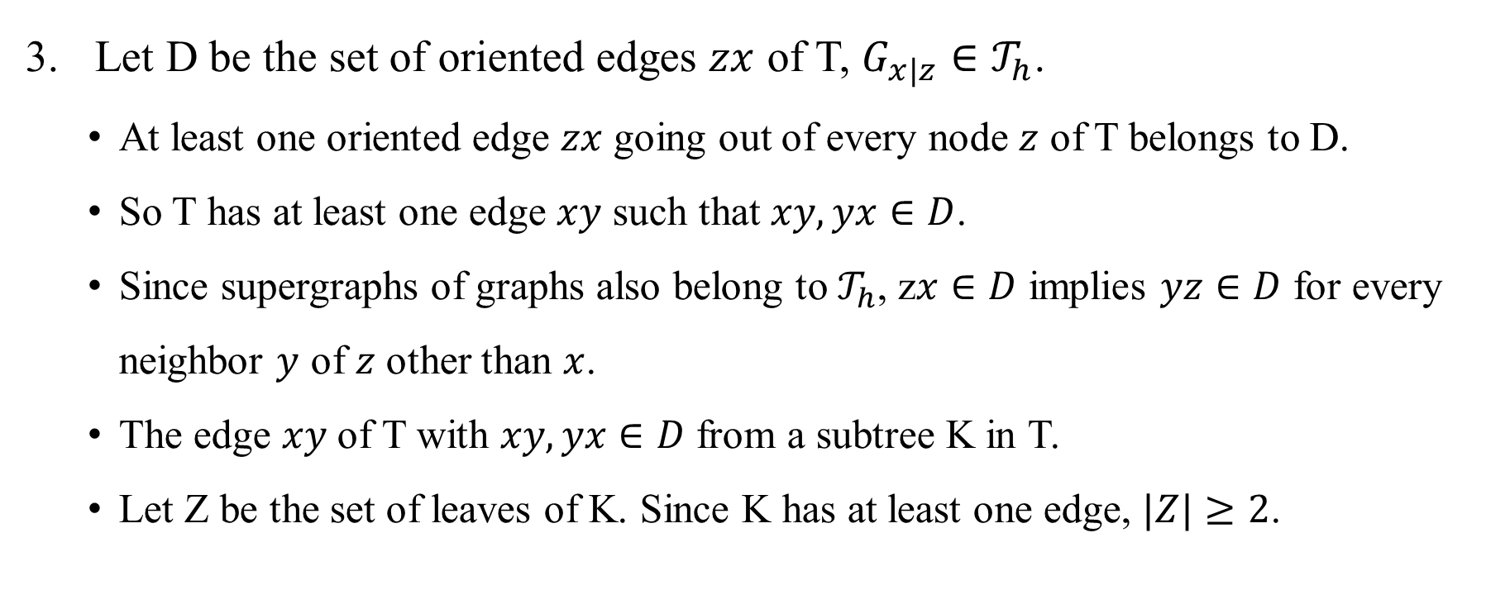
Proof
Let D be the set of oriented edges $zx$ of T, $G_{x|z}∈𝒯_{h}$.
  At least one oriented edge $zx$ going out of every node $z$ of T belongs to D.
  So T has at least one edge $xy$ such that $xy, yx∈D$.
  Since supergraphs of graphs also belong to $𝒯_{h}$, z$x∈D$ implies $yz∈D$ for every neighbor $y$ of $z$ other than $x$.
  The edge $xy$ of T with $xy, yx∈D$ from a subtree K in T.
  Let Z be the set of leaves of K. Since K has at least one edge, $|Z|≥2$.

Slide 27
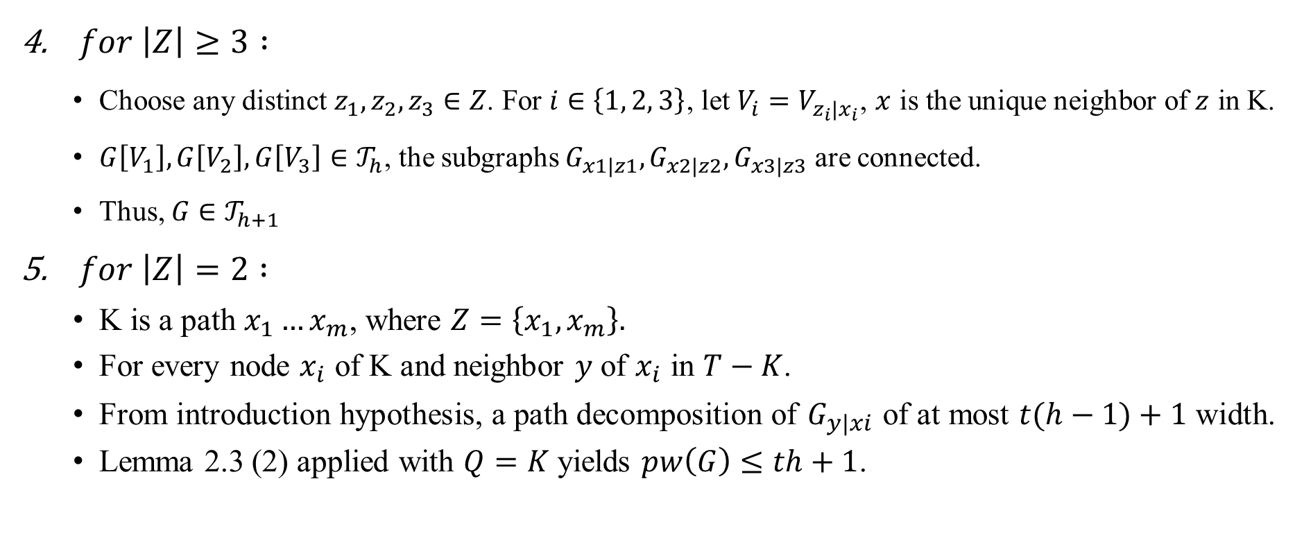
Proof
$for \left|Z\right|≥3 :$
  Choose any distinct $z_{1}, z_{2}, z_{3}∈Z$. For $i∈\left\{1, 2, 3\right\}$, let $V_{i}=V_{z_{i}|x_{i}}$, $x$ is the unique neighbor of $z$ in K.
  $G\left[V_{1}\right], G\left[V_{2}\right], G\left[V_{3}\right]∈𝒯_{h}$, the subgraphs $G_{x1|z1}, G_{x2|z2}, G_{x3|z3}$ are connected.
  Thus, $G∈𝒯_{h+1}$
$for \left|Z\right|=2 :$
  K is a path $x_{1}…x_{m}$, where $Z=\left\{x_{1}, x_{m}\right\}.$
  For every node $x_{i}$ of K and neighbor $y$ of $x_{i}$ in $T−K$.
  From introduction hypothesis, a path decomposition of $G_{y|xi}$ of at most $t(h−1)+1$width.
  Lemma 2.3 (2) applied with $Q=K$ yields $pw\left(G\right)≤th+1$.

Slide 28
Proof of Theorem 1.2

Slide 29
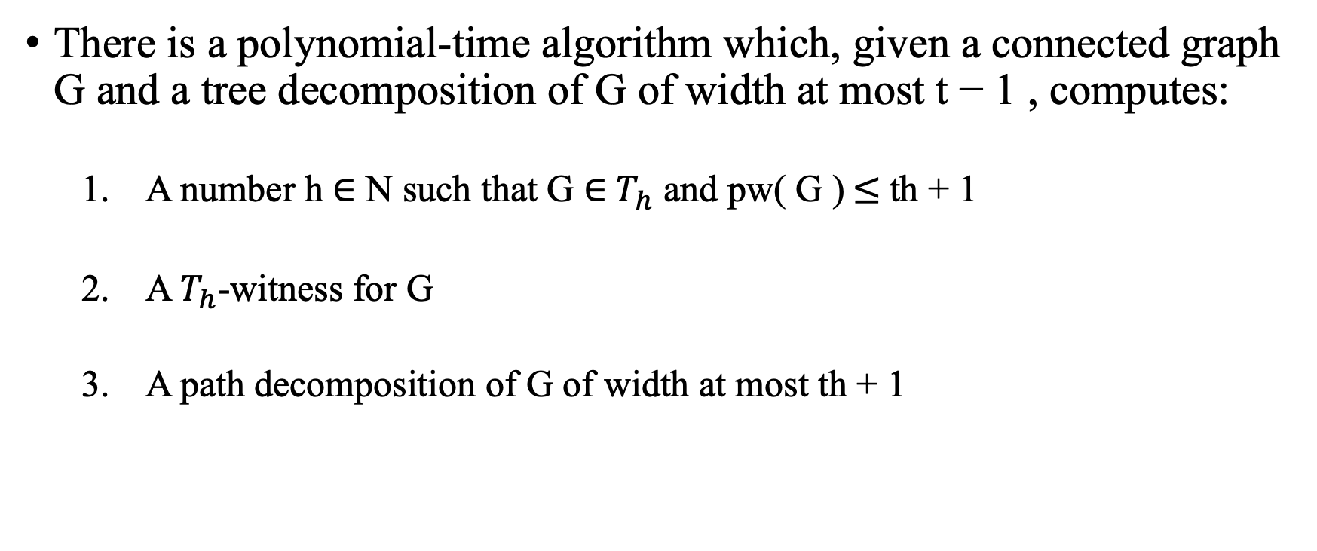
Theorem 4.1
There is a polynomial-time algorithm which, given a connected graph G and a tree decomposition of G of width at most t − 1 , computes:
  A number h ∈ N such that G ∈ $T_{h}$ and pw( G )$≤$th + 1
  A $T_{h}$-witness for G
  A path decomposition of G of width at most th + 1

Slide 30
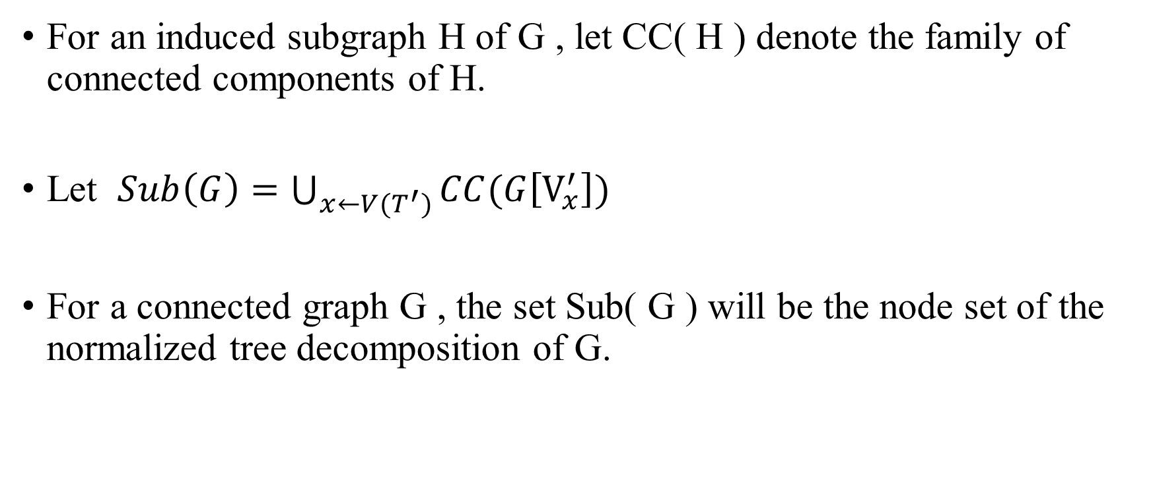
Normalized Tree Decompositions
For an induced subgraph H of G , let CC( H ) denote the family of connected components of H.
Let $Sub\left(G\right)=\bigcup_{x←V(T^{′})}{CC(G\left[V_{x}^{′}\right])}$
For a connected graph G , the set Sub( G ) will be the node set of the normalized tree decomposition of G.

Slide 31
Normalized Tree Decompositions
The following holds for every graph G and for Sub( G ) deﬁned as above.
  If G is connected, then G ∈ Sub( G ).
  If α, β ∈ Sub( G ) , then V ( α ) ⊆ V ( β ) , or V ( β ) ⊆V ( α ) , or V ( α ) ∩ V ( β ) = ∅.
  If α, β ∈ Sub( G ) and V ( α ) ∩ V ( β ) = ∅, then no edge of G connects V ( α ) and V ( β ) .

Slide 32
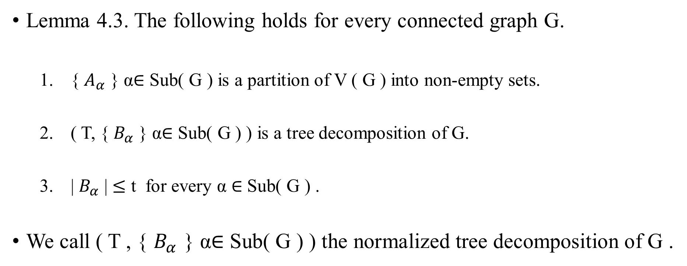
Normalized Tree Decompositions
Lemma 4.3. The following holds for every connected graph G.
  { $A_{α}$ } α∈ Sub( G ) is a partition of V ( G ) into non-empty sets.
  ( T, { $B_{α}$ } α∈ Sub( G ) ) is a tree decomposition of G.
  | $B_{α}$ | $≤$ t for every α ∈ Sub( G ) .
We call ( T , { $B_{α}$ } α∈ Sub( G ) ) the normalized tree decomposition of G .

Slide 33
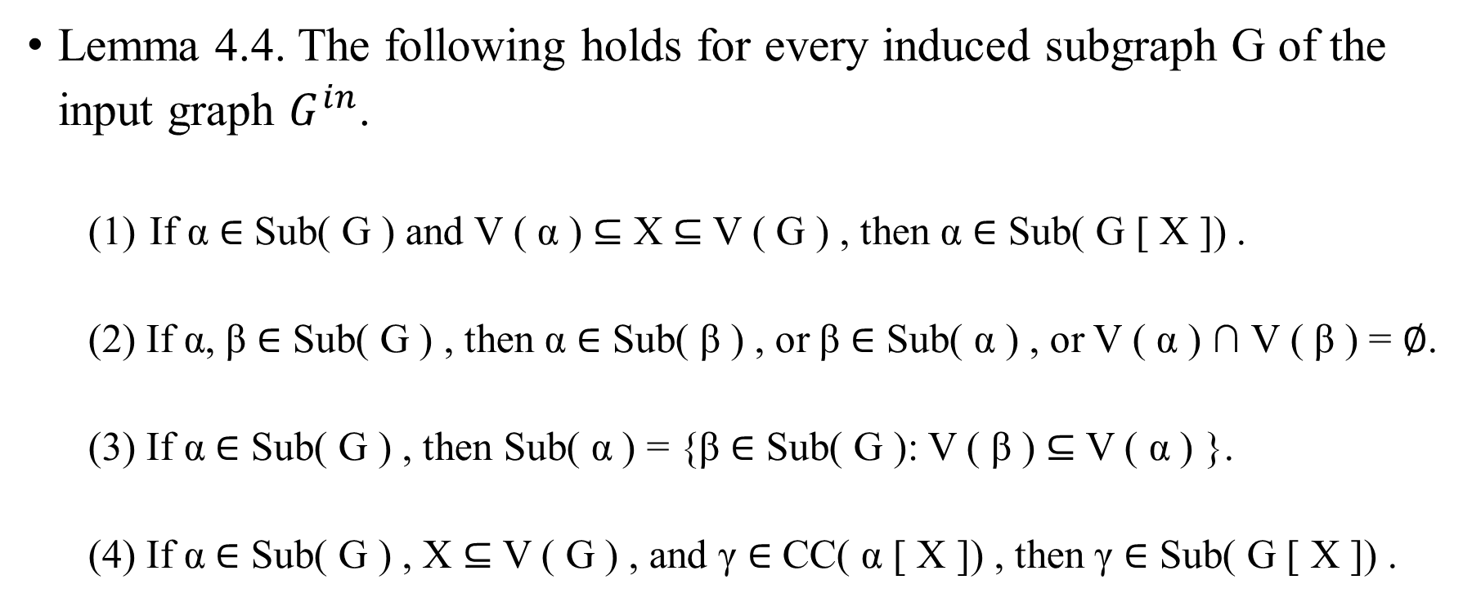
Normalized Tree Decompositions
Lemma 4.4. The following holds for every induced subgraph G of the input graph $G^{in}$.
  If α ∈ Sub( G ) and V ( α ) ⊆ X ⊆ V ( G ) , then α ∈ Sub( G [ X ]) .
  (2) If α, β ∈ Sub( G ) , then α ∈ Sub( β ) , or β ∈ Sub( α ) , or V ( α ) ∩ V ( β ) = ∅.
  (3) If α ∈ Sub( G ) , then Sub( α ) = {β ∈ Sub( G ): V ( β ) ⊆ V ( α ) }.
  (4) If α ∈ Sub( G ) , X ⊆ V ( G ) , and γ ∈ CC( α [ X ]) , then γ ∈ Sub( G [ X ]) .

Slide 34
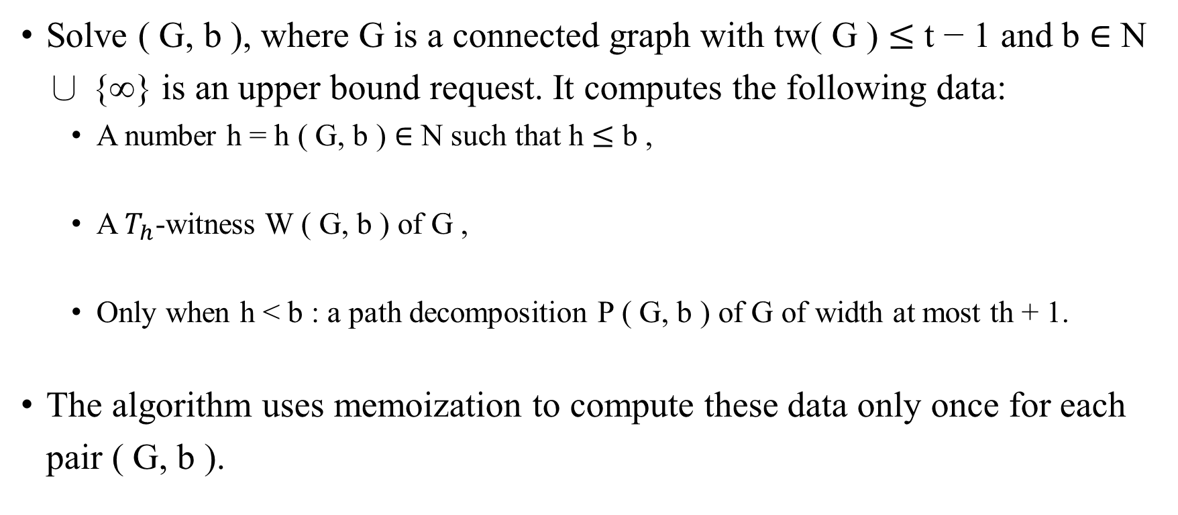
Main Procedure
Solve ( G, b ), where G is a connected graph with tw( G ) $≤$ t − 1 and b ∈ N ∪ {∞} is an upper bound request. It computes the following data:
  A number h = h ( G, b ) ∈ N such that h $≤$ b ,
  A $T_{h}$-witness W ( G, b ) of G ,
  Only when h < b : a path decomposition P ( G, b ) of G of width at most th + 1.
The algorithm uses memoization to compute these data only once for each pair ( G, b ).

Slide 35
Main Procedure solve ( G, b )
For a ﬁxed connected graph G and a ﬁxed upper bound request b ∈ N ∪ {∞} .
  Access to the normalized tree decomposition ( T, {B α } α∈ Sub( G ) ) of G of width at most t − 1, obtained from some initial tree decomposition of G in the way.
  If the normalized tree decompositions for all graphs G considered in the algorithm come from a common input tree decomposition of an input graph Gin.
  A full run of solve ( Gin, ∞ ) makes recursive calls to solve ( G, b ) for only polynominal many distinct pairs ( G, b ).

Slide 36
Complexity Analysis
We let G denote the input graph previously denoted by Gin. The algorithm consists in running solve ( G, ∞ ) on the input graph G makes further recursive calls to solve ( β, b ) for various connected induced subgraphs β of G and upper bound requests b.
Let every pair ( β, b ) such that solve ( β, b ) is run by the algorithm be called a subproblem . We show that if G has n vertices, then there are only O ( n log n ) subproblems.

Slide 37
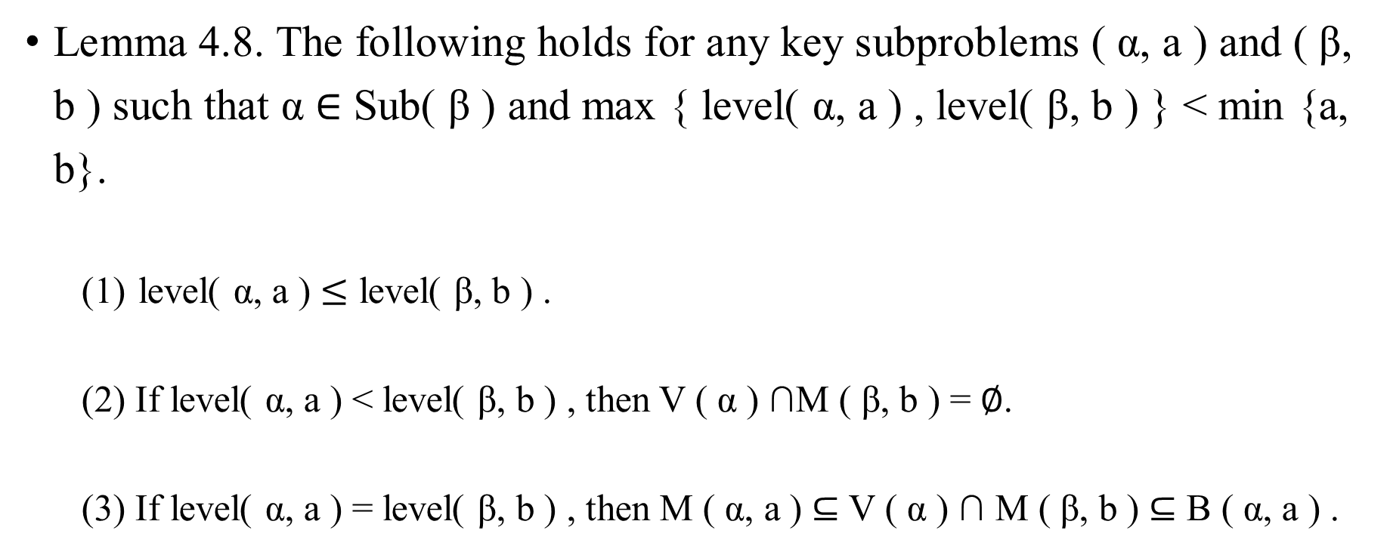
Complexity Analysis
Lemma 4.8. The following holds for any key subproblems ( α, a ) and ( β, b ) such that α ∈ Sub( β ) and max { level( α, a ) , level( β, b ) } < min {a, b}.
  level( α, a ) $≤$ level( β, b ) .
  (2) If level( α, a ) < level( β, b ) , then V ( α ) ∩M ( β, b ) = ∅.
  (3) If level( α, a ) = level( β, b ) , then M ( α, a ) ⊆ V ( α ) ∩ M ( β, b ) ⊆ B ( α, a ) .

Slide 38
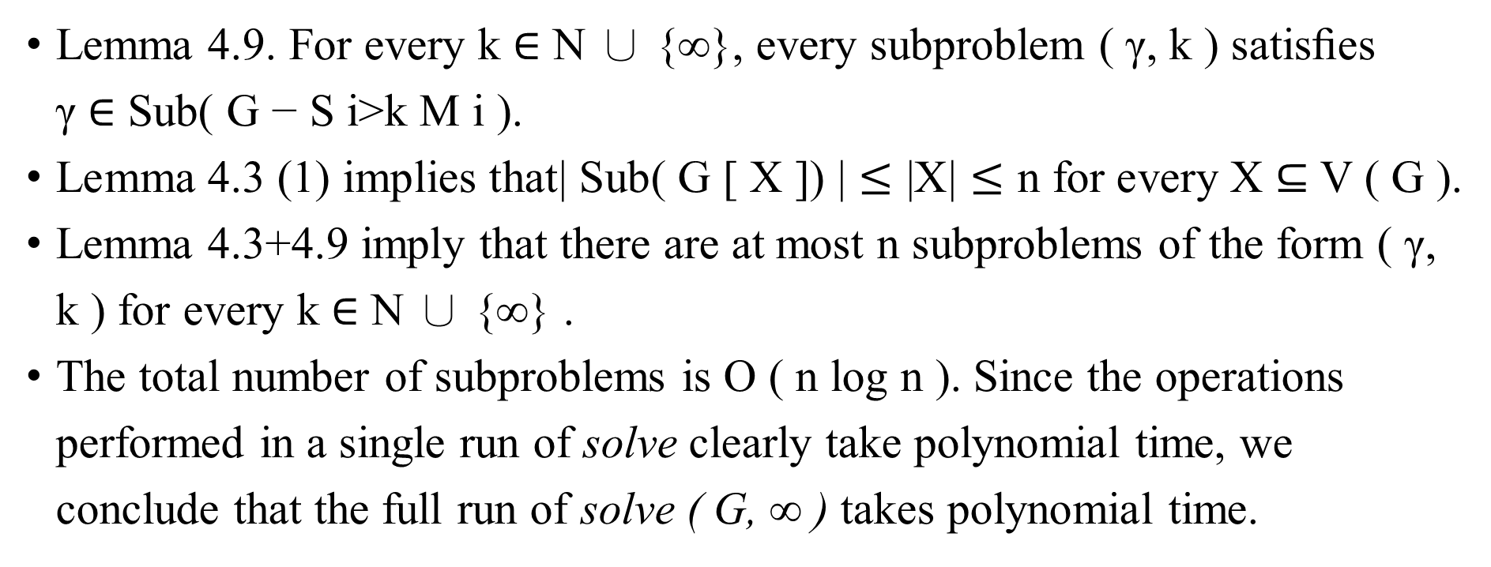
Complexity Analysis
Lemma 4.9. For every k ∈ N ∪ {∞}, every subproblem ( γ, k ) satisﬁes γ ∈ Sub( G − S i>k M i ).
Lemma 4.3 (1) implies that| Sub( G [ X ]) | $≤$ |X| $≤$ n for every X ⊆ V ( G ).
Lemma 4.3+4.9 imply that there are at most n subproblems of the form ( γ, k ) for every k ∈ N ∪ {∞} .
The total number of subproblems is O ( n log n ). Since the operations performed in a single run of solve clearly take polynomial time, we conclude that the full run of solve ( G, ∞ ) takes polynomial time.

Slide 39
Tightness

Slide 40
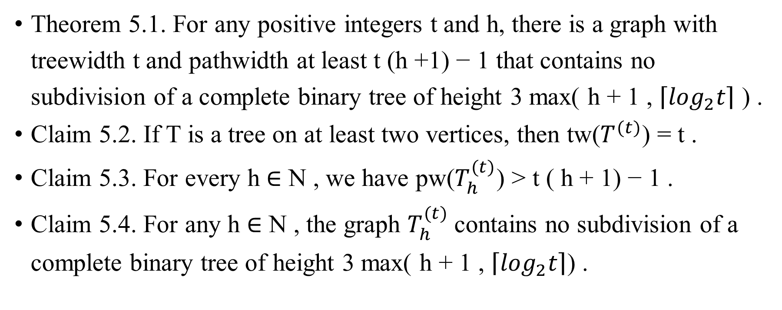
Tightness
Theorem 5.1. For any positive integers t and h, there is a graph with treewidth t and pathwidth at least t (h +1) − 1 that contains no subdivision of a complete binary tree of height 3 max( h + 1 , $\left\lceil \log_{2}t\right\rceil$ ) .
Claim 5.2. If T is a tree on at least two vertices, then tw($T^{(t)}$) = t .
Claim 5.3. For every h ∈ N , we have pw($T_{h}^{(t)}$) > t ( h + 1) − 1 .
Claim 5.4. For any h ∈ N , the graph $T_{h}^{(t)}$contains no subdivision of a complete binary tree of height 3 max( h + 1 , $\left\lceil \log_{2}t\right\rceil$) .

Slide 41
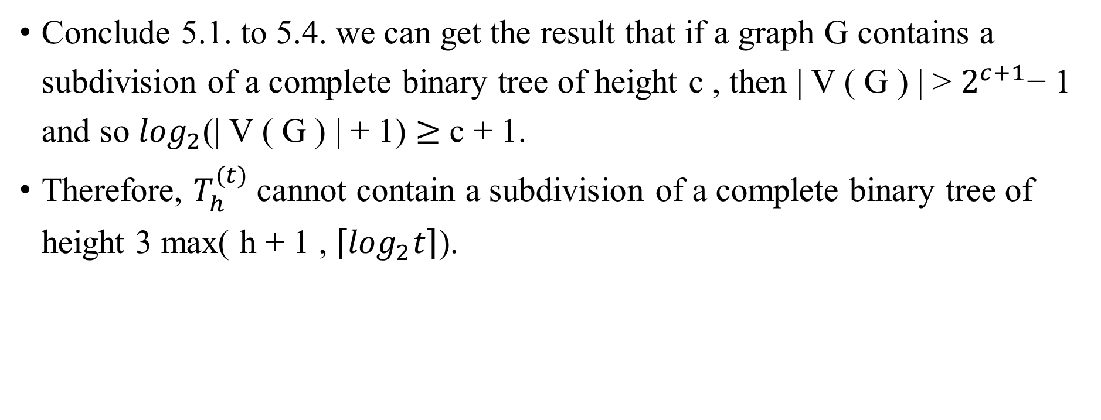
Tightness
Conclude 5.1. to 5.4. we can get the result that if a graph G contains a subdivision of a complete binary tree of height c , then | V ( G ) | > $2^{c+1}$− 1 and so $\log_{2}$(| V ( G ) | + 1) $≥$ c + 1.
Therefore, $T_{h}^{(t)}$cannot contain a subdivision of a complete binary tree of height 3 max( h + 1 , $\left\lceil \log_{2}t\right\rceil$).

Slide 42
Q & A

Slide 43
Thank you

Slide 44
Reference
https://epubs.siam.org/doi/pdf/10.1137/1.9781611976465.117
https://en.wikipedia.org/wiki/Treewidth
https://en.wikipedia.org/wiki/Pathwidth

