Slide 1
Distributed Data Gathering Algorithm Based on Spanning Tree
Shi Dong, Mudar Sarem, and Wengang Zhou
IEEE SYSTEMS JOURNAL, VOL. 15, NO. 1, 289-296, MARCH 2021
Presenter : Feng-Ming Chang, Pei-Wen Sheng
2021/06/01

Slide 2
Outline
Introduction
Network model
Problem description
Algorithm
Experiments

Slide 3
Introduction
Wireless sensor networks(WSNs) are composed of a large number of sensor nodes.
Data gathering is a fundamental operation in various applications of WSNs, where the sensor nodes sense the information and forward the data to a sink node via multihop wireless communications.
This article puts forward an improved data gathering algorithm based on distributed spanning tree, which can prolong the overall networks lifetime.

Slide 4
Network model
Round: This is the time it takes for gathering the data for all the sensor nodes and transferring this data to the sink node.
Node lifetime: The number of the rounds node v_{i} which can survive in a tree T is called the lifetime of the node. The residual energy surviving node $v_{i}$should satisfy E($v_{i}$) > 0. The lifetime’s definition of node is expressed as follows:

Slide 5
Network model
Tree lifetime: When the first node is dead in tree T, the rounds number of the node surviving is the lifetime of the tree. The residual energy of node is denoted as E)$v_{i}$), where the lifetime of the tree is defined as follows:

Slide 6
Network model
WSN consisted of n sensor nodes V $v_{1}, v_{2}, …, v_{n}$ and a sink node s, where a connected undirected graph G(V,E) is built, and the nodes are randomly deployed in L*L Euclidean plane.
For any two nodes, the sink node should satisfy || $v_{i}−v_{j}$|| <= r, where r is the radius of the largest transmission .
The energy consumption of the transmission $E_{T_{r}}$ is defined as follows:

Slide 7
Problem description
The key issue of this article is finding the optimal spanning gathering method according to the energy consumption in order to achieve the objective of maximizing the lifetime when constructing a balanced spanning tree.

Slide 8
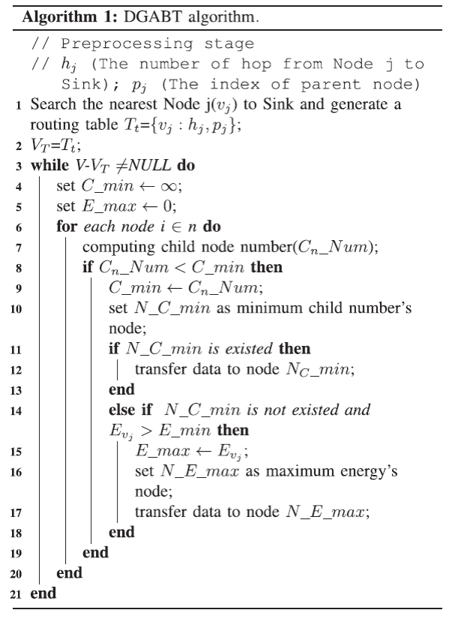
Algorithm

Slide 9
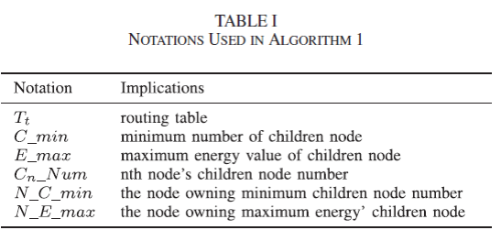
Algorithm

Slide 10
Algorithm
Step 1. Build a neighbor node of each node with the message.
Step 2. Use random routing method to initialize the spanning tree, and then
calculate the child nodes for each node.
Step 3. According to the number of the child nodes, which are sorted from
small to large, priority select the least number of the child nodes as
a node transmission object, if there are two or more child nodes,
choose the maximum residual energy node as a node to transmit
data.
Step 4. According to step 3, adjust the spanning tree, through the nth wheel
data gathering, and thus, the data gathering process is completed.

Slide 11
Algorithm
Analyses :
The time complexity of DGABT algorithm is O(n), where n is the
number of nodes in the network.
Proof :
At the Step 1. of DGABT algorithm, building the neighbor node
$v_{j}$ for each node. The process’s time complexity is O(n).
At the Step 2. in iteration (Algorithm 1, lines 3–18), the time
cost will depend on the whole network topology. If N_C_min is
existed, that is to say no same minimum number of children node.
The time complexity is O(n).

Slide 12
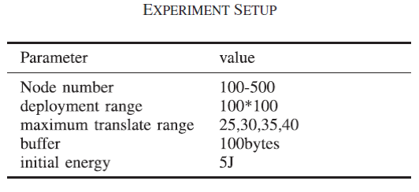
Experiments
Experiment Environment

Slide 13
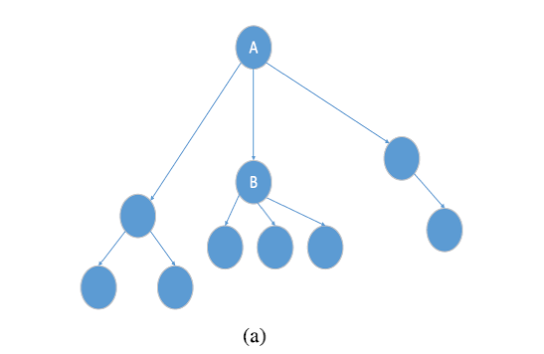
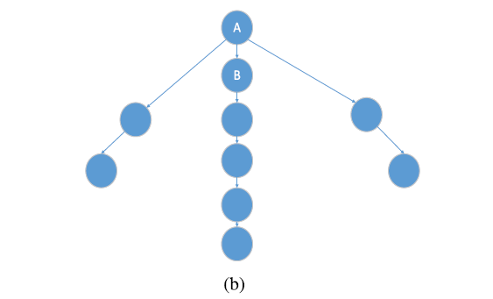
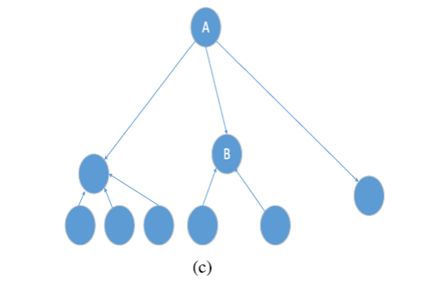
Experiments

Slide 14
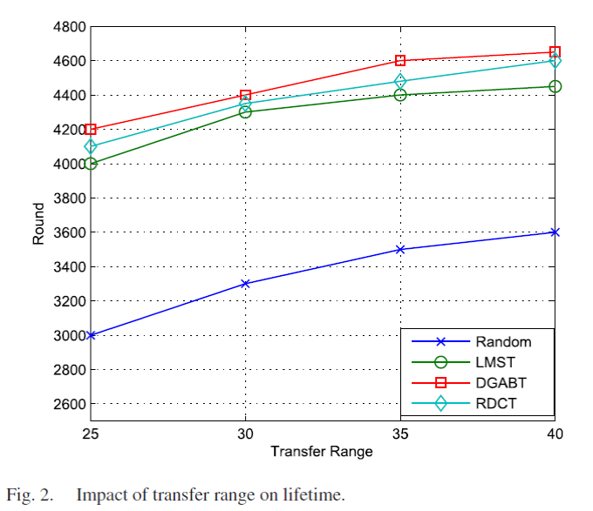
Experiments (Impact of Transfer Range on Lifetime)
The results presented in Fig. 2 show that when the transmission radius increasing, the WSNs lifetime is constantly prolonged.
When the transmission radius increases, so that the nodes have more opportunities to choose parent nodes from the neighbor nodes when constructing the optimal balance tree.

Slide 15
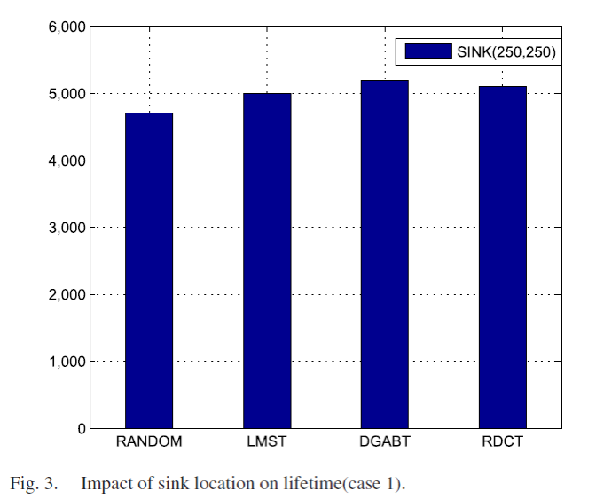
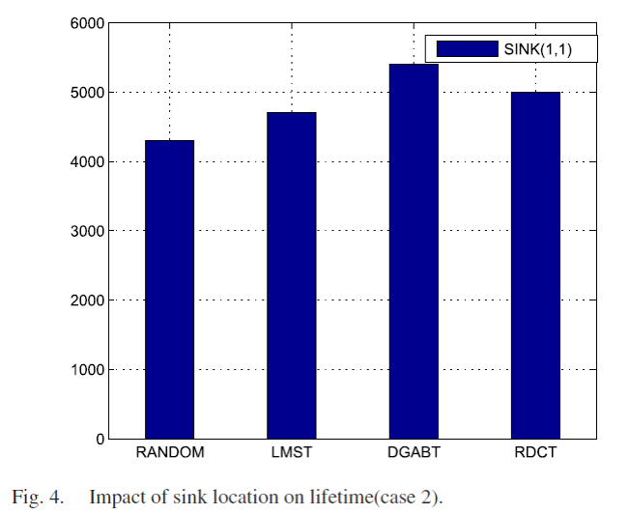
Experiments (Impact of Sink Location on Lifetime)

Slide 16
Experiments (Impact of Sink Location on Lifetime)
Case 1 : Sink node is in the regional center, the coordinates (250, 250), in addition to another 500 nodes and the sink node are randomly distributed in the region.
Case 2 : In the region of the edge node, the coordinates (1, 1), except the sink node, another 500 nodes are randomly distributed in the region.

Slide 17
Experiments (Impact of Sink Location on Lifetime)
RANDOM is the worst because the constraint condition of the network parameter which is not set in the random routing algorithm.
Although the LMST algorithm improves the lifetime of the data gathering tree by setting the parameter, it failed to make the consideration for an appropriate balance of tree.
DGABT algorithm makes full account of the energy consumption of the nodes in the tree to build a balance data gathering tree, which can prolong the entire lifetime of the network.

Slide 18
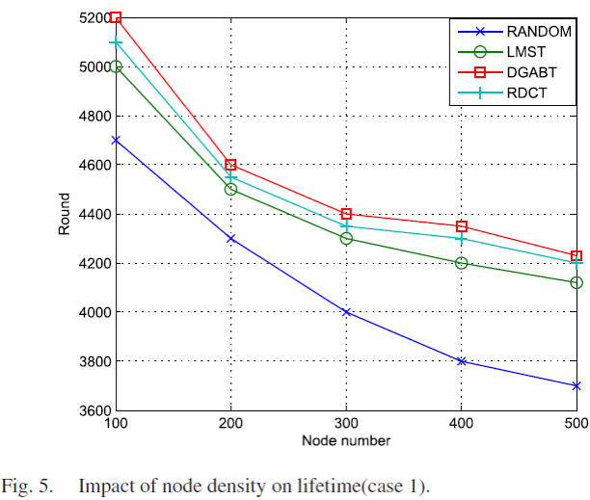
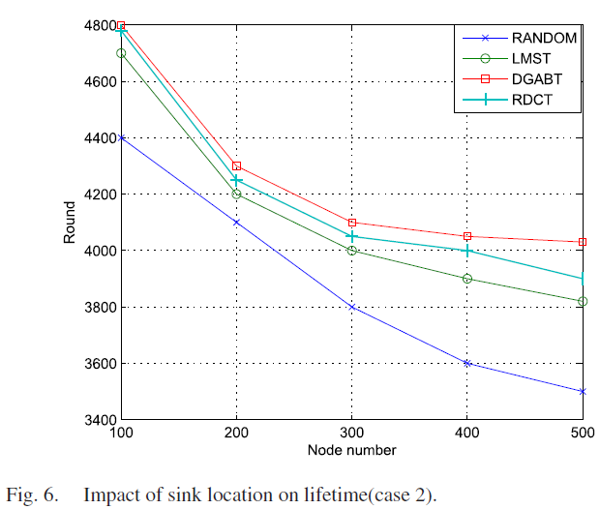
Experiments (Impact of Node Density on Lifetime)

Slide 19
Experiments (Impact of Node Density on Lifetime)
The density of the nodes is increasing, the acquisition data is also growing, and therefore the energy consumption also rises.
The lifetime of sink node which is relatively in middle position is longer than the lifetime of the node of the marginal position because the sink node of location at the edge, whose neighbor nodes are limited.

Slide 20
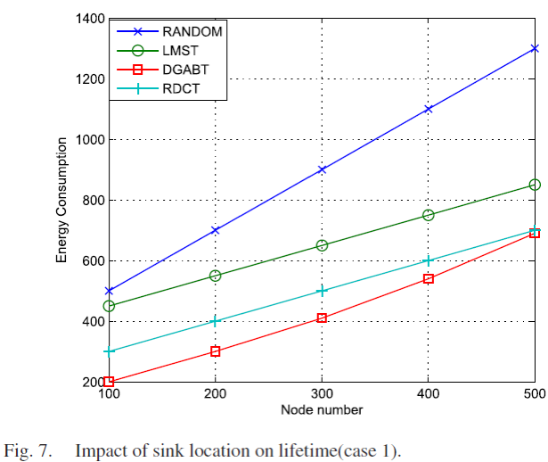
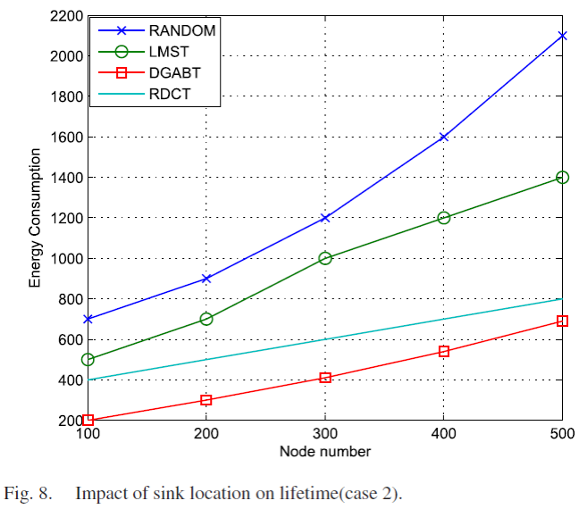
Experiments (Impact of Node Density on Energy Consumption)

Slide 21
Experiments (Impact of Node Density on Energy Consumption)
When the number of the nodes is increasing, more energy is consumed.
DGABT algorithm adopts improved balanced spanning tree which can enlarge the lifetime and reduce the energy consumption of the WSN efficiently.
Energy consumptions are increasing when the sink node lies in the region of the edge node because energy consumptions are increasing when the sink node lies in the region of the edge node.

Slide 22
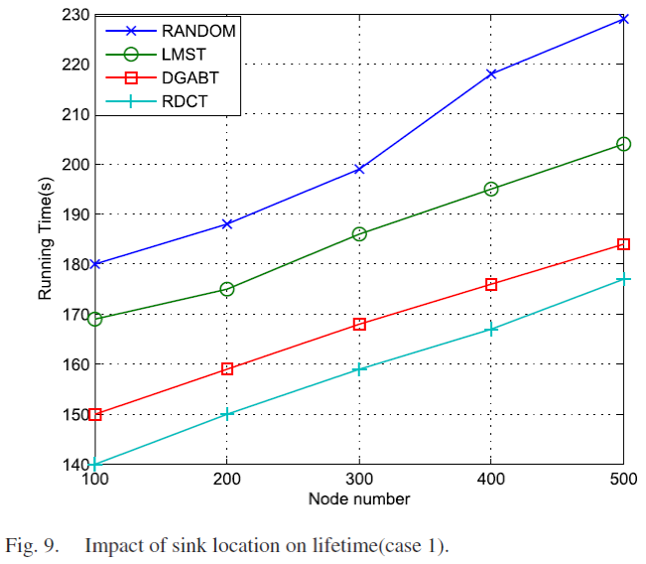
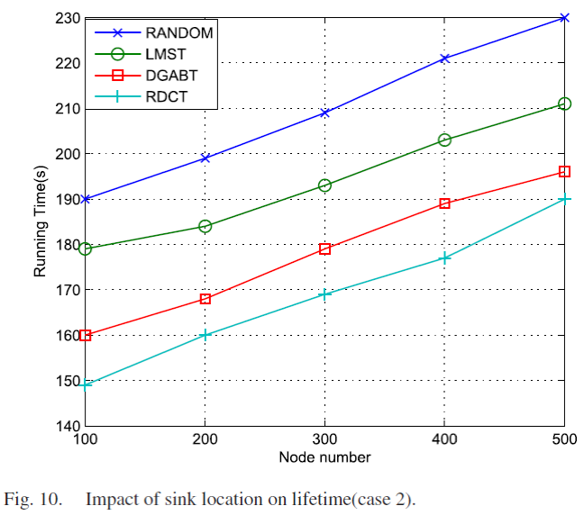
Experiments (Impact of Node Density on Running Time)

Slide 23
Experiments (Impact of Node Density on Running Time)
When the number of the nodes is increasing, the network topology is becoming big. This results in increasing the computing complexity, so that the running time will be increased.
The running time of our proposed DGABT algorithm is longer than the running time of the RDCT algorithm because we make progress to maximize the lifetime of the WSN. Meanwhile, the RDCT algorithm put the computing complexity as its important focus object.

Slide 24
Conclusion
The algorithm is an improved distributed data gathering method that can optimize the balance of the tree.
The algorithm takes into account the greatest WSNs lifetime as a research target for constructing the maximum lifetime spanning tree.
The algorithms running time still need to be further improved.

Slide 25
References
Shi Dong, Mudar Sarem, and Wengang Zhou, “Distributed Data Gathering Algorithm Based on Spanning Tree”, IEEE SYSTEMS JOURNAL, VOL. 15, NO. 1, 289-296, MARCH 2021
H. Ö. Tan and I. Körpeoˇglu, “Power efficient data gathering and aggregation in wireless sensor networks,” ACM Sigmod Rec., vol. 32, no. 4, pp. 66–71, 2003.

