Slide 1
The Stackelberg Minimum Spanning Tree Game
Jean Cardinal · Erik D. Demaine · Samuel Fiorini ·
Gwenaël Joret · Stefan Langerman ·
Ilan Newman · OrenWeimann

Slide 2
Outline
Introduction
Basic results
Complexity and Inapproximability
The best –out-of-k algorithm
Linear programing relaxation

Slide 3
Introduction
A graph with red and blue edges.
Red edges has a fixed cost(representing the competitor’s prices).
The first player chooses an assignment of prices to the blue edges.
The second player then buys the cheapest possible minimum spanning tree, using any combination of red and blue edges.
Stackelberg Minimum Spanning Tree problem (STACKMST)

Slide 5
APX-hard
APX (an abbreviation of "approximable") is the set of NP optimization problems that allow polynomial-time approximation algorithms with approximation ratio bounded by a constant (or constant-factor approximation algorithms for short).

Slide 6
APX-hard
If there is a polynomial-time algorithm to solve a problem within every fixed percentage greater than zero (one algorithm for each percentage), then the problem is said to have a polynomial-time approximation scheme (PTAS).

Slide 7
APX-hard
Unless P=NP, it can be shown that there are problems that are in APX but not in PTAS; that is, problems that can be approximated within some constant factor, but not every constant factor.

Slide 8
APX-hard
A problem is said to be APX-hard if there is a PTAS reduction from every problem in APX to that problem, and to be APX-complete if the problem is APX-hard and also in APX. As a consequence of P ≠ NP ⇒ PTAS ≠ APX, P ≠ NP ⇒ no APX-hard problem is in PTAS.

Slide 10
Step of the game
We are given an undirected graph1 G = (V ,E) whose edge set is partitioned into a red edge set R and a blue edge set B. Each red edge e ∈ R has a nonnegative fixed cost c(e) (the best competitor’s price). The leader owns every blue edge e ∈ B and has to set a price p(e) for each of these edges.

Slide 11
Evaluation
A spanning tree T is a minimum spanning tree (MST) if its total weight
is minimum. The revenue of T is then

Slide 12
Assumption
we assume that the graph contains a spanning tree whose edges are all red; otherwise, there is a cut consisting only of blue edges and the optimum value is unbounded.
we assume that among all edges of the same weight, blue edges are always preferred to red edges; this is a standard assumption.

Slide 13
Related work
similar pricing problem, where one wants to price the edges in B and the customer wants to construct a shortest path between two vertices instead of a spanning tree.
NP-hard and O(log |B|)-approximable

Slide 14
Related work
To find the best prices for a set of items, after bidders have announced their preferences in the form of subset valuations. Envy-free pricing, in particular, can be viewed as a simple Stackelberg game.
APX-hardness and approximability.

Slide 15
We will show
STACKMST is APX-hard, even if there are only two red costs.
STACKMST is O(log n)-approximable, and is O(1)-approximable when the red costs either fall in a constant-size range or have a constant number of distinct values.
The integrality gap of a natural integer linear programming formulation asymptotically matches the approximation guarantee of Best-out-of-k.

Slide 16
Basic results

Slide 17
Lemma 1
In every optimal price function, the price assigned to the blue edges appearing in some MST belong to the set {c(e) : e ∈ R}
1 2 2 3 4 5 1 2 2 2 4 5

Slide 18
Lemma 2
Consider a price function p, a corresponding minimum spanning tree T, and let
F = E(T) ∩B. Then for every e ∈ F, we have

Slide 19
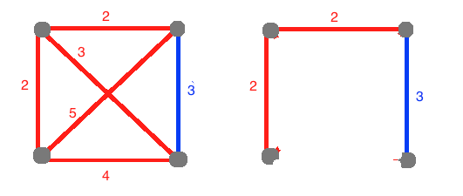

Slide 20
Lemma 3
Let p be an optimal price function and T be a corresponding MST. Suppose that there exists a red edge in T and a blue edge f not in T such that e belongs to the unique cycle C in T+f. Then there exists a blue edge f’ distinct from f in C such that

Slide 22
Complexity and Inapproximability
B97902011 扶雅恩

Slide 23
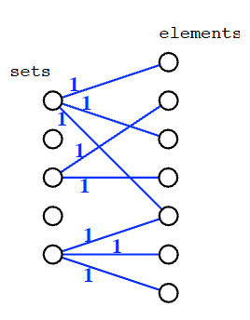
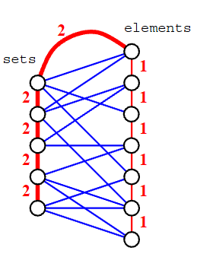
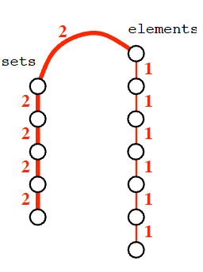
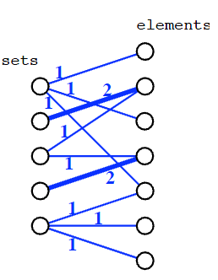
Hardness I
Proof idea:
Reduction from SetCover

Slide 24
APX (approximable)
A problem is said to be APX-hard
if there is a PTAS reduction from every problem in APX to that problem
A problem is APX-complete
if the problem is APX-hard and also in APX
If P≠NP → APX-hard problem is not in PTAS

Slide 25
Hardness II
Proof idea:
Reduction from VertexCover in graphs with Δ≦3
n = E + 1
m = V
r = n + 2m - s - 1

Slide 26
Hardness II (cont’d)

Slide 27
Linear Programming Relaxation
R99922107 李勻

Slide 28
In this section, we give an integer programming formulation for the problem and study its linear programming relaxation.
For each j = 1, … , k, and each blue edge e ∈ B we define a variable x_{j,e}
x_{j,e} = 1 means that the blue edge e appears in T , with a price p(e) of at least c_{j}

Slide 29
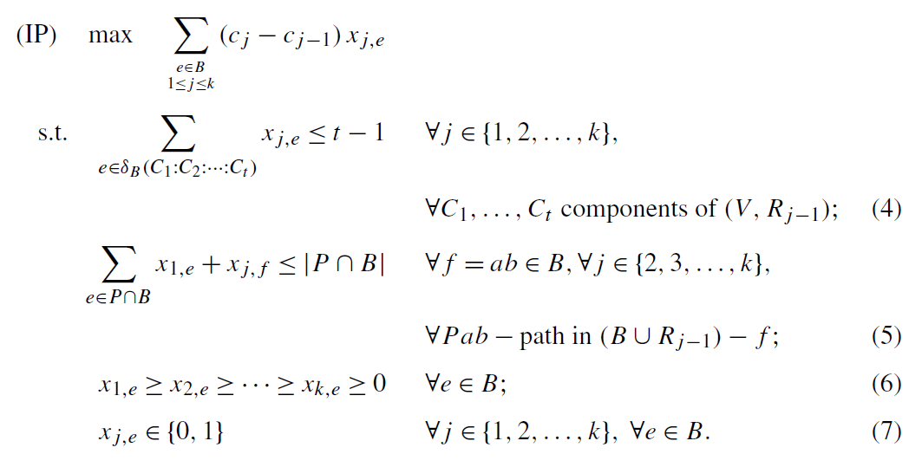
The integer programming formulation

Slide 30
Some intuition
let F be the set of blue edges appearing in T , and let F_{j} = {e ∈ F : p(e) ≥ c_{j} }
F (= F1) must obviously be a forest.
F_{j} (j ∈ {2, … , k}) must be a forest in the graph where every component of (V ,R_{j-1}) has been contracted, since otherwise we could swap in T some edge of F_{j} with an edge in R_{j-1}.

Slide 31
if a cycle C of the graph is such that every red edge in C has cost at most c_{j-1} and some blue edge f of C appears in T with a price at least c_{j} , then there must be another blue edge of C that is not included in T .
1
2
2
3

Slide 32
Proposition 1
The integer program above is a formulation of STACKMST.
claim E(T) ∩ B = F and that the revenue of T is exactly the objective value for x.
let F = {e ∈ B : x_{1,e} = 1}
For e ∈ F, let p(e) = c_{j} if j is the last index for which x_{j,e} = 1 and, for e ∈ B−F, let p(e)=∞.

Slide 33
Proof of Proposition 1
Assume that all edges e ∈ F of price less than c_{j} are in T , for some j ≥ 2. Consider some edge f with p(f) = c_{j} . Suppose that f is not in T .
This means that there exists a cycle in G consisting of blue edges of price at most c_{j} and of red edges of price at most c_{j−1}.
But then (5) is violated, a contradiction.
all edges of F belong to T .

Slide 34
We define a vector x as follows: for e ∈ B, x_{i,e} = 1 if e ∈ F and p(e) ≥ ci , otherwise x_{i,e} = 0.
It is easily checked that the revenue given by p equals the objective function of the IP for x.
If x violates (5) for some e ∈ F, then e also violates the min-max formula given in Lemma 2. This completes the proof.

Slide 35
Proposition 2
The LP can be separated in polynomial time.
For fixed j, (4) can be separated in polynomial time using standard techniques for the forest polytope.
(6) can obviously be separated in polynomial time.

Slide 36
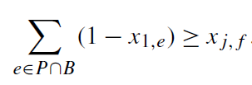
(5) can be rewritten as
Thus, for each fixed j and f = ab, (5) can be separated by finding a shortest ab-path in the graph (V , (B ∪ R_{j−1}) − f ) where every red edge has weight 0 and every blue edge e has weight 1 − x_{1,e} .

Slide 37
Proposition 3
We have (LP) ≤ min{k, 1+lnb, 1+lnW} · (IP), where b denotes the number of blue edges, and W = c_{k}/c₁ is the maximum ratio between red costs.

Slide 38
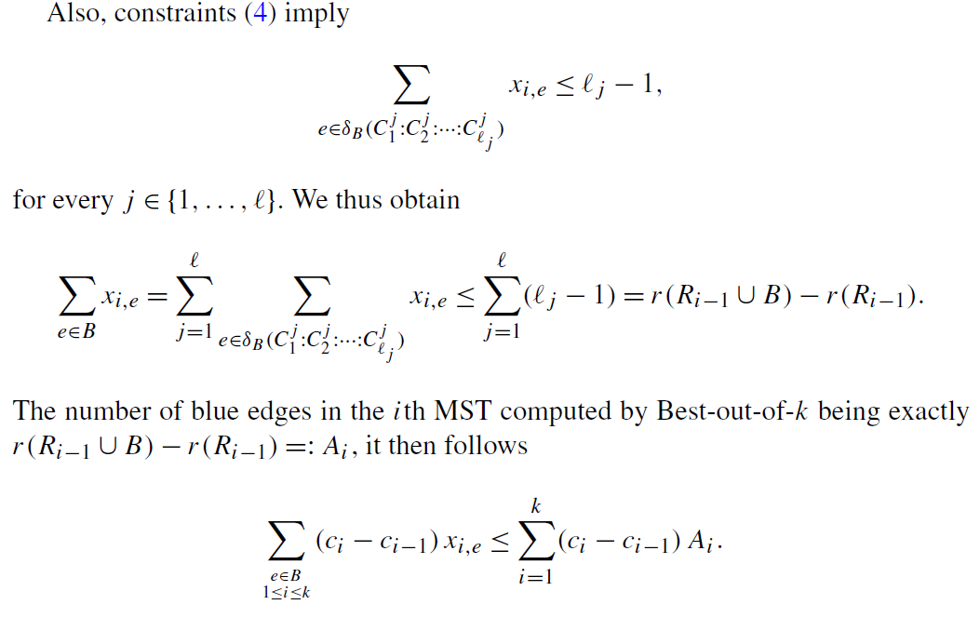

Slide 39
Letting q = max_{i=1,...,k} A_{i} · c_{i} denote the revenue given by the Best-out-of-k algorithm, we deduce
and, letting A_{k+1} = 0,

Slide 40
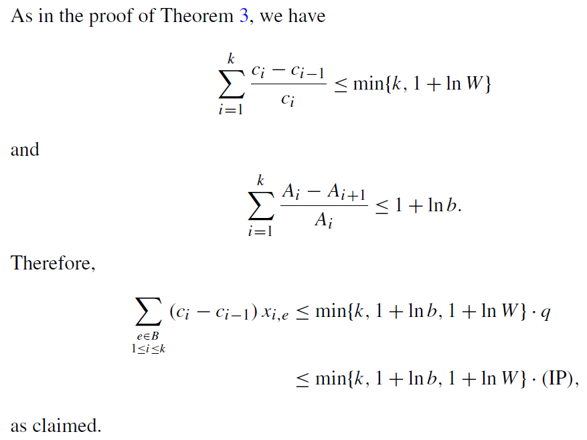

Slide 41
Proposition 4
The integrality gap of the LP is
k on instances with k distinct costs;
(lnW) on instances with maximum ratio between red costs W, and
(lnb) on instances with b blue edges.

Slide 42
conclusion
The integrality gap of a natural integer linear programming formulation asymptotically matches the approximation guarantee of Best-out-of-k.
Thus, any approximation algorithm based on the linear programming relaxation of our integer program (or any weaker relaxation) cannot do better than Best-out-of-k.

