Slide 1
R99945020 林澤豪
F98942047 許芷榕
R00922113 謝宗潛
R98922144 駱家淮

Slide 2
Outline
1. What is tree partition problem
2. Tree partition history
3. some tool will be used here
FTEST0
M(P) and MSEARCH
4. Path partitioning
5. Tree partitioning

Slide 3
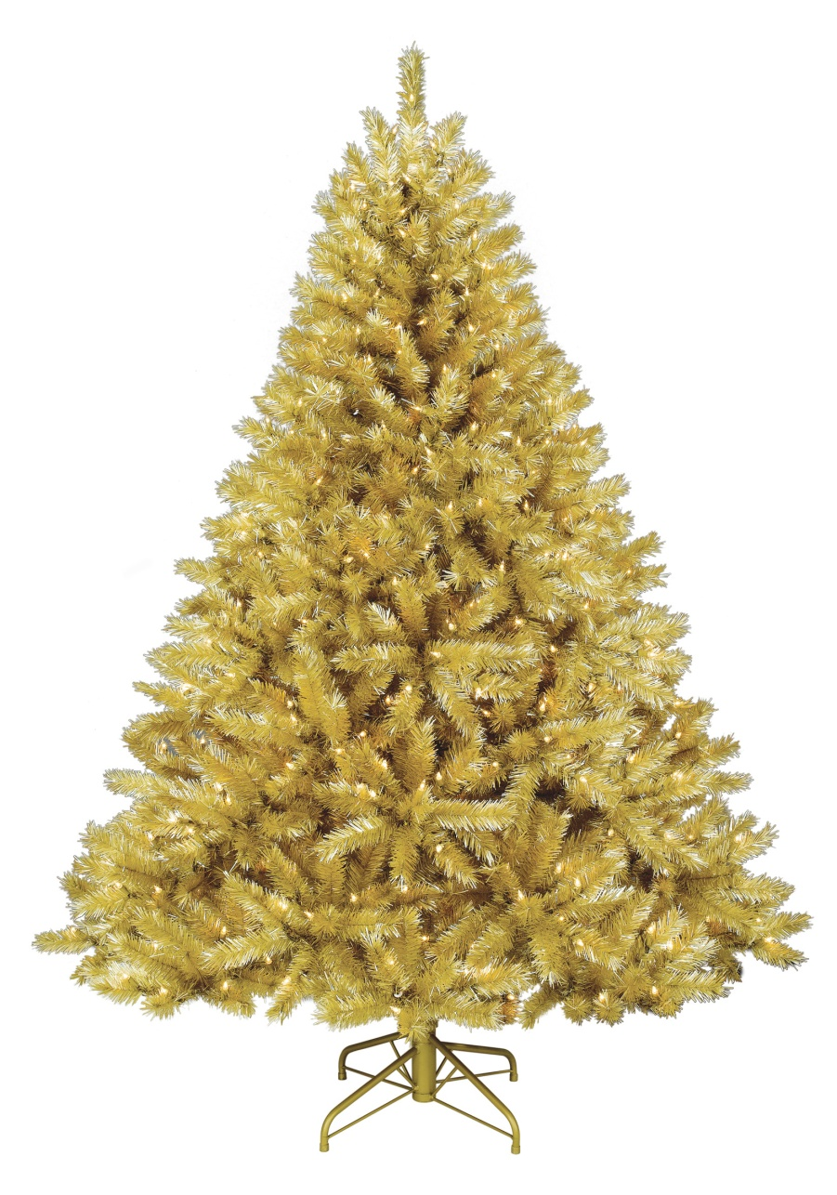
Tree partition(1/2)
+ = ??

Slide 4
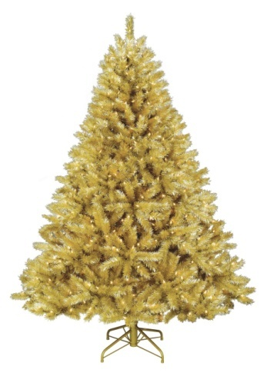
Tree partition(2/2)
Min-max problem
Max-min problem

Slide 5
History
Year | Complexity | Note
1981 | Time : O(n(logn)²) ,Space: O(nlogn) | [MTZC], N. Megiddo, will be improved here
1981 | Time: O(k²rd(T)+kn) | [PS], Y. Perl
1982 | Time: O(k³rd(T)+kn) | [BPS], R. I. Becker and Y. Perl
1983 | Time and Space: O(nlogn) | [FJ1], will be improved here
1983 | Time : O(n(logn)²) , Time : O(n(logn)³) | [M], O(n(logn)²) if the tree is a path, O(n(logn)³) if a general tree
1985 | Time: O(krd(T)(k+log△)+n) | [PV] , Y. Perl, improved BPS
△ is the max degree in the tree
rd(T) is the radius of the tree

Slide 6
FTEST0
3
5
3
1
2
3
4
2
3
4

Slide 7
FTEST0
30
λ=5
k=4
27
5
9
8
6
8
2
3
4

Slide 8
FTEST0
30
λ=5
k=4
27
5
9
8
6
8
2
3
4

Slide 9
FTEST0
11
4
λ=5
k=4
8
1
3
2
1
5
2
6
8
2
3
4
K=4 and return “yes”

Slide 10
FTEST0(reverse)
3
λ=9
k=4
5
3
1
2
3
4
2
3
4

Slide 11
FTEST0(reverse)
30
λ=9
k=4
27
5
9
8
6
8
2
3
4

Slide 12
FTEST0(reverse)
8
4
λ=9
k=4
5
3
8
1
5
9
2
6
8
2
3
K=4 and return “yes”
4

Slide 13
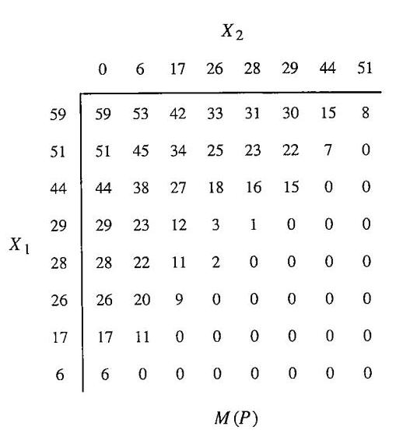
M(P)
6
11
9
2
1
15
7
8

Slide 14
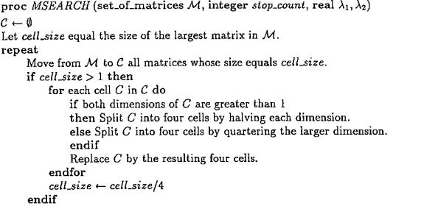
MSEARCH

Slide 15
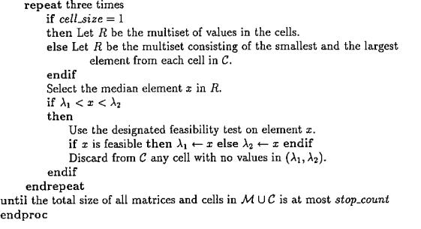
MSEARCH

Slide 16
MSEARCH

Slide 17
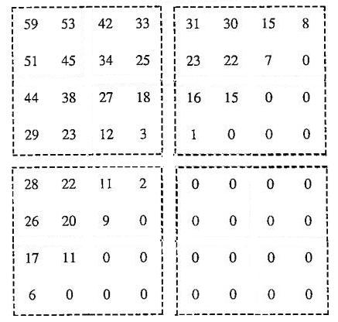
MSEARCH
6
11
{59,3,31,0,28,0,0,0}
K=3
Median: (3+0)/2=1.5
FTEST0: ok
Set λ₁=1.5
Discard matrix
9
2
1
15
7
8

Slide 18
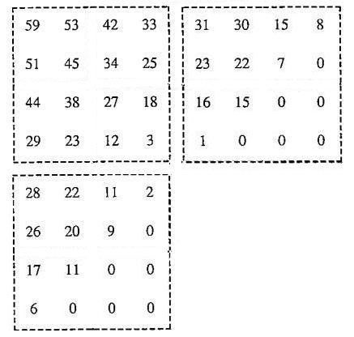
MSEARCH
6
11
{59,3,31,0,28,0}
K=3
Median: (28+3)/2=15.5
FTEST0: no
Set λ₂=15.5
No discard matirx
9
2
1
15
7
8

Slide 19
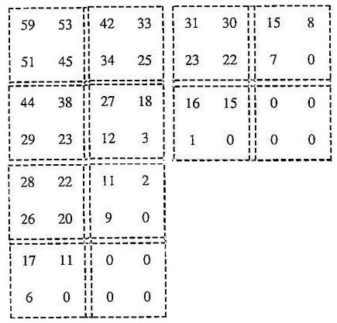
MSEARCH
6
11
{59,45,42,25,31,22,15,0,44,23,27,3,16,0,0,028,20,11,0,17,0,0,0}
K=3
Median: 16.5
Discard matrixes
9
2
1
15
7
8

Slide 20
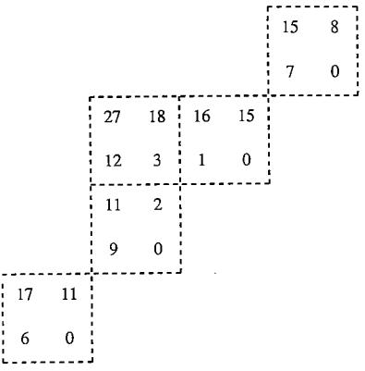
MSEARCH
6
11
{15,0,16,0,27,3,11,0,17,0}
K=3
Median: (11+3)/2=7
Set λ₁=7
No discard matrixes
9
2
1
15
7
8

Slide 21
MSEARCH
6
11
{15,8,7,0,16,15,1,0,27,18,12,3,11,2,9,0,17,11,6,0}
K=3
Median: (8+9)/2=8.5
Set λ₁=8.5
Discard half matrixes
And finally get median=12
9
2
1
15
7
8

Slide 22
MSEARCH
b_{ij} = i th iteration, the j th matrix
B_{i} = Σ^{N}_{j=1} b_{ij}
ncells(i) = after cutting, remain cells
ncells’(i) = after deleting, remain cells
K_{i} = the matrixes be added in this iteration

Slide 23
MSEARCH
Proof:
Let ncells’(i) ≦2B_{i}+2 be the result
4*(ncells’(i-1)+k_{i}) = ncells(i)
By induction: ncells’(i-1) ≦2B_{i-1}+2
ncells(i) ≦4*(2B_{i-1}+2+ k_{i})
≦4*(2B_{i-1}+2k_{i} +2)
≦4*(2B_{i}+2) ≦8B_{i}+8

Slide 24
MSEARCH
For the second part of MSEARCH, each iteration will discard d1+d2+d3:
First time: d1 >= ncells(i) – B_{i} /2
Second time: d2 >= ncells(i) – d1 - B_{i} /2
Third time: d3 >= ncells(i) – d1 – d2 - B_{i} /2
ncells’(i) = ncells(i) – d1 – d2 - d3 ≦(15/8)(B_{i}+1) < 2B_{i}+2

Slide 25
MSEARCH
In cross-splitting: b_{ij} = 2(n_{j}m_{j}/c)^0.5 -1 = O(2(n_{j}m_{j}/c)^0.5) c start from n_{j}m_{j}/4 down to 1. 4 * (2^logm_{j} -1) / 2-1 = O(m_{j})
In quatering-splitting b_{ij} = O(log(n_{j}/m_{j}))
The total splitting time complexity = O(m_{j}log(n_{j}/m_{j}))

Slide 26
Partitioning a Path

Slide 27
Partitioning a path
Given k, partition a path of $n$ vertices for max-min.
The proposed three algorithm overview
PATH1
Phase 1: Gather information.
Phase 2: Use faster feasibility test to complete parametric search.
PATH2
Gather information in more than one phases.
PATH3
Use a variety of refinement.
O(n log log n)
O(n log*n)
O(n)

Slide 28
Algorithm PATH1
Phase 1 – collect information
Set $λ_{1}=0, λ_{2}=∞$.
Form an f(n)-partition of path $P$.
Form a set $ℳ_{1}$ of sorted matrices.
$MSEARCH$ using feasibility test $FTEST0$.
Compute functions using $DIGEST1$.
Phase 2 – complete parametric search
$MSEARCH$ using feasibility test $FTEST1$.
$λ^{∗}=λ_{1}$
$∎$

Slide 29
Form an f(n)-partition of path $P$
r-partition of a path $P$
A partition of the vertices of $P$ into subpaths $P_{j}$, where each subpath contains $r$ vertices, and the last subpath contains at most $r$ vertices.
f(n)
The largest power of 2 which no larger than $\log{n}$.
Total $\left\lceil \frac{n}{f(n)}\right\rceil$ subpaths.

Slide 30
Algorithm PATH1
Phase 1 – collect information
Set $λ_{1}=0, λ_{2}=∞$.
Form an f(n)-partition of path $P$.
Form a set $ℳ_{1}$ of sorted matrices.
$MSEARCH$ using feasibility test $FTEST0$.
Compute functions using $DIGEST1$.
Phase 2 – complete parametric search
$MSEARCH$ using feasibility test $FTEST1$.
$λ^{∗}=λ_{1}$
$∎$

Slide 31
Form a set $ℳ_{1}$ of sorted matrices
Each subpath $P_{j}$ forms a sorted matrix $M(P_{j})$.
Each $M(P_{j})$ with dimension $f\left(n\right)×f\left(n\right)$.
Last one might have smaller dimension size.
All $M(P_{j})$ form a set $ℳ_{1}$ of $\left\lceil \frac{n}{f(n)}\right\rceil$ sorted matrices.

Slide 32
Algorithm PATH1
Phase 1 – collect information
Set $λ_{1}=0, λ_{2}=∞$.
Form an f(n)-partition of path $P$.
Form a set $ℳ_{1}$ of sorted matrices.
$MSEARCH$ using feasibility test $FTEST0$.
Compute functions using $DIGEST1$.
Phase 2 – complete parametric search
$MSEARCH$ using feasibility test $FTEST1$.
$λ^{∗}=λ_{1}$
$∎$

Slide 33
𝑀𝑆𝐸𝐴𝑅𝐶𝐻 using feasibility test 𝐹𝑇𝐸𝑆𝑇0
Call $MSEARCH$ with algorithm input:
The set $ℳ_{1}$ of matrices
Stopping count $\frac{n}{{\left(f\left(n\right)\right)}^{2} }$
Using feasibility test $FTEST0$
Output search boundary $λ_{1},λ_{2}.$
At most $\frac{n}{{\left(f\left(n\right)\right)}^{2} }$ active values remains.
Active value is any candidate value $λ$ from a subpath and $λ_{1}<λ<λ_{2}$.

Slide 34
Algorithm PATH1
Phase 1 – collect information
Set $λ_{1}=0, λ_{2}=∞$.
Form an f(n)-partition of path $P$.
Form a set $ℳ_{1}$ of sorted matrices.
$MSEARCH$ using feasibility test $FTEST0$.
Compute functions using $DIGEST1$.
Phase 2 – complete parametric search
$MSEARCH$ using feasibility test $FTEST1$.
$λ^{∗}=λ_{1}$
$∎$

Slide 35
Compute functions using 𝐷𝐼𝐺𝐸𝑆𝑇1
For subpaths with no active values in their matrices, compute
$ncut(l)$
Maximum number of cuts from $v_{l}$ to $t_{j}$, that each connected component except the last, has weight $≥λ_{2}$.
$rmdr(l)$
Maximum possible weight of the last component given number of cut in subpath from $v_{l}$ to $t_{j}$ is $ncut(l)$.
$λ_{2}=$20
$$ncut\left(l\right)=1$$
$$rmdr\left(l\right)=8$$
$$t_{j}$$
$$v_{l}$$

Slide 36
$$DIGEST1$$
A dynamic programming to compute $ncut(l)$ and $rmdr(l)$ for all vertices $v_{l}$ in subpath $P_{j}$.
Range $l$ from $t_{j}$ back to $f_{j}$.
If $w\left(l, t_{j}\right)<λ_{2}$, $ncut\left(l\right)=0, rmdr\left(l\right)=w\left(l,t_{j}\right).$
Otherwise, $ncut\left(l\right)=1+ncut\left(h+1\right)$, $rmdr\left(l\right)=rmdr\left(h+1\right).$
$h$ is the smallest index such that $w\left(l,h\right)≥λ_{2}$.
$$λ_{2}=12$$
$$f_{j}$$
$$t_{j}$$

Slide 37
Algorithm PATH1
Phase 1 – collect information
Set $λ_{1}=0, λ_{2}=∞$.
Form an f(n)-partition of path $P$.
Form a set $ℳ_{1}$ of sorted matrices.
$MSEARCH$ using feasibility test $FTEST0$.
Compute functions using $DIGEST1$.
Phase 2 – complete parametric search
$MSEARCH$ using feasibility test $FTEST1$.
$λ^{∗}=λ_{1}$
$∎$

Slide 38
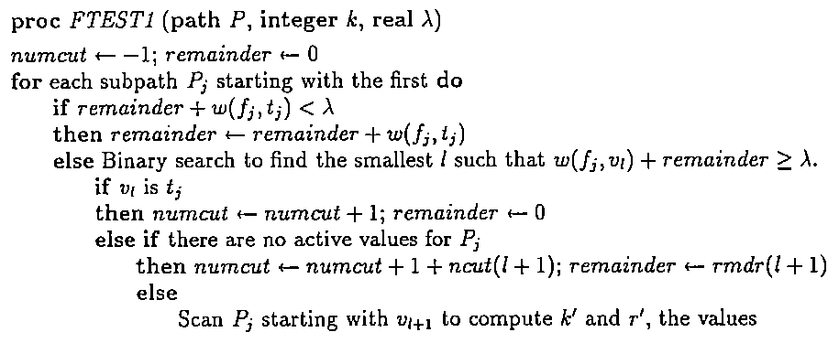

Slide 39
Algorithm PATH1
Phase 1 – collect information
Set $λ_{1}=0, λ_{2}=∞$.
Form an f(n)-partition of path $P$.
Form a set $ℳ_{1}$ of sorted matrices.
$MSEARCH$ using feasibility test $FTEST0$.
Compute functions using $DIGEST1$.
Phase 2 – complete parametric search
$MSEARCH$ using feasibility test $FTEST1$.
$λ^{∗}=λ_{1}$
$∎$

Slide 40
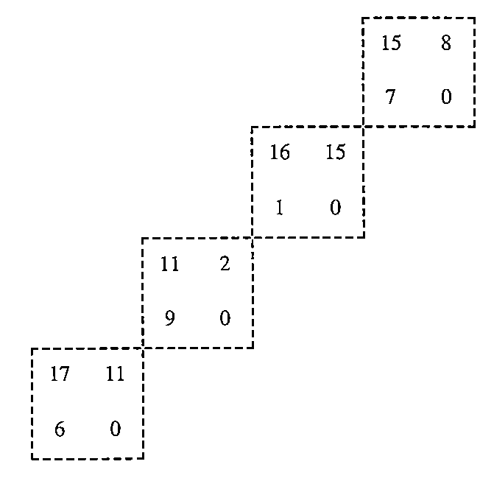
Example (1/6)
$k=3, n=8, f\left(n\right)=2$
Stopping count $=\frac{n}{(f{\left(n\right)}^{2})}=2$
$ℳ_{1}$
$λ_{1}=0, λ_{2}=∞$
$λ_{1}=7.5, λ_{2}=∞$
$λ_{1}=7.5, λ_{2}=$13
$λ_{1}=10, λ_{2}=$13
Medeian$=\frac{7+8}{2}=7.5$
$λ=7.5$ (O) -> $λ_{1}=7.5$
Medeian$=\frac{11+15}{2}=13$
$λ=13$ (X) -> $λ_{2}=13$
Medeian$=\frac{9+11}{2}=1$0
$λ=10$ (O) -> $λ_{1}=1$0
The number of value remains $≤$ stopping value 2
-> $MSEARCH$ stops

Slide 41
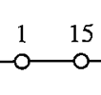
Example (2/6)
$k=3, n=8, f\left(n\right)=2$
$ℳ_{1}$
$λ_{1}=10, λ_{2}=$13
Subpaths with no active value:
$ncut\left(5\right)=1$
$rmdr\left(5\right)=0$
$$ncut\left(6\right)=1$$
$rmdr\left(6\right)=0$
$$ncut\left(7\right)=1$$
$rmdr\left(7\right)=0$
$ncut\left(8\right)=0$
$rmdr\left(8\right)=8$

Slide 42
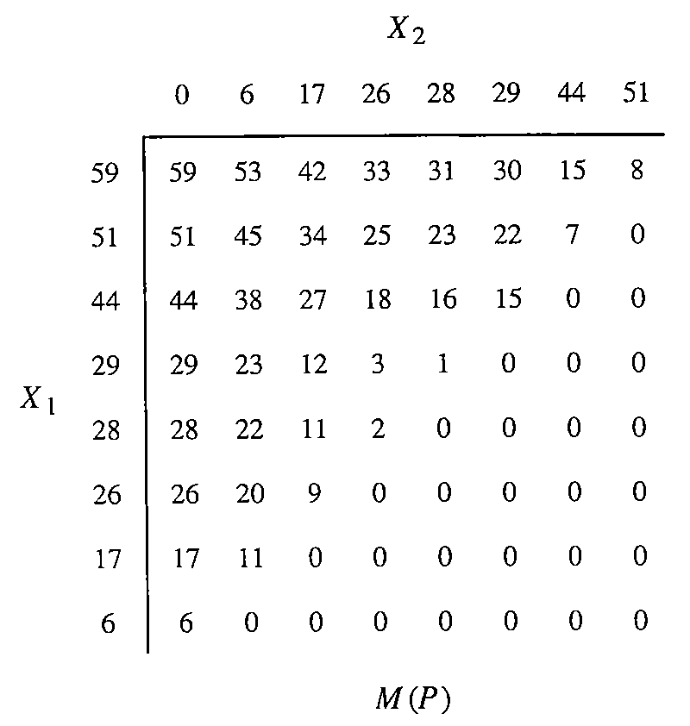
Example (3/6)
$λ_{1}=10, λ_{2}=$13
Phase 2 of algorithm PATH1:
Only test a value $λ$ which $10<λ<13$
Test feasibility of $λ$ using $FTEST1$
$λ=1.5$
$λ=$17

Slide 43
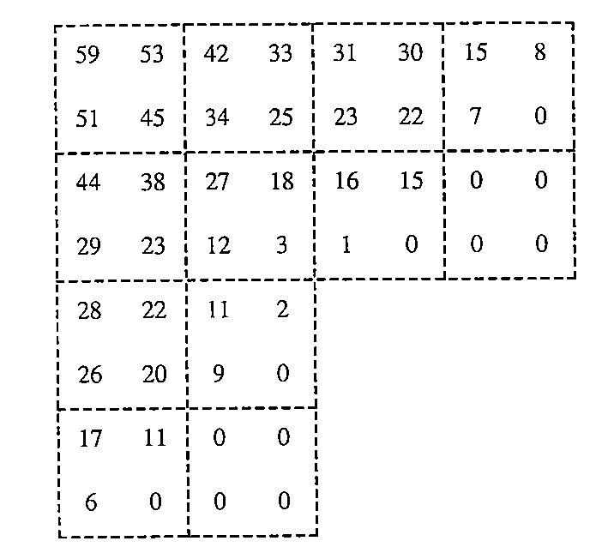
Example (4/6)
$λ_{1}=10, λ_{2}=$13
Phase 2 of algorithm PATH1:
Only consider a value $λ$ which $10<λ<13$
Test feasibility of $λ$ using $FTEST1$
$λ=16.5$
$λ=$0
$λ=$7

Slide 44
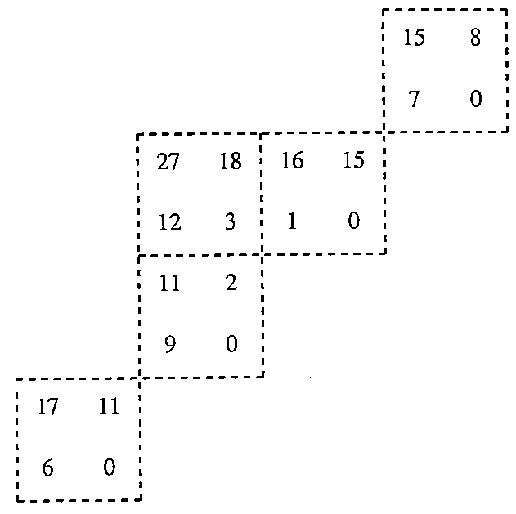
Example (5/6)
$λ_{1}=11, λ_{2}=$13
$λ_{1}=10, λ_{2}=$13
Phase 2 of algorithm PATH1:
Only consider a value $λ$ which $10<λ<13$
Test feasibility of $λ$ using $FTEST1$
$λ=8.5$
$λ=15$
$λ=$11 -> $FTEST1$(O)

Slide 45
Example (6/6)
$λ_{1}=11, λ_{2}=$13
$λ_{1}=10, λ_{2}=$13
$λ_{1}=12, λ_{2}=$13
Phase 2 of algorithm PATH1:
Only consider a value $λ$ which $10<λ<13$
Test feasibility of $λ$ using $FTEST1$
$λ=$12 -> $FTEST1$(O)
All values are discarded, $MSEARCH$ terminates.
Return $λ^{∗}=λ_{1}=12$

Slide 46
Complexity of Algorithm PATH1
Phase 1 – collect information
Set $λ_{1}=0, λ_{2}=∞$.
Form an f(n)-partition of path $P$.
Form a set $ℳ_{1}$ of sorted matrices.
$MSEARCH$ using feasibility test $FTEST0$.
Compute functions using $DIGEST1$.
Phase 2 – complete parametric search
$MSEARCH$ using feasibility test $FTEST1$.
$λ^{∗}=λ_{1}$
$∎$

Slide 47
𝑀𝑆𝐸𝐴𝑅𝐶𝐻 using feasibility test 𝐹𝑇𝐸𝑆𝑇0.
By Theorem 2.1, the number of test values is $O(max⁡\{log\max_{j}\left\{n_{j}\right\}, log⁡(\frac{m}{p+1})⁡\})$.
$p=\frac{n}{r^{2}}$ -> number of test values$=O(\log{\log{n}})$
The test values are produced in $O(n)$.
Each feasibility test using $FTEST0$ takes $O\left(n\right).$
The total time is $O(n\log{\log{n})}.$

Slide 48
Complexity of Algorithm PATH1
Phase 1 – collect information
Set $λ_{1}=0, λ_{2}=∞$.
Form an f(n)-partition of path $P$.
Form a set $ℳ_{1}$ of sorted matrices.
$MSEARCH$ using feasibility test $FTEST0$.
Compute functions using $DIGEST1$.
Phase 2 – complete parametric search
$MSEARCH$ using feasibility test $FTEST1$.
$λ^{∗}=λ_{1}$
$∎$
$$O(n\log{\log{n})}$$

Slide 49
Compute functions using 𝐷𝐼𝐺𝐸𝑆𝑇1
Lemma 3.1. Let $P_{j}$ be a subpath with no active values. Then $DIGEST1$ computes $ncut(l)$ and $rmdr(l)$ for all vertices $v_{l}$ in $P_{j}$ in linear time.
For each of $r$ values of $h$, a constant time amount of work is done. The remaining work can be apportioned as constant for each of $O\left(r\right)$ values of $l$.
For each $P_{j}$, takes $O(\log{n})$.
There are total $Θ(\frac{n}{logn})$ paths and thus takes $O(n)$ time to complete all.

Slide 50
Complexity of Algorithm PATH1
Phase 1 – collect information
Set $λ_{1}=0, λ_{2}=∞$.
Form an f(n)-partition of path $P$.
Form a set $ℳ_{1}$ of sorted matrices.
$MSEARCH$ using feasibility test $FTEST0$.
Compute functions using $DIGEST1$.
Phase 2 – complete parametric search
$MSEARCH$ using feasibility test $FTEST1$.
$λ^{∗}=λ_{1}$
$∎$
$$O(n\log{\log{n})}$$
$O(n$)

Slide 51
𝑀𝑆𝐸𝐴𝑅𝐶𝐻 using feasibility test 𝐹𝑇𝐸𝑆𝑇1
Produce test values
By Theorem 2.1, the number of test values is $O\left(\log{n}\right)$ and produced in $O(n)$.
Test feasibility
What is the complexity of $FTEST1$?

Slide 52
𝑀𝑆𝐸𝐴𝑅𝐶𝐻 using feasibility test 𝐹𝑇𝐸𝑆𝑇1
Lemma 3.2. Let $P$ be a path of n vertices partitioned into $\left\lceil \frac{n}{r}\right\rceil$ subpaths, each of size at most $r$. Let all but at most $\frac{n}{r^{2}}$ subpaths have computed all $ncut(l)$ and $rmdr\left(l\right)$. $FTEST1$ determines the feasibility of a test in $O(\left(\frac{n}{r}\right)\log{r})$ time.
There are $\left\lceil \frac{n}{r}\right\rceil$ subpaths to be examined. Consider subpath $P_{j}$. The search for $v_{l}$ uses $O\left(\log{r}\right)$ time.
If there are no active values in $P_{j}$, the remained operations take constant time. There are $Θ(\frac{n}{r})$ such paths, which take $O\left(\left(\frac{n}{r}\right)\log{r}\right)$ in total.
If there active values for $P_{j}$, exam the path takes $O\left(r\right)$. Only $O(\frac{n}{r^{2}})$ subpaths with active values, which take $O(\frac{n}{r})$ in total.

Slide 53
𝑀𝑆𝐸𝐴𝑅𝐶𝐻 using feasibility test 𝐹𝑇𝐸𝑆𝑇1
Produce test values
By Theorem 2.1, the number of test values is $O\left(\log{n}\right)$ and produced in $O(n)$.
Test feasibility
Each feasibility test takes $O(\frac{n\log{\log{n}}}{\log{n}})$.
All tests take $O(n\log{\log{n}})$.

Slide 54
Complexity of Algorithm PATH1
Phase 1 – collect information
Set $λ_{1}=0, λ_{2}=∞$.
Form an f(n)-partition of path $P$.
Form a set $ℳ_{1}$ of sorted matrices.
$MSEARCH$ using feasibility test $FTEST0$.
Compute functions using $DIGEST1$.
Phase 2 – complete parametric search
$MSEARCH$ using feasibility test $FTEST1$.
$λ^{∗}=λ_{1}$
$∎$
$$O(n\log{\log{n})}$$
$O(n$)
$$O(n\log{\log{n})}$$
$$O(n\log{\log{n})}$$

Slide 55
PATH2
PATH2 is an improved algorithm of PATH1.
With complexity $O\left(n\log^{∗}{n}\right).$
By applying PATH1 strategy with more than two phases.
The size of subpaths will be larger and larger in each phase.
Prior phase provide data to fasten the current phase, and decrease the difference between $λ_{1}$ and $λ_{2}$.
Notes:
為什麼可以把complexity壓低要講清楚

Slide 56
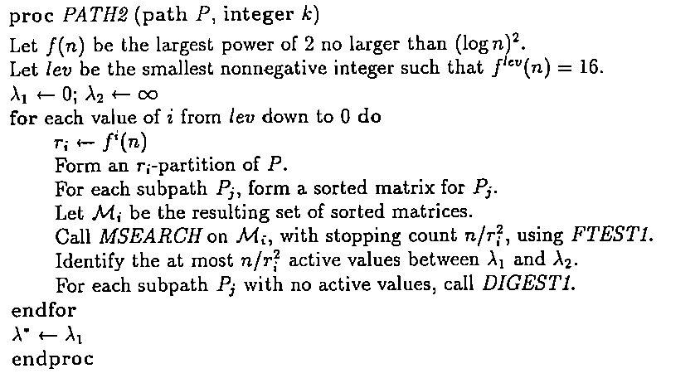
PATH2 are called only when $n≥16.$

Slide 57
Complexity of PATH2
Theorem 3.4. Algorithm PATH2 solves the max-min k-partitioning problem on a path of n vertices in $O(n\log^{∗}{n})$ time.
There are $lev+1$ phases, where $lev$ is $O(\log^{∗}{n})$. Each call to $MSEARCH$ with matrices of size $r_{i}×r_{i}$ uses $O(n)$ time and generates $O(\log{r_{i}})$ test values.
On phase $lev$, performing all tests takes $O(n)$.
On other phase I, takes $O\left(\frac{n}{r_{i+1}}\log{r_{i+1}}\log{r_{i}}\right).$
Since $r_{i+1}$ is $Θ\left({\left(\log{r_{i}}\right)}^{2}\right)$, total time is $O\left(n\right)$.
The time to compute $ncut(∙)$ and $rmdr(∙)$ is $O\left(n\right)$.

Slide 58
PATH3: Linear time path partitioning

Slide 59
Before we start…
The algorithm of O(nlog*n) time complexity (PATH2):
For each rotation, find a closer bound to the answer by dividing into larger subpath each time
Total O(log*n) rotations is needed to get the answer
O(n) time for each rotation is required to do MSEARCH and counting inactive cells’ rmdr/ncut

Slide 60
The main idea to speed up PATH2
Instead of recounting all values every rotation, reuse the ncut and rmdr values counted in last rotation
Trimming the matrix between rotations, so that MSEARCH will not need to process all the sub-matrices

Slide 61
The first part: a new digest way
No need to recalculate all inactive cells’ vertices every time, just recalculate them when needed
When to?
How to?
How about the complexity?

Slide 62
DIGEST2

Slide 63
When to do DIGEST2
Maintain a queue for those vertices(in the subpath) of which rmdr and ncut values needed to be updated
When does a vertex needed to be updated?
The first time this vertex was become inactive
The end of the subpath been extended since the subpath growing larger so that new cuts can be found in the new subpath
In other words: the total weight from next(l) to the end of subpath > current upper bound

Slide 64
How to do DIGEST2
For each vertex:
Updating it’s ncut value by:
Generating the value for a new vertex, or
Using its previous result + number of new cut appeared after previous “next vertex”
Keep updating “next” value instead of rmdr value for each vertex
Only the rmdr value of the vertices at the tail of subpath needed to be updated

Slide 65
How to do DIGEST2: Step by step
Check if the vertex needs to be updated in order
Find the next “related” vertex
If the “next” vertex exists, relate to it
If not, it’s its first time been updated. Check vertex by vertex
Check if the related vertex we found is a vertex at the end part of the subpath?
If yes, then the update end here.
If no, then put the related vertex into queue.
Update the vertex next/ncut in reverse order.

Slide 66
Time complexity of DIGEST2
For each vertex, it needs a “vertex by vertex update” once totally in all rotation at most. It costs O(n) time
How many times will a vertex be updated more than once in total?
Each round bounded by (n/r_{i})*r_{i+1}
The time complexity of rearrangements of queues is O(n) because it’s always a rotated sorted list

Slide 67
Trim the matrix
Counting all submatrices is not efficient enough!
Trim the submatrices before send them to MSEARCH:
Trim the row or column that are too small before each rotation
Between rotations, keep a “possible area” that contains only matrix of which value is not too large. Send only the intersection area that both in trimmed matrix and possible area to be processed in MSEARCH
In order to trim the matrix, the “thin matrices” should be processed by MSEARCH to get the information needed for trimming

Slide 68
Trim the matrix: process thin matrices
At the very beginning of each rotation, take every submatrices’ first column and row as a ”thin matrix” and apply them to MSEARCH first
For each value on the thin matrices, find out whether it is too large, too small or in active area

Slide 69
Trim the matrix: process thin matrices(cont.)

Slide 70
Trim the matrix: trim the small part
Discard all rows and columns start with a too small value and form a new set of matrices

Slide 71
Trim the matrix: build possible area and find intersection
Maintain a area that could have active value in it by removing those rows or columns ended with a too large value

Slide 72
Trim the matrix: build possible area and find intersection (cont.)
Since the memory can only keep matrix area, some scattered active value not in the matrix area might be abandoned
In that case, use another set to keep those active value from missing
In the following rotations, send both the intersection area of possible areas and trim matrices and possible active values kept in set to MSEARCH to process

Slide 73
PATH3

Slide 74
Before complexity analysis: Reviewing theorem 2.1

Slide 75
Time complexity of trimming process
Analysis: rotation i for instance
It takes O(n/r_{i+1}) time to form intersection submatrices. These submatrices include O(n/r_{i+1}) thin matrices. And O((n/r_{i+1})logr_{i}) time is consumed to process O(logr_{i}) search values
O(n/r_{i+1}) time is used to trim the matrix
The total dimension value of remaining submatrices is bounded by O(2n/r_{i} + large(i)), thus there will be O((n/r_{i} + large(i))/r_{i} ) r_{i} x r_{i} matrices in the worse case

Slide 76
Time complexity of trimming process (cont.)
By theorem 2.1, the time to process matrices and set of possible values by MSEARCH is as following:
It takes O((n/r_{i} + large(i)) + n/r_{i+1} ) time to produce O(log r_{i}) search values
Each search value costs O(n/r_{i+1}(log r_{i+1})) time to test.
But while generating search value, the new “possible area” for next rotation is also produced at the same time. Thus, the total cost of producing search value + generating possible area = O(n/r_{i+1}(log r_{i}) + large(i))

Slide 77
Tree Partitioning

Slide 78
Methods
1.
2.
3.

Slide 79
Edge partition

Slide 80
Vertex partition

Slide 81
r-partition

Slide 82
Method 1
Two phases
First phase reduce the problem of partitioning a tree to the problem of partitioning a tree with fewer than leaves.
When there are at least leaves, at least half of the leaf-paths are of length at most

Slide 83
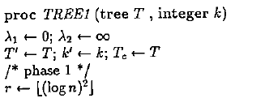
Method 1
Initialize

Slide 84
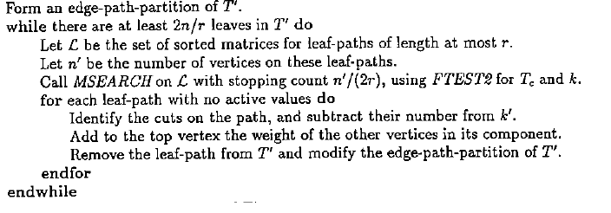
Method 1
First phase

Slide 85
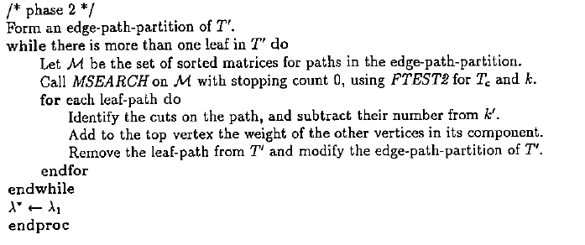
Method 1
Second phase

Slide 86
Method 1

Slide 87
Method 1
In the while loop of phase 1:
MSEARCH take O(n) to produce O(loglogn) search value. And cost O(n) to test each search value.
It needs O(logr) = O(loglogn)
So the total time is O(n(loglogn)^2)

Slide 88
Method 1
By lemma 4.1, feasibility test will use O((n/r)logr) = O(nloglogn/(logn)^2)
The number of calls to MSEARCH is O(logn), and each call will produce O(logn) test value.
Then the total time of phase 2 is O(nloglogn)

Slide 89
Method 2

Slide 90
Method 2
There will be lev+1 phases, where lev is O(log*n).
Phase i will produce O((logri)^2) test values.
The total time of phase i will be O((n/ri+1)logri+1(logri)^2).
ri+1 is θ((logri)^3), then the time of each phase will be O(n)
The total time is O(nlog*n)

Slide 91
Tree3: Linear Tree partitioning

Slide 92
General ideas and difficulties encountered
Using the same technique transform PATH2 into PATH3 on tree causes some difficulties:
Prune a leaf path may cause additional maintain time for DIGEST2 because of the unsure vertex weight changing
To trim the submatrices on trees like PATH3, steady enough submatrices might be needed s.t. each rotation can preserve useful information for the following rotations

Slide 93
The first problem of algorithm improvement
Copy tree each rotation in a straight forward way cost too much time (O(nlog*n) totally)
Thus, find a new way to maintain and store the pruned tree and original tree is necessary

Slide 94
New structure

Slide 95
How does the structure work?
When pruning a leaf path, simply remove the value in the table
After pruning, if a leaf path became the only child of some vertex, move the leaf path to the left of its parent to form a new leaf path
Use pointer to remember where the subpaths’ parents are

Slide 96
Additional value
Keep the value of each vertex’s all descendants’ weight (including itself)
These value can be maintained in the same cost as the cost of moving when the right most child is always pruned, which is not always the case. Thus, another mechanism to solve this problem is needed

Slide 97
Light path
A light path is a path’s total weight under current upper bond, otherwise it is a heavy path
For a light path, maintain its total weight only
At i_{th} rotation after tree being pruned, there will be at most O(n/r_{i}) light path with active value. Reduce it to O(n/r_{i}²) by applying the total weight of each light path to MSEARCH

Slide 98
Heavy path
Use overlapping subpath idea to maintain the heavy path
Each vertex will be included in at most 2 overlapping subpath
For any 2 adjacent overlapping subpath, the overlapping range should be at least larger than current upper bound to ensure all the possible active value can be generated by those subpaths

Slide 99
To maintain heavy path structure
In the beginning, there’s no heavy path
Heavy path appear when:
Upper bound reduced
Set 2 overlapping subpaths as the first and the last subpath which both cover the whole path
Path concatenation
There will be 3 cases

Slide 100
To maintain heavy path structure(cont.)
When it is a heavy path after concatenating:
Case 1: light path + light path
Set 2 overlapping subpaths as the first and the last subpath which both cover the whole path
Case 2: light path + heavy path
Stretch one side of overlapping subpath to cover the light path
Case 3: heavy path + heavy path
Combine the last overlapping subpath of the ancestor with the first overlapping subpath of the descendant

Slide 101
Light/Heavy path mechanism
The new mechanism solve the maintenance cost problem of additional value mechanism
Maintain a light path cost O(n) time in total
Maintain a heavy path: Instead of recalculate all ancestors' value, only the corresponding overlapping subpath will be recalculated. It cost O(1) time for each vertex, and O(n) time in total
Each vertex will be contained in at most 2 overlapping subpaths, and each will be updated at most twice (first time appearing and combining with adjacent overlapping subpath)

Slide 102
Building the RB-tree
The new mechanism makes applying the algorithm developed previously to the O(n) algorithm of solving tree partition problem possible
A log base search function for subpaths is needed for the feasibility test function, and the light/heavy path mechanism won’t guarantee including the whole subpath
Build and maintain a RB-tree for each subpath to replace binary search

Slide 103
TREE3

Slide 104
The time complexity for TREE3
As phase i started, there will be O(n/r_{i+1}) matrices, O(n/r_{i+1}²) light paths and O(n/r_{i+1}²) elements in set
The first step of pruning and relocating/recalculating subpaths totally costs O(n) time
Maintaining the RB-tree during concatenations costs O(loglogr_{i+1}) each time. It will appear at most O(n/r_{i+1}) times

Slide 105
The time complexity for TREE3(cont.)
To inactivate some light paths costs O(n/r_{i}) time to produce O(log r_{i}) test values, which can be tested in O((n/r_{i+1})logr_{i}logr_{i+1})=O((n/r_{i})logr_{i}) time
The last part of TREE3 and rebuilding the overlapping subpaths are proved to cost O(n) time over all rotations
TREE3 solves` the tree partitioning problem in O(n) time

