Slide 1

EOBDBR: an Efficient Optimum Branching-Based Distributed Broadcast Routing Protocol for Wireless Ad Hoc Networks
Speaker: Li-Sheng Chen
Jan 2, 2012

Slide 2
Outline
Introduction
Related Work
EOBDBR: An Efficient Optimum Branching-Based
Distributed Broadcast Routing Algorithm
Performance Evaluation
Conclusion

Slide 3
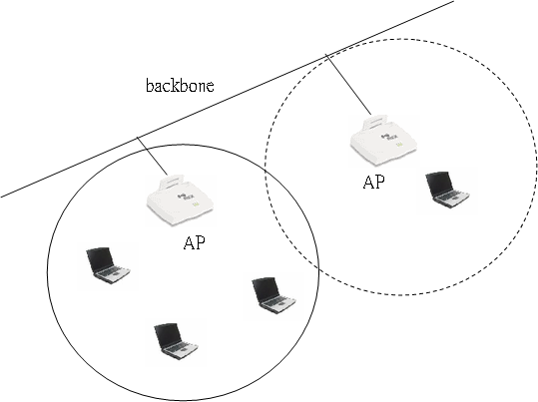
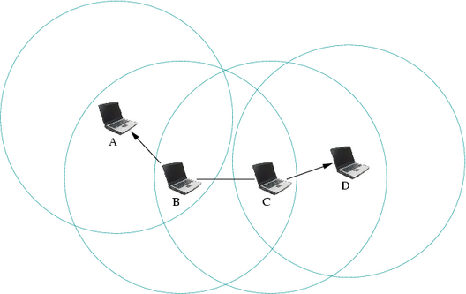
Introduction
Infrastructure Mode
AP: Access Point
Ad-Hoc Mode

Slide 4
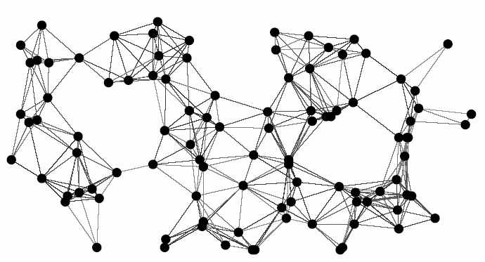
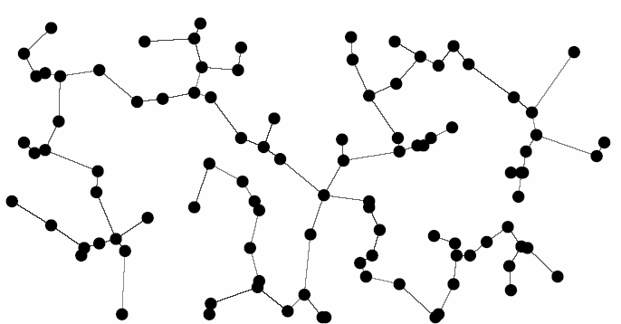
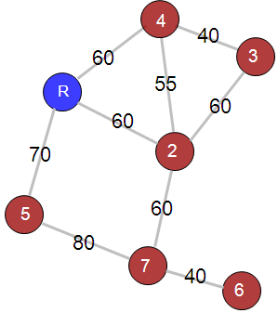
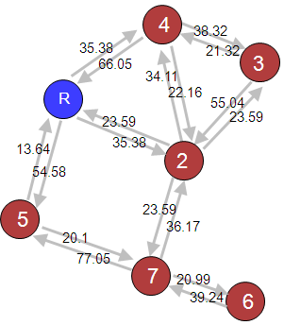
Minimum Spanning Tree
Network Topology
Directed Graph
Undirected Graph
Objectives
Efficient broadcast routing algorithm for Ad Hoc networks
with asymmetric cost model
Extend the network lifetime
Local information and distributed computing
Reduce the power consumption

Slide 5
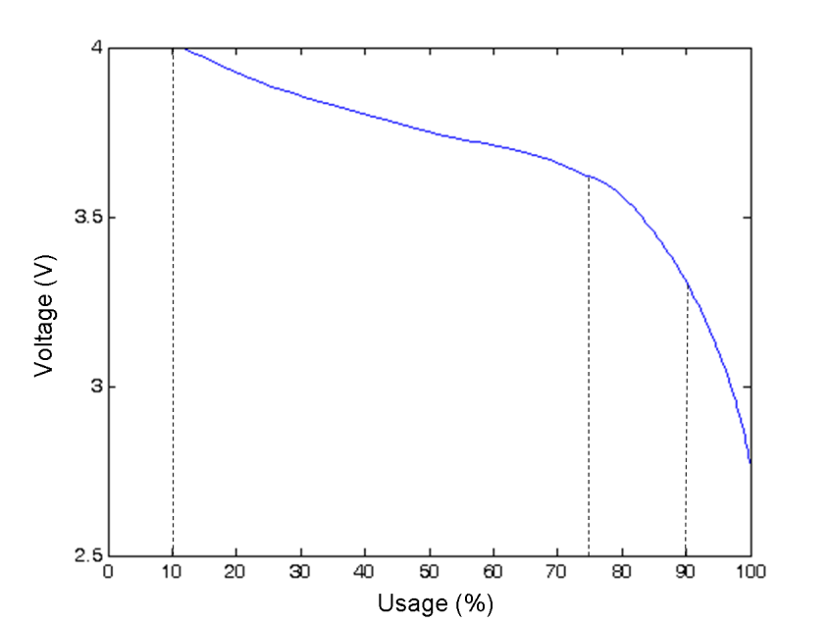
Link Cost Model
Transmission energy per bit based on two-ray path loss :
(1)
Curve fitting of battery discharge
(2)
B is battery voltage , u is battery usage
Weighting function
(3)
Link cost between node i and node j
(4)
C ij = Link cost between node i and node j
d ij = Distance between node i and node j

Slide 6
Minimum Cost Spanning Tree (MCST) in Directed Graph
Note: Below we will often call a minimum cost spanning tree an optimum branching
2
5
5
7
8
2
3
6
1
8
7
4
Directed Graph
2
2
5
5
5
5
7
8
8
1
3
7
3
1
6
1
1
7
6
8
4
8
4
7
Prim’s MCST: (1, 2), (2, 3), and (1, 4)
= 5+5+6 = 16
Real MCST: (1, 2), (1, 4), and (4,3)
= 5+6+1 = 12

Slide 7
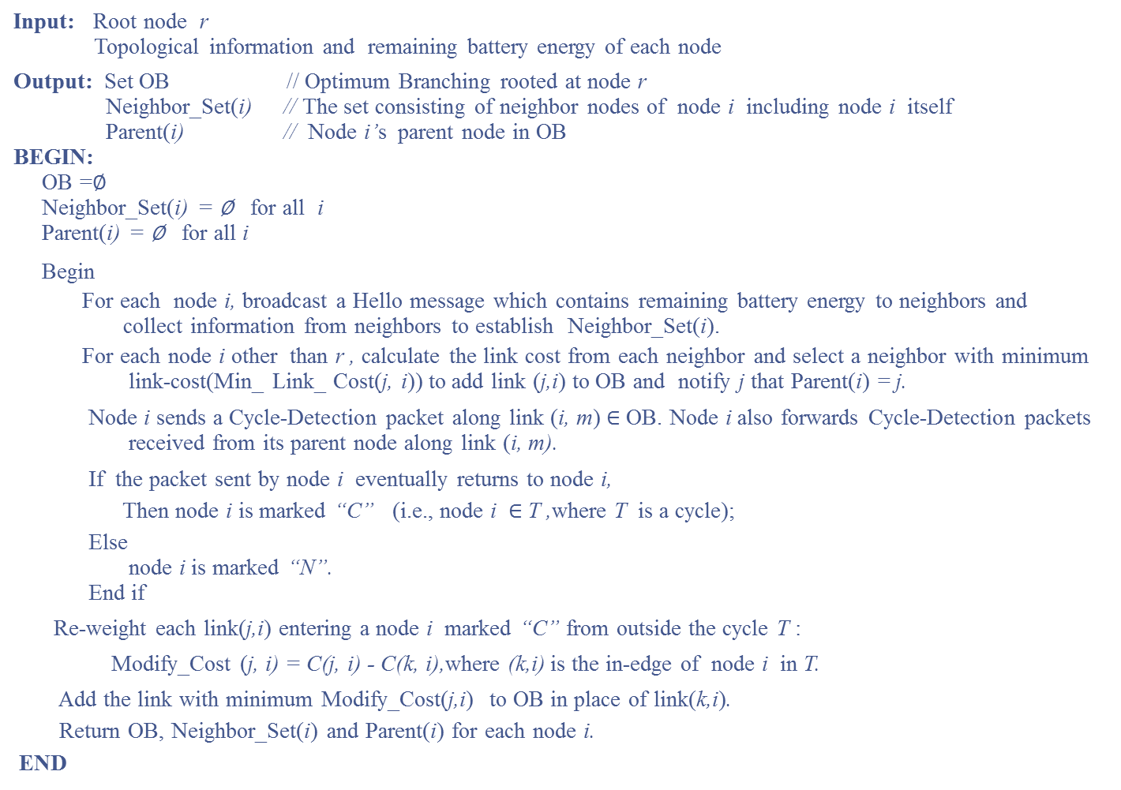
Algorithm EOBDBR
Input: Root node r
Topological information and remaining battery energy of each node
Output: Set OB // Optimum Branching rooted at node r
Neighbor_Set(i) // The set consisting of neighbor nodes of node i including node i itself
Parent(i) // Node i’s parent node in OB
BEGIN:
OB =∅
Neighbor_Set(i) = ∅ for all i
Parent(i) = ∅ for all i
Begin
For each node i, broadcast a Hello message which contains remaining battery energy to neighbors and
collect information from neighbors to establish Neighbor_Set(i).
For each node i other than r , calculate the link cost from each neighbor and select a neighbor with minimum
link-cost(Min_ Link_ Cost(j, i)) to add link (j,i) to OB and notify j that Parent(i) = j.
Node i sends a Cycle-Detection packet along link (i, m) $∈$ OB. Node i also forwards Cycle-Detection packets
received from its parent node along link (i, m).
If the packet sent by node i eventually returns to node i,
Then node i is marked “C” (i.e., node i $∈$ T ,where T is a cycle);
Else
node i is marked “N”.
End if
Re-weight each link(j,i) entering a node i marked “C” from outside the cycle T :
Modify_Cost (j, i) = C(j, i) - C(k, i),where (k,i) is the in-edge of node i in T.
Add the link with minimum Modify_Cost(j,i) to OB in place of link(k,i).
Return OB, Neighbor_Set(i) and Parent(i) for each node i.
END

Slide 8
EOBDBR: An Efficient Optimum Branching-Based Distributed Broadcast Routing Algorithm
Step1: Finding the Minimum In-edge of Each Node
Step2: Cycle Detection
Step3: Re-weighting the Edges
Step4: Cycle Removal
Final broadcast tree.
4
4
[63, 36.80]
[63, 73.49]
[57, 37.84]
[63, 46.50]
[57, 36.69]
R
3
[50, 36.71]
3
[50, 30.47]
[60, 50.32]
[51, 30.48]
[60, 66.05]
[60, 35.58]
[51, 37.74]
2
[65, 40.01]
2
[65, 79.09]
[50, 36.71]
5
[50, 38.01]
[50, 68.48]
[60, 33.42]
[60, 80.20]
7
[60, 80.20]
[60, 73.91]
6
Note that the first number in the 2-tuple on each edge is the distance between nodes and the second number is the corresponding link cost calculated by Equation (4).

Slide 9
Sweeping for Eliminating Unnecessary Transmissions
4
[63, 73.49]
[57, 37.84]
[63, 46.50]
[57, 36.69]
R
[50, 36.71]
3
[50, 30.47]
[60, 50.32]
[51, 30.48]
[60, 66.05]
[51, 37.74]
[65, 40.01]
2
[65, 79.09]
[50, 36.71]
5
[50, 68.48]
[60, 33.42]
[60, 80.20]
7
[60, 80.20]
[60, 73.91]
6

Slide 10
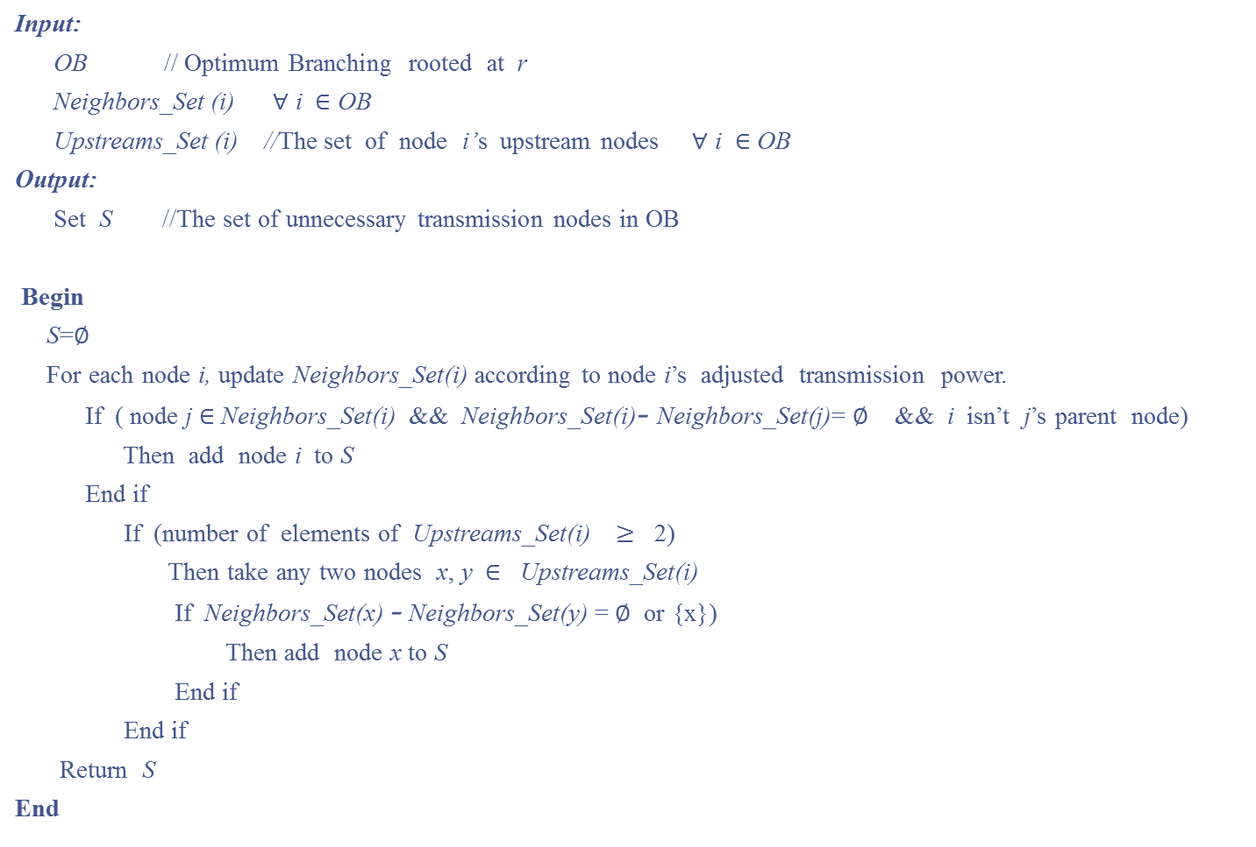
Algorithm Sweep (Optimum Branching)
Input:
OB // Optimum Branching rooted at r
Neighbors_Set (i) ∀ i $∈$ OB
Upstreams_Set (i) //The set of node i’s upstream nodes ∀ i $∈$ OB
Output:
Set S //The set of unnecessary transmission nodes in OB
Begin
S=∅
For each node i, update Neighbors_Set(i) according to node i’s adjusted transmission power.
If ( node j $∈$Neighbors_Set(i) && Neighbors_Set(i)- Neighbors_Set(j)= ∅ && i isn’t j’s parent node)
Then add node i to S
End if
If (number of elements of Upstreams_Set(i) $≥$ 2)
Then take any two nodes x, y $∈$ Upstreams_Set(i)
If Neighbors_Set(x) - Neighbors_Set(y) = ∅ or {x})
Then add node x to S
End if
End if
Return S
End

Slide 11
Sweeping for Eliminating Unnecessary Transmissions
Step 1:
Leaf nodes don’t need re-broadcast
Step 2:
Node 2 : Neighbor_Set ( Node 2) – Neighbor_Set ( Node R)
= { 2, 3, 4, 7} – { R, 2, 4, 5} = { 3, 7}
Node 3: Neighbor_Set ( Node 3) – Neighbor_Set ( Node 2)
= { 2, 3, 4} – { 2, 3, 4, 7 } = Ø
=> Node 3 is a unnecessary transmission node
Node 5: Neighbor_Set ( Node 5) – Neighbor_Set ( Node R)
= { 5, 7 } – {R, 2, 4, 5} = { 7}
Node 7: Neighbor_Set ( Node 7) – Neighbor_Set ( Node5 )
= { 2, 5, 6, 7} – { 5, 7 } = { 2, 6 }
Step 3:
Node 2 : Neighbor_Set ( Node 2) – Neighbor_Set ( Node 5)
= { 2, 3, 4, 7} – { 5, 7} = { 2, 3, 4}
Node 5: Neighbor_Set ( Node 5) – Neighbor_Set ( Node 2)
= { 5, 7 } – { 2, 3, 4, 7} = {5}
=> Node 5 is a unnecessary transmission node

Slide 12
Sweeping for Eliminating Unnecessary Transmissions
Example:
4
[63, 73.49]
[57, 37.84]
[63, 46.50]
[57, 36.69]
R
[50, 36.71]
3
[50, 30.47]
[60, 50.32]
[51, 30.48]
[60, 66.05]
[51, 37.74]
[65, 40.01]
2
[65, 79.09]
[50, 36.71]
5
[50, 68.48]
[60, 33.42]
[60, 80.20]
7
[60, 80.20]
[60, 73.91]
6

Slide 13
Performance Evaluation
Simulation Parameters
Number of nodes | 5 to 50, randomly distributed in a 2D space
Topology sizes (in ) | 350*350, 400*400, 450*450, and 500*500
Maximum transmission radius range | 100 m
Battery voltage | Randomly distributed between 3V and 4V
Data packet size | 512 bytes
Control packet size | 24 bytes
Bit rate | 2 Mbps
Performance Metrics
Comparison of Broadcast Routing Algorithms
Number of control packets
EOBDBR (Efficient Optimum Branching-Based Distributed
Broadcast Routing)
Total Power Consumption
DBIP (Broadcast Incremental Power)
Number of Rebroadcast Nodes
DMCDS (Distributed Minimum Connected Dominating Set)
Network Lifetime
FSP (Flooding with Self-Pruning)
Maximum Hop Count
AHBP (Ad Hoc Broadcast Protocol)

Slide 14
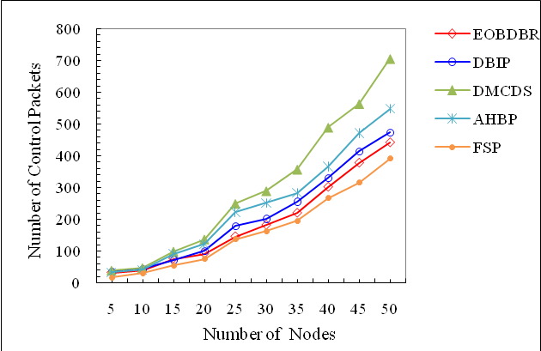
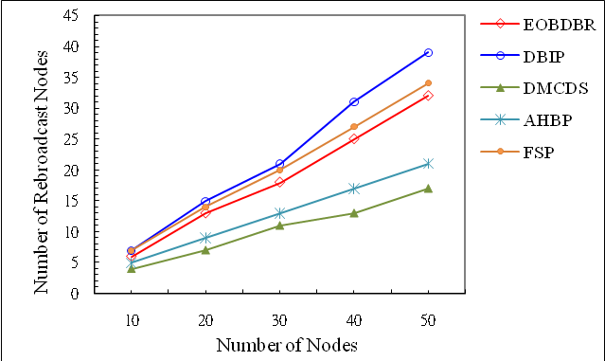
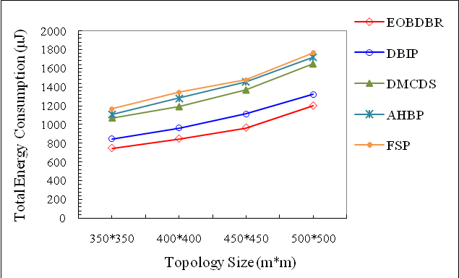
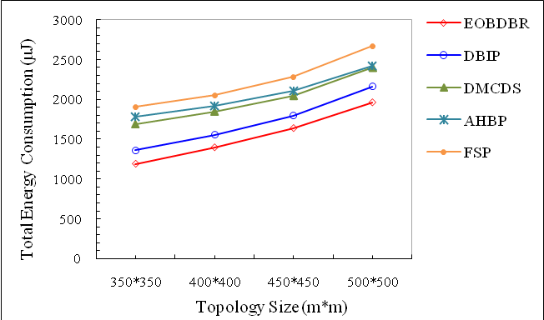
Number of Control Packets
Number of Rebroadcast Nodes
Total Energy Consumption for 30 Nodes
Total Energy Consumption for 50 Nodes

Slide 15
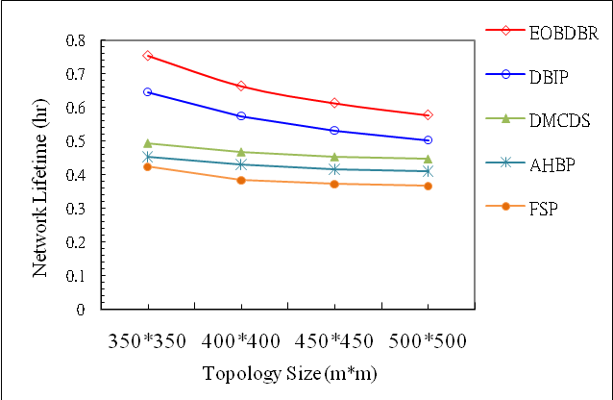
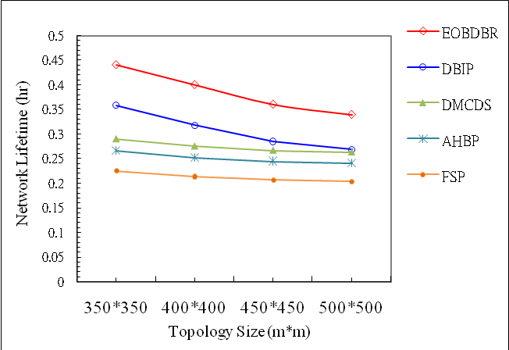
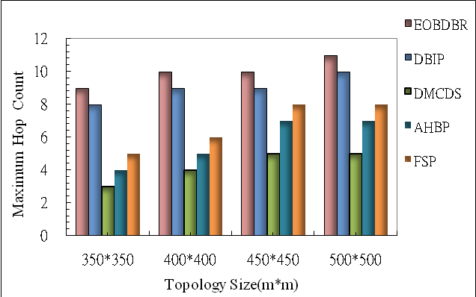
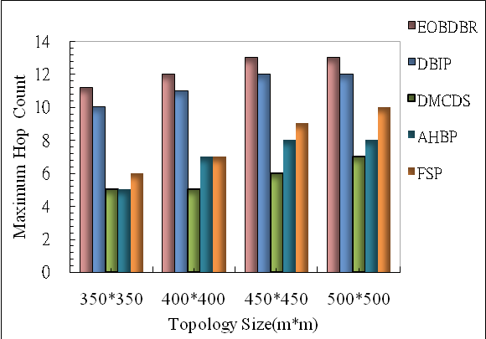
Network Lifetime for 30 Nodes
Network Lifetime for 50 Nodes
Maximum Hop Count for 30 Nodes
Maximum Hop Count for 50 Nodes

Slide 16
Conclusion
This cost model is more practical when important factors affecting energy cost
In the directed topology, simple MST algorithms yield only sub-optimal broadcast paths
A more robust broadcast route is established with a longer lifetime
EOBDBR prevails over the others in terms of path energy and lifetime

Slide 17
Thanks for
Your Attention ~

