Slide 1

Constructing Minimal Spanning Steiner Trees with Bounded Path Length
Some of the Slides in this Presentation are Referenced from : Physical Design for Nanometer IC by Prof. Yao-Wen Chang
Presenter : Cheng-Yin Wu, NTUGIEE

Slide 2
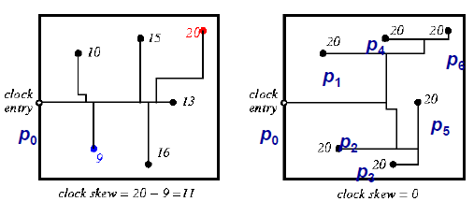
Introduction to “Bounded” Tree (1/2)
A real world critical problem
  (Clock Tree) Routing in VLSI Circuit
Source : Physical Design for Nanometer IC by Prof. Yao-Wen Chang

Slide 3
Introduction to “Bounded” Tree (2/2)
Critical Path Delay (Speed)
  Maximum delay from source to any sink
  Optimum : A shortest path tree rooted at source
Routing Capacitance (Power)
  Power dissipation is linear to routing capacitance
  Optimum : A minimum spanning tree
Draw a balance between : Speed and Power
  Balance between MST and SPT ?!

Slide 4
MST v.s. SPT Trade-off – Example
Define R = max dist_{G} (s, v ϵ V)
Define Cost(T) = ∑ w(e ϵ T(E))
Source (s)
Sinks
Cost (MST) ≤ R + π
Cost (SPT) = (N – 1)R

Slide 5
Bounded Radius Spanning Tree
NP-Complete
Known as Bounded path length minimum spanning tree
radius_{T} (u) = max dist_{T} (u, v ϵ V)
  R = radius_{T} (s) if T = SPT(s)
Problem Formulation
  Given routing graph G(V, E) with w(e ϵ E) > 0, find a minimal cost routing tree T with
  radius_{T} (s) ≤ (1 + ε) R for any given ε ≥ 0
  Two extreme cases : MST(ε → ∞) and SPT(ε = 0)

Slide 6
Overview of My Following Presentation
Both heuristics and exact algorithms
Heuristics (Sound Not Complete)
  Previous works : BPRIM, BRBC
  This work : BKRUS, BH2
Exact Algorithms (Sound and Complete)
  (Improved) Previous works : BMST_G
  This work : BKEX
To the best of my knowledge, it is the most premier work in tackling this problem
BRBC
BKRUS
BH2
BKEX

Slide 7
Bounded Radius Bounded Cost Spanning Tree (1/2)
Awerbuch, et al., “Cost-sensitive analysis of communication protocols,” ACM
Symp. Principles of Distributed Computing, 1990.
Cong, Kahng, Robins, Sarrafzadeh, Wong, “Performance-driven global routing
for cell based IC's,” ICCD-91 (and TCAD, June 1992)
One of the first work on this problem
Claims
  radius_{T} (s) ≤ (1 + ε) R
  Cost(T) ≤ (1 + 2/ε) Cost(MST) (Omit Today)
  Polynomial time Heuristic

Slide 8
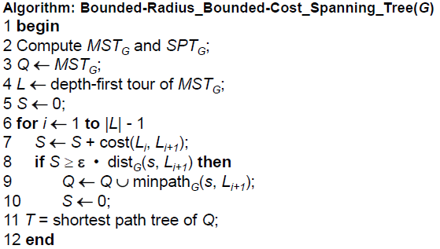
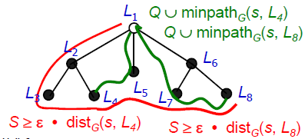
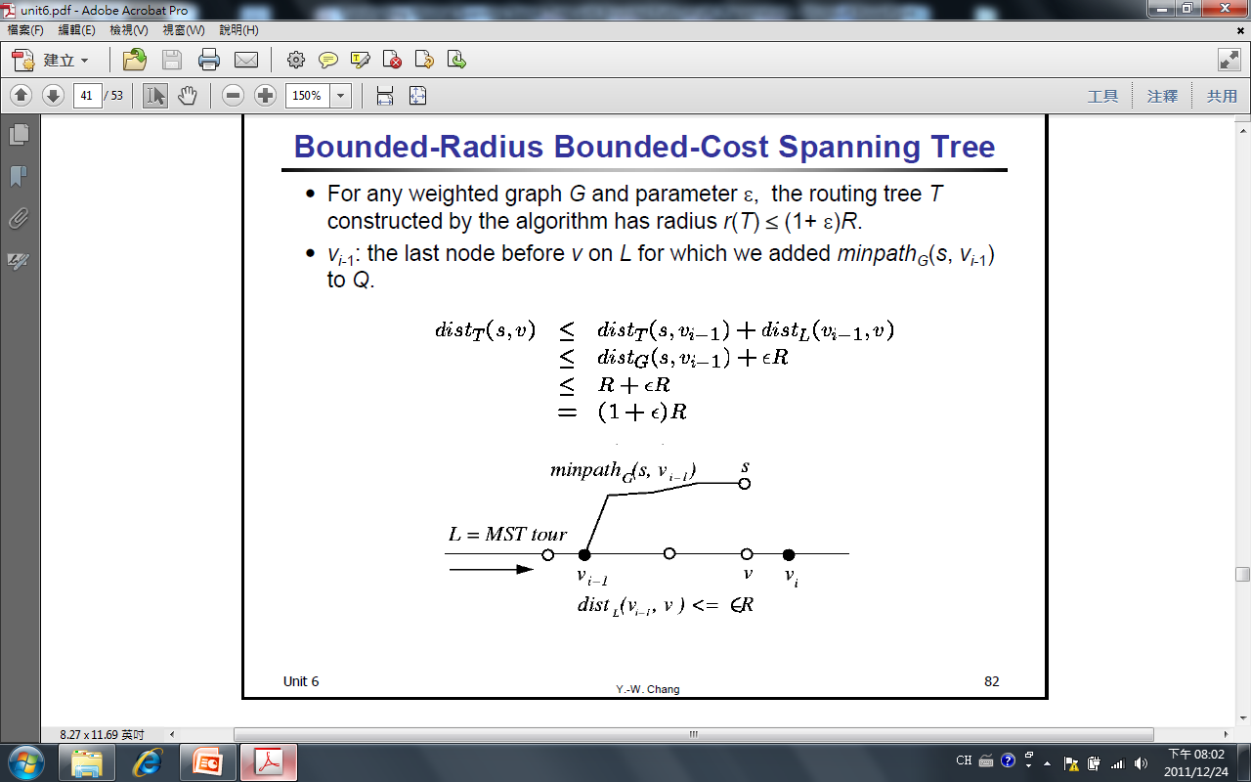
Bounded Radius Bounded Cost Spanning Tree (2/2)
Source : Physical Design for Nanometer IC by Prof. Yao-Wen Chang

Slide 9
BKRUS : Bounded Kruskal MST
A heuristic similar to BPRIM (previous work), BKRUS extends existing Kruskal MST algorithm to bounded radius cases
  Achieving better performance over benchmarks
Goal : radius_{BKT} (s) ≤ (1 + ε) R
Classical Kruskal MST Algorithm – Review
  http://www.cs.man.ac.uk/~graham/cs2022/greedy/

Slide 10
BKRUS Algorithm (1/3)
Extension for upper bound constraint
  Two subtrees t_{u}, t_{v} are merged by edge (u, v) if the merged tree t_{M} satisfies radius_{tM} (s) ≤ (1 + ε) R
t_{M}
u
v
t_{u}
t_{v}

Slide 11
BKRUS Algorithm (1/3)
Extension for upper bound constraint
  Two subtrees t_{u}, t_{v} are merged by edge (u, v) if the merged tree t_{M} satisfies radius_{tM} (s) ≤ (1 + ε) R
  Case 1 : If s ϵ t_{u}
  dist_{tu}(S, u) + dist_{G}(u, v) + radius_{tv}(v) ≤ (1 + ε) R
  Similar case for s ϵ t_{v}
u
v
t_{u}
t_{v}

Slide 12
BKRUS Algorithm (1/3)
Extension for upper bound constraint
  Two subtrees t_{u}, t_{v} are merged by edge (u, v) if the merged tree t_{M} satisfies radius_{tM} (s) ≤ (1 + ε) R
  Case 2 : If neither s ϵ t_{u} nor s ϵ t_{v}
  dist_{G}(S, x) + radius_{tM}(x) ≤ (1 + ε) R
  If such x does not exist
  (u, v) is not feasible
u
x
v
t_{u}
t_{v}

Slide 13
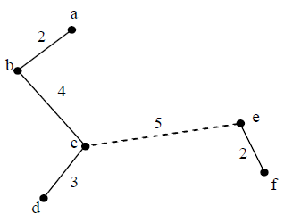
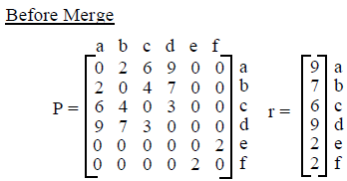
BKRUS Algorithm (2/3)
BKRUS maintains two matrices for t_{M}
  P[V, V] denotes path lengths between (V, V) pairs
  r[V] denotes radii of every V
  (1). If s ϵ t_{u}, t_{v}, check : dist_{tu}(S, u) + dist_{G}(u, v) + radius_{tv}(v) ≤ (1 + ε) R
  (2). Else, check : dist_{G}(S, x) + radius_{tM}(x) ≤ (1 + ε) R, x ϵ t_{M}

Slide 14
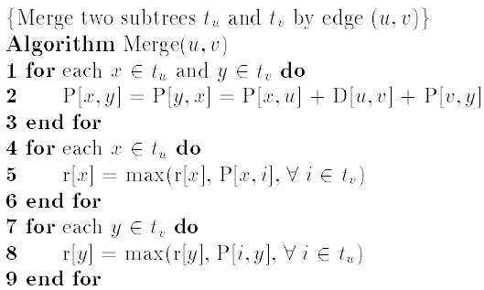
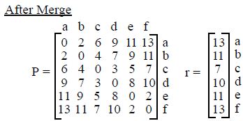
BKRUS Algorithm (2/3)

Slide 15
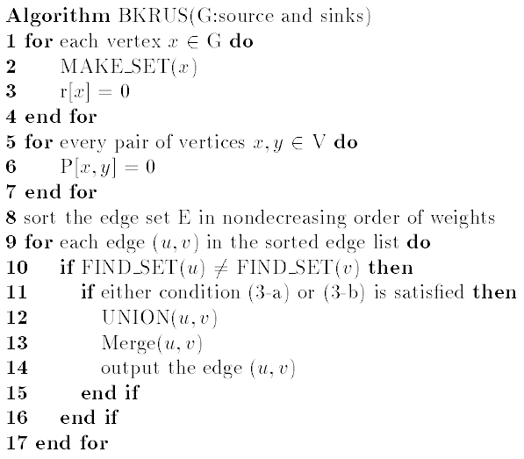
BKRUS Algorithm (3/3)
E times
O(V)
O(V²) ONLY (V – 1) times
Complexity = O(EV + V³)

Slide 16
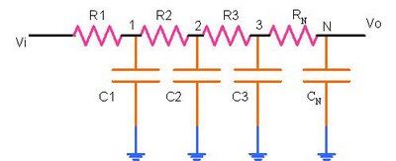
Extension to Elmore Delay Model
Elmore delay model is a more accurate delay estimation model on VLSI circuit
  Now, path delay is a
  function to driving
  network, not edge itself
So, new radii after each MERGE should be re-computed again
dist(x, y) is replaced by R(x, y)(C(x, y)/2 + C_{L})

Slide 17
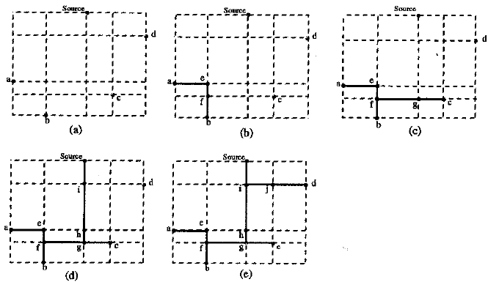
BKRUS Algorithm for Steiner Tree
A variation of BKRUS, named BKST
Hanan Grid

Slide 18
Exact Algorithms – Gabow
Definition : T-exchange
  Given a pair of edges (e, f) where e ϵ T, f ϵ G \ T, and T \ e U f is a spanning tree, we define exchange of (e, f) has weight = w(f) – w(e)
Gabow’s Algorithm tries to find k smallest spanning trees evolved from original spanning tree with one exchange in every iteration
  Problem : Exponential Space Complexity (V^{V – 2})
  Solution : Once a feasible solution is found, return

Slide 19
Exact Algorithms – Gabow
More on T-exchange
  If T is the minimum spanning tree, i.e. Cost(T) is the minimum among all spanning trees
    NO negative weight of exchange can be found
  Further, if (e, f) is the minimal T-exchange, T \ e U f is a spanning tree with the next smallest cost
In reality, some edges in original graph can be excluded at a preprocessing of Gabow’s algorithm (omitted here)

Slide 20
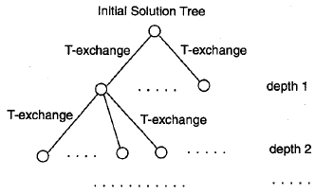
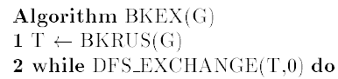
Exact Algorithms – BKEX (1/2)
Motivation : Global Optimization
Definition : Negative-Sum-Exchange(s)
  A sequence of T-exchanges where sum of their weights are negative
BKEX starts from initial feasible solution, and reduce routing cost toward the optimal
  As a post-processing algorithm
  for, e.g. BKT

Slide 21

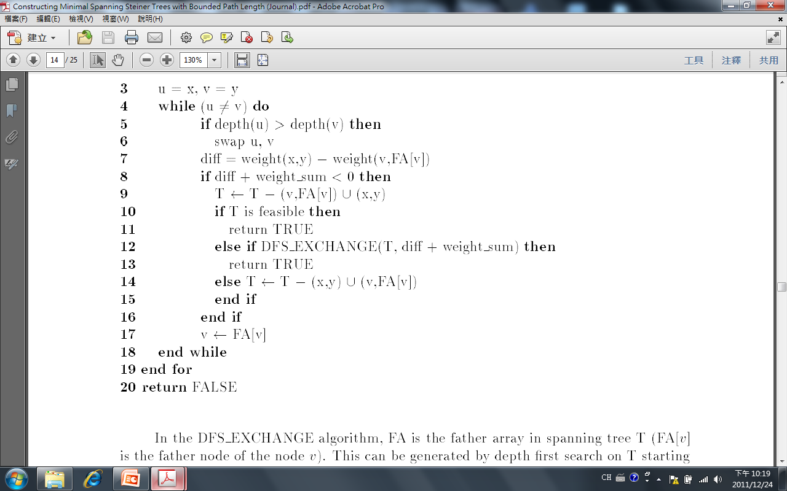
Exact Algorithms – BKEX (2/2)
depth = 0
depth = 1
depth = 2
depth = 3
x
depth = 4
y
depth = 5
Complexity = O(E^{n} V^{n+1})

Slide 22
Heuristic from Exact Algorithms – BH2
BKT is a local minimum solution
  If an edge is rejected during the BKRUS algorithm, then that edge cannot become feasible at a later time (proof is omitted in the presentation)
  It can be shown BKT is a local optimum with respect to a single T-exchange
In order to jump out of local optimum, at least double T-exchanges are needed → BH2
  E.g. negative-sum-exchanges : +3, -5 → -2
  Complexity = O(E² V³)

Slide 23
Upper and Lower Bounded MST
Sometimes we desire a spanning tree that consider both max and min dist_{G}(S, x) while minimizing routing cost
  For instance, clock skew in clock tree synthesis
Problem can be re-formulated as
  ε₁ R ≤ radius_{T} (s) ≤ (1 + ε₂)
  Some combinations of ε₁, ε₂ render NO solution
    However, for Steiner Trees, solutions may exist
How can BKRUS be extended now ?!

Slide 24
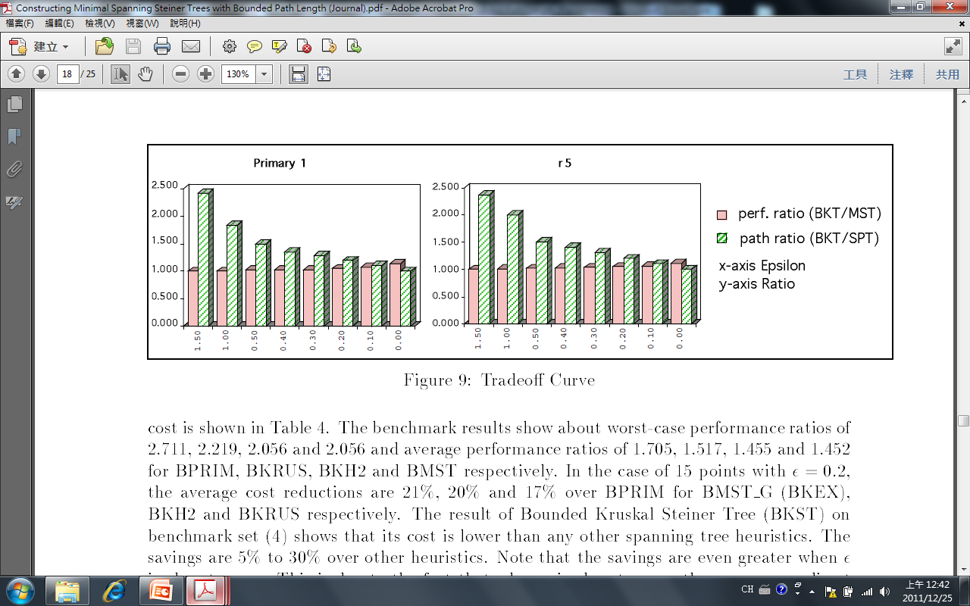
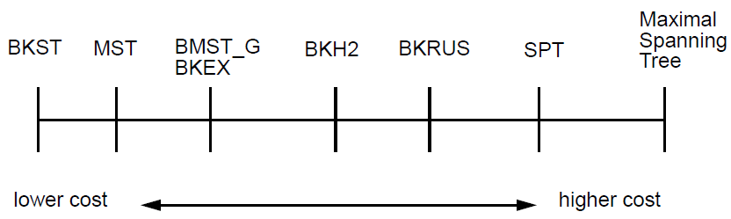
Experiments – Tradeoff Curve

Slide 25
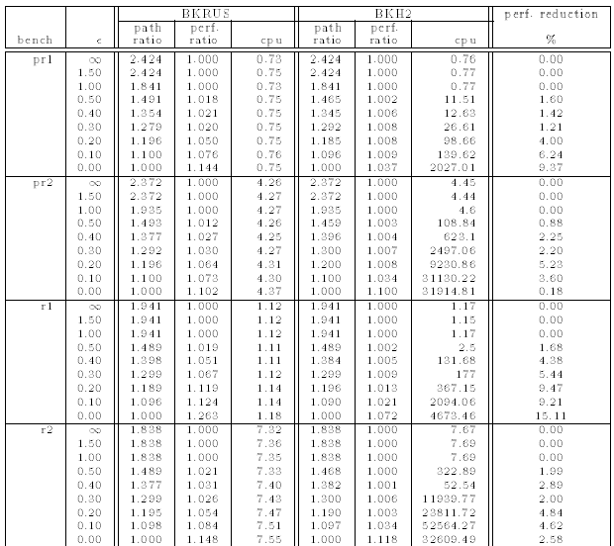
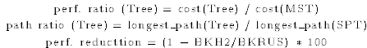
Experiments – BH2 Improvements

Slide 26
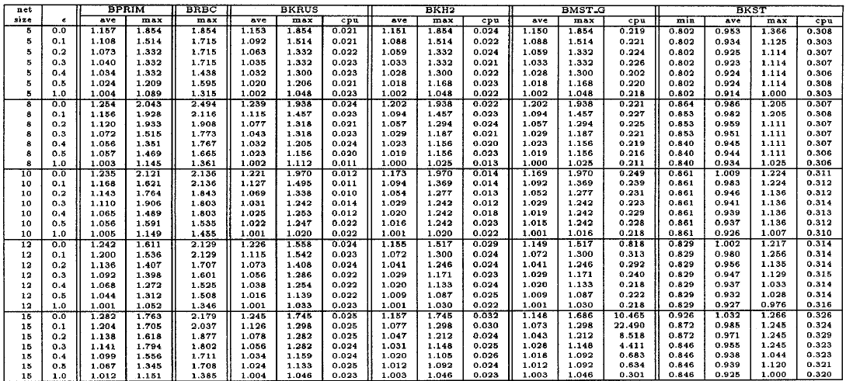
Experiments – Routing Cost Over MST
  Max = 2.711, 2.219, 2.056, 2.056
  Avg = 1.705, 1.517, 1.455, 1.452

Slide 27
Conclusion and Future Work
Schemes for bounded path length minimal spanning tree with upper (and lower) bound control are presented
  With applications to , e.g. Elmore delay model
Two optimal algorithms
  BMST_G extends Gabow’s method
  BKEX using negative T-exchange technique
Heuristic BKRUS can be further enhanced with BKH2 as a post processing

Slide 28


