Slide 1
Steiner Ratio
A Proof of the Gilbert-Pollak Conjecture on the Steiner Ratio
D,-Z. Du and F. K. Hwang
Algorithmica 1992
The Steiner Ratio Conjecture of Gilbert-Pollak May Still Be Open
N. Innami˙B.H. Kim˙Y. Mashiko˙K.Shiohama
Algorithmica 2010

Slide 2
Steiner Ratio
r99944014
r99944015
r99944033
r99944020
b95701241
b96902118
b95902077
r99944012
r99944009
網媒一 姚甯之 Ning-Chih Yao
網媒一 林書漾 Shu-Yang Lin
網媒一 黃詩晏 Shih-Yen Hwang
網媒一 吳宜庭 Yi-Ting Wu
工管五 高新綠 Hsin-Liu Kao
資工四 何柏樟 Bo-Jhang Ho
資工四 王柏易 Bo-Yi Wang
網媒一 黃彥翔 Yan-Hsiang Huang
網媒一 鄭宇婷 Yu-Ting Cheng

Slide 3
Steiner ratio
P – a set of n points on the Euclidean plane
SMT(P) – Steiner Minimum Tree
    Shortest network interconnecting P
    contain Steiner points and regular points
MST(P) – Minimum Spanning Tree
Steiner ratio : L(SMP)/L(MST)

Slide 4
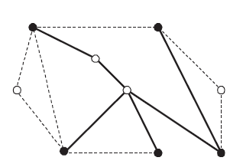
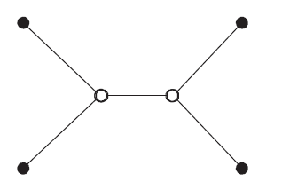
SMT
Graph SMT
  Vertex set and metric is given by a finite graph
Euclidean SMT
  V is the Euclidean space(three-dimensional ) and thus infinite
  Metric is the Euclidean distance
  Ex: the distance between (x1,y1) and (x2,y2)
terminal
non_terminal

Slide 5
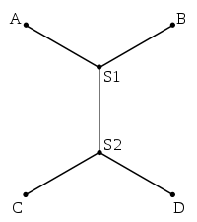
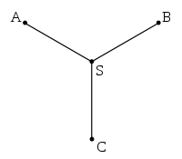
SMT
SMT(P)
  Shortest network interconnecting P
  contain Steiner points and regular points
  A SMT( Steiner Minimum Tree) follows :
    All leaves are regular points.
    Any two edges meet at an angle of at least 120
    Every Steiner point has degree exactly three.
P:{A,B,C,D}
Steiner points: S1,S2
Regular points: A ,B, C,D
P:{A,B,C}
Steiner points: S
Regular points: A ,B, C,

Slide 6
Steiner topology
An ST for n regular points
  at most n-2 Steiner points
  n-2 Steiner points
    full ST
    full topology
B
A
B
A
S2
S
D
S1
D
C
Not full ST
C
full ST

Slide 7
ST
  not a full ST
    decomposed into full sub-trees of T
    full sub-topologies
    edge-disjoint union of smaller full ST
full sub tree
full sub tree
full sub tree
E
B
A
D
S3
S1
S2
G
F
Not full ST
C

Slide 8
Steiner Trees
t(x) – denote a Steiner Tree T
vector x – (2n-3) parameters
    All edge lengths of T , L(e)>=0
    All angles at regular points of degree 2 in T
A
B
S
D
vector x : { L(SA), L(SB), L(SC), L(BD), Angle(SBD) }
C

Slide 9
Inner Spanning Trees
a convex path
  If a path P denoted S1. . .Sk
    Only one or two segments
    SiSi+3 does not cross the piece Si Si+1Si+2 Si+3
P1: S1˙S2˙S3˙S4˙S5
P2: S1˙S2˙S3˙S4
S5
S1
S1
S3
S4
S4
S2
S3
S2
P1 is a convex path
P2 is a not convex path

Slide 10
Inner Spanning Trees
adjacent points
  regular points
    a convex path connecting them
Adjacent points for examples :
{S1,S4}
{S2,S5}
{S1,S5}
S5
S1
S4
P1: S1˙S2˙S3˙S4˙S5
S2
S3

Slide 11
Inner Spanning Trees
adjacent points
  in a Steiner topology t
    they are adjacent in a full subtopology of t
E
B
A
D
S1
S2
G
C
F

Slide 12
characteristic areas
P3
P(t;x)
  regular points on t(x)
S2
P2
P4
S1
S3
C(t;x)
  characteristic area of t(x)
P8
P9
S7
S6
S4
P1
P7
S5
P5
P6

Slide 13
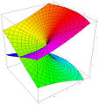
characteristic areas
P(t;x)
  regular points on t(x)
C(t;x)
  characteristic area of t(x)
P3
S2
P2
P4
S1
S3
P8
P9
P1
P9
S7
S6
S4
S5
P5
P7
P1
P6

Slide 14
Inner Spanning Trees
In the area of C(t;x)
An Inner Spanning Trees of t (x)
  Spanning on P(t;x)
P3
P2
P4
P8
P9
P5
P7
P1
P6

Slide 15
Inner Spanning Trees
  Spanning on P(t;x)
Not an Inner Spanning Trees of t (x)
Not In the area of C(t;x)
P3
P2
P4
P8
P9
P5
P7
P1
P6

Slide 16
Steiner Ratio
l(T)
  the length of the tree
Theorm1
  For any Steiner topology t and parameter vector x, there is an inner spanning tree N for t at x such that
t(x) : a Steiner tree
N : an inner spanning tree

Slide 17
Steiner Ratio
Lt(x)
length of the minimum inner spanning tree of t(x)
  x ∈ Xt
  Xt : the set of parameter vectors x such that l (t (x) ) = 1
Lemma 1:
  Lt(x) is a continuous function with respect to x
Lt(x)
x
Lt(x)
x

Slide 18
Steiner Ratio
  Thm1
  Lemma1
l (t(x)) ≥ (√3/2) l(N)
  Lt(x) is a continuous function with respect to x
ft(x) = l(t(x)) – (√3/2)Lt(x)
ft(x) = L(SMT) – (√3/2)L (MST)
l (t(x)) -> length of a Steiner tree
Lt(x) -> length of an min inner spanning tree

Slide 19
Steiner Ratio
Steiner ratio : L(SMT) /L (MST)
ft(x) = L(SMT) – (√3/2)L (MST)
if ft(x) ≥ 0
then L(SMT) /L (MST) ≥ (√3/2)
ft(x) = L(SMT) – (√3/2)L (MST)

Slide 20
Theorem 1
Theorem 1 : for any topology y and parameter x,
there is an inner spanning tree N for t at x
such that:
That is ,for any x and any t, there exist inner spanning tree N such that:

Slide 21
Between f_{t}(x) and Theorem 1
Theorem 1 holds if f_{t}(x)>=0 for any t any x.
By Lemma 1: f_{t}(x) is continuous, so it can reach the minimum value in X_{t}.

Slide 22
Between F(t) , F(t*) and Theorem1
Let F(t) = min_{x} f_{t}(x) x X_{t}
Then theorem 1 holds if F(t)>=0 for any t.
Let t* = argmin_{t} F(t)
t:all Steiner topologies
Then theorem 1 holds if F(t*)>=0.

Slide 23
Prove Theorem 1 by contradiction
P : Theorem 1 (F(t*)>=0)
~P : exist t* such that F(t*)<0
Contradiction : If ~P => P then P is true.
Assume F(t*)<0 and n is the smallest number of points such that Theorem 1 fail.
Some important properties of t* are given in the following two lemmas.

Slide 24
Lemma 4.
t* is a full topology
Assume t* is not a full topology
=> for every x X_{t}
ST t*(x) can be decomposed into
edge-disjoint union of several ST T_{i}’s
T_{i}=t_{i}(x(i)) , t_{i} : topology , x(i) : parameter
=> T_{i} has less then n regular points
=> find an inner spanning tree m_{i}
such that

Slide 25
=>
m : the union of m_{i}
=>
=>
=> F(t*) ≥ 0 , contradicting F(t*) ＜ 0 .

Slide 26
Let x be a minimum point.
Every component of x is positive.
Lemma 5.
Definition :
Companion of t* :
t is full topology
if two regular point are adjacent in t
they are adjacent in t*
Minimum point :
,

Slide 27
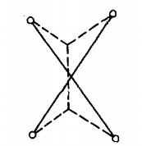
Assume that x has zero components
1.
regular steiner : contradiction! (similar to lemma 4)
point point
2.
steiner steiner : find a “t” with conditions
point point and P(t;y)=P(t*;x)
實線: t*(x) with zero component (steiner point重和)
虛線: t(y)

Slide 28
steiner steiner : find a “t” with conditions
point point and P(t;y)=P(t*;x)
1. t is a companion of t*
2. there is a tree T interconnecting n points in P(t*;x) , with full topology t and length less than l(t*(x))

Slide 29
find “t”
1. if the ST of topology t exists:
let
since
and t(hy) is similar to t(y)

Slide 30
Definition:
any tree of topology t : t(y, Θ)
L_{t}(y, Θ) : the length of minimum inner spanning tree for t
G(t)=minimum value of g_{t}(y, Θ)

Slide 31
2. if the ST of topology t does not exist:
1. y has no zero component :
t(y, Θ) must be a full ST
→ G(t)=F(t) → F(t)<F(t*) contradiction!
2. y has zero components :
consider subgraph of t induced
(1) if every connected component of subgraph having an edge contains a regular point
=> by Lemma 4
find a full topology t’, G(t’)<0

Slide 32
2. if the ST of topology t does not exist:
(2) if exists such connected component of subgraph having an edge contains a regular point =>
find a full topology t’, G(t’)<G(t)
repeating the above argument, we can find infinitely many full topologies with most n regular points contradicting the finiteness of the number of full topology

Slide 33
Lemma 6~9

Slide 34
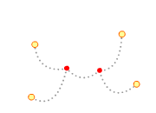
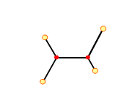
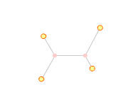
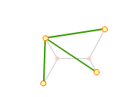
Lemma 6
Let t be a full topology and s a spanning tree topology. Then l(s(t; x)) is a convex function with respect to x.

Slide 35
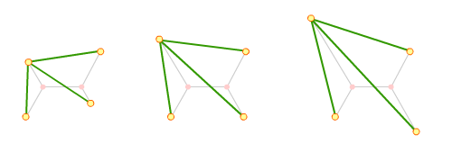
Lemma 6
Let t be a full topology and s a spanning tree topology. Then l(s(t; x)) is a convex function with respect to x.

Slide 36
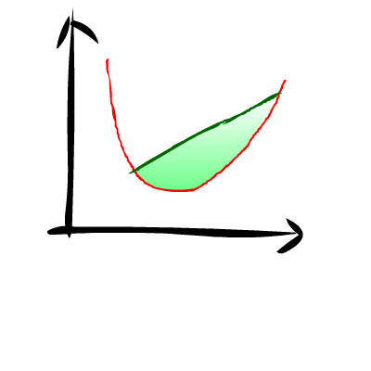
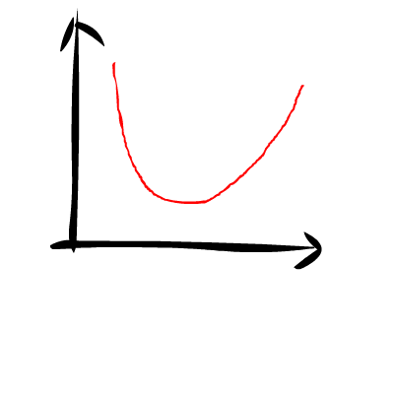
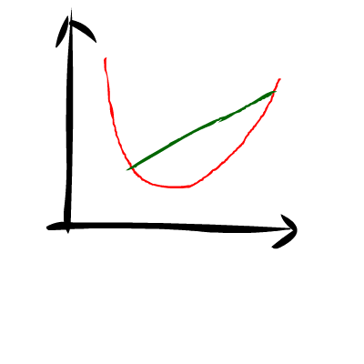
Convex Function
contains concave curves

Slide 37
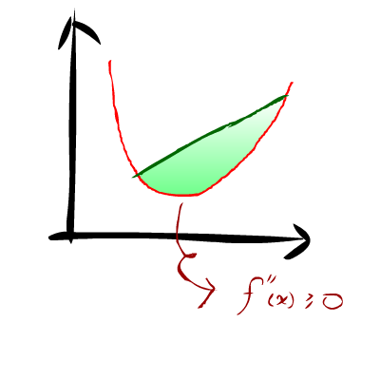
Convex Function
contains concave curves
2nd deviation func-tion must be non-negative everywhe-re

Slide 38
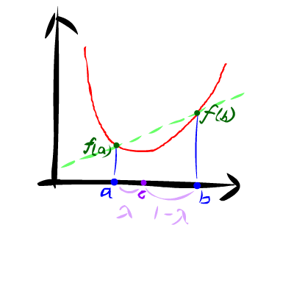
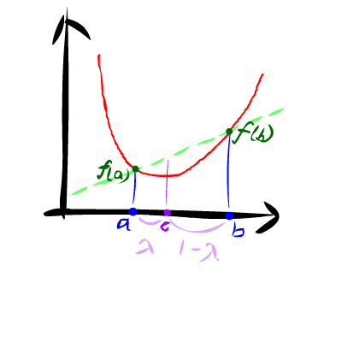
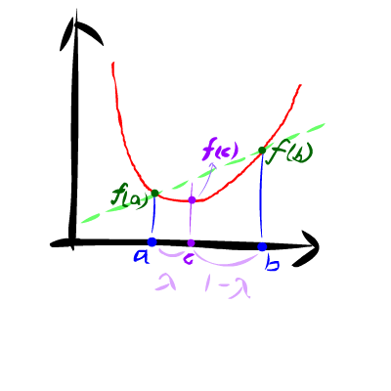
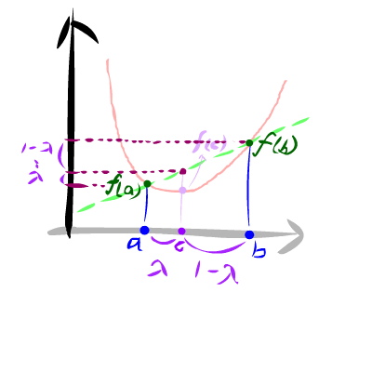
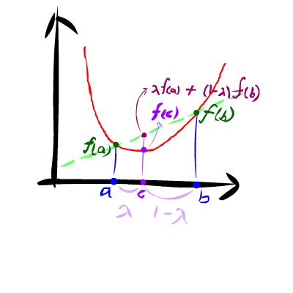

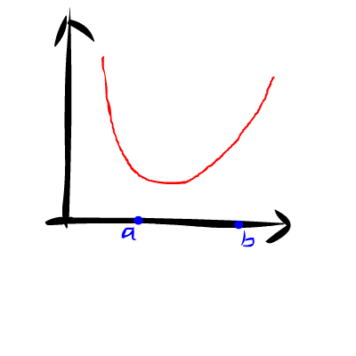
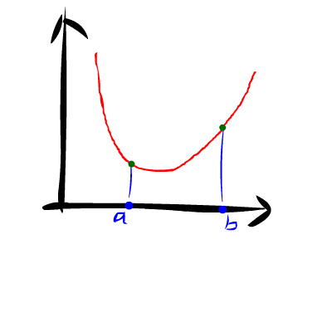
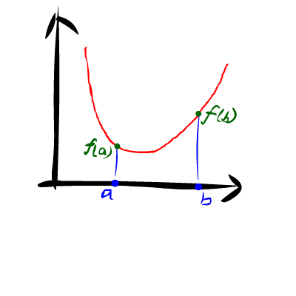
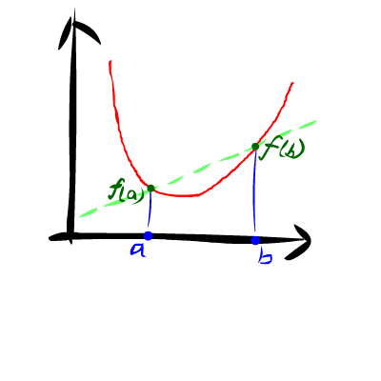
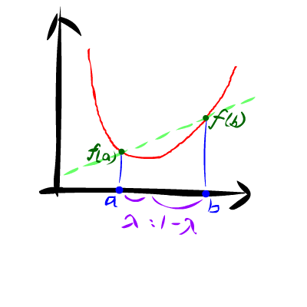
Convex Function
contains concave curves
2nd deviation func-tion non-negative
c = λa + (1-λ)b, then f(c) <= λf(a) + (1-λ)f(b)

Slide 39
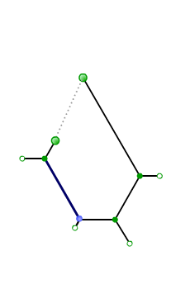
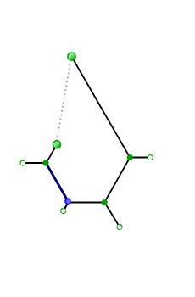
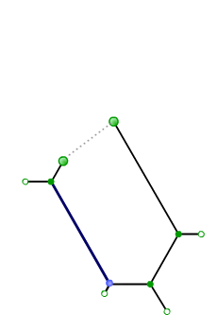
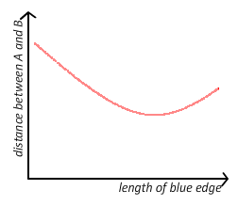
Lemma 6
Consider each edge of inner spanning tree …
Consider one element of the vector …
The sum of convex functions is a convex function
B
B
B
A
Flash demo: http://www.csie.ntu.edu.tw/~b96118/convex.swf

Slide 40
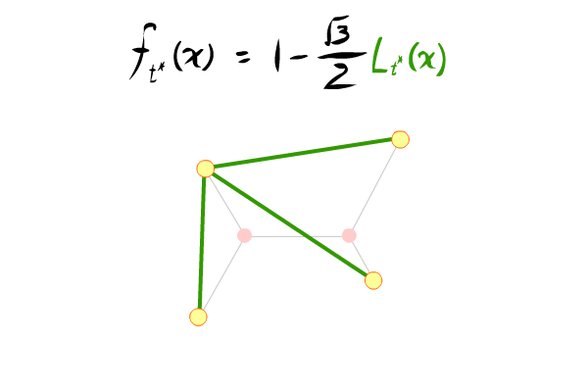
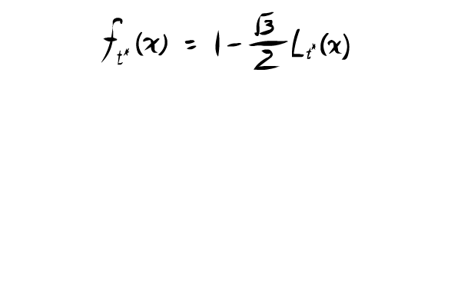
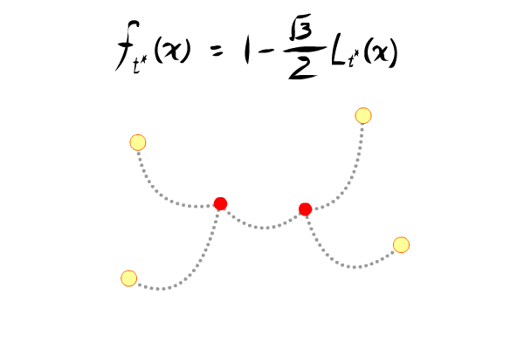
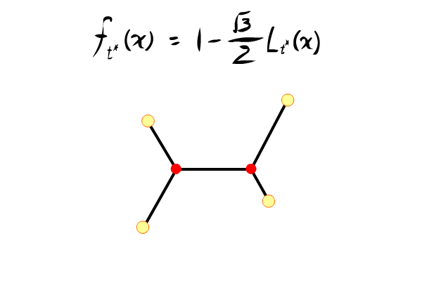
Lemma 7

Slide 41
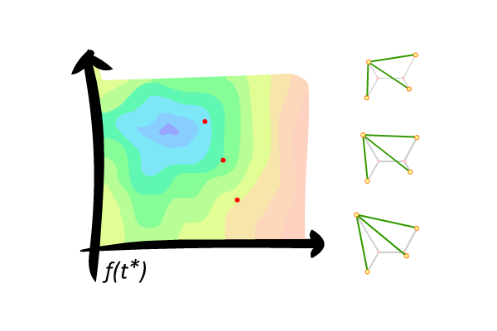
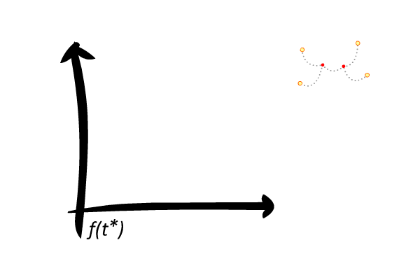
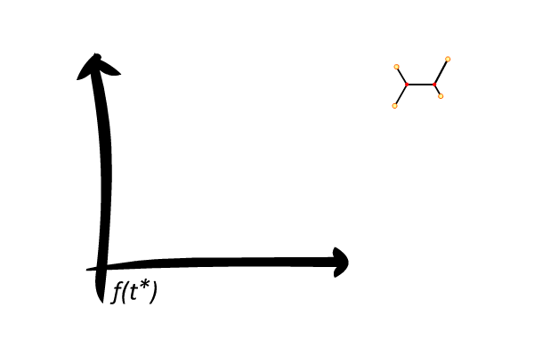
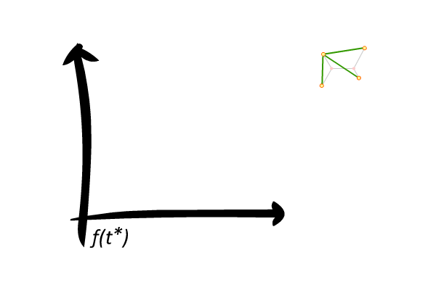
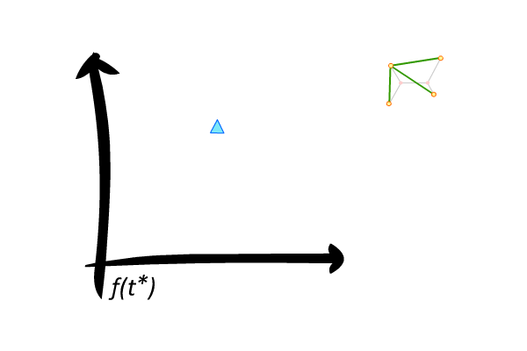
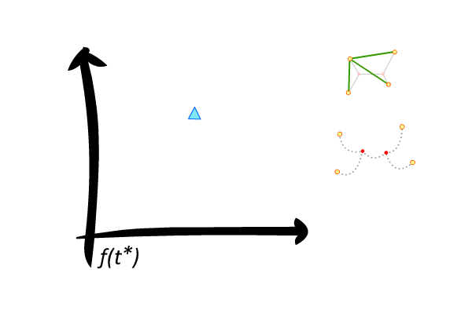
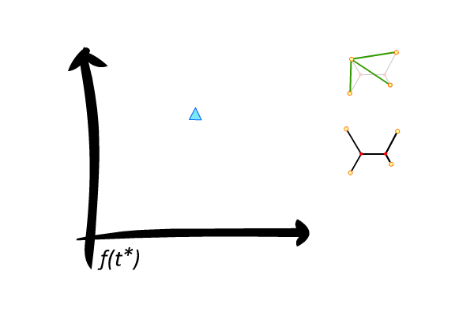
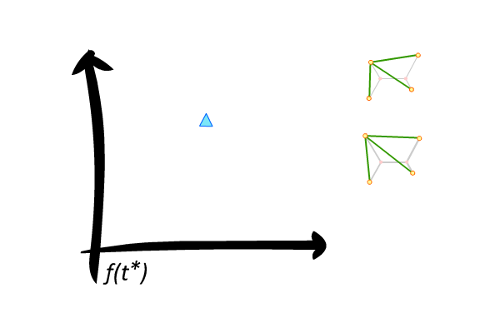
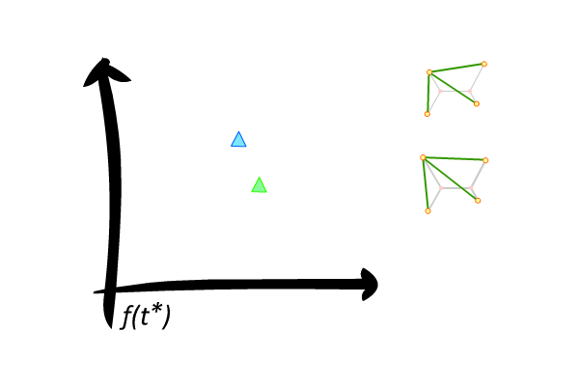
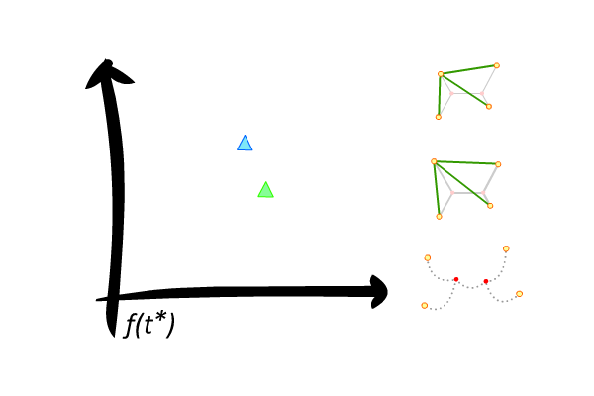
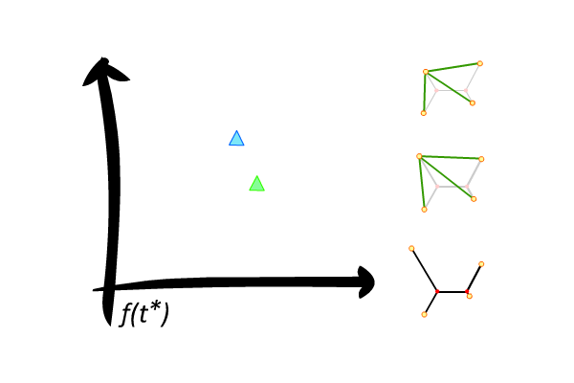
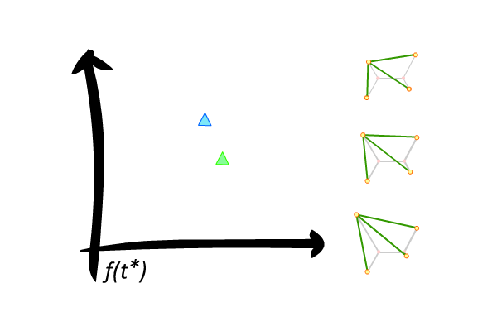
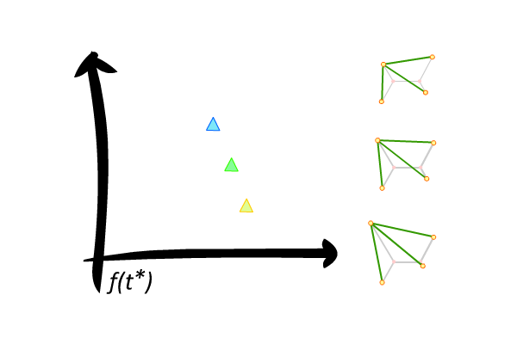
Lemma 7

Slide 42


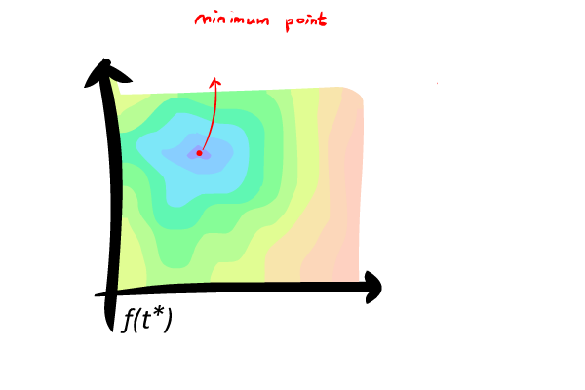
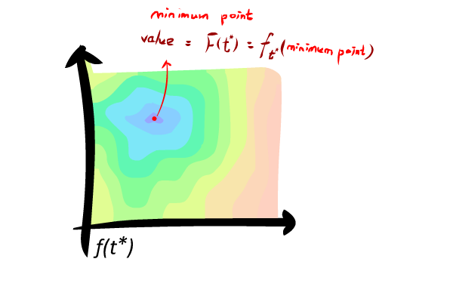
Lemma 7

Slide 43


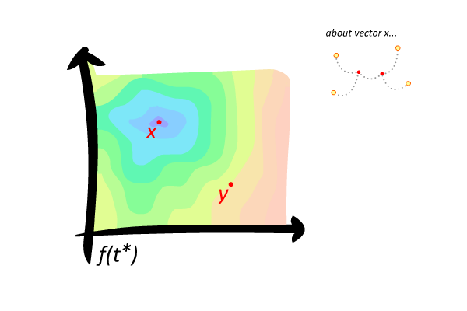


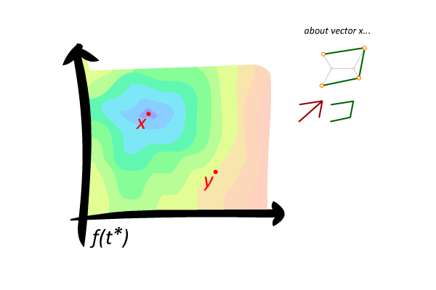



Lemma 7
Suppose that x is a minimum point and y is a point in X_{t*}, satisfying MI(t*; x) MI(t*; y). Then, y is also a minimum point.

Slide 44








Lemma 7
Suppose that x is a minimum point and y is a point in X_{t*}, satisfying MI(t*; x) MI(t*; y). Then, y is also a minimum point.

Slide 45










Lemma 7
Suppose that x is a minimum point and y is a point in X_{t*}, satisfying MI(t*; x) MI(t*; y). Then, y is also a minimum point.

Slide 46





Lemma 7
Suppose that x is a minimum point and y is a point in X_{t*}, satisfying MI(t*; x) MI(t*; y). Then, y is also a minimum point.

Slide 47




Lemma 7
Suppose that x is a minimum point and y is a point in X_{t*}, satisfying MI(t*; x) MI(t*; y). Then, y is also a minimum point.

Slide 48










Lemma 7
Suppose that x is a minimum point and y is a point in X_{t*}, satisfying MI(t*; x) MI(t*; y). Then, y is also a minimum point.

Slide 49












Lemma 8
Γ(t;x) is the union of minimum inner spanning trees

Slide 50












Lemma 8
Two minimum inner spanning trees can never cross, i.e., edges meet only at vertices.
Proof by contradiction
Without loss of generality, assume that EA has a smallest length among EA, EB, EC, ED.
l(AC) < l(AE) + l(EC)
l(AE) + l(EC) ≤ l(CD)
→ l(AC) < l(CD)
We obtain an inner spanning tree with length less than that of U, contradicting with the minimality of U.
Therefore,2 Minimum Inner Spanning Trees can never cross.
Remove the edge CD from the tree U, the remaining tree has two connected components containing C and D, respectively
A is in the connected component containing D.
Use AC to connect the 2 components

Slide 51


























Lemma 9
Another example
Let n be the minimum spanning tree containing the longest edge e
Γ(t;x)
A ploygon of Γ(t;x) is a cycle which is a subgraph of Γ(t;x)
Replace e with another edge in the polygon
Let m be the minimum inner spanning tree containing the longest edge e
The length of the new tree is shorter than the original!
Proof by contradiction
Therefore, polygon of Γ(t;x) cannot have only one longest edge
Every polygon of Γ(t; x) has at least two equal longest edges.
Replace e with another edge in the polygon
The length of the new tree is shorter than the original!

Slide 52




Triangulation
Full topology with n regular points
P(t*; x)
Add n-3 diagonals to obtain n-2 triangles
Embedded Γ(t*; x)

Slide 53
Triangulation
Edge-length representation
Edge-length independent

Slide 54

Critical Structure
Γ(t*; x) is a triangulation of
P(t*; x) such that
All triangles are equilateral triangles

Slide 55
Critical Structure
Let x ∈X_{t} be a minimum point such that t*(x) has maximum number of minimum spanning trees.
Then Γ(t*; x) is a critical structure

Slide 56
Critical Structure
Proof: if Γ(t*; x) is not critical, then one of the following may happen:
(a). Γ(t*; x) has an edge not on any polygon
(b). Γ(t*; x) has a non-triangle polygon
(c). Γ(t*; x) has a non-equilateral triangle

Slide 57
Critical Structure
Case (a): Γ(t*; x) has an edge e not on any polygon
U ⊆ Γ(t*; x) be a minimum spanning tree contain e

Slide 58


Critical Structure
Let e’ not in Γ(t*; x) be an edge on the same triangle of e such that U-{e}+{e’} forms a spanning tree
l(e’) > l(e)

Slide 59

Critical Structure
Shrinking e’ until l(e) = l(e’)

Slide 60
Critical Structure
Let P(l) be the new set of regular points with l(e’) = l
Let L ⊆ [l(e’), l(e)] such that for l ∈ L, exists minimum point y such that P(l) = P(t*; y)
L is nonempty

Slide 61
Critical Structure
Let l* be min{L} and y* be the minimum point such that P(l*) = P(t*; y*)
Then l* ≠ l(e), otherwise t*(y*) has more number of minimum spanning trees than t*(x)

Slide 62

Critical Structure
But if l* ≠ l(e), then we can find l < l * such that P(l) and P(l*) has the same set of minimum spanning trees, contradict to that l* is minimum.

Slide 63

Critical Structure
For case (b),
Γ(t*; x) has a non-triangle polygon.
We can shrink an edge not in Γ(t*; x) and obtain a contradiction by similar argument.

Slide 64


Critical Structure
For case (c),
Γ(t*; x) has a non-equilateral triangle
We can increase all shortest edges in Γ(t*; x) and obtain a contradiction by similar argument.

Slide 65

Critical Structure
Hence, Γ(t*; x) is a critical structure.
Finally, we want to say that a minimum spanning tree m of Γ(t*; x) is not too larger than t*(x) by this critical property.

Slide 66

Lattice point
Let a be the length of an edge in
Γ(t*; x).
We can put Γ(t*; x) onto lattice points.
Then the length of a minimum spanning tree of Γ(t*; x) is (n-1)a

Slide 67

Another tree structure…
A Hexagonal tree of points set P is a tree structure using edges with only 3 directions each two meet at 120 °
Permit adding points not in P

Slide 68
Hexagonal Tree
Let L_{h}(P) denote the minimum Hexagonal tree of P, we first show that
L_{S}(P) ≥ √ 3/2 L_{h}(P)
And then we will show that the points set P with critical structure Γ, L_{h}(P) = L_{m}(P)

Slide 69

Hexagonal Tree
Triangle Property
∠A ≥ 120 ° then
BC ≥
√ 3/2 (AB + AC)

Slide 70

Hexagonal Tree
Hence we have L_{S}(P)
≥ √ 3/2 L_{h}(P)

Slide 71



Hexagonal Tree
Minimum Hexagonal Tree
Straight and Non-straight edge
Full and Sub-full Hexagonal Tree
Junction

Slide 72



Hexagonal Tree
There is a Minimum Hexagonal Tree such that any junction has at most one non-straight edge

Slide 73
Hexagonal Tree
There is a Minimum Hexagonal Tree such that any junction is on a lattice point
Suppose not, consider bad points set P with minimum number of regular points such that, for any Minimum Hexagonal Tree H of P, there is a junction not on a lattice point.

Slide 74
Hexagonal Tree
If a Minimum Hexagonal Tree H has a junction not on a lattice point…
Then we can either shorten the tree or decrease the number of junctions
H is full and no junction is on a lattice point

Slide 75

Hexagonal Tree
There is a junction J of H not on a lattice point and adjacent to two regular points A, B

Slide 76


Hexagonal Tree
Let C be the third point adjacent to J
C is not a regular point
➔ C is a junction

Slide 77







Hexagonal Tree
If JA and JB are both straight

Slide 78



Hexagonal Tree
If JA is straight and JB non-straight

Slide 79
Hexagonal Tree
Finally, there is a Minimum Hexagonal Tree H with all junctions on lattice points
Suppose there is m junctions on H, then l(H) = (m+n-1)a ≥ (n-1)a = L_{m}(P) ≥ L_{h}(P)
➔ L_{h}(P) = L_{m}(P)
➔ L_{S}(P) ≥ √ 3/2 L_{h}(P) = √ 3/2 L_{m}(P)

Slide 80
Steiner Ratio
The Steiner Ratio Conjecture of Gilbert-Pollak May Still Be Open

Slide 81
Abstract
Lemma 1: L_{t}(x) is a continuous function with respect to x
  L_{t}(x) : length of the minimum inner spanning tree for t(x)
Disproof of the continuity of L_{t}(x).

Slide 82

Continuity
Given $ε>0$, there exist $δ>0$such that $\left|f\left(x\right)−L\right|<ε$whenever $0<\left|x−c\right|<δ$,then the limit of $f(x)$ at $x=c$ is $L$, and denoted by $\lim_{x→c}{f\left(x\right)=L}$
$\lim_{x→a}{f\left(x\right)=f(a)}$

Slide 83


Proof of Discontinuity
$∃ t, x, y$when $y→x$
    $t$ : Seiner topology
    $x$: parameter with zero components
    $y$ : parameter without zero component
    $MIST(t(x))$ : minimum inner spanning tree of $t(x)$
    $L(MIST\left(t\left(x\right)\right))$: length of $MIST(t(x))$
$$L(MIST(t(x)))<\lim_{y→x}{L(MIST(t(y))) }⁡$$

Slide 84
Steiner tree
P3
regular point
S2
Steiner point
P2
P4
S1
S3
P8
P9
S7
S6
S4
P1
S5
P5
P7
P6
t(y)

Slide 85
Convex path
P3
S2
P2
P4
S1
S3
P8
P9
S7
Path S_{a}S_{b} is a convex path if
Only one or two segments
S_{i}S_{i+3} does not cross the piece
S_{i}S_{i+1}S_{i+2}S_{i+3}, for all a ≤ i ≤ b-3
S6
S4
P1
S5
P5
P7
P6
t(y)

Slide 86
Convex path
P3
S2
P2
P4
S1
S3
P8
P9
S7
Path S_{a}S_{b} is a convex path if
Only one or two segments
S_{i}S_{i+3} does not cross the piece
S_{i}S_{i+1}S_{i+2}S_{i+3}, for all a ≤ i ≤ b-3
S6
S4
P1
S5
P5
P7
P6
t(y)

Slide 87
Convex path
P3
S2
P2
P4
S1
S3
P8
P9
S7
Path S_{a}S_{b} is a convex path if
Only one or two segments
S_{i}S_{i+3} does not cross the piece
S_{i}S_{i+1}S_{i+2}S_{i+3}, for all a ≤ i ≤ b-3
S6
S4
P1
S5
P5
P7
P6
t(y)

Slide 88
Convex path
P3
S2
P2
P4
S1
S3
P8
P9
S7
Path S_{a}S_{b} is a convex path if
Only one or two segments
S_{i}S_{i+3} does not cross the piece
S_{i}S_{i+1}S_{i+2}S_{i+3}, for all a ≤ i ≤ b-3
S6
S4
P1
S5
P5
P7
P6
t(y)

Slide 89
Convex path
P3
S2
P2
P4
S1
S3
P8
P9
S7
Path S_{a}S_{b} is a convex path if
Only one or two segments
S_{i}S_{i+3} does not cross the piece
S_{i}S_{i+1}S_{i+2}S_{i+3}, for all a ≤ i ≤ b-3
S6
S4
P1
S5
P5
P7
P6
t(y)

Slide 90
Convex path
P3
S2
P2
P4
S1
S3
P8
P9
S7
Path S_{a}S_{b} is a convex path if
Only one or two segments
S_{i}S_{i+3} does not cross the piece
S_{i}S_{i+1}S_{i+2}S_{i+3}, for all a ≤ i ≤ b-3
S6
S4
P1
S5
P5
P7
P6
t(y)

Slide 91
Convex path
P3
S2
P2
P4
S1
S3
P8
P9
S7
Path S_{a}S_{b} is a convex path if
Only one or two segments
S_{i}S_{i+3} does not cross the piece
S_{i}S_{i+1}S_{i+2}S_{i+3}, for all a ≤ i ≤ b-3
S6
S4
P1
S5
P5
P7
P6
t(y)

Slide 92
Convex path
P3
S2
P2
P4
S1
S3
P8
P9
S7
Path S_{a}S_{b} is a convex path if
Only one or two segments
S_{i}S_{i+3} does not cross the piece
S_{i}S_{i+1}S_{i+2}S_{i+3}, for all a ≤ i ≤ b-3
S6
S4
P1
S5
P5
P7
P6
t(y)

Slide 93
Convex path
P3
S2
P2
P4
S1
S3
P8
P9
S7
Path S_{a}S_{b} is a convex path if
Only one or two segments
S_{i}S_{i+3} does not cross the piece
S_{i}S_{i+1}S_{i+2}S_{i+3}, for all a ≤ i ≤ b-3
S6
S4
P1
S5
P5
P7
P6
t(y)

Slide 94
Convex path
P3
S2
P2
P4
S1
S3
P8
P9
S7
Path S_{a}S_{b} is a convex path if
Only one or two segments
S_{i}S_{i+3} does not cross the piece
S_{i}S_{i+1}S_{i+2}S_{i+3}, for all a ≤ i ≤ b-3
S6
S4
P1
S5
P5
P7
P6
t(y)

Slide 95
Characteristic Area
P3
S2
P2
P4
S1
S3
P8
P9
S7
Path S_{a}S_{b} is a convex path if
Only one or two segments
S_{i}S_{i+3} does not cross the piece
S_{i}S_{i+1}S_{i+2}S_{i+3}, for all a ≤ i ≤ b-3
S6
S4
P1
S5
P5
P7
P6
t(y)
Notes:
這樣子我們就得到了所以的Convex path

Slide 96
Minimum Inner Spanning Tree
P3
S2
P2
P4
S1
S3
P8
P9
S7
One of segments is removed to get a minimum inner spanning tree
S6
S4
P1
S5
P5
P7
P6
t(y)

Slide 97
Minimum Inner Spanning Tree
P3
S2
P2
P4
S1
S3
P8
P9
S7
S6
S4
P1
S5
P5
P7
P6
t(y)

Slide 98
Start to Converge
P3
S2
P2
P4
S1
S3
P8
P9
S7
S6
S4
P1
S5
P5
P7
P6
t(y)

Slide 99
Converging
P3
S2
P2
P4
S1
S3
P8
P9
S7
S6
S4
P1
S5
P5
P7
P6
t(y->x)

Slide 100
Minimum Inner Spanning Tree
P3
S2
P2
P4
S1
S3
P8
P9
S7
S4
P1
P7
S5
P5
P6
t(x)

Slide 101
P3
S2
P2
P4
S1
S3
P8
P9
S7
The Steiner tree is decomposed into two full Steiner trees T1 and T2 at P7 = S6.
S4
P1
P7
S5
P5
P6
t(x)

Slide 102
Characteristic Area
P3
S2
P2
P4
S1
S3
P8
P9
S7
S4
P1
P7
S5
P5
P6
t(x)

Slide 103
Convex Path
P3
S2
P2
P4
S1
S3
Path S_{a}S_{b} is a convex path if
Only one or two segments
S_{i}S_{i+3} does not cross the piece
S_{i}S_{i+1}S_{i+2}S_{i+3}, for all a ≤ i ≤ b-3
S4
P1
P7
S5
P5
P6

Slide 104
Characteristic Area
P3
S2
P2
P4
S1
S3
P8
P9
S7
S4
P1
P7
S5
P5
P6
t(x)

Slide 105
Minimum Inner Spanning Tree
P3
S2
P2
P4
S1
S3
P8
P9
S7
S4
P1
P7
S5
P5
P6
t(x)

Slide 106
Minimum Inner Spanning Tree
P3
S2
P2
P4
S1
S3
P8
P9
S7
S4
P1
P7
S5
P5
P6
t(x)

Slide 107
Comparison
P3
P3
S2
S2
P2
P4
P2
P4
S1
S3
S1
S3
P8
P9
P8
P9
S7
S7
S6
S4
S6
S4
P1
P7
S5
P5
P1
S5
P5
P7
P6
P6
t(x)
t(y->x)

Slide 108
Comparison
P3
P3
S2
S2
P2
P4
P2
P4
S1
S3
S1
S3
P8
P9
P8
P9
S7
S7
S6
S4
S6
S4
P1
P7
S5
P5
P1
S5
P5
P7
P6
P6
t(x)
t(y->x)

Slide 109

Comparison
P3
P3
S2
S2
P2
P4
P2
P4
S1
S3
S1
S3
P8
P9
P8
P9
S7
S7
S6
S4
S6
S4
P1
P7
S5
P5
P1
S5
P5
P7
P6
P6
t(x)
t(y->x)
$$L(MIST(t(x)))<\lim_{y→x}{L(MIST(t(y))) }⁡$$

Slide 110


Continuity
If $f$ is continuous at $a$, then
$$\lim_{x→a}{f\left(x\right)=f(a)}$$
But now we get
which means $L$ is not continuous at $x$
$$L(MIST(t(x)))<\lim_{y→x}{L(MIST(t(y))) }⁡$$

Slide 111
Assumption
Lemma 1: L_{t}(x) is a continuous function with respect to x
We disprove the continuity of L_{t}(x)
Lemma 1 is not true.

Slide 112
Minimum Spanning Tree
P3
S2
P2
P4
S1
S3
P8
P9
S7
If the minimum spanning tree is not limited in the characteristic area, the minimum spanning can be continuous
The Steiner Ratio problem may still open
S6
S4
P1
S5
P5
P7
P6

