Slide 1
Undirected Single-Source Shortest Paths with Positive Integer Weights in Linear Time
MIKKEL THORUP
1999 Journal of ACM

Slide 2

Presenters
資工四 陳代樾
資工四 張愈敏
資工四 胡升鴻
資工四 呂哲安
資工四 陳縕儂
資工四 黃鈞愷

Slide 3
Outline
Introduction
Preliminary
Avoiding the Sorting Bottleneck
The Component Hierarchy
Visiting Minimal Vertices
Towards Linear Time
The Component Tree

Slide 4
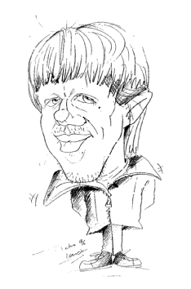
Introduction(1)
Mikkel Thorup
  http://www.diku.dk/~mthorup/

Slide 5
Introduction(2)
Single Sorce Shortest Path
Problem (SSSP)
Given a positively weighted graph G with a source vertex s, find the shortest path from s to all other vertices in the graph

Slide 6
Introduction(3)
Since 1959, all developments in SSSP have been based on Dijkstra’s algorithm O(n² + m)
Our target is toward linear time and linear space algorithm.
The algorithm avoids the sorting bottleneck by building a hierarchical bucketing structure, identifying vertex pairs that may be visited in any order.

Slide 7
Introduction(4)
1
min
7
7
∞
9
8
a
8
b
min
4
4
9
11
c
9
∞
min
1
2
min
Initial
7
∞
e
4
8
8
∞
8
d
8
min
1
1
f
∞
7
7
min
3
g
i
0
4
4
∞
5
h
5
4
1
min
min
Non-Decreasing Order

Slide 8
Introduction(5)
Notation:
  G = (V, E)
    | v | = n , | E | = m
  weighted function l : edge → positive integer
    If (v, w) ∉ E , define l(v, w) = ∞
  d(v) : distance from s to v
  D(v) : super distance
    D(v) ≧ d(v)

Slide 9

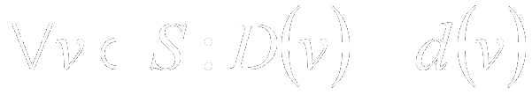
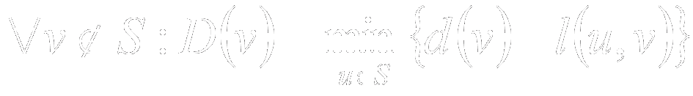
Introduction(6)
For each vertex we have
We have a set such that
and

Slide 10
Introduction(7)
In fact, Dijkstra’s algorithm can be implemented in linear time ⬄ linear time sorting
Since we do not know how to sort in linear time, this implies that we are deviating from Dijkstra’s algorithm in that we do not visit the vertices in order of increasing distance from s
Our algorithm is based on a hierarchical bucketing structure.
→ may visit the vertices in any order

Slide 11
Outline
Introduction
Preliminary
Avoiding the Sorting Bottleneck
The Component Hierarchy
Visiting Minimal Vertices
Towards Linear Time
The Component Tree

Slide 12
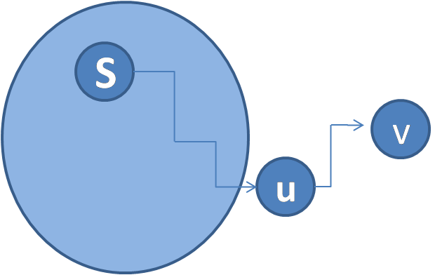
Preliminary(1)
Lemma 1.
If v ∈ V\S minimize D(v) , D(v) = d(v)
Proof: D(v) ≥ d(v) ≥ d(u) = D(u) ≥ D(v)
Lemma 2.
  min D(V\S) = min d(V\S) is non-decreasing

Slide 13
Preliminary(2)
Notation:
  x >> i : x / 2^{i}
    If x ≦ y => x >> i ≦ y >> i
  If W ⊆ V , min D(W) >> i : (min{ D(w) | w ∈ W }) >> i

Slide 14
Preliminary(3)
Bucket
which elements can be inserted and deleted, and from which we can pick out an unspecified element.
each operation should be supported in O(1).

Slide 15
Outline
Introduction
Preliminary
Avoiding the Sorting Bottleneck
The Component Hierarchy
Visiting Minimal Vertices
Towards Linear Time
The Component Tree

Slide 16
Avoiding the Sorting Bottleneck(1)
Dijkstra’s algorithm
  visit the vertices in order of increasing D(v)
  Sorting bottleneck
New approach
  visit the vertices where D(v) = d(v)
  , but possibly D(v) > min D(V\S)
  Using bucket to maintain

Slide 17
Avoiding the Sorting Bottleneck(2)
Lemma 3.
Suppose the vertex set V divides into disjoint subsets V₁, … , V_{k} and all edges between the subsets have length at least δ.
Further suppose for some i, v ∈ V_{i}\S that D(v)=min D(V_{i}\S) ≦min D(V\S)+δ.
Then d(v)=D(v).

Slide 18
Avoiding the Sorting Bottleneck(3)
1
For some i, v ∈ V_{i}\S,
D(v) = min D(V_{i}\S)
≦ min D(V\S) + δ
i=3, δ =1
Then, d(v) = D(v)
0
1
4
4
4
1
2
7
∞
∞
4
1
1
∞
3
δ
7
∞
∞
4
1
V1
V2
V3

Slide 19
Avoiding the Sorting Bottleneck(4)
Criteria on D(v) = d(v):
D(v) = min D(V_{i}\S) ≦ min D(V\S) + δ
min D(V_{i}\S) ≦ min D(V\S) + 2^{α}
min D(V_{i}\S) >> α ≦ min D(V\S) >> α

Slide 20
Avoiding the Sorting Bottleneck(5)
Bucket number: ∆+2 【Δ = Σe l(e) >> α】
bucket each i ∈ {1, . . . , k} according to min D(Vi\S) >> α.
i belongs in bucket B(min D(Vi\S) >> α)
Index: min D(Vi\S) >> α
Content: i : 1,2,…,k
Ix: smallest index of a nonempty bucket
j
i
…
content
…
0
1
2
3
4
∞
index
ix
Δ+ 2

Slide 21
Avoiding the Sorting Bottleneck(6)
suppose ix is maintained as the smallest index of a nonempty bucket
If i ∈ B(ix) and v ∈ Vi\S minimizes D(v),
then D(v) = min D(Vi\S) ≦min D(V\S) +δ ,
so D(v) = d(v) by Lemma 3,
and hence v can be visited
j
i
…
content
…
0
1
2
3
4
∞
index
ix
Δ+ 2

Slide 22
Avoiding the Sorting Bottleneck(7)
1
0
1
δ = 2⁰ , α = 0
4
4
4
B(min D(Vi\S) >> α) = i
1
2
7
∞
∞
4
min D(V\S) = min d(V\S) is nondecreasing
1
1
∞
ix
3
δ
7
∞
∞
5
3
…
2
3
1
…
4
1
0
1
…
4
5
6
7
…
∞
…
V1
V2
V3

Slide 23
Outline
Introduction
Preliminary
Avoiding the Sorting Bottleneck
The Component Hierarchy
Visiting Minimal Vertices
Towards Linear Time
The Component Tree

Slide 24
Component Hierarchy(1)
  Introduction
  G_{i}：the subgraph of G with l(e) < 2^{i}
  [v]_{i}：the connected component on level i containing v
  children of [v]_{i}：[w]_{i-1}, w ∈ [v]_{i}
1
4
4
1
2
[v]₁
7
v
4
1
1
w
[w]₁
3
[v]₂
1
v
4
G₀
G₁
G₃=G
G₂

Slide 25
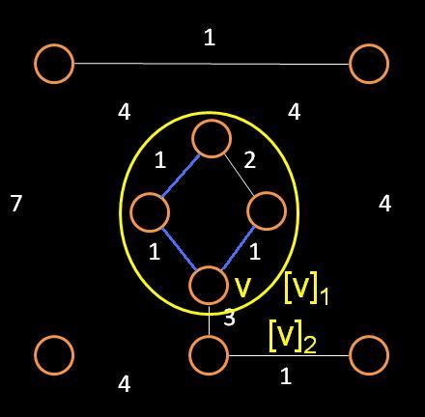
Component Hierarchy(2)
Introduction
  [v]_{i} is a min-child of [v]_{i+1}
  if min D([v]_{i}⁻) >> i = min D([v]_{i+1}⁻) >> i
  [v]_{i} is minimal if [v]_{j} is a min-child of [v]_{j+1} for j = i, …, b-1

Slide 26
Component Hierarchy(3)
Dijkstra’s algorithm
  visit v, if v ∈ V\S minimizes D(v)
For all i , min D([v]_{i}⁻) >> i = min D([v]_{i+1}⁻) >> i = D(v) >> i
→ [v]₀ minimal
  min D(v) = d(v) → [v]₀ minimal
  D(v) = d(v) ← [v]₀ minimal

Slide 27
Component Hierarchy(4)
Lemma 5.
If v ∉ S ,[v]_{i} is minimal, and i ≤ j ≤ w,
min D([v]_{i}⁻) >> j-1 = min D([v]_{j}⁻) >> j-1 .
if j = i → trivial
if j > i, min D([v]_{i}⁻) >> j - 1 = min D([v]_{j-1}⁻) >> j - 1
= min D([v]_{j}⁻) >> j - 1 .

Slide 28
Component Hierarchy(5)
Lemma 8.
If v ∉ S and [v]_{i} is minimal, min D([v]_{i}⁻) = min d([v]_{i}⁻). In particular, D(v) = d(v) if [v]₀ = {v} is minimal.
  Lemma 6.
  Suppose v ∉ S and there is a shortest path to v where the first vertex u outside S is in [v]_{i} .
  Then d(v) ≥ min D([v]_{i}⁻) .
  Lemma 7.
  Suppose v ∉ S and [v]_{i+1} is minimal. If there is no shortest path to v where the first vertex outside S is in [v]_{i} . Then d(v) >> i > min D([v]_{i+1}⁻) >> i .

Slide 29
Component Hierarchy(6)
  Lemma 6.
  Suppose v ∉ S and there is a shortest path to v where the first vertex u outside S is in [v]_{i} .
  Then d(v) ≥ min D([v]_{i}⁻) .
  u is th first vertex outside S → D(u) ≤ d(v)
  u ∈ [v]_{i}⁻ → d(v) ≥ D(u) ≥ min D([v]_{i}⁻)

Slide 30
Component Hierarchy(7)
  Lemma 7.
  Suppose v ∉ S and [v]_{i+1} is minimal. If there is no shortest path to v where the first vertex outside S is in [v]_{i} . Then d(v) >> i > min D([v]_{i+1}⁻) >> i .
  If u ∉ [v]_{i+1}, d(v) >> i + 1 > min D([v]_{i+2}⁻) >> i + 1 = min D([v]_{i+1}⁻) >> i+1 (induction)
  → d(v) >> i > min D([v]_{i+1}⁻) >> i
  If u ∈ [v]_{i+1}, D(u) >> i ≥ min D([v]_{i+1}⁻) >> i
  but u ∉ [v]_{i}, dist(u , v) ≥ 2^{i}.
  d(v) >> i = (D(u)+ dist(u , v)) >> i
  ≥ min D([v]_{i+1}⁻) >> i + 1

Slide 31
Component Hierarchy(8)
Lemma 8.
If v ∉ S and [v]_{i} is minimal, min D([v]_{i}⁻) = min d([v]_{i}⁻).
In particular, D(v) = d(v) if [v]₀ = {v} is minimal.
  D(w) ≥ d(w) for all w → min D([v]_{i}⁻) ≥ min d([v]_{i}⁻)
  v is an arbitrary vertex in [v]_{i},
  show that d(v) ≥ min D([v]_{i}⁻)
  If u ∈ [v]_{i} → Lemma 6
  If u ∉ [v]_{i} → Lemma 7 d(v) ≫ i > min D([v]_{i+1}⁻) ≫ i .
  = min D([v]_{i}⁻) ≫ i

Slide 32
Outline
Introduction
Preliminary
Avoiding the Sorting Bottleneck
The Component Hierarchy
Visiting Minimal Vertices
Towards Linear Time
The Component Tree

Slide 33
Visiting Minimal Vertices (1)
Definition
  visiting a vertex requires that [v]₀ = {v} is minimal
  when v is visited, v is moved to S and relax
Lemma 10.
For all [v]_{i}, max d([v]_{i}\[v]_{i}⁻) >> i-1 ≦ min d([v]_{i}⁻) >> i-1
By lemma 5
D(w) >> i – 1 = min D([w]₀⁻) >> i – 1 = min D([w]_{i}⁻) >> i – 1
By lemma 8
D(w) = d(w) and min D([w]_{i}⁻) = min d([w]_{i}⁻)
→ d(w) >> i – 1 = min d([v]_{i}⁻) >> i – 1

Slide 34
Visiting Minimal Vertices (2)
Lemma 11.
min D([v]_{i}⁻) >> i = min d([v]_{i}⁻) >> i, visiting w ∈ V\S changes min D([v]_{i}⁻) >> i
→ w ∈ [v]_{i}⁻ , and the change in min D([v]_{i}⁻) >> i is increased by one
min D([v]_{i}⁻) = min d([v]_{i}⁻) is nondecreasing

Slide 35
Visiting Minimal Vertices (3)
Lemma 12.
  If [v]_{i} is minimal, it remains minimal until
  min D([v]_{i}⁻) >> i is increased.
  (min d([v]_{i}⁻) >> i is increased)
  min D([v]_{i}⁻) >> i = min D([v]_{i+1}⁻) >> i
  j is the smallest number such that [v]_{j+1} is minimal (j ≥ i)
  〈e〉^{b} and 〈e〉ª denote the expression e should be evaluated before or after the event of visiting some vertex
  〈min d([v]_{i}⁻) >> j〉ª
  ≥〈min d([v]_{j}⁻) >> j〉ª (j ≥ i)
  >〈min D([v]_{j+1}⁻) >> j〉ª (Lemma 9)
  ≥〈min D([v]_{j+1}⁻) >> j〉^{b} (nondecreasing)
  =〈min D([v]_{i}⁻) >> j〉^{b} ([v]_{i} is minimal)
  =〈min d([v]_{i}⁻) >> j〉^{b} ([v]_{i} is minimal)

Slide 36
Visiting Minimal Vertices (4)
Lemma 13.
  If [v]_{i} has once been minimal, in all future,
  min D([v]_{i}⁻) >> i = min d([v]_{i}⁻) >> i.
  First time [v]_{i} turns minimal (by lemma 8)
  Visiting some vertex w
    [v]_{i} is minimal (by lemma 8)
    [v]_{i} is nonminimal (lemma 11, 12, D(v) ≥ d(v))
    [v]_{i}⁻ is emptied (both D and d -> ∞)

Slide 37

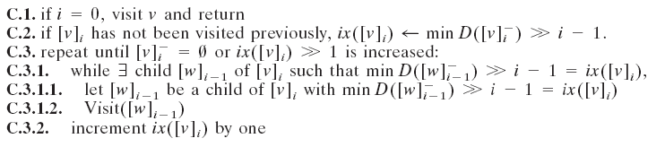
Visiting Minimal Vertices (5)
A recursive call for Visit([v]_{i}) where [v]_{i} is minimal

Slide 38
Visiting Minimal Vertices (6)
Visit([g]₃)
min D([h]₂⁻) >> 2
= min D([g]₃⁻) >> 2
Visit([h]₂)
min D([h]₁⁻) >> 1
= min D([h]₂⁻) >> 1
Visit([h]₁)
min D([h]₀⁻) >> 0
= min D([h]₁⁻) >> 0
Visit([h]₀)
7
1
∞
a
b
4
∞
4
c
1
2
∞
∞
7
d
e
4
1
∞
1
f
2
0
g
h
i
s
4
4
1
∞

Slide 39
Outline
Introduction
Preliminary
Avoiding the Sorting Bottleneck
The Component Hierarchy
Visiting Minimal Vertices
Towards Linear Time
The Component Tree

Slide 40
Towards Linear Time (1)
Component Tree
→ Number of nodes ≤ 2n-1
1
a
b
l(e) < 2³
4
4
c
1
2
l(e) < 2²
7
d
e
4
1
1
l(e) < 2¹
f
2
c
d
e
f
h
i
a
b
g
g
h
i
4
1

Slide 41
Towards Linear Time (2)
Linear-Sized Bucket Structure
for all children [w]_{h} of [v]_{i},
bucket [w]_{h} in B([v]_{i}, min D([w]_{h}⁻) >> i - 1)
ix₀([v]_{i}) = min D([v]_{i}) >> i – 1 = min d([v]_{i}) >> i – 1
ix∞([v]_{i}) = ix₀([v]_{i}) + ∆([v]_{i})
≥ max d([v]_{i}) >> i – 1
[v]_{i}
ix([v]_{i})
=min D([v]_{i}) >> i -1
∑ l(e)/ 2^{i-1}
 |  |  |  |  | …
ix₀ |  |  |  |  | … | ix∞
content
index

Slide 42
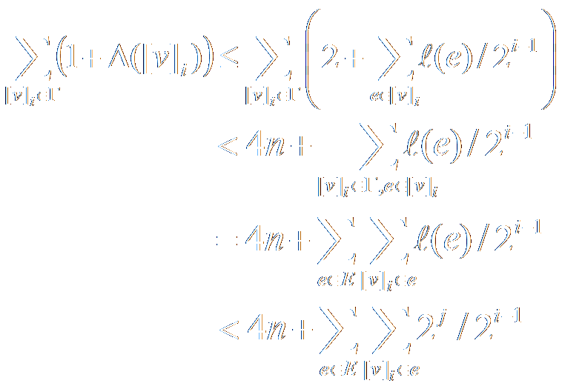
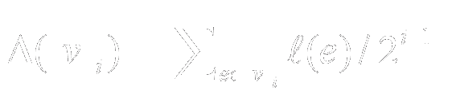
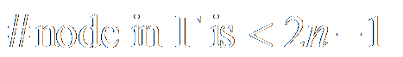
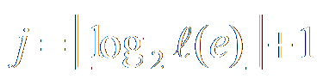
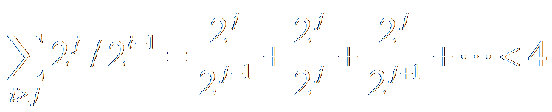
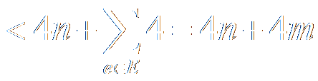
Towards Linear Time (3)
Lemma 18.
The total number of relevant bucket is < 4m + 4n

Slide 43

Towards Linear Time (4)

Slide 44
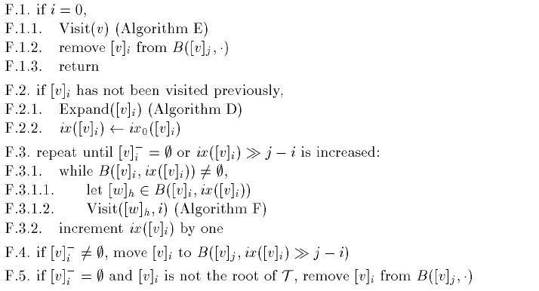
Towards Linear Time (4)
Visit([v]_{i}, j)

Slide 45
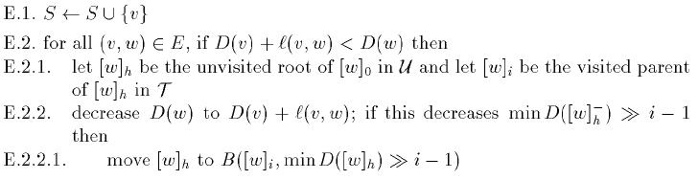
Towards Linear Time (4)
Visit([v]_{i}, j)
Visit(v)

Slide 46
Towards Linear Time (4)
Visit([v]_{i}, j)

Slide 47
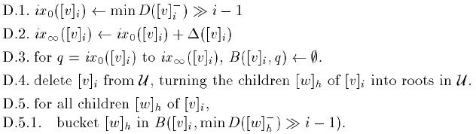
Towards Linear Time (4)
Expand([v]_{i})
[v]_{i}
 |  |  | …
Ix₀ |  |  | … |  |  | ix∞
Min D([v]_{i}) >> i - 1
ix₀([v]_{i}) + ∆([v]_{i})

Slide 48
Towards Linear Time (4)
Visit([v]_{i}, j)

Slide 49
Towards Linear Time (4)
∞
7
Source: g
S ← {g}
Visit([g]₃)
1
a
b
4
∞
4
c
1
2
7
d
∞
e
∞
4
1
1
f
∞
3
g
h
i
g
4
1
c
d
e
f
h
i
a
b
0
4
∞
[g]₃
 |  |  | …
Ix₀ 4 >> 2 = 1 |  |  | … |  |  | ix∞ 1 + 8 = 9
∆([g]₃) = 33 >> 2 = 8

Slide 50
Towards Linear Time (4)
∞
7
Source: g
S ← {g}
Visit([g]₃)
1
a
b
4
∞
4
c
1
2
7
d
∞
e
∞
4
1
1
f
∞
3
g
h
i
g
4
1
c
d
e
f
h
i
a
b
0
4
∞
[g]₃
Ф | Ф | Ф | … | Ф | Ф | Ф
Ix₀ 4 >> 2 = 1 |  |  | ... |  |  | ix∞ 1 + 8 = 9
∆([g]₃) = 33 >> 2 = 8

Slide 51
Towards Linear Time (4)
∞
7
1
a
b
[c]₂
4
∞
4
c
1
2
[a]₁
7
∞
∞
d
e
4
1
1
f
∞
[g]₀
3
c
d
e
f
h
i
a
b
g
g
h
i
4
1
0
4
∞
Ф
 | Ф | Ф | … | Ф | Ф | Ф
Ix₀ 4 >> 2 = 1 |  |  | ... |  |  | ix∞ 1 + 8 = 9
[a]₁
[g]₃
[c]₂

Slide 52
Towards Linear Time (4)
ix([g]₃) ← 1
Visit([a]₁, 3)
[a]₁
[c]₂
[g]₃
 | Ф | Ф | … | Ф | Ф | Ф
Ix₀ 4 >> 2 = 1 |  |  | ... |  |  | ix∞ 1 + 8 = 9

Slide 53
Towards Linear Time (4)
∞
7
Visit([a]₁, 3)
1
a
b
4
∞
4
c
1
2
7
d
∞
e
∞
4
1
1
f
∞
3
c
d
e
f
h
i
a
b
g
g
h
i
4
1
0
4
∞
 |  |  | …
Ix₀ 7 >> 0 = 7 |  |  | … |  |  | ix∞ 7 + 1 = 8
[a]₁
[a]₀
[b]₀
∆([a]₁) = 1 >> 0 = 1

Slide 54
Towards Linear Time (4)
ix([a]₁) ← 7
Visit([a]₀, 1)
Visit(a)
 |  |  | …
Ix₀ 7 >> 0 = 7 |  |  | … |  |  | ix∞ 7 + 1 = 8
[a]₁
[a]₀
[b]₀
∆([a]₁) = 1 >> 0 = 1

Slide 55
Towards Linear Time (4)
Visit(a)
S ← S U {a} = {g, a}
₈
∞
7
1
a
b
4
₁₁
4
c
∞
1
2
7
d
∞
e
∞
4
1
1
f
∞
3
g
h
i
g
4
1
c
d
e
f
h
i
a
b
0
4
∞
 |  |  | …
Ix₀ 7 >> 0 = 7 |  |  | … |  |  | ix∞ 7 + 1 = 8
[a]₁
[a]₀
[b]₀
∆([a]₁) = 1 >> 0 = 1

Slide 56
Towards Linear Time (4)
ix([a]₁) ← ix([a]₁) + 1 (7 → 8)
ix([a]₁) >> 3 – 1 (1 → 2)
[a]₁ ≠ Ф
Visit([c]₂, 3)
Stop while()!
Ix₀ 7 >> 0 = 7 | ix∞ 7 + 1 = 8
[a]₁
[b]₀
[c]₂
[a]₁
[g]₃
 |  | Ф | … | Ф | Ф | Ф
ix₀ 4 >> 2 = 1 | 2 |  | ... |  |  | ix∞ 1 + 8 = 9

Slide 57
Towards Linear Time (4)
₈
7
Visit([c]₂, 3)
1
a
b
4
₁₁
4
c
1
2
7
d
∞
e
∞
4
1
1
f
∞
3
c
d
e
f
h
i
a
b
g
g
h
i
4
1
∞
0
4
 |  |  | …
ix₀ 4 >> 1 = 2 |  |  | … |  | 5 | ix∞ 2 + 4 = 6
[c]₂
[h]₁
[c]₁
∆([c]₂) = 9 >> 1 = 4

Slide 58
Towards Linear Time (4)
ix([c]₂) ← 2
Visit([h]₁, 2)
 | Ф | Ф | … | Ф |  | Ф
ix₀ 4 >> 1 = 2 |  |  | … |  | 5 | ix∞ 2 + 4 = 6
[c]₂
[h]₁
[c]₁

Slide 59
Towards Linear Time (4)
₈
7
Visit([h]₁, 2)
1
a
b
4
₁₁
4
c
1
2
7
d
∞
e
∞
4
1
1
f
∞
3
c
d
e
f
h
i
a
b
g
g
h
i
4
1
∞
0
4
 |  |  | …
ix₀ 4 >> 0 = 4 |  |  | … |  |  | ix∞ 4 + 1 = 5
[h]₁
[h]₀
[i]₀
∆([c]₂) = 1 >> 0 = 1

Slide 60
Towards Linear Time (4)
ix([h]₁) ← 4
Visit([h]₀, 1)
Visit(h)
ix₀ 4 >> 0 = 4 | ix∞ 4 + 1 = 5
[h]₁
[h]₀
[i]₀

Slide 61
Towards Linear Time (4)
Visit(h)
S ← S U {h} = {g, a, h}
₈
7
1
a
b
4
₁₁
4
c
1
2
7
d
∞
e
∞
4
[c]₁
1
1
∞
f
₇
3
g
h
i
1
∞
c
d
e
f
h
i
a
b
g
4
₅
0
4
 |  | Ф |  | Ф
ix₀ 4 >> 1 = 2 | 3 | 4 | 5 | ix∞ 2 + 4 = 6
ix₀ 4 >> 0 = 4 | ix∞ 4 + 1 = 5
[c]₂
[c]₁
[h]₁
[h]₀
[i]₀

Slide 62
Towards Linear Time (4)
ix([h]₁) ← ix([h]₁) + 1 (4 → 5)
Ix([h]₁) >> 2 – 1 (2 → 2)
Visit([i]₀, 1)
Visit(i)
ix₀ 4 >> 0 = 4 | ix∞ 4 + 1 = 5
[h]₁
[i]₀

Slide 63
Towards Linear Time (4)
Visit(i)
S ← S U {i} = {g, a, h, i}
₈
7
1
a
b
4
₁₁
4
c
1
2
7
d
∞
e
∞
4
1
1
f
₇
3
g
h
i
c
d
e
f
h
i
a
b
g
4
1
₅
0
4
ix₀ 4 >> 0 = 4 | ix∞ 4 + 1 = 5
[h]₁
[i]₀

Slide 64
Towards Linear Time (4)
[h]₁⁻ = Ф, [h]₁ is not the root of T
ix([c]₂) ← ix([c]₂) + 1 (2 → 3)
Ix([c]₂) >> 3 – 2 (1 → 1)
Visit([c]₁, 2)
 |  | Ф | Ф | Ф
ix₀ 4 >> 1 = 2 | 3 | 4 | 5 | ix∞ 2 + 4 = 6
[c]₂
[h]₁
[c]₁

Slide 65
Towards Linear Time (4)
Visit([c]₁, 2)
₈
7
1
a
b
4
₁₁
4
c
1
2
7
d
∞
e
∞
4
1
1
f
₇
3
c
d
e
f
h
i
a
b
g
g
h
i
4
1
₅
0
4
[f]₀
 |  |  | …
ix₀ 7 >> 0 = 7 |  |  | … |  |  | ix∞ 7 + 3 = 10
[c]₁
[e]₀
[d]₀
[c]₀
∆([c]₁) = 3 >> 0 = 3

Slide 66
Towards Linear Time (4)
ix([c]₁) ← 7
Visit([f]₀, 1)
Visit(f)
[f]₀
 |  |  | …
ix₀ 7 >> 0 = 7 |  |  | … |  |  | ix∞ 7 + 3 = 10
[c]₁
[e]₀
[d]₀
[c]₀

Slide 67
Towards Linear Time (4)
Visit(f)
S ← S U {f} = {g, a, h, i, f}
₈
7
1
a
b
4
₁₁
4
c
1
2
7
∞
∞
d
₈
e
₈
4
1
1
f
₇
3
g
h
i
4
1
₅
c
d
e
f
h
i
a
b
g
0
4
ix₀ 7 >> 0 = 7 | 8 | 9 | ix∞ 7 + 3 = 10
[c]₁
[f]₀
[e]₀
[d]₀
[c]₀

Slide 68
Towards Linear Time (4)
ix([c]₁) ← ix([c]₁) + 1 (7 → 8)
Ix([c]₁) >> 2 – 1 (3 → 4)
[c]₁⁻ ≠ Ф
ix([c]₂) ← ix([c]₂) + 1 (3 → 4)
Ix([c]₂) >> 3 – 2 (1 → 2)
[c]₂⁻ ≠ Ф
[c]₁
[c]₂
 |  |  | Ф | Ф
ix₀ 4 >> 1 = 2 | 3 | 4 | 5 | ix∞ 2 + 4 = 6
[c]₂
 |  | Ф | … | Ф | Ф
ix₀ 4 >> 2 = 1 | 2 |  | … |  | ix∞ 1 + 8 = 9
[g]₃
[a]₁

Slide 69
Towards Linear Time (4)
Visit([c]₂, 3)
Visit([c]₁, 2)
Visit([e]₀, 1)
Visit(e)
[c]₂
[a]₁
[g]₃
 |  | Ф | … | Ф | Ф
ix₀ 4 >> 2 = 1 | 2 |  | ... |  | ix∞ 1 + 8 = 9
 |  | Ф | Ф | Ф
ix₀ 4 >> 1 = 2 | 3 | 4 | 5 | ix∞ 2 + 4 = 6
[c]₂
[c]₁
ix₀ 7 >> 0 = 7 | 8 | 9 | ix∞ 7 + 3 = 10
[c]₁
[e]₀
[d]₀
[c]₀

Slide 70
Towards Linear Time (4)
Visit(e)
S ← S U {e} = {g, a, h, i, f, e}
₈
7
1
a
b
4
₁₁
4
c
₁₀
1
2
7
d
₈
e
₈
4
1
1
f
₇
3
g
h
i
4
1
₅
c
d
e
f
h
i
a
b
g
0
4
Visit([d]₀, 1)
Visit(d)
ix₀ 7 >> 0 = 7 | 8 | 9 | ix∞ 7 + 3 = 10
[c]₁
[e]₀
[d]₀
[c]₀

Slide 71
Towards Linear Time (4)
Visit(d)
S ← S U {d} = {g, a, h, i, f, e, d}
₈
7
1
a
b
4
₉
4
c
₁₀
1
2
7
d
₈
e
₈
4
1
1
f
₇
3
g
h
i
4
1
₅
c
d
e
f
h
i
a
b
g
0
4
ix₀ 7 >> 0 = 7 | 8 | 9 | ix∞ 7 + 3 = 10
[c]₁
[d]₀
[c]₀

Slide 72
Towards Linear Time (4)
ix([c]₁) ← ix([c]₁) + 1 (8 → 9)
Ix([c]₁) >> 2 – 1 (4 → 4)
Visit([c]₀, 1)
Visit(c)
ix₀ 7 >> 0 = 7 | 8 | 9 | ix∞ 7 + 3 = 10
[c]₁
[c]₀

Slide 73
Towards Linear Time (4)
Visit(c)
S ← S U {c}
= {g, a, h, i, f, e, d, c}
₈
7
1
a
b
4
₉
4
c
1
2
7
d
₈
e
₈
4
1
1
f
₇
3
g
h
i
4
1
₅
0
4
c
d
e
f
h
i
a
b
g
ix₀ 7 >> 0 = 7 | 8 | 9 | ix∞ 7 + 3 = 10
[c]₀
[c]₁

Slide 74
Towards Linear Time (4)
 |  | Ф | Ф | Ф
ix₀ 4 >> 1 = 2 | 3 | 4 | 5 | ix∞ 2 + 4 = 6
[c]₂
[c]₁
Visit([a]₁, 3)
Visit([b]₀, 1)
Visit(b)
[c]₂
[a]₁
[g]₃
 |  | Ф | … | Ф | Ф
ix₀ 4 >> 2 = 1 | 2 |  | ... |  | ix∞ 1 + 8 = 9
Ix₀ 7 >> 0 = 7 | ix∞ 7 + 1 = 8
[a]₁
[b]₀

Slide 75
Towards Linear Time (4)
Visit(b)
S ← S U {b}
= {g, a, h, i, f, e, d, c, b}
₈
7
1
a
b
4
₉
4
c
1
2
7
d
₈
e
₈
4
1
1
f
₇
3
g
h
i
4
1
₅
0
4
Ix₀ 7 >> 0 = 7 | ix∞ 7 + 1 = 8
c
d
e
f
h
i
a
b
g
[a]₁
[b]₀

Slide 76
Towards Linear Time (4)
Finish!!!!
[a]₁
[g]₃
 |  | Ф | … | Ф | Ф
ix₀ 4 >> 2 = 1 | 2 |  | ... |  | ix∞ 1 + 8 = 9
₈
7
1
a
b
4
₉
4
c
1
2
7
d
₈
e
₈
4
1
1
f
₇
3
g
h
i
4
1
₅
0
4

Slide 77
Towards Linear Time (5)
Total: O(n + m)
Total: O(n+ m)
Total: O(n)
Total: O(n + m)

Slide 78
Outline
Introduction
Preliminary
Avoiding the Sorting Bottleneck
The Component Hierarchy
Visiting Minimal Vertices
Towards Linear Time
The Component Tree

Slide 79

The Component Tree(1)
Notations:
First step: construct a minimum spanning tree M
  - From the paper of Fredman and Willard [1994]
  - Can be done deterministically in linear time
Ο

Slide 80
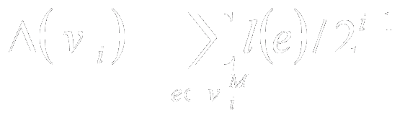
The Component Tree(2)
Redefine Δ as
Note that M has only n-1 edges
Reduce algorithm D、E from Ο(m) to Ο(n)

Slide 81
The Component Tree(3)
We can process a tree in linear time and space
  From the paper of Gabow and Tarjan [1985]
  Support union-find operations at constant cost
Find(v) returns the canonical vertex
Let e₁, …, e_{n-1} be the edges of M sorted according to by packed merging
  From the paper of Alberts and Hagerup 1997; Andersson et al. 1995
↔

Slide 82
The Component Tree(4)
Roughly, Algorithm G is:
Sequentially, for i = 1, … , n-1 ,
call union(e_{i})
If msb(l(e_{i})) < msb(l(e_{i+1})) ,
collect all the new component of S
s(v) = sum of the weight of the edges
X : old canonical elements

Slide 83
The Component Tree(5)
1
a
b
4
4
c
1
2
7
d
e
4
1
1
f
3
g
h
i
4
1
c
d
e
f
h
i
a
b
g

Slide 84
Thanks for your listening! ☺

