Slide 1
Faster Swap Edge Computation in Minimum Diameter Spanning Trees
Beat Gfeller
ESA 2008
Presenters: 陳鵬仁 張凱崴 余相甫 徐國鐘 鄒承孝 沈 定 陳學毅

Slide 2
Outline
Primitive Knowledge!!
Failing on Diameter Edges
Failing on Non-Diameter Edges

Slide 3
Primitive Knowledge!!
Primitive Knowledge!!
余相甫

Slide 4
MDST
Given a simple graph
Spanning Tree T
  Communication between nodes
  Why trees?
MDST
  Minimum Diameter Spanning Tree
  Minimize the maximum travel time

Slide 5
事事難料 Edge會掉
Edge e fails
  => 2 disconnect components
Entire repair
  Find a new MDST on
  May change many edges
Ad hoc repair
  Construct only one new edge to connect
  Swap Edge
e
f

Slide 6
Best Swap
Edge e fails
  Many edges can connect 2 disconnect parts
Best swap edge f
  Resulting tree with minimum diameter
ABS
  All Best Swap
  Find

Slide 7
Terminology
  2-edge connected simple graph
  : a spanning tree
Edge weight
  l(e) : nonnegative
  d(x,y) : distance between x and y on the tree T
Path

Slide 8
Terminology (Cont.)
Diameter
  : diameter of tree T
Subtree on T rooted at s
  : parent of x
  : subtree rooted at x
  : child of x

Slide 9
Terminology (Cont.)
Fail edge
  Denote by
Swap edge
  Denote by
  Connect two disjoint parts
  : all swap edges for e

Slide 10
Terminology (Cont.)
  A spanning tree of
  : longest path contains f in
  : longest path in
Best swap edge f
  With respect to diameter
  Minimize

Slide 11
Terminology (Cont.)
L(T,r)
  Length of longest path starts from r
nc(v)
  the node on D(T) closest to v
  Could be v itself
nca(a,b)
  Nearest common ancestor of a and b

Slide 12
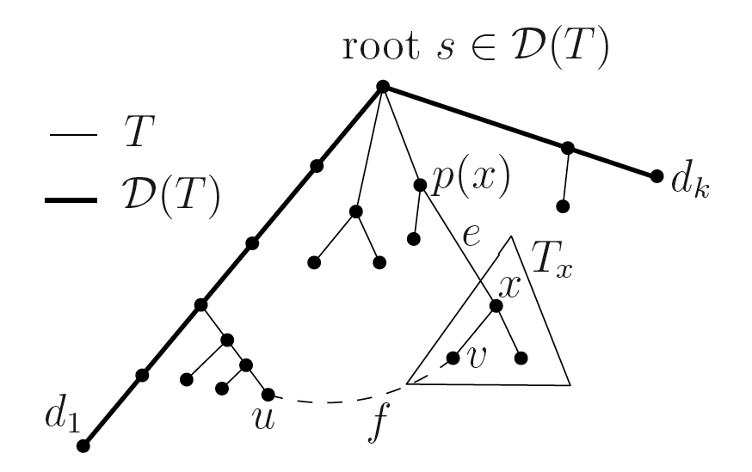
Terminology (conclude)

Slide 13
Formal Problem Definition:
What we are given :
  G : two edge connected simple graph
  T : a MDST of G
  D(T) : a diameter of T
Objective:
  Find best swap edge

Slide 14
ABS: Previous Results
Hassin, et al. (1997) find MDST in
Nardelli, et al. (2001)
  Best swap tree diameter <= 5/2 diameter of entirely adjust tree
Ito, et al. (2005)
  Time:
  Space:

Slide 15
Main Result
Solving ABS
  Time :
  Space:
Compare to Ito, et al.
  Better when m is smaller

Slide 16
Main Idea
Find candidate , and evaluate
  Quality of a swap edge f
    Present by me
  Case1:
    Diameter edges
  Case2:
    Non-diameter edges

Slide 17
Quality of Swap Edge
Calculate efficiently
Calculate efficiently
Calculate L(T, r) efficiently
Calculate efficiently

Slide 18
Lemma 1
Proof:
  If does not contains f , D(T) is a diameter of T
We will focus on from now
  Consider paths contain f only

Slide 19
e
contains three parts
  : f itself
  : a longest path start from u
  : a longest path start from v
Calculate
v
u
f

Slide 20
Lemma 2
Let be a diameter of T
Proof:
  We’ve already proved in exam !
Calculate
  Recall that

Slide 21
on a Tree
We need to calculate
Floyd-Warshall Algorithm
  preprocess time
  space
  query time

Slide 22
on a Tree (Cont.)
We need to calculate
Linear approach
  O(n) preprocess time
  O(n) space
  O(1) query time

Slide 23
d(a,b) on a Tree (Cont.)
Root T at any node s
A labeling of nodes allows nca(a,b)
  Preprocess within O(n) time and space
  Answer any query within O(1)
  Implement by RMQ
A labeling depth(x)
  depth(x) = d(s, x)
  Implement by preorder traverse

Slide 24
d(a,b) on a Tree (Cont.)
Let x = nca(a,b)
d(a,b)
  From a to the nearest ancestor x
  From x to b
d(a,b) = d(a,x) + d(b,x)
  depth(a) + depth(b) – 2*depth (x)
  O(1) query time
s
x
a
b

Slide 25
Main Idea
Find candidate , and evaluate
  Quality of a swap edge f
    Calculate efficiently
  Case1:
  Case2:

Slide 26
Failing on Diameter Edges
陳鵬仁
張凱崴

Slide 27
Failing on Diameter Edges
nc(r)
d_{S}
d_{E}
r
We can solve this case in
  Time complexity O(m log n)
  Space complexity O(m)
How to find the longest path starting from r?
Define nc(r) is the nearest node to r on diameter D(T)

Slide 28
Lemma 3
Given a tree T = (V, E_{T}), diameter D(T) with endpoints d_{S}, d_{E}, a failing edge e on D(T). For any node r, one of the longest path in T-e starting from r contains nc(r).
In other word, we must touch diameter before we arrive the furthest node.

Slide 29
e
nc(r)
d_{E}
d_{S}
r

Slide 30
e
d_{S}
nc(r)
d_{E}
r

Slide 31
Prof. of Lemma 3
d_{S}
e
D(T)
nc(r)
x
r
z
By contradiction

Slide 32
Prof. of Lemma 3
d_{S}
e
nc(r)
x
r
z
By contradiction

Slide 33
How far can d_{S}/d_{E} reach?
Definition:
  μ_{S}(d_{i}, d_{i+1})
    the longest path in T starting from d_{S} without using edge (d_{i},d_{i+1})
  μ_{E}(d_{i}, d_{i+1})
    the longest path in T starting from d_{E} without using edge (d_{i}, d_{i+1})

Slide 34
How far can d_{S}/d_{E} reach?(cont.)
d₁
d₃
d₅
d₇ = d_{E}
d₂
e
d₄
d₆
nc(r)
d_{S}=d₀
r
  μ_{S}(d₀, d₁) = μ_{E}(d_{k-1}, d_{k}) = 0
  μ_{S}(e) = μ_{S}(d₃, d₃₊₁) = 6

Slide 35
How far can d_{S}/d_{E} reach?(cont.)
d₁
d₂
d₃
d₄
d₅
d₇ = d_{E}
e
d₆
d_{S}=d₀
nc(r)
h(d₃)
r
  Claim that we can calculate μ_{S}, μ_{E} recursively in O(n)
  Define h(d_{i}): the length of a longest path starting in d_{i}, and not using any edges on the diameter D(T)
  h(d_{i}) for all d_{i} can be calculated in O(n) by doing DFS from an ambiguous root r on D(T)
Notes:
35

Slide 36
How far can d_{S}/d_{E} reach?(cont.)
d_{i-1}
d_{i}
d_{i+1}
e
d_{S}=d₀
μ_{s}(d_{i-1}, d_{i}),
h(d_{i})
  We can calculate μ_{S}, μ_{E} recursively in O(n)
    μ_{S}(d₀, d₁) = μ_{E}(d_{k-1}, d_{k}) = 0
    μ_{S}(d_{i}, d_{i+1}) = max{μ_{s}(d_{i-1}, d_{i}), d(d_{S}, d_{i})+h(d_{i})}
    μ_{E}(d_{i}, d_{i+1}) = max{μ_{E}(d_{i+1}, d_{i+2}), d(d_{E}, d_{i+1})+h(d_{i+1})}
  We have all h(d_{i}) in O(n), then all procedure will finished in O(n)
Notes:
36

Slide 37
How far can r reach?
  Lemma 4
    Given a diameter of T , D(T) = d_{S}, d₂, …, d_{E} , a failing edge e = (d_{i}, d_{i+1}). The longest path on T - (d_{i}, d_{i+1}) starting from an ambiguous node r (if r is in the same subtree with d_{S}) is
    d(r, nc(r)) + max{d(nc(r), d_{S}), μ_{S}(d_{i}, d_{i+1}) - d(nc(r), d_{S})}
    or
    d(r, nc(r)) + max{d(nc(r), d_{E}), μ_{E}(d_{i}, d_{i+1}) - d(nc(r), d_{E})}
    , if r is in the same subtree with d_{E}
Notes:
37

Slide 38
d(r, nc(r)) + max{d(nc(r), d_{S}), μ_{S}(d_{i}, d_{i+1}) - d(nc(r), d_{S})}
nc(r)
d_{i+1}
d_{i}
e
d_{S}=d₀
μ_{s}(d_{i-1}, d_{i})
d(r, nc(r))
r

Slide 39
d(r, nc(r)) + max{d(nc(r), d_{S}), μ_{S}(d_{i}, d_{i+1}) - d(nc(r), d_{S})}
nc(r)
d_{i}
d_{S}=d₀
e
d_{i+1}
d(nc(r), d_{S}) > μ_{S}(d_{i}, d_{i+1}) - d(nc(r), d_{S})
μ_{s}(d_{i-1}, d_{i})
nc(r)
d_{i}
d_{i+1}
e
d_{S}=d₀
r
d(r, nc(r))
μ_{s}(d_{i-1}, d_{i})
d(nc(r), d_{S}) > μ_{S}(d_{i}, d_{i+1}) - d(nc(r), d_{S})
r
  By Lemma 3, the longest path from r must reach nc(r) first. We can observe the following two cases.
If the furthest path from r is toward to d_{S} at nc(r)

Slide 40
d(r, nc(r)) + max{d(nc(r), d_{S}), μ_{S}(d_{i}, d_{i+1}) - d(nc(r), d_{S})}
nc(r)
d_{i}
d_{S}=d₀
e
d_{i+1}
d(nc(r), d_{S}) < μ_{S}(d_{i}, d_{i+1}) - d(nc(r), d_{S})
μ_{s}(d_{i-1}, d_{i})
nc(r)
d_{i}
d_{i+1}
e
d_{S}=d₀
r
d(r, nc(r))
μ_{s}(d_{i-1}, d_{i})
r
  By Lemma 3, the longest path from r must reach nc(r) first. We can observe the following two cases.
If the furthest path from r is toward to d_{E} at nc(r)
Notes:
40

Slide 41
Find for all
R96922050 張凱崴

Slide 42
Four Cases of
+
+
+
+

Slide 43
Observations on Different
is independent of

Slide 44
An Intuition of Finding
+
+
+
+

Slide 45
An Intuition of Finding
+
+
+
+
+
+
+
+

Slide 46

Observations on different

Slide 47

The Definition of

Slide 48

Virtual Edge (I)
+
+
+
+

Slide 49
Virtual Edge (II)
+
+
+
+

Slide 50
Construct Virtual Edges

Slide 51

Find Maximal vitual edges of the 4 cases for all in
+
+
+
+

Slide 52
Consider only
1
2
3
4
5
6
7
8
9
Heap ( ) = {1,3,5,9 }
+

Slide 53
Using Heap to Find Maximal
For each
1
2
3
4
5
6
7
8
9
Heap ( ) = { }
+

Slide 54
Using Heap to Find Maximal
For each
1
2
3
4
5
6
7
8
9
Heap ( ) = { 2,6,9 }
+

Slide 55
Using Heap to Find Maximal
For each
1
2
3
4
5
6
7
8
9
Heap ( ) = {2,5,6,9 }
+

Slide 56
Using Heap to Find Maximal
For each
1
2
3
4
5
6
7
8
9
Heap ( ) = {3,5,6,9 }
+

Slide 57

Using Heap to Find Maximal
For each
1
2
3
4
5
6
7
8
9
Heap ( ) = {1,3,5,9 }
+

Slide 58
[Algorithm] Step 1
Construct virtual edges
+
+
+
+

Slide 59
[Algorithm] Step 2
Using 4 heap to find maximal virtual edges of the 4 cases for all in
1
2
3
4
5
6
7
8
9
+
+
+
+

Slide 60
[Algorithm] Step 3
Compare the 4 virtual edge of each
+
+
+
+
+
+
+
+

Slide 61
Failing on non-diameter edges
陳學毅
鄒承孝
沈 定
徐國鐘

Slide 62
Swap Edges for Failing Non-diameter Edges
Choose a vertex r in the diameter of T as root of T.
We first consider the swap edge which is a backedge.
let f = (u, v) be an edge not in tree T s.t. u is a descendant of v in T.
We called such edge f as a backedge.
Hence, f could be the backup edge for each edge on the path from v to u in T.

Slide 63
Backedge f = (u, v)
Let the path in T from v to u is (e₁, … , e_{k})
Assume e_{i} is the failing edge.
The part with v will also contain D(T).
Hence L(T-e_{i},v) = L(T,v).

Slide 64
Midpoint Edge
Midpoint is on the D(T) such that midpoint has equal length to the two endpoint of D(T). (mid point may lie on an edge)
The edge contains midpoint is called midpoint edge. (if there may be more than one midpoint edge, any of them can be chosen)
By Lemma 2, for any vertex v, the longest path start on one side of the midpoint edge and go to the opposite end of the diameter.

Slide 65
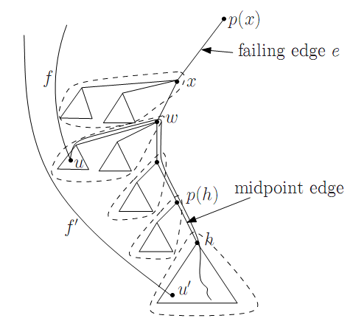
For some failing edge e
Let e = (p(x),x), f = (u,v)
Let (p(h),h) be the midpoint edge in T_{x}
By Lemma 2, all longest path in T_{x} will contains (p(h), h).

Slide 66
Swap edge e by f
In the same part with v, it also contains D(T).
The only path changed in T – e + f are the paths which contain the edge f = (u,v)

Slide 67
Group the Swap Edge Candidate
Group such backedge by their endpoint in T_{x}

Slide 68
Lemma 6
Lemma 6 : In any group, a best swap candidate for failing edge e is a swap edge f = (u,v) s.t.
L(T,v) + l(f) + depth(u) is minimum.

Slide 69
Lemma 6 (continued)
In order to compare the swap candidate between different group, we need to modify the value before to be more precise to the longest path pass (u,v).

Slide 70
Lemma 6 (continued)
Let nca(u,h) = w
L(T,v) + l(f) + (depth(u) – depth(w)) + d(w,v_{deep})
v_{deep} is the endpoint
of D(T_{x}) in T_{h}

Slide 71
Relation between groups
R97922063 鄒承孝

Slide 72
Relation between Groups
Lemma 7. Let e = (x, p(x)) and c ∈ C(x).
If midpoint edge of D(T_{x}) is (c, x) or ∈ T_{c}.
Then, midpoint edge of D(T_{x}) ∈ path from midpoint edge of D(T_{c}) to e.
c
x
Midpoint edge of D(T_{x}) lies on this path
Midpoint edge of D(T_{c})

Slide 73
Proof
Case 1: midpoint edge of D(T_{x}) is (c, x)
  Straightforward.
Case 2: midpoint edge of D(T_{x}) ∈ T_{c}
  (h, p(h)): midpoint edge of D(T_{x})
  T’ and T”: subtrees by deleting (h, p(h)) from T_{c}, where h ∈ T’ and p(h) ∈ T”, respectively.

Slide 74
Proof (concluded)
Case 2: midpoint edge of D(T_{x}) ∈ T_{c}
  Assume otherwise, then midpoint edge of D(T_{c}) ∈ T”.
  By definition, farthest vertex of p(h) in T_{x} ∈ T’.
  Similarly, farthest vertex of p(h) in T_{c} ∈ T”.
  But farthest vertex of p(h) in T_{x} is farthest vertex of p(h) in T_{c} or farthest vertex of p(h) in T_{x} – T_{c}, neither is ∈ T’.
  Contradiction!

Slide 75
Relation between Groups
Midpoint edge moves “upwards”.
So the relation between groups of swap edges can be established.

Slide 76
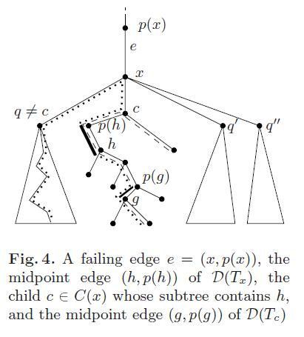
Relation between Groups
(h, p(h)): midpoint edge of D(T_{x})
(g, p(g)): midpoint edge of D(T_{c})

Slide 77
G_{upper}(x, x)
start-at(x): swap edges with lower endpoint = x
end-at(x): swap edges with upper endpoint = x
q ∈ C(x) and q ≠ c
G_{upper}(x, x) = start-at(x) ∪
{∪_{q} GR(q)} \
end-at(x)
p(x)
x
c
…

Slide 78
G_{upper}(x, w)
w ∈ path form p(h) to c
G_{upper}(x, w) = G_{upper}(c, w) \
end-at(x)
Recursive definition.
p(x)
x
c
…
w
…
p(h)

Slide 79
G_{lower}(x)
d ∈ path from p(g) to h
G_{lower}(x) = G_{lower}(c) ∪
{∪_{d} G_{upper}(q)} \
end-at(x)
Recursive definition
p(x)
x
c
…
h
…
p(g)
g
G_{lower}(c)

Slide 80
5.2 Data Structure and Inductive Approach
沈 定

Slide 81
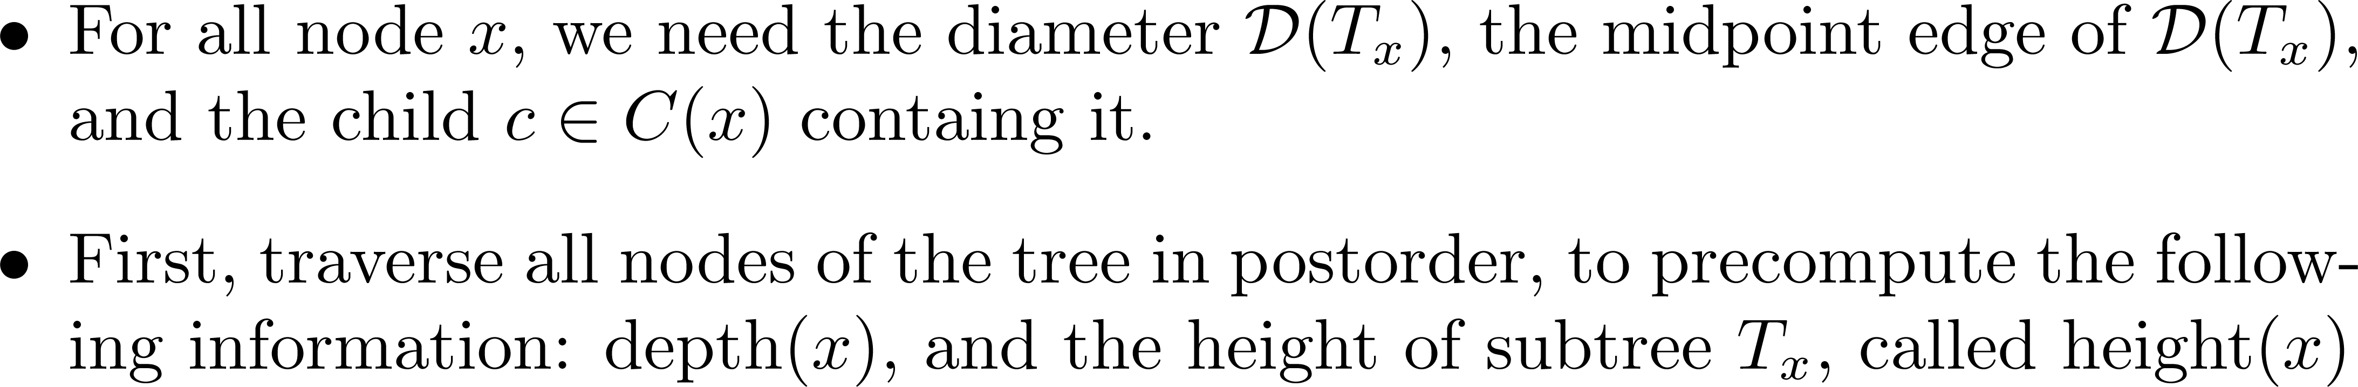
Preprocessing Step

Slide 82
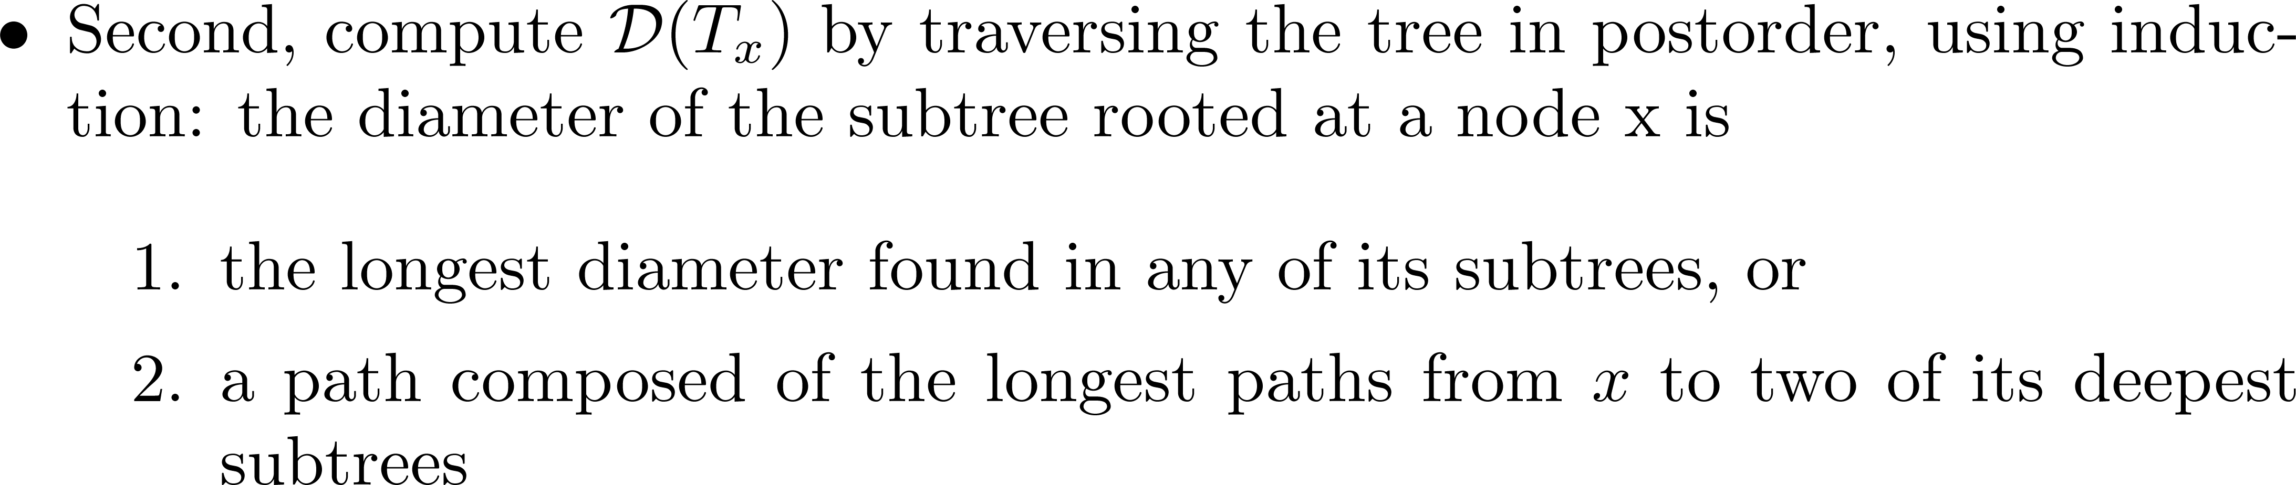
Preprocessing Step

Slide 83
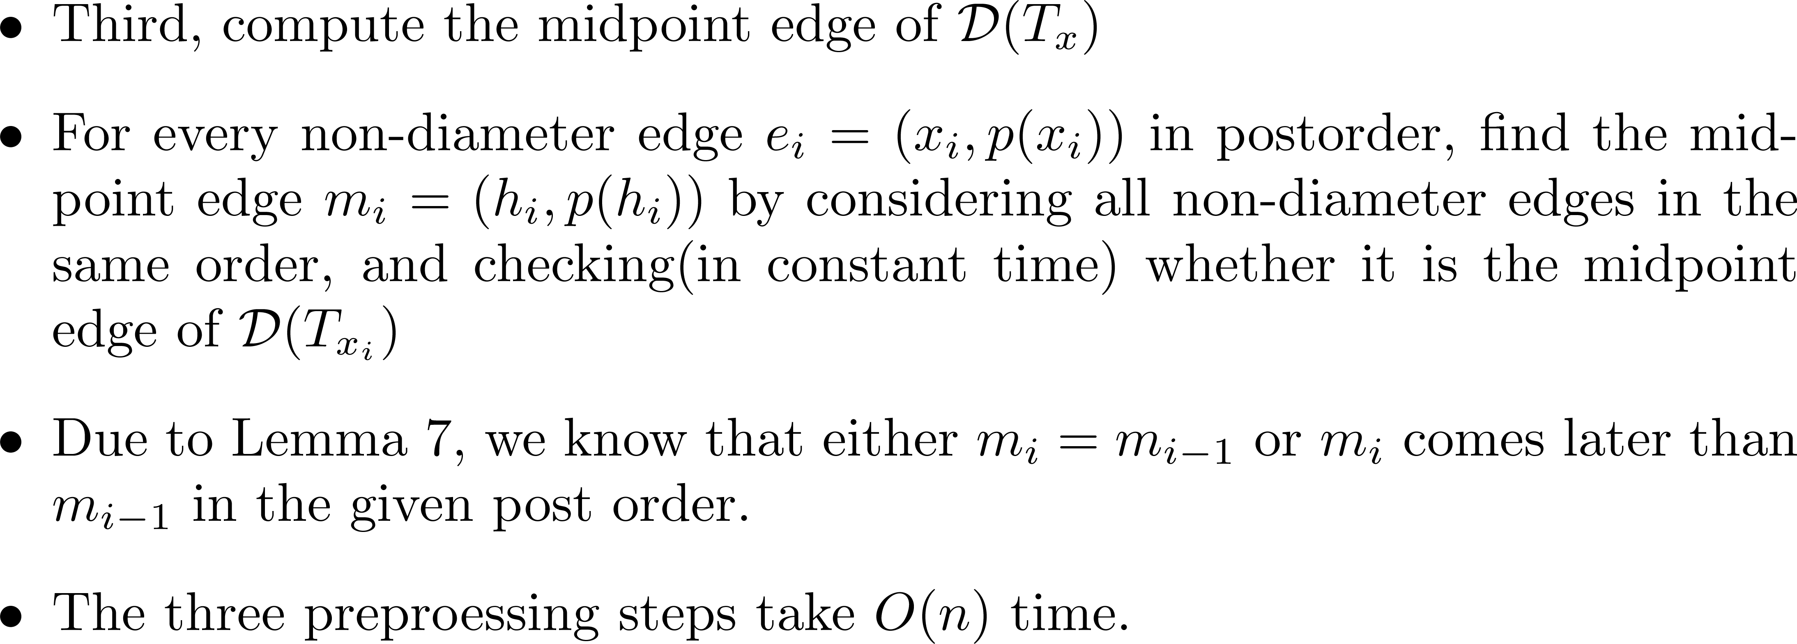
Preprocessing Step

Slide 84
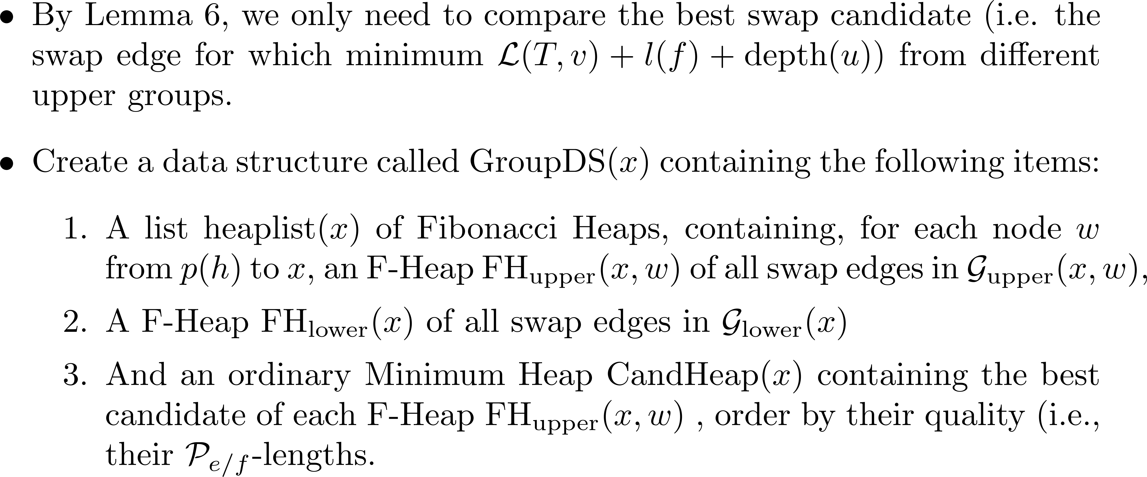
Main Algorithm

Slide 85
Main Algorithm

Slide 86
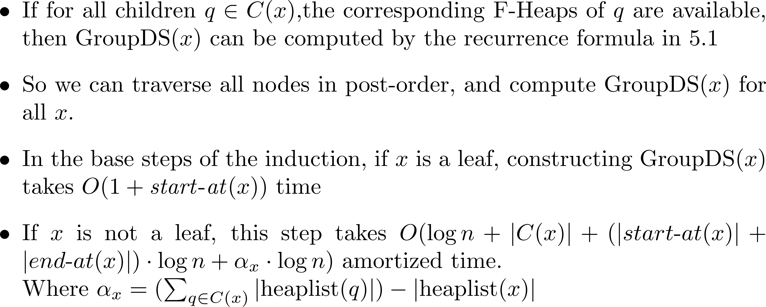
Main Algorithm

Slide 87
Result

Slide 88
Transforming Non-tree Edges to Backedges
徐國鐘

Slide 89
If swap edges ≠ backedges
We now describe to replace any edge f by at most two “virtual” backedges , whose lengths are defined in such a way that the best swap edge computed by our algorithm is correct.

Slide 90
Replacement
Replace f = (u, v) by f₁ := (u, v₁) and f₂ := (v, u₂)
  with lengths
  l(f₁) := l(f) + d(v, v₁)
  l(f₂) := l(f) + d(u, u₂)
If the path from u to v in T uses one or more edges of D(T)
  define v₁ := nc(u) and u₂ := nc(v).
Otherwise
  we define v₁ := nca(u, v) and u₂ := nca(u, v).

Slide 91
Case 1
u₂=nc(v)
D(T)
d_{S}
v₁=nc(u)
d_{E}
v
u
f
f₂
f₁
l(f₁) := l(f) + d(v, v₁)
l(f₂) := l(f) + d(u, u₂)

Slide 92
Case 2
D(T)
d_{S}
d_{E}
f₂
f₁
v
u
f
l(f₁) := l(f) + d(v, v₁)
l(f₂) := l(f) + d(u, u₂)

Slide 93
Reasons
Reason
  f₁ represents f exactly for all failing edges on the path in T from u to v₁, and f₂ represents f exactly for all edges from v to u₂
  for each non-diameter tree edge, one of f₁, f₂ represents f
The lengths of f₁ and f₂ are defined exactly such that for any failing edge e for which f_{i} is a swap edge, it holds |D(T_{e/fi} )| = |D(T_{e/f} )|.

Slide 94
Revealing figure
u₂=nc(v)
D(T)
d_{S}
v₁=nc(u)
d_{E}
e
v
u
f
f₂
f₁

Slide 95
Revealing figure: Case 1_1
l(f₁) := l(f) + d(v, v₁)
D(T)
u₂
D(T)
u₂
d_{S}
d_{S}
v₁
v₁
d_{E}
e
d_{E}
e
v
u
v
u
f
f₁

Slide 96
Revealing figure: Case 1_2
l(f₁) := l(f) + d(v, v₁)
l(f₁) := l(f) + d(v, u₂)-d(u₂,v₁)
e
e
v
u
v
u
f
f₁

Slide 97
Revealing figure: Case 1_3
l(f₁) := l(f) + d(v, v₁)
l(f₁) := l(f) + d(v, u₂)-d(u₂,v₁)
D(T)
u₂
D(T)
u₂
d_{S}
d_{S}
v₁
v₁
d_{E}
d_{E}
e
e
v
u
v
u
f
f₁

Slide 98
Comment
The proof is not closed yet.
Possible solution in the Case 1_3
  |P_{e/f}|<=|D_{T}| may be always true for the case.
  Try to face crossing edges instead of using replacement.
The typo is terrible.

Slide 99
Finis

