Slide 1
Expanders via Random Spanning Trees
R97922031 許榮財
R97922073 黃佳婷
R97922081 黃怡嘉

Slide 2
Outline
Introduction
Preliminaries
Uniform random spanning trees
Expansion when base graph is a complete graph
Expansion when base graph is a bounded-degree graph
Splicers of random graphs

Slide 3
Introduction 1/3
Present a new method for obtaining sparse expanders from spanning trees
Motivated by the problem of routing reliably and scalably in a graph
Recovery from failures if considered one of the most important problems

Slide 4
Introduction 2/3
In practice, efficient routing also needs to be compact and scalable
Memory overhead should be linear or sublinear in the number of vertices
The most commonly used method in practice is shortest path routing
One tree per destination
O(n) bounded on the size of the routing table that needs to be stored at each vertex

Slide 5
Introduction 3/3
Main problem of shortest-path routing: lack of path diversity
Recovery is usually achieved by recomputing shortest path trees in the remaining network
So, we consider a simple extension of tree-based routing – using multiple trees
The union of trees has reliability approaching
It raises the question:
For a given graph, does there exist a small collection of spanning trees such that the reliability of the union approaches that of the base graph?

Slide 6
Preliminaries 1/4
G=(V,E) , an undirected graph
For , , the set of neighbors of v
For ,
and

Slide 7
Preliminaries 2/4
edge expansion of G
vertex expansion of G

Slide 8
Preliminaries 3/4
Example: vertex expansion = 1

Slide 9
Preliminaries 4/4
A family of graphs is an edge expander if the edge expansion of the family is bounded below by a positive constant
K_{n} : the complete graph on n vertices
For ,

Slide 10
Uniform random spanning trees 1/6
The algorithm by Aldous and Broder
Start at any node
1) If all nodes have been visited, halt
2) Choose a neighbor of the current node uniformly at random
3) If the node has never been visited before, add the edge to that node to the spanning tree
4) Make the neighbor the current node and go back to step 1
T_{G} denotes a uniformly random spanning tree
U_{G}^{k} denotes the union of k such trees chosen independently

Slide 11
Uniform random spanning trees 2/6
Negative correlation of edges
An event A ⊆ 2^{E(G)} is upwardly closed if for all B ∈ A and e ∈ E(G), we have B ∪ {e} ∈ A
We say that an event A ignores an edge e if for all B ∈ A we have B ∪ {e} ∈ A and B \ {e} ∈ A

Slide 12
Uniform random spanning trees 3/6
Theorem : Let P be the uniform probability measure on the set of spanning trees extended to all subsets of edges. If A is an upwardly closed event that ignores some edge e, then

Slide 13
Uniform random spanning trees 4/6
Proof:
Let A be the event “e₁, … , e_{k-1} ∈ T_{G} “
By the theorem,
Let B be the event “e₁ ∈ T_{G} ,… , e_{k-1} ∈ T_{G} “
By the theorem,

Slide 14
Uniform random spanning trees 5/6
Negatively correlated random variables and tail bounds
For e ∈ E, deﬁne indicator random variables X_{e} to be 1 if e ∈ T , and 0 otherwise. Then for any subset of edges e₁, . . . , e_{k} ∈ E we have

Slide 15
Uniform random spanning trees 6/6
Let be a family of 0–1 negatively correlated random variables such that are also negatively correlated. Let p_{i} be the probability that X_{i} = 1. Let
Then for λ > 0

Slide 16
Expansion when base graph is a complete graph
R97922073 黃佳婷

Slide 17
Expansion when base graph is a complete graph
Theorem 1.3.
The union of two uniformly random spanning trees of the complete graph on n vertices has constant vertex expansion with probability
1 - o(1).

Slide 18
Expansion when base graph is a complete graph
T1
T2
G = T1∪T2
Г’(A)
+
=
A
The vertex expansion of G is
= 1
with probability 1 - o(1).

Slide 19
Expansion when base graph is a complete graph
K_{n}: complete graph with n vertices
T: a random spanning tree in K_{n}
A:
c: a given expansion constant
We will give an upper bound on the probability that
A’: , |A’| ＝ ca
We will bound the probability that
= c

Slide 20
Expansion when base graph is a complete graph
We will bound the probability that , and use a union bound over all possible choices of A and A’.
t random independent spanning trees (t =2)
the probability ≤

Slide 21
Expansion when base graph is a complete graph
A random walk on V starting outside of A defines a random spanning tree
Let X₁, X₂,… denote the states of this random walk
Let τ_{i} be the first time that the walk has visited i different vertices of A
X₁ | X₂ | X₃ | X₄ | X₅ | X₆ | X₇ | X₈ | X₉ | …
10 | 5 | 4 | 5 | 2 | 4 | 1 | 6 | 2 | …
 | τ₁=1 | τ₂=2 |  | τ₃=4 |  | τ₄=6 | τ₅=7 |  | …

Slide 22
Expansion when base graph is a complete graph
Let Y_{i} = τ_{i+1} – τ_{i} , for i = 1,…, a –1
the gap between first visits i and i+1
Y_{i} are independent
Let Z_{i} = 1, if Y_{i} = 1
Z_{i} = 0, otherwise
For i = 1,…, a –1,
X₁ | X₂ | X₃ | X₄ | X₅ | X₆ | X₇ | X₈ | X₉ | …
10 | 5 | 4 | 5 | 2 | 4 | 1 | 6 | 2 | …
 | τ₁=1 | τ₂=2 |  | τ₃=4 |  | τ₄=6 | τ₅=7 |  | …
 | Z₁=Y₁ =1 | Z₂=0 Y₂=2 |  | Z₃=0Y₃=2 |  | Z₄=Y₄ =1

Slide 23
Expansion when base graph is a complete graph
For i = 2,…, a,
For i = 1,
X₁ | X₂ | X₃ | X₄ | X₅ | X₆ | X₇ | X₈ | X₉ | …
10 | 5 | 4 | 9 | 2 | 4 | 1 | 6 | 2 | …
 | τ₁=1 | τ₂=2 |  | τ₃=4 |  | τ₄=6 | τ₅=7 |  | …
 | Z₁=Y₁ =1 | Z₂=0 Y₂=2 |  | Z₃=0Y₃=2 |  | Z₄=Y₄ =1

Slide 24
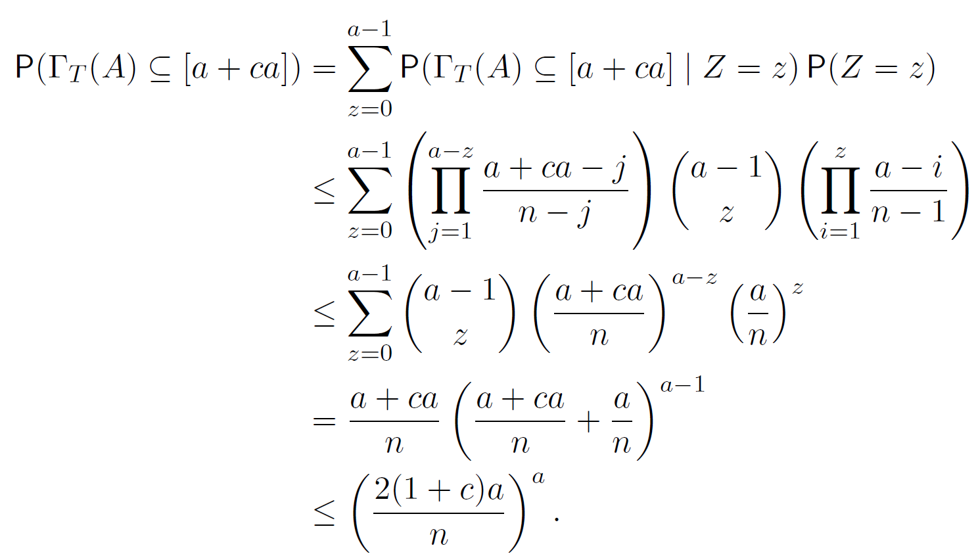
Expansion when base graph is a complete graph
Let

Slide 25
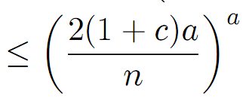
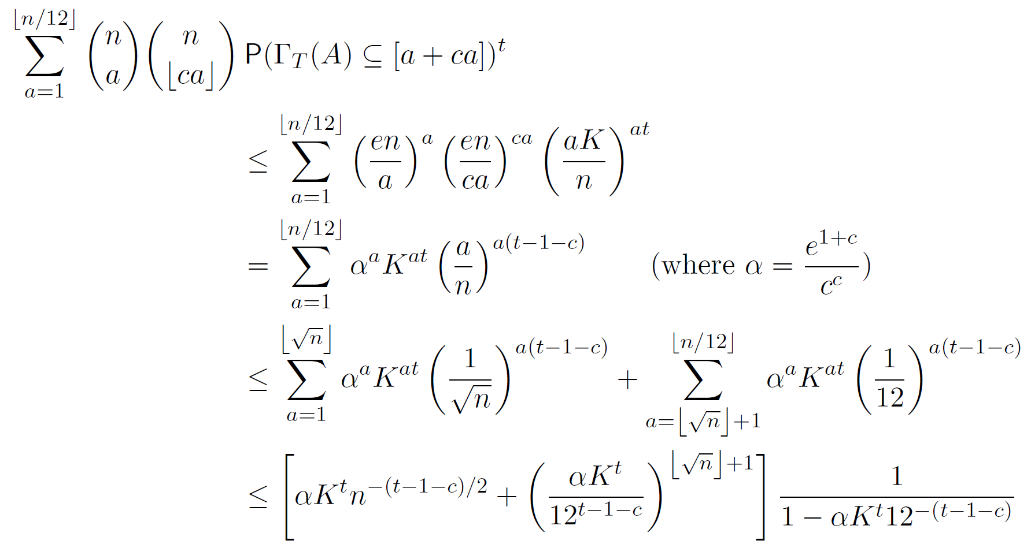
Expansion when base graph is a complete graph
Let K = 2(1+c)

Slide 26
Expansion when base graph is a complete graph
The probability goes to 0, when n→ ∞,
, t = 2, and a sufficiently small constant c

Slide 27
Expansion when base graph is a complete graph
Any fixed edge from K_{n} appears in T with probability
iff no edge between A and
V ＼[a+ca] is present in T
and negative correlation implies that this happens with probability at most

Slide 28
Expansion when base graph is a complete graph
|A|=a
V
|A’|=ca
|Γ’(A)| ≦ ca

Slide 29
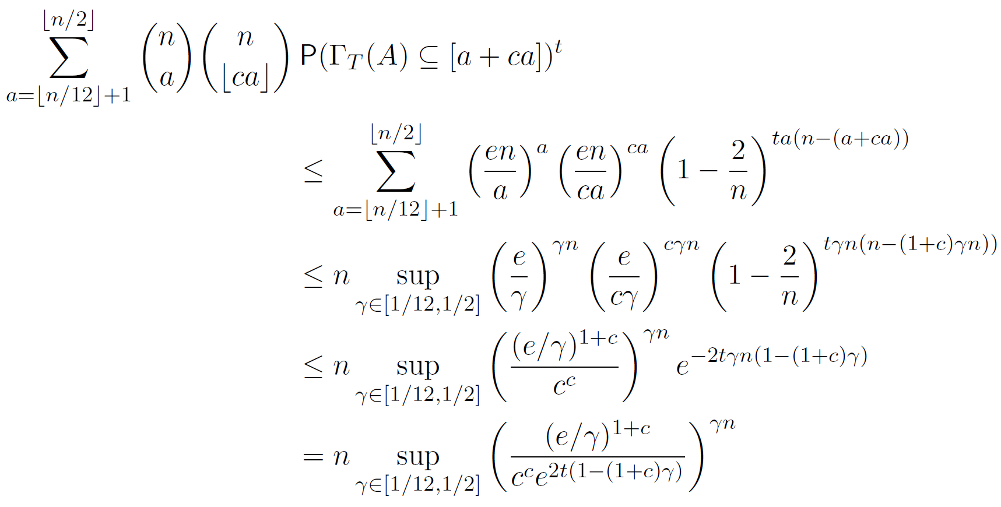
Expansion when base graph is a complete graph

Slide 30
Expansion when base graph is a complete graph
For any c > 0, is convex for >0
The sup is attained at one of the boundary points 1/12 and 1/2
For t = 2 and a sufficiently small constant c, is strictly less than 1 at these boundary points
This implies that this sum goes to 0 as n→ ∞

Slide 31
Expansion when base graph is a bounded-degree graph
R97922031 許榮財

Slide 32
Notation
d : the number of degree
Xe :
the indicator random variable taking value 1 if e belongs T, and value 0 otherwise

Slide 33
Proof of Theorem 1.1

Slide 34
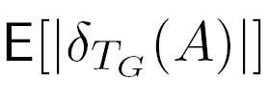
Step 1
The random walk construction of random spanning trees that for any edge(u,v) E.
P[(u,v) T] 1/d(u),and A V.
A
E
Show

Slide 35
Step 1
Using Theorem 3.2
Where p is the average of P[Xe =1] for
. Since P[Xe =1] 1/d for all edges e.
For p 1/d , and

Slide 36
Step 1
We can get
Due to Negatively correlation property

Slide 37
Step 2
Bad cut : a cut A such that and
The number of cuts in the first tree of size a is no more than

Slide 38
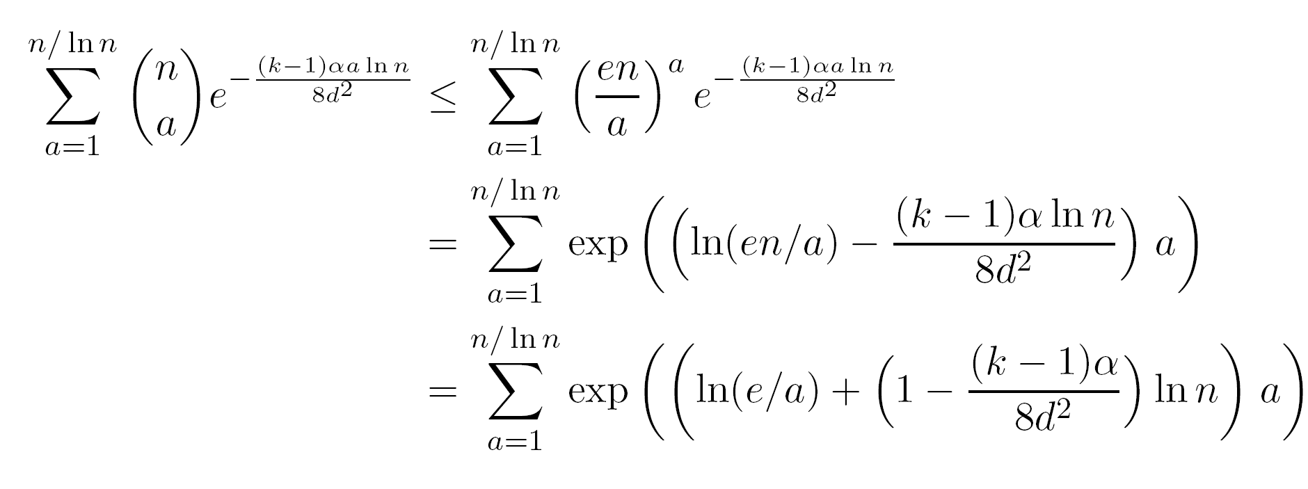
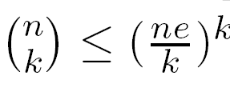
Step 2
The probability that a bad cut is at most
Choosing makes sum o(1).

Slide 39
Step 2

Slide 40
Proof of Theorem 1.2

Slide 41
Step 1
We begin with a d-regular edge expander G’ on n vertices with a Hamiltonian cycle.
And d > 4.
Let

Slide 42
Step 1
Let H be a Hamiltonian path in G’
Subdivide H into subpaths ,….., of length
Interact : for any

Slide 43
Step 1
, and any subpath can interact with at most other subpaths
We can find a set of paths among ,…., .so that no two paths in interact.

Slide 44
Step 1
G : Add edges to G’
If the subgraph doesn’t have a Hamiltonian cycle , then add edges to it so that it becomes Hamiltonian.
Add an edge between the two end-point of ,if such and edge didn’t already exist in G’.
Increase the degree of each vertex at most 2

Slide 45
Step 1
For , event occurs if the random walk , on first visit to
Go around without going out or visiting any vertex twice
Then go on traverse without going out or visiting any vertex twice

Slide 46
Step 1
For all
If event happens then in the resulting tree T , then

Slide 47
Step 2
Mutually independent.
The probability that doesn’t occur for any at most

Slide 48
Step 2
When , the probability is

Slide 49
Step 2
With high probability there is a path
such that
The edge expansion of P is

Slide 50
Splicers of random graphs

Slide 51
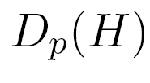
Step1
Given an undirected graph H and . Construct a random directed graph denoted
with vertex set V(H) and independent for every edge (u,v) of H

Slide 52
Notation
Covering walk of a graph : A walk passing through all vertices.
D : the distribution on covering walks of the complete graph starting at a vertex
: the distribution on covering walks of the complete graph given by first choosing H according to and running Process starting from

Slide 53
Notation
T : the uniform distribution on spanning trees of
: the distribution on trees obtained by first choosing H from , then generating a random spanning tree according to Process

Slide 54
Process Bp
Start at a vertex of
At a vertex v, an edge is traversed as follows. Suppose out of outgoing edges at v are previously traversed.
Then , the probability of picking a previously traversed edge is 1 / (n -1)

Slide 55
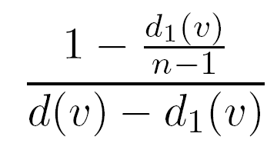
Process Bp
The probability for each new edges is
If all vertices have been visited , output the walk and stop . If has not happened and at current vertex v one has , stop with on output

Slide 56
Lemma 7.1
There exists an absolute constant c such that for p > the total variation distance between the distribution

Slide 57
Lemma 7.2
There exists an absolute constant c such that for p > the total variation distance between the distribution

Slide 58
Theorem 1.4

Slide 59
Proof of Theorem 1.4
In the random graph H , we generate two random trees by using one long sequence of edges.
Using the same coupling as in Lemma 7.2.
these sequences have variation distance

Slide 60
Proof of Theorem 1.4
The spanning trees of H obtained by the first process have total variation distance to random spanning trees of the complete graph
Using Theorem 1.3 , the union of these trees has constant vertex expansion with high probability.

Slide 61
Theorem 1.5

Slide 62
Proof of Theorem 1.5
: the 2-splicer obtained from H via process
For sufficiently large constant C , with high probability , all cuts in random graph H satisfy

Slide 63
Proof of Theorem 1.5
For
a

Slide 64
Proof of Theorem 1.5
Maximum degree of a vertex in a random spanning tree in the complete graph is

Slide 65
Thank you for your attention!

