Slide 1
Distributed Algorithms for Constructing Approximate Minimum Spanning Trees in Wireless Sensor Networks IEEE Transactions on Parallel and Distributed Systems, vol. 20, no. 1, January 2009
林明志、盧曉珍、楊孟翰
簡廷因、陳怡安、孫安承

Slide 2
Agenda
Overview
Algorithm and Analysis
Random-NNT
Coordinate-NNT
UDG-NNT
GHS V.S. NNT
Simulation Results
Dynamic Algorithm for NNT
Concluding Remarks and Future Work

Slide 3
Overview
D97725004 林明志

Slide 4
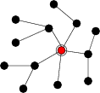
Motivation
The minimum spanning tree (MST) problem is an important and commonly occurring primitive in the design and operation of data and communication networks
Algorithms require large number of messages and time make them impractical for resource-constrained networks such as wireless sensor networks

Slide 5
Introduction
The classical GHS algorithm
Essentially optimal to the message complexity
Θ (n ln n + |E|) messages
Time efficient distributed algorithms
Essentially optimal to the time complexity
O (Diam(G) + n^{1/2}polylog(n)) time
Involve a lot of message transfers

Slide 6
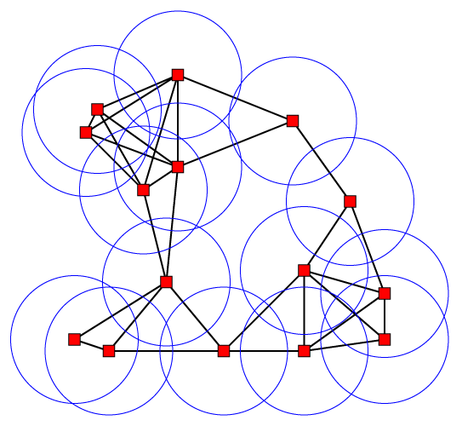
Introduction (cont’d)
Wireless network modeled by a unit disk graph (UDG)
Ω (n ln n) messages
Sensor network
Local and distributed
Energy-constrained
Dynamic (reconfiguration)

Slide 7
Introduction (cont’d)
Develop simple local distributed algorithms which are energy efficient, and preferably also time efficient, even at the cost (quality) of being suboptimal

Slide 8
Introduction (cont’d)
There has been work on local algorithms for construction of low-weight connected subgraphs but little work on localized construction of exact or approximate MSTs
A structure is low-weight if its total edge length is within a small factor of the total edge length of the MST, but the structure may have cycles
Local minimum spanning tree (LMST)
Not a low-weight structure

Slide 9
Nearest Neighbor Tree (NNT)
A fundamental step in MST problem is cycle detection
NNT: Each node chooses a unique rank, a node connects to the nearest node of higher rank
The NNT scheme is closely related to the Nearest Neighbor algorithm
NNT with any ranking of the nodes gives an
O(ln n)-approximate to MST

Slide 10
Definition
Weighted MST problem
Find a tree T spanning N nodes such that is minimized
Radiation energy r^{α}
When α = 1, the traditional MST problem
α is 2 and can range up to 4 in environments

Slide 11
Definition (cont’d)
Cost (quality)
e: an edge of T
Work
r: transmission distance for message i
M: number of messages exchanged by the nodes

Slide 12
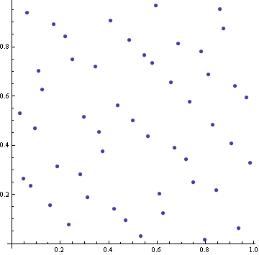
Network model
Wireless network composed of n nodes distributed uniformly at random in a unit square
Local broadcasting,
d(u, v)≦R
Complete graph model
UDG, multihop setting
To have a connected graph, WHP ( )
‧v
R
u

Slide 13
Contributions and Results
Random-NNT
Ranks are chosen randomly
Coordinate-NNT
Ranks are based on coordinates of the nodes
UDG-NNT
Multihop wireless networks modeled by a UDG

Slide 14
Contributions and Results (cont’d)
The tree produced by the NNT has low cost
The NNT can be used to design a simple dynamic algorithm for maintaining a low-cost spanning tree
The time, message, and work complexities of the NNT algorithms are close to the optimal in several settings

Slide 15
Performance of NNT and GHS
Quality bounds
Co-NNT is better than Random-NNT
Message, time, and work complexity
NNT have lower message, time, and work complexity compared to the message-optimal GHS

Slide 16
Performance of NNT and GHS (cont’d)
Simulation results
Work and messages for NNT are significantly smaller than for GHS
Quality of the NNT trees is very close to MST
Maintaining a low-cost tree dynamically
The expected number of rearrangements (nodes whose outgoing edge must change) is O(ln n)

Slide 17
A local distributed algorithm for construction of approximate MST
F95942045 盧曉珍

Slide 18
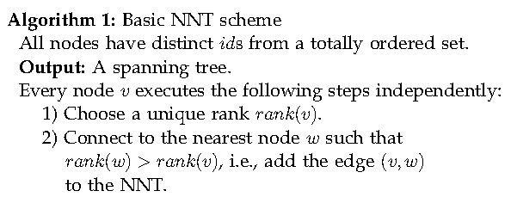
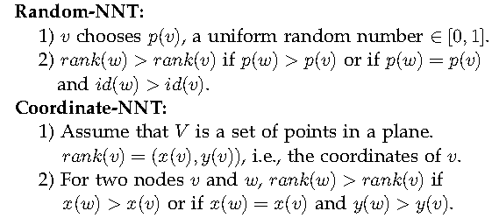
The NNT algorithm
ID and Rank
→simple, local, no cycle, and robust

Slide 19
Lemma 1
NE(v): the size of the neighborhood that node v needs to search to find its connecting edge
proof:
v
U₁
u₂
u_{i}

Slide 20
The NNT Algorithm: Random-NNT
D95922001 楊孟翰

Slide 21
The NNT Algorithm
Three types of messages:
Request
Available
Connect
For all nodes, these phases are synchronized by making all nodes wait for T_{i}, the time required to complete exchanging the message, in phase i

Slide 22
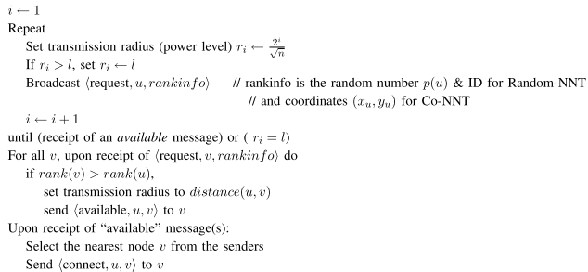
Algorithm 2: Distributed NNT algorithm for wireless networks
The algorithm is executed by each node u independently and simultaneously
Message format <msg name, sender, [recipient], [other info]>

Slide 23
Analysis of the NNT algorithms
The quality of the tree T produced by NNT
The number of messages M
The work complexity
The time complexity of NNT algorithms

Slide 24
Random-NNT
Theorem 2. E[Q_{α}(Random-NNT)]
O(lnn) for α=2
O(n^{1-α/2}) for α<2
O(1) for α>2
r_{i}=2*r_{i-1}
Unit square
u

Slide 25
Proof of Theorem 2
Given one node u, 令符合條件的NN是v, v必定出現在R_{i}的機率 (也就是要到phase i才能找到符合條件的NN v), 對所有i加總, 再對所有u加總

Slide 26
Random-NNT (cont’d)
Theorem 3. The expected work complexity of Random-NNT algorithm E[W]
O(lnn) for α=2
O(n^{1- α/2}) for α<2
O(1) for α>2
A(v, u, i) = the event that v replies to u in phase i
T_{i} = the event that u needs ith transmission (u進入phase i)
v是k^{th} NN

Slide 27
Proof of Theorem 3
v在R_{i}
v是k^{th} NN
構成C_{i-1}
Given one node u, 令傳’available’是v (k^{th} NN of u), v在i^{th} phase傳的機率, 對所有k加總, 考慮radiation energy (r_{i}的α次方)
rank(u)最大
構成C_{i-1}
對所有u加總

Slide 28
Random-NNT (cont’d)
Corollary 4. for i ≧2
The expected number of nodes that needs ith transmission:
The expected number of required transmissions by a node to find a higher ranked node:
對所有nodes加總
對所有phases加總

Slide 29
Random-NNT (cont’d)
Theorem 5. The expected message complexity of Random-NNT algorithm is O(n)
Theorem 3去掉radiation energy (r的α次方)

Slide 30
Random-NNT (cont’d)
Scheduling messages and resolving collisions
K_{i} = number of messages that potentially collide with u’s messages in phase i; k_{i} ≧2
F_{i} = a time frame containing at least k_{i} time slots; each phase i contains O(lnn) such time frames
If a message is in collision, u picks a random slot in the next frame for this message
Probability of a message not colliding = (1-1/k_{i})^{ki-1} ≧ 1/e
The time to complete phase i = T_{i} = O(k_{i}lnn)
所有time slots都不會collide

Slide 31
Random-NNT (cont’d)
Theorem 6. The time complexity of Random-NNT algorithm is O(ln³n) WHP
The total number of messages by nodes within r₁ (phase 1)

Slide 32
Proof of Theorem 6
Let |C_{i}|=y and |C_{i-1}|=x; z=|R_{i}|=y-x
Assume y≧60lnn => E[x]≧y/4≧15lnn

Slide 33
Proof of Theorem 6 (cont’d)
any node在any phase收到O(lnn)messages的機率的期望值

Slide 34
Analysis of Coordinate NNT
D97922019 簡廷因

Slide 35
Analysis of Coordinate NNT
The expected quality
The expected work complexity
The expected message complexity
The time complexity

Slide 36
Proof of Theorem 7
Theorem 7. The expected quality of Co-NNT for and 2 are and , respectively.

Slide 37
Proof of Theorem 7 (cont’d)
We put the cell containing u, then
one cell from above u and one
cell from below u, by interleaving
them.
We put the cells in Column k + 1 in their original order beginning from the bottommost cell to the topmost cells , then the cells in Column k + 2 in the same order, and so on.

Slide 38
Proof of Theorem 7 (cont’d)
Node u connects to a node in the ith next cell, if the next cells are empty and there is a node in the ith next cell.
The probability that the next cells are
empty is
所有其他n-1個點都在這
ith
u
…
v
…
i-1
n-(i-1)

Slide 39
Proof of Theorem 7 (cont’d)
P’ be the probability that there is a node in the ith cell given that the first cells are empty
Pi be the probability that u connects to a node v in the ith cell

Slide 40
Proof of Theorem 7 (cont’d)

Slide 41
Proof of Theorem 8
The expected work complexity of Co-NNT algorithm, for and 2 are and , respectively.

Slide 42
Proof of Theorem 8 (cont’d)
We subdivide the area into cells and consider the rearrangement of the cells in a single row as described in the proof of Theorem 7.
The transmission radius for ith phase is
Length of each cell is
cells
cells
cells
…
…
i-1 phase
i phase

Slide 43
Proof of Theorem 8 (cont’d)
A node u need ith transmission if the next cells are empty.
Let Ti be the event that u needs ith transmission. and for

Slide 44
Proof of Theorem 8 (cont’d)
The number of available messages u receives in phase i is the number of nodes in
cells that are covered by the transmission i but not by transmission .
cells
cells
cells
…
…
i-1 phase
i phase

Slide 45
Proof of Theorem 8 (cont’d)
For , the expected number of such nodes in these cells, given that the first cells are empty, is
The expected number of replies in the first
phase is

Slide 46
Proof of Theorem 8 (cont’d)
In addition, in each phase, there are at most one request message and one connect message by u. Thus, the expected work by u

Slide 47
Proof of Theorem 8 (cont’d)
The total work by n nodes
Putting and 2, we have the desired result.

Slide 48
Proof of Theorem 9
Theorem 9. The expected message complexity of Co-NNT algorithm is .

Slide 49
Proof of Theorem 9 (cont’d)
When , the total work is equal to the number of messages M. Thus, using , we have .

Slide 50
Proof of Theorem 10
Theorem 10. The time complexity of distributed Co-NNT algorithm is O(ln³n) WHP.

Slide 51
Proof of Theorem 10
Using the same argument as in Theorem 6
the running time for the first phase of Co-NNT algorithm is WHP.
After ( )st phase, the maximum number of unconnected nodes in any circle of radius is constant,

Slide 52
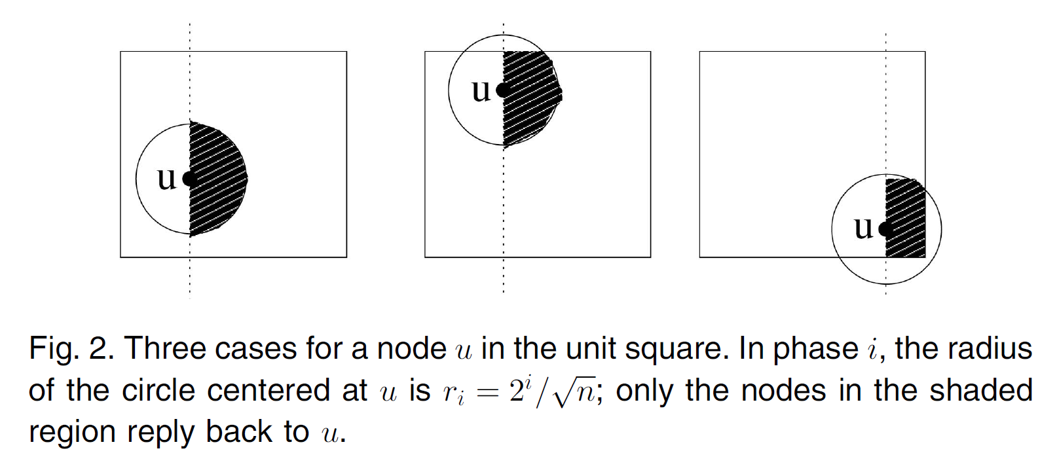
Proof of Theorem 10 (cont’d)
Let Bi denote the common region among the right half-plane, the disk with radius ri centered at u, and the unit square
Let ai be the area of the region Bi

Slide 53
Proof of Theorem 10 (cont’d)
Using simple geometry, it can easily be shown that for any position of u in the unit square.
Let ni be the number of nodes in Bi excluding u.

Slide 54
Proof of Theorem 10 (cont’d)
Case : Then, . By Chernoff
bound with and , we have
Thus, the probability that u receives more than replies is at most .

Slide 55
Proof of Theorem 10 (cont’d)
Case : Then, .
In this case, the probability that u needs ith transmission, is
Thus, with probability at least , either u does not need phase i or the number of replies in phase i is .

Slide 56
Proof of Theorem 10 (cont’d)
This statement holds simultaneously for all of
phases for all n nodes with probability at least (by the union bound).
The running time of each phase is
The total time is WHP.

Slide 57
NNT Algorithm for Multihop Wireless Networks
F95942045 盧曉珍

Slide 58
UDG model
Two nodes can communicate if and only if d(u,v)≤R,
The sink node is designated as the root of the tree

Slide 59
UDG-NNT Algorithm
Phase 1: rank generation
Sink s picks p(s), send p(s) and ID(s) to neighbors
u receives the first message from a neighbor, v. u generates p(u) [p(v)-1, p(v)).
u then sends p(u) and ID(u) to neighbors.
Later messages are simply stored.
The rank(u) is determined by p(u) and ID(u)

Slide 60
UDG-NNT Algorithm – cont.
After phase 1
Ranks of all neighbors are known
Sink s has highest rank
Each node u has at least one neighbor v such that rank(v) > rank(u)
Phase 2: each node, except s, sends a connect message to its nearest neighbor with higher rank

Slide 61
Analysis of UDG-NNT
Quality:
→
Message complexity:
Work complexity:
Time complexity:
a node has to spend time to transmit its message.
D: the diameter of UDG.

Slide 62
GHS v.s. NNT
Exact solution
Approximate solution
High message and work complexity
Low message and work complexity
D95725004
陳怡安

Slide 63
GHS
A well-studied distributed MST algorithm
Computes “EXACT” MST
Upper bounds of time and message complexity have been analyzed in original paper
Here we analysis the lower bounds of time and message complexity

Slide 64
GHS: Utilizing two properties of MST
Definition – MST fragment
A connected sub-tree of MST
Property 1
Given a fragment of an MST, let e be a minimum-weight outgoing edge of the fragment. Then joining e and its adjacent non-fragment node to the fragment yields another fragment of an MST.
8
3
e
1
4
2
5
6
7
Notes:
在圖中一個

Slide 65
GHS: Utilizing two properties of MST
Property 2
8
3
1
If all the edges of a connected graph have different weights, then the MST is unique.
4
2
5
6
7
8
8
3
X
3
1
1
4
4
5
2
5
2
6
6
7
7

Slide 66
GHS
Idea of MST based on properties 1 & 2
Enlarge fragments in any order, combine fragments with a common edge (property 1)
The union of these fragments is also a fragment (property 2)
8
3
8
3
8
3
1
1
1
4
4
4
2
5
2
5
2
5
6
6
6
7
7
7
……

Slide 67
GHS algorithm
Every fragment changes its state and merges with other fragment iteratively
Until it cannot find any outgoing edges
End
No minimal edge can be found
Find
Test, Reject or Accept, Connect
Sleeping
Initiate
Found
Awakes

Slide 68
Initiate
Test (Asynchronously)
8
8
3
3
1
1
4
4
5
2
6
5
2
6
Finds the outgoing edge
7
7
core
Reject
8
3
Accept
8
3
1
1
4
4
2
6
5
5
2
6
7
7
Cycle
Outgoing edge
Notes:
黃色的fragment, 藍色的fragment
Core: 將藍色fragment 連起來的edge
Edge 兩端為指揮中樞，發送initialize message , 帶core 的weight
對於不知道是否為同一fragment 的node, 送test message 過去: 每個n(u)只會被u 問過一次，

Slide 69
Determine the minimal outgoing edge
Every interior sends the Report when resolved its outgoing and all its children sent theirs.
8
3
1
4
2
5
6
7

Slide 70
Lower Bound of Messages
Radius of neighborhood:
The smallest radius to keep the nodes connected with high probability
Expected number of neighbors:
Every node at least exchanges messages
Every edge can be “rejected” only once
A node can receive at most one “accept” message
The total expected number of messages is:

Slide 71
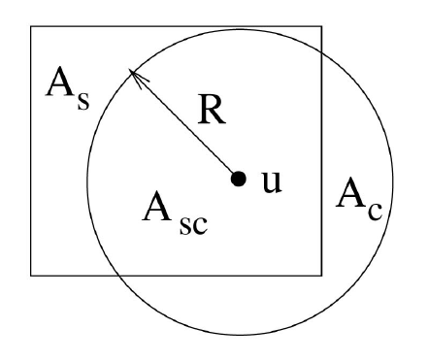
Lower Bound of Work
If we redistribute the nodes in As to Ac, the expected distance to u will decrease!!
方型和圓型同樣的面積

Slide 72
Cumulated Probability of r is the i-th NN’s radius
C_{i}(r): i-th NN 的半徑小於或等於r的機率的加總
== 1- i-th NN 的半徑大於r 的機率
== 1- (在半徑裏的NN小於i個的機率)
對r微分
u
Probability Density Function
r
R

Slide 73
T_{k}
T_{k+1}

Slide 74
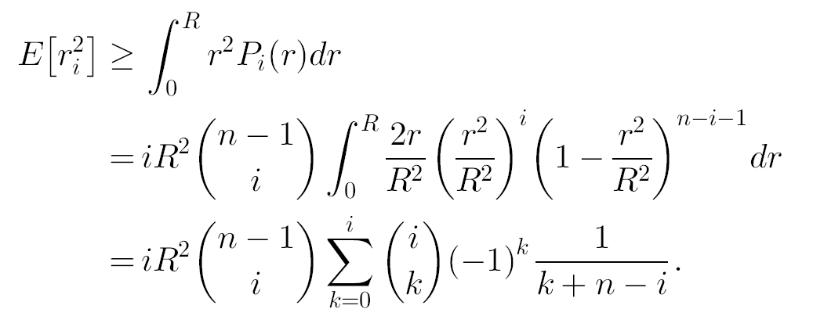
Upper Bound : R’= ,
u

Slide 75
Analyze test/accept/reject messages only
Every node pass messages to adjacent edges one by one
Expected number of neighbors of a node is cln n
Expected work of GHS is
Expected total work is

Slide 76
Simulation

Slide 77
Environment
Experimental Setup
Number of Nodes: varying from 50 to 5000
Node distributions:
a) Uniformly random distributions in the unit square.
Realistic distributions of points in an urban setting.
b) TRANSIMS ( TRansportation ANalysis SIMulation System )
Number of Runs: 50
Measures:
quality for α = 1 and 2
number of messages
work for α = 2
Notes:
TRANSIMS 是一套運輸規劃專用的模擬軟體，同時考慮了交通安全、空
氣品質、能源消耗、土地使用計畫等因素，甚至於能在超級電腦上模擬美國Dallas
市區25 平方英哩的交通狀況。

Slide 78
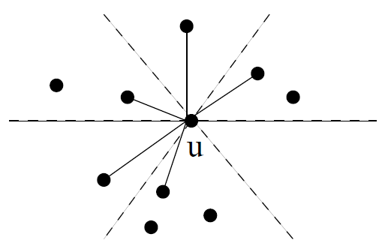
Comparison
Co-NNT vs. GHS-Yao
Yao graph – complement of geometry for GHS
Random-NNT, UDG-NNT vs. GHS

Slide 79
Measurement
Quality
α = 1
α = 2
Number of messages
Work
α = 2

Slide 80
Quality for α = 1

Slide 81
Quality for α = 2

Slide 82
Number of Messages

Slide 83
Work

Slide 84
Experiments on Real Data
A section of downtown Portland, OR.
2.9KM x 2.95KM, approximately 9 square KM.
The distribution of points
Cars on the roadway
Data resource : TRANSIMS simulation
does a very detailed modeling of urban traffic, combing a variety of data sources ranging from census data to activity surveys to land use data.

Slide 85
Experiment Results
Work is computed for α = 2.
3 snapshots, at 1 minute intervals.

Slide 86
Main Results
Co-NNT always outperforms Random-NNT on quality, number of messages, work.
For α = 1, all NNTs give a good approximation to MST, especially Co-NNT within 10%.
For α = 2, Random-NNT no good, but UDG-NNT and Co-NNT remains within a factor of 2.
Number of messages and work done by NNT are significantly smaller than GHS.

Slide 87
Dynamic Algorithm for NNT

Slide 88
Goal
To maintain a tree of good quality, as nodes are added or deleted.
To maintain an NNT tree.

Slide 89
Measurement
Number of rearrangements
The number of the edges to be deleted from and added to the tree, to maintain NNT, due to addition or deletion of a node.

Slide 90
Dynamic Random-NNT
After a node v is added to the network, there will be some nodes u under 2 circumstances
rank(v) < rank(u)
rank(v) > rank(u)
What happens?

Slide 91
Dynamic Random-NNT
After a node v is added to the network, there can be some nodes u such that
rank(v) > rank(u) and d(u,v) < d(u,nnt(u))
u must change its connection from previous nnt(u) to v.
v is the new nnt(u).
u is affected by v.
Problem : find out the affected nodes.

Slide 92
Dynamic Random-NNT Data Structure
Each node maintains two lists
Q(v)
The set of nodes in closed ball B( v , nnt(v) )
v 涵蓋那些nodes
L (v)
L(v) = { u | v Є Q(u) }
v 被那些nodes涵蓋
Closed ball B( v , r )
以v為圓心，r為半徑所形成的space

Slide 93
Affected Nodes
How to find the affected nodes by the data structure Q(v) and L(v) ?

Slide 94
Find Affected Nodes
Node v joined the network.
Divide the 2π angle around v into 6 wedges of equal size.
Let w₁ ,w₂ ,…,w₆ be the closest nodes in these wedges.
Only the nodes in L(w_{i}) can be affected.
Why?

Slide 95
Dynamic Random-NNT Algorithm

Slide 96
Dynamic Random-NNT Algorithm
If a node v is added
1) v chooses a random rank, and creates two lists of nodes, Q(v) and L(v), which are initially empty.

Slide 97
Dynamic Random-NNT Algorithm
If a node v is added
2) v checks its neighbors v1, v2, … in non-decreasing order of d(v, vi), till it finds the closest neighbor vj of higher rank. v adds each such vi, i ≤ j, in Q(v) and sends a message to vi to add it in L(vi).

Slide 98
Dynamic Random-NNT Algorithm
If a node v is added
3) v finds the closest node in each of the 6 wedges. For each of these closest nodes, w, v sends an UPDATE message to each u Є L(w). Node u, upon receipt of this message, does the following:

Slide 99
Dynamic Random-NNT Algorithm
3)
a) Let u1, u2, … be the neighbors of u in non-decreasing order of d(u, ui), and uk be nnt(u).
b) If d(u, v) ≤ d(u, uk) and rank(v) > rank(u), u removes um from Q(u) and itself from L(um), for every j < m ≤ k, where v = uj . Further u connects to v, instead of uk, and adds v to Q(u) and itself to L(v).
c) If d(u, v) ≤ d(u, uk) and rank(v) < rank(u), u adds v to Q(u) and itself to L(v).

Slide 100
Dynamic Random-NNT Algorithm
If a node v is deleted
1) v sends a message to each u Є Q(v). Node u, after receiving this message, removes v from L(u).

Slide 101
Dynamic Random-NNT Algorithm
If a node v is deleted
2) v also sends a message to each u Є L(v). Node u, upon receipt of this message, removes v from Q(u). If nnt(u) = v, u checks the neighbors vi beginning from distance d(u, v) onward until it finds the new nearest node of higher rank, adds each such vi in Q(u), and sends a message to vi to add u in L(vi).

Slide 102
Measurement
Lemma 13
For any sequence of n node insertions and deletions, the total charge on any node u is O(ln n) WHP.
1 charge = 1 cover

Slide 103
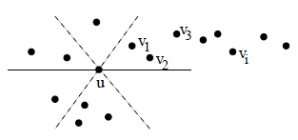
Proof of Lemma 13
Consider any point u, and partition the 2π angle around u into 6 cones, each of angle π/3.
Order the points in the cone as v₁, v₂, …., based on increasing distance from u.

Slide 104
Proof of Lemma 13
Node v_{i} places a charge on u only if
rank(v_{i}) > rank(v_{j}), for all 1 ≤ j < i.
Probability = 1 / i .
Total expected charge =

Slide 105
Measurement
Corollary 15
Degree of any node v in the NNT is O(ln n) W.H.P.
Proof
The degree of v is at most the charge on v.
Proved by lemma 13.

Slide 106
Measurement
Theorem 16
For any sequence of n node insertions and deletions, the number of rearrangements per insertion or deletion is O(ln n) WHP.

Slide 107
Proof of Theorem 16
When v is added
Only the nodes u Є L(v) may need to change its connection.
2|L(v)| = O(ln n) W.H.P. ( Lemma 13 )
When v is deleted
Only the nodes u such that nnt(u) = v need to find a new parent to connect to.
Deletion of D(v) edges and addition of D(v) – 1 new edges.
2D(v) – 1 = O(ln n) W.H.P. ( Corollary 15 )

Slide 108
Concluding Remarks and Future Work
D97725004 林明志

Slide 109
Concluding Remarks and Future Work
NNT is a simple and local scheme for constructing and maintaining low-cost trees
Future Work
For arbitrary point distributions
Tradeoff between the amount of local information and the quality of the tree
Tighter bound for quality of UDG-NNT
Determine whether it is possible to design a distributed exact MST algorithm with better work complexity than GHS and obtain a lower bound on work complexity

Slide 110
Thank you for your attention!

