Slide 1
Approximation Algorithms for Quickest Spanning Tree Problems
Presenter:
施佩汝 劉冠廷 何元臣
陳裕美 洪家榮

Slide 2

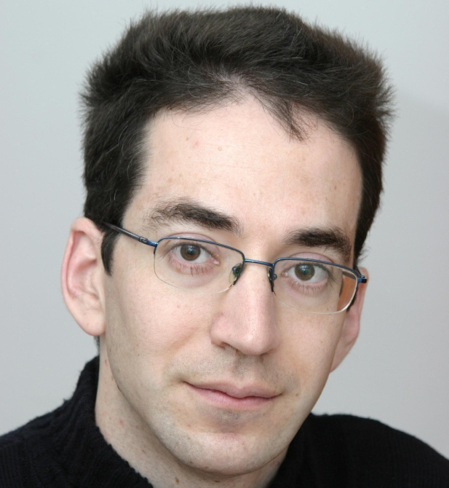
Author
Refael Hassin
Asaf Levin
Notes:
Refael Hassin: Department of Statistics and Operations Research, Tel Aviv University, Israel
Asaf Levin: Department of Statistics, The Hebrew University, Israel

Slide 3
Outline
Introduction
A 2-approximation algorithm for the quickest radius spanning tree problem
Inapproximability of the quickest radius spanning tree problem
The quickest diameter spanning tree problem
Discussion

Slide 4
Introduction
施佩汝

Slide 5
Introduction
G = (V, E): undirected multi-graph
for each e Є E
l(e) ≧ 0: length
c(e)＞ 0: capacity
r(e)＝ 1/c(e): reciprocal capacity

Slide 6
Example
node
l(e) = 1, r(e) = 1
l(e) = 1, r(e) = 2
node
node
l(e) = 1, r(e) = 1

Slide 7
Introduction
For a path P that connects u and v,
The length of P: l(P) = Σ_{eЄP}l(e)
The reciprocal capacity of P: max_{eЄP}r(e)
t(P) = l(P) + σr (P): transmission time
σ = 1

Slide 8
Example
l(P) = 2, r(P) = 2, t(P) = 4
node
l(e) = 1, r(e) = 1
l(e) = 1, r(e) = 2
node
node
l(e) = 1, r(e) = 1

Slide 9
Introduction
Quickest Path Problem (QPP)
Find a path of given pair of vertices u, v Є V, whose transmission time is minimized

Slide 10
Example
l(P1) = 2, r(P1) = 2, t(P1) = 4
node
l(e) = 1, r(e) = 1
l(e) = 1, r(e) = 2
u
v
l(e) = 1, r(e) = 1

Slide 11
Example
l(P1) = 2, r(P1) = 2, t(P1) = 4
node
l(e) = 1, r(e) = 1
l(e) = 1, r(e) = 2
u
v
l(e) = 1, r(e) = 1
l(P2) = 1, r(P2) = 1, t(P2) = 2

Slide 12
Example
l(P1) = 2, r(P1) = 2, t(P1) = 4
node
l(e) = 1, r(e) = 1
l(e) = 1, r(e) = 2
u
v
l(e) = 1, r(e) = 1
l(P2) = 1, r(P2) = 1, t(P2) = 2

Slide 13
Introduction
In broadcast networks, one usually asks for a small maximum delay of a message sent by a root vertex to all the other vertices in the network
Quickest Radius Spanning Tree Problem
rad_{t}(T) = max_{vЄV} t(P^{T}_{root,v}) is minimize

Slide 14
Example
node
l(e) = 2, r(e) = 0
l(e) = 1, r(e) = 0
l(e) = 1, r(e) = 0
root
node
l(e) = 1, r(e) = 0
l(e) = 2, r(e) = 0
l(e) = 1, r(e) = 0
node

Slide 15
Example
node
l(e) = 2, r(e) = 0
l(e) = 1, r(e) = 0
l(e) = 1, r(e) = 0
root
node
l(e) = 1, r(e) = 0
l(e) = 2, r(e) = 0
l(e) = 1, r(e) = 0
rad_{T} = 2
node

Slide 16
Introduction
In other communication networks, one seeks a small upper bound on the delay of transmitting a message between any pair of vertices
Quickest Diameter Spanning Tree Problem
diam_{t}(T) = max_{u, vЄV}t(P^{T}_{u,v}) is minimize

Slide 17
Example
node
l(e) = 2, r(e) = 0
l(e) = 1, r(e) = 0
l(e) = 1, r(e) = 0
node
node
l(e) = 1, r(e) = 0
l(e) = 2, r(e) = 0
l(e) = 1, r(e) = 0
diam_{T} = 2
node

Slide 18
Introduction
Shortest Paths Tree (SPT)
Given an undirected multi-graph G = (V, E), with a special vertex root Є V.
e Є E is endowed with a length l(e) ≧ 0
T = (V, E_{T}): spanning tree such that for every u Є V, l(P^{T} _{root, u}) = l(P^{G} _{root, u})
SPT (G, root, l)

Slide 19
Introduction
Contribution
A 2-approximation algorithm for Quickest Radius Spanning Tree Problem.
For any ε > 0, unless P = NP there is no approximation algorithm with performance guarantee of 2 – ε for the Quickest Radius Spanning Tree Problem.
A 3/2-approximation algorithm for Quickest Diameter Spanning Tree Problem.
For any ε > 0, unless P = NP there is no approximation algorithm with performance guarantee of 3/2 – ε for the Quickest Diameter Spanning Tree Problem.

Slide 20
A 2-approximation algorithm for quickest radius spanning tree problem
劉冠廷

Slide 21
Problem
Find a spanning tree T of G such that is minimized.

Slide 22
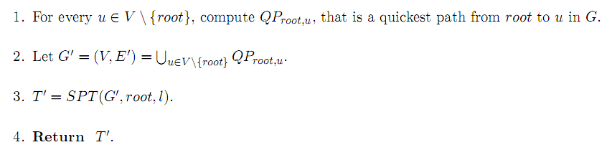
Algorithm

Slide 23



Example 1
root
1
l 2 , r 0
l 2 , r 0
l 0 , r 1
l 0 , r 1
2
3
G
Rad_{t}(T’) = t(root , 1) = 2

Slide 24
Example 2
root
1
l 1 , r 0
l 0 , r 2
l 1 , r 1
l 1 , r 0
l 1 , r 1
2
3
l 1 , r 1
4
G
Rad_{t}(T’) = t(root , 3 , 4) = 3

Slide 25
Time
It is dominated by the time complexity of step1
O(m² + mn logm) , n = |V| , m = |E|
Y. L. Chen and Y. H. Chin, “The quickest path problem” , 1990

Slide 26




Theorem 2
The algorithm is a 2-approxiamtion for the QUICKEST RADIUS SPANNING TREE PROBLEM
OPT = l(P) + max r(P)
root
r(e)

Slide 27


Theorem 2
OPT = l(P) + max r(P)
root
l(e)

Slide 28




Theorem 2
+ )

Slide 29
Inapproximability of the quickest radius spanning tree problem
何元臣

Slide 30
2-approximaiton for quickest radius spanning tree
Unless P = NP, no (2-ε) approximation algorithm exists for any ε > 0.
Steps:
No approximation algorithm with a performance guarantee of (3/2 – ε).
An example showing quick_radius is a 2-apporixmation algorithm at best.
Use ideas from previous two parts to form main result

Slide 31
3/2 lower bound on the approximation ratio
Reduction from SAT
SAT(Boolean satisfiability problem)
Boolean expression written using only AND, OR, NOT, variables and parentheses.
Literal = variable
An expression is said to be satisfiable if logical values can be assigned to variables to make the formula true.
NP-Complete
Conjunctive Normal Form (CNF)
(X1vX3’vX4’) (X2vX4)
Notes:
Given the expression, is there some assignment of TRUE and FALSE values to the variables that make the entire expression true?

Slide 32
3/2 lower bound on the approximation ratio
X1 X2 X3 X4
root leaf
X1’ X2’ X3’ X4’
C1 C2 (X1vX3’vX4’) (X2vX4)
E3 : l(e) = 0.5, r(e) = 0
E2 : l(e) =0.5, r(e) = 0
E1 : l(e) = 0, r(e) = 1

Slide 33
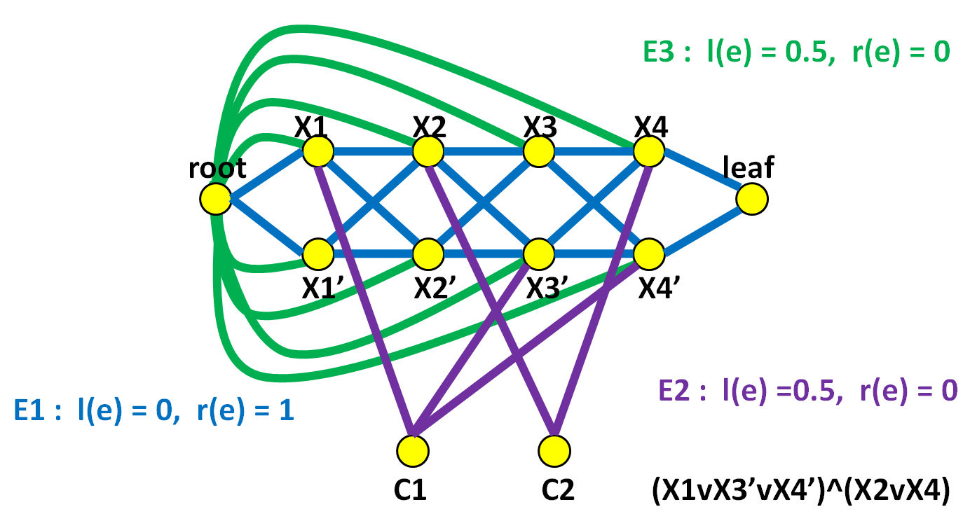
3/2 approximation low bound
Find Spanning Tree on G
If the formula is satisfiable, rad_{t}(T) = 1
If the formula is not satisfiable, rad_{t}(T) ≥ 3/2

Slide 34
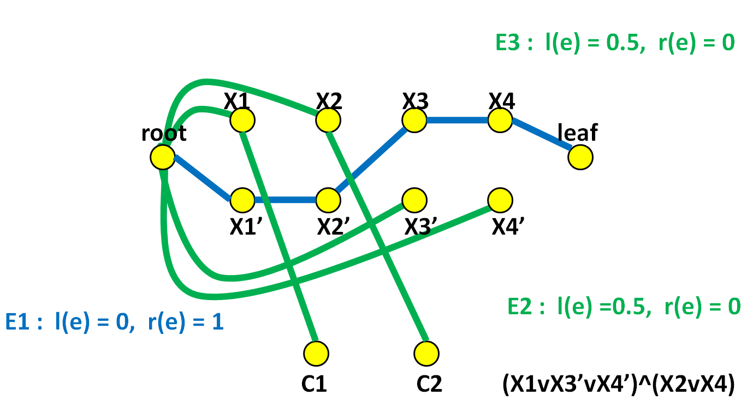
Find the Spanning Tree
T = (V, E_{T}), =
root to leaf from E₁, all intermediate vertices are false literals
(root, li) from E₃, one edge from E₂, a true literal to each clause
Notes:
consider two paths: (root-leaf) && (root-clause)

Slide 35
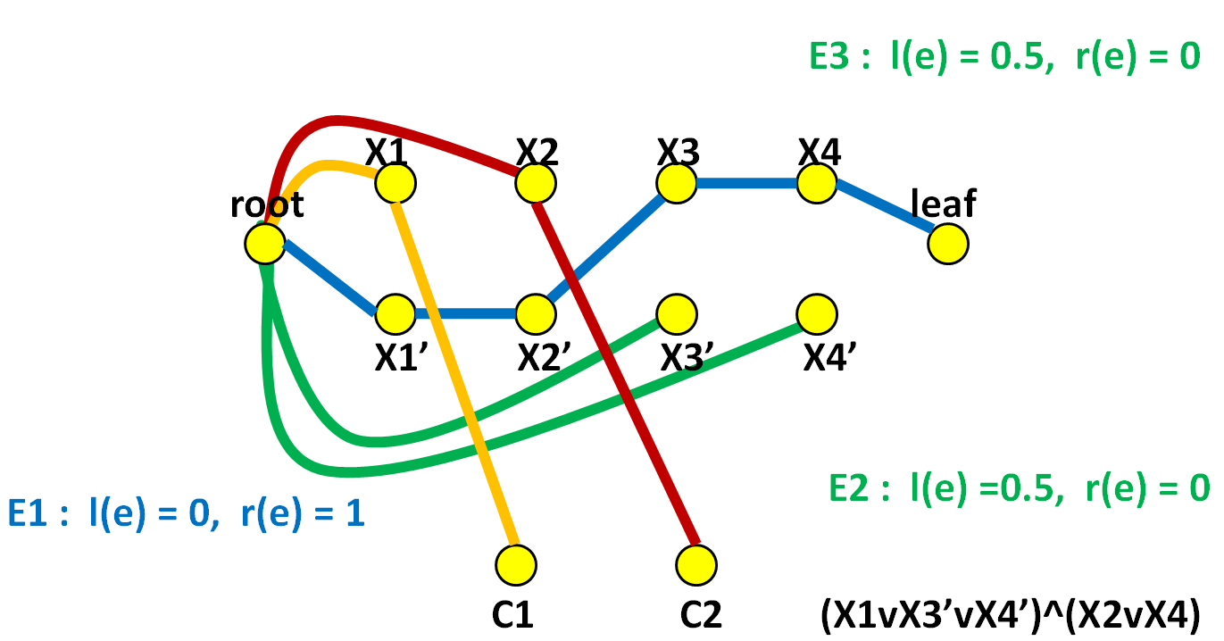
Find the Spanning Tree
If the formula is satisfiable, rad_{t}(T) = 1
rad(root – leaf) = rad(root – C1) = rad(root – C2) = 1

Slide 36
Find the Spanning Tree
If the formula not satisfiable, rad_{t}(T) ≥ 3/2
if the path from root to leaf (P) contains an edge from E₃ (at least one) ➔ rad_{t}(T) ≥ 3/2
otherwise, for some clause C_{j}, all of its literals are in P, rad_{t}(root – C_{j}) ≥ 3/2

Slide 37
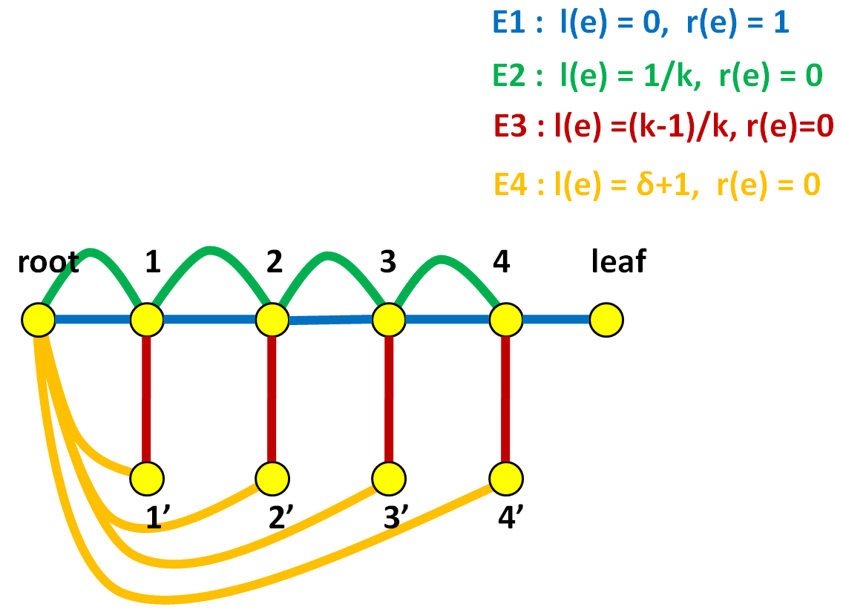
On using only quickest path edges
G’: the union of a quickest root – u path in G for all u V.
claim: spanning tree T’ of G’ satisfies rad_{t}(T) ≥ (2-ε) OPT for all T’ of G’. (OPT: optimal solution)
k = 5,
δ > 0
G

Slide 38
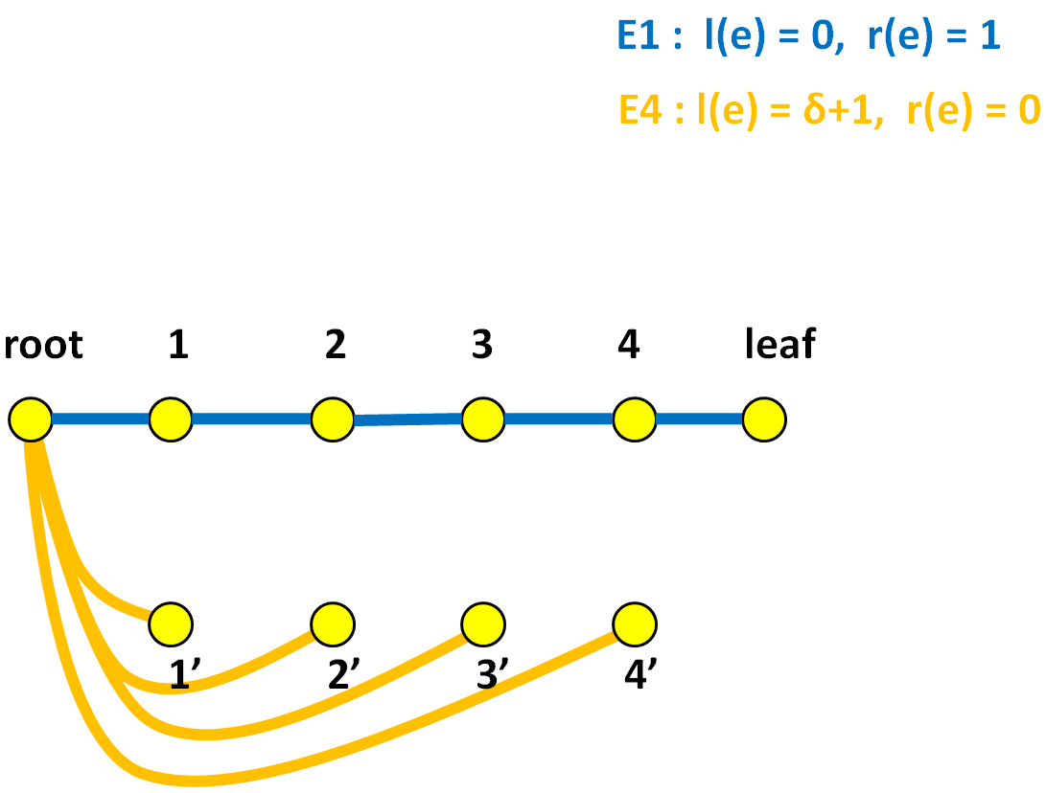
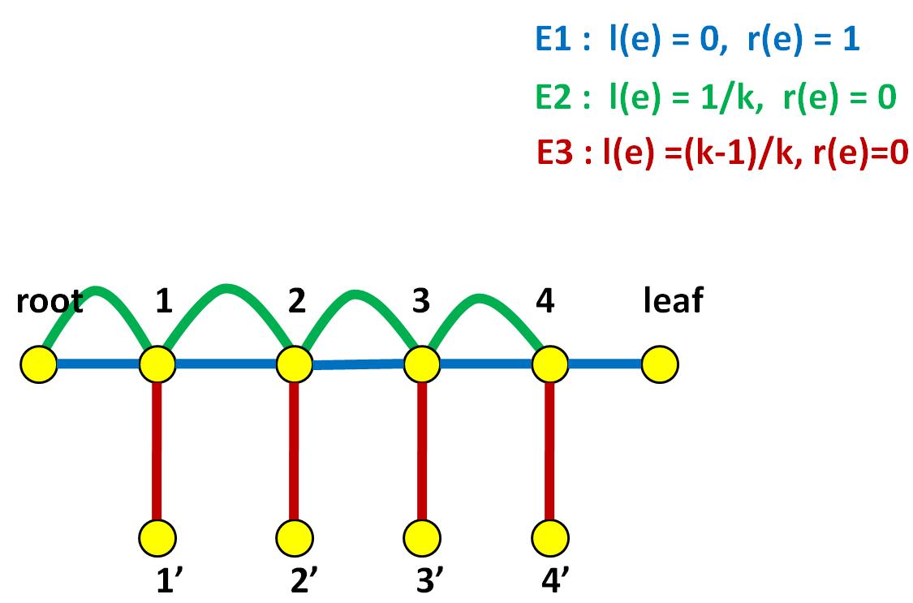
On using quickest path edges
Two best quickest radius spanning trees on G
rad_{t}(T) = δ + 1

Slide 39
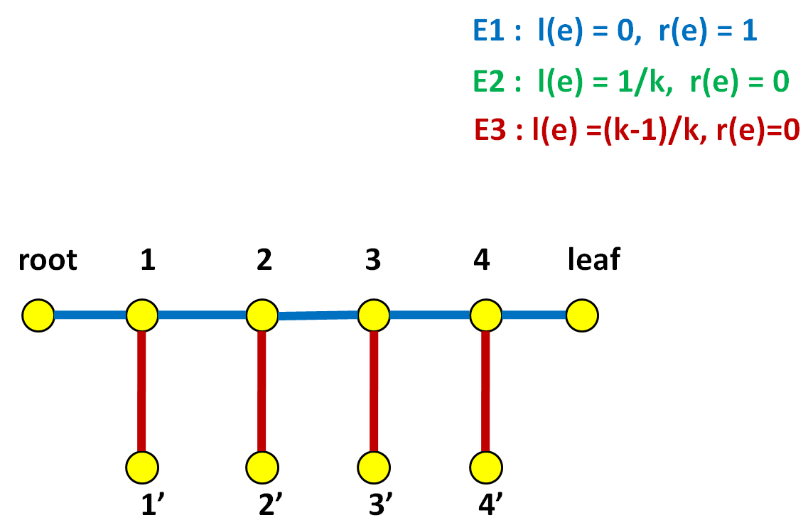
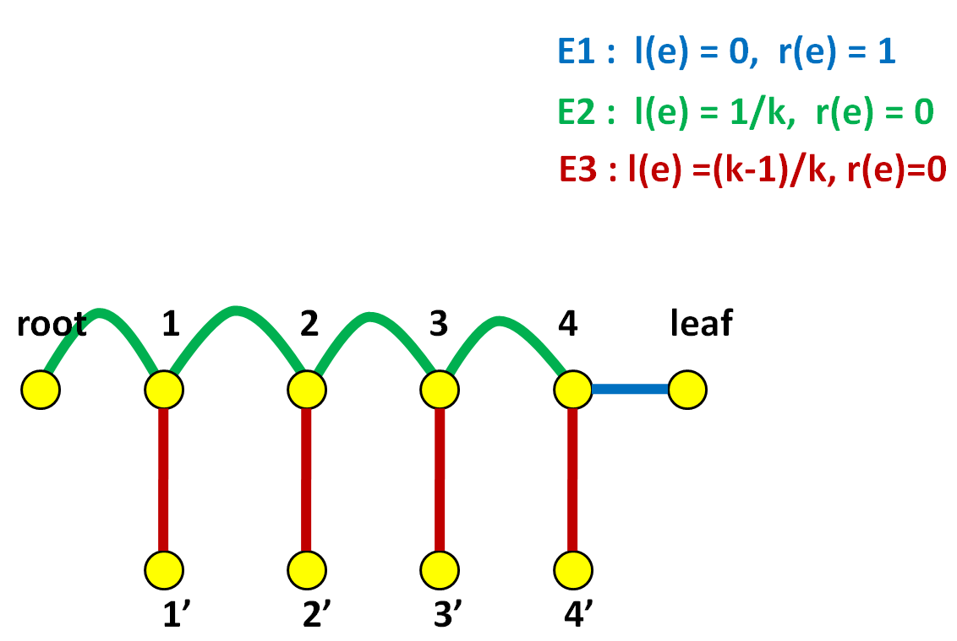
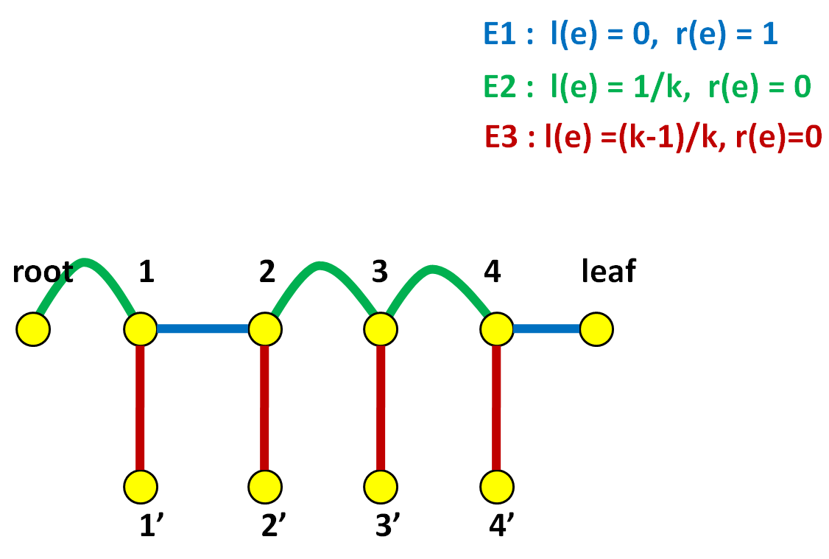
On using quickest path edges
rad_{t}(T) = 2-(1/k)
rad_{t}(T) = 2-(1/k)
rad_{t}(T) ≥ 2-(1/k)

Slide 40
On using quickest path edges
the approximation ratio then is
And we are going to show the bound is tight
2- (1/k)
2 - ε
≥
δ+1

Slide 41
Theorem 4
If P ≠ NP, then there is no ( 2 - ε )-approximation algorithm for the QUICKEST RADIUS SPANNING TREE PROBLEM for any ε > 0
陳裕美

Slide 42
root
X1j X2j X3j X4j
tail j-1 head j tail j headj+1
X1’j X2’j X3’j X4’j
C1j C2j (X1vX3’vX4’)^(X2vX4)
E3 : l(e) = j/k , r(e) = 0
Level j
E1 : l(e) = 0 , r(e) = 1
E2 : l(e) =1 - j/k , r(e) = 0

Slide 43
rad_{t}(T) = 1 (the optimal case)

Slide 44
root
X1j X2j X3j X4j
tail j-1 head j tail j headj+1
X1’j X2’j X3’j X4’j
C1j C2j (X1vX3’vX4’)^(X2vX4)
E3 : l(e) = j/k , r(e) = 0
E1 : l(e) = 0 , r(e) = 1
E2 : l(e) =1 - j/k , r(e) = 0
SAT: X1 = false, X2 = true, X3 = true, X4 = false

Slide 45
rad_{t}(T) = 1
Root (head₁) to tail_{k-1} :
E1 : l(e) + r(e) = 0 + 1 = 1
Root to C_{ij} :
E2 + E3 = j/k + (1 – j/k) = 1

Slide 46
rad_{t}(T’) ≠ 1, we want to prove rad_{t}(T’) ≥ 2-1/k

Slide 47
root
X1j X2j X3j X4j
tail j-1 head j tail j headj+1
X1’j X2’j X3’j X4’j
C1j C2j (X1vX3’vX4’)^(X2vX4)
E3 : l(e) = j/k , r(e) = 0
E1 : l(e) = 0 , r(e) = 1
E2 : l(e) =1 - j/k , r(e) = 0

Slide 48
If the SAT formula is not satisfied
Look at the path from head to tail
For every level j = 1, .. , k-1, (V, E_{T}∩E₁) does not contain a path from head_{j} to tail_{j}. -----------case I
There is some level j, 1 ≤ j ≤ k-1 , (V, E_{T}∩E₁) does not contain a path from head_{j} to tail_{j}. ------case II
Look at the path from root to C_{ij} ----case III

Slide 49
But before the proof..
Claim:
for every q = 1,2,…..,j, (V, E_{T}∩E₁) does not contain a path from head_{q} to tail_{q} , then l(P^{t}_{root,tailj}) ≥ j/k.

Slide 50
Proved by induction
For j = 1, the claim is trivial since P^{t}_{root,tailj} must have an edge from E2∪E3
Assume that the claim holds for all previous level, we prove it for j.

Slide 51
Proved by induction
By assumption, (V, E_{T}∩E₁) does not contain a tail_{j} – head_{j} path.
Has an edge from E₃
l(P^{t}_{root,tailj}) ≥ j/k
Has two edges from E₂
l(P^{t}_{tailj-1,tailj}) ≥ 2/k
and add l(P^{t}_{root,tailj})
2/k + (j-1)/k = (j+1)/k > j/k
E3 : l(e) = j/k , r(e) = 0
E2 : l(e) =1 - j/k , r(e) = 0

Slide 52
Now back to the proof!!
rad_{t}(T’) ≠ 1, we want to prove rad_{t}(T’) ≥ 2-1/k

Slide 53
If the SAT formula is not satisfied
Look at the path from head to tail
For every level j = 1, .. , k-1, (V, E_{T}∩E₁) does not contain a path from head_{j} to tail_{j}. -----------case I
There is some level j, 1 ≤ j ≤ k-1 , (V, E_{T}∩E₁) does not contain a path from head_{j} to tail_{j}. ------case II
Look at the path from root to C_{ij} ----case III

Slide 54
Case I For every level j = 1, .. , k-1, (V, E_{T}∩E₁) does not contain a path from head_{j} to tail_{j}.
By claim– for every q = 1,2,…..,j, (V, E_{T}∩E₁) does not contain a path from head_{q} to tail_{q}, then l(P^{t}_{root,tailj}) ≥ j/k. Because now j = k-1: l(P^{t}_{root,tailk-1}) ≥ k-1/k = 1 – 1/k

Slide 55
Case II There is some level j, 1 ≤ j ≤ k-1 , (V, E_{T}∩E₁) does not contain a path from head_{j} to tail_{j}.
WLOG suppose 1,…, j-1 does not contain a path form head_{j} to tail_{j}. otherwise j,…, k-1 contains a path (V, E_{T}∩E₁) from head_{j} to tail_{j}.
For j ≥ 2, By claim for j-1, l(P^{t}_{root,tailj-1}) ≥ (j-1)/k.
If (tail_{j-1},head_{j}) is E_{T}, then l(P^{t}_{root,tailj-1}) ≥ (j-1)/k.
If (tail_{j-1}, head_{j})is from E₃, then it connects a vertex from a level at least j to root. l(P^{t}_{root,tailj-1}) = j/k ≥ (j-1)/k.
If j = 1, then l(P^{t}_{root,tailj}) ≥ (j-1)/k

Slide 56
Case I + Case II
We have l(P^{t}_{root,tailj-1}) ≥ (j-1)/k in E₁.
root
X1j X2j X3j X4j
tail j-1 head j tail j headj+1
X1’j X2’j X3’j X4’j
C1j C2j (X1vX3’vX4’)^(X2vX4)
E3 : l(e) = j/k , r(e) = 0
E1 : l(e) = 0 , r(e) = 1
E2 : l(e) =1 - j/k , r(e) = 0

Slide 57
Case III Look at the path from root to C_{ij}
Since the formula is not satisfied by this truth assignment, there is a clause vertex C_{jp} such that all of its neighbors are in E₁.
root
X1j X2j X3j X4j
tail j-1 head j tail j headj+1
X1’j X2’j X3’j X4’j
C1j C2j (X1vX3’vX4’)^(X2vX4)
E3 : l(e) = j/k , r(e) = 0
E1 : l(e) = 0 , r(e) = 1
E2 : l(e) =1 - j/k , r(e) = 0

Slide 58
Case III
l(P^{t}_{root,Cjp}) = (1 – j/k ) + (j-1)/k = 1 – 1/k
t(e) = l(e) + r(e) = 1 - 1/k + 1 = 2 – 1/k
Therefore, rad_{t}(T’) > = 2 – 1/k

Slide 59
The quickest diameter spanning tree (QDST) problem
洪家榮

Slide 60
In QDST problem
In this section we consider the quickest diameter spanning tree problem. We present a 3/2-approximation algorithm, and prove that unless P = NP this is the best possible.
Denote by OPT the cost of an optimal solution, Topt = (V,Eopt), to the quickest diameter spanning tree problem.
Denote by MDT(G, l) the minimum diameter spanning tree of a graph G where the edges are endowed with a length function l.

Slide 61
The algorithm

Slide 62


Lemma 5
Let . For every pair of vertices
Proof:
The claim clearly holds if the path contains an edge e with .
Assume otherwise (that the claim does not hold), and let be such that there exists and contains an edge e with , and
are edge-disjoint. Then,
and the claim follows.
For a tree T, denote by
u
y
v
z
Notes:
OPT 代表的事 Optimal tree 上的 diameter，因此在 optimal tree 上任意兩點的距離，都小於 OPT

Slide 63
Theorem 6
Algorithm quick diameter is a 3/2-approximation algorithm for the quickest diameter spanning tree problem.
Proof:
By the optimality of (for the minimum diameter spanning tree problem),
2. By Lemma 5, Therefore, by 1,
3. Since
4. By 2 and 3,
5. By 1,
6. By 5,
7. By 4 and 6,
Notes:
只考慮兩種 tree 的 length function 狀況。因為 T’ 是對 G‘ 取 MDT(G, l) 因此不考慮 r 的狀況下，T’ 的 diaml 應該要比 Opt 的小。
By Lemma 5，經由移項可得。接著套用 1 的結果得到。
因為建立 T‘ 時未必會取到 rmax
By 2+3
By 1
By 5，左邊換成 diaml + rT‘ 因為 3，因此得到 6
By 4+6，移項可得

Slide 64
Theorem 7
If P≠NP, then there is no (3/2 -ε)-approximation algorithm for the quickest diameter spanning tree problem for any ε> 0.
Proof:
We prove the claim via reduction from SAT. We take the graph G from the proof of Theorem 4, and add a new vertex leaf, that is adjacent only to root by an edge e with l(e) = 1 and r(e) = 0.
By the proof of Theorem 4, if the formula can be satisfied, then there is a tree, T, whose radius is 1 (by extending the tree derived in the proof of Theorem 4 with the edge (root, leaf)). The diameter of a tree is at most twice its radius. Therefore, there is a spanning tree T such that
Notes:
第二段的證明，其實 diam 應該可以直接寫 = 2，因為 leaf 只與 root 連接，無論是怎樣的 spanning tree 都必須經由這個 edge 來到 leaf。則當 SAT 為 T，By Theorem 4，由 root 出發的 spanning tree 的 diam 為 1，加入該段 edge 則為 2。

Slide 65
Since leaf is adjacent (in G) only to root, each feasible solution is decomposed into a spanning tree over the original vertex set and the edge (root, leaf). By the proof of Theorem 4, if the formula cannot be satisfied, then every spanning trees T has a vertex u (u≠ leaf) such that and . Therefore,
Given ε> 0 we can pick an integer k such that

Slide 66
(l, r) = (1, 0)
leaf

Slide 67
Discussion
施佩汝

Slide 68
Discussion
Consider the transmission time along paths instead of the usual length of the path.
There are numerous other graph problems of interest that ask to compute a minimum cost subgraph where the cost is a function of the distances among vertices on the subgraph. Defining these problems under the transmission time definition of length opens an interesting area for future research.

Slide 69
Thank You

Slide 71
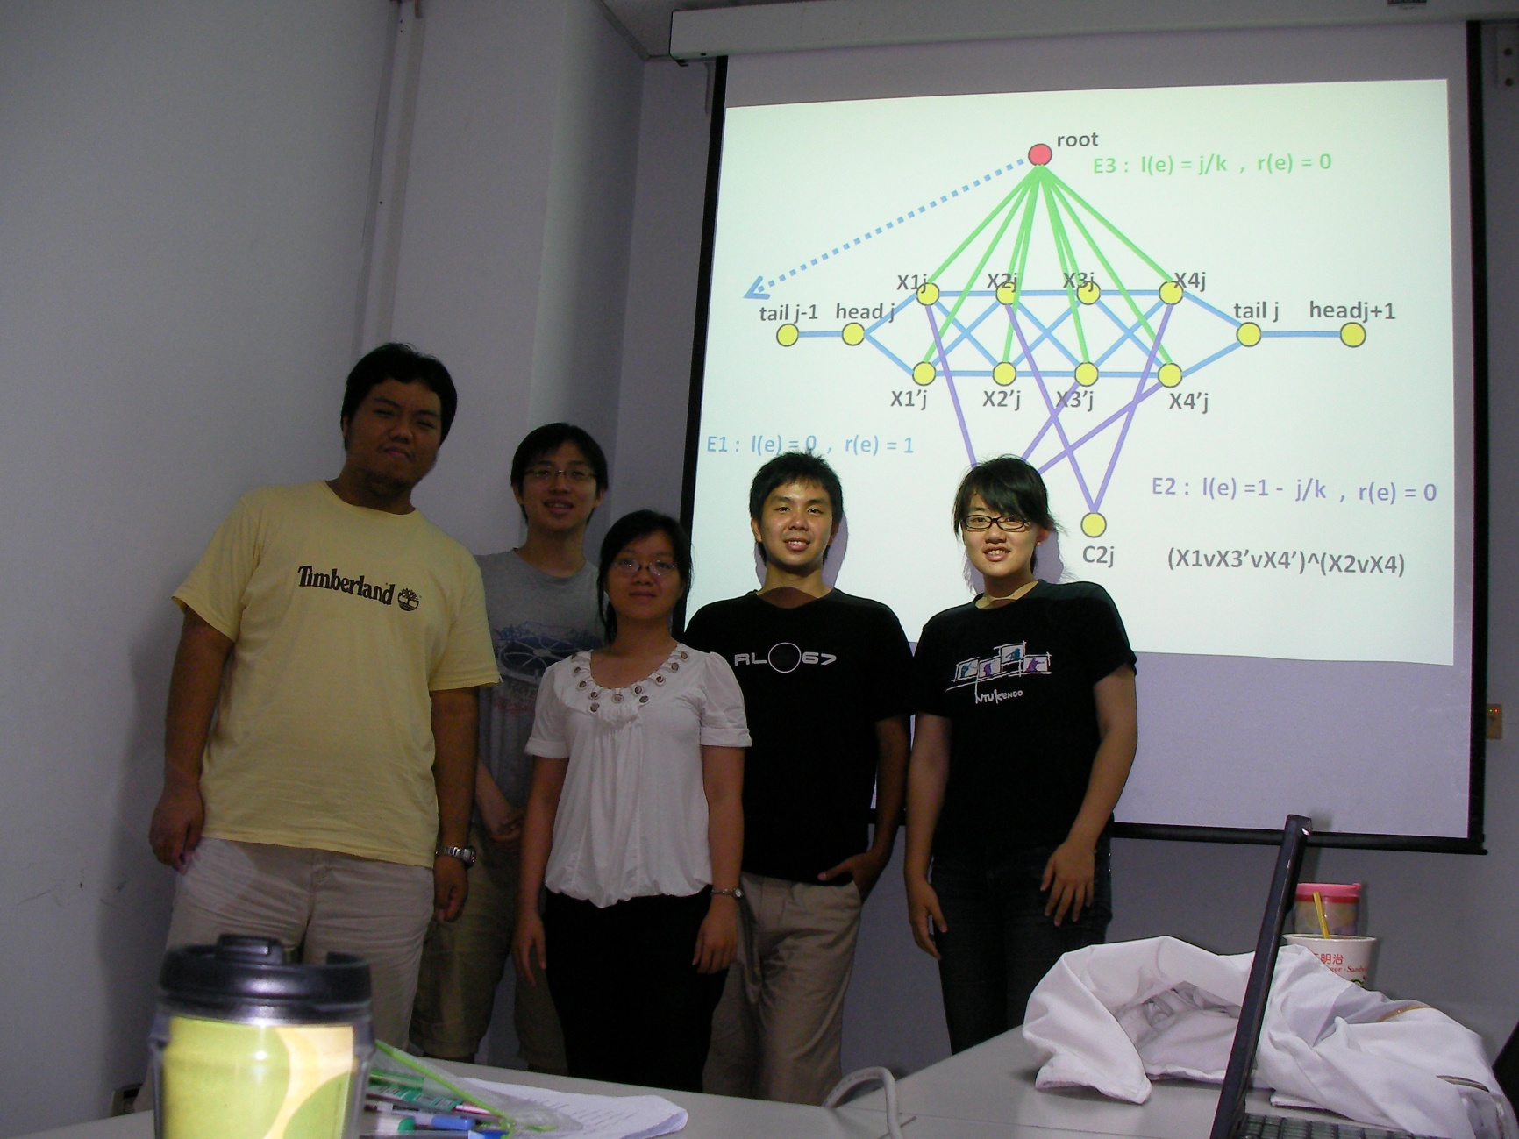
洪家榮 何元臣 施佩汝 劉冠廷 陳裕美 (左到右)

Slide 72
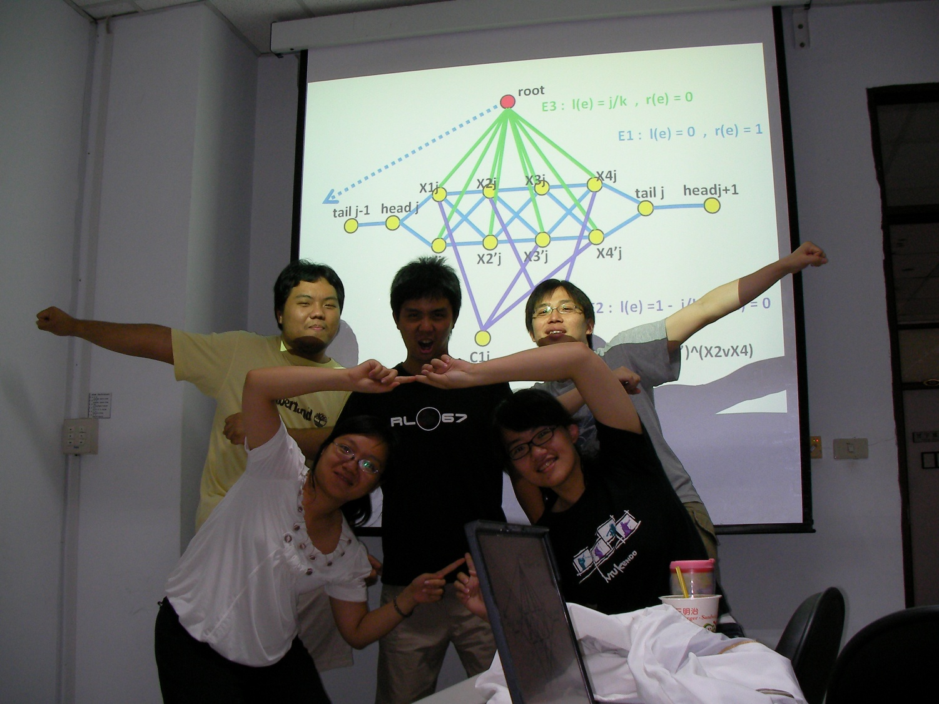

圖論演算法…

Slide 73
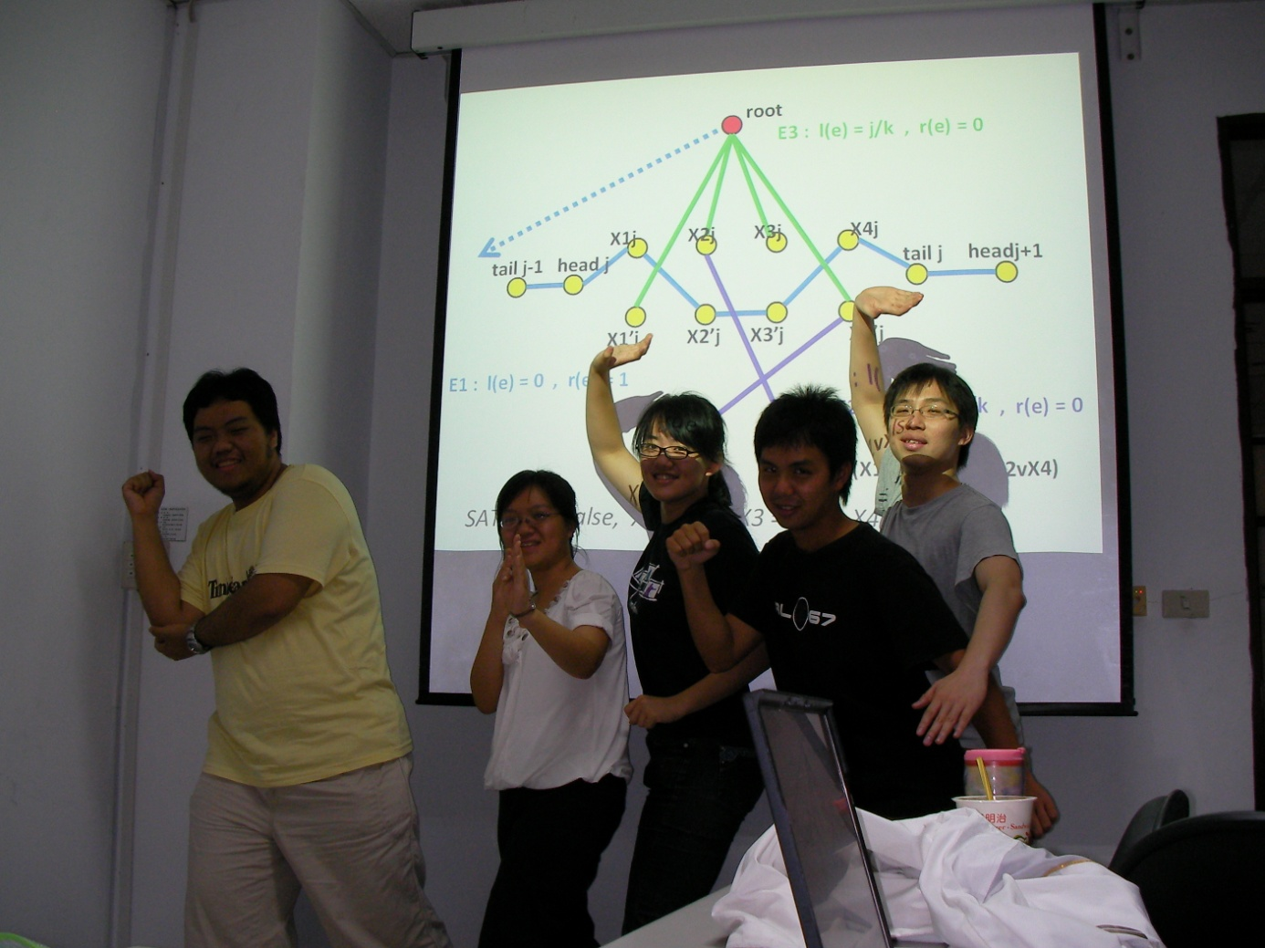

讓人心曠神怡

