Slide 1
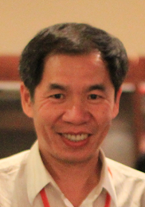
Algorithms for Biological Sequence Analysis
Kun-Mao Chao (趙坤茂)
National Taiwan University
http://www.csie.ntu.edu.tw/~kmchao/

Slide 2
About this course
Course: Algorithms for Biological Sequence Analysis
Fall semester, 2022
9:10 – 12:10 Tuesday, R105@CSIE Building
3 credits
Website: http://www.csie.ntu.edu.tw/~kmchao/seq22fall
Instructor: Kun-Mao Chao (趙坤茂)
Teaching assistant:
邱詠智 r10922064 followed by @ntu.edu.tw

Slide 3
Coursework
Homework assignments and Class participation (10%)
Two midterm exams (70%; 35% each):
Midterm #1: Oct. 11, 2022 (tentative)
Midterm #2: Nov. 22, 2022 (tentative)
Oral presentation of selected papers/projects (20%)
Some basic knowledge on algorithms is required.
Background in bioinformatics and computational biology is welcome but not required for taking this course.

Slide 4
Topics
Part I: Sequence Homology
Introduction to basic algorithmic strategies
Pairwise sequence alignment
Multiple sequence alignment
Chaining algorithms for genomic sequence analysis
Suboptimal alignment
Comparative genomics
Compressed / constrained sequence comparison
Part II: Sequence Composition
Sequence assembly
Maximum-sum and maximum-density segments
SNP and haplotype data analysis
Burrows-Wheeler Transform and FM-Index
Other advanced topics

Slide 5
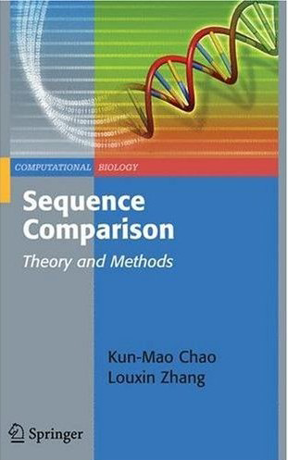
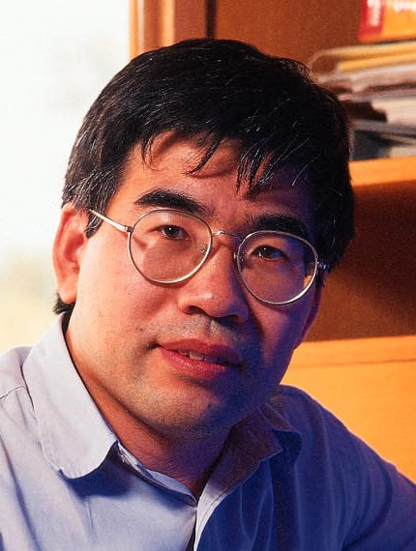
A Sequence Analysis Book Published by Springer
Sequence Comparison: Theory and Methods
by Kun-Mao Chao and Louxin Zhang

