Slide 1
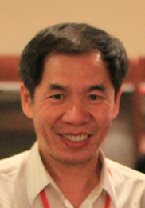
Interesting Sequences
Kun-Mao Chao (趙坤茂)
Department of Computer Science and Information Engineering
National Taiwan University, Taiwan
WWW: http://www.csie.ntu.edu.tw/~kmchao

Slide 2
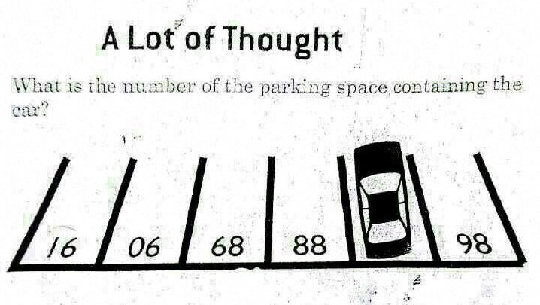
Source: http://puzzling.stackexchange.com

Slide 3
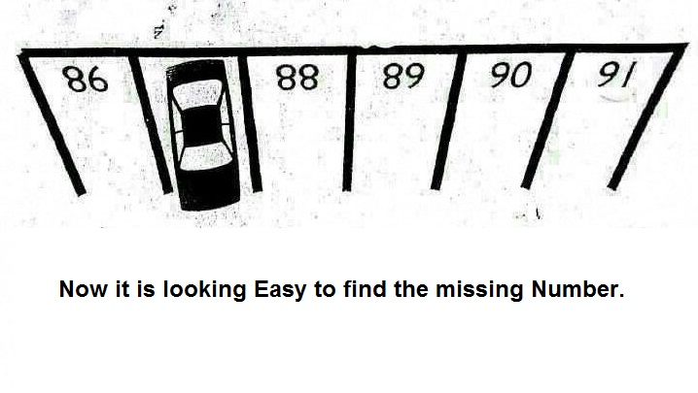
Source: http://puzzling.stackexchange.com

Slide 4

Source: My niece’s email

Slide 5

Source: My niece’s email

Slide 6

Source: My niece’s email

Slide 7
Count every " F" in the following text:
FINISHED FILES ARE THE RE
SULT OF YEARS OF SCIENTI
FIC STUDY COMBINED WITH
THE EXPERIENCE OF YEARS...
Source: My niece’s email

Slide 8
Olny srmat poelpe can raed tihs.
cdnuolt blveiee taht I cluod aulaclty uesdnatnrd waht I was rdanieg. The phaonmneal pweor of the hmuan mnid, aoccdrnig to a rscheearch at Cmabrigde Uinervtisy, it deosn't mttaer in waht oredr the ltteers in a wrod are, the olny iprmoatnt tihng is taht the frist and lsat ltteer be in the rghit pclae. The rset can be a taotl mses and you can sitll raed it wouthit a porbelm.
Source: My niece’s email

Slide 9

Consonant vs. Vowel
We can read consonants, but not vowels.
W cn rd cnsnnts, bt nt vwls.
E a ea ooa, u o oe. ?
-- A History of Writing
SPP, LKK, …
A counter Example: covfefe vs. coverage/coffee

Slide 10
Guess why they are grouped together?
(Hint: You need to know Mandarin to answer this.)
(Tone 1)
Group 1: 1, 3, 7, 8
Group 2: 2, 4, 6
Group 3: 5, 9
(Tone 4)
(Tone 3)
Source: My nephew’s riddle

Slide 11
趙元任 《施氏食獅史》
Dr. Yuan Ren Chao’s Essay
(Every character in this article sounds like “Shi!”)
石室詩士施氏，嗜獅，誓食十獅。施氏時時適市視獅。十時，適十獅適市。是時，適施氏適市。氏視是十獅，恃矢勢，使是十獅逝世。氏拾是十獅屍， 適石室。石室濕，氏使侍拭石室。石室拭，氏始試食是十獅。食時，始識是十獅，實十石獅屍。試釋是事。

Slide 12
Yet Another Dr. Chao’s Essay
(Every character in this article sounds like “Fu!”)
浮桴負富夫，甫赴傅府，復覆。富婦付伕扶夫，俯撫腐膚敷腹。
Note: Here Dr. Chao refers to “Kun-Mao Chao,” not the master “Dr. Yuan Ren Chao.” ☺
Created by me in September, 2007, revised in September, 2022.

Slide 13

Source: My niece’s email

Slide 14
Homework #1
Handout: September 6, 2022;
Due: September 23, 2022 (via NTU COOL)
Submit a one-page slide including:
Your Name
A sequence which, in your opinion, is sort of interesting and/or inspiring
A short reason explaining why it’s interesting and/or inspiring.
[Refer to the sample solutions coming right up.]

Slide 15
A Circular Sequence
(This phrase can start at any word.)
清
以
心
可
也
Kun-Mao Chao (趙坤茂)
Source: My neighbor

Slide 16
The longest word in English
Methionylthreonylthreonylglutaminylarginyl...isoleucine 189,819 letters audio video
Lopadotemachoselachogaleokranioleipsano...pterygon 183 letters
Pneumonoultramicroscopicsilicovolcanoconiosis 45 letters
Hippopotomonstrosesquipedaliophobia 35 letters
Supercalifragilisticexpialidocious 34 letters
Pseudopseudohypoparathyroidism 30 letters
Floccinaucinihilipilification 29 letters
Kun-Mao Chao (趙坤茂)
Source: Wikipedia …

Slide 17

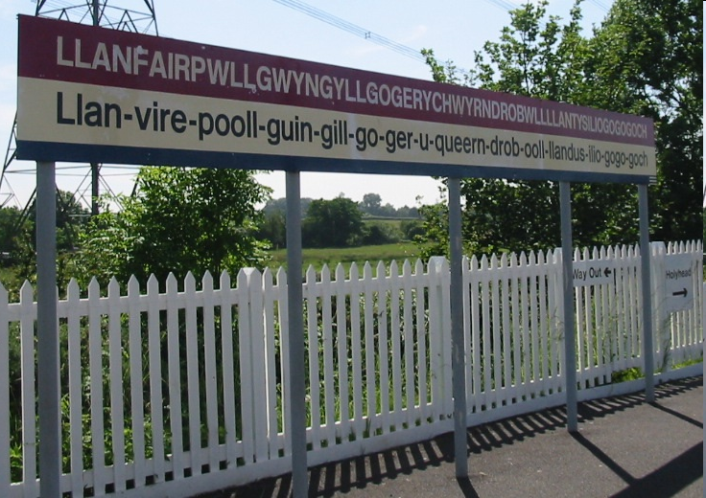
The longest place name in English
Kun-Mao Chao (趙坤茂)
Source: Wikipedia

Slide 18
Popple illusion with Japanese letter
Sequence of “杏マナー” and “ーナマ杏”
杏マナー杏マナー杏マナー杏マナー杏マナー杏マナー杏マナー
杏マナー杏マナー杏マナー杏マナー杏マナー杏マナー杏マナー
杏マナー杏マナー杏マナー杏マナー杏マナー杏マナー杏マナー
ーナマ杏ーナマ杏ーナマ杏ーナマ杏ーナマ杏ーナマ杏ーナマ杏
ーナマ杏ーナマ杏ーナマ杏ーナマ杏ーナマ杏ーナマ杏ーナマ杏
ーナマ杏ーナマ杏ーナマ杏ーナマ杏ーナマ杏ーナマ杏ーナマ杏
杏マナー杏マナー杏マナー杏マナー杏マナー杏マナー杏マナー
杏マナー杏マナー杏マナー杏マナー杏マナー杏マナー杏マナー
杏マナー杏マナー杏マナー杏マナー杏マナー杏マナー杏マナー
ーナマ杏ーナマ杏ーナマ杏ーナマ杏ーナマ杏ーナマ杏ーナマ杏
ーナマ杏ーナマ杏ーナマ杏ーナマ杏ーナマ杏ーナマ杏ーナマ杏
ーナマ杏ーナマ杏ーナマ杏ーナマ杏ーナマ杏ーナマ杏ーナマ杏
This is one of the famous phrases which were introduced on TV show in 2006.
There are no meaning for this phrase, but it shows interesting illusion called Popple illusion. I think it's very interesting, so I still remember this even it was introduced more than 10 years ago.
資工系 B02902115 松井孔明

Slide 19




長き夜の 遠の睡りの 皆目醒め 波乗り船の 音の良きかな
なかきよの とおのねふりの みなめさめ
なみのりふねの おとのよきかな
English Meaning:
From a distant sleep in the long night, everyone is awaken,
Is it the by the sound of the surfing boat?
Interesting Points:
Generally speaking it is quite difficult for Japanese to have long palindrome in the “word” level due to the syntax structure; nevertheless, this Japanese poem is delicately created with a artistic concept.
Palindrome
A palindrome is a word, number, phrase, or other sequence of characters which reads the same backward as forward.

Slide 20
Reverse Sequence
The original and the reverse phrases are the same
Was it a car or a cat I saw?
Was I tac a ro rac a ti saw
Hsiao-tse Chang (張孝澤) d96945015
Source: Internet

Slide 21


Palindrome in English
R04922156 許凱翔
eye, eve, …
peep
level, radar
marram – a type of grass
reviver
deleveled
aibohphobia – fear of palindrome
tattarrattat – a knock on the door
Any symmetric things in the world is inherently elegant and beautiful.
Source: Wiktionary

Slide 22
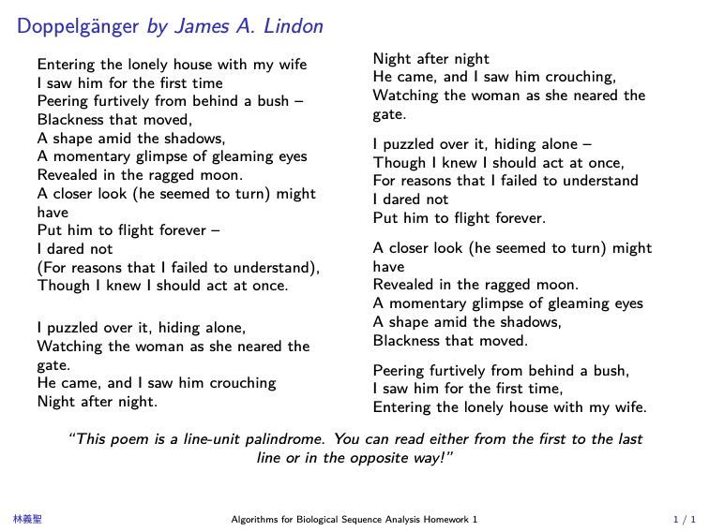

Slide 23
Anagrams
R96945033翁小涵
A Gentleman | = | Elegant Man
Astronomer | = | moon starer
The Country Side | = | No City Dust Here
Eleven plus two | = | Twelve plus one
Dormitory | = | Dirty Room
New York Times | = | monkeys write
Bill Gates | = | gets a bill
Princess Diana | = | end is a car spin
George Dubya | = | You're Bad Egg
Hello Kitty | = | Kill The Toy
Mother-in-law | = | Woman Hitler
Desperation | = | A Rope Ends It
I'm pregnant | = | parting men
Darling I love you | = | Avoiding our yell
將一個英文單字中包含的字母重新排列後，產生新的意思，以下為在網路上找到的例子。

Slide 24
A sequence which is sort of interesting or inspiring.
There is a “lie” in believe,
“over” in lover,
“end” in friend,
“us” in trust,
“ex” in next,
and “if” in life.
At first, I was looking for the sentence “Even believe has a lie in it.” but after searching on Google, I found the whole sentence.
Nothing is forever.

Slide 25
Sometimes you have to think outside the box.
Connect all nine points without letting the pen leave the paper, with four straight lines.
I like this one because it always reminds me to think outside the box. When I was younger,
a math teacher showed it to me and since then I always try to think about a problem from different perspectives. It also remindes me that there is a solution to (mostly) every problem, no matter how impossible it seems to be.
- Julia Pelzer, T07901105

Slide 26
Some math
1
1
3
3
5
5
7
7
?
2
2
8
8
9
9
4
4
I found this – years ago – in an episode of simpsons and liked it very much since in this case intuition and a good eye is all you need.
Sebastian Gütgemann

Slide 27
HW#1 Perfect Numbers Sequence
R06945028 陳胤竹
The sequence: 6, 28, 496, 8128, 33550336, 8589869056, 137438691328 …
The sequence I want to introduce is perfect numbers.
The perfect numbers have some special properties.
  1.The perfect number is equal to the sum of all of its factors.
    for example:
    factors of 6: 1, 2, 3. 6 = 1 + 2 + 3
    factors of 28: 1, 2, 4, 7, 14, 28 = 1 + 2 + 4 + 7 + 14
  2.Perfect numbers (even perfect numbers) are all ended with ”6” or “28”.
  3. They can be the sum of “consecutive integers”
    for example:
    6=1+2+3
    28=1+2+3+4+5+6+7
    496=1+2+3+…+30+31

Slide 28
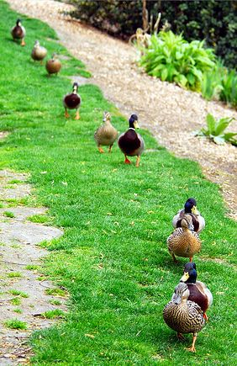
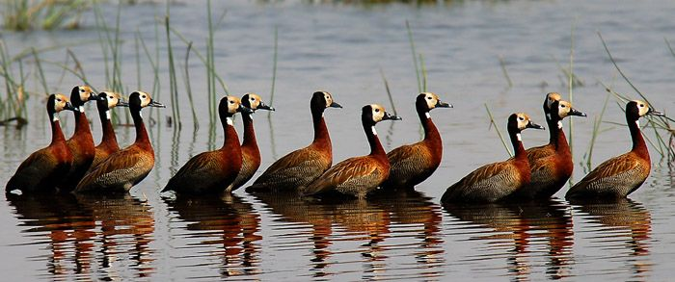
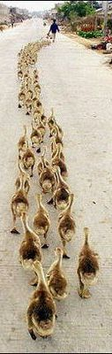
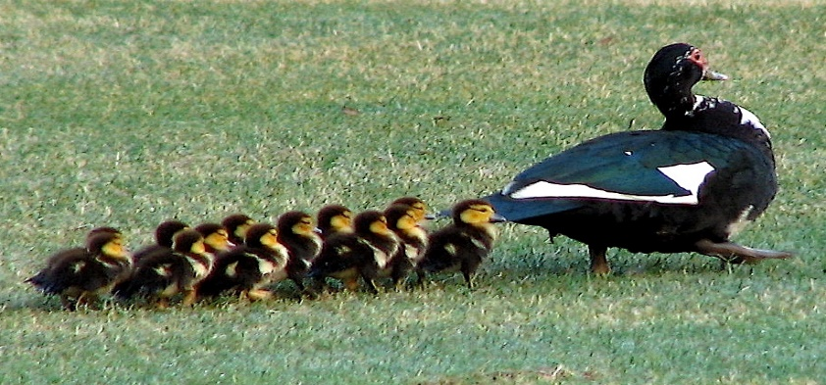
Ducks in a row
Source: Internet
It's really interesting to see ducks walking in a row!
And the most interesting part is that the phrase “ducks in a row” also means to organize things well, and that is what I need to do now!
R97922071 莊秋芸

Slide 29
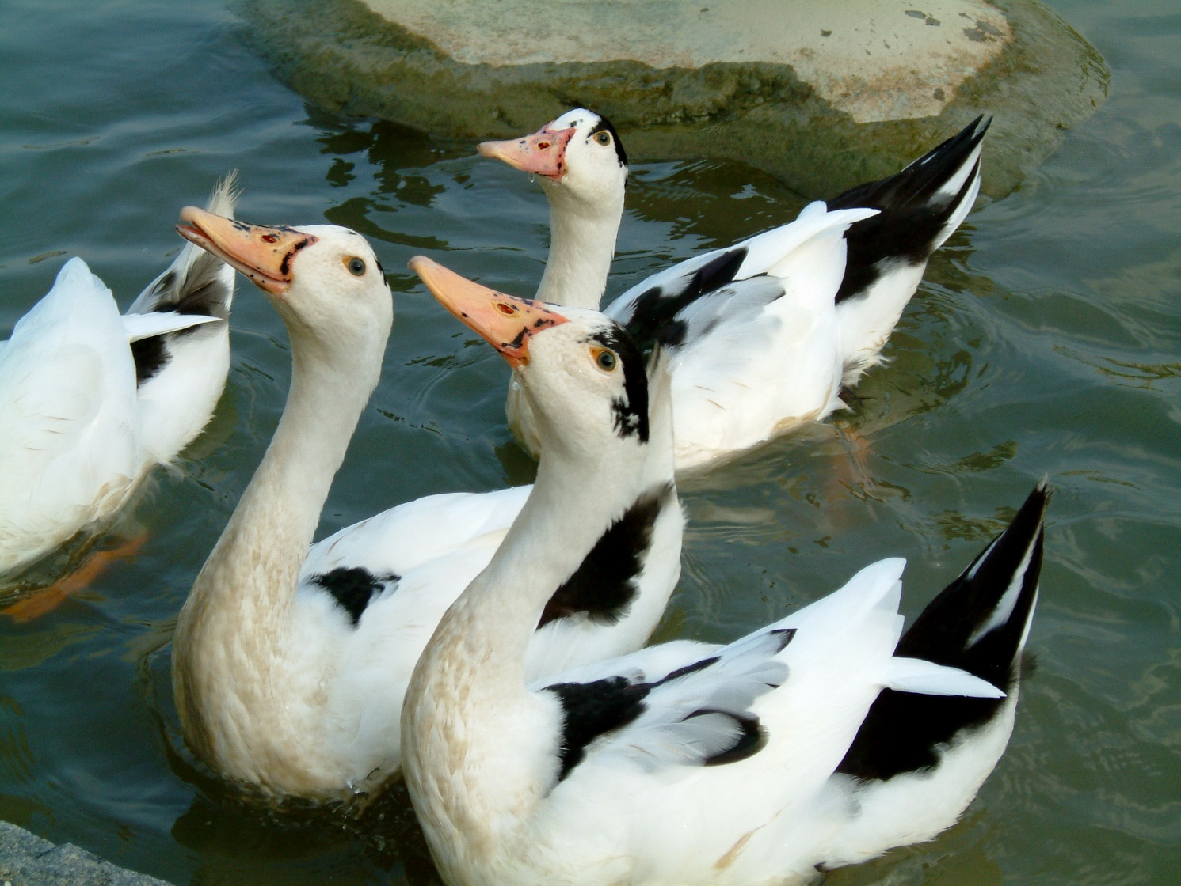
Ducks not in a row @NTU
Chao

Slide 30
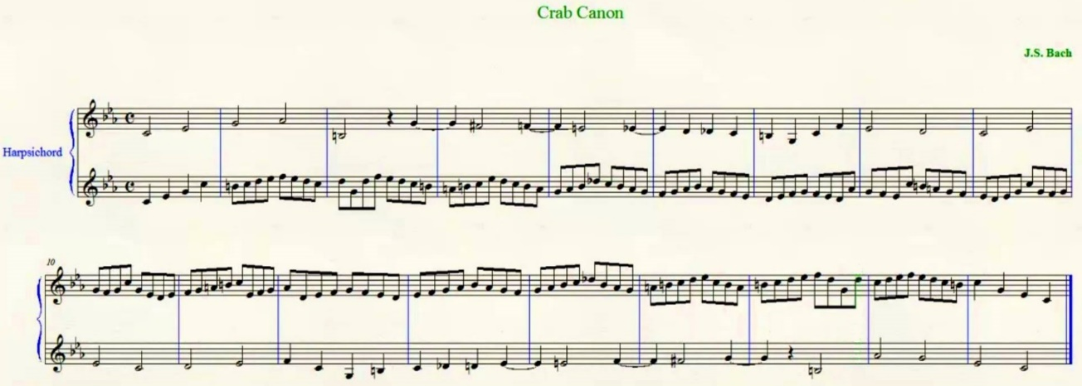
逆行卡農 (Crab canon) R06945024 陳泓宇
圖片來源：https://www.youtube.com/watch?v=W5Rk6Fqbo3Y
在查回文詩時，我發現類似於回文的概念也可以在音樂中發現！
在巴赫(Johann Sebastian Bach)的「音樂的奉獻(The Musical Offering)」曲集中的2 Canons a 2便是一個例子，這類曲子被稱為逆行卡農(Crab Canon)，順著彈或倒著彈都有不錯的旋律，所以讓第二聲部為第一聲部反過來同時演奏，直覺覺得有點奇怪，但卻滿好聽的。
https://www.youtube.com/watch?v=36ykl2tJwZM
從這段影片可以清楚看出一、二聲部是反過來的
https://www.youtube.com/watch?v=xUHQ2ybTejU
也有影片以莫比烏斯帶來凸顯這段曲子的特性

Slide 31
缺字文
This is an unusual paragraph. I'm curious how quickly you can find out what is so unusual about it? It looks so plain you would think nothing was wrong with it! In fact, nothing is wrong with it! It is unusual though. Study it, and think about it, but you still may not find anything odd. But if you work at it a bit, you might find out! Try to do so without any coaching!
這是缺字文這一段話完全沒有使用到”e”這個字母。
來源:維基百科
網媒所 R06944041 朱柏昇

Slide 32
Only the fool would take trouble to verify that his sentence was composed of ten a‘s, three b’s, four c‘s, four d’s, forty-six e‘s, sixteen f’s, four g‘s, thirteen h’s, fifteen i‘s, two k’s, nine l‘s, four m’s, twenty-five n‘s, twenty-four o’s, five p‘s, sixteen r’s, forty-one s‘s, thirty-seven t’s, ten u‘s, eight v’s, eight w‘s, four x’s, eleven y‘s, twenty-seven commas, twenty-three apostrophes, seven hyphens and, last but not least, a single!
An autogram
Source: Scientific American, 1982
An autogram means a sentence that describes itself. From the example above, the numbers of each alphabet in the sentence were designed to fit the amounts indicated by the contents. I think this kind of sentences is so amazing due to its perfect coordination.
R04945020 吳季芸

Slide 33
Snowball sentence
I do not know where family doctors acquired illegibly perplexing hand-writing; nevertheless, extraordinary pharmaceutical intellectuality, counter-balancing indecipherability, transcendentalizes intercommunications incomprehensibleness. (by Dmitri Borgmann)
每個字的長度是遞增的。中文也有用此種方式寫成的金字塔型詩，但是用英文寫的話，到後面要找到合適的字看起來就困難許多。
R04922122 陳琤

Slide 34
Buffalo buffalo Buffalo buffalo buffalo buffalo Buffalo buffalo.
這個句子之所以有趣在於，僅僅是重複一個英文單字八次，卻可以得到一個文法正確的英文句子。
翻譯成中文是「水牛城中某些被其他美洲野牛所恐嚇的美洲野牛，又去恐嚇了另一些美洲野牛。」
句中的 buffalo 分為三種：a. 水牛城 n. 美洲野牛 v. 恐嚇。
用上述 a、n、v 標記後就較容易閱讀：
Buffaloª buffalo^{n} Buffaloª buffalo^{n} buffalo^{v} buffalo^{v} Buffaloª buffalo^{n}.
[Those] (Buffalo buffalo) [whom] (Buffalo buffalo) buffalo, buffalo (Buffalo buffalo).
[HW1] R04922024 資工所 碩一 鄭佳銘
Source: Wikipedia

Slide 35
Quine: a computer program which produces its own source
Python:
Like a mirror which reflects itself.
s = ‘s = %r\nprint(s%%s)
print(s%s)
JavaScript:
Quine = function () {var str = arguments.callee.toString(); Quine = console.log(str.substring(52, 60) + str +
str.substring(32, 37) + str.substring(9, 11));}.call()
C:
main(){char *c="main(){char *c=%c%s%c;printf(c,34,c,34);}";printf(c,34,c,34);}
Haskell:
main = putStr (quine q)
quine s = s ++ show s
q = "main = putStr (quine q)\nquine s = s ++ show s\nq = "
Sources:
  https://en.wikipedia.org/wiki/Quine_(computing)
  https://www.nyx.net/~gthompso/quine.htm
By Johntim J.C. Kuo, 郭宗霆 D01922018

Slide 36
