Slide 1
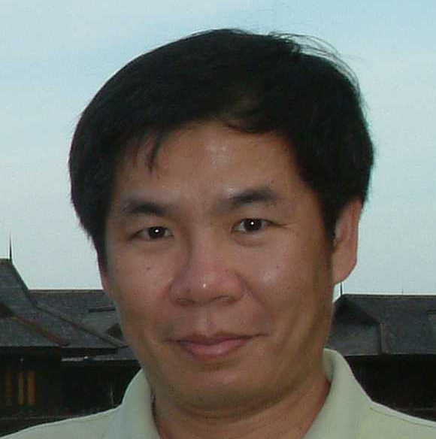
The 3SUM problem
Kun-Mao Chao (趙坤茂)
Department of Computer Science and Information Engineering
National Taiwan University, Taiwan
WWW: http://www.csie.ntu.edu.tw/~kmchao

Slide 2
The 3SUM problem
The 3SUM problem asks if a given set of n real numbers contains three elements that sum to zero
More logarithmic-factor speedups for 3SUM, (median,+)-convolution, and some geometric 3SUM-hard problems
TM Chan - ACM Transactions on Algorithms (TALG), 2019
  A terrific reference!
  http://tmc.web.engr.illinois.edu/talks/halg19_talk.pdf

Slide 3
A Simple Example
3, -1, -4, 5, 9, -7, -3 (A given sequence)
-7, -4, -3, -1, 3, 5, 9 (Sorted)
-7, -4, -3, -1, 3, 5, 9 (Check if -7 is in?)
  -7, -4, -3, -1, 3, 5, 9 (-7-4+9=-2<0 → -4 is out!)
  -7, -4, -3, -1, 3, 5, 9 (-7-3+9=-1<0 → -3 is out!)
  -7, -4, -3, -1, 3, 5, 9 (-7-1+9=1>0 → 9 is out!)
  -7, -4, -3, -1, 3, 5, 9 (-7-1+5=-3<0 → -1 is out!)
  -7, -4, -3, -1, 3, 5, 9 (-7+3+5=1>0 → 5 is out!)
  -7 is not in!

Slide 4
A Simple Example (Cont’d)
-7, -4, -3, -1, 3, 5, 9 (Check if -4 is in?)
  -7, -4, -3, -1, 3, 5, 9 (-4-3+9=2>0 → 9 is out!)
  -7, -4, -3, -1, 3, 5, 9 (-4-3+5=-2>0 → -3 is out!)
  -7, -4, -3, -1, 3, 5, 9 (-4-1+5=0 → Bingo!)
  The triple (-4, -1, 5) is a solution!
O(n) time to check if the leftmost element of the remaining sorted sequence is in or not
In total, O(n) x O(n) = O(n²) time
Can we solve the 3SUM problem in O(n^{2-ε}) time for some ε>0? It’s still open!

