Slide 1
Numbers

Slide 4
HW1 b04701232 陳柔安
Interesting sequence: look-and-say sequence
If started with any digit d from 0 to 9 then d will remain indefinitely as the last digit of the sequence. For d different from 1, the sequence starts as follows:
d, 1d, 111d, 311d, 13211d, 111312211d, 31131122211d, …
e.g. 1, 11, 21, 1211, 111221, 312211, 13112221, 1113213211, ...
Why interesting?
No digits other than 1, 2, and 3 appear in the sequence, unless the seed number contains such a digit or a run of more than three of the same digit.
The sequence grows indefinitely, except for the degenerate sequence: 22, 22, 22, 22, …

Slide 5
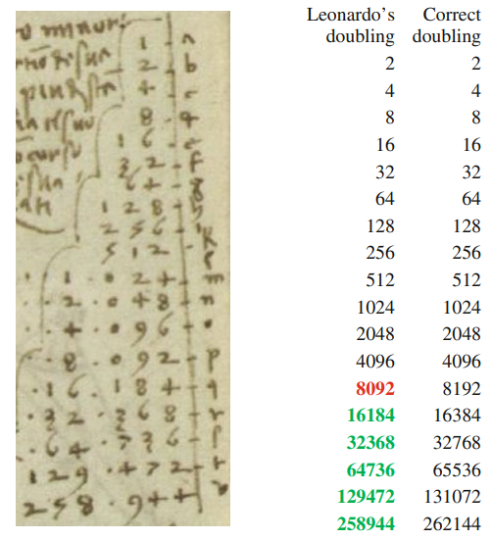

Slide 6
Find the next number of the sequence 1, 3, 5, 7, _
R07922158 王俊中
The answer is 217341. Because when
f(1) = 1, f(2) = 3, f(3) = 5, f(4) = 7, f(5) = 217341
有時候我們會很直覺的利用過往的經驗去判斷、下決定、或回答問題，這數列雖然太過誇張，也許是個很極端的例子。但我認為也很適合提醒自己在面對任何的決定以及問題時都應該從更多面向、可能去加以觀察、思考再做出判斷。
Reference: http://joyreactor.com/post/1666199

Slide 7
13717421/1111111111＝ 0.0123456789012345678901234567890123456789...
HW1 Interesting Sequences
這是我在網路上偶然看到的，我自己當下看到覺得還蠻有趣的 上面兩個特殊數字相除以後，會得到一個一直從 0 ~ 9 的循環小數
R07922168 洪靖秦

Slide 10
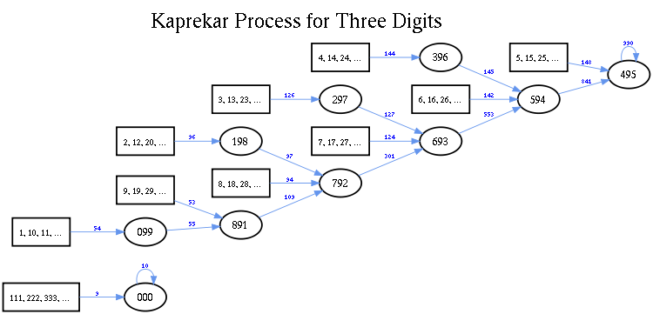
黑洞數 Kaprekar's constant
徐展鴻 R08922035
只要將數字重新置換，組合成最大的值和最小的數再加以相減，最後必定會掉入黑洞。 三位數： 495 、四位數： 6174
數學界竟然也有黑洞的性質，Amazing！
981 – 189 = 792
972 – 279 = 693
963 – 369 = 594
954 – 459 = 495
620 – 026 = 594
954 – 459 = 495
6321 – 1236 = 5085
8550 – 0558 = 7992
9972 – 2799 = 7173
7731 – 1377 = 6354
6543 – 3456 = 3087
8730 – 0378 = 8352
8532 – 2358 = 6174
3321 – 1233 = 2088
8820 – 0288 = 8532
8532 – 2358 = 6174
7641 – 1467 = 6174

Slide 11
Truncatable Primes
R08922041 資工碩一 張立暐
Left-truncatable primes (OEIS A024785):
2, 3, 5, 7, 13, 17, 23, 37, 43, 47, 53, 67, 73, 83, 97, 113, 137, 167, 173, 197, 223, 283, 313, 317, 337, 347, 353, 367, 373, 383, 397, 443, 467, 523, 547, 613, 617, 643, 647, 653, 673, 683, 743, 773, 797, 823, 853, 883, 937, 947, 953, 967, 983, 997, ... , 357686312646216567629137
Right-truncatable primes (OEIS A024770):
2, 3, 5, 7, 23, 29, 31, 37, 53, 59, 71, 73, 79, 233, 239, 293, 311, 313, 317, 373, 379, 593, 599, 719, 733, 739, 797, 2333, 2339, 2393, 2399, 2939, 3119, 3137, 3733, 3739, 3793, 3797, 5939, 7193, 7331, 7333, 7393, … , 73939133
It’s interesting that these prime numbers (contain no zero) remain prime when the last “right/left” digit is successively removed. For example, 7393 is a right-truncatable prime, since 7393, 739, 73, and 7 are all prime.
Related: (truncatable) PRIME DAYs!
20190823 is prime
190823 is prime
90823 is prime
823 is prime
23 is prime
3 is prime
There are only 53 (truncatable) prime days from 2000 to 2999.
20191001 is not prime. It is divisible by 139.

Slide 12
Palindromic Prime
R08922049 資工碩一 林政豪
A palindromic prime is a prime number that is also a palindromic number.
The first few decimal palindrome primes are: 2, 3, 5, 7, 11, 101, 131, 151, 181, 191, 313, 353, 373, 383, 727, 757, 787, 797, 919, 929 … and the biggest one found so far is 10⁴⁷⁴⁵⁰⁰ + 999 × 10²³⁷²⁴⁹ + 1。
Except for 11, all palindromic primes have an odd number of digits, because all palindromes with even number of digits can be divided by 11.
Due to the superstitious significance of the numbers it contains, the palindromic prime 1000000000000066600000000000001 is known as Belphegor's Prime with “666” in the center, on either side enclosed by thirteen zeroes and a one. Coincidence? I don’t think so.
There are lots of examples of primes and palindromes, so I’m curious about what happens to a prime which is also a palindrome. I found it interesting, especially the Belphegor's Prime.

Slide 13
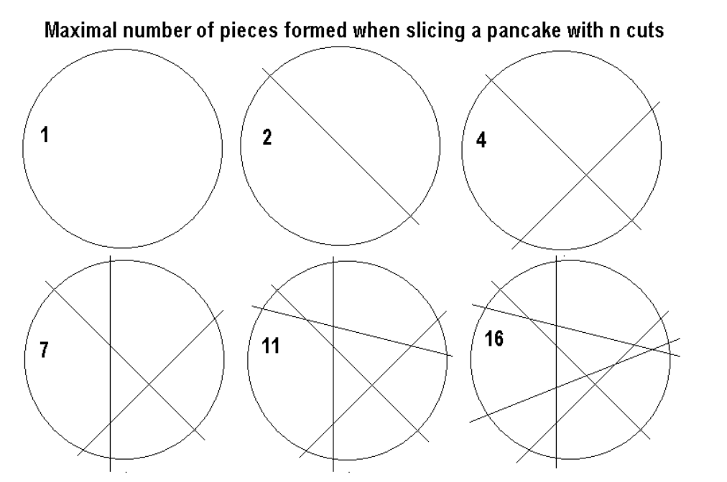
Lazy caterer's sequence
[hw1] R08922060 林映廷
Definition $p(n)$ : The maximum $p$ pieces with given $n$ cuts
$$p\left(n\right)=\left({n+1 \atop 2}\right)+1=\left({n \atop 2}\right)+\left({n \atop 1}\right)+\left({n \atop 0}\right)=\frac{n^{2}+n+1}{2}$$
這個序列有趣的地方在,正常切蛋糕或派時,都想著能等分切,會有先入為主的想法,以為這樣的切法會有最多的塊數,實際上則不然。結果來說,在下某一刀前,不要切到之前存在過的交點,這樣的切法正好符合Lazy caterer’s sequence。
Image source from FAMOUS MATHEMATICAL SEQUENCES AND SERIES
Proof can be referenced to Lazy caterer's sequence - Wikipedia

Slide 14
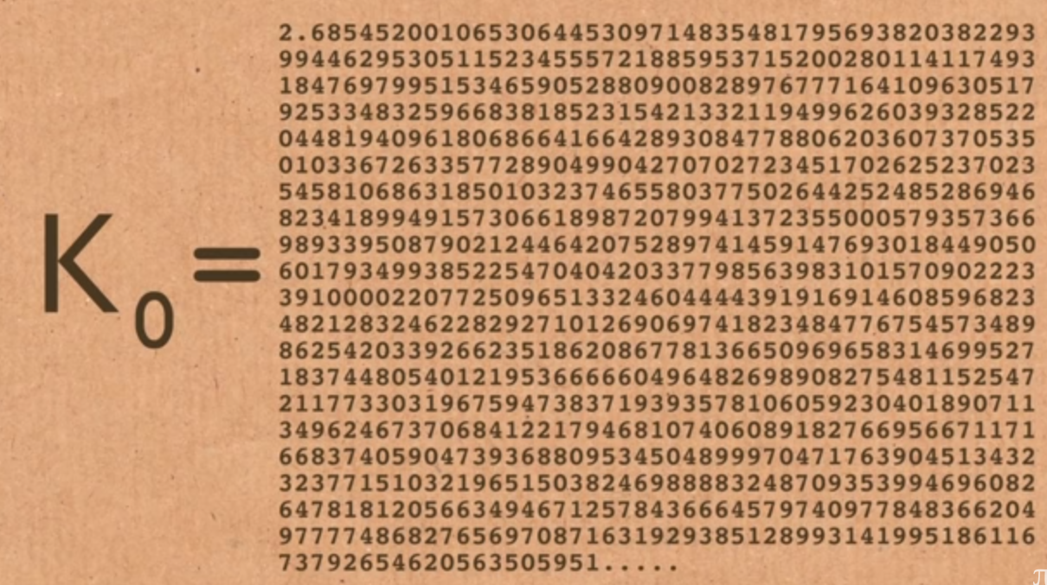
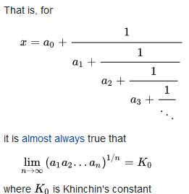
Khinchin's constant
R08922112 林溥博
In number theory, Aleksandr Yakovlevich Khinchin proved that for almost all real numbers x, coefficients ai of the continued fraction expansion of x have a finite geometric mean that is independent of the value of x and is known as Khinchin's constant.
It is interesting that almost every numbers share a same value in terms of the geometric mean of the coefficients of the continued fraction expansion, and that K0 itself is thought to follow this rule as well.
Reference: Wikipedia, Numberphile

Slide 15
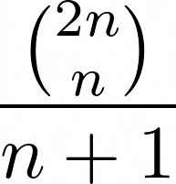
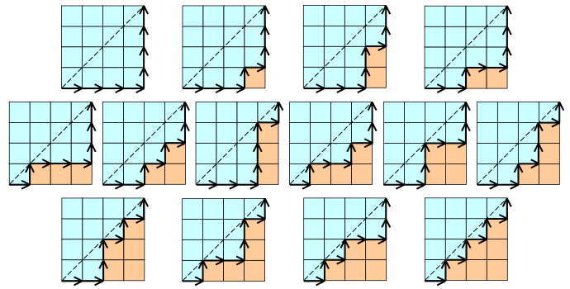
The Catalan Numbers
d05945019
楊宗儒
The n-th formula of them is
The first few terms are: 1, 1, 2, 5, 14, 42, 132, 429
They count at least 150 different kind of combinatorial objects. The famous mathematician Richard P. Stanley wrote a monograph on them (ISBN: 1107427746.)
For example in graph objects:
The binary trees with n vertices
The ordered trees with n+1 vertices
Triangulations of a convex polygon with n+2 vertices
Dyck Paths from (n-1, 0) to (0, n-1)
Noncrossing partitions of the set [n]
Dyck Paths. Courtesy to Dmharvey on Wikipedia

Slide 16
Lobb number
Reason :
number of ways that n + m open parentheses and n − m close parentheses can be arranged to form the start of a valid sequence of balanced parentheses
Xie Bing Ang 謝秉昂

Slide 17
3, 0, 2, 3, 2, 5, 5, 7, 10, 12, 17… (Perrin Sequence)
B05203047 資工四 徐衍新
This sequence is interesting since p|P(p) where P(p) is the p-th member of the Perrin sequence and p is a prime number
Conversely, if n | P(n) , it doesn’t imply n is a prime number
But the counter example is rare, only two can be found below 10^6, that is, 271441 and 904631
I choose this sequencebecause I just found the sequence and prove p|P(p) independently, and thought that the counter statement may be true. After testing, I found 271441 and 904631 which is the counter example below 10^6. By asking Google, I found that this is called “Perrin Pseudoprime” and this sequence has already been found. The smallest Perrin pseudoprime 271441 was found in 1982 by Adams and Shanks.

Slide 18
Fibonacci hided in a fraction
$\frac{1}{999999999999999999999998999999999999999999999999}$
=0.000000000000000000000000 000000000000000000000001
000000000000000000000001 000000000000000000000002
000000000000000000000003 000000000000000000000005
000000000000000000000008 000000000000000000000013
000000000000000000000021 000000000000000000000034
000000000000000000000055 000000000000000000000089…
這個神奇的分數（分母是除了第24位為8，其餘皆為9的48位數）化成小數時，會從第48位開始，規律地每隔24位出現一組非零數字，而這些數字恰好可以組成費波那契數列！
R08922085曾千育

Slide 19
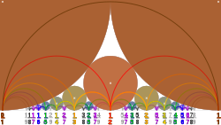
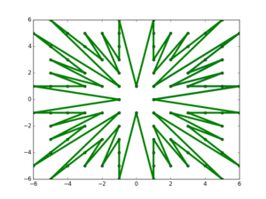
Farey 序列
R08946007
選取一個正整數 n。把所有分母不超過 n 的 最簡 分數找出來，從小到大排序。這個分數序列就叫做 Farey 序列。下面展示的就是 n = 7 。
在 Farey 序列中，對於任意兩個相鄰分數，先算出前者的分母乘以後者的分子，再算出前者的分子乘以後者的分母，則這兩個乘積一定正好相差1 。Farey序列擁有許多有趣的特性。
Farey sunburst of order 6
Comparison of Ford circles and a Farey diagram with circular arcs for n from 1 to 9. Each arc intersects its corresponding circles at right angles. In the SVG image, hover over a circle or curve to highlight it and its terms.

Slide 20
Interesting sequence [4, 9, 16, 25]
These are my student id since junior high school, they are all square number
D08922025 曾奕青

Slide 21
[1981, 1985, 1987, 1993, 1994, 1999, 2002, 2006, 2009]
Interesting? Why? KM Chao’s Life Big Events
https://www.csie.ntu.edu.tw/~kmchao/basic.html
R08922054 資工碩一 張凱捷

Slide 22
3952, 3886, 3869, 3858, 3844, 3805, 3785, 3742, 3711, 3705, 3703, 3668, 3642, 3632, 3619, 3607, 3603, 3594, 3564, 3560, ……….
These numbers are the height of top 20 peaks of Taiwan 100 Mountains(百岳). They show how high the back of Taiwan is, and demonstrate that why Taiwan is famous with high mountain.
In addition, they also remind me the touched feeling when I stood on some of these peaks, especially the number 3952 which stands for Mt. Jade, the highest mountain in Taiwan.
R08922079 洪浩翔

Slide 23
Words

Slide 24
R08922A03 黃志揚 來源: Wikipedia
Palindrome 迴文
1.
黃山落葉松葉落山黃
2.
小巷殘月凝天空，親人故土鄉情濃。
笑聲猶在空懷舊，憔心客愁滿蒼穹。
穹蒼滿愁客心憔，舊懷空在猶聲笑。
濃情鄉土故人親，空天凝月殘巷小。
說明：
迴文在中文裡面是高級的文法，在 CS 裡面有一些演算法來檢測序列是否對稱。

Slide 25
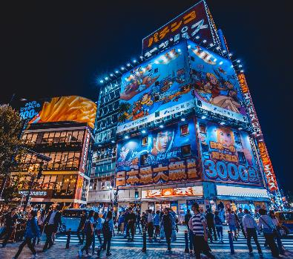
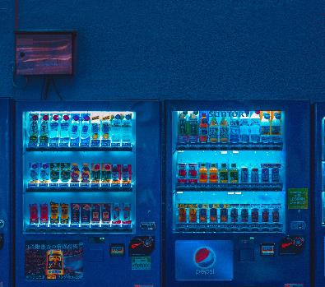
長き夜の 遠の睡りの 皆目醒め 波乗り船の 音の良きかな
なかきよの とおのねふりの みなめさめ
なみのりふねの おとのよきかな
English Meaning:
From a distant sleep in the long night, everyone is awaken,
Is it the by the sound of the surfing boat?
Interesting Points:
Generally speaking it is quite difficult for Japanese to have long palindrome in the “word” level due to the syntax structure; nevertheless, this Japanese poem is delicately created with a artistic concept.
Palindrome
A palindrome is a word, number, phrase, or other sequence of characters which reads the same backward as forward.

Slide 26
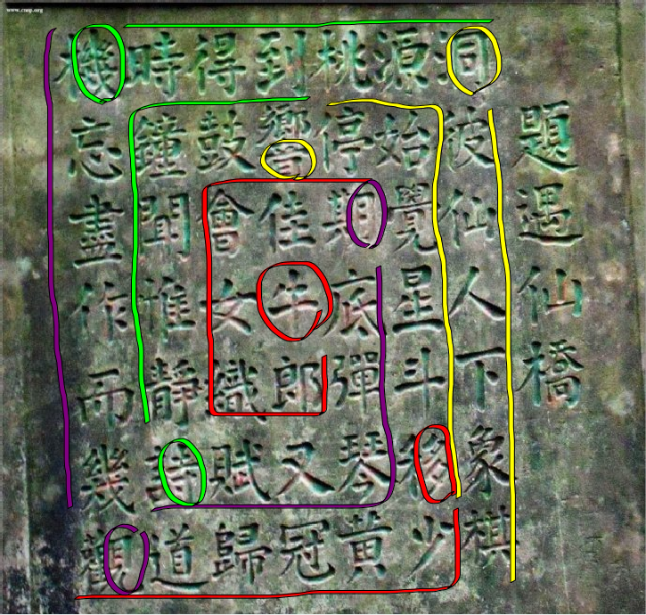
藏頭詩
位於湖南桃源縣
刻有一七言絕
句於石碑上:
題遇仙橋:
洞彼仙人下象棋
源始覺星斗移少
桃停期底彈琴黃
到響佳牛郎又冠
得鼓會女織賦歸
時鐘聞惟靜詩道
機忘盡作而幾觀
此七言絕句有趣在於讀的順序,
正確讀法為從最中間的牛字按順
時鐘方向讀
全詩理解為：
牛郎織女會佳期，
月底彈琴又賦詩。
寺靜惟聞鐘鼓響，
音停始覺星斗移。
多少黃冠歸道觀，
見幾而作盡忘機。
幾時得到桃源洞，
同彼仙人下象棋。
R07922138 傅家靖

Slide 27
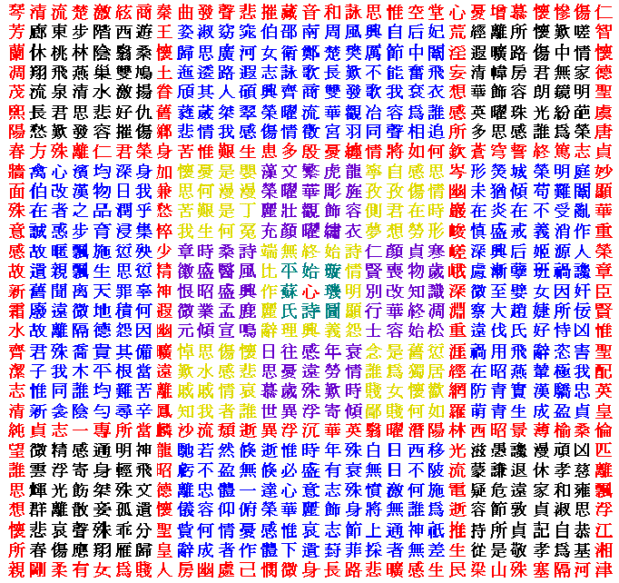
璇璣圖
作者是前秦女詩人蘇蕙。《璇璣圖》縱橫各29行，總共841字，縱、橫、斜、交互、正、反讀或退一字、迭一字讀均可成詩。
e.g.黃書讀法
自詩情起，五言四句： 詩情明顯怨，怨義興理辭；
辭麗作比端，端無終始詩。
自初行退一字，每首七言四句，俱逐句退成回文： 智懷德聖虞唐貞，妙顯華重榮章臣
還有非常多種讀法
Form wiki
R07922181 黃子賢

Slide 29
HW1 Interesting Sequence
學號: R08942074 姓名:紀伯翰
MACHI DIDI 2.0 (大人物) (feat. 熊仔) 最後一段歌詞
回文序列:
建中時的我 便以韻押的傳神
現在我讓舊技巧導領我戰勝
一絲不苟 有drop the beat強迫症
逆轉flow我把意涵轉到變順
============================
順便倒轉含義把我flow轉逆
震破牆壁的drop有夠不思議
聖戰我領導 巧技就讓我再現
神傳的押韻 已變我的石中劍

Slide 30
蘇軾 - 題金山寺
R08944005 網媒一 謝宏祺
潮隨暗浪雪山傾，遠浦漁舟釣月明。 輕鷗數點千峰碧，水接雲邊四望遙。
橋對寺門松徑小，檻當泉眼石波清。 晴日海霞紅靄靄，曉天江樹綠迢迢。
迢迢綠樹江天曉，藹藹紅霞晚日晴。 清波石眼泉當檻，小徑松門寺對橋。
遙望四邊雲接水，碧峰千點數鷗輕。 明月釣舟漁浦遠，傾山雪浪暗隨潮。
順讀、倒讀意境不同，可作為兩首詩來賞析，如果順讀是月夜景色到江天破曉的話，那麼倒讀則是黎明曉日到漁舟唱晚。

Slide 31
Palindrome (迴文)
r08944028 網媒所 碩一 賴達
Able was I ere I saw Elba.
Never odd or even.
Madam, I'm Adam.
Mr. Owl ate my metal worm.
Do geese see God?
Was it a car or a cat I saw?
左列的文字，倒著念跟正著唸都一樣。
第一句最為有名，是拿破崙的名言，
ere 是 before的意思，原意為
“在看到Elba島之前，我無所不能”
另外有人翻譯成
“落敗孤島孤敗落”
不只還原了原意，也保留了迴文的特性
Reference:
https://en.wikipedia.org/wiki/Palindrome
https://kknews.cc/zh-tw/history/4px3lp2.html

Slide 32
Images

Slide 33
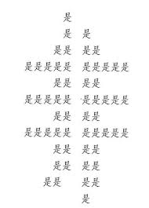
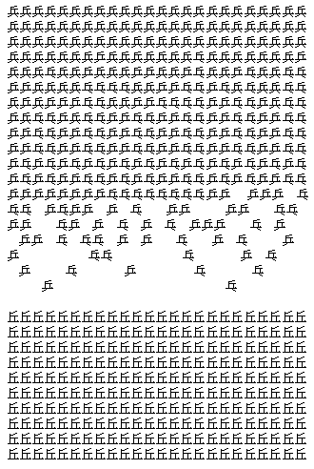
圖像詩
資工六 B03902041 廖名淳
圖像詩是結合文字的意義以及透過文字的編排位置或是字形效果組成的圖案的含意有呼應的效果。
陳黎〈戰爭進行曲〉：
有趣的地方在於由上到下呈現戰爭的三種狀態，用「兵」、「乒」或「乓」或「丘」代表士兵的圖像，「兵」是身體健全的士兵，「乒」或「乓」是斷一隻腳的，「丘」是全斷腳的，形容戰爭的過程中不斷有士兵腳斷掉，有趣在於用字的圖像反映士兵真實的樣態。
積是成非，每個字是「是」，所有的「是」字組成了「非」，有趣的地方在於透過安排字的位置可以形容一個成語。

Slide 34
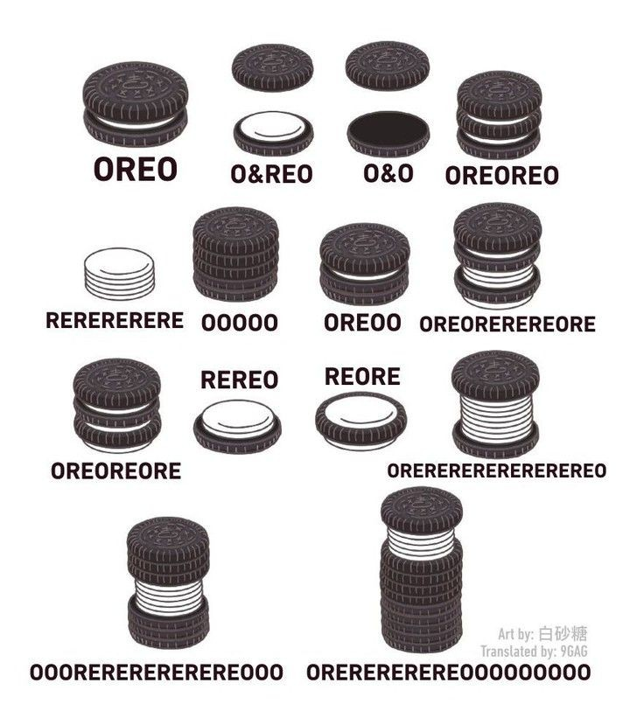
An interesting sequence
R08942125 廖克允

Slide 35
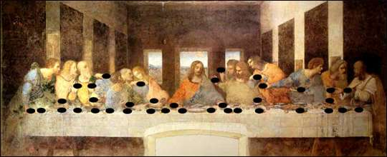
Da Vinci Musical Notes in 'Last Supper'
The Last Supper is a late 15th-century mural painting by Italian artist Leonardo da Vinci housed by the refectory of the Convent of Santa Maria delle Grazie in Milan, Italy. It is one of the Western world's most recognizable paintings.
An Italian musician has indicated that the positions of hands and loaves of bread can be interpreted as notes on a musical staff and, if read from right to left, as was characteristic of Leonardo's writing, form a musical composition.
I was deeply fascinated by this sequence of musical notes in my childhood. The hand positions in the paint compose a sequence of musical notes. How interesting it is!
Source:
https://en.wikipedia.org/wiki/The_Last_Supper_(Leonardo)
https://stylesource01.wordpress.com/2007/11/14/hidden-music-in-last-supper-painting-da-vinci/
R07921075 電機所 蕭大哲

Slide 36
Others

Slide 37
In the beginning God created the heavens and the earth (Genesis 1:1)
The hidden pattern of SEVENS in the very first verse of the Bible. Throughout the Bible the number 7 appears repeatedly as a symbol of divine perfection, which makes me think this implies in the beginning God created the world with perfection.
Ivan Panin carefully examined the Hebrew text of Genesis 1:1 and discovered an incredible phenomenon of multiples of 7 that could not be explained by chance. Genesis 1:1 was composed of seven Hebrew words containing a total of 28 letters. In total, Panin discovered 30 separate codes involving the number 7 in this first verse of the Bible.
P07922005 黃筑葭
A Partial Listing of the Phenomenal Features of Sevens Found in Genesis 1:1
The number of Hebrew words = 7
The number of letters equals 28 (7x4 = 28)
The first 3 Hebrew words translated "In the beginning God created" have 14 letters (7x2 = 14)
The last four Hebrew words "the heavens and the earth" have 14 letters (7x2 = 14)
The fourth and fifth words have 7 letters
The sixth and seventh words have 7 letters
The three key words: God, heaven and earth have 14 letters (7x2 = 14)
The number of letters in the four remaining words is also 14 (7x2 = 14)
The middle word is the shortest with 2 letters. However, in combination with the word to the Right or left it totals 7 letters
The Hebrew numeric value of the first, middle and last letters is 133 (7x19 = 133)
The Hebrew numeric value of first and last letters of all seven words is 1393 (7x199 = 1393)

Slide 38
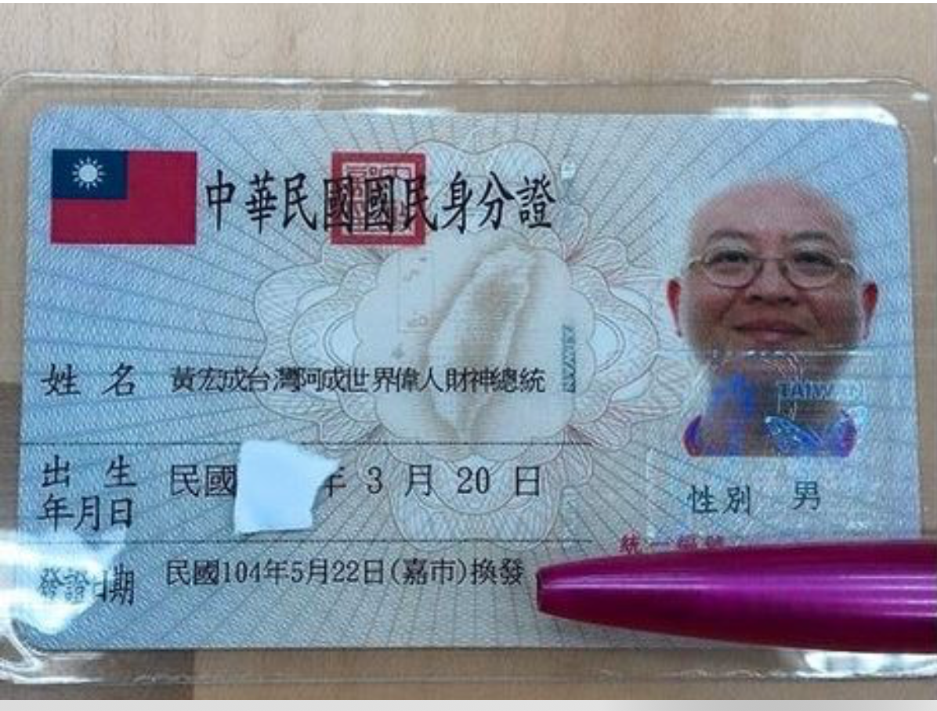
R07922130
台灣最長的姓名：
黃宏成台灣阿成世界偉人財神總統
Reason: 覺得很有趣，沒想到真的有這麼好笑的名字
Source: https://www.ettoday.net/news/20150524/510888.htm

Slide 39
成功男人的標志 r08944041，網媒所，楊書文
3歲，不尿褲子
5歲，能自己吃飯
18歲，能自己開車
20歲，有性生活
30歲，有錢
40歲，有錢
50歲，有錢
60歲，有性生活
70歲，能自己開車
80歲，能自己吃飯
90歲，不尿褲子
這段一開始似乎充滿著對主流膚淺（？）價值觀的追求，但讀到最後卻讓人不勝唏噓。首尾相接呈現了生命的輪迴，更感慨於人類一代一代都像老鼠一樣在滾輪上賣命跑著。看似膚淺卻讓人對自己的人生規劃有所省思，並深刻反省著千萬不要為了寫作業通霄不睡以免老了活得沒尊嚴Ｑ

Slide 41
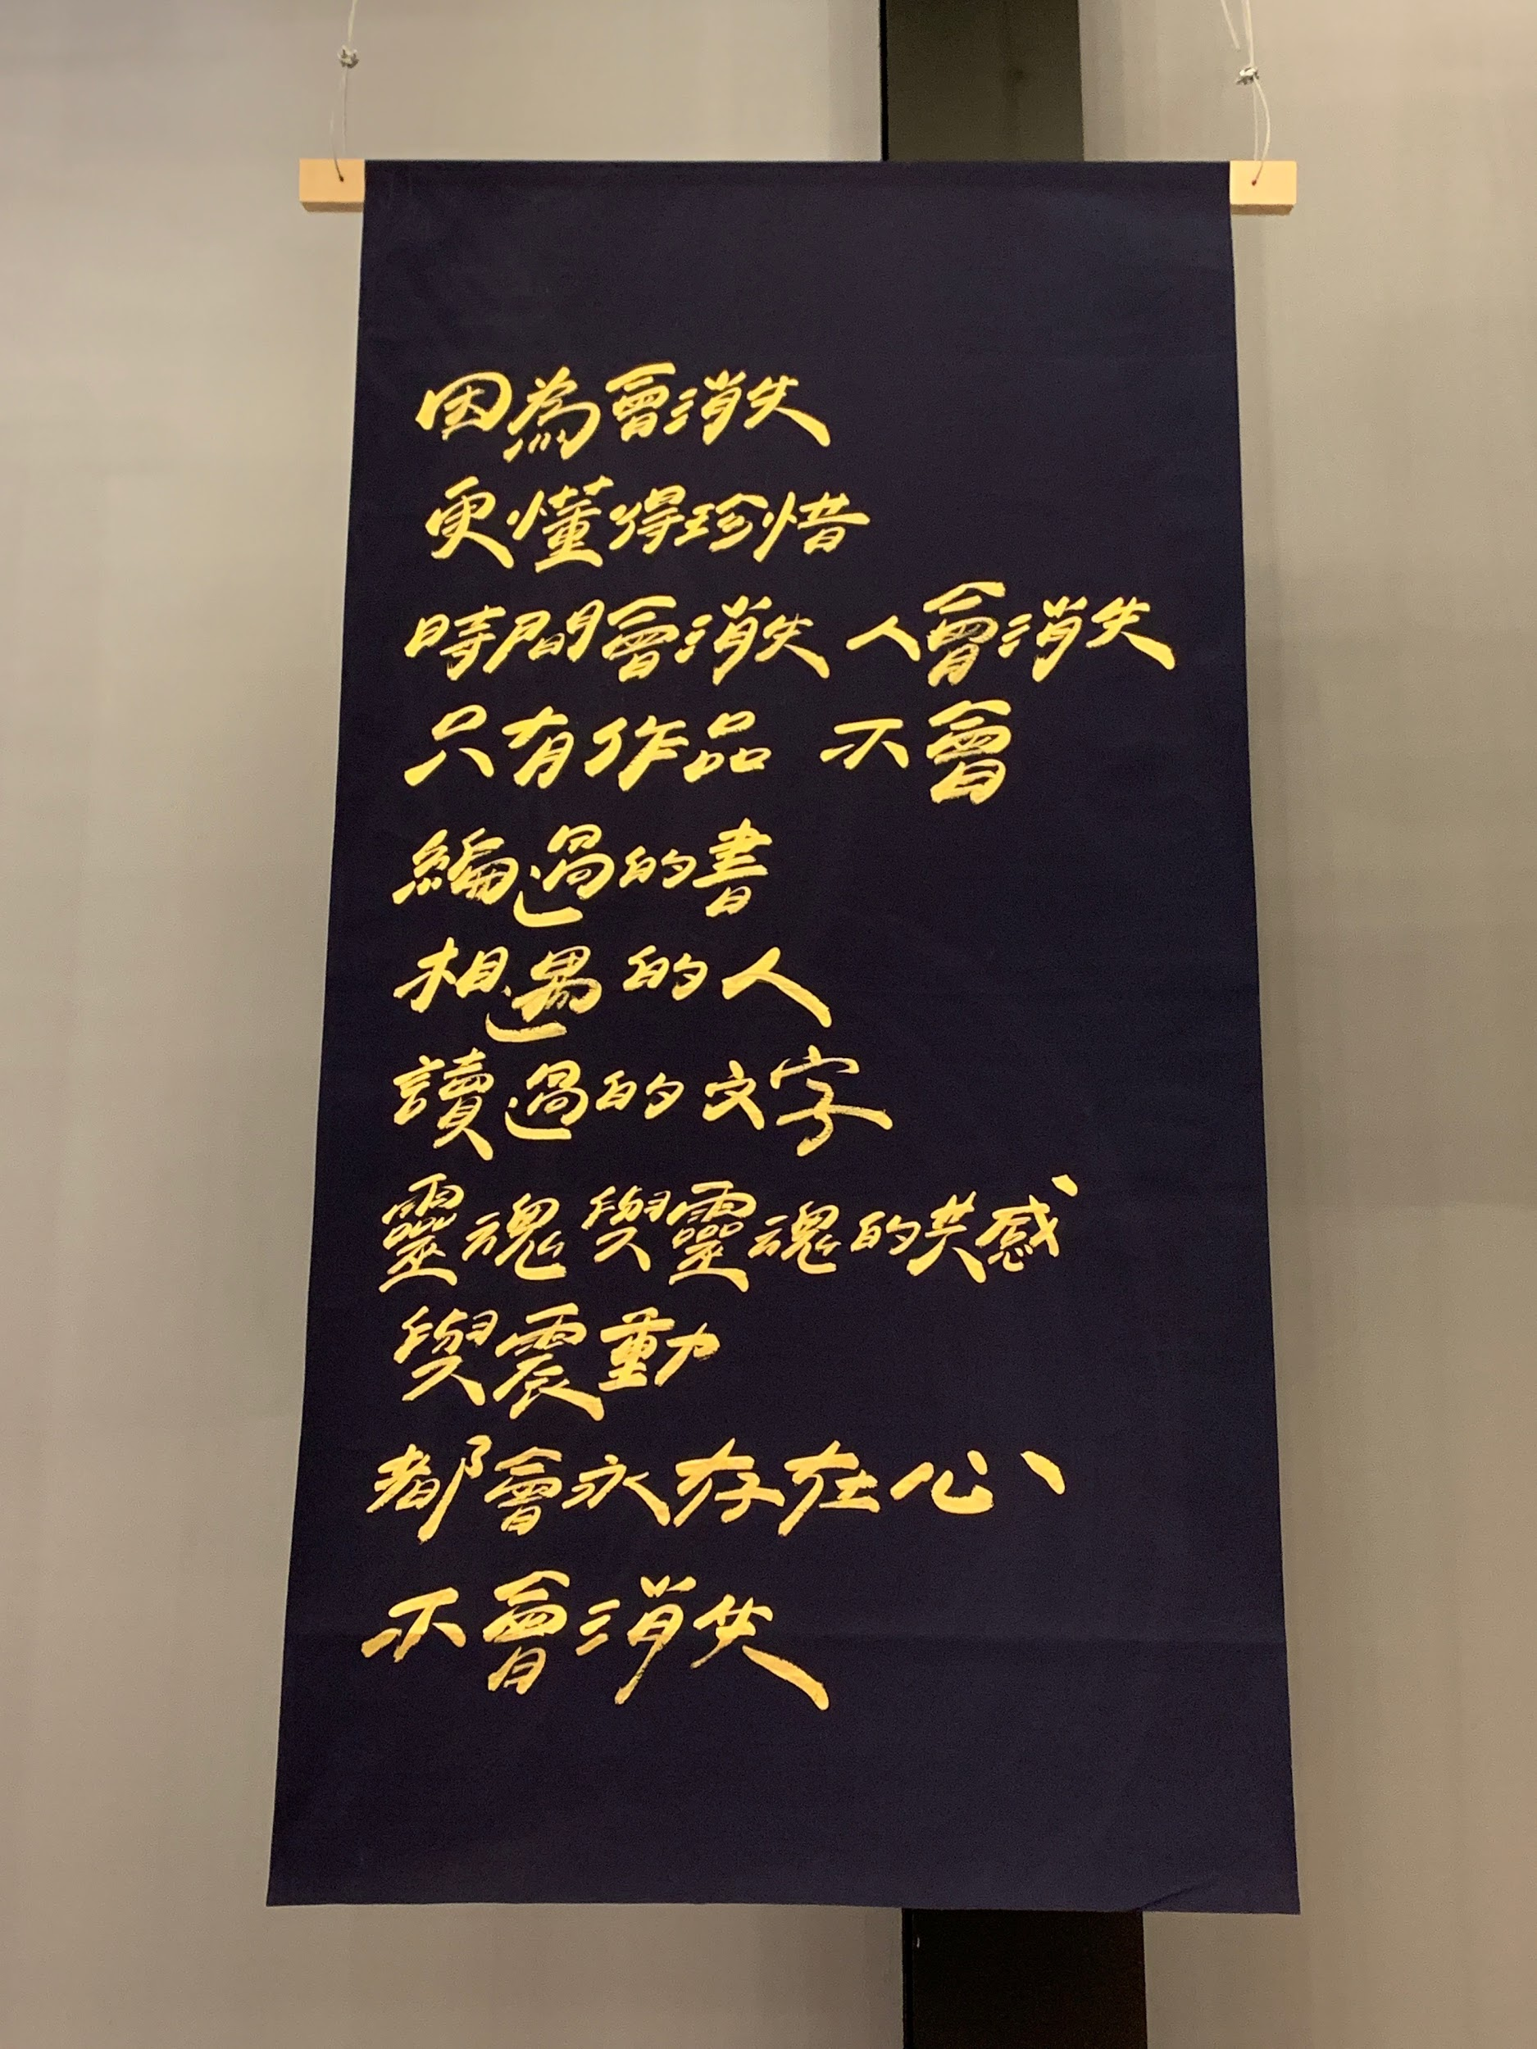
不會消失的文字
今天(2019/9/27)去聽了我非常好的朋友推薦的簽書會，離開前在會場看到的旗子。這段序列/文字最有趣的地方在於，它打動了我，就如同它字面上傳達的意思一樣，它真的要永遠留存在我心中了。另外它順著念或倒著唸，其實都說得通，讀起來也不會卡卡。我想這就是文字的魔力吧！
資工所 r08922099 王 甯

