Slide 1
2018 HW1
Interesting or Inspiring Sequences

Slide 2
Number

Slide 3
Hw1 An interesting sequence r06922114陳啟元
The sequence : 1, 2, 4, 8, 16, 22, 26, 38, 62, 74, 102, …
which is defined by a(n+1) = a(n) + (the product of the nonzero digits of a(n)). (e.g. 74 = 62 + 6 * 2)
Why it’s interesting? : There is a theory by Paul Loomis states that starting from any positive integer, its sequence will join the sequence started from 1.
(e.g. 3, 6, 12, 14, 18, 26, 38, 62, 74, 102, ...)

Slide 4
Digit Product Sequence
R07922054 駱定暄
初始條件：從正數開始
數列遞迴規則：後一項數字為前一項數字非零位的乘積，加上前一項數字本身。ex. 102的下一項為(1*2)+102=104
舉例，從1開始：1, 2, 4, 8, 16, 22, 26, 38, 62, 74, …
有趣的事情是，所有正數起始的數列，最後都會與從1開始的數列重合，比方說，從3開始的數列，會在26與從1開始的數列重合
參考資料：https://facstaff.bloomu.edu/ploomis/sequences.html

Slide 5
Florian Heemeyer (A07945101)
Morris Number Sequence
1, 11, 21, 1211, 111221, 312211, 13112221, 1113213211 …..
Explantation:
This sequence grows indefinitely but contains just the digits 1, 2 and 3.
n | Previous value | Value n
1 | - | 1
2 | “One one” | 11
3 | “Two ones” | 21
4 | “One two & one one” | 1211

Slide 6
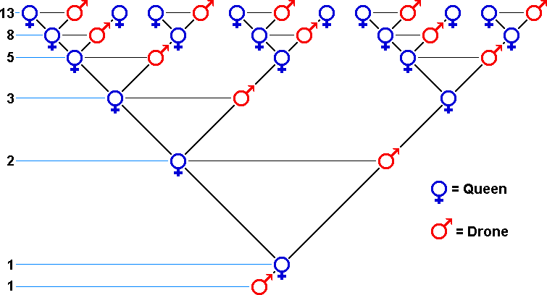
Keming Kao
T07902108
On the right is an interesting application of the Fibonacci sequence: When male bees are born, the egg is unfertilized, so there is only 1 parent. When female bees are born, the egg is fertilized, so they have 2 parents. After a few generations, we see that each one corresponds to sequential Fibonacci numbers!
Credit: Internet

Slide 7
HW#1 Perfect Numbers Sequence
R06945028 陳胤竹
The sequence: 6, 28, 496, 8128, 33550336, 8589869056, 137438691328 …
The sequence I want to introduce is perfect numbers.
The perfect numbers have some special properties.
  1.The perfect number is equal to the sum of all of its factors.
    for example:
    factors of 6: 1, 2, 3. 6 = 1 + 2 + 3
    factors of 28: 1, 2, 4, 7, 14, 28 = 1 + 2 + 4 + 7 + 14
  2.Perfect numbers (even perfect numbers) are all ended with ”6” or “28”.
  3. They can be the sum of “consecutive integers”
    for example:
    6=1+2+3
    28=1+2+3+4+5+6+7
    496=1+2+3+…+30+31

Slide 8
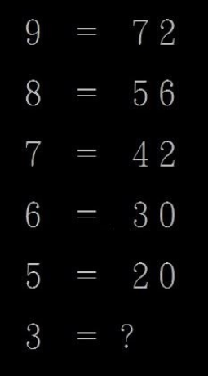
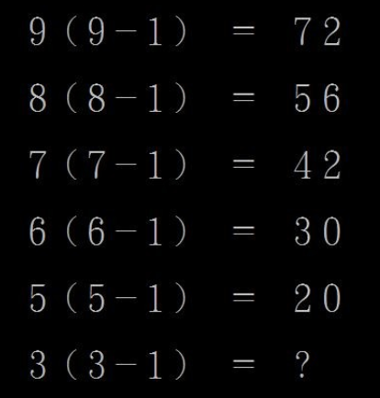
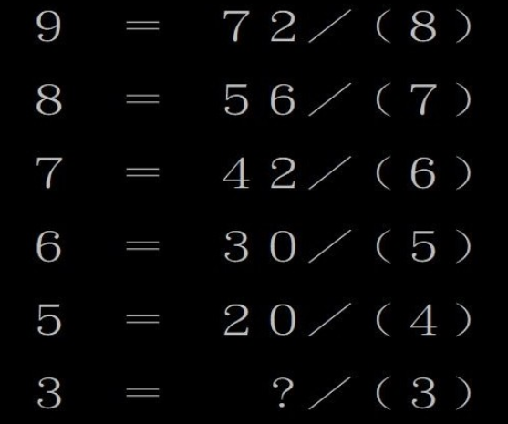
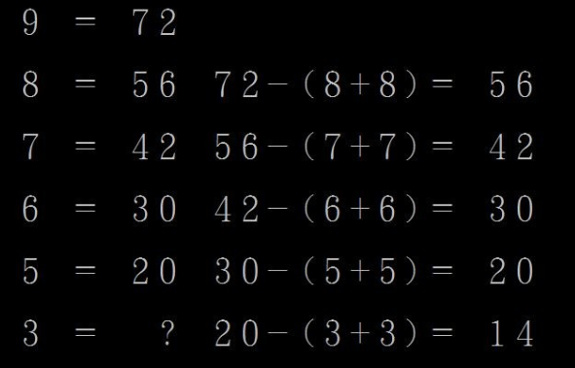
D07945011江尚瑀
It has three kinds way to find the answer.
The answer is 14.
The answer is 6.
The answer is 9.
Source: Internethttps://www.ettoday.net/news/20170608/940920.htm

Slide 9
R07922061 陳力
Catalan numbers oeis.org/A000108
1, 1, 2, 5, 14, 42, 132, 429…
Reason:
  Corresponds to counting of many combinatorial objects
  Binary trees, bracket sequences…

Slide 10
Interesting Sequence HW1
381654729
此數前n項組成的數字會被n整除
恰好是1~9不重複數字組成，且唯一
設數字為abcdefghi，偶數位置必須被2整除b, d, f, h為偶數
e必定為5，cd為4的倍數，fgh為8的倍數(gh為8的倍數)
abc, def, ghi為3的倍數，efg-bcd+a為7的倍數
R06922026 柯東爵
Ref: http://www.mathland.idv.tw/fun/divndigit.htm

Slide 11
INTERESTING SEQUENCE : 142857
REASON WHY IT IS INTERESTING
142857 * 1 = 142857
142857 * 2 = 285714
142857 * 3 = 428517
142857 * 4 = 571428
142857 * 5 = 714285
142857 * 6 = 857142
142857 * 7 = 999999
142 + 857 = 999
14 + 28 + 57 = 99
142857 * 142857 = 20408122449, 20408 + 122449 = 142857
B05303003 資工三 黃奎鈞

Slide 12
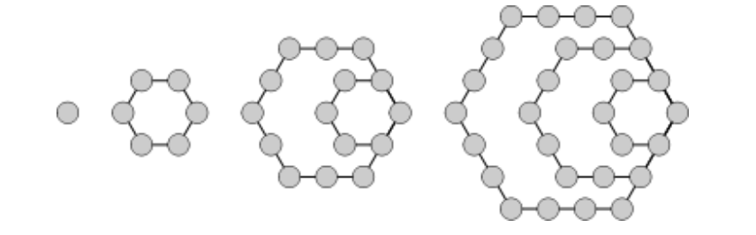

Hexagonal Numbers
An hexagonal number or hexagon number counts the objects that can form an equilateral hexagon. The nth hexagon number is the number of dots or balls in an hexagon with n dots on a side:
The formula for the nth hexagonal number:
The first few hexagonal numbers are:
1, 6, 15, 28, 45, 66, 91, 120, 153, 190, 231…
Marya Rezzouk, [ID:A07922202]

Slide 13
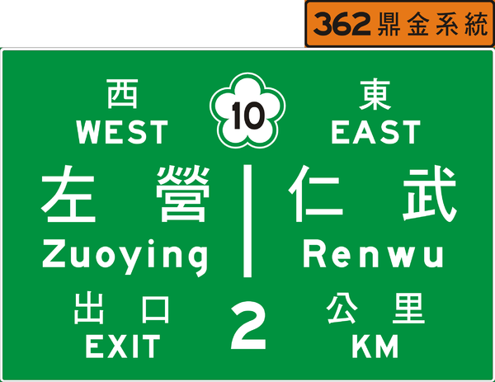
Hw1
Name：吳孟軒
Sequence：
0, 1, 2, 5, 6, 10, 11, 13, 15, 17, 23, 25, 27, 32, 33, 35, 41, 49, 52, 55, 57, 59, 62, 65,
67, 69, 71, 83, 86, 91, 95, 99, 110, 125, 132, 140, 150, 159, 160, 165, 168, 174, 178, 181, 189, 192, 198, 207, 211, 220, 229, 230, 235, 240, 243, 250, 257, 264, 270, 272, 284, 288, 299, 303, 311, 315, 319, 324, 327, 330, 335, 338, 342, 349, 356, 362, 367, 369, 370, 371, 372, 373, 374
這個序列是高速公路交流道公里數。小時候常常往返家與阿嬤家，在車上無聊就把一些交流道的公里數與交流道數字記起來了，於是對這些里程數很熟悉！但是現在交流道沒專屬數字，只剩下公里數，也是少了一些童年回憶。

Slide 14
[HW1] Freemasonry cipher
Student ID : r07922153
Name : Sakura Yamaki(八巻 櫻)
Interesting sequence is as follow.
6288 1918 2237 130002
6289 1945 2166 100221
6290 1789 2226 1111111
Reference : https://tocana.jp/2018/06/post_17327_entry_2.html
Explanation :
  Just on the morning of June 25th 2018, the official Twitter account of Freemason Japan Grand Lodge tweeted a strange sequence that seems to be cipher as described above.
  And this cipher has not been solved yet, so I think that it’s interesting!

Slide 15
poem

Slide 16
趣言能適意，茶品可清心。
心清可品茶，意適能言趣。
這首詩不只有回文格式，念起來亦順暢帶有閒趣。
B04902064 李衡

Slide 17
B04902084 王建元
王安石的回文詩【碧蕪】
碧蕪平野曠，黃菊晚村深；
客倦留甘飲，身閑累苦吟。
倒讀成：
吟苦累閑身，飲甘留倦客；
深村晚菊黃，曠野平蕪碧。
有趣的地方是無論正讀還是反讀，詩裡疲倦愁苦的意境都不變，而且仍然充滿詩意。

Slide 18
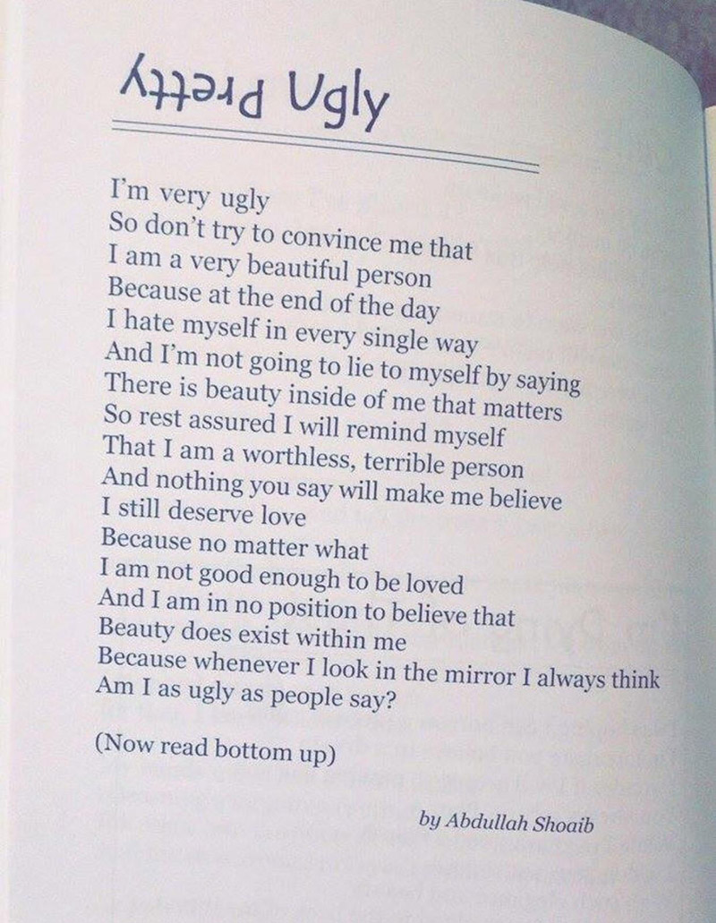
英文回文詩
這是一首英文回文詩，可以從開頭往下讀，也可以從結尾一行一行倒回讀。之前比較常見到中文的回文詩，英文回文詩受限於語言的關係，比較少能一字一字倒回來讀，但一句一句倒回來唸倒是可以。
選這首詩的原因是因為覺得有被這首詩激勵到，由上往下讀時能夠感覺到整首詩充滿了自卑的想法，覺得自己不夠好、不會受人喜愛。但由下往上讀回時，整首詩充滿了樂觀與自信，作者似乎是想傳達「你是美麗、有價值的人」的想法給讀者。這首詩似乎也是在提醒我們：你決定如何讀這首詩就代表你怎麼看待自己。
Source: https://www.sunnyskyz.com/blog/2515/There-Are-2-Ways-To-Read-This-Poem-The-One-You-Choose-Will-Be-The-Difference-In-Your-Life
資工所 R07922117 黃榆珊

Slide 19
聯珠迴文詩
D04945013
生醫電資所 博四 游文萱
聯珠迴文詩是因詞語相互套結而得名，其為七言絕句的延伸變革，句型字數以四、三配對。清代吳絳雪的《春夏秋冬》乍看會讓人百思不得其解，但是每一句都可以用廻文自成一首七言絕句，分別描寫春、夏、秋、冬的景色。
讀法：以一至七字為首句，四至十字為承句，然後倒句回讀之，為轉句及末句。
範例：X1 X2 X3 X4 X5 X6 X7 X8 X9 X10
❶
❷
❹
❸
《春夏秋冬》
清•吳絳雪
鶯啼岸柳弄春晴夜月明
香蓮碧水動風涼夏日長
秋江楚雁宿沙洲淺水流
紅爐透炭炙寒風御隆冬
《春》
鶯啼岸柳弄春晴，
柳弄春晴夜月明。
明月夜晴春弄柳，
晴春弄柳岸啼鶯。
《夏》
香蓮碧水動風涼，
水動風涼夏日長。
長日夏涼風動水，
涼風動水碧蓮香。
《秋》
秋江楚雁宿沙洲，
雁宿沙洲淺水流。
流水淺洲沙宿雁，
洲沙宿雁楚江秋。
《冬》
紅爐透炭炙寒風，
炭炙寒風御隆冬。
冬隆御風寒炙炭，
風寒炙炭透爐紅。

Slide 20
賴達 資工四 b04902034
四字詞性相同之四字成語可隨意排序，意義不變
名詞類:琴棋書畫、絲竹管弦、金石絲竹、規矩繩墨、禮義廉恥、風雲月露、東西南北、樓台亭閣、王侯將相
動詞類:捭闔縱橫、起承轉合、望聞問切、嬉笑怒罵、賞罰黜陟、洗削更革、切磋琢磨、打滾撒潑、挑撥離間
形容詞:悲歡離合、輕重緩急、溫柔敦厚、喜怒哀樂、隱晦曲折、清新俊逸、豐亨豫大、光明磊落、忠孝節義
參考連結

Slide 21
分醫所 碩二 周毓慈 P06448007
古之欲明明德於天下者，先治其國；欲治其國者，先齊其家；欲齊其家者，先修其身；欲修其身者，先正其心；欲正其心者，先誠其意；欲誠其意者，先致其知；致知在格物。
物格而后知至，知至而后意誠，意誠而后心正，心正而后身修，身修而后家齊，家齊而后國治，國治而后天下平。
以前背大學的時候就覺得這段很有趣，前面的遞升和後面的遞降相互乎應，又字詞前後順序互換還是相同的意思，實在覺得中文非常奧妙！

Slide 22
六十老兒生一子人言非是我子也家產田園盡付與女婿外人不得爭執。
六十老兒生一子，人言：『非是我子也！』家產田園盡付與女婿，外人不得爭執。
六十老兒生一子，人言非，是我子也！家產田園盡付與。女婿外人，不得爭執。
D07943002 陳彥龍

Slide 23
HW1. an interesting sequence
Kai-Pu Chen, D04945020, BEBI
Acrostic word for Father’s day in English
FUN
HANDSOME
INTELLIGENT
HAPPY
HERO
GREAT
I think the sequence is interesting because there is a new hiding meaningfully vocabulary (FATHER) in lots of words.
Especially, it can represent for Happy Father’s Day to admire that father is a fun, handsome, intelligent, happy, a hero and great man in the world! And it’s like Chinese poem called 藏頭詩!
Reference: https://www.pinterest.com/pin/86412886572984901/

Slide 24
R07922080 資工碩一 于建民
Janet was quite ill one day.
Febrile trouble came her way.
Martyr-like, she lay in bed;
Aproned nurses softly sped.
Maybe, said the leech judicial
Junket would be beneficial.
Juleps, too, though freely tried,
August ill, for Janet died.
Sepulchre was sadly made.
Octaves pealed and prayers were said.
Novices with ma'y a tear
Decorated Janet's bier.
At first sight it looks like an ordinary story. But after careful examination, one can find out that there’s some special hidden patterns: the initial three letters of each line are the abbreviations for twelve months! This is also called an “acrostic poem”. I find this kind of sequences quite interesting because there may be some information hidden behind the words other than their literal meanings.
Source: https://zh.wikipedia.org/wiki/%E9%9B%A2%E5%90%88%E8%A9%A9

Slide 25
A sequence which is sort of interesting or inspiring.
There is a “lie” in believe,
“over” in lover,
“end” in friend,
“us” in trust,
“ex” in next,
and “if” in life.
At first, I was looking for the sentence “Even believe has a lie in it.” but after searching on Google, I found the whole sentence.
It reminds people to be cautious and nothing is forever. It is interesting of the “words” and inspiring of the meaning.

Slide 26
Led Zepplin's Stairway to Heaven
其中一段歌詞經過倒轉播放，竟然變成了撒旦崇拜的內容。
解說影片： https://youtu.be/IXpEtF4i1oI
參考資料： https://en.wikipedia.org/wiki/Stairway_to_Heaven
https://en.wikipedia.org/wiki/Backmasking
歌詞片段
If there's a bustle in your hedgerow
Don't be alarmed now
It's just a spring clean for the May queen
Yes, there are two paths you can go by
But in the long run
There's still time to change the road you're on
倒轉播放的結果
Oh, here's to my sweet Satan
The one whose little path would make me sad whose power is Satan
He'll give, he'll give you 666
There was a little toolshed where he made us suffer, sad Satan
R06922042 藍祥予

Slide 27
BUSY
Being Under Satan's Yoke
Being a Christian, this acronym is frequently used as a reminder that Satan separates a man from God by making him busy. Matthew 11:29 wrote:
  Take my yoke upon you and learn from me, for I am gentle and humble in heart, and you will find rest for your souls. For my yoke is easy and my burden is light.
He thus has called us to take his yoke, which gives us peace, provided that we first relieve ourselves from our own yoke of busyness.
R07922039 陳耘志

Slide 28
童年諺語歌謠
臨醫所博一 劉士嶢 D07421006
剪刀石頭布，你沒穿內褲，內褲夾在聯絡簿，送給老師當禮物，老師看了很生氣，一腳踢到美國去，美國小姐真美麗，送你一盒巧克力，邊走邊吃邊放屁，阿里巴巴打屁屁
小姐小姐別生氣，明天帶妳去看戲，看什麼戲？
看妳爸爸流鼻涕，剃剃剃光頭，投投投大海，海海海龍王，王王王八蛋，盪盪盪鞦韆，牽牽牽牛花，花花花公子，子子你是我的乖孫子
回想起小時候一些廣為人知但不太入流的順口溜，之所以能讓人琅琅上口，就是因為每一句的尾巴跟下一句的開頭相同，如同古文中的頂真修辭法。若將歌謠的每一句看成一個序列，也能想像這些序列藉由相似或互補的首尾相連接，饒富趣味。
來源: 話說童年哼唱遊戲

Slide 29
other

Slide 30
Interesting Sequence
There are some names of diseases that contains certain irony which I found very amusing. For example:
Hippopotomonstrosesquippedaliophobia: As one of the longest word in the dictionary, it means the fear of long words.
Aibohphobia: Different from the previous phobia, this word -- the fear of palindromes -- is probably more of a joke than actual disease. However, it is still interesting since the word itself is a palindrome sequence.
B04902022 陳譽穆

Slide 31
[HW1] b03902125
林映廷
uvuvwevwevwe onyetenyevwe ugwemubwem ossas
I think it’s interesting because the name of certain African is funny, lengthy, and not easy to remember. You can see following two vedios to understand my punch line. His parents’ name is so, too.
vedio 1 : https://www.youtube.com/watch?v=efmtZ1-qtt0
vedio 2 : https://www.youtube.com/watch?v=_q3b6wqXC6U

Slide 32
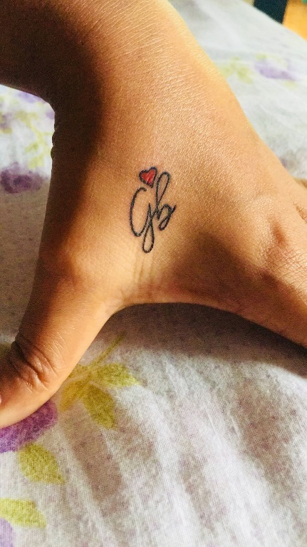

Upside
Downside
It is a tattoo that I designed for myself. It has the initials of my mother (G) and father (B). Interesting fact:
The letters are same even when we see upside down.
When seen from upside, G seems bigger than B. While from the opposite side, B is larger than G. This means sometimes I listen to my dad’s opinion and sometimes my mom’s opinion. But in both the cases I have the blessings of both.
The love symbol signifies their eternal love for each other and our family.
Note that the loops of G and B make a kind of infinite symbol . This signifies my love for both of them forever.
Source: Own imagination ☺
Student ID: D07945014

Slide 33


Slide 34

Alphabetical Sequence
The skill required to be able to do this is amazing. I certainly couldn’t do it.

Slide 35
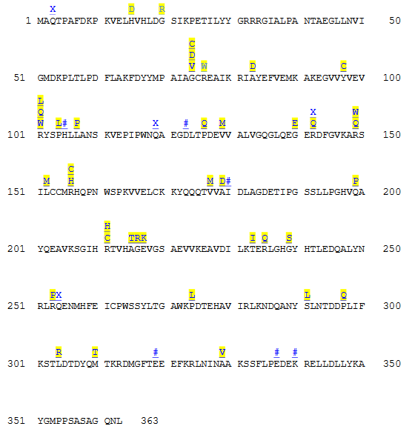
Adenosine Deaminase (ADA) Deficiency - a missense mutation in the adenosine deaminase enzyme
Interesting Sequence:
Reason:
The Adenosine Deaminase (ADA) Deficiency is caused by a mutation on chromosome 20 on the gene which codes the ADA enzyme. As a result, people with this disorder can only produce non-working ADA enzymes.
ADA is an enzyme and thereby also an protein playing an important part for the immune system of the human. This enzyme is mainly produced in cells of the immune system
The ADA enzyme normally breaks down toxic substances which naturally form when the DNA is broken down in the cells, in particular converting adenosine to inosine
By the ADA deficiency, this ADA enzyme is not working properly anymore and the toxic substances can build up in the cells of the immune system, killing these immune cells and affecting the immune system of the human
As a consequence, various infections can arise and harmless bacteria can lead to severe sicknesses
And all of this through missense mutations representing point mutations in a specific sequence on a gene by a change in a single nucleotide, resulting in a codon which codes for a different amino acid and hence creates defect enzymes.
Explanation: Mutations of the protein sequence of ADA are highlighted in yellow
Source: https://learn.genetics.utah.edu/content/disorders/singlegeneeg/
Source:
Analysis of missense mutations in adenosine deaminase using Pathogenic-Or-Not-Pipeline (PON-P), Sreevani Kotha, 2010
[HW1] A07922108 Fabian Krauthausen

Slide 36
Sometimes you have to think outside the box.
Connect all nine points without letting the pen leave the paper, with four straight lines.
I like this one because it always reminds me to think outside the box. When I was younger,
a math teacher showed it to me and since then I always try to think about a problem from different perspectives. It also remindes me that there is a solution to (mostly) every problem, no matter how impossible it seems to be.
- Julia Pelzer, T07901105

Slide 37
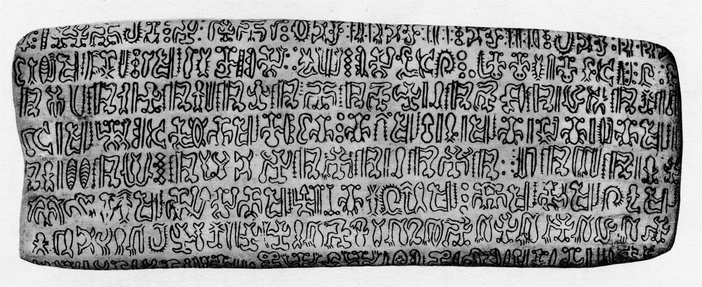
陳主牧
B03705037
這個象形文字序列是：
朗格朗格Rongorongo
根據維基百科，這是一個至今還沒被破解的古代語言，出現在復活節島，多撰寫在木板上，因被西方征服者銷毀而數量稀少。
每次仔細端詳朗格朗格的文字，便會感覺到一股濃烈、詭譎的神秘感。扭曲著、彷彿肢體的奇特線條，有時還會令我莫名地不寒而慄。雖然不明白其中的意義，光是觀看這些奇特的圖形相當有趣。

Slide 38
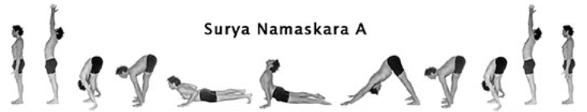
Yoga sequences
Usually yoga poses can be done without any particular order but for Ashtanga yoga, the sequence does matter. As my yoga teacher always said,
“ You fail to proceed to the next pose simply because you haven’t mastered the current one. ”.
Picture below demonstrates two of my favorite sequences from Ashtanga yoga beginner series. We start all practice sessions with five repetitions of sun salutation (Surya Namaskara A) and always end with the finishing sequence. Immersing myself in yoga practice makes me feel calm, peaceful, and contented.
R06945042 張子涵
生醫電資二

Slide 39
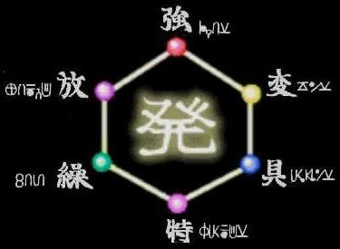
A Circular Sequence
(A way of honing your mind)
姓名:劉晏均
學號:R06945016
系所:生醫電資
Source: Classic Anime

Slide 40
Some math
1
1
3
7
?
3
5
5
7
2
2
8
8
9
9
4
4
I found this – years ago – in an episode of simpsons and liked it very much since in this case intuition and a good eye is all you need.
Sebastian Gütgemann

Slide 41







D07945011江尚瑀
中華文化傳承五千年，千變萬化的中國文字，
更是歷久不衰的藝術資產，瞭解中國文字之美
美麗的姑娘
雄鷹翱翔
長命百歲
雄
孫悟空
唐僧
Source: Internet：中國文字之美

