Slide 1
Interesting Sequences
HW1

Slide 2
Number Sequence

Slide 3
HW#1
Look-and-say sequence
1, 11, 21, 1211, 111221, 312211, 13112221, 1113213211, 31131211131221 ……
後一個數為前一個數的讀法，例如1讀作one one，故下一個數為11。
用讀法來產生數列十分特別。
R05945025 張家瑜
參考資料
Look-and-say sequence. (2017, September 14). In Wikipedia, The Free Encyclopedia.

Slide 4
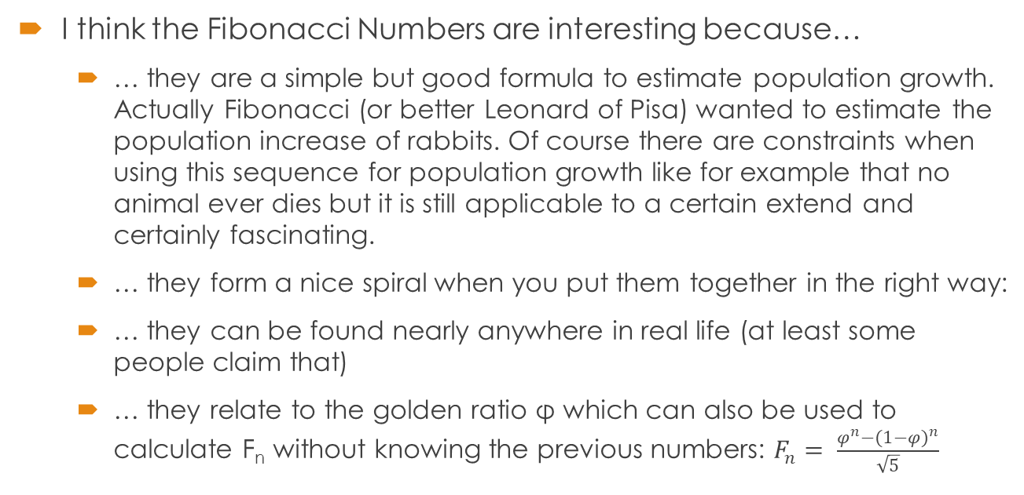
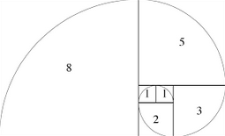
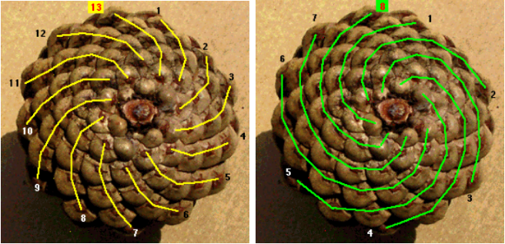
Fibonacci Sequence
Just for fun: Palindroms
  Die Liebe fleht : Helfe bei Leid!
  Eine gueldne, gute Tugend: Luege nie!
  Die Liebe ist Sieger, rege ist sie bei Leid.
[HW1] T06B01105
Karla Hörmann
F₁ | F₂ | F₃ | F₄ | F₅ | F₆ | F₇ | F₈ | F₉ | F₁₀ | F_{n}
1 | 1 | 2 | 3 | 5 | 8 | 13 | 21 | 34 | 55 | F_{n-1}+F_{n-2}
Sources:
previous course material, Freiburg
https://www.mathsisfun.com/numbers/fibonacci-sequence.html
http://www.gnudung.de/kram/sprache/palindrom.htm
13 spirals in one way, 8 in the other

Slide 5
142857
循環數：142857乘以1~6，其積仍由1、4、2、8、5、7六個數組成
  142857×1 = 142857
  142857×2 = 285714
  142857×3 = 428571
  142857×4 = 571428
  142857×5 = 714285
  142857×6 = 857142
  142857×7 = 999999
R05922050 陳柏佑
參考資料:
https://zh.wikipedia.org/wiki/142857

Slide 6
挑剔數列 資工碩一 葉光哲
將1、2、3、…、n各兩個數字排成長為2n的sequence，
其中滿足：兩個1中間夾著1個數字，兩個2中間夾著2個數字，…，兩個n中間夾著n個數字，則稱此數列為「挑剔數列」。
例：當n=3, 3 1 2 1 3 2
當n=4, 4 1 3 1 2 4 3 2
當n=7, 2 3 7 2 6 3 5 1 4 1 7 6 5 4
以往看到數列中的數字時，數字大多強調的是數值本身的意義，但在這個數列當中，數字強調的是在數列中的相對關係。

Slide 7
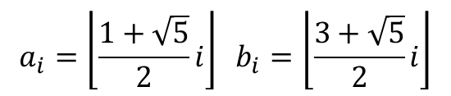

HW1
Name : 張耿健
ID : r05922092

Slide 8
Strobogrammatic number
A strobogrammatic number is a number whose numeral is rationally symmetric, so that it appears the same when rotated 180 degrees.
0, 1, 8, 11, 69, 88, 96, 101, 111, 181, 609, 619, 689, 808, 818, 888, 906, 916, 986, 1001, 1111, 1691, 1881, 1961, 6009, 6119, 6699, 6889, 6969, 8008, 8118, 8698, 8888, 8968, 9006, 9116, 9696, 9886, 9966, ...
This sequence is interesting because of the symmetric beauty. If we rotate the sequence 180 degrees, it’ll become a decreasing sequence as if we re-sorted it by descending order.
We can also find some numbers who are primes:
11, 101, 181, 619, 16091, 18181, 19861, 61819, 116911, 119611, 160091, 169691, 191161, 196961, 686989, 688889, ...
B03902129 資工四 陳鵬宇

Slide 9
6210001000
This number is called a self-descriptive number because there are exactly six 0, two 1, one 2, no 3, no 4, no 5, one 6, no 7, no 8, no 9 in 6210001000. The composition of this number is described by itself ! I first learnt this sequence in the Coursera course discrete-optimization ( 2 1 2 0 0 is called a magic series in that course ), I also found a webpage listing programs written by different languages for finding such numbers. Something interesting is that [n - 4, 2, 1, ..., 0, 0, 1, 0, 0, 0] is the only solution for n >= 7 ( proved here )
B03902062 資工四 董文捷

Slide 10
Algorithms for Biological Sequence Analysis [HW1]
B05902122 黃柏文
<0, 4, 2, 6, 1, 5, 3, 7> and <0, 8, 4, 12, 2, 10, 6, 14, 1, 9, 5, 13, 3, 11, 7, 15>
Rule: sort <0, 1, 2, 3, 4, 5, 6, 7> and <0, 1, 2, 3, 4, 5, 6, 7, 8, 9, 10, 11, 12, 13, 14, 15> according to the reversed binary representation. To reverse the binary representation, one can generate a table of bitmask and then(let T be the number):
T=((T&0x3)<<2)|((T&0xc)>>2)
T=((T&0x5)<<1)|((T&0xa)>>1)
This can be verified with the observation of complete binary tree.

Slide 11
Prefix-invariant base64 code
ID / Name: R06922148 / 林祥瑞
[EXAMPLE] base64("Vm0wd2QyU") = "Vm0wd2QyUXlV"
[Claim]
You can choose an arbitrary string and encode it repeatedly. They *must* finally fall into a prefix invariant base64 string staring with “Vm0wd2...”.
We can start with “love” and base64-encode it repeatedly.
bG92ZQo=
Ykc5MlpRbz0K
WWtjNU1scFJiejBLCg==
V1d0ak5VMXNjRkppZWpCTENnPT0K
VjFkMGFrNVZNWE5qUmtwcFpXcENURU...
VmpGa01HRnJOVlpOV0U1cVVtdHdjRn...
Vm1wR2EwMUhSbkpPVmxwT1YwVTFjVl...
Vm0xd1IyRXdNVWhTYmtwUFZteHdUMV...
Vm0weGQxSXlSWGROVldoVFltdHdVRl...
Vm0wd2VHUXhTWGxTV0dST1ZsZG9WRm...
Vm0wd2QyVkhVWGhUV0d4VFYwZFNUMV...
Vm0wd2QyUXlWa2hWV0doVVYwZDRWRl…
...
[Proof]
We can proof this claim by the facts:
After nth base64 iteration of any input, its first character is always “V”.
(induction) If S is prefix-invariant, that is, S and S’ = base64(S) has a common prefix, S’ is also prefix-invariant, due to the fact S’ has approx. 4 / 3 length of S.
Hence, “Vm0...” is determined by “Vm...”, “Vm0w...” is determined by “Vm0...”, and so forth.
Notes:
Proof - part 1
We can prove this claim inductively. We can make use of the fact that base64 encoding of X is about 4 / 3 times longer than X.
Let P the prefix of X = P + X' and X is prefix-invariant with len(P) >= 3.
We get the encoding Y = base64(X) = base64(P + X') = P + y + Y'. y is the immediate character after P.
Let the new prefix P' = P + y is determined by the prefix P included in X.
We can find Y is also prefix-invariant with prefix P' since base64(Y) will have a prefix P' = P + y, where P and y are both determined by P.
Proof - part2
The next, we construct a table like this.
[input X -> first character of base64(X)]
0 -> M
1 -> M
2 -> M
3 -> M
4 -> N
5 -> N
6 -> N
7 -> N
8 -> O
9 -> O
A -> Q
a -> Y
B -> Q
b -> Y
C -> Q
c -> Y
D -> R
d -> Z
E -> R
e -> Z
F -> R
f -> Z
G -> R
g -> Z
h -> a
H -> S
i -> a
I -> S
j -> a
J -> S
+ -> K
k -> a
K -> S
/ -> L
l -> b
L -> T
m -> b
M -> T
n -> b
N -> T
o -> b
O -> T
p -> c
P -> U
q -> c
Q -> U
r -> c
R -> U
s -> c
S -> U
t -> d
T -> V
u -> d
U -> V
v -> d
V -> V
w -> d
W -> V
x -> e
X -> W
y -> e
Y -> W
z -> e
Z -> W
We pick an entry "+" and follow the arrows. We have "+" -> "K" -> "S" -> "U" -> "V" -> "V" -> ... .
In fact, any entry will finally fall into "V". That is, any prefix-invariant string always starts with "V".
Furthermore, any prefix-invariant string is prefixed with "Vm0...".
With the lemmas from part 1 & 2, we may claim it to be true.

Slide 12
Literal Sequence

Slide 13
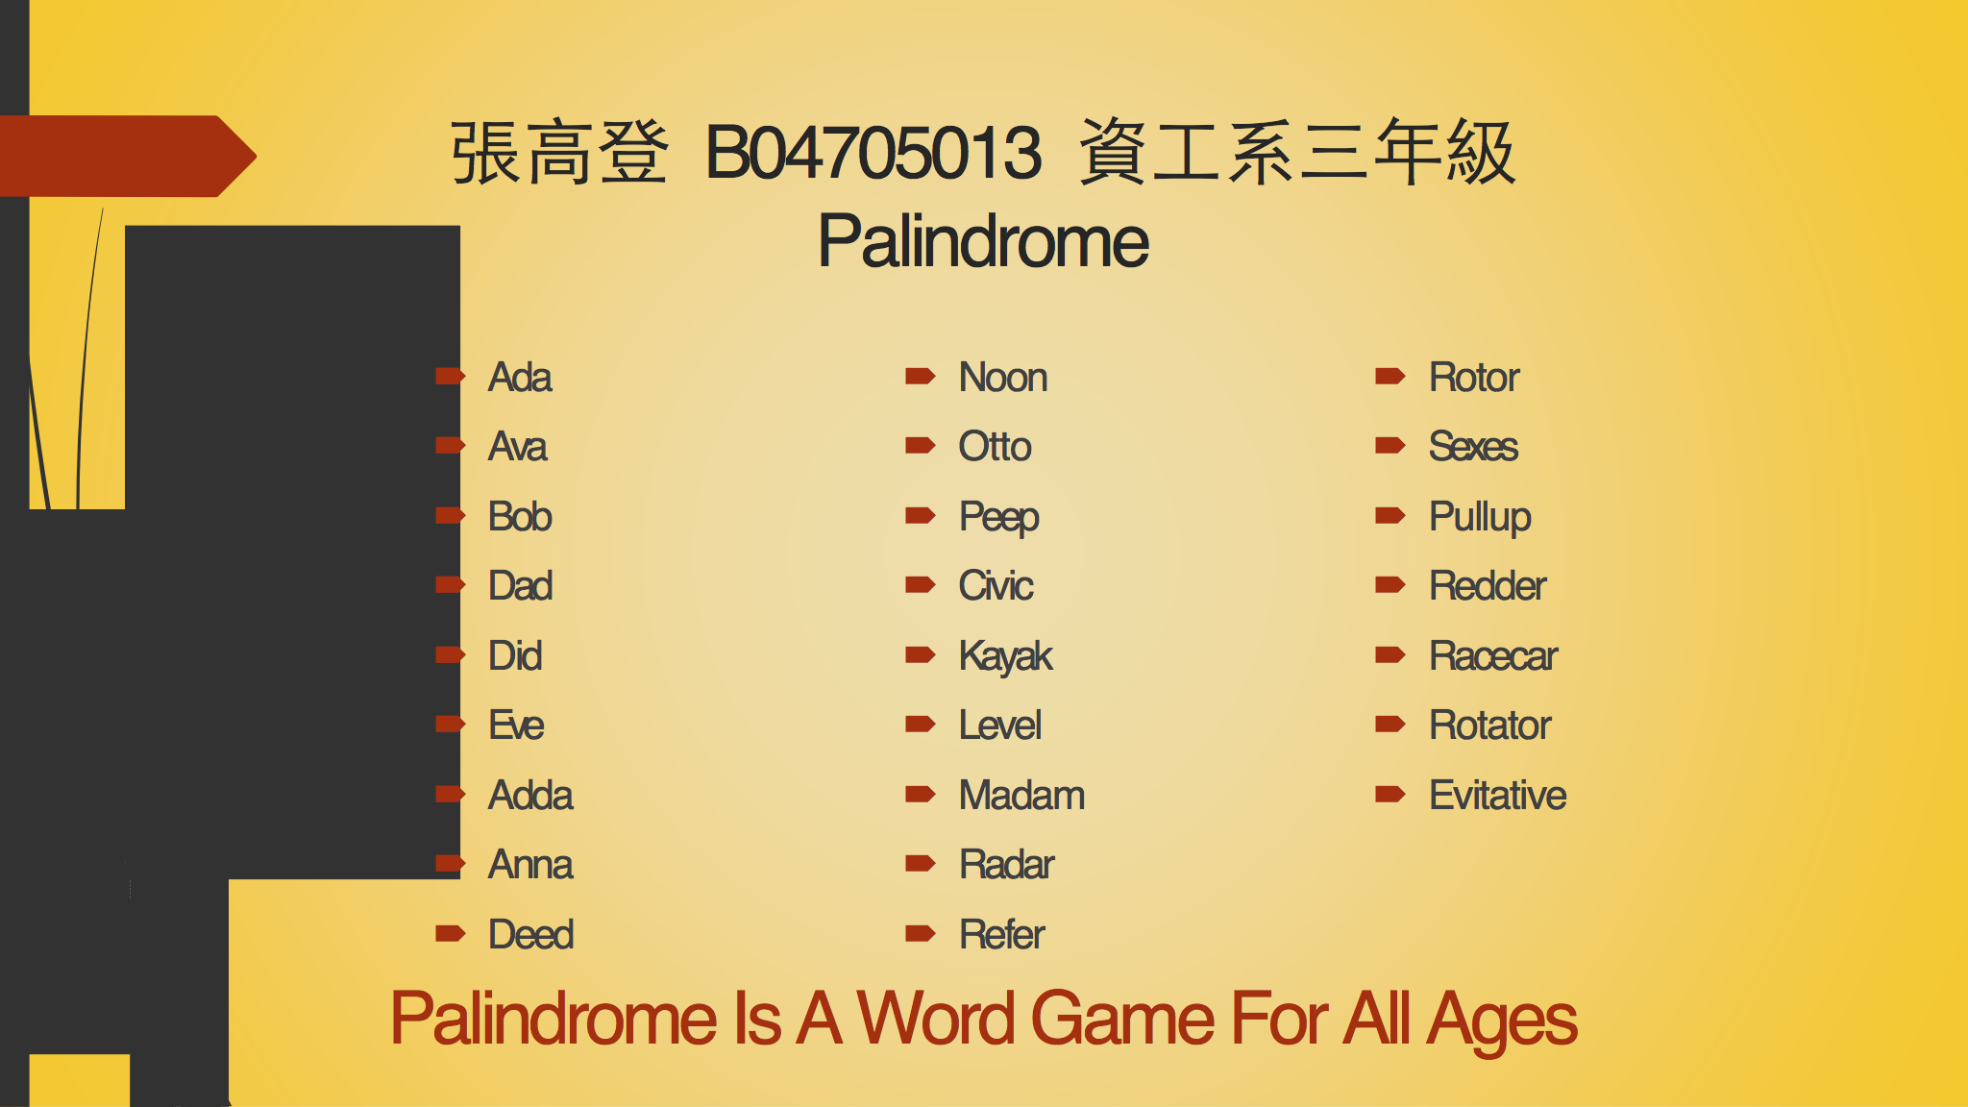
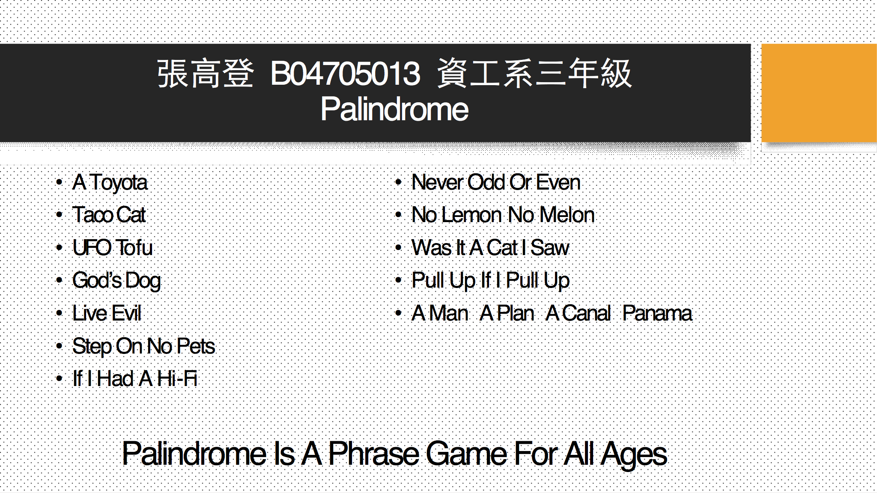
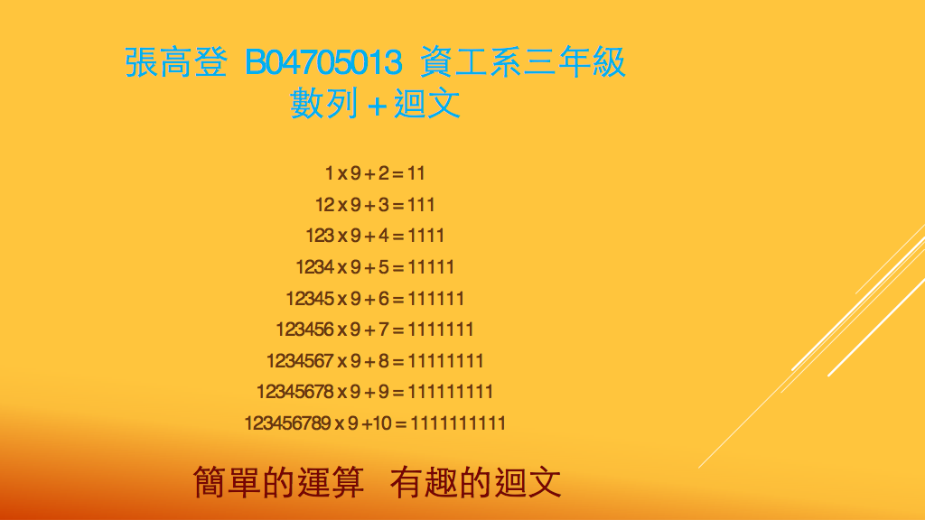
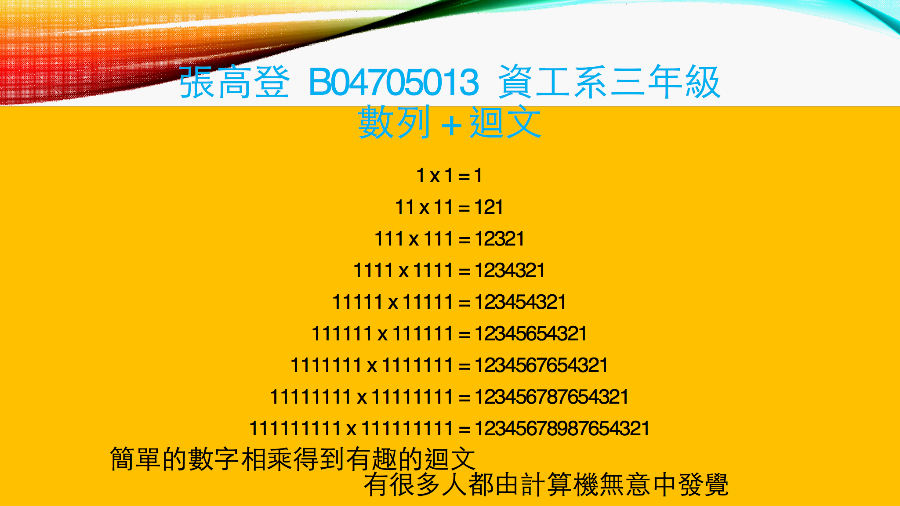


Slide 14
family
Family可以是father and mother, I love you 取每個單字的第一個未母組成,不知道是巧合還是後來人發現的,十分有趣
B03902123 陳至侃

Slide 15
Popple illusion with Japanese letter
Sequence of “杏マナー” and “ーナマ杏”
杏マナー杏マナー杏マナー杏マナー杏マナー杏マナー杏マナー
杏マナー杏マナー杏マナー杏マナー杏マナー杏マナー杏マナー
杏マナー杏マナー杏マナー杏マナー杏マナー杏マナー杏マナー
ーナマ杏ーナマ杏ーナマ杏ーナマ杏ーナマ杏ーナマ杏ーナマ杏
ーナマ杏ーナマ杏ーナマ杏ーナマ杏ーナマ杏ーナマ杏ーナマ杏
ーナマ杏ーナマ杏ーナマ杏ーナマ杏ーナマ杏ーナマ杏ーナマ杏
杏マナー杏マナー杏マナー杏マナー杏マナー杏マナー杏マナー
杏マナー杏マナー杏マナー杏マナー杏マナー杏マナー杏マナー
杏マナー杏マナー杏マナー杏マナー杏マナー杏マナー杏マナー
ーナマ杏ーナマ杏ーナマ杏ーナマ杏ーナマ杏ーナマ杏ーナマ杏
ーナマ杏ーナマ杏ーナマ杏ーナマ杏ーナマ杏ーナマ杏ーナマ杏
ーナマ杏ーナマ杏ーナマ杏ーナマ杏ーナマ杏ーナマ杏ーナマ杏
This is one of the famous phrase which was introduced on TV show in 2006.
There are no meaning for this phrase, but it shows interesting illusion called Popple illusion. I think it’s very interesting, so I still remember this even it was introduced more than 10 years ago.
資工系 B02902115 松井孔明

Slide 16
缺字文
This is an unusual paragraph. I'm curious how quickly you can find out what is so unusual about it? It looks so plain you would think nothing was wrong with it! In fact, nothing is wrong with it! It is unusual though. Study it, and think about it, but you still may not find anything odd. But if you work at it a bit, you might find out! Try to do so without any coaching!
這是缺字文這一段話完全沒有使用到”e”這個字母。
來源:維基百科
網媒所 R06944041 朱柏昇

Slide 17
Interesting Sequence
資工所張馭荃(R05922052)
“Rose is a rose is a rose is a rose. ” 首先出現於詩人Gertrude Stein在1913年做的詩"Sacred Emily“.
第一個 “Rose” 是一個人的名字，剩下的” rose”則是指玫瑰。
直譯：蘿絲就是玫瑰就是玫瑰就是玫瑰。
“A rose is a rose is a rose. ” Stein之後在其他作品中使用其變體。
直譯：是一朵玫瑰的玫瑰 才是玫瑰。
意思是"things are what they are"，人或事物都應保持其本來面貌

Slide 18
Chinese Lyrics Palindrome
建中時的我 便已韻押的傳神
現在我讓舊技巧導領我戰勝
一絲不苟 有drop da beat強迫症
逆轉flow我把意涵轉到變順
順便倒轉含義 把我flow轉逆
震破牆壁的drop有夠不思議
聖戰我領導 巧技就讓我再現
神傳的押韻 已變我的石中劍
https://youtu.be/AMIseWBhEO8
Only Palindrome for syllables(both Chinese and English syllables)
Since, for Chinese, same syllables have many different meanings, which forms an interesting and amusing Rap lyrics.
B02902090 楊茂榮
Source: 麻吉弟弟 ft. 熊仔 [ MACHI DIDI 2.0 (大人物) ]

Slide 19
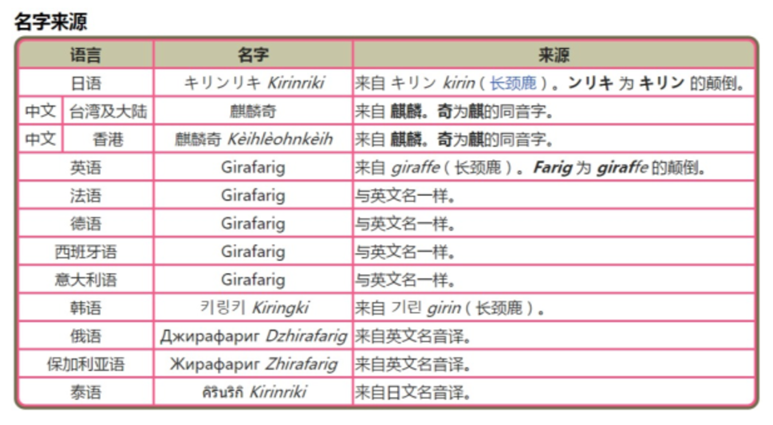

林雅琦
麒麟奇
是一種寶可夢的名字，他在很多語言裡面名字發音都是回文，在亞洲國家麒麟本來就是長頸鹿的意思，而英文名字Girafarig，也類似giraffe，覺得當初幫他命名的人很有智慧（而且默默覺得跟我的名字有點像～）

Slide 20

連環詩
連環詩，又叫轆轤體詩。也是一種回文詩的表現形式。是一種銜頭接尾格的詩，可以像轆轤一樣旋轉而得詩，相傳為宋代秦少游首創，而蘇東坡詩為佳。單人耘先生是林散之大師的最早入室弟子之一，先生自幼勤於詩書畫，其中有首轆轤花。這類詩的形式通常排列成圓圈形，字數不限，讀的方法很多，一般從圓圈最上邊的當中一字起頭，然後按順時針或逆時針方向，每五字或七字一斷，即可讀成若干首五言詩或七言詩。
靜思伊久阻歸期，
久阻歸期憶別離，
憶別離時閒漏轉，
時閒漏轉靜思伊。
蘇東波
戴嘉星
R06922108

Slide 21
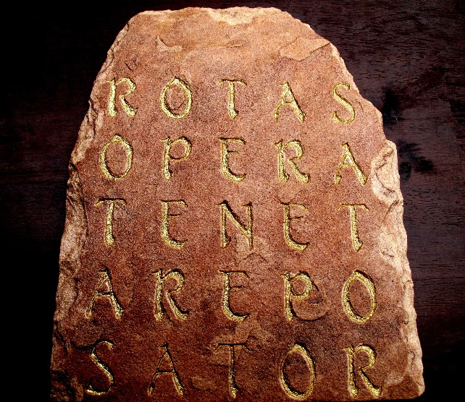
HW1 ntnu_40243118s-Sator Square
Ching-Tien,Wang(王擎天)
S A T O R
A R E P O
T E N E T
O P E R A
R O T A S
A five-word square written in Latin
It can be found in ruin of Pompeii
Many people think it reads
“Sator Arepo Tenet Opera Rotas.”
("The farmer Arepo has works wheels”)
I choose this word because I think it is interesting that it can be read in different direction.
Source:https://s-media-cache-ak0.pinimg.com/originals/d4/eb/69/d4eb69c7126a942cd4a09eb25971af6d.jpg

Slide 22
Anagrammatic Poems: Anagrammatic poetry is poetry with the constrained form that either each line or each verse is an anagram of all other lines or verses in the poem.
The Marriage of True Minds
by William Shakespeare
Let not the marriage of true minds
Admit impediments. Love is not love
Which alters when it alteration finds
Or bends with the remover to remove.
O no, it is an ever-fixed mark
That looks on tempests and is never shaken.
It is the star to every wand'ring bark,
Whose worth's unknown, although his height be taken.
Oh Damn! Must I Refrigerate?
by Leslie Marie Kapshaw
I, altogether a formed instrument,
Despite slim motivation, mend love
In what we'd call a fitter Shinto shrine;
Where vermin rot, betroth some dove.
A fork (an extreme division
Soon eventless in the dark paths) makes not
That street biker advisory warning
So. I laugh when he knows what the non-bikers thought.
anagrammatic
R04122013 張辰

Slide 23
Life Sequence

Slide 24
機車車牌
B03B01026 郭芛宏
這是最近家裡新買機車的車牌號碼。現代生活中，各式各樣的具有規則與意義的序列，可以說是不可或缺的重要組成。
現行規則:
三碼英文加上四碼數字是自2012開始實施
2015年開始不分車種一車一號
車牌號碼中不會有4出現

Slide 25
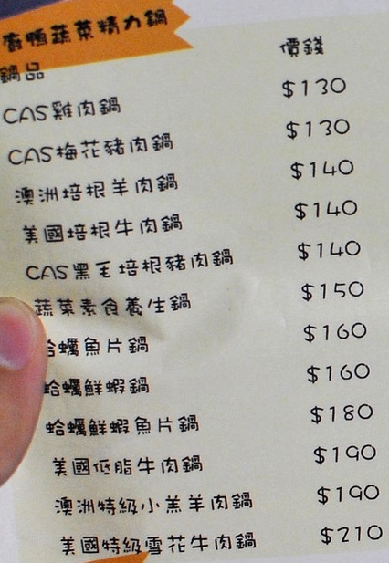
HW1
140 140 150 150 150 160 180 180 200 200 200 220
This is the price sequence of 溏老鴨平價小火鍋.
It’s interesting because I like to eat hot pot.
The price increased on 2017/09/01.
Name : 樂正
ID : r05922051

Slide 26
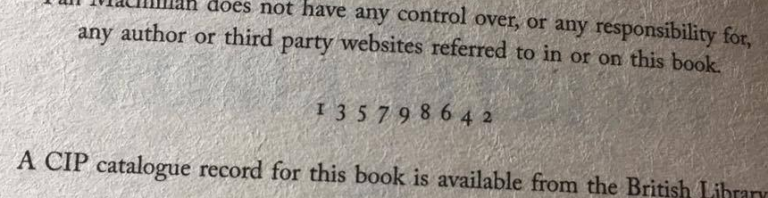
Printer’s Key
B02902073 林品君
I knew that there is a ”number line” in the front page of books for quite a while, but had no idea about the meaning. Actually, these numbers are used to record the number of printing of edition. The smallest number in the line is the number of printing of that edition, and the publisher will remove one number each time. For example, when there is the second printing, the “1” is removed. The strange index is designed to keep the line of numbers roughly centered when numbers are. This sequence is interesting to me because it’s just like code.

Slide 27
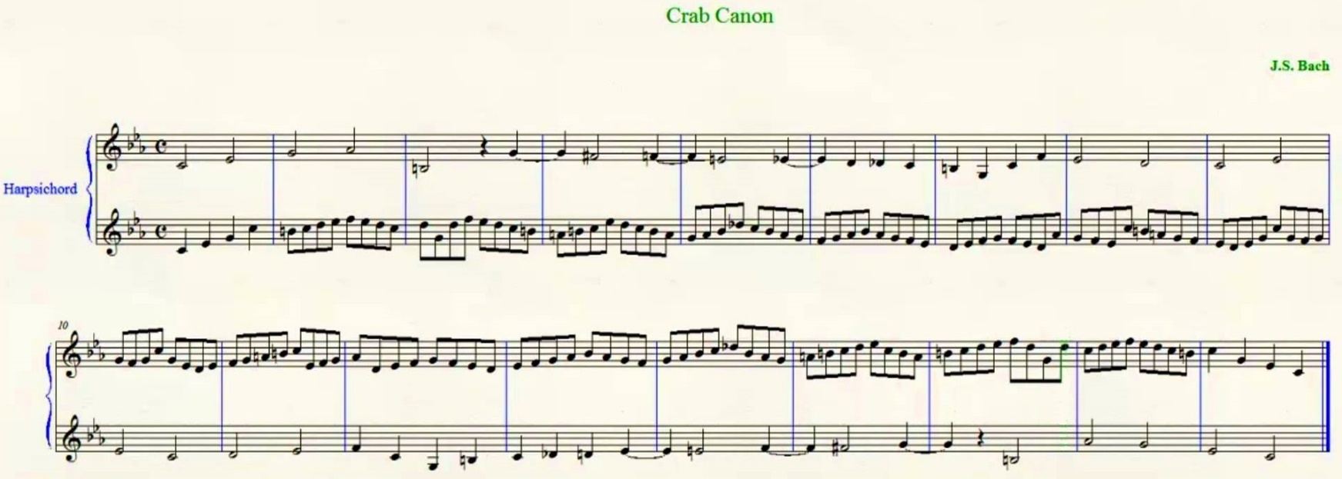
逆行卡農 (Crab canon) R06945024 陳泓宇
圖片來源：https://www.youtube.com/watch?v=W5Rk6Fqbo3Y
在查回文詩時，我發現類似於回文的概念也可以在音樂中發現！
在巴赫(Johann Sebastian Bach)的「音樂的奉獻(The Musical Offering)」曲集中的2 Canons a 2便是一個例子，這類曲子被稱為逆行卡農(Crab Canon)，順著彈或倒著彈都有不錯的旋律，所以讓第二聲部為第一聲部反過來同時演奏，直覺覺得有點奇怪，但卻滿好聽的。
https://www.youtube.com/watch?v=36ykl2tJwZM
從這段影片可以清楚看出一、二聲部是反過來的
https://www.youtube.com/watch?v=xUHQ2ybTejU
也有影片以莫比烏斯帶來凸顯這段曲子的特性

