Slide 1
Improved Algorithmic Complexity for the 3SEQ Recombination Detection Algorithm
Speaker | : | 樂正、張耿健、張馭荃、葉光哲
Author | : | Ha Minh Lam、Oliver Ratmann、Maciej F. Boni

Slide 2
Outline
Introduction
The proposed algorithm
Improvement
Experimental results and discussion

Slide 3
Outline
Introduction
The proposed algorithm
Improvement
Experimental results and discussion

Slide 4
Recombination
Three nucleotide(核甘酸) sequences : $P , Q , C$
$$P :A T C G T C G G G T A$$
$$Q :C A A C A G A T T A C$$
$$C :A T C C A G G G G T C$$

Slide 5
Informative Sites
The nucleotide in $C$ is identical to one parental sequence $P(Q),$but different from $Q(P).$
$$P :A T C C G T C G G G T A A$$
$$Q :C A A C C A G A T T A C A$$
$$C :A T C C C A G G G G T C A$$
Not informative site

Slide 6
Double-breakpoint Recombinant
$$P :A T C G T C G G G T A$$
$$Q :C A A C A G A T T A C$$
$$P :A T C G T C G G G T A$$
$$Q :C A A C A G A T T A C$$
$$C^{′}:A T A C A G A T T T A$$
$$C :A T C C A G G G G T C$$
$$C^{′′}:A T C C A G G G G T A$$
$$C :A T C C A G G G G T C$$
right-side is the most likely recombination breakpoint

Slide 7
Graph Representation
$$P :A T C G T C G G G T A$$
$$Q :C A A C A G A T T A C$$
$$C :A T C C A G G G G T C$$
+1 +1 +1 -1 -1 -1 +1 +1 +1 +1 -1
$m$ up-steps
$n$ down-steps
$$±1 sequence$$
$$l r$$

Slide 8
Maximum descent
0 1 2 3 4 5 6 7 8 9 10
A:+1 +1 +1 -1 -1 -1 +1 +1 +1 +1 -1
B:+1 +2 +3 +2 +1 +0 +1 +2 +3 +4 +3
Maximum descent = $max⁡$_{l < r} $(Bl – Br)$
$$l r$$
In this case, Maximum descent = 3 at$l=2, r=5$

Slide 9
Statistical Tests
Given three sequences $P ,Q ,C$
Null hypothesis : $C$is not recombination of $P ,Q$
the informative sites will become random permutation

Slide 10
Random Permutation
$$l r$$
Maximum descent = 3
$$l r$$
Maximum descent = 2

Slide 11
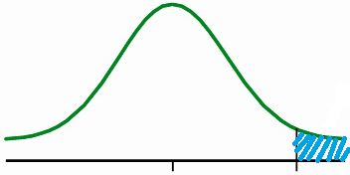
Statistical Tests
suppose that the maximum descent $=k$
$$k$$
$P−value$ is the probability that maximum descent$≥k$
for a random arrangement

Slide 12
Outline
Introduction
The proposed algorithm
Improvement
Experimental results and discussion

Slide 13
Some Notations
$xm,n,k :$ the probability that $m$up-steps , $n$down-steps , and the maximum descent is exactly $k$
$$l r$$
$$m=8 , n=5 , k=4$$

Slide 14
Example
For $m=1, n=2$there are $\frac{3!}{2!1!}=3$ permutations.
Md = 2
Md = 1
Md = 2
$$x1,2,0=0 , x1,2,1=\frac{1}{3} , x1,2,2=\frac{2}{3} , x1,2,3=0$$

Slide 15
Some Notations
$pm,n,k :$ the probability that $m$up-steps , $n$down-steps , and the maximum descent is $≥$ $k$
$$pm,n,k= \sum_{l=k}^{n}{ xm,n,l}$$
$p$can be computed from $x$

Slide 16
Some Notations
$ym,n,k ,j :$ the probability that $m$up-steps , $n$down-steps , the maximum descent is exactly $k$ and the minimum value is exactly $j$ unit below the origin
$$l r$$
$$m=8 , n=5 , k=4 , j=1$$

Slide 17
Some Notations
$$xm,n,k= \sum_{j=0}^{k}{ ym,n,k,j}$$
$x$can be computed from $y$
so we only need to concentrate on how to compute $y$

Slide 18
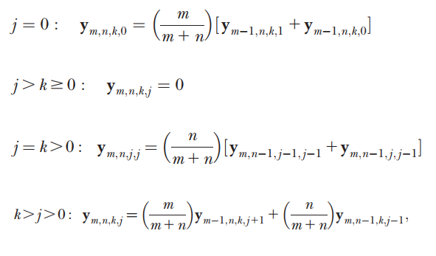
Dynamic Programming
(1)
(2)
(3)
(4)
Transfer need $O(1)$time complexity

Slide 19
Dynamic Programming
$$ym,n,k ,j$$
Transfer need $O(1)$time complexity
$O({mn }^{3}$) states
Time complexity $O({mn }^{3}$)
Space complexity $O({mn }^{3}$)

Slide 20
Outline
Introduction
The proposed algorithm
Improvement
Experimental results and discussion

Slide 21
Rewritten
$$xm,n,k= \sum_{j=0}^{k}{ ym,n,k,j}$$
expanded by (1) expanded by (4) expanded by (3)
$$= ym,n,k,0+ \sum_{j=1}^{k−1}{ ym,n,k,j}+ym,n,k,k$$
Can be deduced from recursive relation of $y$

Slide 22
Recursive Relation
$$xm,n,k$$
Can see this equation as the recursive function of $x$
We only need to know $ym,n,k,j$ for which $k=j$

Slide 23
Improvement
building dp table for $y$
Original method
Time complexity $O({mn }^{3}$)
Space complexity $O({mn }^{3}$)
Improved method
Time complexity $O({mn }^{3}$)
Space complexity $O({mn }^{2}$)
Since for $y$we only need to memorize those with $k=j$

Slide 24
Complexity Analysis
for computing $x$
Transfer need $O(1)$time complexity
$O({mn }^{2}$) states
Time complexity $O({mn }^{2}$)
Space complexity $O({mn }^{2}$)
$$xm,n,k$$

Slide 25
Complexity Analysis
for computing $x , y , p$ , overall
Time complexity $O({mn }^{3}$)
Space complexity $O({mn }^{2}$)

Slide 26
Outline
Introduction
The proposed algorithm
Improvement
Experimental results and discussion

Slide 27
New Applications
The 3SEQ maximum descent statistic describes clustering patterns in sequences of binary outcomes, and is therefore not confined to recombination analysis.

Slide 28
New Applications (1) : Seasonality
A particular population behavior or climatic characteristic can be noted to occur or not occur every day.
E.g., rain or no rain
An ordered sequence of the days in the year will show if the occurrence of one of the behaviors is clustered and thus if this feature was seasonal in that one year.

Slide 29
New Applications (2) : Disease Severity
When a process is expected to behave at an intermediate range or when an observation is expected to be made at intermediate values only, this pattern can be tested.
E.g., Dengue virus (登革熱) does not cause severity for all ages equally.
First infection (childhood) is typically nonsevere; secondary infections (older children or teenagers) have a higher chance of severity.

Slide 30
New Applications (2) : Disease Severity
Disease severity in a surveillance system should be seen in the intermediate age ranges.
Disease severity can be tested if each age band is overrepresented or underrepresented in the pool of patients experiencing dengue-like severe disease in a hospital.

Slide 31
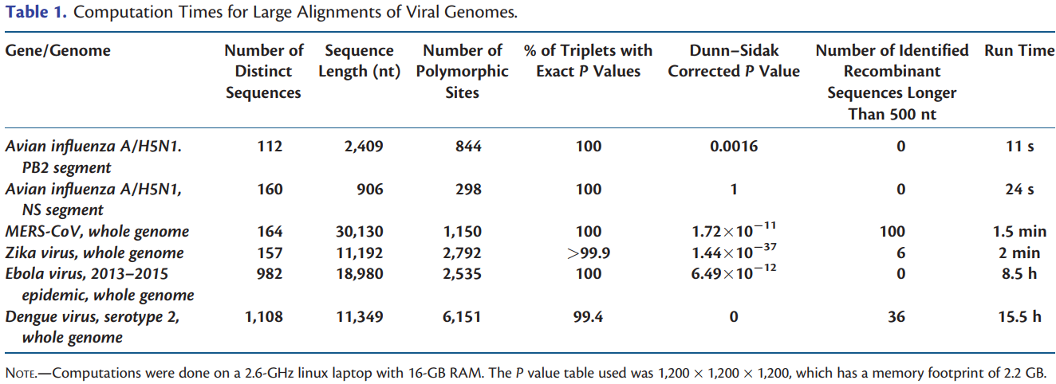
Discussion

Slide 32
Discussion
In general, when recombinants are identified by a mosaicism statistic like the one used by 3SEQ, a phylogenetic analysis should be performed to ensure that the recombination signal is preserved when the entire evolutionary history of the sample is taken into account.

