Slide 1
The singles seen: Sequencing gets specific
Karla Hörmann Algorithms for biological sequences 2017/12/19

Slide 2
Content
The Article
Pick a Cell, any Cell
PCR
Variation under Unnatural Selection
One from Many
Background
Author
Publishing
Reading the Transcript
General
10x Genomics Software

Slide 3
The Singles Seen: Sequencing Gets Specific
Notes:
Lumper: finding connections, bundling different texts/ evidences/ … into big ideas
Splitter: dividing the world into finer categories (splits)
Sequencing and nucleic acids amplifications tech: faster, cheaper, better
Can sequence individual cells
Lumper or splitter?
Holistic study or dissect into fundamental components (reductionist)?
Molecular biologists: reductionists/ splitter
Sequence DNA/ RNA fast and accurate but data only representation of population of cells, no individual genome; only average of all cells in culture but variations between cells
New technology -> single cell DNA (subtle differences across cells) / RNA (different transcriptional activity across cells)

Slide 4
General
Need to know own needs
Need clear experimental question
Need good planning
Need careful sample handling
Result:
possible to choose right methods
no unwanted costs
Important to sequence multiple cells before identifying variants!
Sandberg (2014)
Notes:
Needs: What do you want from samples? How much depth? How much sensitivity? How much information?
Image:
“Cells from a healthy or pathological tissue are dissociated, analyzed independently with single-cell RNA-seq and clustered based on their gene expression profiles. Clustering of cells reveals a cell-type map that can be used to assess the composition of the tissue including the identification of new cell types or subtypes. These rich data can be used to address many questions of gene expression and regulation within or between cell types and between tissues.” (Sandberg, 2014)
Source:
https://www.nature.com/articles/nmeth.2764

Slide 5
Reading the Transcript
Divide sample of cell into small droplets
Add gel beads (containing oligonucleotides/ “barcode”)
Standard RNA sequencing yields cell RNA and “barcode”
Huge amount of data -> need for software
Can reconstruct RNA sequence pool from each cell
Notes:
Single cell RNA sequencing best supported
Companies offering devices for it or the service itself
10x system
Partition of sample of cells with microfluidic chip -> super small droplets
Droplets + gel beads (they contain oligonucleotides/ short nucleic acid polymers/ short DNA RNA, like barcode)
Nearly every cell gets own barcode
Standard RNA sequencing -> cell’s RNA and barcode
With the help of the barcode is 10 x software able to reconstruct RNA sequence pool from each cell (know RNA of single cells)
Lot of data -> need software
10 x software is open source and can deconvolute data, analyse it, visualize

Slide 6
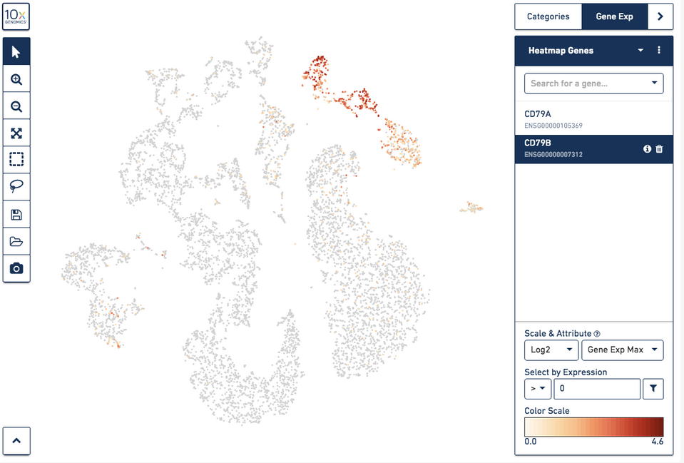
10x Genomics Software
10x Genomics(2017)
Notes:
Source for picture: https://support.10xgenomics.com/single-cell-gene-expression/software/visualization/latest/tutorial-celltypes

Slide 7
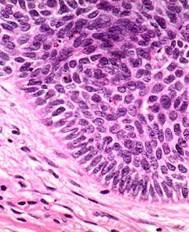
Pick a Cell, any Cell
1st step: how to pick a cell
Spread cell over array of magnetic rafts
Lift and transfer desired cell with inverted microscope
2nd step: amplifying DNA
PCR (Polymerase Chain Reaction)
MDA (Multiple Displacement Amplification)
3rd step: construct libraries and sequence them
https://www.pinterest.com/pin/332562753707494898/
Notes:
DNA sequencing shallow -> only say ‘variant’ if appears in more than one library
Cost problem

Slide 8
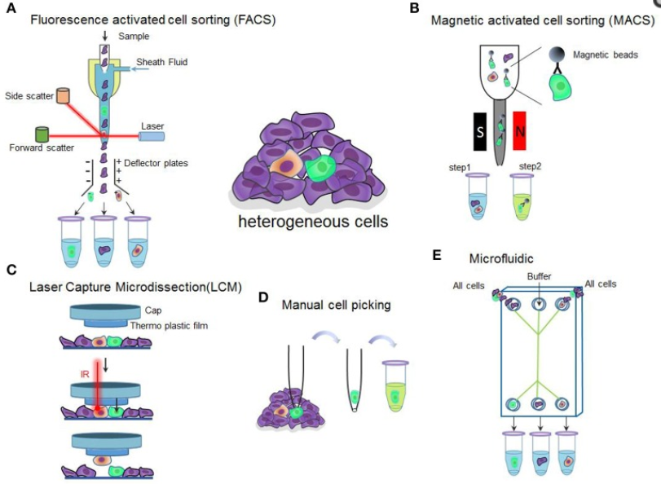
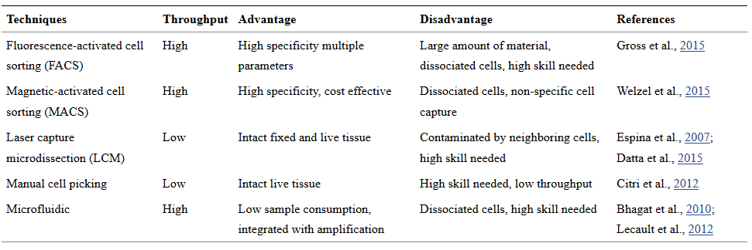
Pick a Cell, any Cell
Notes:
Source: https://www.ncbi.nlm.nih.gov/pmc/articles/PMC5078503/

Slide 9
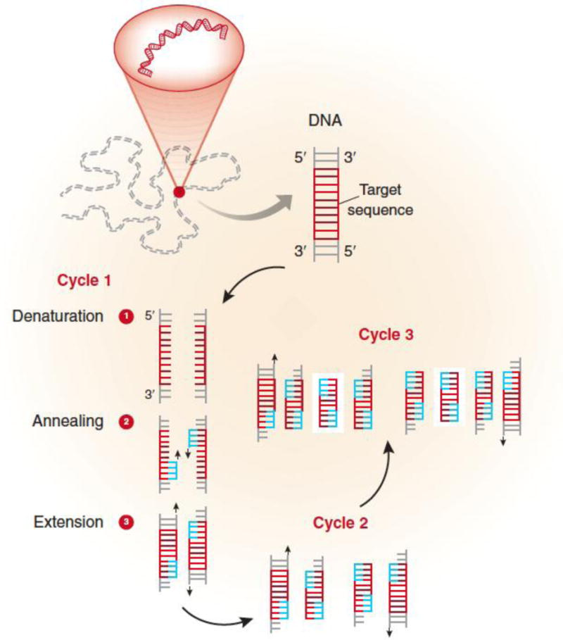
Polymerase Chain Reaction (PCR)
Garibyan, L., & Avashia, N. (2013)
Notes:
PCR (Polymerase Chain Reaction)
MDA (Multiple Displacement Amplification)
Above two: secondary copies of genome serve as template for further amplification
MALBAC multiple annealing and looping-based amplification cycles
Amplifying only original genome
In general MDA improvement of PCR and MALBAC improvement of MDA for SINGLE CELL
One of the differences is that PCR exponential but MALBAC linear
MDA with same temperature but PCR different
Sources:
https://www.ncbi.nlm.nih.gov/pmc/articles/PMC4102308/

Slide 10
Variation under Unnatural Selection
Normal cell isolation and genome amplification faulty
Problem: cell-lysis protocols
Solution: new technology avoids heating
Reasons to use contractors
Expertise
Many amplification methods (PCR/ MDA/ MALBAC)
https://www.pinterest.com/pin/332562753707494898/
Notes:
Normal cell isolation and genome amplification -> ~mio. False positive single nucleotide variants
Need for improvement
Problem: cell lysis (destroy cell membrane) protocols: unwanted artefact produced due to elevated temp.
New technology avoids this heating
SignulOmnics and Novogene work together on this one
Why researchers should use contractors:
Expertise
Many amplification methods
PCR
MDA (Multiple Displacement Amplification)
Above two: secondary copies of genome serve as template for further amplification
MALBAC multiple annealing and looping-based amplification cycles
Amplifying only original genome
In general MDA improvement of PCR and MALBAC improvement of MDA for SINGLE CELL
One of the differences is that PCR exponential but MALBAC linear
MDA with same temperature but PCR different
Source for picture: https://www.pinterest.com/pin/332562753707494898/

Slide 11
One from Many
Great advancements in this field
Isolating single genomes
Amplifying single genomes
Lowering costs
More standardized methods
Holism or reductionism?
https://www.pinterest.com/pin/332562753707494898/
Notes:
Holism or reductionism?
Interested in bigger picture/ entire system, not just one cell
Complete map of variation in small tumour would take millions of cells (possible?! Abgate’s sea water)
Combine both
Source for picture: https://www.pinterest.com/pin/332562753707494898/

Slide 12
Background

Slide 13
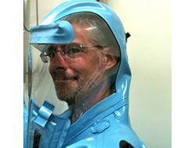
Author
Alan Dove
“I am a science journalist, podcaster, blogger, and editor who lives in western Massachusetts” (Doyle, n.d.)
Bachelor in Biology (Towson State University, Maryland)
Ph. D. in Microbiology (Columbia University, New York)
Brian (2013)

Slide 14
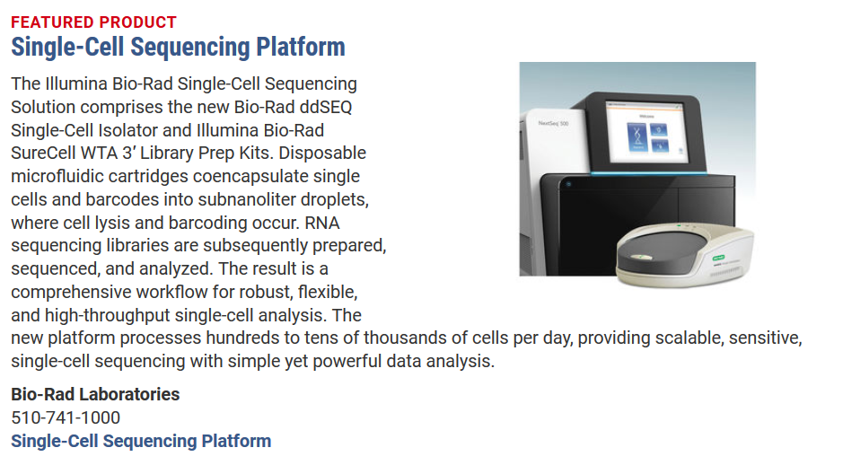
Publishing
http://www.sciencemag.org/features/2017/11/singles-seen-sequencing-gets-specific
Science/ AAAS Custom Publishing Office
https://www.10xgenomics.com/
Notes:
Custom publishing: selling your product/ service without selling it but by educating or entertaining customers
Sources for pictures:
https://www.10xgenomics.com/
http://www.sciencemag.org/features/2017/11/singles-seen-sequencing-gets-specific

Slide 15
References
Brian. (2013, May). Alan Dove, Ph.D. Retrieved on November 15, 2017 from http://thepostdocway.com/spotlight/alan-dove-phd
Dove, A. (2017). The singles seen: Sequencing gets specific. Science, 358 (6363), p. 677 – 679. Retrieved from http://www.sciencemag.org/features/2017/11/singles-seen-sequencing-gets-specific
Dove, A. (n.d.). Alan Dove, Ph.D. Retrieved on November 15, 2017 from http://alandove.com/grav/
Garibyan, L., & Avashia, N. (2013). Research Techniques Made Simple: Polymerase Chain Reaction (PCR). The Journal of Investigative Dermatology, 133(3), e6. http://doi.org/10.1038/jid.2013.1
Hu, P., Zhang, W., Xin, H., & Deng, G. (2016). Single Cell Isolation and Analysis. Frontiers in Cell and Developmental Biology, 4 (116). http://doi.org/10.3389/fcell.2016.00116
Pulizzi, J. (2010, December 20). Custom Publishing vs. Content Marketing. Retrieved on November 15, 2017 from http://contentmarketinginstitute.com/2010/12/custom-publishing-content-marketing/
Sandberg, R. (2014) Entering the era of single-cell transcriptomics in biology and medicine. Nature Methods, 11, 22–24. doi:10.1038/nmeth.2764
10xGenomics. (2017). Identifying Cell Types. Retrieved on November 16, 2017 from https://support.10xgenomics.com/single-cell-gene-expression/software/visualization/latest/tutorial-celltypes

