Slide 1
Neptune: a bioinformatics tool for rapid discovery of genomic variation
in bacterial populations
Nucleic Acids Research, 2017, Vol. 45, No. 18 e159
Eric Marinier, Rahat Zaheer, Chrystal Berry, Kelly A. Weedmark, Michael Domaratzki, Philip Mabon, Natalie C. Knox,
Aleisha R. Reimer, Morag R. Graham, Linda Chui, Laura Patterson-Fortin, Jian Zhang, Franco Pagotto, Jeff Farber, Jim Mahony,
Karine Seyer, Sadjia Bekal, C´ ecile Tremblay, Judy Isaac-Renton,
Natalie Prystajecky, Jessica Chen, Peter Slade and Gary Van Domselaar
戴嘉星、董文捷

Slide 2
Outline
Introduction
Materials and methods
K-mer generation
Extraction
Filtering
Scoring
Output
Example
Results
Conclusion

Slide 3
Neptune
Rapidly locating differentially abundant genomic content in bacterial populations
Using an exact k-mer matching strategy, while accommodating k-mer mismatches
Neptune is a system for discovering discriminatory bacterial sequence signatures and conducting comparative analyses of arbitrary groups of genome sequences
Notes:
designed an efficient system for rapidly locating differentially abundant genomic content in bacterial populations using an exact k-mer matching strategy, while accommodating k-mer mismatches
designed Neptune as a system for discovering discriminatory bacterial sequence signatures and conducting comparative analyses of arbitrary groups of genome sequences

Slide 4
Signature
A signature is defined as a string of characters (nucleotides 核苷酸) that is capable of discriminating a group of sequences of interest (the inclusion group) from a background group of sequences (the exclusion group)
Notes:
*Signatures may reside in genic or intergenic regions and may correspond to genomic islands, phage regions or entire operons.
*No requirement for signatures to contain functionally meaningful content

Slide 5
System overview

Slide 6
System overview

Slide 7
k-mer generation
k-mer : all the possible substrings of length k that are contained in a string
Produces the distinct set of k-mers for every inclusion and exclusion target and aggregates these k-mers together before further processing
Concerned only with the existence of a k-mer
Converts all k-mers to the lexicographically smaller of either the forward k-mer or its reverse complement.
Notes:
*Not concerned with the number of times a k-mer is repeated within a target

Slide 8
How to select k?
The k-mer length is automatically calculated unless provided by the user
$\sum_{x<y}{P(k_{x}=k_{y})}≈\left({w−k+1 \atop 2}\right){P\left(k_{x}=k_{y}\right) }_{A}<0.05$
We should choose k that the probability of any two arbitrary k-mers are the same is less than 0.05
Notes:
*w be the size of the largest target in bases
*P is the probability of any two arbitrary k-mers

Slide 9
System overview

Slide 10
Extraction
Neptune evaluates all k-mers in each reference, which may be classified as inclusion or exclusion k-mers.
An inclusion k-mer is observed in a sufficient number of inclusion targets and not observed in a sufficient number of exclusion targets
There may be mismatches in the reference, which exclude it from the largest homologous k-mer matching group
Allowing k-mer gaps in our extraction process
$∨_{gap}=μ+\sqrt{\frac{1}{1−α}}∙σ$
Notes:
We model this problem as some statistical distribution, and use the mean and variance of the distribution model to formula the gap size
Where $α$ be our statistical confidence
maximum k-mer gap size between exact matching inclusion k-mers as recurrence times of success runs in Bernoulli trials.

Slide 11
Extraction
Notes:
An overview of Neptune’s signature extraction process. The reference is decomposed into its composite k-mers. These k-mers may be classified as either inclusion or exclusion and are used to infer inclusion and exclusion sequence in the reference. A signature is constructed from inclusion k-mers containing sufficiently small k-mer gaps and no exclusion k-mers.

Slide 12
Extraction
Neptune outputs several ‘candidate signatures’
Begin with the last base position of the first inclusion k-mer
Contain an allowable number of k-mer gaps and no exclusion k-mers
End with the first base position of the last inclusion k-mer

Slide 13
System overview

Slide 14
Filtering
Neptune uses BLAST to locate signatures that align with any exclusion target and removes any signature that shares 50% identity with any exclusion target aligning to at least 50% of the signature
This process is done to avoid investigating signatures that are not highly discriminatory
Notes:
The candidate signatures produced will be relatively sensitive, but not necessarily specific, because signature extraction is done using exact k-mer matches

Slide 15
System overview
Notes:
After the signatures are filtered, Neptune will use BLAST to assign a score to every signature, representing the discriminatory power.

Slide 16
Scoring
$score\left(S\right)=\sum_{i=0}^{|I|}{\frac{|A(S,I_{i})|∙PI(S,I_{i})}{\left|S\right||I|}}−\sum_{i=0}^{|E|}{\frac{|A(S,E_{i})|∙PI(S,E_{i})}{\left|S\right||E|}}$
$|A(S,I_{i})|$ | length of the highest-scoring aligned region between a signature, S, and an inclusion target, $I_{i}$
$\left|S\right|$ | length of signature S
$PI(S,I_{i})$ | percent identity (identities divided by the alignment length) between the aligned region of S and $I_{i}$
$|I|$ | number of inclusion targets
$|E|$ | number of exclusion targets
Signatures are sorted based on their scores with highest-ranking signatures appearing first in the output.
Notes:
$PI(S,I_{i})$ = Matches / Length of aligned region
between −1.0 and +1.0
This score is maximized when all inclusion targets contain a region exactly matching the entire signature and there exists no exclusion targets that match the signature
positive scores closer to 1.0 -> highly discriminatory
scores close to 0.0 -> indiscriminate and likely undesirable
A high-valued negative score -> a measure of discrimination in the inverse direction (i.e. it indicates that the reported sequence is a strong signature for the exclusion group rather than for the inclusion group).

Slide 17
System overview
Notes:
After each signature is given a score, Neptune will generate some output files.

Slide 18
Output
Neptune produces a list of candidate, filtered and sorted signatures for all references
The candidate signatures are guaranteed to contain no exact matches with any exclusion k-mer.
A consolidated signature file is additionally provided as part of Neptune’s output.
Contains a consolidated list of the top-scoring signatures
Homologous signatures are reported only once.
Notes:
The detailed output will be presented in the following example.

Slide 19
Command
neptune
--inclusion inclusion_directory/
--exclusion exclusion_directory/
--output output_directory/
Optional parameters
--kmer : The size of the k-mers
--gap : Maximum allowable k-mer gap size
Notes:
We installed Neptune on 64-bit Linux system, and executed Neptune with the inclusion and exclusion data provided in the github repository.
To execute Neptune in the terminal,
Where inclusion, exclusion, output are mandatory parameters
Use –kmer to specify the size of k-mers, --gap to specify the maximum allowable k-mer gap size.
If not specified, the optional parameters will be automatically calculated base on the equations mentioned in previous slides.

Slide 20
Inclusion
Inclusion\inclusion1.fasta
>inclusion1
CGCCC……AGCAA
Inclusion\inclusion2.fasta
>inclusion2
CGCCC……AGCAA
Inclusion\inclusion3.fasta
>inclusion3
CGCCC……AGCAA
Notes:
Inclusion and exclusion targets are both in FASTA format. The first line is the description line, giving a name for the sequence.
3 inclusion targets in the inclusion directory.

Slide 21
Exclusion
exclusion\exclusion1.fasta
>exclusion1
CGCCC……AGCAA
exclusion\exclusion2.fasta
>exclusion2
CGCCC……AGCAA
exclusion\exclusion3.fasta
>exclusion3
CGCCC……AGCAA
Notes:
There are also 3 exclusion targets in the exclusion directory.

Slide 22
Report
output\candidates\inclusion1.fasta.report
Reference Size = 5944
GC-Content = 0.44
Inclusion Genomes = 3
Minimum Inclusion Hits = 1.0
k-mer Size = 15
Maximum k-mer Gap Size = 44
Minimum Signature Size = 60
Notes:
Neptune will generate a report
since we did not specify any optional parameters,
GC-content (lambda),
Minimum Inclusion Hits,
k-mer Size,
Maximum k-mer Gap Size,
automatically calculated
Minimum Signature Size = four times the size of k

Slide 23
Aggregate k-mers
output\aggregate.kmers
AAAAAAAAGAAAACA 3 3
.
.
.
.
.
.
TTTTCTGCGTCAAAA 3 3
9213 k-mers
Notes:
These two numbers represent the number of inclusion and exclusion targets the k-mer appears in

Slide 24
Candidates
output\candidates\inclusion1.fasta
>0 len=103 ref=inclusion1 pos=99
TAGTC……GAAAA
>1 len=640 ref=inclusion1 pos=3497
CGCGG……GGACA
>2 len=98 ref=inclusion1 pos=5209
GCGAG……CATCC
Notes:
As mentioned in the previous slides, these candidate signatures are relatively sensitive, but not necessarily specific
This is an arbitrary, run-unique ID assigned to the signature, and ref indicate from which sequence the signature was extracted

Slide 25
Filtered
output\filtered\inclusion1.fasta
>1 len=640 ref=inclusion1 pos=3497
CGCGG……GGACA
>0 len=103 ref=inclusion1 pos=99
TAGTC……GAAAA
>2 len=98 ref=inclusion1 pos=5209
GCGAG……CATCC
Notes:
The filtering step removes signatures that align sufficiently with any exclusion target. In this example, no signature is filtered out.

Slide 26
Sorted
output\sorted\inclusion1.fasta
>0 score=1.0000 in=1.0000 ex=0.0000 ref=inclusion1
TAGTC……GAAAA
>1 score=0.9979 in=0.9979 ex=0.0000 ref=inclusion1
CGCGG……GGACA
>2 score=0.9966 in=0.9966 ex=0.0000 ref=inclusion1
GCGAG……CATCC
Notes:
Based on the equation mentioned in the previous slides, each signature is assigned a score. Signatures are sorted in descending order by their score.

Slide 27
Consolidated
output\consolidated\consolidated.fasta
>1.0 score=1.0000 len=103 ref=inclusion3
TAGTC……GAAAA
>0.1 score=0.9979 len=640 ref=inclusion1
CGCGG……GGACA
>0.2 score=0.9966 len=98 ref=inclusion1
GCGAG……CATCC
Notes:
The consolidated signatures combine signatures from all references. Signatures are added in a greedy manner by selecting the next highest scoring signature available from all references ( like merge sort ). In many circumstances, this consolidated output might be considered the final output of Neptune.

Slide 28
Validation
A simulated Bacillus anthracis (炭疽桿菌) dataset
Listeria monocytogenes (李斯特菌) dataset
Escherichia coli (大腸桿菌) dataset
Notes:
https://www.youtube.com/watch?v=7Hrvev2DdT8
https://www.youtube.com/watch?v=sDgam2lzWZc
https://www.youtube.com/watch?v=01RIOvA9UqE
Satisfying result.

Slide 29
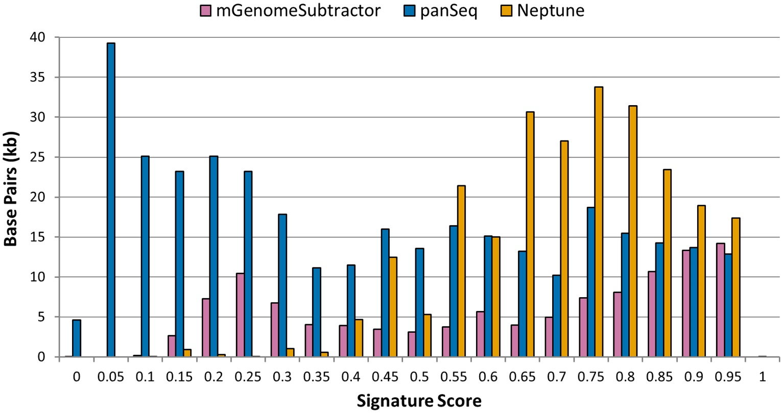
Comparison (1)
Notes:
Sequences with calculated scores closer to 1 are highly discriminatory, whereas those nearing 0 have no discriminatory power to distinguish between inclusion and exclusion genome groups.

Slide 30
Comparison (2)
 | Neptune | mGenomeSubtractor | panSeq
Median | 0.79 | 0.71 | 0.44
Interquartile range | 0.68 – 0.88 | 0.35 – 0.88 | 0.19 – 0.72
Minimum | 0.10 | -0.01 | -0.73
Maximum | 1.00 | 1.00 | 1.00
Average base | 0.74 | 0.65 | 0.43

Slide 31
Conclusion
Neptune can locate signatures in both simulated and biological datasets with high sensitivity and specificity
Neptune provides an array of gene candidates to investigate for their possible role in pathogenesis (發病機制) and functional genomics.
Neptune is a powerful and flexible tool for locating signature regions with minimal prior knowledge for wide-ranging applications of bacterial characterization.

