Slide 1
Detecting evolutionary forces in language change (2017)
Authors: Mitchell G. Newberry, Christopher A. Ahern, et al.
Presenter: Chen Chang (Peter) r05945030
Date: 2017/12/26

Slide 2
Linguistics and Evolutionary Biology
Competition between forms
  Syntactic structure, phonetics, morphology, etc.
Selective mechanism
  Selection
  Stochastic Drift

Slide 3
A null model of language change
Stochastic drift, random fluctuations in the frequencies of alternative forms, can accumulate to produce substantial change over time.
Evidence of directional force

Slide 4
Three language changes of interest
Development of the morphological past tense in contemporary American English
  Spilt → spilled
The rise of the periphrastic ‘do’ in Early Modern English
  You say not → You do not say
Jespersen’s cycle of sentential negation in Middle English
  Ic ne secge → I ne seye not → I say not

Slide 5
Materials and Methods
Corpus Data: annotated texts that range in time from the Norman conquest of England to the 21st century.
Methods: Compare the frequencies of alternative linguistic variants over time to predictions under the Wright-Fisher model of neutral stochastic drift.

Slide 6
Frequency Increment Test (FIT)
First they applied a transformation that produces homoscedastic frequency increments under the null hypothesis of stochastic drift.
The FIT tests a null hypothesis of neutral drift against an alternative hypothesis of some directional force influencing the course of evolution.
Directional drift/mutations vs. neutral stochastic drift

Slide 7
Past-tense verb conjugation
Verb Selection
  Corpus of Historical American English; tag
  Lemmas with two past-tense variants with minimum 50 occurrences each
  Post processing
  Rare vs. Common
  Two-sided P value is computed to reject neutral stochastic drift

Slide 8
Results
6 Polymorphic verbs, each with nominal P < 0.05

Slide 9
Results
Cases that the irregular variants are favored
  Lighted → Lit
  Waked → Woke
  Sneaked → Snuck
  Dived → Dove
Cases that the regular form is preferred
  Wove → Weaved
  Smelt → Smelled

Slide 10
Regulation
Economy or cognitive ease
Trends toward past-tense regulation have been observed, especially for rare words, from Old to Modern English.

Slide 11
Irregularization
One possible explanation: rhyming
Psychological studies have found speakers willing to copy or invent irregular variants that rhyme with existing irregular verbs
Irregular variant of a polymorphic past-tense verb is favored if similar-sounding irregular verbs are on the rise in the corpus.
However, opposite trend has also been observed.

Slide 12
Drift
Can explain most of the cases in Modern English
Drift vs. Selection
Rare words vs. common words: rare words experience more stochasticity in transmission

Slide 13
Do-support
Penn Parsed Corpora of Historical English
Potential do-support in different contexts:
  Affirmative questions (Do you…)
  Negative questions (Don’t you…)
  Negative declaratives (I don’t…)
  Negative imperatives (Don’t do…)

Slide 14
Results
The rise of the periphrastic ‘do’ was more rapid in negative declarative and imperative statements, for which drift is rejected, than it was in affirmative questions, for which drift isn’t rejected

Slide 15
Results
The periphrastic ‘do’ first drifted by chance to high frequency in questions, which then induced a directional bias towards ‘do’ in declarative and imperative statements for reasons of grammatical consistency or cognitive ease.

Slide 16
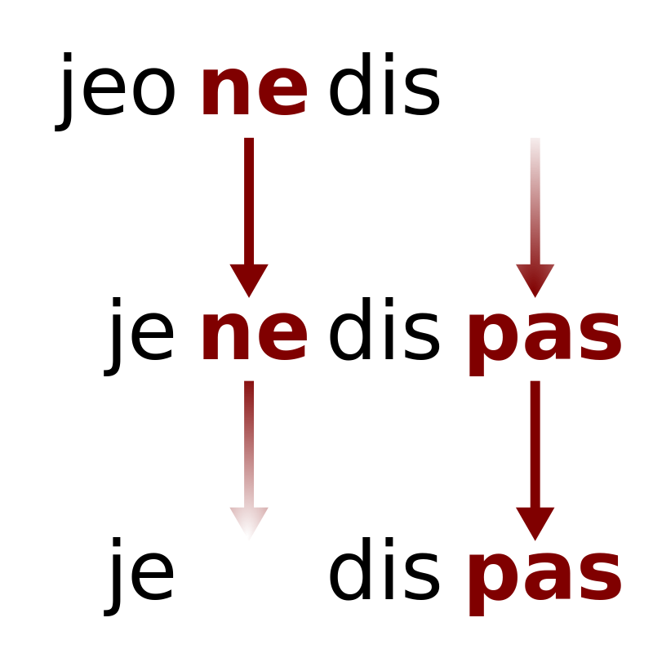
Jespersen’s cycle
Jespersen's Cycle (JC) describes the historical development of the expression of negation in a variety of languages
Stage I: negation is expressed by a single pre-verbal element
Stage II: both a preverbal and a post-verbal element are obligatory
Stage III: the original preverbal element becomes optional or is lost altogether
Reference: https://en.wikipedia.org/wiki/Jespersen%27s_Cycle
Notes:
Jespersen's Cycle (JC) is a series of processes in historical linguistics, which describe the historical development of the expression of negation in a variety of languages, from a simple pre-verbal marker of negation, through a discontinuous marker (elements both before and after the verb) and in some cases through subsequent loss of the original pre-verbal marker.

Slide 17
Results
Reject neutral drift.
This provides statistical support for longstanding hypotheses that changes in verbal negation are driven by directional forces, such as phonetic weakening, or a tendency for speakers to over-use more emphatic forms of negation that then lose emphasis as they become dominant.
Notes:
Jespersen's Cycle (JC) is a series of processes in historical linguistics, which describe the historical development of the expression of negation in a variety of languages, from a simple pre-verbal marker of negation, through a discontinuous marker (elements both before and after the verb) and in some cases through subsequent loss of the original pre-verbal marker.

Slide 18
Conclusion
Combining massive digital corpora with time series inference techniques from population genetics now allows us to disentangle distinct forces that drive language evolution.
However, how exactly individual-level cognitive processes in a language learner produce population-level phenomena, such as drift and selection, remains a topic for future research.
Notes:
Jespersen's Cycle (JC) is a series of processes in historical linguistics, which describe the historical development of the expression of negation in a variety of languages, from a simple pre-verbal marker of negation, through a discontinuous marker (elements both before and after the verb) and in some cases through subsequent loss of the original pre-verbal marker.

