Slide 1

第一組:
林盈安
徐銘聰
簡上祐
Dec. 12th 2016

Slide 2
Outline
Overview:
  Ranking of scientific papers &
  How high up do bioinformatics papers rank?
Bioinformatics tools:
  ClustalW
  Phylogenetics Tree

Slide 3

Nature’s Most-Cited Research of All Time
Nature ranked papers published from 1900 - present day by citation (SCI; science citation index)
Database: Thomson Reuter’s Web of Science
Many of the world’s most famous papers do not make the cut.
Ex. Theory of Relativity,
Nobel Prize winning discoveries etc.

Slide 4
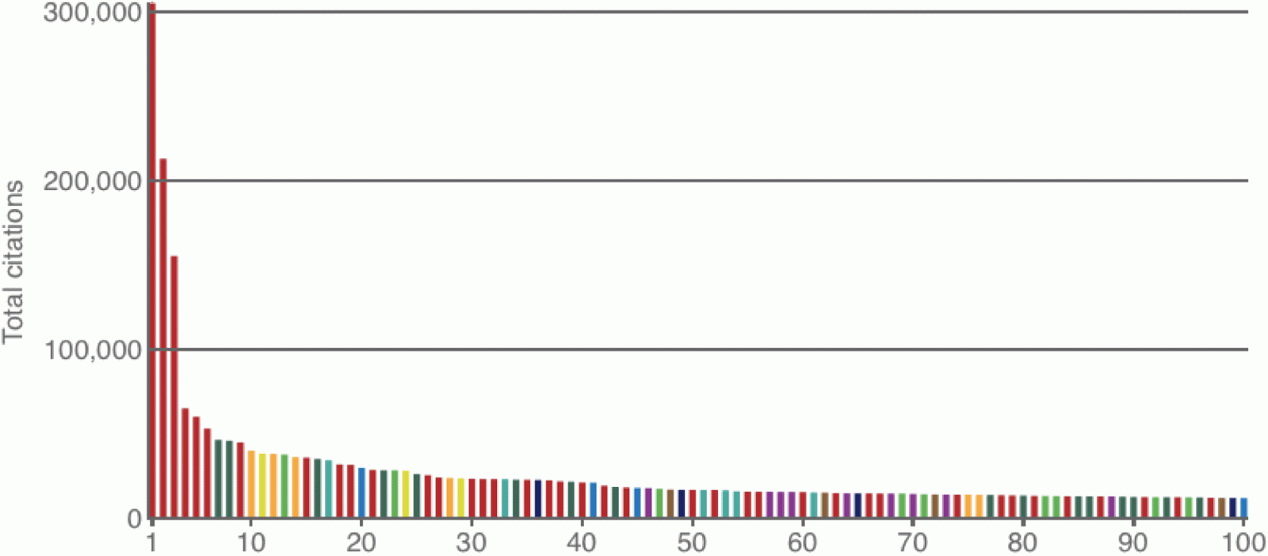
Top 100 Papers
Top 100 papers = 1 cm
58 million
Thomson Reuter’s Web of Science includes:
  Social sciences
  Arts and humanities
  Conference proceedings
  Books
  Etc.

Slide 5


Of the top 100 papers,
10% of the papers
are bioinformatics or
phylogenetic related.
First one appears in the top 10 list:
ClustalW
(progressive MSA)

Slide 6
Most-cited bioinformatics papers
Rank | Title | Journal | Year | Times cited (2014.10.29*) | Times cited (2016.12.11) | Subject
10 | Clustal W: improving the sensitivity of progressive MSA | Nucleic Acids Res. | 1994 | 40289 | 53364 | Bioinformatics
12 | BLAST | J. Mol. Biol. | 1990 | 38380 | 62877 | Bioinformatics
14 | Gapped BLAST and PSI-BLAST | Nucleic Acids Res. | 1997 | 36410 | 59926 | Bioinformatics
28 | Clustal X: flexible strategies for MSA | Nucleic Acids Res. | 1997 | 23826 | 35571 | Bioinformatics
75 | A comprehensive set of sequence-analysis programs for the vax | Nucleic Acids Res. | 1984 | 14226 | 14252 | Bioinformatics
76 | MODEL TEST: testing the model of DNA | Bioinformatics | 1998 | 14099 | 18787 | Bioinformatics
* Van Noorden, Richard, Brendan Maher, and Regina Nuzzo. "The top 100 papers." Nature 514.7524 (2014): 550-553.

Slide 7
Most-cited Phylogenetic papers
Rank | Title | Journal | Year | Times cited (2014.10.29*) | Times cited (2016.12.11) | Subject
20 | The neighbor-joining method: a new method for reconstructing phylogenetic trees. | Mol. Biol. Evol. | 1987 | 30176 | 45184 | Phylogenetics
41 | Confidence limits on phylogenies: an approach using the bootstrap | Evolution | 1985 | 21373 | 31437 | Phylogenetics
45 | MEGA4: Molecular Evolutionary Genetics Analysis (MEGA) software version 4.0. | Mol. Biol. Evol. | 2007 | 18286 | 28613 | Phylogenetics
100 | MrBayes 3: Bayesian phylogenetic inference under mixed models. | Bioinformatics | 2003 | 12209 | 19181 | Phylogenetics
* Van Noorden, Richard, Brendan Maher, and Regina Nuzzo. "The top 100 papers." Nature 514.7524 (2014): 550-553.

Slide 8
Google scholar’s
Most-Cited Research of All Time
Also ranked by citation
But Google Scholar’s search engine pulls references from a much greater literature base
Ex. large volume of books,
Economic papers etc.
Many world’s most famous papers also do not make the cut.

Slide 9
Google Scholar’s Most-cited bioinformatics or Phylogenetic papers
Rank | Title | Journal | Year | Times cited (2014.10.17*) | Times cited (2016.12.11) | Subject
24 (14) | Gapped BLAST and PSI-BLAST | Nucleic Acids Res. | 1997 | 52605 | 59926 | Bioinformatics
26 (12) | BLAST | J. Mol. Biol. | 1990 | 52314 | 62877 | Bioinformatics
35 (10) | Clustal W: improving the sensitivity of progressive MSA | Nucleic Acids Res. | 1994 | 47523 | 53364 | Bioinformatics
62 (20) | The neighbor-joining method: a new method for reconstructing phylogenetic trees. | Mol. Biol. Evol. | 1987 | 37613 | 45184 | Phylogenetics
98 (28) | Clustal X: flexible strategies for MSA | Nucleic Acids Res. | 1997 | 30937 | 35571 | Bioinformatics
* Numbers from Google Scholar. Extracted 17 October 2014.
Van Noorden, Richard, Brendan Maher, and Regina Nuzzo. "The top 100 papers." Nature 514.7524 (2014): 550-553.

Slide 10
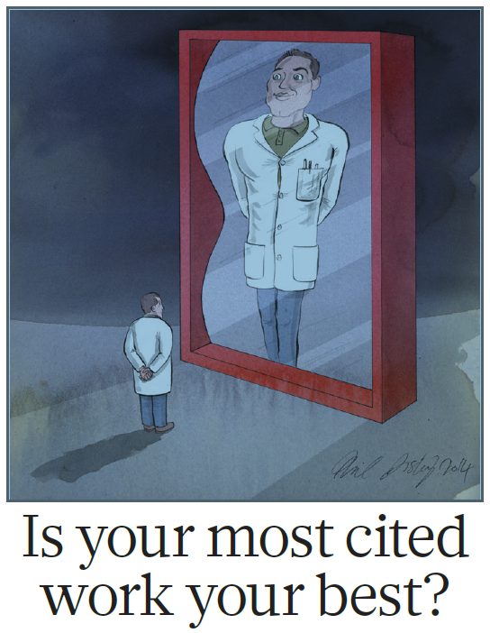

Slide 11
Why bioinformatics?
Big data, personalized medicine, precision medicine etc.
Human genome project (1990-2003)
Craig Venter and whole genome shotgun sequencing
Bioinformatics helps us to:
Better understand the link between biology and function
Human genetic history and diseases

Slide 12
most-cited bioinformatics papers according to nature’s 2014 ranking
Three major areas of focus:
BLAST
Clustal
Phylogenetics

Slide 13
BLAST
BLAST (Basic Local Alignment Search Tool)
Currently ranked no. 12 and 14 out of the top 100 list
Introduction of BLAST will be covered by another group

Slide 14
Clustal
A series of programs for multiple sequence alignment
Can align sequences from different organisms, from seemingly unrelated sequences, and predict how a change at a specific point in a gene or protein might affect its function

Slide 15
Clustal: several versions
ClustalW, currently ranked no.10 on the list
ClustalX, a later version, currently ranked no.28 on the list
There are several versions of Clustal, all align sequences by three main steps:
  Start with a pairwise alignment
  Create a guide tree (or use a user-defined tree)
  Use the guide tree to carry out multiple sequence alignment

Slide 16
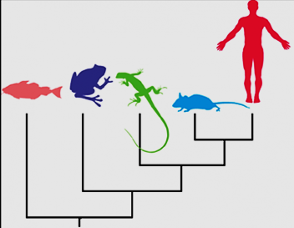
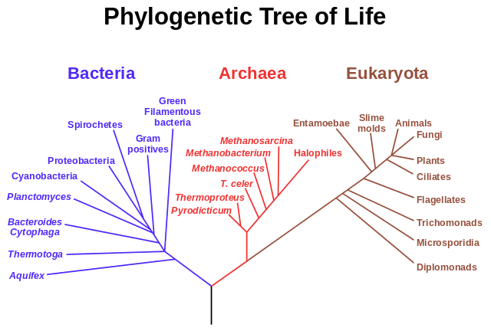
Phylogenetic Tree
The study of evolutionary relationships between species
Ex.

Slide 17
Phylogenetics
Speaker: Ming-Tsung Hsu (徐銘聰)
Date: 2016.12.12

Slide 18
Web of Science Top 100
Rank | Title | Journal | Year | Times cited (2014.10.29*) | Times cited (2016.12.11) | Subject
20 | The neighbor-joining method: a new method for reconstructing phylogenetic trees. | Mol. Biol. Evol. | 1987 | 30176 | 45184 | Phylogenetics Phylogenetic reconstruction
41 | Confidence limits on phylogenies: an approach using the bootstrap | Evolution | 1985 | 21373 | 31437 | Phylogenetics Statistics
45 | MEGA4: Molecular Evolutionary Genetics Analysis (MEGA) software version 4.0. | Mol. Biol. Evol. | 2007 | 18286 | 28613 | Phylogenetics Tool
100 | MrBayes 3: Bayesian phylogenetic inference under mixed models. | Bioinformatics | 2003 | 12209 | 19181 | Phylogenetics Phylogenetic reconstruction + Tool
* Van Noorden, Richard, Brendan Maher, and Regina Nuzzo. "The top 100 papers." Nature 514.7524 (2014): 550-553.

Slide 19

Phylogenetic reconstruction
Distance-based methods
  UPGMA (Unweighted Pair Group Method with Arithmetic mean)
  Neighbor Joining
  Fitch-Margoliash
Character-based methods
  Maximum Parsimony
  Maximum Likelihood (Probability-based)
  Bayesian Inference (Probability-based)
Notes:
http://www.evolution-textbook.org/content/free/book/toc.html
http://www.evolution-textbook.org/content/free/contents/ch27.html

Slide 20
Phylogenetic reconstruction
Distance-based methods
  UPGMA (Unweighted Pair Group Method with Arithmetic mean)
  Neighbor Joining
  Fitch-Margoliash
Character-based methods
  Maximum Parsimony
  Maximum Likelihood (Probability-based)
  Bayesian Inference (Probability-based)
Notes:
http://www.evolution-textbook.org/content/free/book/toc.html
http://www.evolution-textbook.org/content/free/contents/ch27.html

Slide 21
Distance-based methods
UPGMA / Neighbor Joining / Fitch-Margoliash
Distance matrix
 | A | B | C | D | E | F
A | 0 | 2 | 4 | 6 | 6 | 8
B | 2 | 0 | 4 | 6 | 6 | 8
C | 4 | 4 | 0 | 6 | 6 | 8
D | 6 | 6 | 6 | 0 | 4 | 8
E | 6 | 6 | 6 | 4 | 0 | 8
F | 8 | 8 | 8 | 8 | 8 | 0

Slide 22
Distance-based methods
UPGMA / Neighbor Joining / Fitch-Margoliash
Distance matrix
 | A | B | C | D | E | F
A |  | 2 | 4 | 6 | 6 | 8
B | 2 |  | 4 | 6 | 6 | 8
C | 4 | 4 |  | 6 | 6 | 8
D | 6 | 6 | 6 |  | 4 | 8
E | 6 | 6 | 6 | 4 |  | 8
F | 8 | 8 | 8 | 8 | 8

Slide 23
Distance-based methods
UPGMA / Neighbor Joining / Fitch-Margoliash
Distance matrix
 | A | B | C | D | E | F
A
B | 2
C | 4 | 4
D | 6 | 6 | 6
E | 6 | 6 | 6 | 4
F | 8 | 8 | 8 | 8 | 8

Slide 24
Distance-based methods
UPGMA / Neighbor Joining / Fitch-Margoliash
Distance matrix
 | A | B | C | D | E
B | 2
C | 4 | 4
D | 6 | 6 | 6
E | 6 | 6 | 6 | 4
F | 8 | 8 | 8 | 8 | 8

Slide 25
UPGMA
A bottom-up (agglomerative) hierarchical clustering method
Divisive clustering
abcdef
bcdef
def
bc
ef
a
b
c
d
e
f
Agglomerative clustering
Notes:
UPGMA (Unweighted Pair Group Method with Arithmetic Mean): https://en.wikipedia.org/wiki/UPGMA
WPGMA (Weighted Pair Group Method with Arithmetic Mean): https://en.wikipedia.org/wiki/WPGMA
http://mirlab.org/jang/books/dcpr/dcHierClustering.asp?title=3-2%20Hierarchical%20Clustering%20(%B6%A5%BCh%A6%A1%A4%C0%B8s%AAk)&language=Chinese
http://www.sthda.com/english/wiki/hierarchical-clustering-essentials-unsupervised-machine-learning

Slide 26
UPGMA
A bottom-up (agglomerative) hierarchical clustering method
1
A
 | A | B | C | D | E
B | 2
C | 4 | 4
D | 6 | 6 | 6
E | 6 | 6 | 6 | 4
F | 8 | 8 | 8 | 8 | 8
1
B
Notes:
UPGMA (Unweighted Pair Group Method with Arithmetic Mean): https://en.wikipedia.org/wiki/UPGMA
WPGMA (Weighted Pair Group Method with Arithmetic Mean): https://en.wikipedia.org/wiki/WPGMA
http://mirlab.org/jang/books/dcpr/dcHierClustering.asp?title=3-2%20Hierarchical%20Clustering%20(%B6%A5%BCh%A6%A1%A4%C0%B8s%AAk)&language=chinese

Slide 27
UPGMA
A bottom-up (agglomerative) hierarchical clustering method
1
A
 | (A,B) | C | D | E
C | (4+4)/2
D | (6+6)/2 | 6
E | (6+6)/2 | 6 | 4
F | (8+8)/2 | 8 | 8 | 8
1
B
2
D
2
E
Notes:
UPGMA (Unweighted Pair Group Method with Arithmetic Mean): https://en.wikipedia.org/wiki/UPGMA
WPGMA (Weighted Pair Group Method with Arithmetic Mean): https://en.wikipedia.org/wiki/WPGMA
http://mirlab.org/jang/books/dcpr/dcHierClustering.asp?title=3-2%20Hierarchical%20Clustering%20(%B6%A5%BCh%A6%A1%A4%C0%B8s%AAk)&language=chinese

Slide 28
UPGMA
A bottom-up (agglomerative) hierarchical clustering method
1
1
A
 | (A,B) | C | (D,E)
C | 4
DE | (6+6)/2 | (6+6)/2
F | 8 | 8 | (8+8)/2
1
B
2
C
2
D
2
E
Notes:
UPGMA (Unweighted Pair Group Method with Arithmetic Mean): https://en.wikipedia.org/wiki/UPGMA
WPGMA (Weighted Pair Group Method with Arithmetic Mean): https://en.wikipedia.org/wiki/WPGMA
http://mirlab.org/jang/books/dcpr/dcHierClustering.asp?title=3-2%20Hierarchical%20Clustering%20(%B6%A5%BCh%A6%A1%A4%C0%B8s%AAk)&language=chinese

Slide 29
UPGMA
A bottom-up (agglomerative) hierarchical clustering method
1
1
A
 | ((A,B),C) | (D,E)
DE | (6+6)/2=6
F | (8+8)/2=8 | 8
1
1
B
2
C
2
1
D
2
E
Notes:
UPGMA (Unweighted Pair Group Method with Arithmetic Mean): https://en.wikipedia.org/wiki/UPGMA
WPGMA (Weighted Pair Group Method with Arithmetic Mean): https://en.wikipedia.org/wiki/WPGMA
http://mirlab.org/jang/books/dcpr/dcHierClustering.asp?title=3-2%20Hierarchical%20Clustering%20(%B6%A5%BCh%A6%A1%A4%C0%B8s%AAk)&language=chinese

Slide 30
UPGMA
A bottom-up (agglomerative) hierarchical clustering method
1
1
A
 | (((A,B),C),(D,E))
F | (8+8)/2=8
1
1
B
2
1
C
2
1
D
Root
2
E
4
F
Notes:
UPGMA (Unweighted Pair Group Method with Arithmetic Mean): https://en.wikipedia.org/wiki/UPGMA
WPGMA (Weighted Pair Group Method with Arithmetic Mean): https://en.wikipedia.org/wiki/WPGMA
http://mirlab.org/jang/books/dcpr/dcHierClustering.asp?title=3-2%20Hierarchical%20Clustering%20(%B6%A5%BCh%A6%A1%A4%C0%B8s%AAk)&language=chinese

Slide 31
UPGMA
A bottom-up (agglomerative) hierarchical clustering method
1
1
A
 | A | B | C | D | E
B | 2
C | 4 | 4
D | 6 | 6 | 6
E | 6 | 6 | 6 | 4
F | 8 | 8 | 8 | 8 | 8
1
1
B
2
1
C
UPGMA
2
1
D
Root
2
E
4
F
Notes:
UPGMA (Unweighted Pair Group Method with Arithmetic Mean): https://en.wikipedia.org/wiki/UPGMA
WPGMA (Weighted Pair Group Method with Arithmetic Mean): https://en.wikipedia.org/wiki/WPGMA
http://mirlab.org/jang/books/dcpr/dcHierClustering.asp?title=3-2%20Hierarchical%20Clustering%20(%B6%A5%BCh%A6%A1%A4%C0%B8s%AAk)&language=chinese

Slide 32
UPGMA
A bottom-up (agglomerative) hierarchical clustering method
1
1
A
 | A | B | C | D | E
B | 5
C | 4 | 7
D | 7 | 10 | 7
E | 6 | 9 | 6 | 5
F | 8 | 11 | 8 | 9 | 8
1
4
B
2
1
C
3
1
D
Root
2
E
4
F
Notes:
UPGMA (Unweighted Pair Group Method with Arithmetic Mean): https://en.wikipedia.org/wiki/UPGMA
WPGMA (Weighted Pair Group Method with Arithmetic Mean): https://en.wikipedia.org/wiki/WPGMA
http://mirlab.org/jang/books/dcpr/dcHierClustering.asp?title=3-2%20Hierarchical%20Clustering%20(%B6%A5%BCh%A6%A1%A4%C0%B8s%AAk)&language=chinese

Slide 33
UPGMA
A bottom-up (agglomerative) hierarchical clustering method
2
1
A
 | A | B | C | D | E
B | 5
C | 4 | 7
D | 7 | 10 | 7
E | 6 | 9 | 6 | 5
F | 8 | 11 | 8 | 9 | 8
1
2
C
3
0.5
B
UPGMA
2.5
1.5
D
Root
2.5
E
4.5
F
Notes:
UPGMA (Unweighted Pair Group Method with Arithmetic Mean): https://en.wikipedia.org/wiki/UPGMA
WPGMA (Weighted Pair Group Method with Arithmetic Mean): https://en.wikipedia.org/wiki/WPGMA
http://mirlab.org/jang/books/dcpr/dcHierClustering.asp?title=3-2%20Hierarchical%20Clustering%20(%B6%A5%BCh%A6%A1%A4%C0%B8s%AAk)&language=chinese

Slide 34
UPGMA
A bottom-up (agglomerative) hierarchical clustering method
True tree
2
 | A | B | C | D | E
B | 5
C | 4 | 7
D | 7 | 10 | 7
E | 6 | 9 | 6 | 5
F | 8 | 11 | 8 | 9 | 8
1
1
A
1
A
1
2
1
4
C
B
3
UPGMA
???
2
0.5
B
1
C
2.5
3
Root
1.5
D
Root
1
D
2.5
2
E
E
4.5
4
F
F
ultrametric tree
Not ultrametric tree
Notes:
UPGMA (Unweighted Pair Group Method with Arithmetic Mean): https://en.wikipedia.org/wiki/UPGMA
WPGMA (Weighted Pair Group Method with Arithmetic Mean): https://en.wikipedia.org/wiki/WPGMA
http://mirlab.org/jang/books/dcpr/dcHierClustering.asp?title=3-2%20Hierarchical%20Clustering%20(%B6%A5%BCh%A6%A1%A4%C0%B8s%AAk)&language=Chinese
https://en.wikipedia.org/wiki/Ultrametric_space

Slide 35
UPGMA
A bottom-up (agglomerative) hierarchical clustering method
 | A | B | C
A | 0
B | D_{AB} | 0
C | D_{AC} | D_{BC} | 0
Ultrametric criterion
D_{AB} ≤ max(D_{AC}, D_{BC})
D_{AC} ≤ max(D_{AB}, D_{BC})
D_{BC} ≤ max(D_{AB}, D_{AC})
Tree 1.
1
 | A | B | C | Ultrametric criterion
A | 0 |  |  | D_{AB} = 2 ≤ max(4,4)
B | 2 | 0 |  | D_{AC} = 4 ≤ max(2,4)
C | 4 | 4 | 0 | D_{BC} = 4 ≤ max(2,4)
1
A
1
B
2
C
Tree 2.
1
 | A | B | C | Ultrametric criterion
A | 0 |  |  | D_{AB} = 5 ≤ max(4,7)
B | 5 | 0 |  | D_{AC} = 4 ≤ max(5,7)
C | 4 | 7 | 0 | D_{BC} = 7 > max(5,4)
1
A
4
B
2
UPGMA
C
Notes:
UPGMA (Unweighted Pair Group Method with Arithmetic Mean): https://en.wikipedia.org/wiki/UPGMA
WPGMA (Weighted Pair Group Method with Arithmetic Mean): https://en.wikipedia.org/wiki/WPGMA
http://mirlab.org/jang/books/dcpr/dcHierClustering.asp?title=3-2%20Hierarchical%20Clustering%20(%B6%A5%BCh%A6%A1%A4%C0%B8s%AAk)&language=Chinese
https://en.wikipedia.org/wiki/Ultrametric_space

Slide 36
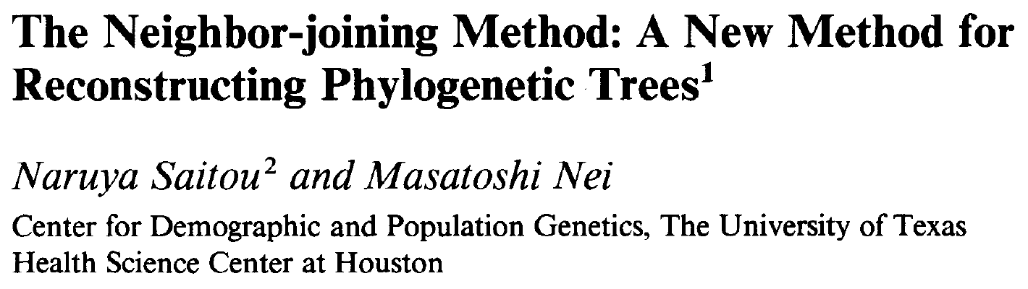
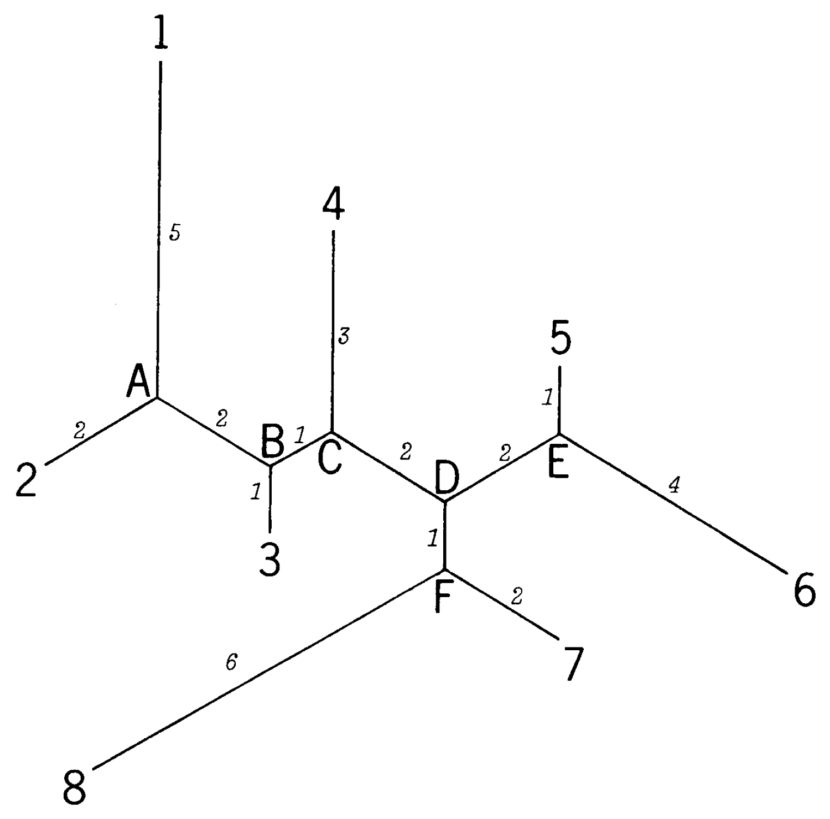
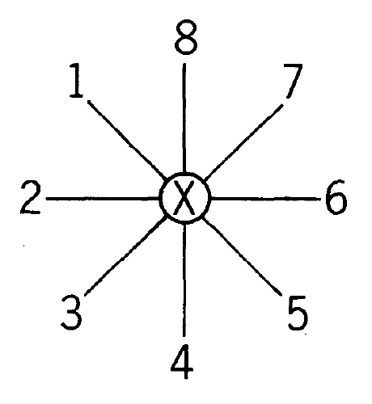
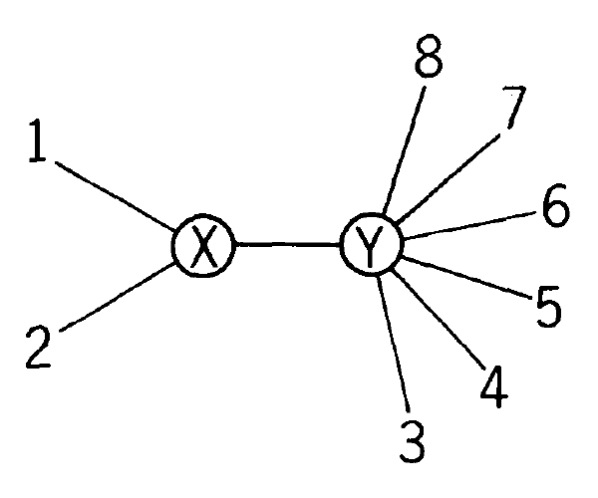
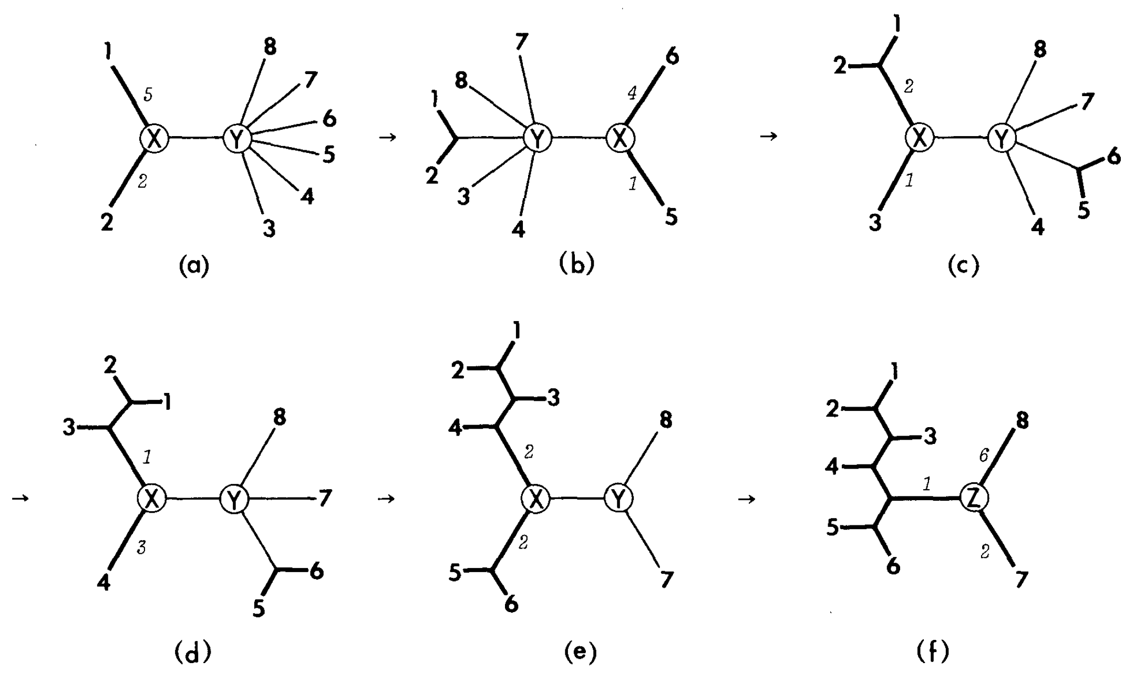
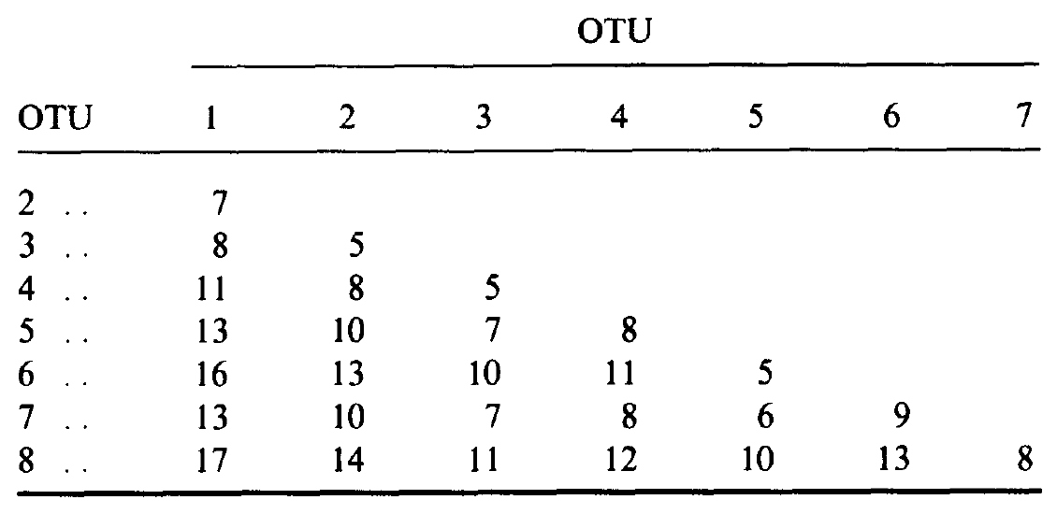
Neighbor Joining
Notes:
Neighbor joining: https://en.wikipedia.org/wiki/Neighbor_joining
Saitou, Naruya, and Masatoshi Nei. "The neighbor-joining method: a new method for reconstructing phylogenetic trees." Molecular biology and evolution 4.4 (1987): 406-425.

Slide 37
Neighbor Joining
A bottom-up (agglomerative) clustering method
True tree
1
1
A
 | A | B | C | D | E
B | 5
C | 4 | 7
D | 7 | 10 | 7
E | 6 | 9 | 6 | 5
F | 8 | 11 | 8 | 9 | 8
1
4
B
???
2
1
C
3
Root
1
D
2
E
4
F
A
Neighbor Joining
F
B
A star-like tree
E
C
D
Notes:
Neighbor joining: https://en.wikipedia.org/wiki/Neighbor_joining

Slide 38
Neighbor Joining
A
F
B
OTU: Operational Taxonomic Unit
N = 6
E
C
D
Step 1-1. S_{x} = (sum all D_{x})/(N-2), N = # of OTUs in the set
S_{A} = (5+4+7+6+8)/(6-2) = 7.5
S_{B} = (5+7+10+9+11)/(6-2) = 10.5
S_{C} = (4+7+7+6+8)/(6-2) = 8
S_{D} = (7+10+7+5+9)/(6-2) = 9.5
S_{E} = (6+9+6+5+8)/(6-2) = 8.5
S_{F} = (8+11+8+9+8)/(6-2) = 11
 | A | B | C | D | E
B | 5
C | 4 | 7
D | 7 | 10 | 7
E | 6 | 9 | 6 | 5
F | 8 | 11 | 8 | 9 | 8
Step 1-2. M_{ij} = D_{ij} – S_{i} – S_{j} → smallest(M)
M_{AB} = D_{AB}–S_{A}–S_{B} = 5-7.5-10.5 = -13
M_{DE} = D_{DE}–S_{D}–S_{E} = 5-9.5-8.5 = -13
Step 1-4.
F
B
A
U1
1
4
E
C
Step 1-3. S_{iU} = D_{ij}/2 + (S_{i} – S_{j})/2
S_{AU1} = D_{AB}/2+(S_{A}–S_{B})/2 = 5/2+(7.5-10.5)/2 = 1
S_{BU1} = D_{AB}/2+(S_{B}–S_{A})/2 = 5/2+(10.5-7.5)/2 = 4
D
Step 1-5. D_{xU} = (D_{ix} + D_{jx} – D_{ij})/2
Notes:
Neighbor joining: https://en.wikipedia.org/wiki/Neighbor_joining

Slide 39
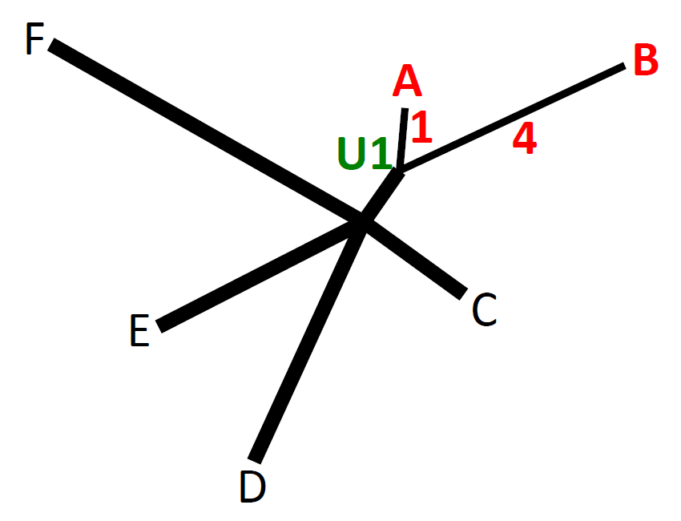
Neighbor Joining
OTU: Operational Taxonomic Unit
N = 5
Step 1-5. D_{xU} = (D_{ix} + D_{jx} – D_{ij})/2
Step 2-1. S_{x} = (sum all D_{x})/(N-2), N = # of OTUs in the set
S_{U1} = (3+6+5+7)/(5-2) = 7
S_{C} = (3+7+6+8)/(5-2) = 8
S_{D} = (6+7+5+9)/(5-2) = 9
S_{E} = (5+6+5+8)/(5-2) = 8
S_{F} = (7+8+9+8)/(5-2) = 10.67
 | U1 | C | D | E
C | 4-1 (7-4)
D | 7-1 (10-4) | 7
E | 6-1 (9-4) | 6 | 5
F | 8-1 (11-4) | 8 | 9 | 8
Step 2-2. M_{ij} = D_{ij} – S_{i} – S_{j} → smallest(M)
M_{CU1} = D_{CU1}–S_{C}–S_{U1} = 3-8-7 = -12
M_{DE} = D_{DE}–S_{D}–S_{E} = 5-9-8 = -12
Step 2-4.
F
B
A
U1
1
4
2
U2
C
E
Step 2-3. S_{iU} = D_{ij}/2 + (S_{i} – S_{j})/2
S_{DU2} = D_{DE}/2+(S_{D}–S_{E})/2 = 5/2+(9-8)/2 = 3
S_{EU2} = D_{DE}/2+(S_{E}–S_{D})/2 = 5/2+(8-9)/2 = 2
3
D
Step 2-5. D_{xU} = (D_{ix} + D_{jx} – D_{ij})/2
Notes:
Neighbor joining: https://en.wikipedia.org/wiki/Neighbor_joining

Slide 40
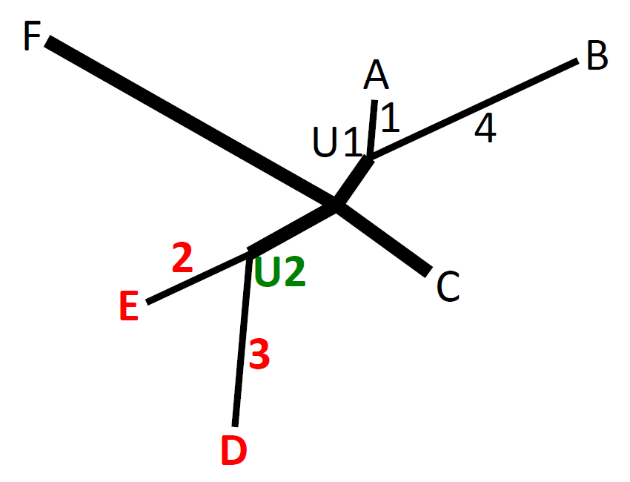
Neighbor Joining
OTU: Operational Taxonomic Unit
N = 4
Step 2-5. D_{xU} = (D_{ix} + D_{jx} – D_{ij})/2
Step 3-1. S_{x} = (sum all D_{x})/(N-2), N = # of OTUs in the set
S_{U1} = (3+3+7)/(4-2) = 6.5
S_{C} = (3+4+8)/(4-2) = 7.5
S_{U2} = (3+4+6)/(4-2) = 6.5
S_{F} = (7+8+6)/(4-2) = 10.5
 | U1 | C | U2
C | 3
U2 | 6-3 (5-2) | 7-3 (6-2)
F | 7 | 8 | 9-3 (8-2)
Step 3-2. M_{ij} = D_{ij} – S_{i} – S_{j} → smallest(M)
M_{CU1} = D_{CU1}–S_{C}–S_{U1} = 3-7.5-6.5 = -11
Step 3-4.
F
B
A
U1
1
4
1
U3
2
U2
2
C
E
Step 3-3. S_{iU} = D_{ij}/2 + (S_{i} – S_{j})/2
S_{CU3} = D_{CU1}/2+(S_{C}–S_{U1})/2 = 3/2+(7.5-6.5)/2 = 2
S_{U1U3} = D_{CU1}/2+(S_{U1}–S_{C})/2 = 3/2+(6.5-7.5)/2 = 1
3
D
Step 3-5. D_{xU} = (D_{ix} + D_{jx} – D_{ij})/2
Notes:
Neighbor joining: https://en.wikipedia.org/wiki/Neighbor_joining

Slide 41
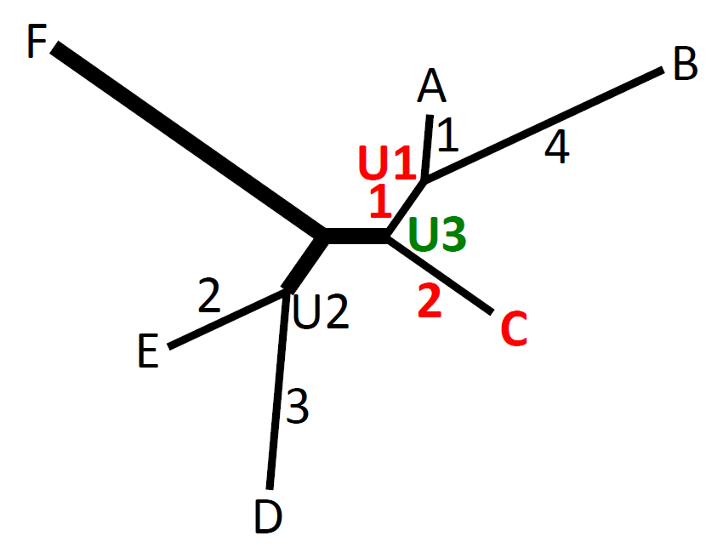
Neighbor Joining
OTU: Operational Taxonomic Unit
N = 3
Step 3-5. D_{xU} = (D_{ix} + D_{jx} – D_{ij})/2
Step 4-1. S_{x} = (sum all D_{x})/(N-2), N = # of OTUs in the set
S_{U2} = (2+6)/(3-2) = 8
S_{U3} = (2+6)/(3-2) = 8
S_{F} = (6+6)/(3-2) = 12
 | U2 | U3
U3 | 4-2 (3-1)
F | 6 | 8-2 (7-1)
Step 4-2. M_{ij} = D_{ij} – S_{i} – S_{j} → smallest(M)
M_{U2F} = D_{U2F}–S_{U2}–S_{F} = 6-8-12 = -14
M_{U3F} = D_{U3F}–S_{U3}–S_{F} = 6-8-12 = -14
M_{U2U3} = D_{U2U3}–S_{U2}–S_{U3} = 2-8-8 = -14
Step 4-4.
F
B
A
U1
1
4
1
U4
1
U3
2
1
2
E
U2
C
Step 4-3. S_{iU} = D_{ij}/2 + (S_{i} – S_{j})/2
S_{U2U4} = D_{U2U3}/2+(S_{U2}–S_{U3})/2 = 2/2+(8-8)/2 = 1
S_{U3U4} = D_{U2U3}/2+(S_{U3}–S_{U2})/2 = 2/2+(8-8)/2 = 1
3
D
Step 4-5. D_{xU} = (D_{ix} + D_{jx} – D_{ij})/2
Notes:
Neighbor joining: https://en.wikipedia.org/wiki/Neighbor_joining

Slide 42
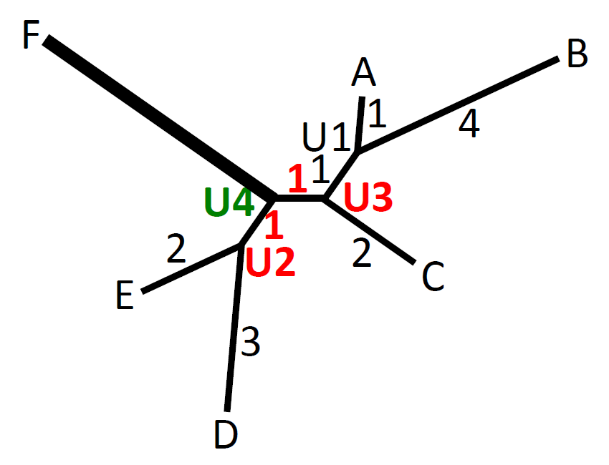
Neighbor Joining
OTU: Operational Taxonomic Unit
N = 2
Step 4-5. D_{xU} = (D_{ix} + D_{jx} – D_{ij})/2
Step 5-1. S_{x} = (sum all D_{x})/(N-2), N = # of OTUs in the set
N-2 = 2-2 = 0
 | U4
F | 6-1 (6-1)
Step 5-2.
F
B
5
A
U1
1
4
1
U4
1
U3
2
1
2
E
U2
C
3
D
Notes:
Neighbor joining: https://en.wikipedia.org/wiki/Neighbor_joining

Slide 43
Neighbor Joining
True tree
1
1
A
1
4
B
2
1
C
3
Root
1
D
2
E
4
 | A | B | C | D | E
B | 5
C | 4 | 7
D | 7 | 10 | 7
E | 6 | 9 | 6 | 5
F | 8 | 11 | 8 | 9 | 8
F
F
B
Neighbor Joining
5
A
1
4
1
1
2
1
2
E
C
3
D
Notes:
Neighbor joining: https://en.wikipedia.org/wiki/Neighbor_joining

Slide 44
Tools
MEGA (Molecular Evolutionary Genetics Analysis)
MrBayes (Bayesian Inference of Phylogeny)
PHYLIP (the PHYLogeny Inference Package)
PAUP (Phylogenetic Analysis Using Parsimony)
iTOL (interactive Tree of Life)
…
Notes:
MEGA: http://www.megasoftware.net/
MrBayes: http://mrbayes.sourceforge.net/
PHYLIP: http://evolution.genetics.washington.edu/phylip.html
PAUP: http://paup.sc.fsu.edu/
iTOL: http://itol.embl.de/

Slide 45
References
Van Noorden, Richard, Brendan Maher, and Regina Nuzzo. "The top 100 papers." Nature 514.7524 (2014): 550-553.
Barton, N. H., D. E. G. Briggs, J. A. Eisen, D. B. Goldstein and N. H. Patel (2007). Evolution, Cold Spring Harbor Laboratory Press.
Saitou, Naruya, and Masatoshi Nei. "The neighbor-joining method: a new method for reconstructing phylogenetic trees." Molecular biology and evolution 4.4 (1987): 406-425.

Slide 46
10th citation: 53,364
CLUSTAL W: improving the sensitivity of progressive multiple sequence alignment through sequence weighting, position specific gap penalties and weight matrix choice (1994)

Slide 47

ClustalW
ClustalW is a general purpose multiple alignment program for DNA or proteins by using progressive alignment.
It can create multiple alignments, manipulate existing alignments, do profile analysis and create phylogentic trees.
It is produced by Julie D. Thompson, Toby Gibson of European Molecular Biology Laboratory, Germany and Desmond Higgins of European Bioinformatics Institute, Cambridge, UK. Algorithmic

Slide 48
Progress Alignment
Proposed by Feng & Doolittle (1987).
Basic Idea:
- Align the two most closest sequences
- Progressively align the most closest related sequences
until all sequences are aligned.
Examples of progressive alignment method
ClustalW, T-coffee, Probcons
- Probcons is currently the most accurate MSA algorithm.
- ClustalW is the most popular software.
It is produced by Julie D. Thompson, Toby Gibson of European Molecular Biology Laboratory, Germany and Desmond Higgins of European Bioinformatics Institute, Cambridge, UK. Algorithmic

Slide 49
Basic algorithm
1. Computing pairwise distance scores for all pairs of
sequences.
2. Generate the guide tree which ensures similar sequences
are nearer in the tree.
3. Aligning the sequences one by one according to the guide
tree.

Slide 50
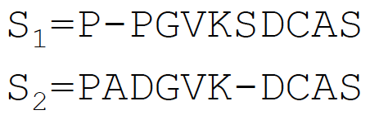
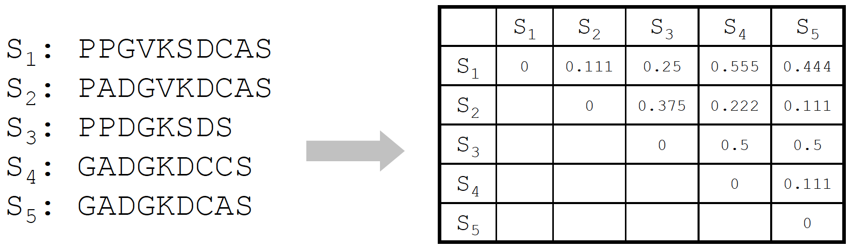
Step 1: Pairwise distance scores
Example: For S1 and S2, the global alignment is
There are 9 non-gap positions and 8 match positions.
The distance is 1 – 8/9 = 0.111
It is produced by Julie D. Thompson, Toby Gibson of European Molecular Biology Laboratory, Germany and Desmond Higgins of European Bioinformatics Institute, Cambridge, UK. Algorithmic

Slide 51
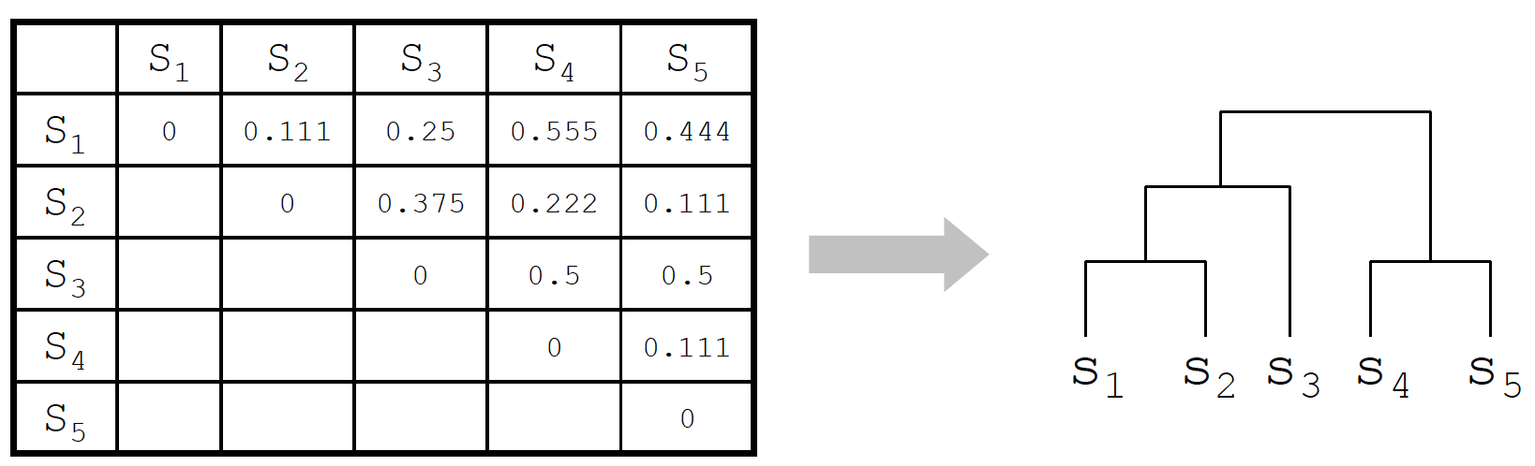
Step 2: Generate guide tree
By neighbor-joining, generate the guide tree.

Slide 52
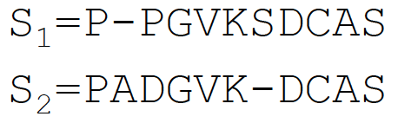
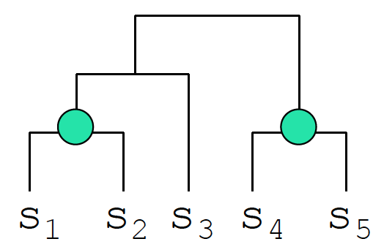
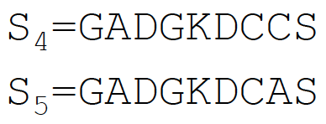
Step 3: Align the sequences according to the guide tree (l)
Aligning S1 and S2, we get
Aligning S4 and S5, we get

Slide 53
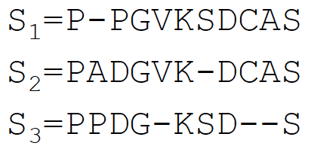
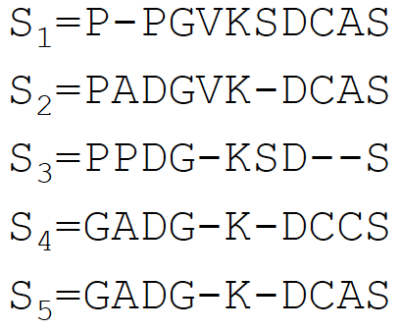
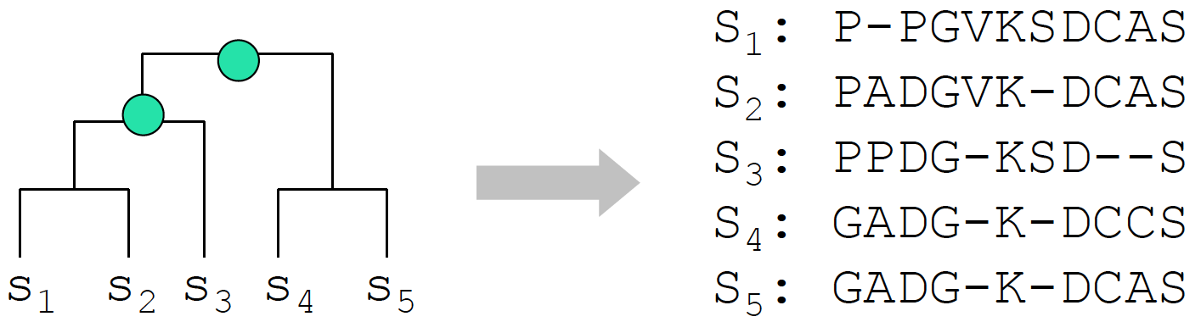
Step 3: Align the sequences according to the guide tree (ll)
Aligning (S1, S2) with S3,
we get
Aligning (S1, S2, S3) with
(S4, S5), we get

Slide 54
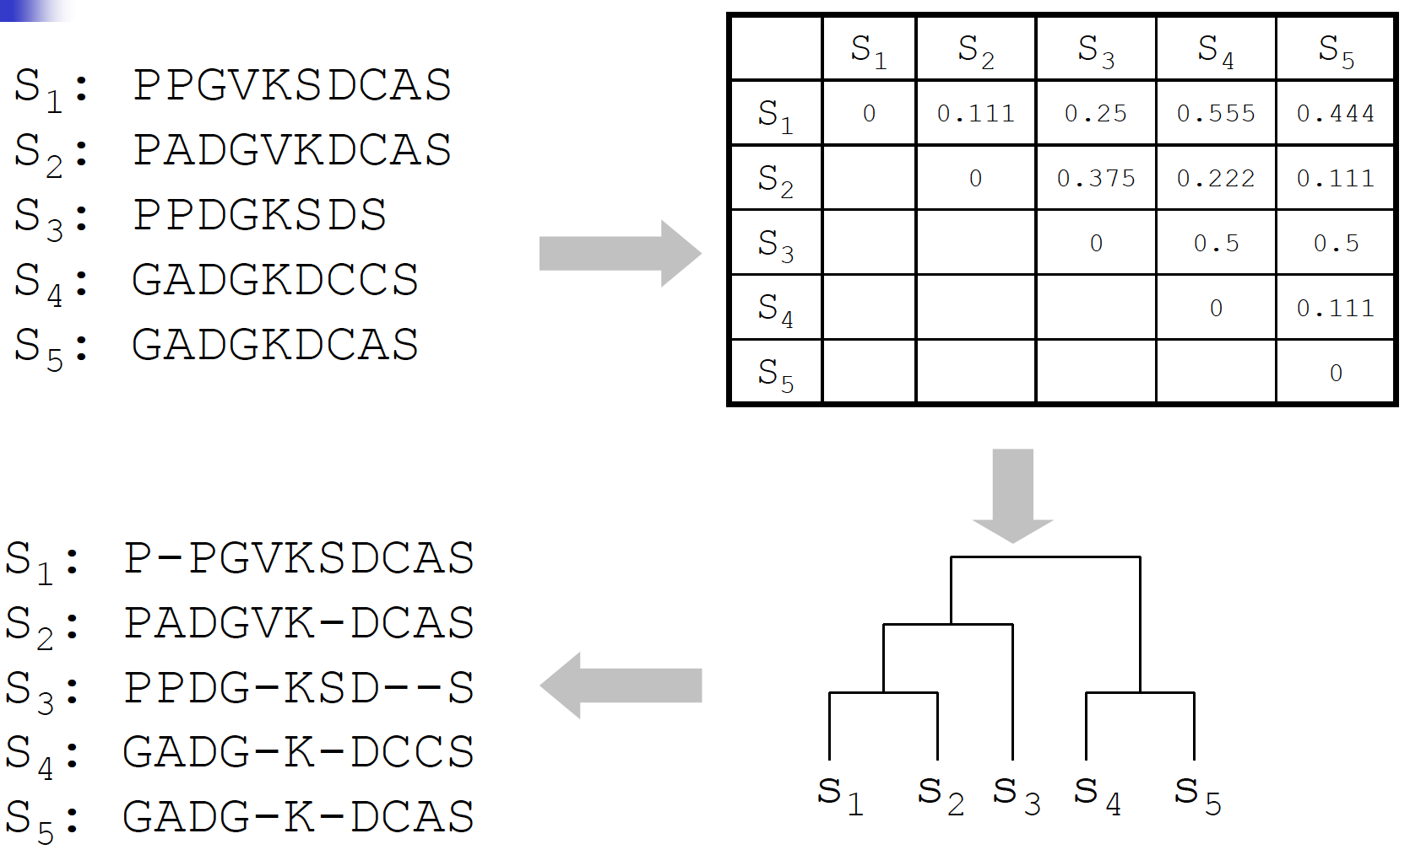
Summary

Slide 55
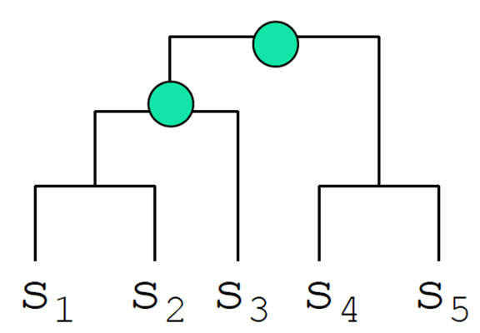
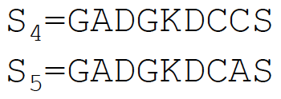
Detail of Profile-Profile alignment (l)
Given two aligned sets of sequences A1 and A2
- A1 is a length 11 alignment of S1, S2, S3
- A2 is a length 9 alignment of S4, S5

Slide 56
Detail of Profile-Profile alignment (ll)
A1[1…11] is the alignment of S1, S2, S3
A2[1…9] is the alignment of S4, S5
Score(A1[9],A2[8]) = δ(C,C)+δ(C,A)+δ(C,C)+δ(C,A)+δ(-,C)+δ(-,A)
By dynamic programming, you can find the best score of the multiple alignments. Takes O(k1n1+k2n2+n1n2) time

Slide 57
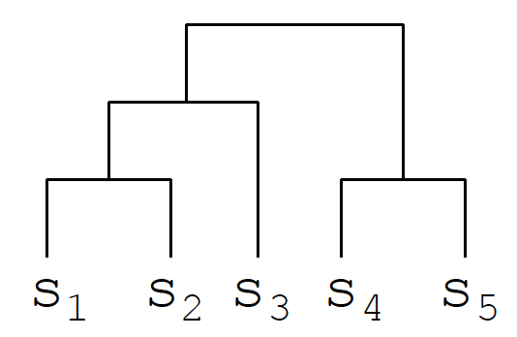
Time complexity
Step 1: Pairwise distance scores.
Takes O($k^{2}n^{2}$) time.
Step 2: Neighbor-joining
Takes O($k^{3}$) time.
Step 3: Perform at most k profile-profile alignments,
Each takes O(${kn+n}^{2}$) time.
Thus, Step 3 takes O($k^{2}{n+kn}^{2}$) time.
Hence, ClustalW takes O($k^{2}{n^{2}+k}^{3}$) time.
Neighbor-joining on a set of k taxa require at most k-2 iterations. Each step has to build and search a matrix. Initially, the matrix size is k $×$ k. Then, the next step is (k-1)$×$(k-1), etc.

