Slide 1
Basic Local Alignment Search Tool Altschul et.al, 1990
傅安 陳岳昇 陳宗涵
2016.12.12

Slide 2
Outline
Introduction and Methods
Results
Conclusion

Slide 3
Introduction
Measures of similarity between sequences to distinguish biologically significant relationships.
Dynamic Programming
Best studied measures at that time
Optimal but impractical
FASTP
Find locally similar regions between two sequences based on identities but not gaps, and then rescores
BLAST
Directly approximates the results, faster than existing algorithms
Search for words which score above T rather than match exactly

Slide 4
MSP
The maximal segment pair measure(MSP)
The highest scoring pair of identical length segments chosen from 2 sequences.
Maybe of any length
Define a segment pair to be locally maximal if its score cannot be improved either by extending or by shorting both segments
Blast can therefore seek all locally maximal segment pairs with scores above some cutoff
Mathematical results allow the statistical significance of MSP scores to be estimated under particular scoring matrix
Ex:PAM-120 for proteins

Slide 5
Rapid approximation of MSP scores
BLAST with w-mers and threshold T and cutoff score S
Let a word pair be a fixed segment pair of length w (w-mers)
Seek only segment pairs that contain a word pair with a score at least T
Scanning through a sequence
Extend the hit if it’s contained within a segment whose score >= S
Appropriate T
The lower the T is, the higher chance a segment pair of at least score S will contain a word pair with score at least T
Increase the number of hits and execution time
How to find the appropriate T?

Slide 6
BLAST basics
BLAST is briefly a 3-step algorithm
Compile list of high-scoring strings(words)
w= 3 or 4 for protein search
w= 11 or 12 for nucleotide search
Search for hits
Using a hash table or a finite state machine
Extend hits to obtain segment pairs

Slide 7
Implementation for proteins
Compiling a list of high-scoring words
Given w and map each word to an integer between 1 and ${20}^{w}$so a word can be used as an index into an array of size ${20}^{w}$
Let the i-th entry of the array point to the list of all occurrences in the query sequence of the i-word
Example using PAM-120 for query sequence ACDE (w=4, T=17):
A C D E
ACDE = +3 +9 +5 +5 = 22
try all possibilities:
AAAA = +3 -3 0 0 = 0 no good
AAAC = +3 -3 0 -7 = -7 no good
...too slow, try directed change

Slide 8
Generating word list
A C D E
ACDE = +3 +9 +5 +5 = 22
change 1st pos. to all acceptable substitutions
gCDE = 1 9 5 5 = 20 ok (=pCDE,sCDE,tCDE)
nCDE = 0 9 5 5 = 19 ok (=dCDE,eCDE,nCDE,vCDE)
iCDE = -1 9 5 5 = 18 ok (=qCDE)
kCDE = -2 9 5 5 = 17 ok (=mCDE)
change 2nd pos.: can't - all alternatives negative and the other three positions only add up to 13
change 3rd pos. in combination with first position
gCnE = 1 9 2 5 = 17 ok
continue - use recursion

Slide 9
Scanning
Example of a finite state machine for string matching: (input alphabet: a,b,c)
Word: ababaca
a
a
a
a
a
b
a
b
a
c
a
0
1
2
3
4
5
6
7
b
b
Database sequence: bcabccaaababacababacabb

Slide 10
Implementation for proteins
Extending hit
Extend hits in both directions (without allowing gaps)
Economize time policy, terminate when score falls a certain distance below the best score found from shorter extensions.
May have missing a higher score extension (in protein default distance is 20, probability is 0.001)

Slide 11
Implementation for DNA
Simpler list
List of all contiguous w-mers in the query sequence. Thus with query sequence length n yields a list of n-w+1 words
Compress the database by packing 4 nucleotides into a single byte
Since all frames of the query sequence are considered separately, any match of length w>=11 must contain a match of length 8 that lies on a byte boundary of one of the words from the query sequence. Thus can scan a (packed) byte at a time, improving speed 4-fold over comparing one nucleotide at a time.

Slide 12
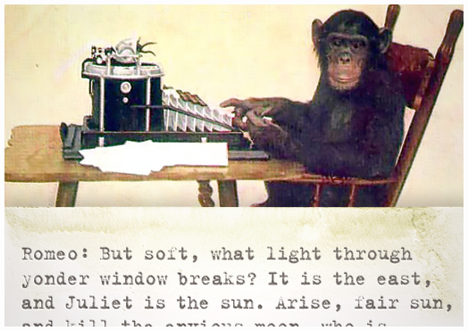
Results
Performance of BLAST with random sequences
Karlin & Altschul Statistics
P(segment pair | Score > S ) = 1 – e^{-y} , where y is Kmn e^{-Sλ}
m, n are sequence lengths
Expected number of ungapped alignments with score S found with random sequence is: E = Kmn e^{-Sλ}
Why do we need to know about random sequences statistics?

Slide 13
Results
Performance of BLAST with random sequences
Why do we need to know about random sequences statistics?
Suppose below A and B are sequences that are actually not related, which can be viewed as two random sequences.
A = “ACTTGCTTA”
B = “CGTTGCACT”
What if we only examine this part?
A = “ACTTGCTTA”
B = “CGTTGCACT”

Slide 14
Results
Performance of BLAST with random sequences
Using the formula mentioned, we can find out the approximate MSP score a pair must have in order to distinguish random sequences.
That is, we are only interested in finding some segment pairs with scores at least S.
Def: q , the probability for BLAST to miss a segment pair with score ≥ S and it doesn’t contain a word score ≥ T.

Slide 15
Results
Performance of BLAST with random sequences
T is fixed, q will decrease exponentially when increasing S linearly.
Figure below suggests the argument above. (Not a theorem)
-ln(q) gets larger
when q decreases
q = 0.45
q = 0.67
w = 4
T = 18

Slide 16
Results
Performance of BLAST with random sequences
Table for different w and T values and the implied q with different S
Shown that S should be at least 55 in order to distinguish from chance similarities.
With w = 4, T = 17. Miss 0.2 MSPs when S = 55, 0.1 while S = 70

Slide 17
Results
The choice of word length and threshold parameters
The critical question: How do we choose w and T ?
Should dive into the table shown previously for more information
Recall the steps of BLAST:
Compile the word list from query with score ≥ T
Scan the database for hits
Extend hits to find pairs with scores ≥ S
w and T directly have an impact on the time for the stages 1 and 3

Slide 18
Results
The choice of word length and threshold parameters
Choose (w,T) = (3,14); (4,16); (5,18)
The level of sensitivity are quite alike for these three sets of parameters
So which one is better?

Slide 19
Results
The choice of word length and threshold parameters
The probability of a hit decreases as w increases
So we should choose larger w in order to decrease the
time in stage 3
However, if w increases, the word list for proteins increase
dramatically! Totally 20^{w} words…
Therefore, choose w = 4 is better than 3 or 5 in practice
So, w is determined, that is 4.

Slide 20
Results
The choice of word length and threshold parameters
Time to choose T…
Why not simply choose the smallest T possible since q can be small ?
Time consuming!!
Number of words grow exponentially when decreasing T
Which means exponentially increase time!
Best choice of T in practice is 17.

Slide 21
Results
Performace of BLAST with homologous sequence
With super-families containing many distantly related proteins, we could obtain result usefully comparable with the random model.
With (PIR code MYMQW), we found 178 sequences containing MSPs with scores between 50 and 80. Using w = 4 and T = 17, the random model suggests BLAST should miss about 24 of these MSPs; in fact, it misses 43. This poorer than expected performance is due to the uniform pattern of conservation in the globins, resulting in a relatively small number of high-scoring words between distantly related proteins.
Contrary example with(PIR code KVMST1), using the same parameters as previously. Of the 33 MSPs with scores between 45 and 65, BLAST missed only 2; the random model suggests it should have missed 8.
Distribution of mutations along sequences has been shown to be more clustered than predicted, thus the BLAST approximation should, on average, perform better on real sequences than predicted by the random model.

Slide 22
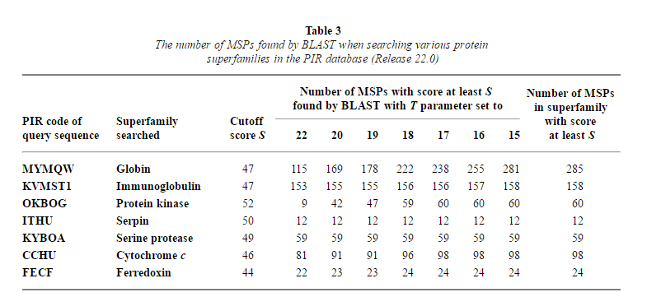
Results
Table 3

Slide 23
Results
The overall performance of BLAST depends upon the distribution of MSP scores for those sequences related to the query.
MSPs that are distinguishable from chance have a high enough score to be found readily by BLAST, even using relatively high values of the T parameter.
In Table 3, with T =18, virtually all the statistically significant MSPs are found in most instances.

Slide 24
Results
Comparison of two long DNA sequence
We used the BLAST algorithm to locate locally similar regions that can be aligned without introduction of gaps.
Human：6 globin genes(ε, Gγ, Aγ, η, δ and β)
Rabbit：4 globin genes(ε, γ, δ and β)
Difference of exons & introns in paired gene -> collection of the highest scoring alignments between similar regions can be expected to have at least 24 alignments between gene pairs
The human β-like globin cluster contains two overlapped L1 and the rabbit cluster has two tandem L1 sequences in the same orientation, both around 6000 bp in length. These human and rabbit L1 sequences are quite similar and their lengths make them highly visible in similarity computations.

Slide 25
Results
An ancestral gene cluster arranged as 5’-ε-γ-η-δ-β-3’
There are inter-gene similarities within the β clusters. For example, there is a region between human ε and ^{G}γ that is similar to a region between rabbit ε and γ.
In Table 4：
Applied a variant of the BLAST programs to these two sequences, with match score 5, mismatch score −4 and, initially, w = 12. The program found 98 alignments scoring over 200, with 1301 being the highest score. Of the 57 alignments scoring over 350.
With smaller values of w, more alignments are found. In particular, with w = 8, an additional 32 alignments are found with a score above 200.

Slide 26
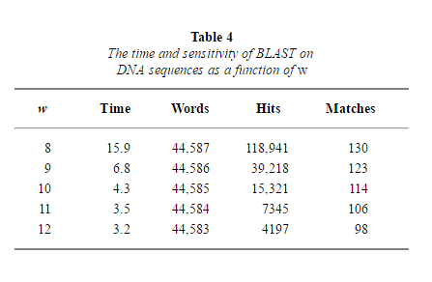
Results
Table 4

Slide 27
Conclusion
The concept underlying BLAST is simple and robust, therefore can be implemented in a number of ways and utilized in a variety of contexts.
Ex：allow for gaps, shared memory version, implementing a similar algorithm for comparing a DNA sequence to the protein database, allowing translation in all six reading frames……etc.
Variations of the basic idea as well as alternative implementations, such as those described above, can adapt the method for different contexts. Given the increasing size of sequence databases, BLAST can be a valuable tool for the molecular biologist.

