Slide 1
Optimal alignments in linear space
Eugene W.Myers and Webb Miller
Notes:
今天我們要報告的主題是 Optimal alignments in linear space

Slide 2
Outline
Introduction
Gotoh's algorithm
O(N) space Gotoh's algorithm
Main algorithm
Implementation
Conclusion
Notes:
這是我們的outline。首先介紹introduction，再來是paper用到的一般的Gotoh演算法和linear space的gotoh演算法，最後是相關的implementation。

Slide 3
Introduction
Notes:
今天我們要報告的主題是 Optimal alignments in linear space

Slide 4
Introduction
Space, not time
Hirschberg’s Algorithm
Maximizing the similarity score of an alignment
Gotoh’s Algorithm
Minimizing the difference score of a conversion
Linear space version for affine gap penalties.
For a megabyte of memory.
W.Myers and Miller : sequences of length 62500
Altschul and Erickson : sequences length < 1070
Notes:
在演算法中，我們通常都在空間和時間取得一個平衡。而今天我們要報告的主題主要是注重在空間的利用上。
課堂在老師教的是 hirschberg的演算法，在這裡使用的是Gotoh的演算法。他們兩個之間的差異在於hirschberg是最大化兩個
Alignment的分數，而Gotoh是去最小化從一個seqeucen轉換到另外一個sequence所需要的cost。這一片paper主要是去
實作gotoh的演算法來計算affine gap penalties，並且在linear space內完成。Paper中提到，在1 megabyte的記憶體中，
他們的程式可以計算長度為62500的sequence，而Erickson他們的程式只能計算小於1070的sequence。

Slide 5
Transformation (1/2)
 | Hirschberg’s Algorithm | Gotoh’s Algorithm
Aligned Pair | $$σ\left(a,b\right)$$ | $$w\left(a,b\right)= σ_{max}−σ\left(a,b\right)$$
Affine Gap Penalties | $$gap(k)=q+rk$$ | $$gap(k)=g+hk$$ $$g=−q$$ $$h = \frac{1}{2}σ_{max}−r$$
Notes:
其實，hisberg跟gotoh是有相關性的。這裡我們先來解釋一下關於Hirschberg和Gotoh之間的一些轉換。
在Hirberg中，match和mismatch是#(a,b)而轉換到Gotoh會變成是w(a,b)，計算方式是XXX.. Gotoh的演算法最不一樣的地方是他所有的cost都是正的。
所以，對於gap的penalties，會有以下的轉換。G = -Q, h = XXX，而H就是 XXX. 而為什麼h還要加一個1/2max呢?

Slide 6
Transformation (2/2)
Match = 8, Mismatch = -5, Gap Symbol = -3, Gap-open = -4
<
$$(−6<−5)$$
$2r<σ\left(a,b\right)$ (Hirschberg) $$=> 2r< σ_{max}−w\left(a,b\right) \\ => σ_{max}−2r>w\left(a,b\right)$$
$∴2h= σ_{max}−2r$
$h= \frac{1}{2}σ_{max}−r$
Notes:
不知道大家還記不記得上課老師說過的，hisberg中2倍的gap penalty扣的分數一定要多過mismatch扣的分數。W(a,b)就是gotoh中mimatch的分數。所以#max-2r是代表gotoh中的兩個gap，因此，一個gap的cost是這樣計算出來的。

Slide 7
Example(1/2)
 | Hirschberg’s Algorithm | Gotoh’s Algorithm
Match | 8 | 0 | $$w\left(a,b\right)= σ_{max}−σ\left(a,b\right)$$
Mismatch | -5 | 13
Gap-open | -4 | 4 | $$g=−q$$
Gap Symbol | -3 | 7 | $$h = \frac{1}{2}σ_{max}−r$$
Notes:
舉個例子來說，hisberg的match是8，對應到convertion cost是0，而mismatch的計算方式也是一樣。

Slide 8
Example(2/2)
 | Hirschberg’s Algorithm | Gotoh’s Algorithm
Cost |  | C (minimum)
1 | A : ACGGTTCAAG B : ACGGTTCAAG | Hirschberg : 10x8 = 80 C = 0 (conversion cost) $∴\frac{1}{2}\left(10+10\right)8−0=80$ (Alignment score)
2 | A : ACGGTTCAAG B : ACGGATCAAG | Hirschberg : 9x8 + (-5) = 67 C = 13 $∴\frac{1}{2}\left(10+10\right)8−13=67$
3 | A : ACGGCTCAAG B : ACGGCTC$−$AG | Hirschberg : 9x8 + (-4-3) = 65 C = 11 (7+4) $∴\frac{1}{2}\left(10+9\right)8−11=65$
Notes:
假設gotoh算出來的conversion cost是C，對照hisberg maximum score 可以利用這個公式算出。Mn就是兩個seq的長度。下面會舉個例子給大家看。對於1來說，兩個一樣的seq，他的conversion cost是0，而用公式轉得到的結果跟hisberg算出的一樣。而2有一個mismatch，hisrsbeg算出的答案是67，跟我們轉換的得到的一樣。3的例子存在著一個gap，他的Conversion cost是一個gap symbol和gap open。所以是11。而用hirsberg算出來的答案，也是跟他一樣。
接下來的所有報告中，我們都會使用Gotoh的演算法，也就是最小化conversion cost。

Slide 9
Gotoh's algorithm
R99922005
黃博平

Slide 10
Some notations
: the i-symbol prefix of A
: the j-symbol prefix of B
C(i, j):minimum cost of a conversion of
to

Slide 11
Simple gap(1/4)
gap(k)= h*k

Slide 12
Simple gap(2/4)
A A G
0.0 | 2.5 | 3.0 | 3.5
2.5 | 0.0 | 2.5 | 3.0
3.0 | 2.5 | 1.0 | 2.5
3.5 | 3.0 | 3.5 | 2.0
4.0 | 3.5 | 3.0 | 4.5
4.5 | 4.0 | 4.5 | 4.0
A
G
T
A
C
Space= O(n^2)

Slide 13
Simple gap(3/4)
m/2

Slide 14
Simple gap(4/4)
Forward score and backward score
Space: O(m+n)

Slide 15
Affine gap(1/8)
A gap of length k : cost = g + k*h
A - - - T A A C T C G A A T C - - T

Slide 16
Affine gap(2/8)
C(i, j):minimum cost of a conversion of
to
D(i, j):minimum cost of a conversion of
to that deletes
I(i, j):minimum cost of a conversion of
to that inserts

Slide 17
Affine gap(3/8)
if i > 0 and j> 0
if i = 0 and j> 0
if i > 0 and j= 0
if i = 0 and j= 0

Slide 18
Affine gap(4/8)
if i > 0 and j> 0
if i = 0 and j> 0

Slide 19
Affine gap(5/8)
if i > 0 and j> 0
if i > 0 and j= 0

Slide 20
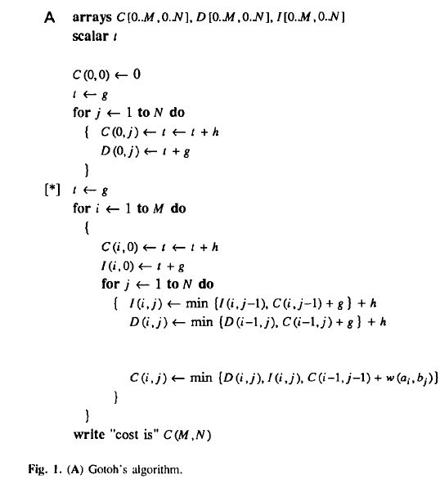
Affine gap(6/8)

Slide 21
Affine gap(7/8)
D
A A G
* | 4.5 | 5.0 | 5.5
* | 5.0 | 5.5 | 6.0
* | 2.5 | 5.0 | 5.5
* | 3.0 | 3.5 | 5.0
* | 3.5 | 4.0 | 4.5
* | 4.0 | 4.5 | 5.0
A
G
T
A
C
C
A A G
0.0 | 2.5 | 3.0 | 3.5
2.5 | 0.0 | 2.5 | 3.0
3.0 | 2.5 | 1.0 | 2.5
3.5 | 3.0 | 3.5 | 2.0
4.0 | 3.5 | 3.0 | 4.5
4.5 | 4.0 | 4.5 | 4.0
A
G
T
A
C
I
A A G
* | * | * | *
4.5 | 5.0 | 2.5 | 3.0
5.0 | 5.5 | 5.0 | 3.5
5.5 | 6.0 | 5.5 | 6.0
6.0 | 6.5 | 6.0 | 5.5
6.5 | 7.0 | 6.5 | 7.0
A
G
T
A
C

Slide 22
Affine gap(8/8)
D
A A G
* | 4.5 | 5.0 | 5.5
* | 5.0 | 5.5 | 6.0
* | 2.5 | 5.0 | 5.5
* | 3.0 | 3.5 | 5.0
* | 3.5 | 4.0 | 4.5
* | 4.0 | 4.5 | 5.0
A
G
T
A
C
C
A A G
0.0 | 2.5 | 3.0 | 3.5
2.5 | 0.0 | 2.5 | 3.0
3.0 | 2.5 | 1.0 | 2.5
3.5 | 3.0 | 3.5 | 2.0
4.0 | 3.5 | 3.0 | 4.5
4.5 | 4.0 | 4.5 | 4.0
A
G
T
A
C
I
A A G
* | * | * | *
4.5 | 5.0 | 2.5 | 3.0
5.0 | 5.5 | 5.0 | 3.5
5.5 | 6.0 | 5.5 | 6.0
6.0 | 6.5 | 6.0 | 5.5
6.5 | 7.0 | 6.5 | 7.0
A
G
T
A
C

Slide 23
O(N) space Gotoh's algorithm
R99922041
陳彥璋

Slide 24
Observation
i-th row of C and D depends only on row i and i-1.
i-th row of I depends only on row i.
D
I
C

Slide 25
Linear Space
Use two one-dimension arrays (CC and DD) and three variables.

Slide 26
Linear Space
$CC\left(k\right)= \left\{\begin{aligned}C\left(i, k\right) , if k<j \\ C\left(i−1, k\right) , if k ≧j\end{aligned}\right.$
$DD\left(k\right)= \left\{\begin{aligned}D\left(i, k\right) , if k<j \\ D\left(i−1, k\right) , if k ≧j\end{aligned}\right.$
e = I(i , j-1)
c = C(i , j-1)
s = C(i-1 , j-1)

Slide 27
Algorithm

Slide 28
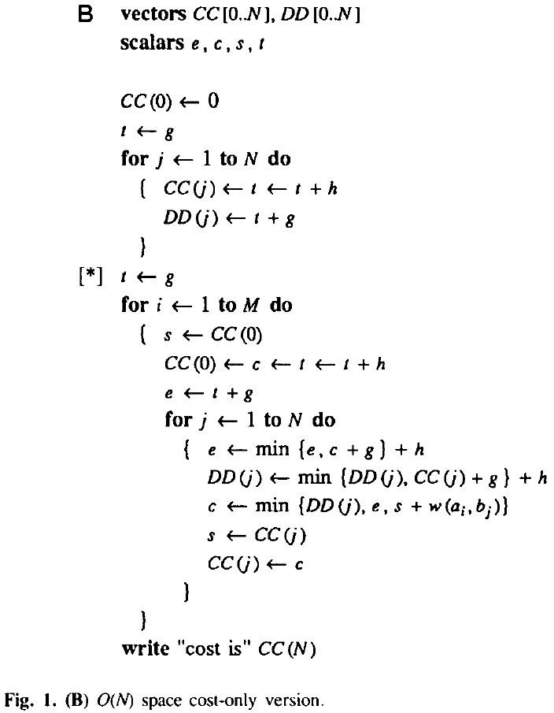
D
A A G
g = 2.0 h = 0.5
* | 4.5 | 5.0 | 5.5
* | 5.0 | 5.5 | 6.0
* | 2.5 | 5.0 | 5.5
* | 3.0 | 3.5 | 5.0
* | 3.5 | 4.0 | 4.5
* | 4.0 | 4.5 | 5.0
A
G
T
A
C
DD
t = 2.0
C
A A G
0.0 | 2.5 | 3.0 | 3.5
2.5 | 0.0 | 2.5 | 3.0
3.0 | 2.5 | 1.0 | 2.5
3.5 | 3.0 | 3.5 | 2.0
4.0 | 3.5 | 3.0 | 4.5
4.5 | 4.0 | 4.5 | 4.0
A
G
T
A
C
CC
I
A A G
* | * | * | *
4.5 | 5.0 | 2.5 | 3.0
5.0 | 5.5 | 5.0 | 3.5
5.5 | 6.0 | 5.5 | 6.0
6.0 | 6.5 | 6.0 | 5.5
6.5 | 7.0 | 6.5 | 7.0
A
G
T
A
C

Slide 29
D
A A G
g = 2.0 h = 0.5
* | 4.5 | 5.0 | 5.5
* | 5.0 | 5.5 | 6.0
* | 2.5 | 5.0 | 5.5
* | 3.0 | 3.5 | 5.0
* | 3.5 | 4.0 | 4.5
* | 4.0 | 4.5 | 5.0
A
G
T
A
C
DD
t = 2.0
C
A A G
0.0 | 2.5 | 3.0 | 3.5
2.5 | 0.0 | 2.5 | 3.0
3.0 | 2.5 | 1.0 | 2.5
3.5 | 3.0 | 3.5 | 2.0
4.0 | 3.5 | 3.0 | 4.5
4.5 | 4.0 | 4.5 | 4.0
A
G
T
A
C
CC
I
A A G
* | * | * | *
4.5 | 5.0 | 2.5 | 3.0
5.0 | 5.5 | 5.0 | 3.5
5.5 | 6.0 | 5.5 | 6.0
6.0 | 6.5 | 6.0 | 5.5
6.5 | 7.0 | 6.5 | 7.0
A
G
T
A
C

Slide 30
D
A A G
g = 2.0 h = 0.5
* | 4.5 | 5.0 | 5.5
* | 5.0 | 5.5 | 6.0
* | 2.5 | 5.0 | 5.5
* | 3.0 | 3.5 | 5.0
* | 3.5 | 4.0 | 4.5
* | 4.0 | 4.5 | 5.0
A
G
T
A
C
C
A A G
DD
0.0 | 2.5 | 3.0 | 3.5
2.5 | 0.0 | 2.5 | 3.0
3.0 | 2.5 | 1.0 | 2.5
3.5 | 3.0 | 3.5 | 2.0
4.0 | 3.5 | 3.0 | 4.5
4.5 | 4.0 | 4.5 | 4.0
A
G
T
A
C
t = 4.5
i = 5
I
A A G
s
CC
* | * | * | *
4.5 | 5.0 | 2.5 | 3.0
5.0 | 5.5 | 5.0 | 3.5
5.5 | 6.0 | 5.5 | 6.0
6.0 | 6.5 | 6.0 | 5.5
6.5 | 7.0 | 6.5 | 7.0
A
G
T
A
C
c
e

Slide 31
D
A A G
g = 2.0 h = 0.5
* | 4.5 | 5.0 | 5.5
* | 5.0 | 5.5 | 6.0
* | 2.5 | 5.0 | 5.5
* | 3.0 | 3.5 | 5.0
* | 3.5 | 4.0 | 4.5
* | 4.0 | 4.5 | 5.0
A
G
T
A
C
C
A A G
DD
0.0 | 2.5 | 3.0 | 3.5
2.5 | 0.0 | 2.5 | 3.0
3.0 | 2.5 | 1.0 | 2.5
3.5 | 3.0 | 3.5 | 2.0
4.0 | 3.5 | 3.0 | 4.5
4.5 | 4.0 | 4.5 | 4.0
A
G
T
A
C
t = 4.5
i = 5
I
A A G
j = 1
s
CC
* | * | * | *
4.5 | 5.0 | 2.5 | 3.0
5.0 | 5.5 | 5.0 | 3.5
5.5 | 6.0 | 5.5 | 6.0
6.0 | 6.5 | 6.0 | 5.5
6.5 | 7.0 | 6.5 | 7.0
A
G
T
A
C
c
e

Slide 32
D
A A G
g = 2.0 h = 0.5
* | 4.5 | 5.0 | 5.5
* | 5.0 | 5.5 | 6.0
* | 2.5 | 5.0 | 5.5
* | 3.0 | 3.5 | 5.0
* | 3.5 | 4.0 | 4.5
* | 4.0 | 4.5 | 5.0
A
G
T
A
C
C
A A G
DD
0.0 | 2.5 | 3.0 | 3.5
2.5 | 0.0 | 2.5 | 3.0
3.0 | 2.5 | 1.0 | 2.5
3.5 | 3.0 | 3.5 | 2.0
4.0 | 3.5 | 3.0 | 4.5
4.5 | 4.0 | 4.5 | 4.0
A
G
T
A
C
t = 4.5
i = 5
I
A A G
j = 1
s
CC
* | * | * | *
4.5 | 5.0 | 2.5 | 3.0
5.0 | 5.5 | 5.0 | 3.5
5.5 | 6.0 | 5.5 | 6.0
6.0 | 6.5 | 6.0 | 5.5
6.5 | 7.0 | 6.5 | 7.0
A
G
T
A
C
c
e

Slide 33
D
A A G
g = 2.0 h = 0.5
* | 4.5 | 5.0 | 5.5
* | 5.0 | 5.5 | 6.0
* | 2.5 | 5.0 | 5.5
* | 3.0 | 3.5 | 5.0
* | 3.5 | 4.0 | 4.5
* | 4.0 | 4.5 | 5.0
A
G
T
A
C
C
A A G
DD
0.0 | 2.5 | 3.0 | 3.5
2.5 | 0.0 | 2.5 | 3.0
3.0 | 2.5 | 1.0 | 2.5
3.5 | 3.0 | 3.5 | 2.0
4.0 | 3.5 | 3.0 | 4.5
4.5 | 4.0 | 4.5 | 4.0
A
G
T
A
C
t = 4.5
i = 5
I
A A G
j = 1
s
CC
* | * | * | *
4.5 | 5.0 | 2.5 | 3.0
5.0 | 5.5 | 5.0 | 3.5
5.5 | 6.0 | 5.5 | 6.0
6.0 | 6.5 | 6.0 | 5.5
6.5 | 7.0 | 6.5 | 7.0
A
G
T
A
C
c
e

Slide 34
D
A A G
* | 4.5 | 5.0 | 5.5
* | 5.0 | 5.5 | 6.0
* | 2.5 | 5.0 | 5.5
* | 3.0 | 3.5 | 5.0
* | 3.5 | 4.0 | 4.5
* | 4.0 | 4.5 | 5.0
A
G
T
A
C
C
A A G
0.0 | 2.5 | 3.0 | 3.5
2.5 | 0.0 | 2.5 | 3.0
3.0 | 2.5 | 1.0 | 2.5
3.5 | 3.0 | 3.5 | 2.0
4.0 | 3.5 | 3.0 | 4.5
4.5 | 4.0 | 4.5 | 4.0
DD
A
G
T
A
C
I
A A G
* | * | * | *
4.5 | 5.0 | 2.5 | 3.0
5.0 | 5.5 | 5.0 | 3.5
5.5 | 6.0 | 5.5 | 6.0
6.0 | 6.5 | 6.0 | 5.5
6.5 | 7.0 | 6.5 | 7.0
CC
A
G
T
A
C
Optimal conversion cost.

Slide 35
What is the conversion of AGTAC and AAG ?

Slide 36
Main algorithm part 1
B95902077
王柏易

Slide 37
Midpoint
Hirschberg (1975): recursive divide-and-conquer
Forward Computing
Backward Computing

Slide 38
Gap Penalty
i-1, j-1 | i, j-1
i-1, j | i, j

Slide 39
Gap Penalty
CC( j) = minimum cost of a conversion of Ai* to Bj
DD( j) = minimum cost of a conversion of Ai* to Bj that ends with a delete

Slide 40
Gap Penalty
RR(N - j) = minimum cost of a conversion of Ai*^{T} to Bj^{T}
SS(N - j) = minimum cost of a conversion of Ai*^{T} to Bj^{T} that begins with a delete

Slide 41
Find Midpoint with Gap Penalty
Forward Computing
How to compute the midpoint?
Backward Computing

Slide 42
Main algorithm part 2
R99922035
李政緯

Slide 43
Midpoint
The problem of calculating the midpoint is that when we concatenate two substrings into one, we may coalesce two gaps into one
Which means that we may consider
min { CC + RR, DD + SS - g, II + JJ - g}

Slide 44
Midpoint
Recall the above algorithm, we do save the space of II and JJ.
We can reduce it into
min {CC + RR, DD + SS - g}

Slide 45
Midpoint
Remember that we should find
min_{j ∈ [0, N]}{min { CC + RR, DD + SS - g, II + JJ - g}}
i*
j j+1

Slide 46
Midpoint
Type 1 recurrence Type 2 recurrence
i*
i*
j*
j*

Slide 47
Example
A = agtac , B = aag, i* = 2
agtac
a__ag
Recurrsive call on (a, a) and (ac, ag)

Slide 48
Implementation
R99922062
涂宗瑋

Slide 49
Implementation
Storage Requirement
Memory v.s. Sequence length
Compared with classic dynamic programming algorithm
Notes:
Linear space algorithm -> space not time

Slide 50
Storage Requirement(1/4)
Vectors : CC,DD,RR, and SS
Space: 4N words
M + N words for an optimal conversion
M = N = 38
40

Slide 51
Storage Requirement(2/4)
16384 words for the table(w):replacement costs
128*128
w | ASCII [1] | ASCII [2] | ASCII[3] | ASCII[4] | ASCII[…] | ASCII[128]
ASCII [1] | W1,1 | W1,2 | W1,3 | W1,4 | W1,… | W1,128
ASCII [2] | W2,1 | W2,2 | W2,3 | W2,4 | W2,… | W2,128
ASCII [3] | W3,1 | W3,2 | W3,3 | W3,4 | W3,… | W3,128
ASCII [4] | W4,1 | W4,2 | W4,3 | W4,4 | W4,… | W4,128
ASCII[…] | W…,1 | W…,2 | W…,3 | W…,4 | W…,… | W…,128
ASCII[128] | W128,1 | W128,2 | W128,3 | W128,4 | W128,… | W128,128

Slide 52
Storage Requirement(3/4)
16 words for the table(w):replacement costs
4*4
 | A | T | C | G
A | W(A,A) | W(A,T) | W(A,C) | W(A,G)
T | W(T,A) | W(T,T) | W(T,C) | W(T,G)
C | W(C,A) | W(C,T) | W(C,C) | W(C,G)
G | W(G,A) | W(G,T) | W(G,C) | W(G,G)

Slide 53
Storage Requirement(4/4)
M + N bytes for the sequences A and B.
A and B could be compressed
DNA sequences only 2(M + N) bits are necessary
Notes:
Compress -> Huffman code

Slide 54
Memory v.s. Sequence length
Maximum length of sequences that can be aligned in a given amount of memory
Altschul and Erickson : 7MN-bit approach
N = Memory / 4*4
N = Memory / 6*4
N = sqrt(Memory *8 / 7)
Memory (bytes) | Linear Space(w/o op.) | Linear Space(with op.) | Altschul and Erickson
64K | 4000 | 2666 | 270
128k | 8000 | 5333 | 382
256k | 16000 | 10666 | 540
1000k | 62500 | 41666 | 1069

Slide 55
Compared with classic dynamic programming algorithm
classic dynamic programming algorithm
(Wagner and Fischer, 1974).

Slide 56
Compared with classic dynamic programming algorithm
Space :
classic dynamic programming algorithm : O(MN)
linear-space algorithm O(N + lgM)
Time :
Both O(MN)
But in practice, linear-space slower than classic dynamic programming algorithm.
linear-space : classic DP = 2.84 : 1

Slide 57
Conclusion
R99945020
林澤豪

Slide 58
Reduce problem
C G G A T C A T
0 | -3 | -6 | -9 | -12 | -15 | -18 | -21 | -24
-3 | 8 | 5 | 2 | -1 | -4 | -7 | -10 | -13
-6 | 5 | 3 | 0 | -3 | 7 | 4 | 1 | -2
-9 | 2 | 0 | -2 | -5 | 5 | 2 | -1 | 9
-12 | -1 | -3 | -5 | 6 | 3 | 0 | 10 | 7
-15 | -4 | -6 | -8 | 3 | 1 | -2 | 8 | 5
-18 | -7 | -9 | -11 | 0 | -2 | 9 | 6 | 3
-21 | -10 | -12 | -14 | -3 | 8 | 6 | 4 | 14
C T T A A C T

Slide 59
Reduce problem(cont.)

Slide 60
Reduce problem(cont.)
m/2
Partition line

