Slide 1
Locating well-conserved regions within a pairwise alignment
2011.06.07
林琬瑜、陳筱雯、何家全、賴宜萍
魏昭寧、洪晧瑜、吳冠龍、蔡長蓉

Slide 2
Paper Info
Author
Kun-Mao Chao, Ross C. Hardison, Webb Miller
Department of Computer Science, Pennsylvania State University, University Park 16802.
Publication
Comput Appl Biosci (1993) 9 (4): 387-396.
doi: 10.1093/bioinformatics/9.4.387
Cited by 21

Slide 3
Outline
Introduction
Algorithms
Basic dynamic programming alignment
Affined-gap penalty alignment
Hirschberg’s optimal path method
Suboptimal alignment
Robustness and uniqueness
Implementation
Examples
Discussion & Conclusion

Slide 4
Introduction
R99944016 林琬瑜

Slide 5
Introduction
Within a single alignment of 2 DNA/protein sequences..
The optimal path does not necessarily yield the best equivalence of residues assessed by structural or functional criteria
Some regions may be more conserved than others
May reveal a region that possesses an important function
An automatic process is needed to compute the conservation degree along the alignments

Slide 6
Introduction
The reliability of different regions within an alignment is widely appreciated
Vingron and Argos, 1990
Determination of reliable regions in protein sequence alignment
Zuker, 1991
Suboptimal sequence alignment in molecular biology: alignment with error analysis
Friemann and Schmitz, 1992
A new approach for displaying identities and differences among aligned amino acid sequences

Slide 7
Introduction
One approach to obtain such information is to determine suboptimal alignments
Alignments come within a specified tolerance of the optimum score
Waterman and Byers, 1985
A dynamic programing algorithm to find all solutions in a neighborhood of the optimum
Saqi and Sternberg, 1991
A simple method to generate non-trivial alternative alignments of protein sequences

Slide 8
Introduction
Many of these earlier papers modify the classic DP for pairwise sequence alignment so that it computes additional “robustness” information
The problem is..
Require space proportional to the product of the sequence lengths
Impractical for long protein sequence

Slide 9
Purpose of this paper
Extend Hirschberg’s approach to compute additional information that in some sense indicates the degree to which the aligned residues are conserved.
Two main methods are developed
Can also efficiently handle the case where alignments are constrained
For each position i of the 1st sequence, can be aligned only to positions between L[i] and R[i] of the second sequence
All methods run in linear space and score-only time

Slide 10
To illustrate the effectiveness
One of the methods is used to locate particularly well-conserved regions in:
β-globin gene
Control region
γ-globin gene
5’flank

Slide 11
Algorithms
Basic dynamic programming alignment
Affined-gap penalty alignment
Hirschberg’s optimal path method
Suboptimal alignment
Left extent finding
Right extent finding
Robustness and uniqueness

Slide 12
Algorithms – Basic Preface
R99922073 陳筱雯

Slide 13
Algorithm Flow
Basic dynamic programming alignment
Affine-gap penalty alignment
L score
Compute
Region
HR score
R score
Robustness Measure
unique

Slide 14
Dynamic-programming Method
0
N
(i-1, j-1)
(i-1, j)
(i, j-1)
(i, j)
M

Slide 15
Dynamic-programming Method
Time complexity
$O(MN)$
Space complexity
$O(MN)$

Slide 16
Affine Gap Penalties
Myers and Miller (1989)
Each gap is accessed with an additional penalty.
Compute the highest score path from ${(0, 0)}_{s}$ to ${(M, N)}_{s}$.
Notes:
為了在分子生物學的應用上

Slide 17
Affine Gap Penalties
Here, a gap of length k is penalized by x+ky.
$$D\left(i, j\right)=max\left\{\begin{aligned}D\left(i−1, j\right)−y \\ S\left(i−1, j\right)−x−y\end{aligned}\right.$$
(i-1, j-1)
(i-1, j)
D
D
$$I\left(i, j\right)=max\left\{\begin{aligned}I\left(i, j−1\right)−y \\ S\left(i, j−1\right)−x−y\end{aligned}\right.$$
I
S
I
S
$$S\left(i, j\right)=max\left\{\begin{aligned}S\left(i−1, j−1\right)+w(a_{i},b_{j}) \\ D(i, j) \\ I(i, j)\end{aligned}\right.$$
D
D
I
S
I
S
(i, j-1)
(i, j)
Twins

Slide 18
The left extent of suboptimal alignments
R99945005 何家全

Slide 19
The optimal path
Since the time and space complexity for the simple dynamic programming is poor, we want a more efficient method for alignments.
Hirschberg’s method might be a good choice to find optimal path.

Slide 20
Hirschberg’s method
0
N
$${Score}^{−}$$
M/2
$${Score}^{+}$$
M

Slide 21
The optimal path
0
N
M/2
M

Slide 22
The optimal path
0
N
M/4
M/2
3M/4
M

Slide 23
The optimal path
Space complexity:
Only one row saved in memory
O(N)
Time complexity:
Each turn with half space removed
MN+0.5MN+0.25MN+…=2MN
O(MN)

Slide 24
The optimal path
Optimal path is not enough for biologists.
WE WANT MORE!

Slide 25
The suboptimal path region
We need to set a threshold value.
All suboptimal paths with score higher than the threshold would be considered.

Slide 26
The modified Hirschberg’s method
0
N
M/2
Suboptimal regions
M

Slide 27
The modified Hirschberg’s method
How could we solve the subproblems in the above figure?

Slide 28
The modified Hirschberg’s method
0
N
$${Score}^{−}$$
$${Score}^{+}$$
M

Slide 29
The modified Hirschberg’s method
0
N
$${Score}^{−}$$
M/2
$${Score}^{+}$$
M

Slide 30
The modified Hirschberg’s method
0
N
M/2
Suboptimal regions
M

Slide 31
The modified Hirschberg’s method
0
N
$${Score}^{+}$$
L-value
M/2
$${Score}^{−}$$
Suboptimal regions
M

Slide 32
The modified Hirschberg’s method
The L-value means the index of the leftmost column for certain row.
In that, we could always get the L-values for each row of the concerned matrix.

Slide 33
The modified Hirschberg’s method
0
N
M/2
M

Slide 34
The robustness measure for each edge of an optimal path
R99945018 賴宜萍

Slide 35
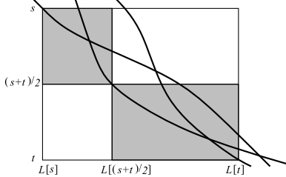
Robustness measure
For each edge of an optimal path, let the robustness measure of that edge be the difference between the optimal score and the highest score of all paths [i.e. from (0,0)s to (M,N)s] that do not use the edge or its twin
RM value
RM[i] >= 0
(i-1, j-1)
(i-1, j)
D
D
I
S
I
S
D
D
I
S
I
S
(i, j-1)
(i, j)

Slide 36
The only problem is that
Cannot guarantee that the second highest scoring edge entering row (s + t)/2 must lie within the rectangle

Slide 37
HR[i] value
The highest score over all edges entering row i that are not contained within a pending subproblem
The only remaining problem is to update HR in linear space and score-only time when a problem is subdivided

Slide 38
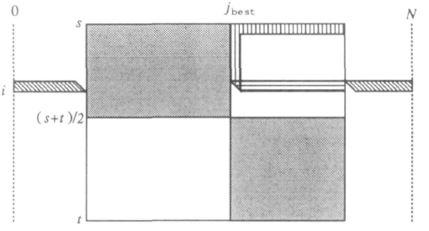
Strategy
Account for the scores of edges in the region denoted Δ, and do this for all i between s and
(s + t)/2 in linear space

Slide 39
Strategy
Make a forward pass to propagate values of Score⁻ to nodes along the vertical segment from (s, j_{best}) to ((s + t)/2, j_{best})

Slide 40
Strategy
A backward pass beginning at row (s + t)/2 propagates values of Score⁺ to the right and bottom borders of Γ, so edges across Γ can be scored

Slide 41
Strategy
0
N
$${Score}^{−}$$
HR[i]
i
$${Score}^{+}$$
M/2
M

Slide 42
Robustness measure
0
N
HR[i]
M/2
RM[i]
M

Slide 43
Computation within a region
R99945053 魏昭寧

Slide 44
Computation within a region
Suppose we have computed the left and right extents of suboptimal paths relative to a given threshold score and that we now want to repeat the process for a larger threshold.

Slide 45
Computation within a region
Our strategy is to cover the region with a small number of non-intersecting upright rectangles whose total area does not exceed twice that of the rectangle’s intersection with the given region

Slide 46
Computation within a region
The total length of the dark segments in Figure is linear in N.
* Lemma. The sum of the segment widths R[i] − L[i] + 1 for i ∈I is at most 3N.
0
N
M

Slide 47
Computation within a region
0
N
M

Slide 48
Computation within a region
0
N
$$I ←empty$$
$$i_{0} ←0$$
$$sumwidths←R\left[0\right]−L\left[0\right]+1$$
M

Slide 49
Computation within a region
assume that L[0] = 0 ≤ R[0], L[M] ≤ N = R[M], and L and R are monotonic in the sense that, e.g., L[i − 1] ≤ L[i] for 1 ≤ i ≤ M.
N
M

Slide 50
Computation within a region
0
N
i=1
$$for i ←1 to M do$$
$$\{ width ←R\left[i\right]−L\left[i\right]+1$$
$sumwidths ←sumwidths+width$
$if\left( R\left[i\right]−L\left[i_{0}\right]+1\right)×\left(i − i_{0}+1\right)>2×sumwidths then$
$\{ I ←I ∪\{i\}$
$i_{0} ←i$
$sumwidths ←width$
}
}
M

Slide 51
Computation within a region
(i₀,L[i₀])
N
(i,R[i])
$$for i ←1 to M do$$
$$\{ width ←R\left[i\right]+L\left[i\right]+1$$
$sumwidths ←sumwidths+width$
$if\left( R\left[i\right]−L\left[i_{0}\right]+1\right)×\left(i − i_{0}+1\right)>2×sumwidths then$
$\{ I ←I ∪\{i\}$
$i_{0} ←i$
$sumwidths ←width$
}
}
M

Slide 52
Computation within a region
N
(i₀,L[i₀])
(i,R[i])
$$for i ←1 to M do$$
$$\{ width ←R\left[i\right]−L\left[i\right]+1$$
$sumwidths ←sumwidths+width$
$if\left( R\left[i\right]−L\left[i_{0}\right]+1\right)×\left(i − i_{0}+1\right)>2×sumwidths then$
$\{ I ←I ∪\{i\}$
$i_{0} ←i$
$sumwidths ←width$
}
}
M

Slide 53
Proof
R99945051 洪晧瑜

Slide 54
Lemma
Suppose i∈I , where I is computed by Figure 8. Let the intersection of row i with the given region extend from column j to column k, i.e., j = L[i] and k = R[i].
Deﬁne c[i] to be k − j + 1 and
C[i] = Σ{c[i] for q∈I and q ≤ i}
Then C[i] ≤ j + 2k.

Slide 55
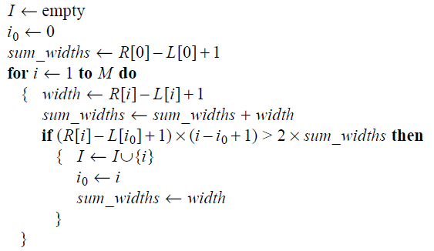
Compute I

Slide 56
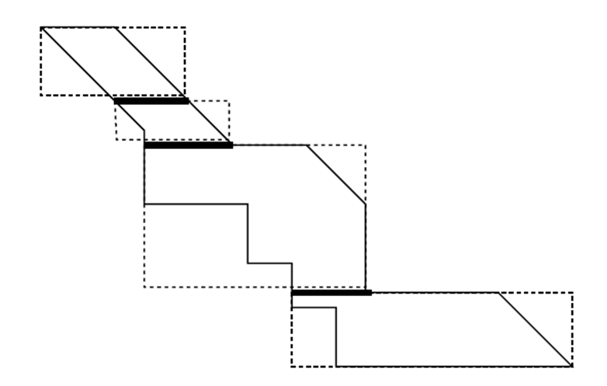
s
i₀
C(i₈)
i₅
i₈
i₁₇
I

Slide 57
Proof (induction on i)
i = i₀(j = j₀ = 0, k = k₀)
C[i₀] = c[i₀] ≤ k₀ + 1 ≤ j₀ + 2k₀ Hold
Let i = i‘ (j = j’, k = k’)
Suppose C[i‘] ≤ j’ + 2k’ Hold

Slide 58
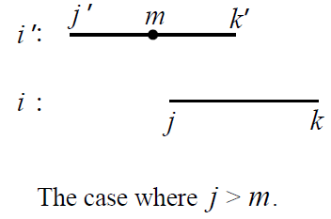
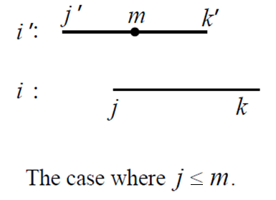
Two cases
Case1: Case2:

Slide 59
Case1:
C[i‘] ≤ j’ + 2k’
C[i‘]
+ (k – j + 1)
C[i] =
≤
≤
=
j’ + 2k’
+ (k - k’)
+ (k’ – j + 1)
j’ + 2k’
+ 2(k - k’)
+ (j - j’)
j + 2k
k’ – j + 1
k - k’
j - j’
≥
k – j + 1

Slide 60
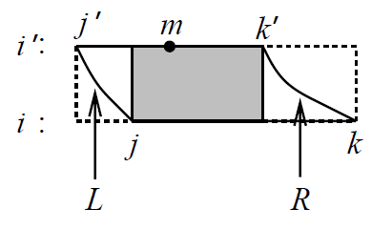
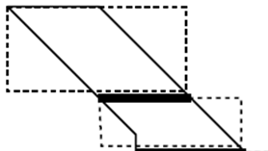
Case2: (1/2)
+ 1
(k- k’)
+ (k’-j+1 )
+ (j-j’ )
>
≥
2
(k’-j +1)
k’− j + 1
+ 1
(k − k’) + ( j − j’) ≥
=
≥
(k’-m+1 )
+(m− j)
+ 1
(m− j’)
+(m− j)
+ 1
k − k’ ≥ 2(m − j) + 1
( j − j’)
k’− j + 1
(k − k’)
m− j
k’− m+1
≤
m− j’
Notes:
k- k’ + k’-j+1 + j-j’ > 2(k’-j +1)

Slide 61
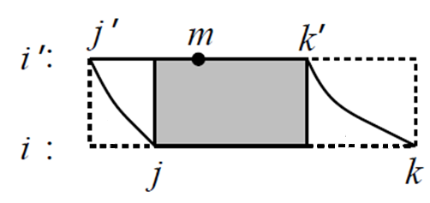
Case2: (2/2)
C[i‘] ≤ j’ + 2k’
C[i’]
+ (k – j + 1)
k − k’ ≥ 2(m − j) + 1
C[i] =
=
≤
=
≤
=
C[i’]
+ (m− j )
+ (k’− m+1)
+ (k − k’)
C[i’]
+ (m− j )
+ ( j − j’)
+ (m− j+ 1)
+ (k − k’)
C[i’]
+ ( j − j’)
+ 2(m − j) + 1
+ (k − k’)
j’ + 2k’
+ ( j − j’)
+ (k - k’)
+ (k − k’)
j + 2k
m− j
k’− m+1
k − k’
≥
( j − j’)
(m− j+1)
k – j + 1

Slide 62
Implementation
R99944013 吳冠龍

Slide 63
Implementation
Left-right
determines both the left and right boundaries
Robust
computes the robustness measure for all edges (including horizontal edges) of an optimal alignment
Unique (substantially faster)
only a bit telling if the aligned pair is in all optimal alignments
if there is a unique optimal edge entering the middle row, then recomputation within the subproblems is not needed to complete the division step

Slide 64
Environment
Developed on Sun workstations running SunOS Unix
Written in C
Tool
http://www.csie.ntu.edu.tw/~kmchao/tools/robust/

Slide 65
Example - 1
R99944013 吳冠龍

Slide 66
Example - 1
Applied to alignments between regulatory regions of the β-like globin gene clusters of humans and rabbit
Robustness property is interpreted as indicating particularly well-conserved sections of the alignment.

Slide 67
DNA Binding Site
Repressor
Activator

Slide 68
Hypersensitive site 4 (HS4) by the β-globin locus control region
The study [Lowrey et al., 1992] has implicated binding sites for the transcription factors NFE2/AP1 and GATA1 in HS4 function
The percent identity calculated for this HS4 core is no greater than for most other segments in this region

Slide 69
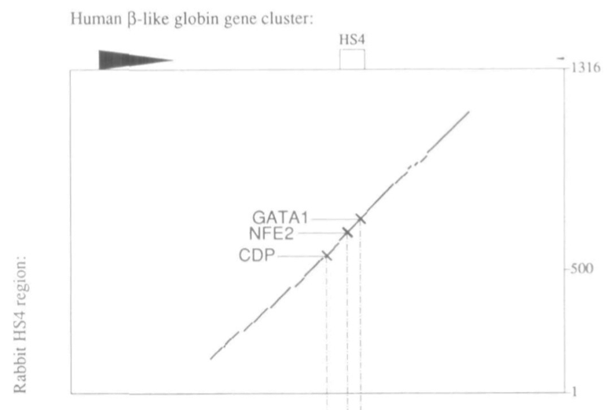
Hypersensitive site 4 (HS4) by the β-globin locus control region
Human β-like globin gene cluster
Rabbit HS4 region:
% ident.

Slide 70
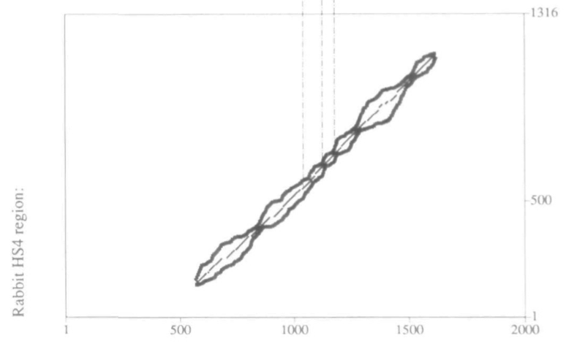
Hypersensitive site 4 (HS4) by the β-globin locus control region
GATA1
CDP
AFE2

Slide 71
Hypersensitive site 4 (HS4) by the β-globin locus control region
The extent of suboptimal alignments support the proposal that the NFE2/AP1 and GATA1 sites are important for HS4 function.

Slide 72
Alignments around constriction points in the comparison of HS4

Slide 73
Example - 2
R99922050 蔡長蓉

Slide 74
Before the Second Example
Notes:
胎兒血紅素是baby在子宮內的最後七個月～出生後六個月使用的血紅素，
通常大多會在出生後12周被成人血紅素取代。
有的人沒有這樣的替代過程，
一直到成人時期仍然使用胎兒血紅素。

Slide 75
Before the Second Example
Notes:
這對健康沒什麼問題，
由圖上可以看出其實胎兒血紅素攜氧律比成人血紅素高。
因為沒有健康問題，
很多被檢查出來的人都是因為有其他血液疾病，例如地中海型貧血，
但持續使用胎兒血紅素的人在症狀上反而比較輕微。
甚至鐮刀型紅血球疾病的一種治療方式就是用藥物重新讓身體製造胎兒血紅素。

Slide 76
5’ to the ϒ-globin gene
Several mutations that lead to persistent expression of fetal hemoglobin (α₂ϒ₂) in adult life map in this region.
Notes:
這個example探討的sequence，
即是前面提到那些沒有幼兒血紅素轉換成人血紅素的人發生突變的位置，
因此被研究的很深入。

Slide 77
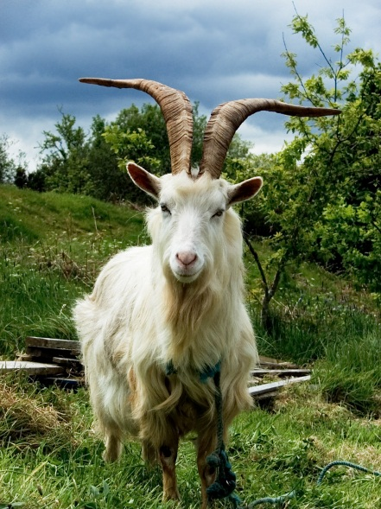
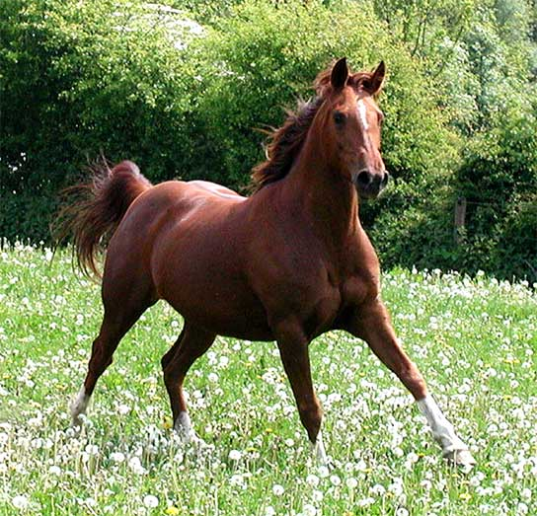
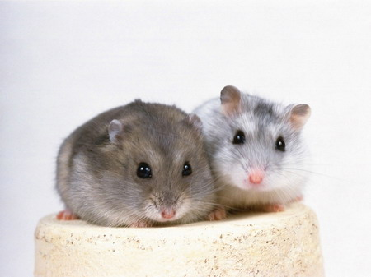
Alignments
Pairwise Alignment
Multiple Alignment
Notes:
這個區段在1993年Hardison和Miller的work有做過許多哺乳類動物之間的pairwise sequence alignment，
1992年Gumucio在靈長類和兔子更有做過multiple sequence alignment。
Virtually all the single-copy region between ε- and ϒ-globin genes aligns in pairwise comparisons among many mammals (reviewed in Hardison and Miller, 1993), and multiple alignments have been generated for the sequences from many primates and rabbits (e.g. Gumucio et al., 1992).

Slide 78
Phylogenetic Footprints
Notes:
1992年那篇paper的multiple alignment發現了許多哺乳類動物在這個sequence上都有共通的小片段，
這些共通小片段是演化時留下來的足跡，稱為phylogenetic footprints。
這是國中生物課本大家熟知的例子，
馬演化的例子，
雖然現代馬只有單趾，
但仍有兩膨大的痕跡在蹄部。
而這些phylogenetic footprints經過研究，
發現大多都是protein的binding site。
These multiple alignments reveal ‘phylogenetic footprints’ of short segments that are invariant in the sequences aligned, and in the vast majority of cases examined these correspond to sites for sequence-specific binding proteins (Gumucio et al., 1992).

Slide 79
Phylogenetic Footprints
Notes:
1992年那篇paper的multiple alignment發現了許多哺乳類動物在這個sequence上都有共通的小片段，
這些共通小片段是演化時留下來的足跡，稱為phylogenetic footprints。
這是國中生物課本大家熟知的例子，
馬演化的例子，
雖然現代馬只有單趾，
但仍有兩膨大的痕跡在蹄部。
而這些phylogenetic footprints經過研究，
發現大多都是protein的binding site。
These multiple alignments reveal ‘phylogenetic footprints’ of short segments that are invariant in the sequences aligned, and in the vast majority of cases examined these correspond to sites for sequence-specific binding proteins (Gumucio et al., 1992).

Slide 80
Notes:
人和兔子的pairwise sequence alignment，
下面的是把suboptimal的部份也考慮進去，
和前面的同學講的一樣有一些地方是沒有suboptimal，
這張圖上mark出來的-930 -960和-1250即是前面提到大部分靈長類和兔子都一樣的phylogenetic footprints

Slide 81
Human and Rabbit Alignment
Notes:
-1250是phylogenetic footprints，也是CSBP1的binding site
GATA1的binding site
perfect match TCCCAGCTGT，這當中包含了E box (CANNTG)，也是某個蛋白質的binding site
-960和-930如同前面提到的是phylogenetic footprints
-960裡有CDP的binding site
這個區段還包含兩個CAC的binding site
之前的paper也和這篇paper得到的alignment有許多共通點，
因此用這篇paper找到的重要sequence的確有生物上的意義。

Slide 82
Discussion & Conclusion
R99945051 洪晧瑜

Slide 83
Conclusion(1/3)
Simple alignment:
structural or functional criteria?
More conserved region
extend Hirschberg’s approach
linear space and score-only time method
Notes:
‧原本的alignment其實不符合”結構”or”功能”的原則
‧擁有重要功能的region

Slide 84
Conclusion(2/3)
Basic dynamic programming alignment
Affined-gap penalty alignment
Hirschberg’s optimal path method
Suboptimal alignment
Robustness and uniqueness
Notes:
‧上課教的Dynamic-programming Method
Hirschberg 的Space-saving Algorithm score- score+
Affine Gap Penalties
‧suboptimal alignments
只考慮超過threshold的suboptimal paths
‧good enough: Robustness measure values RM[i]
衍生出的問題:右上長方形漏網之魚 HR[i]
‧小region(小長方形會被bound在left and right extents內)

Slide 85
Conclusion(3/3)
Extents of suboptimal alignments identifies some important sequences:
Core hypersensitive sites in the LCR (HS4)
Exons of the γ -globin genes (5’ to ϒ-globin gene)
Obviously these are important DNA segments to subject to functional tests for effects on expression of globin genes.
Notes:
‧Extents of suboptimal alignments 這樣的方法 辨識出重要的sequence
-core hypersensitive sites in the LCR
HS4 → binding sites
-exons of the γ -globin genes
5’ to ϒ-globin gene → 這些suboptimal alignments接近prominent phylogenetic footprints, 並透露出其他的potential binding sites.
‧這篇paper找到的重要sequence的確有生物上的意義

