Slide 1
Practical Implementations of
Arithmetic Coding
Paul G. Howard and Jeffrey Scott Vitter
吳浩庠 R99944019
楊鈞傑 R99922150
黃信博 B96902039
吳彥緯 D98922013
蔡佩真 B96901012
李枝新 D99945016
姚甯之 R99944014
朱民晃 R96943077
李佳憲 R99945042

Slide 2
Arithmetic Coding
Advantage
  Flexibility
  Optimality
Disadvantage
  Slowness

Slide 3
Overview
Section 2 : Tutorial on Arithmetic coding
  Basic algorithm
  Dynamic Interval expansion
  Integer arithmetic coding
Section 3
  Improving the speed of Arithmetic coding

Slide 4
Basic Algorithm
1. Begin with at “current interval [L,H) initialized to [0,1).
0 1

Slide 5
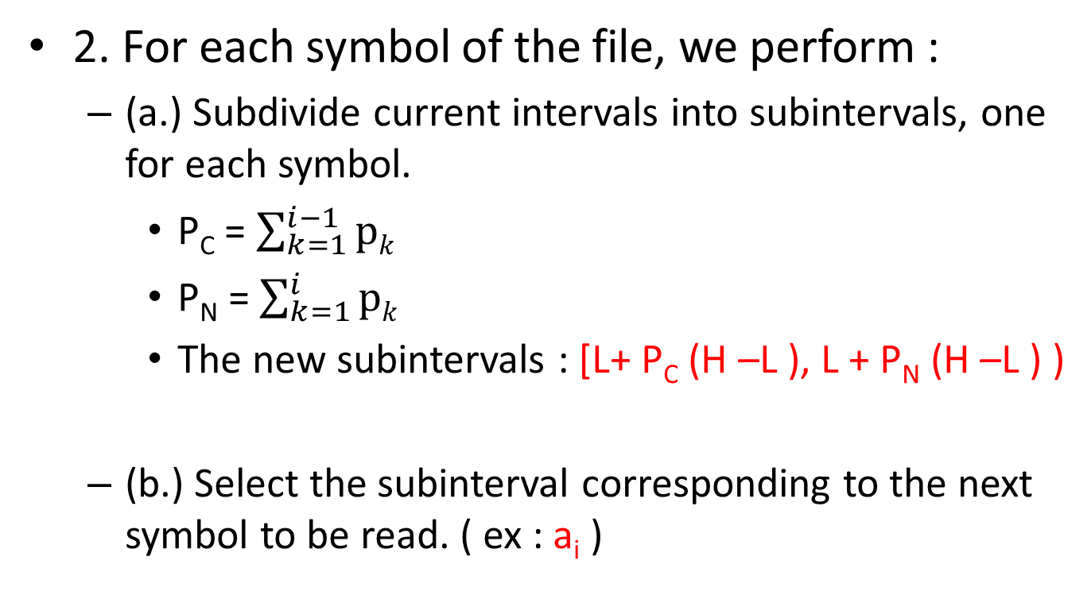
Basic Algorithm
2. For each symbol of the file, we perform :
  (a.) Subdivide current intervals into subintervals, one for each symbol.
    P_{C} = $\sum_{k=1}^{i−1}{\text{p}k}$
    P_{N} = $\sum_{k=1}^{i}{\text{p}k}$
    The new subintervals : [L+ P_{C} (H –L ), L + P_{N} (H –L ) )
  (b.) Select the subinterval corresponding to the next symbol to be read. ( ex : a_{i} )

Slide 6
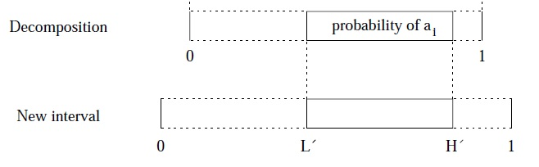
Basic Algorithm

Slide 7
Basic Algorithm
3. Output enough bits to distinguish the final current interval from all other possible final intervals.
  Length of final subinterval
  = product of the probabilities of the individual symbol
  = probability p of the symbols in the file.
  Final step use almost exactly – log2 p bits

Slide 8
Encoding algorithm for arithmetic coding
    L = 0.0 ; H =1.0 ;
    while not EOF do
    range = H -L;
    read(a_{i}) ;
    H = L + range × H(a_{i}) ;
    L = L + range × L(a_{i}) ;
    End while

Slide 9
Arithmetic Coding Example
Symbol | Probability | Range
a | 0.4 | [0.00,0.4)
b | 0.5 | [0.40,0.90)
EOF | 0.1 | [0.90,1.00)
Suppose that we want to encode the following message:
b b b EOF

Slide 10
Arithmetic Coding Example
0.8125
0.00
0.4
0.6
0.70
a
0.4
0.6
0.70
b
b
b
0.90
0.85
0.825
0.8125
EOF
EOF
1.00
0.90
0.85
0.825
0.825

Slide 11
Arithmetic Coding Example
Current Interval [L,H) | Action | Subintervals |  |  | Input
 |  | a | b | EOF
[0.000,1.000) | Subdivide | [0.000,0.400) | [0.400,0.900) | [0.900,1.000) | b
[0.400,0.900) | Subdivide | [0.400,0.600) | [0.600,0.850) | [0.850,0.900) | b
[0.600,0.850) | Subdivide | [0.600,0.700) | [0.700,0.825) | [0.825,0.850) | b
[0.700,0.825) | Subdivide | [0.700,0.750) | [0.750,0.812) | [0.812,0.825) | EOF
[0.8125,0.825)

Slide 12
Arithmetic Coding Example
Final Interval = [0.8125,0.825)
= [0.11010 00000,0.11010 01100)
(binary form)
We can uniquely identify this interval by 1101000.
Probability p = (0.5) x (0.5) x (0.5) x (0.1)
= 0.0125
Code length = - lg p = 6.322

Slide 13
Dynamic Interval expansion
The problem of basic arithmetic coding :
the shrinking current interval requires the use of high precision arithmetic
IEEE 754 standard :
Single precision => 10^⁻⁷
Double pricision => 10^⁻¹⁶
Only less than 30 symbols can be coded!
We need Dynamic Interval expansion

Slide 14
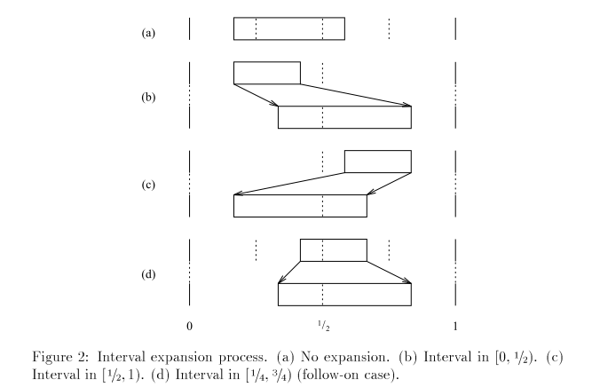
Dynamic Interval expansion
Keep the current interval length a little larger than 1/2

Slide 15
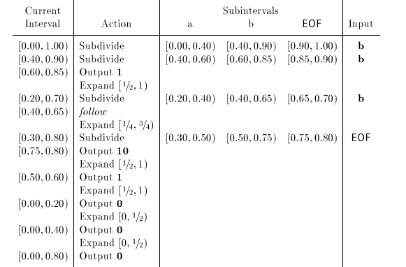
Dynamic Interval expansion
An example :

Slide 16
What’s Arithmetic Coding for?
It’s for compression.
bbb
bbb
0.8125/
1101000
The file to be sent
Encoder
Magic number
Decoder
Received file

Slide 17
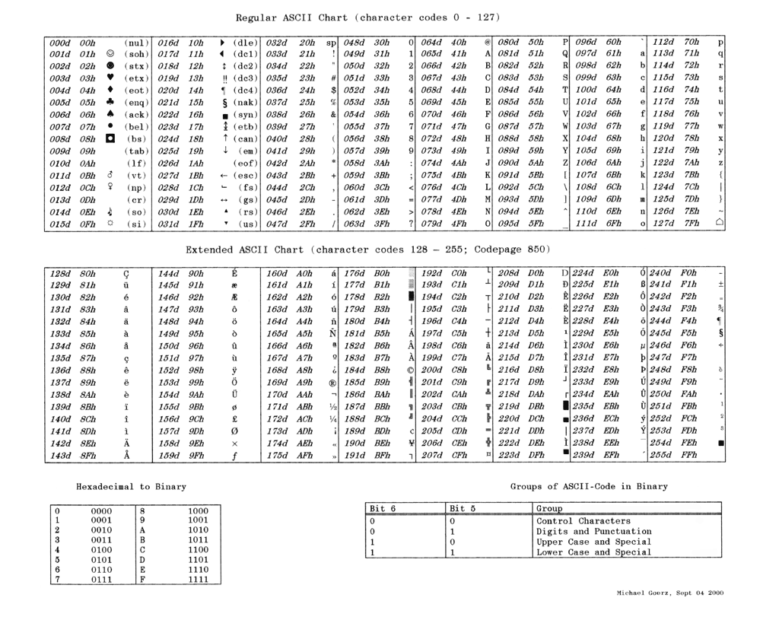
0110 0010
(6) (2)

Slide 18
What’s Arithmetic Coding for?
Compression
Compression is usually fulfilled by making good use of symbol probabilities.
  Unbalanced symbol probabilities imply better compression ratio.
bbb
bbb
0.8125/
1101000
The file to be sent
Encoder
Magic number
Decoder
Received file
01100010
01100010
01100010
00011010
4 bytes = 32bits
01100010
01100010
01100010
00011010
4bytes = 32bits
1101000
7bits
Notes:
http://marknelson.us/1991/02/01/arithmetic-coding-statistical-modeling-data-compression/

Slide 19
Integer Arithmetic Coding
  In practice, arithmetic coding is slow.
    Too many floating-point operations
      Solution1: To buy powerful FP processors
      Solution2: Integer arithmetic coding
Overview
maintain integral intervals here
bbb
0.8125/
1101000
bbb
The file to be sent
Encoder
Magic number
Decoder
Received file
still a real number here

Slide 20






New interval calculation
General Arithmetic Coding
  New interval calculation requires FP operations
Integer Arithmetic Coding
  New interval calculation requires only INT operations

Slide 21
Current Interval-FP | Current Interval-INT | Action | Subinterval a (P_{a} = 0.4) | Subinterval n (P_{b} = 0.5) | Subinterval EOF (P_{EOF} = 0.1) | In-put
[0.00, 1.00) | [0000,9999) | Subdivide | [0.00, 0.40) [0000,4000) | [0.40, 0.90) [4000,9000) | [0.90, 1.00) [9000,9999) | b
[0.40, 0.90) | [4000,9000) | Subdivide | [0.40, 0.60) [4000,6000) | [0.60, 0.85) [6000,8500) | [0.85, 0.90) [8500,9000) | b
[0.60, 0.85) | [6000,8500) | Output 1
 |  | Expand [1/2,1)
[0.20, 0.70) | [2000,7000) | Subdivide | [0.20, 0.40) [2000,4000) | [0.40, 0.65) [4000,6500) | [0.65, 0.70) [6500,7000) | b
[0.40, 0.65) | [4000,6500) | Follow
 |  | Expand [1/4,3/4)
[0.30, 0.80) | [3000,8000) | Subdivide | [0.30, 0.50) [3000,5000) | [0.50, 0.75) [5000,7500) | [0.75, 0.80) [7500,8000) | EOF
[0.75, 0.80) | [7500,8000) | Output 10
 |  | Expand [1/2,1)
[0.50, 0.60) | [5000,6000) | Output 1
 |  | Expand [1/2,1)
[0.00, 0.20) | [0000,2000) | Output 0
 |  | Expand [0,1/2)
[0.00, 0.40) | [0000,4000) | Output 0
 |  | Expand [0,1/2)
[0.00, 0.80) | [0000,8000) | Output 0
[3000+5000*4/10, 3000+5000*9/10)

Slide 22
Drawback of Integer Arithmetic
If there is gain, there is also lost.
Approximation leads to longer code length
  Optimal code length is obtained under
    accurate probability
Current Interval-INT | Action | Subinterval a (P_{a} = 0.88) | Subinterval b (P_{b} = 0.02) | Subinterval EOF (P_{EOF} = 0.1) | Input
[000,999) | Subdivide | [000,880) | [880,900) | [900,999) | a
[000,880) | Subdivide | [000,774.4) [000,774) | [774.4,792) [774,792) | [792,880) | b

Slide 23


Fortunately, it’s limited

Slide 24
Event probabilities
-Generalized symbol probabilities
Step1: Apply other methods to recognize events
Step2: Collect probabilities of events
Step3: Use arithmetic coding
Happy Birthday to You
Happy Birthday to You
Happy Birthday to You
Happy Birthday to You

Slide 25
[Advanced] Adaptive Model
Take advantage of locality
bbbbaabbb
bbbbaabbc
aaaaaabbaa
aaaaaabbac
bbbbaabbb
bbbbaabbc
b:0 a:10 c:11
b:0 a:10 c:11
a:0 b:10 c:11
b:0 a:10 c:11

Slide 26


[Advanced] Scaling
Maintain symbol counts is a problem
  It can be arbitrarily large
By periodically reduce all symbol’s counts by the same factor, we can keep the relative frequencies approximately the same as usual.

Slide 27

[Advanced] High Order Models
P(i) > P(萄)
P(萄|last word = 葡) is almost 100%

Slide 28
Reduced-precision
ARITHMETIC CODING
3-1

Slide 29
Reduced-Precision Arithmetic Coding
Arithmetic operations → table lookups
Reduce the number of possible states
  Reduce N in [0,N)
  N must be even; 4-multiple is preferred
Still completely reversible
Decoder makes the same assignment
Only the average code length is reduced

Slide 30
Definitions and Assumptions
Definitions
  Follow: follow-on case
    Process is described in Dynamic Interval expansion
  α : Cutoff probability between 1/2 and 3/4
    Excess code length is not very sensitive to α
  “-”: no output
Assumptions
  Prob{0} is uniformly distributed on (0,1)
  Input of 0 and 1 are equally likely

Slide 31
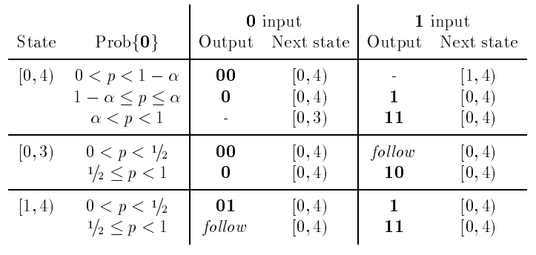
Simplest Non-Trivial Coder (N=4)
Notes:
在哪個範圍就output哪個code，先output確定的bit
只有p在alpha與1之間，而且input為0，才會跑到[0,3) state，而跑到[1,4)也只有一種狀況
[0,3) state 時，input 0沒問題，input 1且0<p<1/2時才會無法判定是01或10，所以follow，回到[0,4)
[1,4) state 時，input 1也沒問題，input 0且1/2<p<1才會無法判定是01或10，所以還是follow，回到[0,4)

Slide 32
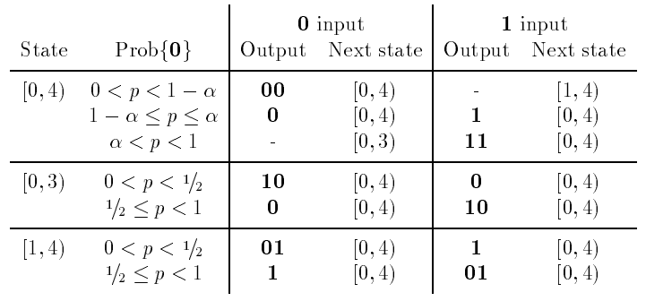
Eliminate the need of “follow”
0-
1-
Notes:
大致與前一個example 相同，除了左端點設為1，右端點設為0
(紅色部份)
[0,3) state 時，input 0時先output端點的1，再output 0
[1,4) state 時，input 1時先output端點的0，再output 1
(綠色部份)
原始：[0,3) state 時，input 0沒問題，input 1且0<p<1/2時才會無法判定是01或10，所以follow，回到[0,4)
現在：10是最左邊的state，[0,3)且input 0時會到；而01是最右邊的state，[1,4)且input 1時會到
所以[0,3)且input 1就可以直接output前面的0，然後這個1就no output，直接回到[0,4)
然後[1,4)且input 0就可以直接output前面的1，然後這個0就no output，直接回到[0,4)
因此不需要進行follow

Slide 33
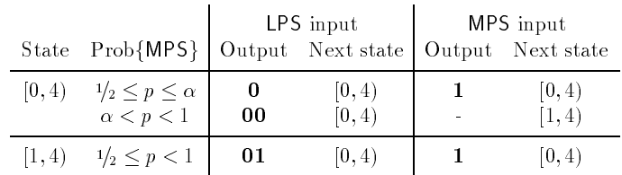
More/Less Probable Symbol Idea
More/Less Probable Symbol (MPS/LPS): 1/0
Consider Prob{MPS} in [1/2, 1) only
Combine transitions and eliminate states
Notes:
1. 由於More Probable Symbol佔了一半以上的機率，我們可以只看另一半的可能性
只要考慮一個中間點alpha (兩種情況)，不必考慮1-alpha與alpha兩個中間點(三種情況)
所以只需要 1 extra state，共 2 states
2. 一開始收到MPS，如果機率在MPS直接output 1，否則先留著不output，只轉換state到[1,4)
如果一開始收到LPS，機率在MPS就output 0，機率在LPS就可以很確定的output兩個0
3. 接著在[1,4)是個暫時的狀態，所以不用考慮機率函數，盡可能轉回原狀態[0,4)
如果收到MPS input，直接output 1回到原狀態[0,4)；
如果收到LPS input，先output 0再輸出前面沒output的1，還是回到原狀態

Slide 34
State |  | LPS input |  | MPS input
 |  | Output | Next state | Output | Next state
[0, 4) | ½≤p≤α | 0 | [0, 4) | 1 | [0, 4)
 | α<p<1 | 00 | [0, 4) | - | [1, 4)
[1, 4) |  | 01 | [0, 4) | 1 | [0, 4)
State | LPS input |  | MPS input
 | Output | Next state | Output | Next state
[0, 4) | 00 | [0, 4) | - | [1, 4)
[1, 4) | 01 | [0, 4) | 1 | [0, 4)

Slide 35
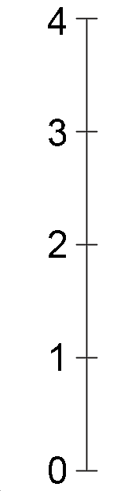
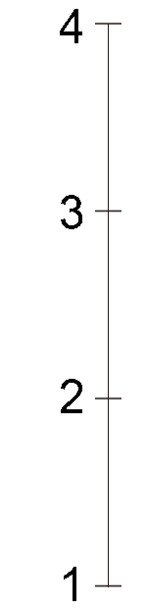
1
1
1
1
0
α
-
1
-
1
00

Slide 36
Maximally Unbalanced Subdivision
State | LPS input |  | MPS input
 | Output | Next state | Output | Next state
[0, 8) | 000 | [0, 8) | - | [1, 8)
[1, 8) | 001 | [0, 8) | - | [2, 8)
[2, 8) | 010 | [0, 8) | - | [3, 8)
[3, 8) | 011 | [0, 8) | 1 | [0, 8)

Slide 37
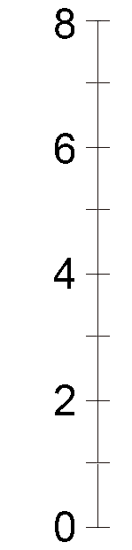
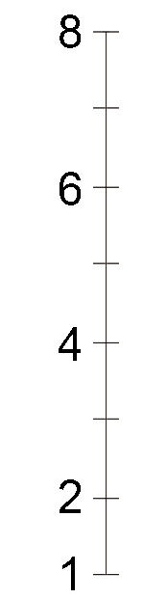
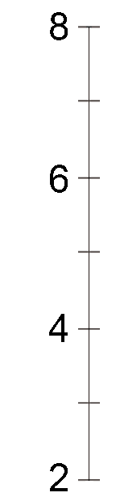
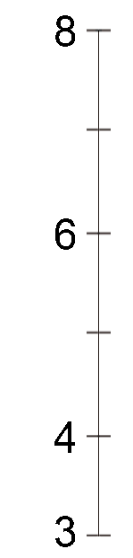
1
1
1
1
0
-
-
-
1
000

Slide 38
Elias Code
State | LPS input |  | MPS input
 | Output | Next state | Output | Next state
[0, 2)/2 | 0 | STOP | 1 | [0, 4)/4
[0, 4)/4 | 00 | STOP | - | [1, 4)/4
[1, 4)/4 | 01 | STOP | 1 | [0, 8)/8
[0, 8)/8 | 000 | STOP | - | [1, 8)/8
[1, 8)/8 | 001 | STOP | - | [2, 8)/8
⁞ | ⁞ | ⁞ | ⁞ | ⁞

Slide 39
N=8
A SIX-STATE CODER

Slide 40
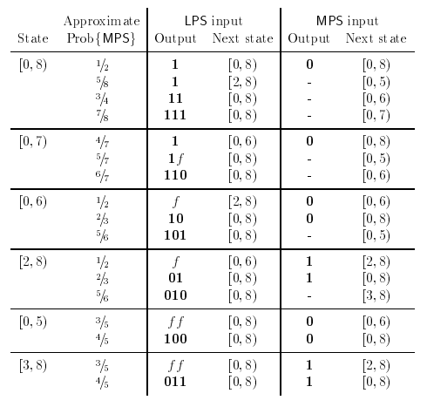
N=8 , a six-state coder

Slide 41
N=8 , a six-state coder
Maximally unbalanced subdivision
a
b
b
b
b
b
Output:0

Slide 42
N=8 , a six-state coder
LPS
MPS
Prob{MPS} =7/8
LPS : 111
MPS : [0,7)

Slide 43
N=8 , a six-state coder
Prob{MPS} =7/8
LPS : 111
MPS : [0,7)
0
1
2
3
4
5
6
7
8
000
001
010
011
100
101
110
111
MPS : [0,7)
LPS :111
0
1
2
3
4
5
6
7

Slide 44
N=8 , a six-state coder
LPS
MPS
Prob{MPS} =4/7
LPS : 1 [0,6)
MPS : 0
Prob{MPS} =5/7
LPS : 1f
MPS : [0,5)
Prob{MPS} =4/7
LPS : 110
MPS : [0,6)

Slide 45
N=8 , a six-state coder
Prob{MPS} =7/8
MPS : [0,7)
0
1
2
3
4
5
6
7
000
001
010
011
100
101
110
MPS : 0
LPS : 1
0
1
2
3
4
5
6
Prob{MPS} =4/7
LPS : 1 [0,6)
MPS : 0
Prob{MPS} =5/7
LPS : 1f
MPS : [0,5)
Prob{MPS} =6/7
LPS : 110
MPS : [0,6)

Slide 46
N=8 , a six-state coder
Prob{MPS} =7/8
MPS : [0,7)
0
1
2
3
4
5
6
7
000
001
010
011
100
101
110
MPS : [0,5)
LPS : 1f
0
1
2
3
4
5
Prob{MPS} =4/7
LPS : 1 [0,6)
MPS : 0
Prob{MPS} =5/7
LPS : 1f
MPS : [0,5)
Prob{MPS} =6/7
LPS : 110
MPS : [0,6)

Slide 47
N=8 , a six-state coder
Prob{MPS} =7/8
MPS : [0,7)
0
1
2
3
4
5
6
7
000
001
010
011
100
101
110
MPS : [0,6)
LPS : 110
0
1
2
3
4
5
6
Prob{MPS} =4/7
LPS : 1 [0,6)
MPS : 0
Prob{MPS} =5/7
LPS : 1f
MPS : [0,5)
Prob{MPS} =6/7
LPS : 110
MPS : [0,6)

Slide 48
Flexible Coder Design
A class of reduced-precision coders

Slide 49
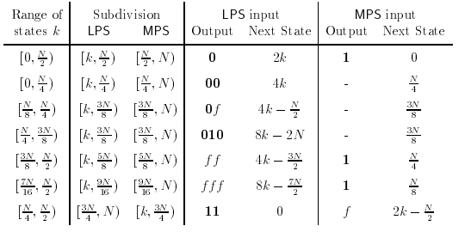
N= any power of 2
    All states are of the form [k,N)
    Denote state [k,N) by k
0
1
2
3
4
5
6
7
8
000
001
010
011
100
101
110
111

Slide 50
N= any power of 2
      Number of states is N/2
      K≥N/2 will produce output, and interval will be expanded
0
1
2
3
4
5
6
7
8
000
001
010
011
100
101
110
111

Slide 51
    In every state [k.N)
      Maximally unbalanced subdivision (at k+1)
        -Prob{MPS} between (N-2/N) and (N-1)/N
0
1
2
3
4
5
6
7
8
000
001
010
011
100
101
110
111
MPS
MPS
MPS
Output:1

Slide 52
    In every state [k.N)
      Also include a nearly balanced subdivision
        -So that we will not lose efficiency when Prob{MPS}≒1/2
0
1
2
3
4
5
6
7
8
000
001
010
011
100
101
110
111
LPS
MPS
Output: 0
Output:1

Slide 53
    In state k
      Divided at k+1
      LPS : output lgN bits of k, and move to state 0
      MPS move to state k+1
        If next state is N/2 : output 1, and move to state 0
0
1
2
3
4
5
6
7
8
000
001
010
011
100
101
110
111

Slide 54
Example
ADDITIONAL OUTPUT AND EXPANSION MAYBE POSSIBLE
0
1
2
3
4
5
6
7
8
000
001
010
011
100
101
110
111
LPS
MPS

Slide 55
Example
ADDITIONAL OUTPUT AND EXPANSION MAYBE POSSIBLE
0
1
2
3
4
5
6
7
8
000
001
010
011
100
101
110
111
MPS
2
3
4
5
6
7
8

Slide 56
Example
ADDITIONAL OUTPUT AND EXPANSION MAYBE POSSIBLE
0
1
2
3
4
5
6
7
8
000
001
010
011
100
101
110
111
LPS
0
1
2
3
4
5
6
7
8

Slide 57
N= any power of 2
  Small number of states
  Every state Porb{MPS} :
    near 1
    near ½
    In between
  We can choose a large N
    highly probable events require negligible code length
    number of states small enough to allow table lookups rather than arithmetic

Slide 58
Partitions - ρ and є
3-2

Slide 59
Partitions - ρ and є
We know that is possible to use a few number of possible probabilities to design a binary arithmetic coder.
Now we want to give a theoretical basis for selecting the probabilities.

Slide 60
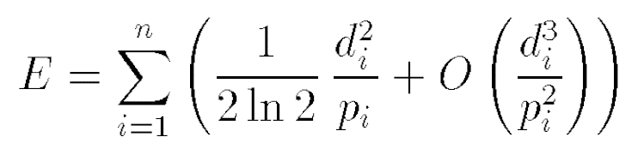
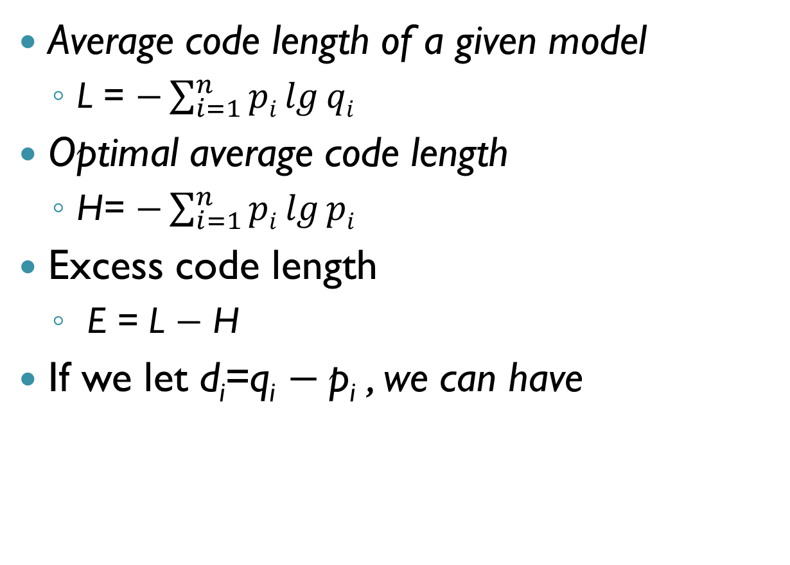
Excess code length
Average code length of a given model
  L = $−\sum_{i=1}^{n}{pi\lg{qi}}$
Optimal average code length
  H= $−\sum_{i=1}^{n}{pi\lg{pi}}$
Excess code length
  E = L $−$ H
If we let d_{i}=q_{i} $−$p_{i} , we can have

Slide 61
Є-partitions
We can partition the space of possible probabilities to guarantee that the use of approximate probabilities will never add more than є to the code length of any event.

Slide 62
Є-partitions
1. set i:=0 and Q₀:=1/2
2. Find P_{i+1} > Q_{i} s.t. E(P_{i+1}, Q_{i})= Є
3. Find Q_{i+1} > P_{i+1} s.t. E(P_{i+1}, Q_{i+1})= Є
4. i++, repeat step 2 and 3 till P_{i+1}or Q_{i+1} reach 1

Slide 63
Є-partitions
Range of actual probabilities | Probability to use
[0.0000, 0.0130) | 0.0003
[0.0130, 0.1421) | 0.0676
[0.1421, 0.3691) | 0.2501
[0.3691, 0.6309) | 0.5000
[0.6309, 0.8579) | 0.7499
[0.8579, 0.9870) | 0.9324
[0.9870, 1.0000) | 0.9997

Slide 64
Є-partitions
Range of actual probabilities | Probability to use
[0.0000, 0.0130) | 0.0003
[0.0130, 0.1421) | 0.0676
[0.1421, 0.3691) | 0.2501
[0.3691, 0.6309) | 0.5000
[0.6309, 0.8579) | 0.7499
[0.8579, 0.9870) | 0.9324
[0.9870, 1.0000) | 0.9997

Slide 65
Є-partitions
Range of actual probabilities | Probability to use
[0.0000, 0.0130) | 0.0003
[0.0130, 0.1421) | 0.0676
[0.1421, 0.3691) | 0.2501
[0.3691, 0.6309) | 0.5000
[0.6309, 0.8579) | 0.7499
[0.8579, 0.9870) | 0.9324
[0.9870, 1.0000) | 0.9997

Slide 66
Є-partitions
Range of actual probabilities | Probability to use
[0.0000, 0.0130) | 0.0003
[0.0130, 0.1421) | 0.0676
[0.1421, 0.3691) | 0.2501
[0.3691, 0.6309) | 0.5000
[0.6309, 0.8579) | 0.7499
[0.8579, 0.9870) | 0.9324
[0.9870, 1.0000) | 0.9997

Slide 67
Є-partitions
Range of actual probabilities | Probability to use
[0.0000, 0.0130) | 0.0003
[0.0130, 0.1421) | 0.0676
[0.1421, 0.3691) | 0.2501
[0.3691, 0.6309) | 0.5000
[0.6309, 0.8579) | 0.7499
[0.8579, 0.9870) | 0.9324
[0.9870, 1.0000) | 0.9997

Slide 68
Є-partitions
Range of actual probabilities | Probability to use
[0.0000, 0.0130) | 0.0003
[0.0130, 0.1421) | 0.0676
[0.1421, 0.3691) | 0.2501
[0.3691, 0.6309) | 0.5000
[0.6309, 0.8579) | 0.7499
[0.8579, 0.9870) | 0.9324
[0.9870, 1.0000) | 0.9997

Slide 69
Є-partitions
Range of actual probabilities | Probability to use
[0.0000, 0.0130) | 0.0003
[0.0130, 0.1421) | 0.0676
[0.1421, 0.3691) | 0.2501
[0.3691, 0.6309) | 0.5000
[0.6309, 0.8579) | 0.7499
[0.8579, 0.9870) | 0.9324
[0.9870, 1.0000) | 0.9997

Slide 70
Є-partitions
Range of actual probabilities | Probability to use
[0.0000, 0.0130) | 0.0003
[0.0130, 0.1421) | 0.0676
[0.1421, 0.3691) | 0.2501
[0.3691, 0.6309) | 0.5000
[0.6309, 0.8579) | 0.7499
[0.8579, 0.9870) | 0.9324
[0.9870, 1.0000) | 0.9997

Slide 71
ρ-partitions
We might wish to limit the relative error so that the code length can never exceed the optimal by more than a factor of 1+ ρ.
Procedure is similar to Є-partitions.
The ρ-partitions are not finite.
  As P approaches 1, the optimal average code length grows very small, so to obtain a small relative loss Q must be very close to P.

Slide 72
ρ-partitions
Range of actual probabilities | Probability to use
… | …
[0.0033, 0.0154) | 0.0069
[0.0154, 0.0573) | 0.0291
[0.0573, 0.1670) | 0.0982
[0.1670, 0.3722) | 0.2555
[0.3722, 0.6278) | 0.5000
[0.6278, 0.8330) | 0.7445
[0.8330, 0.9427) | 0.9018
[0.9427, 0.9846) | 0.9709
[0.9846, 0.9967) | 0.9931
… | …
ρ-partitions for ρ=0.05; the maximum relative error is 5 percent.

Slide 73
Compressed trees
3-3

Slide 74

To apply binary fast arithmetic coding algorithms (mentioned in previous sections), input symbols should be transformed into binary sequences.
Here, compressed trees were proposed to complete the task.
A
0110

Slide 75
Tree construction
Symbol
a
b
c
d
e
f
g
h
Probability
0
0
1/8
1/4
1/8
0
1/8
3/8
38
62
0
100
20
80
-
-
33
67
100
0
25
75
a
b
c
d
e
f
g
h

Slide 76
Linearize the tree
38
62
0
100
20
80
-
-
33
67
100
0
25
75
a
b
c
d
e
f
g
h
38
0
20
-
33
100
25

Slide 77
Compress the tree
38
0
20
-
33
100
25
38
0
20
33
100
25
-
-
By the fact that probability of a and b are both 0, the omitted node could be tracked.
a
b

Slide 78
Conclusion

