Slide 1
A Fast Multiple Longest Common Subsequence (MLCS) Algorithm
Qingguo Wang, Dmitry Korkin, and Yi Shang
組員：
黃安婷 江蘇峰 李鴻欣
劉士弘 施羽芩 周緯志
林耿生 張世杰 潘彥謙
31 May, 2011 @ NTU

Slide 2
Outline
Introduction
Background knowledge
Quick-DP
  Algorithm
  Complexity analysis
  Experiments
Quick-DPPAR
  Parallel algorithm
  Time complexity analysis
  Experiments
Conclusion

Slide 3
Introduction
江蘇峰

Slide 4
The MLCS problem
Multiple DNA sequences
Longest common subsequence

Slide 5
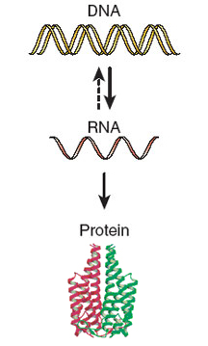
Biological sequences
GCAAGTCTAATACAAGGTTATA
Base sequence
MAEGDNRSTNLLAAETASLEEQ
Amino acid sequence

Slide 6
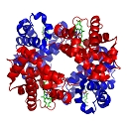

Find LCS in multiple biological sequences
Evolutionary conserved region
DNA sequences
Protein sequences
LCS
Functional motif
Structurally common feature (Protein)
Hemoglobin
Myoglobin

Slide 7
A new fast algorithm
Quick-DP
  For any given number of strings
  Based on the dominant point approach
  (Hakata and Imai, 1998)
  Using a divide-and-conquer technique
  Greatly improving the computation time

Slide 8
The currently fastest algorithm
The divide-and-conquer algorithm
Minimize the dominant point set
(FAST-LCS, 2006 and parMLCS, 2008)
Significant faster on the larger size problem
Sequential algorithm Quick-DP
Parallel algorithm Quick-DPPAR

Slide 9
Background knowledge
- Dynamic programming approach
- Dominant point approach
黃安婷

Slide 10
The dynamic programming approach
 |  | G | T | A | A | T | C | T | A | A | C
 | 0 | 0 | 0 | 0 | 0 | 0 | 0 | 0 | 0 | 0 | 0
G | 0 | 1 | 1 | 1 | 1 | 1 | 1 | 1 | 1 | 1 | 1
A | 0 | 1 | 1 | 2 | 2 | 2 | 2 | 2 | 2 | 2 | 2
T | 0 | 1 | 2 | 2 | 2 | 3 | 3 | 3 | 3 | 3 | 3
T | 0 | 1 | 2 | 2 | 2 | 3 | 3 | 4 | 4 | 4 | 4
A | 0 | 1 | 2 | 3 | 3 | 3 | 3 | 4 | 5 | 5 | 5
C | 0 | 1 | 2 | 3 | 3 | 3 | 4 | 4 | 5 | 5 | 6
A | 0 | 1 | 2 | 3 | 4 | 4 | 4 | 4 | 5 | 6 | 6
MLCS (in this case, “LCS”) = GATTAA

Slide 11
Dynamic programming approach: complexity
For two sequences, time and space complexity = O(n²)
For d sequences, time and space complexity = O(n^{d})
➔ impractical!
Need to consider other methods.

Slide 12
Dominant point approach: definitions
a₂
0 1 2 3 4 5 6 7
 |  | G | T | A | A | T | C | T | A
 | 0 | 0 | 0 | 0 | 0 | 0 | 0 | 0 | 0
G | 0 | 1 | 1 | 1 | 1 | 1 | 1 | 1 | 1
A | 0 | 1 | 1 | 2 | 2 | 2 | 2 | 2 | 2
T | 0 | 1 | 2 | 2 | 2 | 3 | 3 | 3 | 3
a₁
0
1
2
L = the score matrix
p= [p₁, p₂] = a point in L
L[p] = the value at position p of L
a match at point p: a₁ [p₁] = a₂ [p₂]
q = [q₁, q₂]
p dominates q if p₁ ≤ q₁ and p₂ ≤ q₂
denoted by p ≤ q
strongly dominates: p < q
(1, 5) ≤ (1, 6)
A match at (2, 6)

Slide 13
Dominant point approach: more definitions
0 1 2 3 4 5 6 7
 |  | G | T | A | A | T | C | T | A
 | 0 | 0 | 0 | 0 | 0 | 0 | 0 | 0 | 0
G | 0 | 1 | 1 | 1 | 1 | 1 | 1 | 1 | 1
A | 0 | 1 | 1 | 2 | 2 | 2 | 2 | 2 | 2
T | 0 | 1 | 2 | 2 | 2 | 3 | 3 | 3 | 3
0
1
2
p is a k-dominant point if L[p] = k
and there is no q such that L[q] = k
and q ≤ p
D^{k} = the set of all k-dominants
D = the set of all dominant points
A 3-dominant point
Not a 3-dominant point

Slide 14
Dominant point approach: more definitions
0 1 2 3 4 5 6 7
 |  | G | T | A | A | T | C | T | A
 | 0 | 0 | 0 | 0 | 0 | 0 | 0 | 0 | 0
G | 0 | 1 | 1 | 1 | 1 | 1 | 1 | 1 | 1
A | 0 | 1 | 1 | 2 | 2 | 2 | 2 | 2 | 2
T | 0 | 1 | 2 | 2 | 2 | 3 | 3 | 3 | 3
0
1
2
a match p is an s-parent of q if
q < p and there is no other match r
of s such that q < r < p
Par(q, s); Par(q, Σ)
p is a minimal element of A if no
other point in A dominates p
the minima of A =
the set of minimal elements of A
(2, 4) is a T-parent of (1, 3)

Slide 15
The dynamic programming approach
 |  | G | T | A | A | T | C | T | A | A | C
 | 0 | 0 | 0 | 0 | 0 | 0 | 0 | 0 | 0 | 0 | 0
G | 0 | 1 | 1 | 1 | 1 | 1 | 1 | 1 | 1 | 1 | 1
A | 0 | 1 | 1 | 2 | 2 | 2 | 2 | 2 | 2 | 2 | 2
T | 0 | 1 | 2 | 2 | 2 | 3 | 3 | 3 | 3 | 3 | 3
T | 0 | 1 | 2 | 2 | 2 | 3 | 3 | 4 | 4 | 4 | 4
A | 0 | 1 | 2 | 3 | 3 | 3 | 3 | 4 | 5 | 5 | 5
C | 0 | 1 | 2 | 3 | 3 | 3 | 4 | 4 | 5 | 5 | 6
A | 0 | 1 | 2 | 3 | 4 | 4 | 4 | 4 | 5 | 6 | 6
MLCS (in this case, “LCS”) = GATTAA

Slide 16
Dominant point approach
-1
0 1 2 3 4 5 6 7
 |  | G | T | A | A | T | C | T | A
 | 0 | 0 | 0 | 0 | 0 | 0 | 0 | 0 | 0
G | 0 | 1 | 1 | 1 | 1 | 1 | 1 | 1 | 1
A | 0 | 1 | 1 | 2 | 2 | 2 | 2 | 2 | 2
T | 0 | 1 | 2 | 2 | 2 | 3 | 3 | 3 | 3
-1
0
1
2
Finding the dominant points:
(1) Initialization: D⁰ = {[-1, -1]}
(2) For each point p in D⁰, find A = ∪_{p} Par(p, Σ)
(3) D¹ = minima of A
(4) Repeat for D², D³, etc.

Slide 17
Dominant point approach
0 1 2 3 4 5 6 7
 |  | G | T | A | A | T | C | T | A
 | 0 | 0 | 0 | 0 | 0 | 0 | 0 | 0 | 0
G | 0 | 1 | 1 | 1 | 1 | 1 | 1 | 1 | 1
A | 0 | 1 | 1 | 2 | 2 | 2 | 2 | 2 | 2
T | 0 | 1 | 2 | 2 | 2 | 3 | 3 | 3 | 3
0
1
2
➔ MLCS = GAT
Finding the MLCS path from the dominant points:
(1) Pick a point p in D³
(2) Pick a point q in D², such that p is q’s parent
(3) Continue until we reach D⁰

Slide 18
Implementation of the dominant point approach
Algorithm A, by K. Hakata and H. Imai
Designed specifically for 3 sequences
Strategy:
(1) compute minima of each D^{k}(s_{i})
(2) reduce the 3D minima problem into a
2D minima problem
Time complexity = O(ns + Ds logs)
Space complexity = O(ns + D)
n = string length; s = # of different symbols;
D = # of dominant matches

Slide 19
Background knowledge
-Parallel MLCS Methods
周緯志

Slide 20
Existing Parallel LCS/MLCS methods
m, n are lengths of two input string and m≦n | Time | Processor
(LARPBS)(Optical bus) [49] X. Xu, L. Chen, Y. Pan, and P. He | O(mn/p) | p,1≦p≦max(m,n)
CREW-PRAM model [1] A. Apostolico, M. Atallah, L. Larmore, and Mcfaddin | O(log m log n) | O(mn/ log m)
[33] M. Lu and H. Lin | O(log² m + log n) | mn/ log m
(p.s. when log² m log log m ≦ log n) | O(log n) | mn/ log n
[4] K.N. Babu and S. Saxena | O(log m) | mn
 | O(log²n) | mn
[34] G. Luce and J.F. Myoupo | n + 3m + p | m(m+1)/2 cells
(RLE: run-length-encoded) strings [19] V. Freschi and A. Bogliolo | O(m+n) | m+n
m, n are lengths of two input string and m≦n | Time | Processor
(FAST_LCS) [11] Y. Chen, A. Wan, and W. Liu | O(|LCS(X1,X2,…Xn)|) length of multisequences

Slide 21
FAST_LCS
Successor Table
  The operation of producing successors
Pruning Operation

Slide 22
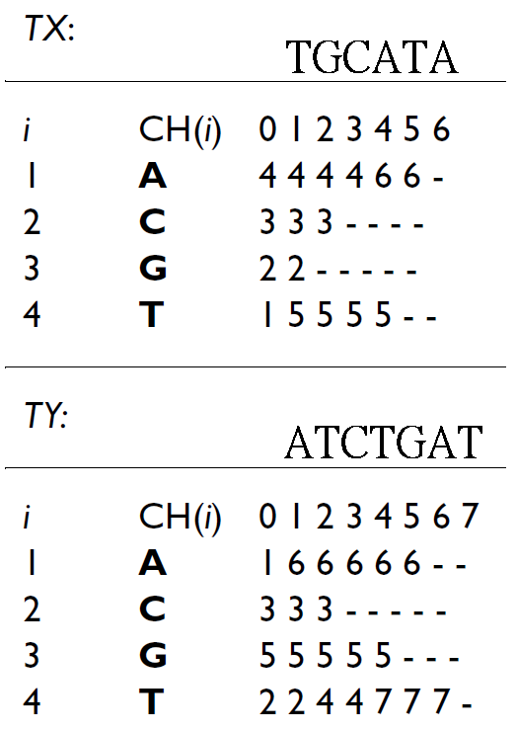

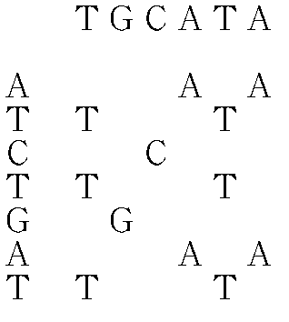
FAST_LCS - Successor Table
TX(i,j)
It indicates the position
of the next character
identical to CH(i)
SX(i,j) = {k|x_{k} = CH(i), k>j }
Identical pair:
X_{i}=Y_{j}=CH(k)
e.g. X₂=Y₅=CH(3)=G,
then denote it as (2,5)
All identical pairs of X and Y
is denoted as S(X,Y)
e.g.
All identical pairs = S(X,Y) = {(1,2),(1,6),(2,5),(3,3),(4,1),(4,6),(5,2),(5,4),(5,7),(6,1),(6,6)}
G is A’s predecessor
A is G’s successor
Notes:
TX(i,j)為第j位置上下一個為CH(i)的位置, “-” 代表後面沒有字了

Slide 23
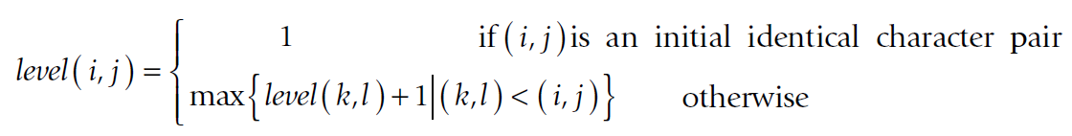
FAST_LCS – Define level and prune
Initial identical pairs
Define level
Pruning operation 1
on the same level, if (k,L)>(i,j), then (k,L) can be pruned
Pruning operation 2
on the same level, if (i₁, j), (i₂, j) , i₁<i₂, then (i₂, j) can be pruned
Pruning operation 3
if there are identical character pairs
(i₁, j), (i₂, j), (i₃, j)…(i_{r},j) then
(i₂, j)…(i_{r},j) can be pruned
1
1
1
2
2
1
3
2
3
4
1
4
Notes:
TX(i,j)為第j位置上下一個為CH(i)的位置, “-” 代表後面沒有字了

Slide 24
FAST_LCS – time complexity
(FAST_LCS)
[11] Y. Chen, A. Wan, and W. Liu
Time complexity:
O(|LCS(X1,X2,…Xn)|)
length of multisequences
Notes:
TX(i,j)為第j位置上下一個為CH(i)的位置, “-” 代表後面沒有字了

Slide 25
Quick-DP
- Algorithm
- Find s-parent
林耿生

Slide 26
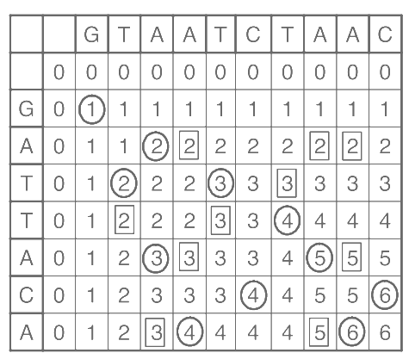
Quick-DP

Slide 27
Example: D²→D³
Par_{s}
Minima(Par_{s})
T
T
A
A

Slide 28
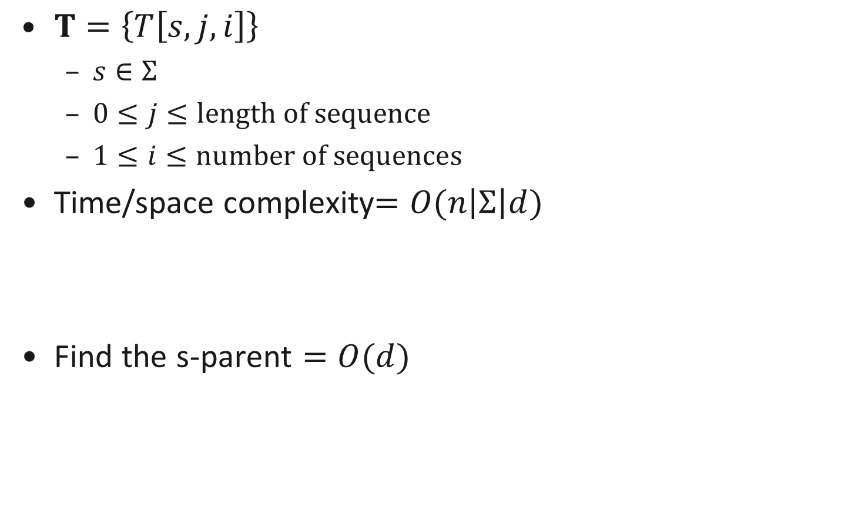
Find the s-parent

Slide 29
Quick-DP
- Minima
- Complexity Analysis
張世杰

Slide 30
Minima()
Q
R

Slide 31
Minima() Time Complexity
Step1 : divide N points into subsets R and Q
=> O(N)
Step2 : minimize R and Q individually
=> 2T(N/2, d)
Step3 : remove points in R that are dominated by points in Q
=> T(N, d-1)
Combine these, we have the following recurrence formula :
T(N, d) = O(N) + 2T(N/2, d) + T(N, d-1)

Slide 32


Minima() Time Complexity
T(N, d) denote the complexity.
T(N, 2) = O(N) if the point set is sorted.
  The sorting of points takes time.
  Presort the points at the beginning and maintain the order of the points later in each step.
By induction on d, we can solve the recurrence formula and establish that :

Slide 33

Complexity
Total time complexity :
Space complexity :

Slide 34
Experiments of Quick-DP
潘彥謙

Slide 35
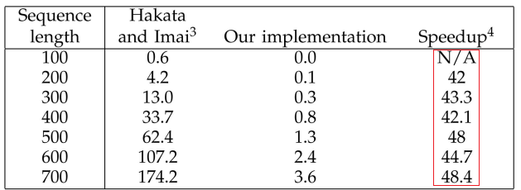
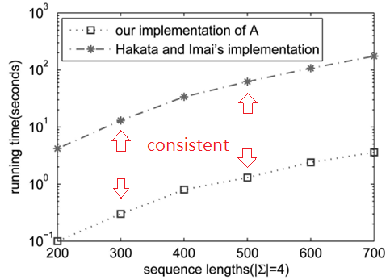
Experimental results of Quick-DP

Slide 36
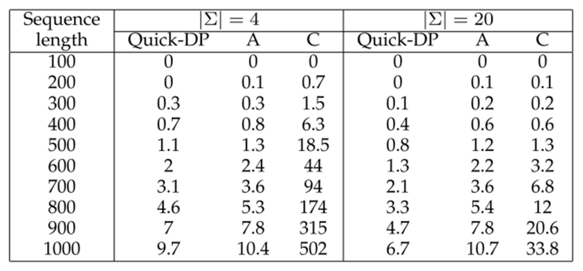
Random Three-Sequence
Hakata & Imai’s algorithm[22]
  A: only for 3-sequence
  C: any number of sequences

Slide 37
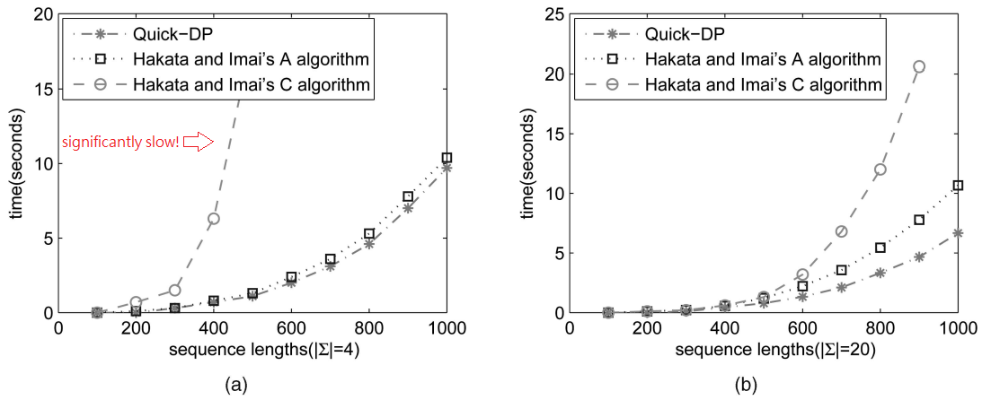
Random Three-Sequence

Slide 38
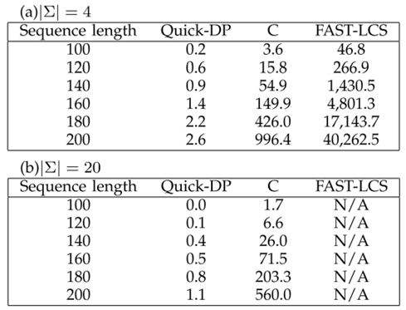
Random Five Sequences
Hakata & Imai’s C algorithm:
  any number of sequences and alphabet size
FAST-LCS[11]:
  any number of sequences
  but only for alphabet size 4

Slide 39
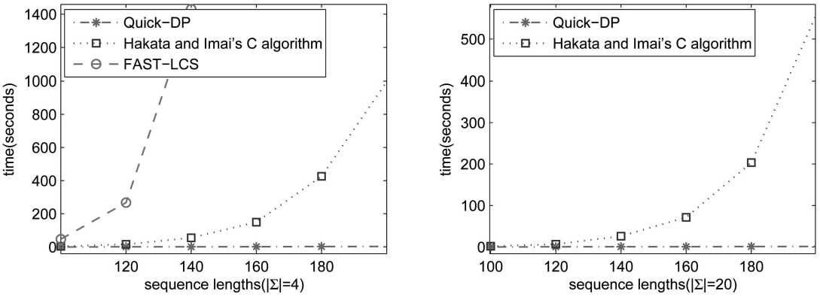
Random Five Sequences

Slide 40
Quick-DPPAR Algorithm
施羽芩

Slide 41
Parallel MLCS Algorithm (Quick-DPPAR)
Parallel Algorithm
  The minima of parent set
  The minima of s-parent set
Q
slave₁
R
slave₁
Q
slave₂
R
master
slave₃
Q
R
Q
slave_{Np}
R

Slide 42
Quick-DPPAR
Step1 : The master processor computes
master

Slide 43
Quick-DPPAR
Step2 : Every time the master processor computes a new set of k-dominants (k = 1, 2, 3, . . . ), it distributes evenly among all slave processors
slave₁
slave₂
master
slave₃
slave_{Np}

Slide 44
Quick-DPPAR
Step3 : Each slave computes the set of parents and the corresponding minima of k-dominants that it has, and then, sends the result back to the master processor
slave₁
Q
R
slave₂
Q
R
slave₃
Q
R
slave_{Np}
Q
R

Slide 45
Quick-DPPAR
Step3 : Each slave computes the set of parents and the corresponding minima of k-dominants that it has, and then, sends the result back to the master processor
slave₁
slave₂
master
slave₃
slave_{Np}

Slide 46
Quick-DPPAR
Step4 : The master processor collects each s-parent set , as the union of the parents from slave processors and distributes the resulting s-parent set among slaves
slave₁
slave₂
master
slave₃
slave_{Np}

Slide 47
Quick-DPPAR
Step5 : Each slave processor is assigned to find the minimal elements only of one s-parent set
slave₁
slave₂
master
slave₃
slave_{Np}

Slide 48
Quick-DPPAR
Step6 : Each slave processor computes the set of (k+1)-dominants of and sends it to the master
Q
slave₁
R
Q
slave₂
R
slave₃
Q
R
Q
slave_{Np}
R

Slide 49
Quick-DPPAR
Step7 : The master processor computes
Go to step 2,
until is empty
slave₁
slave₂
master
slave₃
slave_{Np}

Slide 50
Time Complexity Analysis of Quick-DPPAR
李鴻欣

Slide 51
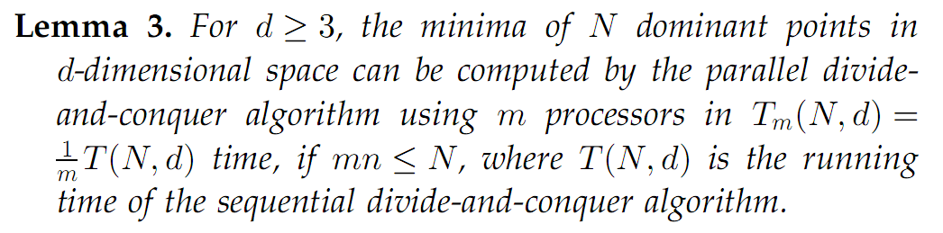
Time Complexity Analysis

Slide 52
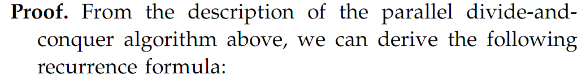
Time Complexity Analysis
dividing N points into
two subsets R and Q
minimizing R
and Q individually
removing points in R
that are dominated by Q

Slide 53
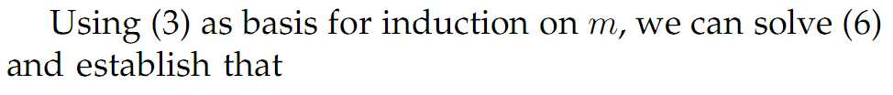
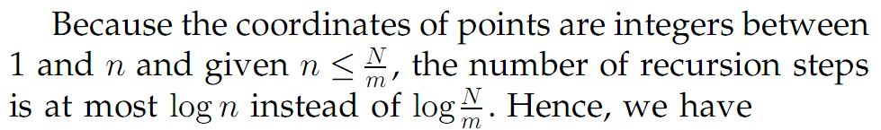
Time Complexity Analysis

Slide 54
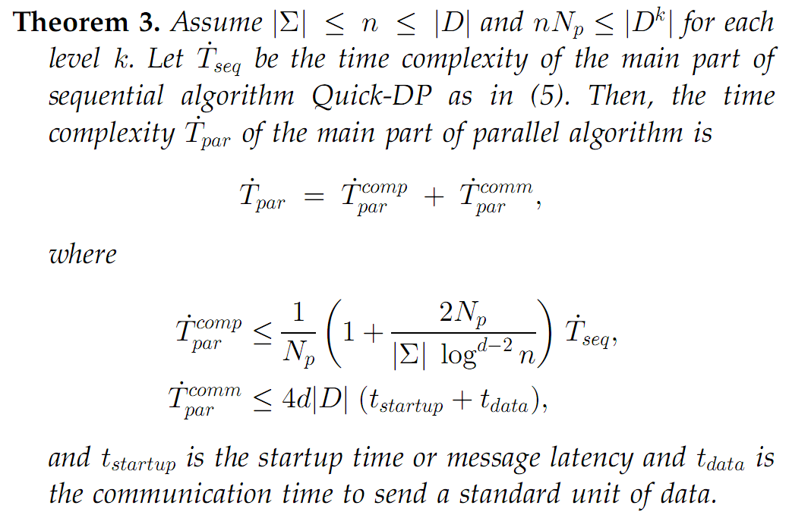
Time Complexity Analysis
for computation
for commutation

Slide 55
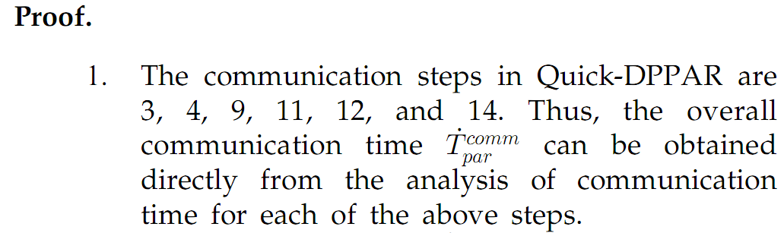
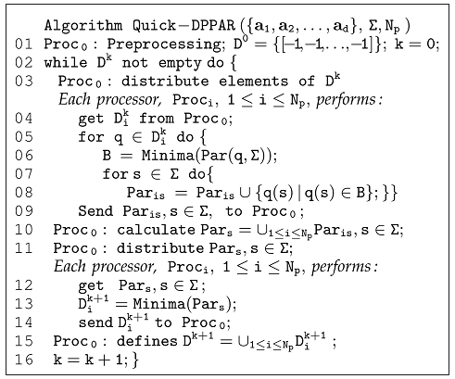
Time Complexity Analysis
common to
sequential Quick-DP
exclusive for
Quick-DPPAR
(1)
(2)
(3)

Slide 56
Time Complexity Analysis
--------------------(1) & (2)
--------------------(3)

Slide 57
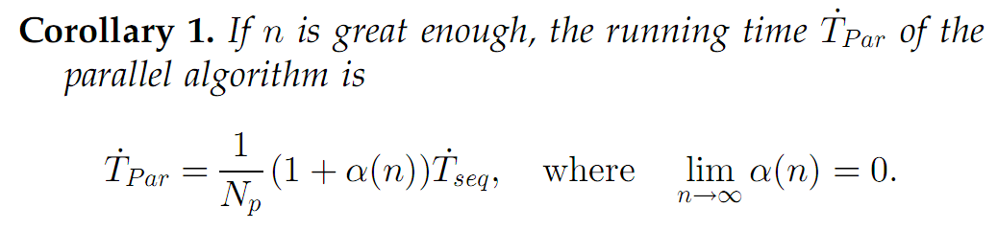
Time Complexity Analysis

Slide 58
Experiments of Quick-DPPAR
劉士弘

Slide 59
Experiments of Quick-DPPAR
The parallel algorithm Quick-DPPAR was implemented using multithreading in GCC
  Multithreading provides fine-grained computation and efficient performance
The implementation consists of one master thread and slave threads
  1. The master thread distributes a set of dominant points evenly among slaves to calculate the parents and the corresponding minima
  2. After all slave threads finish calculating their subsets of parents, they copy these subsets back to the memory of the master thread
  3. the master thread assigns each slave to find the minimal elements of s-parents,
  4. The set of minima is then assigned to be the st dominant set
  Repeat 1-4 until an empty parent set is obtain

Slide 60
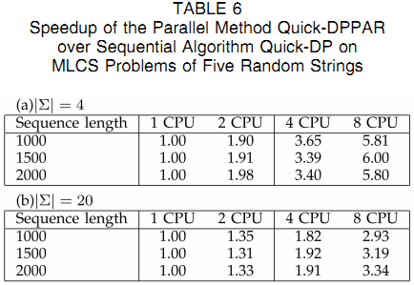
Experiments of Quick-DPPAR
We first evaluated the speedup of parallel algorithm Quick-DPPAR over sequential algorithm Quick-DP
  Speed-up is defined here as the ratio of the execution time of the sequential algorithm over that one of the parallel algorithm

Slide 61
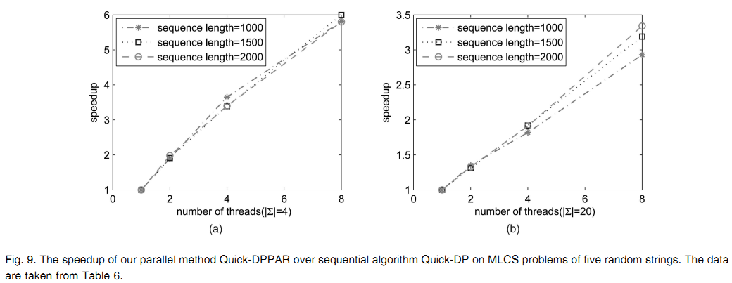
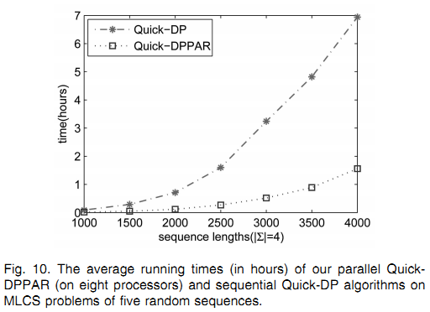
Experiments of Quick-DPPAR

Slide 62
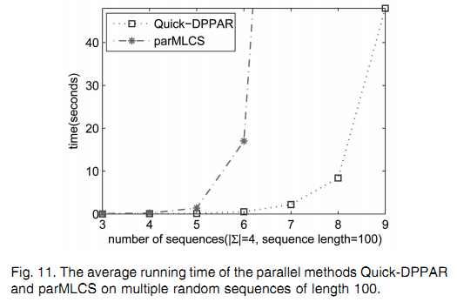
Experiments of Quick-DPPAR
Quick-DPPAR was compared with parMLCS, a parallel version of Hakata and Imai’s C algorithm, on multiple random sequences

Slide 63
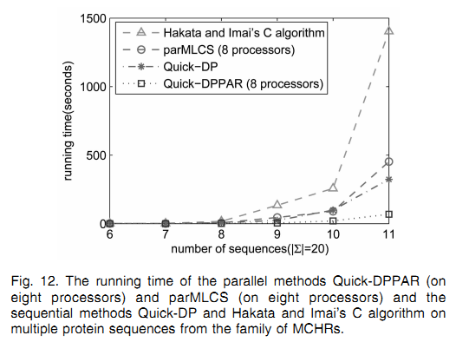
Experiments of Quick-DPPAR
We also tested our algorithms on real biological sequences by applying our algorithms to find MLCS of various number of protein sequences from the family of melanin-concentrating hormone receptors (MCHRs)

Slide 64
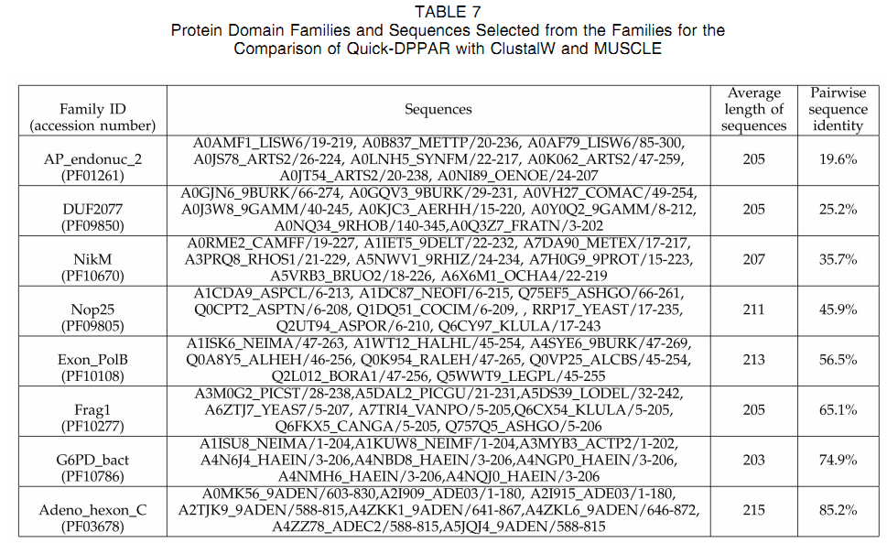
Experiments of Quick-DPPAR
We compared Quick-DPPAR with current multiple sequence alignment programs used in practice, ClustalW (version 2) and MUSCLE (version 4)
  As test data, we chose eight protein domain families from the Pfam database
Calculated by MUSCLE
http://www.drive5.com/muscle/

Slide 65
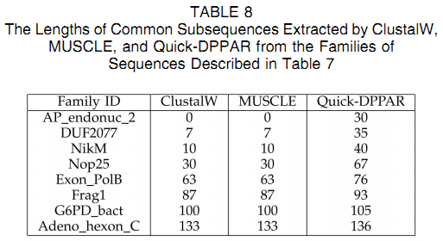
Experiments of Quick-DPPAR
For the protein families in Table 7, it took Quick-DPPAR 8.1 seconds, on average, to compute the longest common subsequences for a family
While it took MUSCLE only 0.8 seconds to align sequences of a family
The big advantage of Quick-DPPAR over ClustalW and MUSCLE is that Quick-DPPAR guarantees to find optimal solution

Slide 66
Conclusion
江蘇峰

Slide 67
Summary
Sequential Quick-DP
  A fast divide-and-conquer algorithm
Parallel Quick-DPPAR
  Achieving near-linear speedup with respect to the sequential algorithm
Readily applicable to detecting motifs of more than 10 proteins.

Slide 68
Q&A

