Slide 1

The early introduction of dynamic programming into computational biology
第1組
R02922113 謝名宣
R02922064 黃宥勝
R02922077 黃志恒
R02945040 王亮之

Slide 2
Reference
The early introduction of dynamic programming into computational biology.
David Sankoff
2000 Bioinformatics, 16 , 41-47.

Slide 3
Outline
Introduction
Dynamic programming for sequence comparison
Multiple alignment and phylogeny
Secondary structure

Slide 4
Introduction

Slide 5
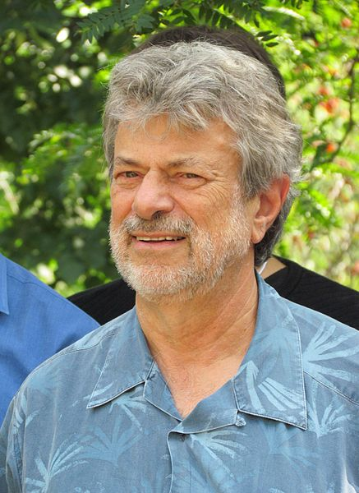
Introduction of writer
David Sankoff
David Sankoff currently holds the Canada Research Chair in Mathematical Genomics at the University of Ottawa.
He studied at McGill University, doing a PhD in Probability Theory with Donald Dawson. He joined the new Centre de recherches mathématiques (CRM) of the University of Montreal in 1969 and was also a professor in the Mathematics and Statistics Department from 1984–2002.
He is one of the founding fathers of bioinformatics whose fundamental contributions to the area go back to the early 1970s.

Slide 6
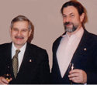
Introduction of writer
In 1971, Cedergren asked Sankoff to find a way to align RNA sequences. Sankoff knew little of algorithm design and nothing of discrete dynamic programming, but as an undergraduate he had effectively used the latter in working out an economics problem matching buyers and sellers. The same approach worked with alignment.

Slide 7
Introduction
In 1994-1995, DIMACs sponsored a theme year on computational biology.
As a participation in a workshop which organized by Alberto Apostolico and Raffaele Giancarlo, Sankoff led to consider some of the early interactions in the field now known as computational biology.
After reading a paper by Walter Goad on the impact of Stanislaw Ulam in this field, puzzled Sankoff greatly.

Slide 8
Introduction
Ulam: ’I started all this’.

Slide 9
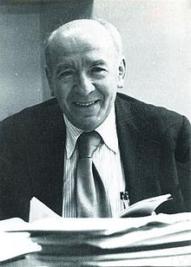
Introduction
Sankoff had also read a joint interview of Ulam and Mark Kac, led him to reflect on this misperception on the part of Ulam, and to crystallize the realization that ironically, Kac, his colleague of many year, had play a crucial in the earliest development of the field.
This paper is dedicated to the memory of Mark Kac.

Slide 10
Introduction
In this article, Sankoff will draw on his recollections of the earliest phases of the field to describe how certain fundamental ideas found their ways into the vernacular of the computational biologist.

Slide 11
Dynamic programming for sequence comparison

Slide 12
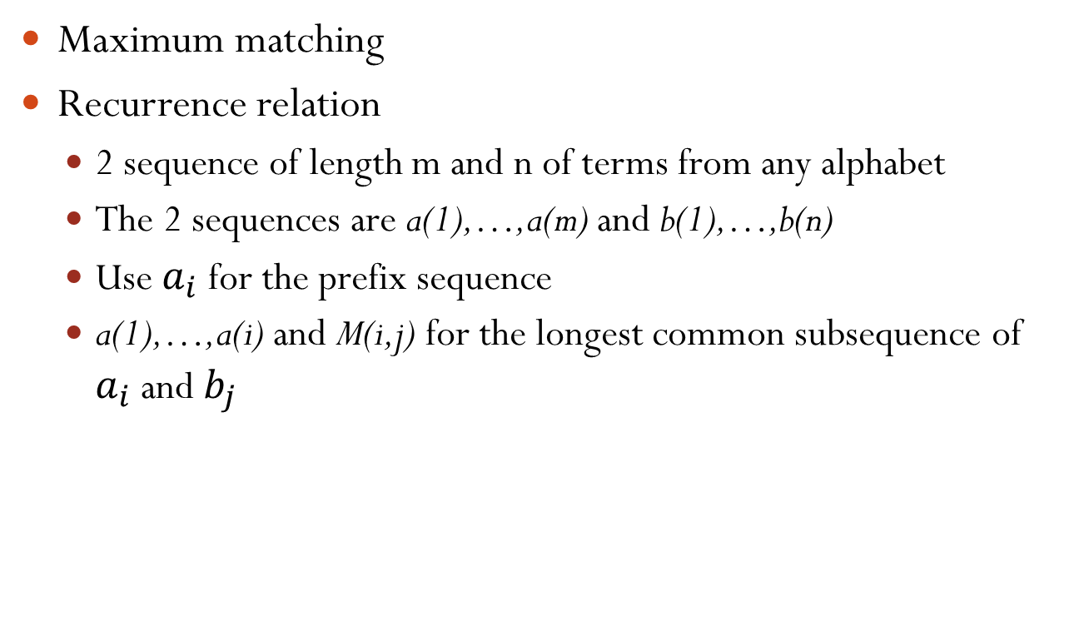
Longest common subsequence
Maximum matching
Recurrence relation
  2 sequence of length m and n of terms from any alphabet
  The 2 sequences are a(1),…,a(m) and b(1),…,b(n)
  Use $a_{i}$ for the prefix sequence
  a(1),…,a(i) and M(i,j) for the longest common subsequence of $a_{i}$ and $b_{j}$

Slide 13
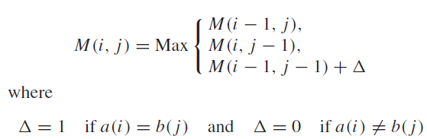
Longest common subsequence

Slide 14
Longest common subsequence
initial condition
  M(i,0) = M(0,j) = 0
The length of the longest common subsequence
  M(m,n)
All longest common subsequence
  Traceback routine on the matrix M

Slide 15
Edit distance
Stanislaw Ulam
Sequence comparison problem
Dynamic Programming-Sellers
  Maximum matching
  Cubic computing time
  Can be done in quadratic time

Slide 16


Edit distance
Using D(i,j) for the minimum number of steps to convert $a_{i}$ to $b_{j}$

Slide 17
Edit distance
initial condition
  D(i,0) = D(0,i) = i
The edit distance between the two sequences
  D(m,n)
All appropriate sets of edit steps
  Traceback routine on the matrix D

Slide 18

Generalization
A different weight s>0
The longest common subsequence problem and the shortest edit distance problem become essentiall identical
  When s≧2

Slide 19
Optimal local alignment
Smith and Waterman
Dynamic Programming
  Simple
  Not-obvious

Slide 20

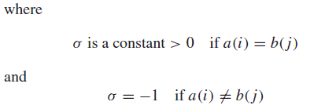
Optimal local alignment

Slide 21
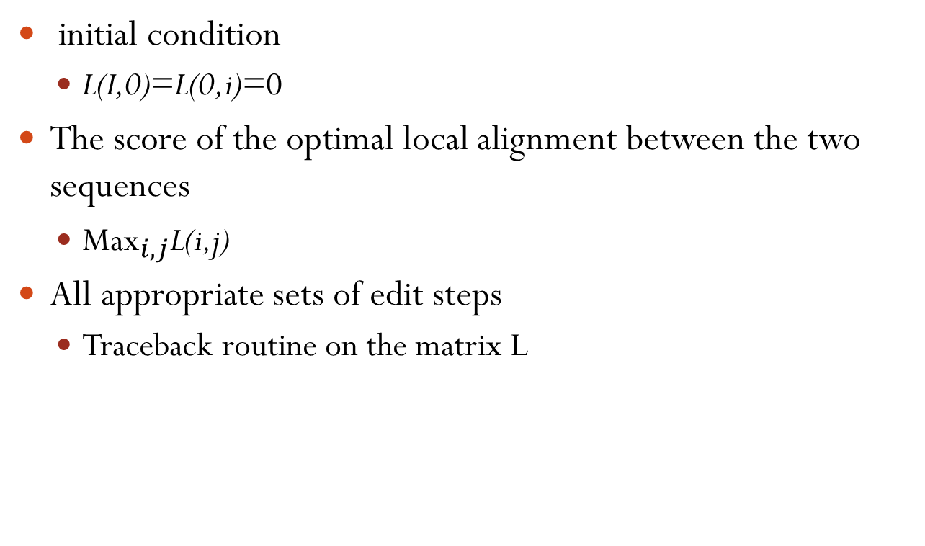
Optimal local alignment
initial condition
  L(I,0)=L(0,i)=0
The score of the optimal local alignment between the two sequences
  ${\text{Max}}_{i,j}$L(i,j)
All appropriate sets of edit steps
  Traceback routine on the matrix L

Slide 22
Multiple alignment and phylogeny

Slide 23
Multiple alignment and phylogeny
Cedergren and Sankoff became interested in assessing the relative rates of 12 possible substitution mutations among the four based {A,C,G,U}
Idea:
  Isolate each position in the RNA
  Count the number of mutations
  Combine the data of all positions

Slide 24
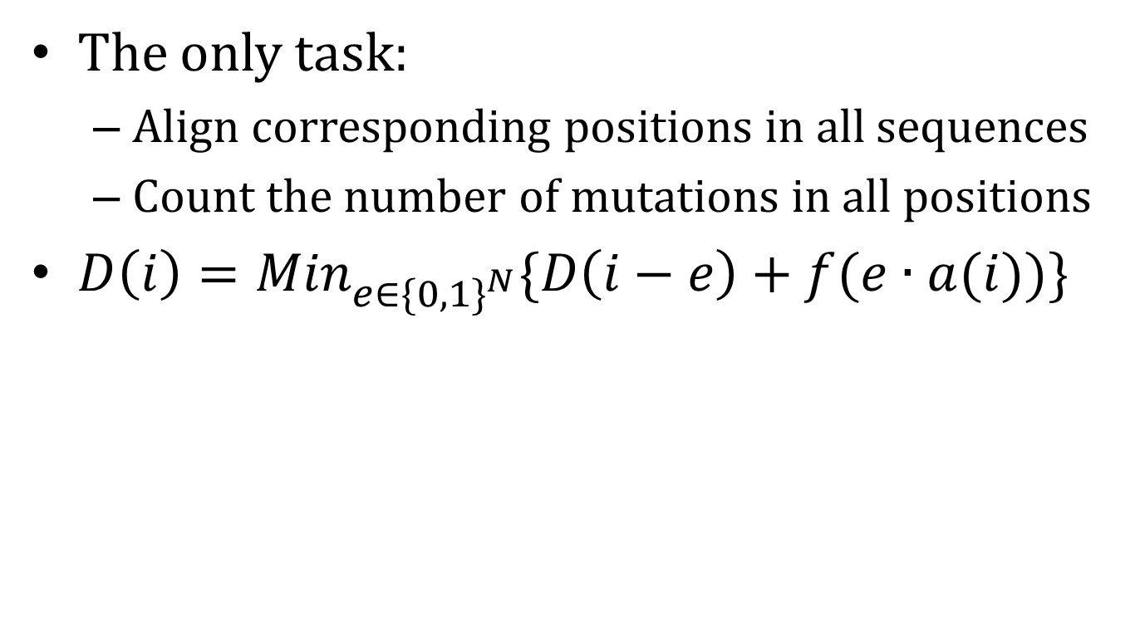
Multiple alignment and phylogeny
The only task:
  Align corresponding positions in all sequences
  Count the number of mutations in all positions
$D\left(i\right)={Min}_{e∈{\{0,1\}}^{N}}\{D\left(i−e\right)+f(e∙a(i))\}$

Slide 25
Multiple alignment and phylogeny
Sankoff published a short paper with Cedergren and his student Cristiane Morel (Sankoff et al., 1973)
Significant of the paper
  Mutation frequencies
  Reconstruction of the ancestral sequence
  Formal algorithm for multiple sequence alignment

Slide 26
Multiple alignment and phylogeny
Sankoff rushed off a manuscript containing this algorithm to Mark Kac, and requested him to communicate it to PNAS
After waiting for 6 month for a reply from Kac…
  Not good enough for some cases
  Should optimize the tree topology simultaneously
Published his algorithm elsewhere (Sankoff, 1975)

Slide 27
Secondary structure

Slide 28
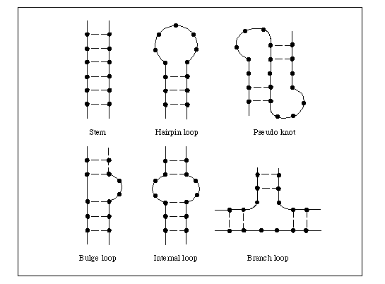
Secondary structure
Stem
Given two regions：
a(i),…..,a(i+h)
a(j),…..,a(j-h)
For h=0,……k
a(i+5)
a(j-5)
a(i+4)
a(j-4)
a(i+3)
a(j-3)
a(i+2)
a(j-2)
a(i+1)
a(j-1)
a(i)
a(j)

Slide 29
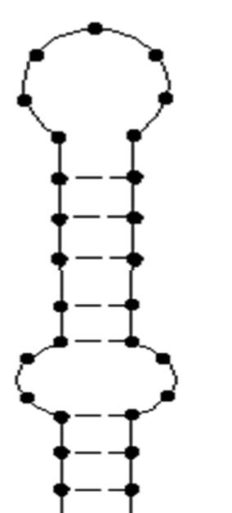
Secondary structure
R-loops
Given a(ir),….., a(kr) are all unpaired
For r=1,…..,R
R= 1 = Hairpin
R= 2 = Interior loop
R ≥ 3 = Multiple loop
Special case
ex:bugle (R=2)
R=1
a(i1)
a(k1)
R=2
a(i2)
a(k2)

Slide 30
Secondary structure
R-loops
Given a(ir),….., a(kr) are all unpaired
For r=1,…..,R
R= 1 = Hairpin
R= 2 = Interior loop
R ≥ 3 = Multiple loop
Special case
ex:bugle (R=2)

Slide 31
Secondary structure
Secondary struture stems disrupted only by bugles and other interior loops could be detected by dynamic programming comparison.
Sankoff devised an iterative algorithem.But the method turn out to be very dependent on the crude energy estimates at the time.(1976)

Slide 32
Secondary structure
A single-pass dynamic programming algorithm was published by Ruth Nussinov. (1978)
Michael Zuker wrote a very effective and wide disseminated program based on the Nussinov’s principle. (1981)
Mark Kac invited him to gaive a talk at Rockefeller University and re-stimulated his interest in secondary structure.

Slide 33

Secondary structure
The dynamic programming recurrence fundamental to folding may be represented as:
simutaneously solving the folding and mutiple alignment problems. (1985)

Slide 34
Thanks for your listening

