Slide 1
Gapped BLAST and PSI-BLAST : a new generation of protein database search programs
Team2
邱冠儒 黃尹柔 田耕豪 蕭逸嫻 謝朝茂 莊閔傑
2014/05/12

Slide 2
BLAST
Basic local alignment search tool
Enable to compare query sequence of amino-acid or protein or DNA to database
To find similarity between sequences

Slide 3
BLAST
1.Make a k-letter word list of the query sequence
2.Using the scoring matrix (for protein ,BLOSOM62 is often used) to score the comparison of k-letter word and possible matching word
3.Words which score above threshold T is remained
4.Scan the database sequences for exact matches with the remaining high-scoring words
Notes:
The (i,j) th entry is equal to the probability of the ith amino acid being transformed into the jth amino acid in a certain amount of evolutionary time

Slide 4
BLAST
5.Extend the exact matches to high-scoring segment pair (HSP)
6.Evaluate the significance of the HSP score
7.Show local alignments of the query and each of the matched database sequences

Slide 5
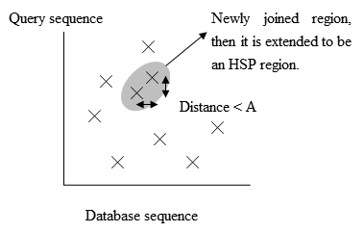
refinement
(i) criterion for extending word pairs is modified －lower threshold T －two word pairs

Slide 6
refinement
(ii)The ability to generate gapped alignments has been added －allow threshold T increase
－increase speed

Slide 7
refinement
(iii)Position-specific score matrix －BLAST is easily generalized
－speed and ease of operation

Slide 8
Statistical Preliminaries
S’：normalized score λ、K is determined by score matrix
E：expect score N=m*n ex: for query protein length 250 and database 50million residues, to achieve E-value of 0.05 ,S’ is around 38

Slide 9
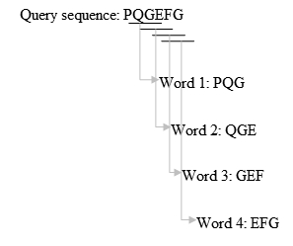
Original BLAST (Algorithm)
extract each substring of length k from the query sequence
“word”
For proteins, k=3; for DNA, k=11

Slide 10
Original BLAST (Algorithm)
For each word in the query sequence, find a set of word with score higher than k (when aligned with the word in the query sequence)
Score:
scoring matrix

Slide 11
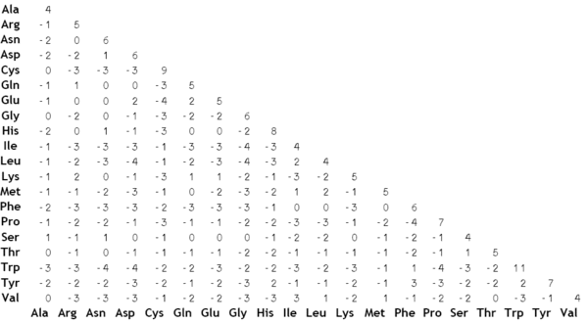

Slide 12
Original BLAST (Algorithm)
Scan the database, for these words which has score>T when aligned with some words in the query sequence
“hit”

Slide 13
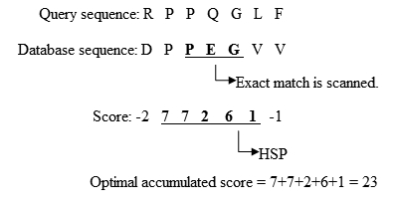
Original BLAST (Algorithm)
Extend the hit in both direction, to generate HSP
(HSP: High-scoring Segment Pair)
Find HSP of statistical significance

Slide 14
Refinement: the Two-Hit method
Extension is the most time-consuming part in the algorithm
(>90% execution time)
Observation:
HSP length >>word length(k)
→an HSP may contain multiple hits on the same diagonal and close to each other

Slide 15
Refinement: the Two-Hit method
(Query) …PQGEFGVVVEEFQEE…
(Database) …PVGGVGPFEEEFVQE…
(Query) …PQGEFGVVVEEFQEE…
(Database)…PVGGEEFVGPFEVQE…
(Query) …PQGEFGVVVEEFQEE…
(Database)…EEFVQEPVGGVGPFE…

Slide 17
Refinement: the Two-Hit method
Method:
Choose a window length A, invoke an ungapped extension when 2 hits are found within distance A and on the same diagonal
T value need to be lowered to get sufficient sensitivity

Slide 18
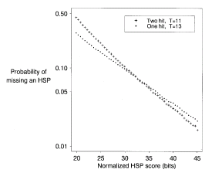
Results
Sensitivity
Speed~2 times faster!

Slide 19
Gapped Alignment
(Original BLAST):
Several distinct HSPs on the same database sequence are combined
Several HSP with only moderate score can be combined to have great significance
But for HSPs with moderate scores, the sensitivity is low…
→compensate by lowering T?

Slide 20
Gapped Alignment
Define a moderate score S_{g}, trigger gapped extension for all HSP with score> S_{g}
Can tolerate probability of missing HSP
Ex: result should > 0.95, p: miss probability of HSP
(Orignial) need to detect both HSPs: (1-p)(1-p)>0.95 p<0.025
(New) only need to detect one HSP:p²<0.05 p<0.22
→T can be raised to speed up!

Slide 21
Summary
Ungapped extension:
Require 2 hits of score >T, and within distance A to evoke
Gapped extension:
For HSPs with score higher than Sg, gapped extension is evoked

Slide 22
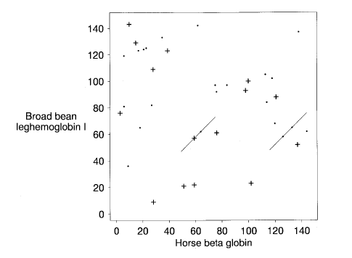
Gapped Local Alignment
EX. Broad bean leghemoglobin I V.S. Horse beta globin
Construct a k-letter “word” list
Scan database for “hit”
Extend “hit”
─ Two-Hit Method
Notes:
SWISS-PROT 經過注釋的蛋白質序列數據庫

Slide 23
Finding the seed
< 11
central residue
> 11
central residue of highest-scoring length-11 HSP
60
62

Slide 24
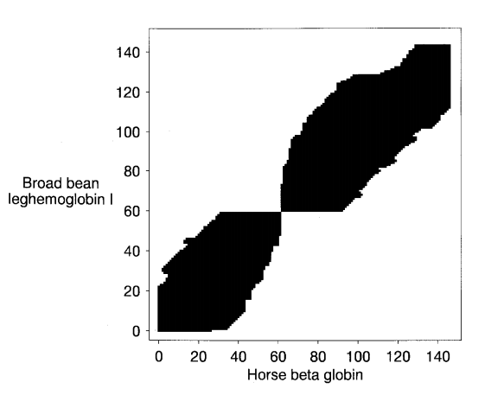
Gapped extensions
- Considering cells for which the optimal local alignment score falls no more than Xg

Slide 25
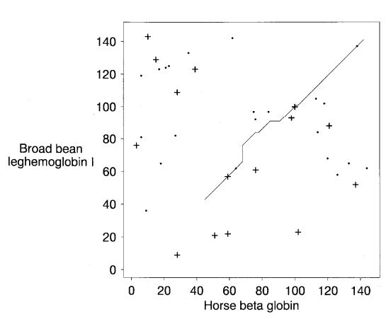
Optimal Local Alignment

Slide 26
Relative Time Spent by BLAST & Gapped BLAST

Slide 27
Position-specific iterated BLAST
Construct a position-specific score matrix(profile or motif) from the output of a BLAST run
More sensitive
Detection of weak relationships
For each iteration takes little more than the same time to run

Slide 28
Position-specific score matrix architecture
The score for alignment a letter with a pattern position is given by the matrix itself
For a query of length L
A position-specific matrix of dimension $L×20$

Slide 29
Position-specific score matrix architecture
Improved estimation of the probabilities with which amino acid occur at various pattern position
More sensitive
Relatively precise definition of the boundaries of important motifs
Local alignment
The size of the search space may be greatly reduced, lowering random noise
Gap score
In each iteration, employ the same gap scores that are used in the first BLAST run

Slide 30
Multiple alignment construction
Collect all database sequence segments with E-value below a threshold(0.01)
Multiple alignment M
Retain any rows that are >98% identical to one another
Gap characters inserted into the query are simply ignored
Reduced multiple alignment M_{C}

Slide 31
Sequence weights
A mistake to give all sequences of the alignment equal weight
Assign weights to the various sequences
Any columns consisting of identical residues are ignored in calculating weights
Column’s observed residue frequency
The effective number of independent observations
The relative number N_{C}

Slide 32
Target frequency estimation
The score of a column is
$$\log\left({Q_{i}}/{P_{i}}\right)$$
The estimated probability for residue I to be found in that column, Qi
Complicated by small sample size and prior knowledge of relationships among the residues
The background probabilities, Pi
The data-dependent pseudocount method
The residue pseudocount frequency, gi
$$g_{i}=\sum_{j}{\frac{f_{j}}{P_{j}}q_{ij}}$$
$$Q_{i}=\frac{αf_{j}+βg_{i}}{α+β}$$

Slide 33
BLAST applied to position-specific score matrices
The scale λ_{u} of the matrix scores
The score for a column is
$$\frac{⁡\ln\left({Q_{i}}/{P_{i}}\right)}{{\text{λ}}_{u}}$$
The gapped alignment scale parameter λ_{g}

Slide 34
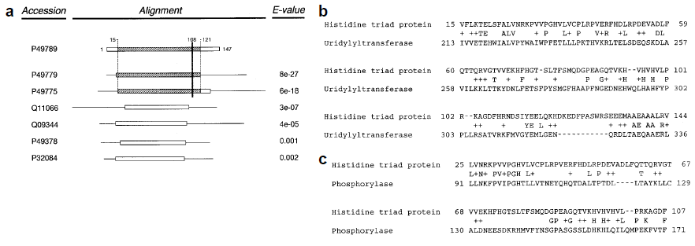
SWISS-PROT
108

Slide 35
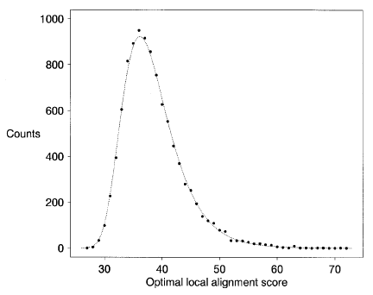

Slide 36
Performance of PSI-BLAST-shuffled database test
Original sequence
CCCCCCCCCCDDDDDDDDDDEEEEEEEEEEFFFFFFFFFF
shuffled sequence
DDCCCFFEFEEDFCCEFCCEDEEFCEDFFEDDDEDFFDCC
EDECDECDFDFCCDCDFCDECCDDEFEFFDCFFECEEFFE
EDDFFDCEFECEFCCFCCFEDECDCDCDEDFDFDFEFCEE
.
.
.
Test the accuracy of PSI-BLAST
Query compare with Database
Significant alignments
Significant alignments compare with Shuffled Database
Score E value

Slide 37
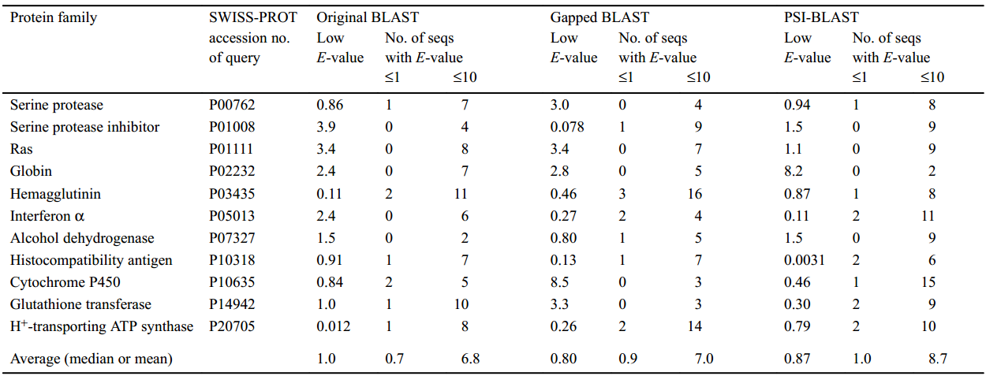
Performance of PSI-BLAST-shuffled database test
(Lowest E-value)
It can automate the construction of position-specific score matrices during multiple iterations of the PSI-BLAST program.

Slide 38
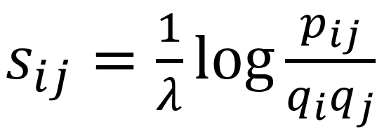
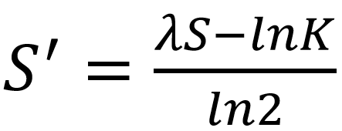
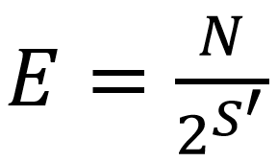
PSI - Gapped
Normalized speed
0.028
1
2.94
1.15
Gapped BLAST is fast
PSI-BLAST finds weak homologs

Slide 39
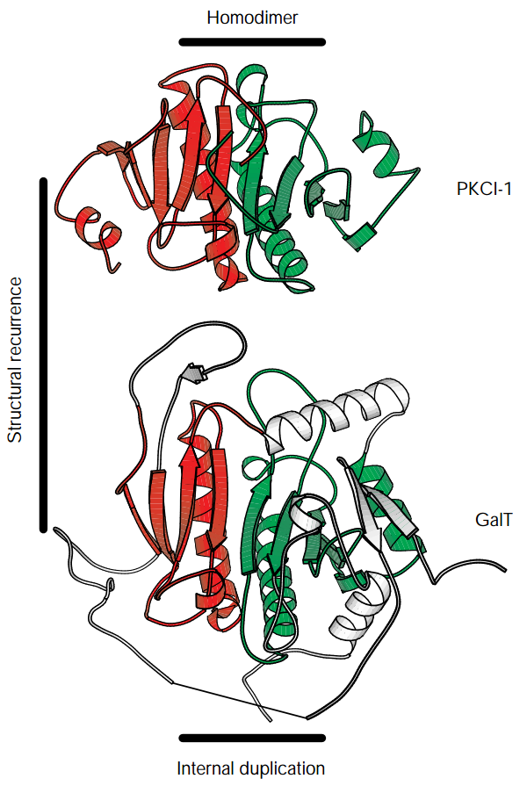
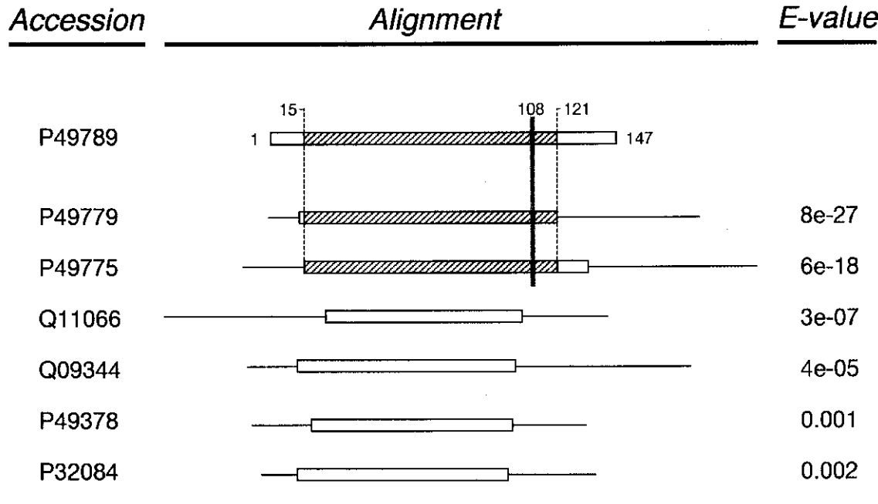
HIT and GALT protein
Structure
PSI-BLAST
HIT
Member of HIT
family protein
HIT
Family protein
GALT
P43424
HIT protein & GALT protein alignment
Lowest E value = 2x10⁻⁴

Slide 40
HIT protein
HIT protein / H.Influenza GALT
E = 4x10⁻⁵
HIT protein / yeast 5’’,5’’’-P1,P4-tetraphosphate phosphorylase I
E = 2x10⁻⁴

Slide 41
DISCUSSION
In addition to the major algorithmic changes described above, we have modified an aspect of the original BLAST program’s output routine that on occasion caused important similarities to be overlooked.

Slide 42
Future Improvement
Gap costs-In many cases, the new gap costs generate local alignments that are both more accurate and more statistically significant.
Realignment-the realignment procedure can prevent inaccurate pairwise alignments from corrupting the evolving multiple alignment, and can accelerate the recognition of related sequences, all for very little computational cost.

Slide 43
CONCLUSION
the new gapped version of BLAST is both considerably faster than the original one, and able to produce gapped alignments.
For many queries, the PSI-BLAST extension can greatly increase sensitivity to weak but biologically relevant sequence relationships.
PSI-BLAST retains the ability to report accurate statistics, per iteration runs in times not much greater than gapped BLAST, and can be used both iteratively and fully automatically.

