Slide 1
生醫資訊學導論_期末報告
Origin and Spread of de Novo Genes in
Drosophila melanogaster Populations
第7組
課程老師:趙坤茂老師
報告學生:游偉寗、唐皇、黃雍文
報告日期:103.5.26

Slide 2
大綱
1.簡介--游偉寗
2.實驗--游偉寗
3.結果與討論--唐皇
4.總結--黃雍文

Slide 3
1.簡介

Slide 4
Comparative genomic analyses have revealed that genes may arise from ancestrally nongenic sequence.

Slide 5
We identified 142 segregating and 106 fixed testis-expressed de novo genes in a population sample of Drosophila melanogaster.

Slide 6
Evidence for these “de novo” genes has generally derived from a combination of phylogenetic and genomic/transcriptomic analyses that reveal evidence of lineage- or species-specific transcripts associated with nongenic orthologous sequences in sister species.

Slide 7
De novo genes, which were first identified in Drosophila, have also been identified in humans, rodents, rice, and yeast .

Slide 8
In Drosophila, de novo genes tend to be specifically expressed in tissues associated with male reproduction.

Slide 9
we used population genomic and transcriptomic data from Drosophila melanogaster and its close relatives to investigate the origin and spread of de novo genes within populations.

Slide 10
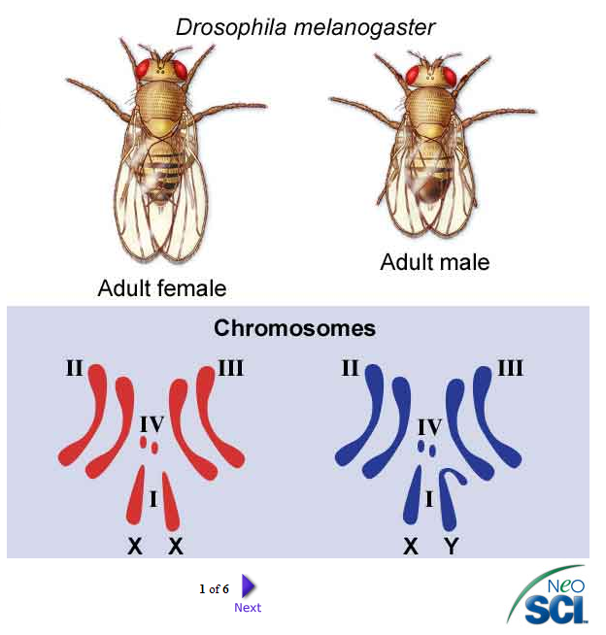

Slide 11
2.實驗

Slide 12
Illumina paired-end RNAsequencing (RNA-seq) and de novo and reference-guided assembly and alignment were used to characterize the testis transcriptome of six previously sequenced inbred Raleigh (RAL) D. melanogaster strains.

Slide 13
The RNA-sequencing data from each strain were used for de novo transcriptome assembly, as well as a reference sequence guided transcriptome assembly. These two approaches are complementary, and as expected, were highly concordant.

Slide 14
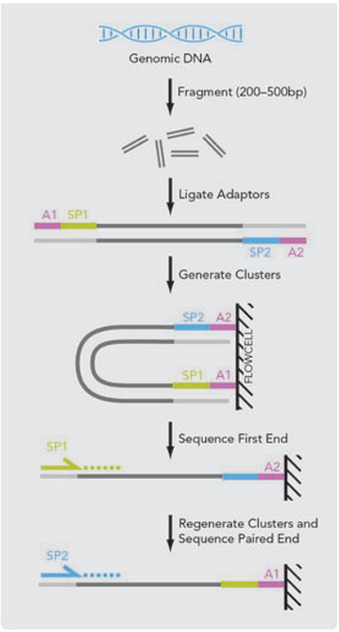
Illumina paired-endRNAsequencing (RNA-seq):

Slide 15
de novo transcriptome assembly
De novo transcriptome assembly is the method of creating a transcriptome without the aid of a reference genome.

Slide 16
reference-based assembly
A set of assembled transcripts allows for initial gene expression studies. Prior to the development of transcriptome assembly computer programs, transcriptome data were analyzed primarily by mapping on to a reference genome.

Slide 17
De novo vs. reference-based assembly:
Though genome alignment is a robust way of characterizing transcript sequences, this method is disadvantaged by its inability to account for incidents of structural alterations of mRNA transcripts, such as alternative splicing Since a genome contains the sum of all introns and exons that may be present in a transcript, spliced variants that do not align continuously along the genome may be discounted as actual protein isoforms.

Slide 18
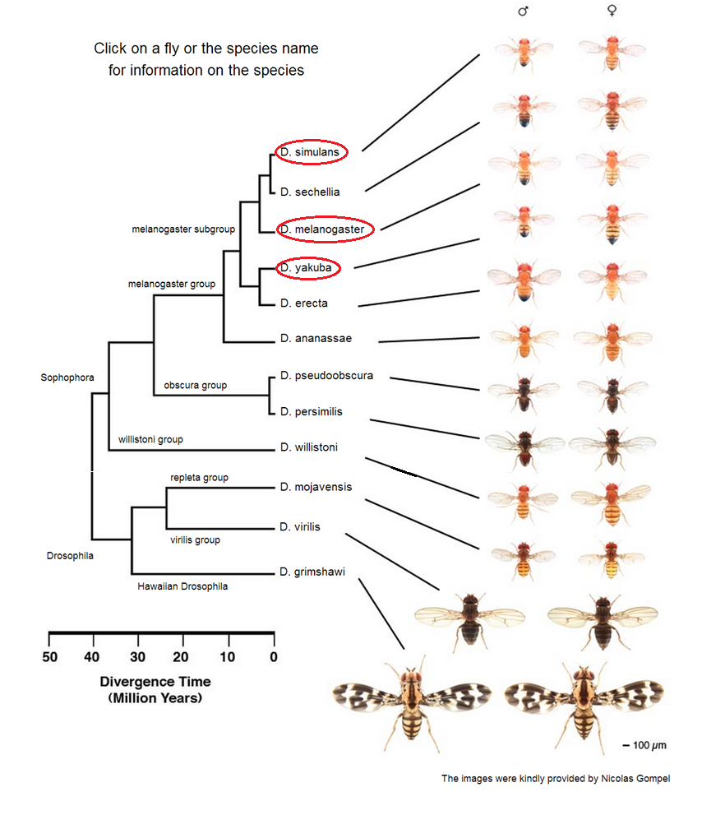
3.結果與討論

Slide 19
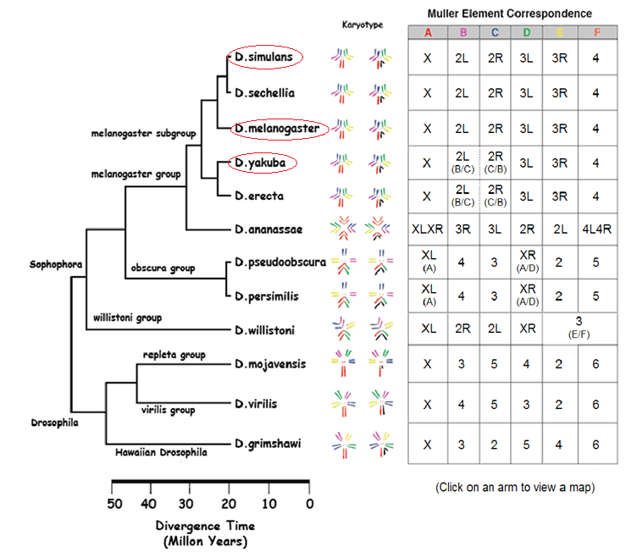

Slide 20
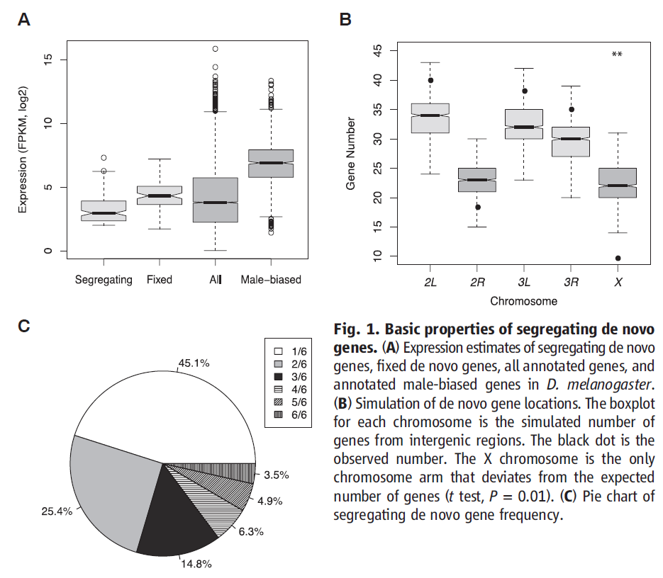

Slide 21
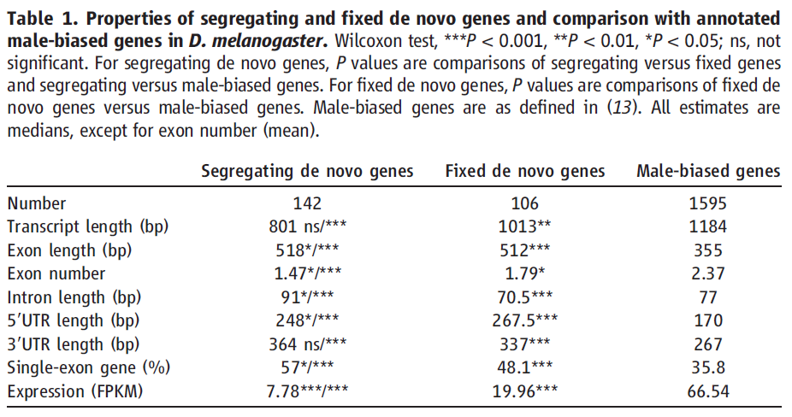
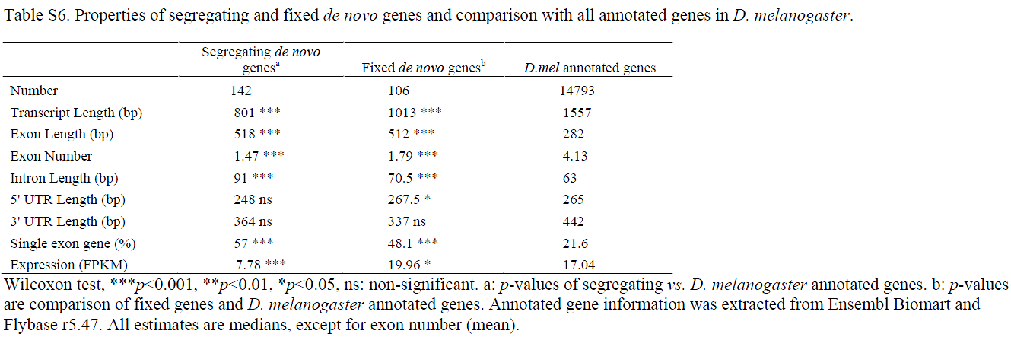

Slide 22
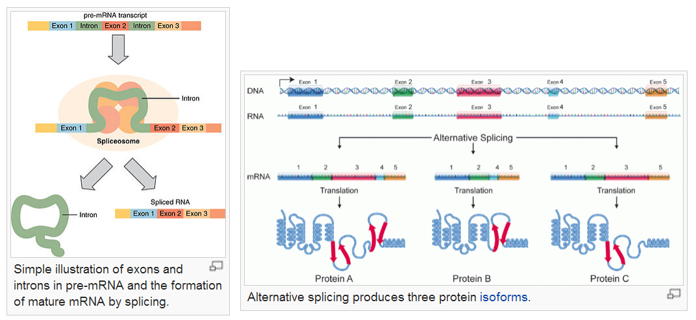

Slide 23
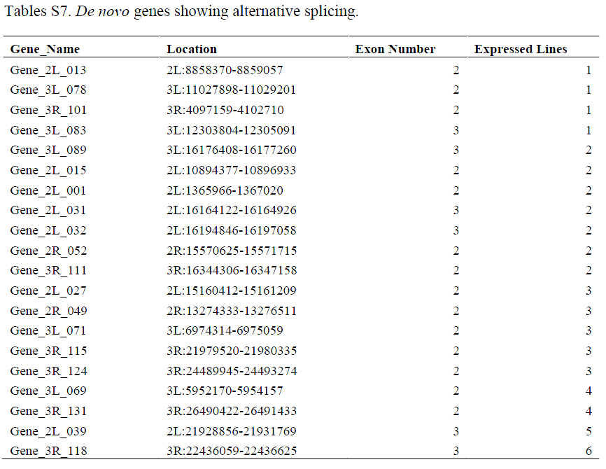

Slide 24
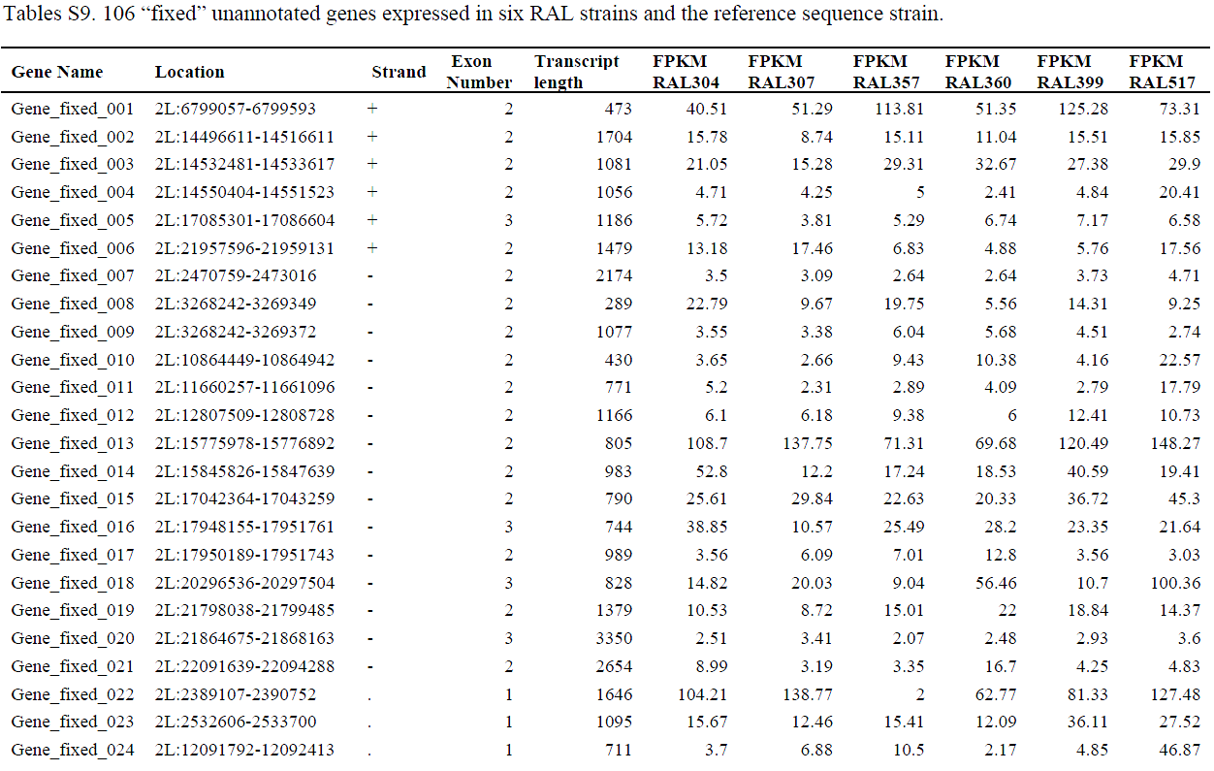

Slide 25
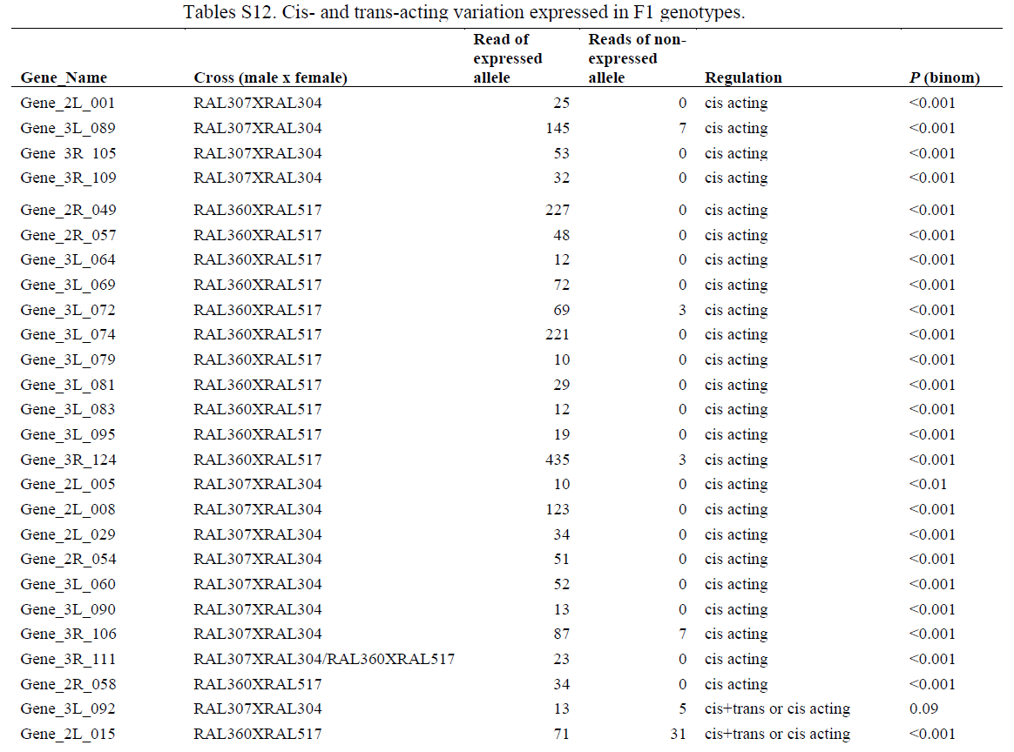

Slide 26
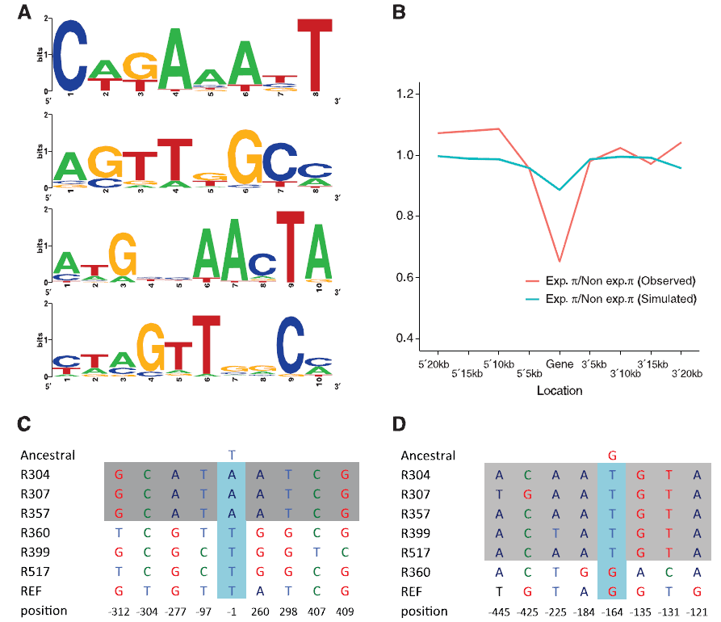
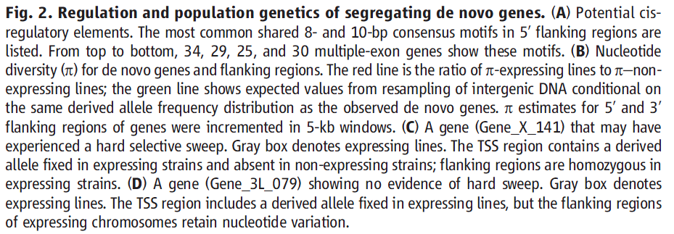

Slide 27
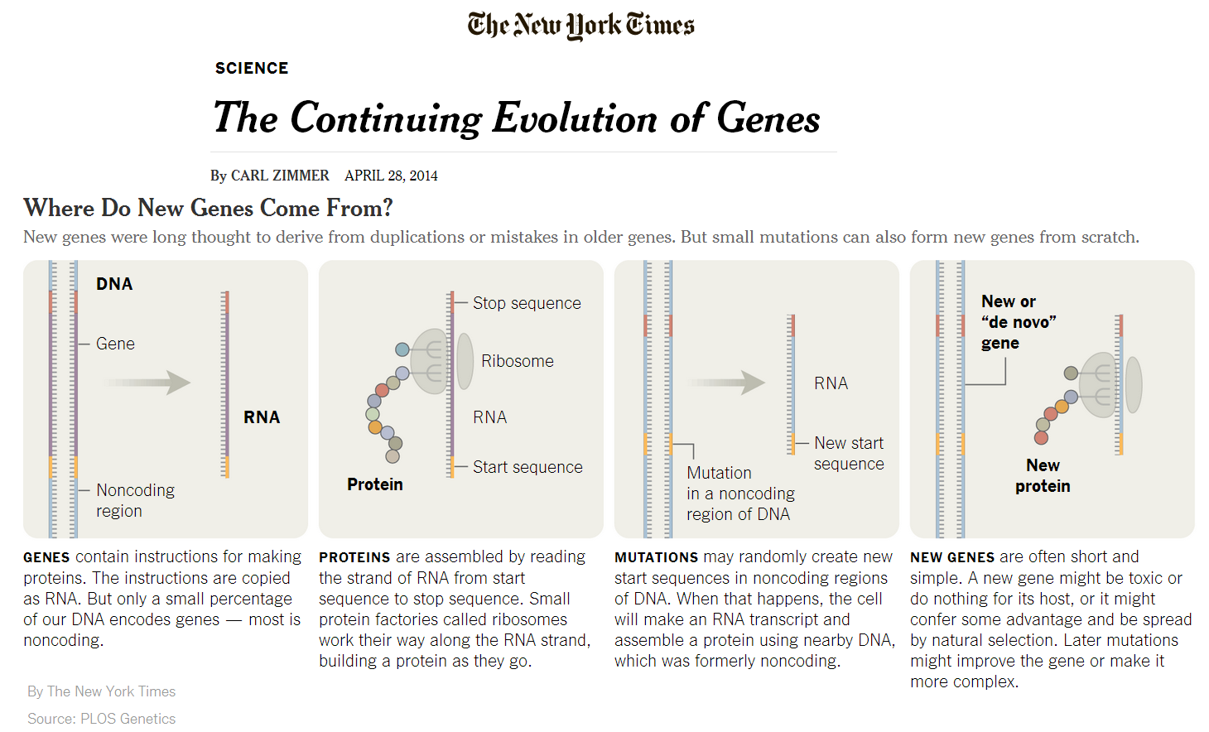

Slide 28
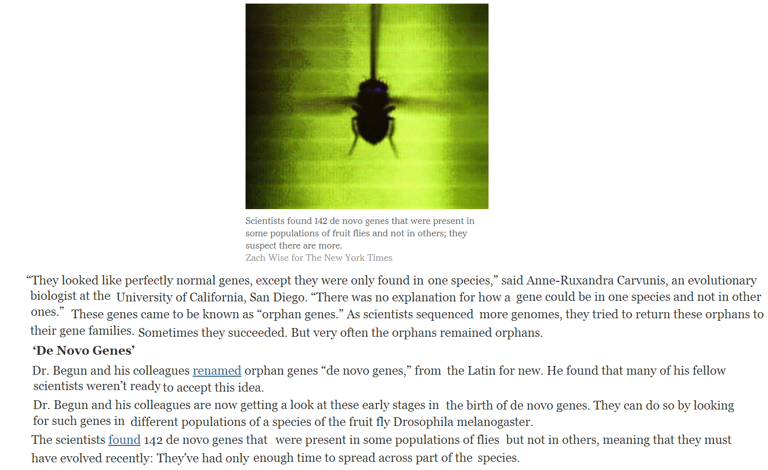

Slide 29
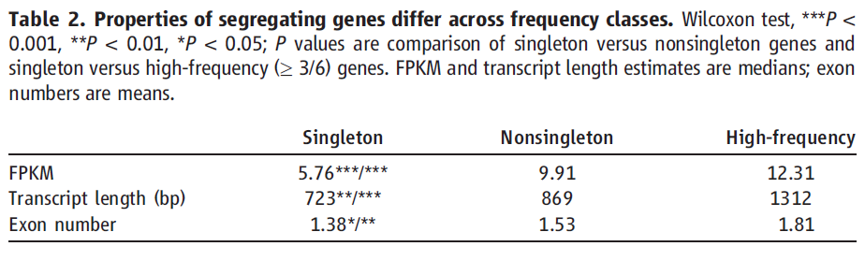
4.總結

Slide 31
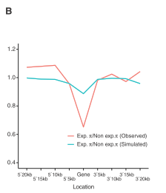

Slide 32
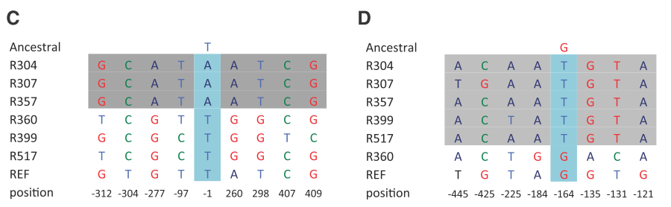

Slide 33
Conculsion
There are many polymorphic de novo male-specific genes likely recruited by selection primarily from ancestral, unexpressed ORFs.
Existence of many more fixed de novo D.melanogaster genes than previously inferred
de novo genes have been influenced by directional selection

