Slide 1
Electronic Medical Records as a Tool in Clinical Pharmacology: Opportunities and Challenges
報告人：蘇為碩 宋柏融 李曉婷 陳凱普 洪詩涵
2014/05/19
Notes:
老師、各位同學大家好，今天我們這一組要為各位報告的題目是「電子醫療紀錄作為臨床藥理學研究工具的機會與挑戰」。我是今天的第一個報告者蘇為碩，依序著將會是宋柏融、李曉婷、陳凱普、洪詩涵等四位同學替這個題目作接續的報導。

Slide 2
Introduction
蘇為碩

Slide 3
Electronic Medical Records
EMR v.s. Traditional Medical Records
Passive v.s. Active
EMR Capabilities
Preventive medical alerts
Aggregate outcomes for many patients
Public health surveillance
The era of big data

Slide 4
EMR with DNA information
Expansion of EMR systems
Combines DNA biorepositories with electronic medical record (EMR) systems for large-scale, high-throughput genetic research with the ultimate goal of returning genomic testing results to patients in a clinical care setting.
eMERGE

Slide 5
EMR as a Tool in Clinical Pharmacology
Clinical Pharmacology
Science of drugs and their clinical use
Connects the gap between medical practice and laboratory science
What information can EMR provide?
Longitudinal record of health status
Ex: case of rofecoxib and myocardial infarction
Possibly with DNA information

Slide 6
EMR as a Tool in Clinical Pharmacology
EMR-based phenotyping
Manual v.s. Automated
Inclusion of longitudinal data
Enables studies of variability in phenotype
Gene-Disease associations

Slide 7
EMR-based discovery in clinical pharmacology Approach to EMR-based phenotype

Slide 8
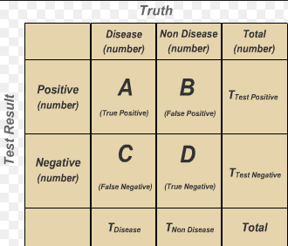
Traditional & Modern EMR-based phenotyping
Traditional approach for phenotyping has been successfully used in an EMR environment, but it is cumbersome and time-consuming and generally cannot generate very large cohorts.
Recent efforts have been focused on developing electronic algorithms for determining specific phenotypes from EMRs.
The criterion that we and others have adopted is that algorithms should have very high positive predictive values (PPVs, generally >90–95%) to be able to identify cohorts for case–control studies.
Notes:
A common experimental design starts with construction of a cohort of cases and controls for a specific phenotype (e.g., a disease or exposure status to a medication) from EMR data.

Slide 9
A general processing
Developing an algorithm and deploy it in an EMR system until a set of cases (generally 50–100) is identified for manual review.
This manual review then determines the PPV and deficiencies in the electronic phenotyping algorithm.
The algorithm is then refined and the process iterated until the threshold PPV is attained.

Slide 10
Phenotype algorithms
Structured data, e.g., ICD-9 codes, lab results
Narrative data, e.g., various types of clinical notes, text messages between patients and care providers
ICD: The International Classification of Diseases (ICD) is the standard diagnostic tool for epidemiology, health management and clinical purposes.

Slide 11
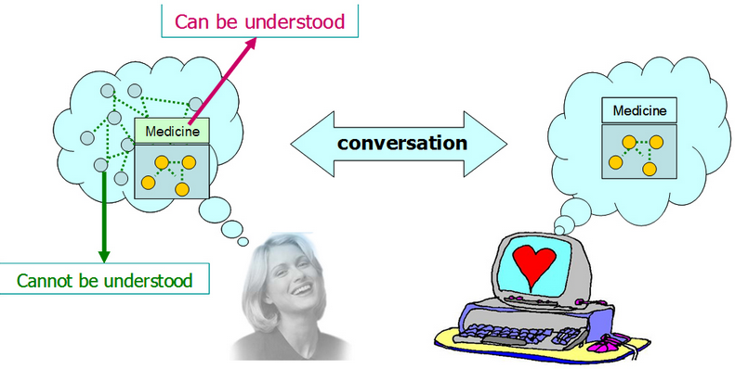
Natural-language processing
Natural-language processing technologies that can extract structured information (e.g., smoker: yes or no) from unstructured narrative clinical text have been used in such algorithms.
The use of natural-language processing is especially important to detect diseases and events occurring at facilities outside the recording center and entered as part of the patient’s past medical history and for discovery of rare events that may not be represented in typical coding systems.

Slide 12
Features of EMRs
Longitudinal data (縱貫性研究)
- Studies of variability in phenotype
-- disease complications
-- tempo of disease progression
-- response to drug exposures
Structured medication data
- inpatient → Physician order entries and drug administration
records
- outpatient → Resides in the narrative text of clinic notes or
interoffice communications
Notes:
縱貫性研究（Longitudinal studies）是針對長時間不同階段觀察的一種方法，主要是對同一主題觀察其研究變項在不同時期的演變，普遍用於測量變化及解釋因果等研究。
e.g., phone call records with patients)
Medication 用藥

Slide 13
Advantage of longitudinal data
The ability to distinguish among related diagnoses
- Data from the multiple visits represented in an EMR
Preliminary data indicate that phenotype definitions developed in one EMR can be successfully deployed in others

Slide 14
Drug exposures-manual method
Change over time
-- Intolerance, insurance status
-- Patient/provider preferences
-- Desire to reach clinical targets
-- Compliance
Manual method:
experts review different sources
-- cumbersome and costly
-- limited sample size
Notes:
Drug exposures change frequently over time because of intolerance, insurance status, patient/provider preferences, and the desire to reach clinical targets. Compliance is another important issue in drug-related studies.
纍贅的

Slide 15
Drug exposures-informatics method
These methods have successfully exploited the longitudinal nature of the EMR to identify drug-response phenotypes
-- cardiovascular events during clopidogrel therapy after coronary
stenting.
Rigorous characterization of phenotype, misclassification bias is minimized
→ greater insights into the true genetic architecture underlying
treatment response
Notes:
Clopidogrel血小板凝集抑制劑>冠狀動脈硬化
真正了解基因遺傳架構的治療反應

Slide 16
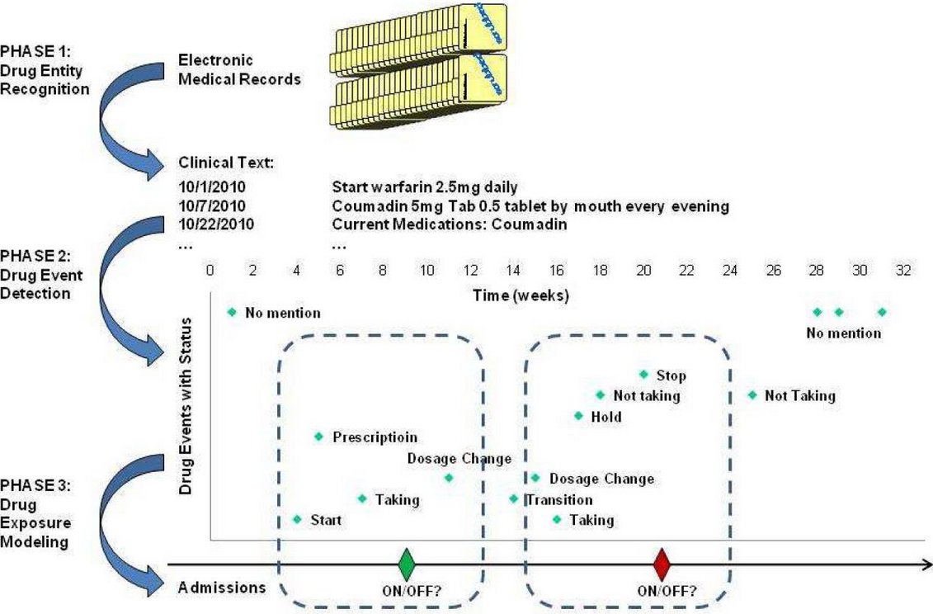
Drug exposures-informatics method -- an application to Warfarin
Notes:
抗凝血劑用藥
結合natural language processing(NLP) & Machine learning
1.Entity藥名 藥的特性 來源 藥效 使用的頻率
2.在特定時間內的 Complication hold on off
3.Model 應用 time-series data，但noisy 和不夠完整，須由病人主動提供資訊

Slide 17
Collaboration
Among investigators with expertise in multiple disciplines
Biomedical informatics
Clinical pharmacology
Epidemiology
Practitioners
Notes:
Emr良好的環境

Slide 18
Gene–disease associations
+ EMR
The genome-wide association study (GWAS) paradigm
whole genome association study
associations of phenotypes to single-nucleotide polymorphisms (SNPs)
S: SNPs
P: phenotypes
Figure from Chao, KM
Incorporate genome data with EMG
Notes:
在探討及病的過程中，病人基因型常扮演的重要角色
在基因體學的相關研究(GWAS)中，SNPs是其中的一個議題，常被用來探討及病和SNPs間的correlation

Slide 19
+ GWAS
EMR
Example:
Common in following diseases: atrial fibrillation (心房顫動), Crohn’s disease, multiple sclerosis (多發性硬化症), rheumatoid arthritis (類風濕關節炎), or type 2 diabetes
-> common 21 SNPs
S: SNPs
P: phenotypes
(diseases)
Figure from Chao, KM
Notes:
1.是一種炎症性胃腸病，患者的結腸、小腸或胃部會出現發炎、充血或淋巴脹大的跡象。
2.「硬化」指的是這些髓鞘脫失的區域因為組織修復的過程中產生的疤痕組織而變硬。這些硬塊可能會有好幾個，隨著時間的進展，新的硬塊也可能出現，所以稱作「多發性硬化症」，與關節硬化沒有關係。
3.二型糖尿病指身體對胰島素產生抗性，以致葡萄糖無法輸送到有需要的身體部位。例如當肌肉等身體組織對胰島素失去反應，便不能再利用血葡萄糖製造能量。這時葡萄糖會積聚在血液，導致血糖上升
第2型糖尿病的身體雖能製造胰島素，但不是量不夠，就是無法被身體善加利用。無法利用胰島素的原因有二：
beta細胞能製造胰島素，但其量不足以降低血糖來滿足身體對能量的需求。
有一種情況稱為「胰島素抗性」，亦即體內細胞無法正常運作使葡萄糖進入細胞。

Slide 20
Application of EMRs to pharmacogenomics
Discuss phenotypes with treated drugs to patient’s genomic data (SNPs)
Example:
Breast Cancer: during tamoxifen treatment, SNPs of Estrogen-receptor implicated as risk factors for venous thromboembolic disease
(靜脈血栓)
Notes:
Tamoxifen: 在乳癌病人治療當中常用的藥物
有研究證明~在tamoxifen藥物的治療下，如果ER上有特定SNP的pattern~副作用可能會有導致靜脈血栓形成的風險
醫生在用藥前如果知道乳癌病人EMR病例中有這些特定SNPs，可以避免試用tamoxifen這個藥物，降低血酸形成這個副作用生成

Slide 21
Application of EMRs to pharmacogenomics
Example 2:
HMG-CoA reductase inhibitors (statins): decrease low-density lipoprotein cholesterol
Few SNPs related to statins treatment
Single dose effects
Potency (ED50), efficancy (Emax)
Example 3:
association between CYP2C19*2 or ABCB1 and cardiovascular risk in patients receiving clopidogrel after coronary stenting
Notes:
是指在一群試驗動物中能使半數（50%）動物產生陽性藥效反應的劑量，是反映藥效的定量指標。

Slide 22
Phenome scanning
Phenome-wide association study (PheWAS)
Concept: inverse of the GWAS paradigm
examines the relationship between a single genetic variant and a large range of phenotypes

Slide 23
GWAS and PheWAS
Example:
GWAS: examined 1,317 hypothyroidism cases and 5,053 controls -> FOXE1 SNPs
PheWAS: FOXE1 SNPs -> identified thyroiditis (甲狀腺炎), nodular and multinodular goiters (甲狀腺腫大), and thyrotoxicosis (甲狀腺毒症)

Slide 24
Summary
Challenge
Methods to identify valid cases and controls are being refined
The use of these SNPs for pharmacogenomics has lagged further behind
the phenotyping for drug response is necessarily more complex
no human can be expected to keep track

Slide 25
Summary
Opportunity
Information exchange between EMRs
discovery of new drug actions and of genomic influences on disease phenotypes and drug responses
Genomic variation → prevention, prognosis and treatment
Application in Point of care system

Slide 26
Notes:
http://briancimins.com/2011/09/08/thank-you-for-always-believing-in-the-sport-we-love-grappling-by-brian-cimins/

