Slide 1
A Mesoscale Connectome of the Mouse Brain
Team 9
吳全勳 李偉航 王亮博 吳勁廷
梁楷彣 鄭樺 黃家郁 王偉安

Slide 2
Outline
Introduction (吳全勳)
Creating the Allen Mouse Brain Connectivity Atlas (李偉航)
Mapping axonal projections in the whole mouse brain (王亮博)
Brain-wide connectivity matrix (吳勁廷)
An inter-region connectivity model (梁楷彣)
The cortico-striatal-thalamic network (鄭樺)
Discussion (黃家郁 王偉安)

Slide 3
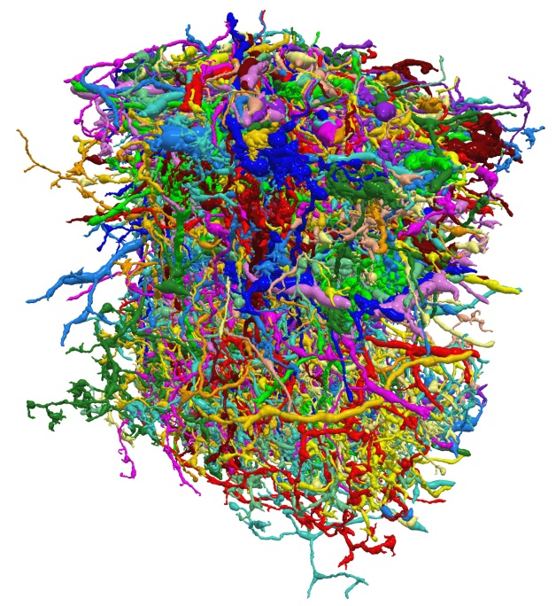

Introduction
What is connectome?
  a comprehensive map of neural connections in the brain
  a wiring diagram
Notes:
神經網路體又叫做連結體，指的是大腦神經元的所有對應組合。
是神經科學領域之新觀念，透過它，我們可以分析大腦內所有神經元網路之連結與交互作用，
進而能理解神經網路對各種複雜行為或生理疾病之影響。
右邊的圖是我偷渡某個樂團的專輯封面，他們剛好拿人類連結體的模擬圖當做封面。
如果我們把它放大來看，就像左邊這張圖。
每條顏色是一個神經元，他們透過突觸連結在一起

Slide 4
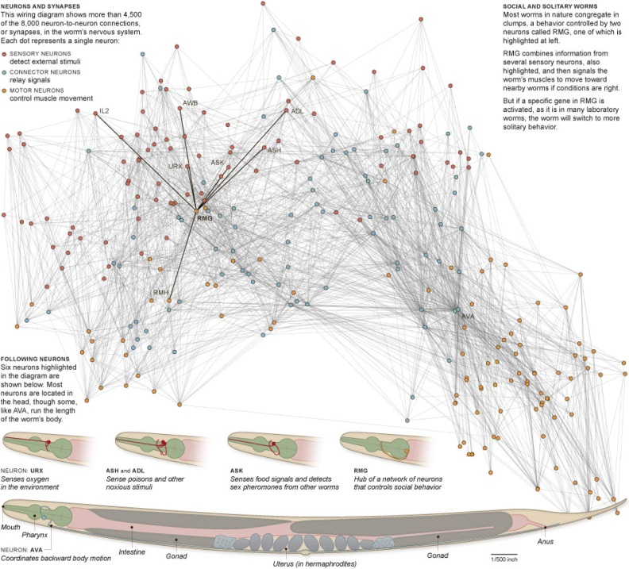
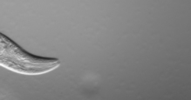
C. elegans
Only 1 species’ connectome has been completely constructed --- Caenorhabditis elegans (C. elegans)
302 neurons connected
by about 7000 synapses.
Notes:
到2012年為止只有一種生物的連結體被人類徹底了解並建造出來，它就是C. elegans. /ˌseɪnɵræbˈdɪtɪs ˈɛlɛɡænz/
中文學名為秀麗隱桿線蟲。
這種線蟲長度約一毫米，全身透明，生活在溫度恆定的環境裡。它也是唯一一個身體內所有細胞可以全部記錄的生物，
也是第一個基因體被完全定序的多細胞生物。
這種線蟲總共有302個神經元，約7000個突觸。科學家花費近十幾年的時間，利用電子顯微鏡得到的影像，重建其神經系統。
許多神經生物學家利用此線蟲做為模式生物，來了解其如何產生趨化性，趨溫性及交配行為。

Slide 5
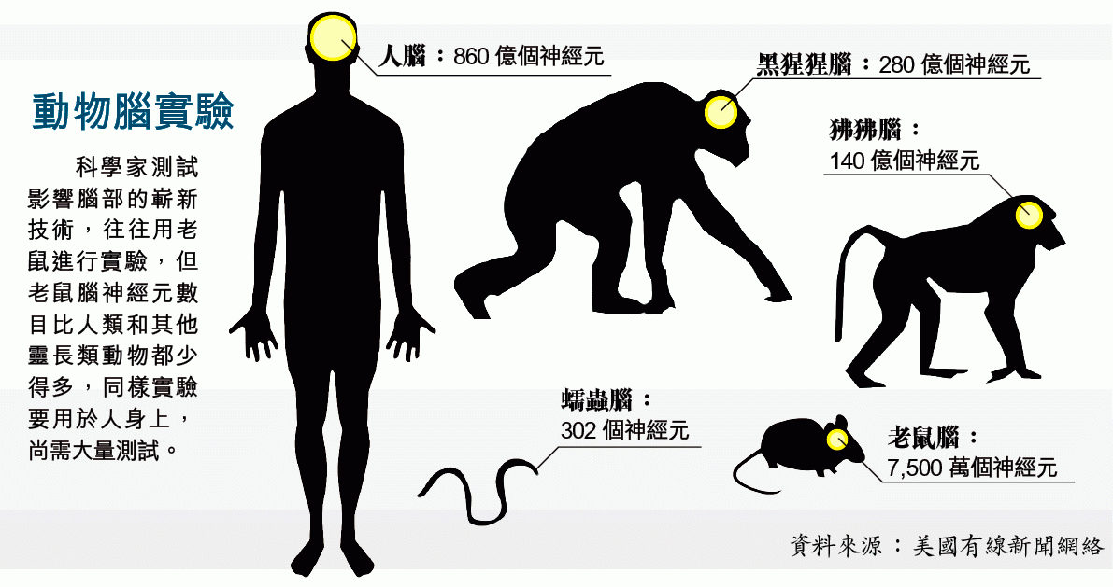
C. elegans
Notes:
相對於線蟲，脊椎動物的神經元數目以及連結遠遠比它複雜的多。
我們對於脊椎動物的神經連結了解仍然片段、不完整，沒有全面性。
好在電腦運算處理能力的暴增以及光學影像技術的增強，人類開始能夠有系統地建立起腦內神經元連結的地圖。
近年來如果蠅的神經網路已經被建立成資料庫。
由於愈來愈多的證據顯示：控制腦部發育與運作的基因藍圖在不同物種間高度雷同，
因此人腦中也很可能具有類似的基本運作單元」

Slide 6
The Scales
Given the enormous range of connectivity in human brain, a comprehensive description can exist at 3 levels:
  macroscale
  white matter fiber tracts using diffusion tensor imaging (DTI)
  mesoscale
  capturing anatomically and functionally distinct neuronal populations, formed by local circuits that link thousands of individual neurons
  microscale
  examining individual synapses at nanometer scale
Notes:
對於大腦神經連結的理解我們可以從三個尺度下去探討
巨觀尺度
不同腦區之間的長距離連接，精確度在毫米以上。
例如利用核磁共振造影(MRI)來觀測水分子在白質區域內的擴散行為，稱做Diffusion Tensor Imaging (DTI)。主要的原理是水分子的擴散會改變水分子在磁場下的排列整齊度，進而減弱收到MRI的訊號，所以只要加上不同的磁場激發設計，就可以找出水分子在不同方向的擴散能力的不同，如此一來，如果水是存在神經纖維裡，裡面的水因為細胞膜的局限會有特定的方向容易擴散，所以就可以利用這種方式把水的擴散能力資訊轉成神經纖維的空間連結資訊。
介觀尺度
尋找不同神經元群之間的連接，比如視覺皮層不同層之間的連接，可以精確到微米和毫米之間。此實驗通常需要有螢光蛋白。
微觀尺度
介在在奈米到微米尺度。透過對突觸的成像來確定兩個神經元之間的連結。繪製方法包括具有超級精度的光學顯微鏡和電子顯微鏡。

Slide 7
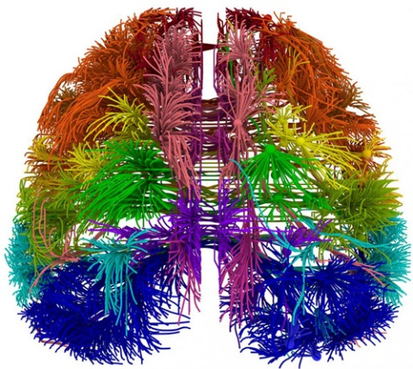
Allen Mouse Brain Connectivity Atlas
The first comprehensive, large-scale data set on how the brain of a mammal is wired.
The mouse brain’s 75 million neurons are arranged in a structure roughly similar to the human brain’s 86 billion neurons, so they provide a powerful model system for
understanding how nerve cells
of the human brain connect,
process, and encode
information.
Notes:
今天我們要介紹的Allen Mouse Brain Connectivity Atlas這個地圖
是全世界第一個全面繪製出的哺乳動物的腦神經連結地圖。
鼠腦大約有750萬個神經元，與人類860億個神經元的構造類似，
因此雖然是鼠腦的地圖，但是仍然是一個很強大的系統，
可以來幫助了解人類腦細胞是如何連結、處理資訊的。

Slide 8
Allen Mouse Brain Connectivity Atlas
Using enhanced green fluorescent protein (EGFP)-expressing adeno-associated viral vectors to trace axonal projections from defined regions and cell types, and high-throughput serial two-photon tomography to image the EGFP-labelled axons throughout the brain.
Allowing spatial registration of individual experiments into a common three dimensional (3D) reference space, resulting in a whole-brain connectivity matrix.
Notes:
使用增強型綠色螢光蛋白和腺相關病毒載體來追蹤特定區域的軸突投射。
軸突投射就是神經脈衝由感覺細胞的軸突通過突觸傳遞到初級神經中樞或其他神經元。
高通量連續雙光子斷層掃描來畫出以綠色螢光蛋白標示的軸突
能把分次實驗的圖像，透過空間變換把一幅圖像映射到另一幅圖像，使得兩圖中對應於空間同一位置的點一一對應起來，
這樣子可以產生出3D的立體影像，最後製造出全腦的連結體矩陣。

Slide 9
Creating the Allen Mouse Brain Connectivity Atlas

Slide 10
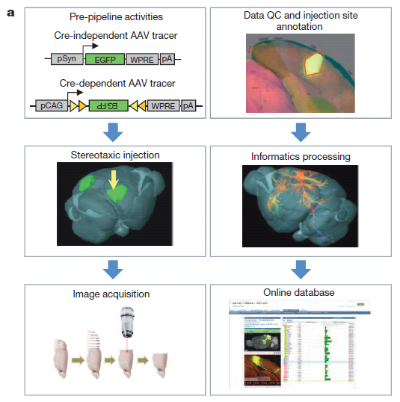
Creating the Allen Mouse Brain Connectivity Atlas

Slide 11
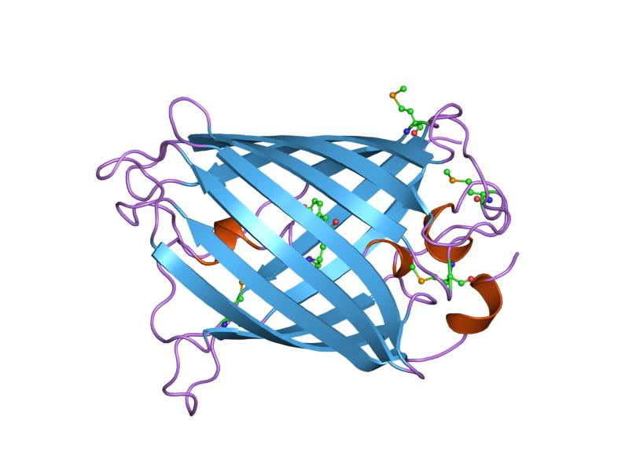
EGFP
enhanced green fluorescent protein
One mutant of GFP
Aequorea victoria
More effective
Notes:
被藍光激發會發出綠光
enhanced GFP (EGFP) was discovered in 1995 by the laboratories of Thastrup^{[15]} and Falkow

Slide 12
Adeno-Associated Virus (AAV)
11 AAV serotypes (AAV1)
High infectiousness
very mild immune response
20nm (4500 nucleotides)
the anterograde tracer to map axonal projections
Notes:
Differ with soluable
Human Gene Therapy 16 (2): 235–47.
AAV 最大的優點是幾乎不產生細胞免疫反應，而且小鼠實驗中發現 AAV 可感染各種細胞

Slide 13
Creating the Allen Mouse Brain Connectivity Atlas

Slide 14
STP tomography system
high-speed two-photon microscopy
automated vibratome sectioning
100um
18hrs
Notes:
不同位置打入tracer 切片
同時放出兩個角度無相關性的光子。利用飛行時間決定射源位置，接收到兩個光子的偵檢器位置即雙曲線之焦點，偵測時間差則可回推路徑距離差。

Slide 15
Creating the Allen Mouse Brain Connectivity Atlas
Discarding 25% of all scanned brains due to insufficient
quality in labelling or imaging.

Slide 16
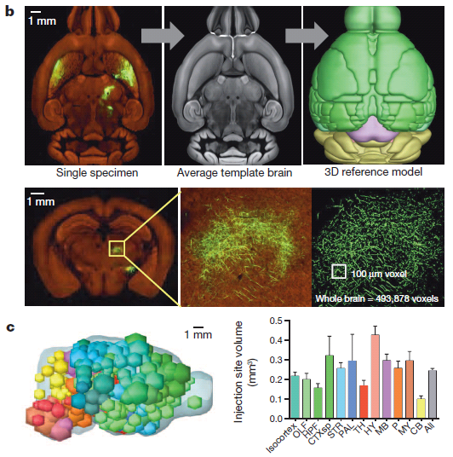
Informatics processing
Notes:
25%

Slide 17
Mapping axonal projections in the whole mouse brain

Slide 18


Mapping axonal projections in the whole mouse brain
Phase I (Cre-independent)
  Axonal projections from 295 non-overlapping anatomical regions were characterized in wild-type mice with a pan-neuronal AAV under human synapsin I promoter
  One can find where these axons go from a specific region
Phase II (Cre-dependent)
  Axonal projections from genetically defined neuronal populations (not region specific)
  Characterized in Cre driver mouse lines with a Cre-dependent AAV
Notes:
The result shown here is mainly Phase I.
What is a Cre driver mouse? And how does the Cre-loxP recombinase mechanism work?

Slide 19
What’s Cre driver mice?
Cre-loxP system allows site-specific recombination in DNA.
In mammalian cells, the Cre-loxP system is often used to produce conditional mutants. That is, we express Cre protein when we need this mutation.
For Cre recombinase mechanism, the gene we’d like to control, reversed EGFP, is flanked(surrounded) by two loxP sites in opposite directions, which both loxP sites will be binded by Cre protein.
When Cre is absent, EGFP has reversed direction and won’t be expressed.
When Cre is expressed, the loxP-flanked DNA region (EGFP in our case) will be reversed so EGFP has normal direction and will be expressed
One can control the condition desired to express Cre. In this case, we can target neuronal activities of our interest.
Notes:
To understand Cre-Lox conditional knockout, here is some useful reference:
(with good demo) https://www.youtube.com/watch?v=ZRWMxMhrzQo
(first 1.5 min) https://www.youtube.com/watch?v=6cPeQ5cjAVI
And a website: https://www.norcomm2.org/norcomm2LS/faq.php

Slide 20
Projection Result (Phase I)
Injection sites cover nearly the entire brain, while some of them were completely missed due to redundancy or injection difficulty
However, they managed to capture all known projection target sites throughout the brain, and are sensitive in detecting thin axon fibres.
(figure in the next page)

Slide 21
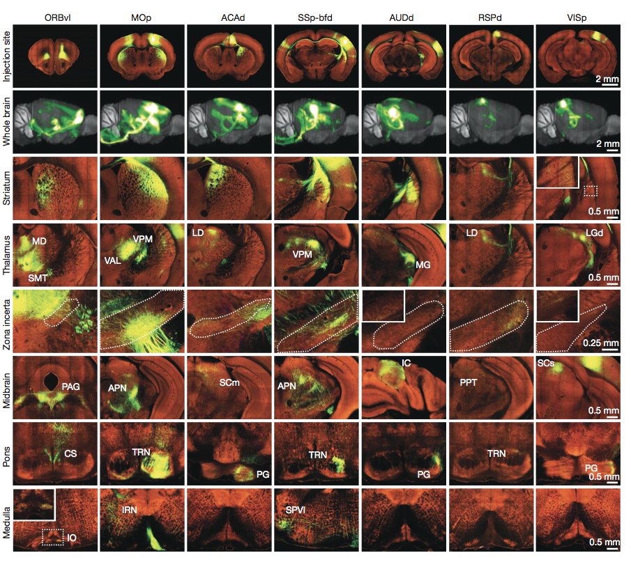


Slide 22
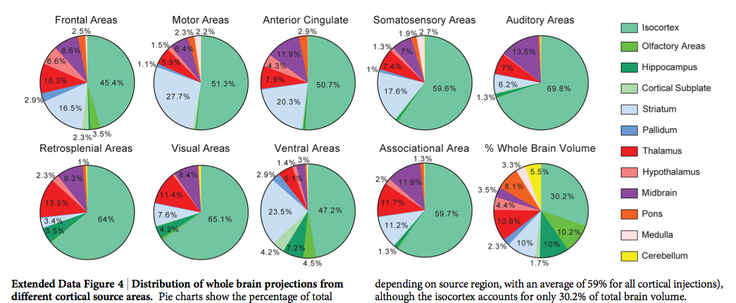
Pie charts show the percentage of projection volume in 12 major brain subdivisions. The last one is the actual volume distribution of those major subdivisions.
Since isocortex handles lots of high-level functionalities (language, sophisticated operation, and consciousness), they are expected to be involved much more into all functional groups.

Slide 23
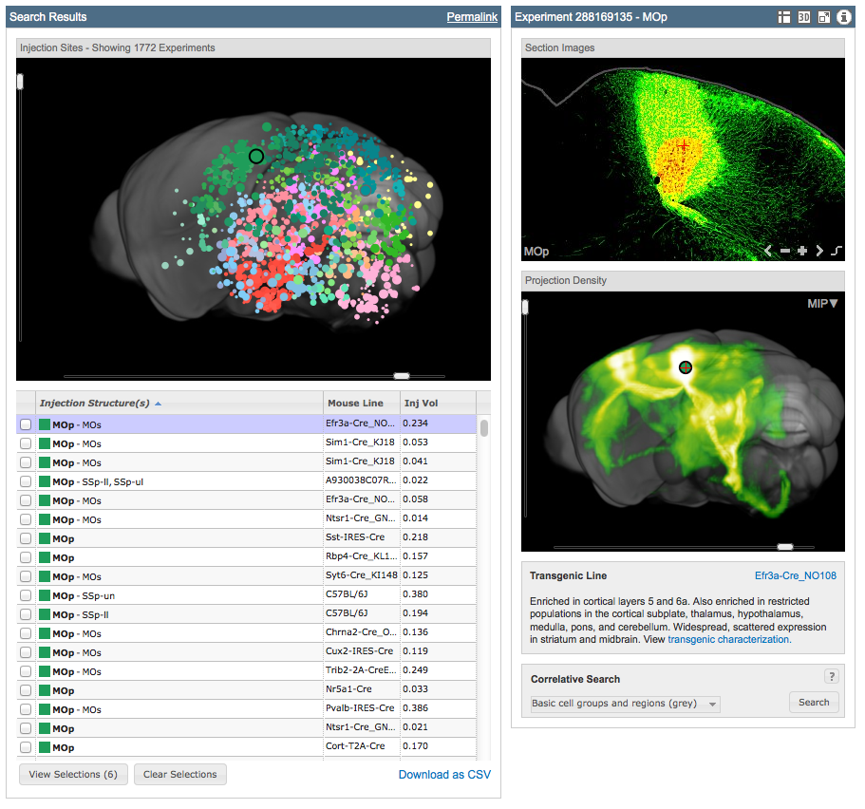
Mouse Connectivity viewer from their website
http://connectivity.brain-map.org/
Notes:
Here we take MOp (primary motor area) as our example. On their
Demo on their website: http://connectivity.brain-map.org/?searchMode=source&sourceDomain=8&primaryStructureOnly=true&initImage=SEGMENTATION&experimentCoordinates=4800,1800,7200&experiment=288169135

Slide 24
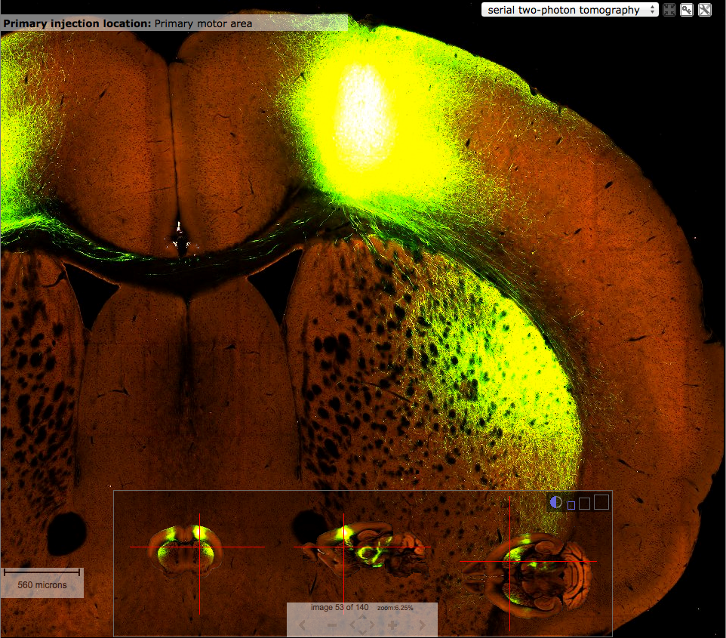

Slide 25
Brain-wide connectivity matrix

Slide 26
Sum of segmented pixels across all voxels in one target region / sum of segmented pixels across voxels in injection volume
Phase I – regional projection mapping
AAV – adeno associated virus

Slide 27
Brain-wide connectivity matrix
The Allen Reference Atlas contains 863 grey-matter structures.
Focused on chosen 295 structure
(non-overlapping region, mid-ontology level, approximate size of the tracer infection)

Slide 28
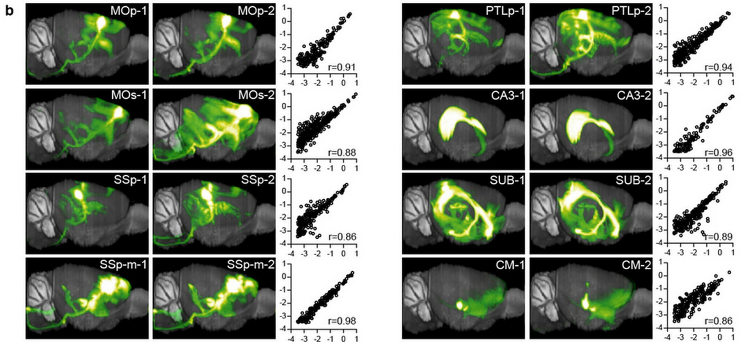
Remain the consistency of projection patterns across different animals and the reliability of using a single experiment

Slide 29
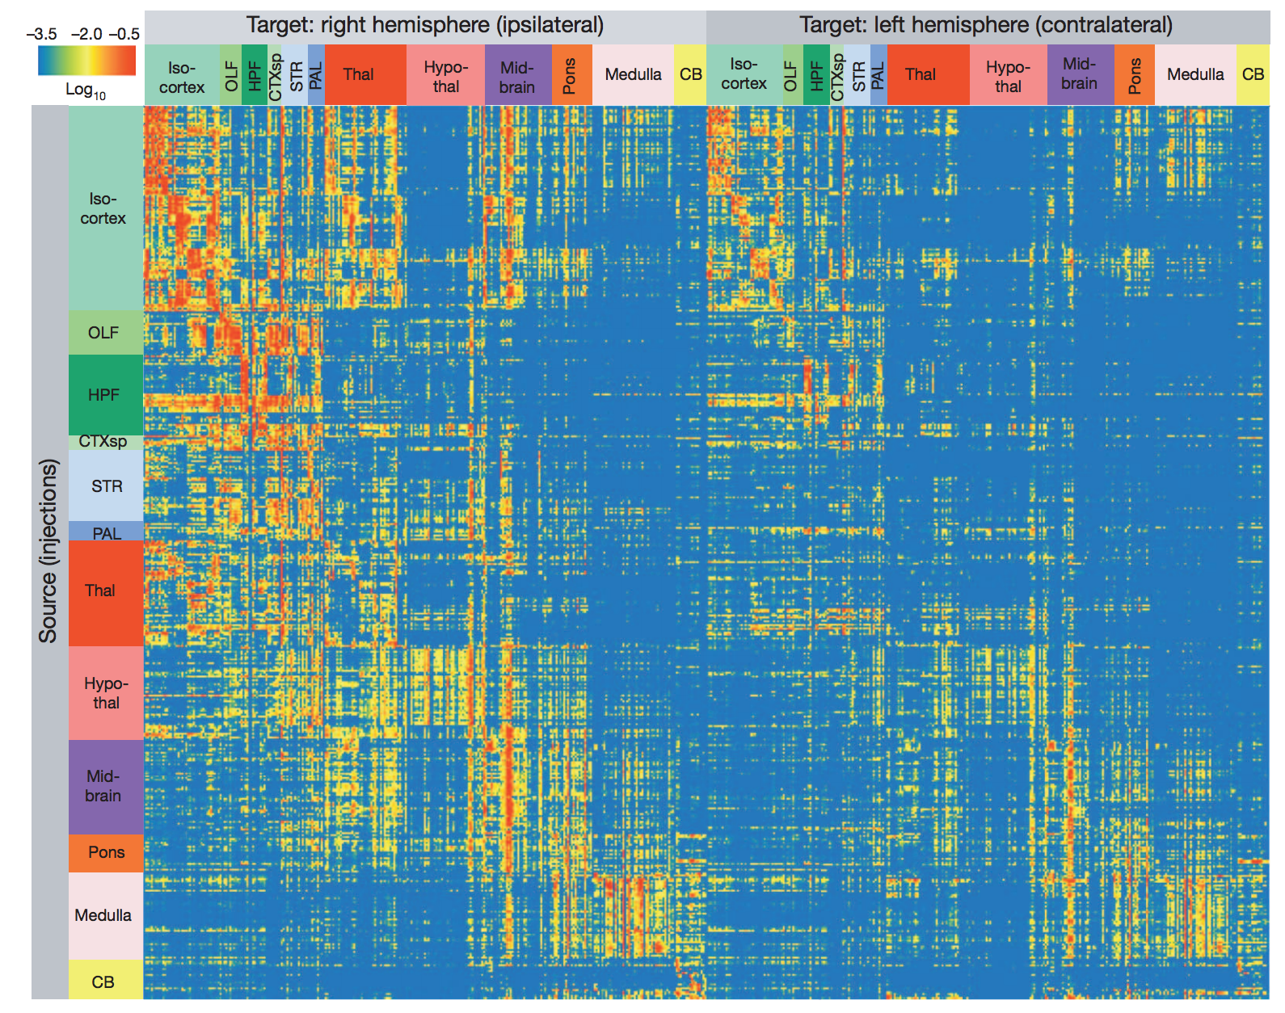
X axis: target region (295 structure for both Left/Right Hemisphere)
Y axis: injection region (469 injection site, include some double injection)

Slide 30
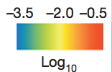
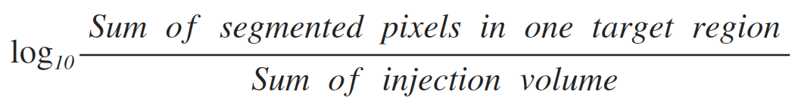

Slide 31
Span a greater than 10^5 fold range across the brain
Ipsilateral(Right) projections generally stronger than Contralatteral(Left)
≅ 4.3 (Right) : 1 (Left)

Slide 32
63% Ipsilateral and 51% Contralateral values above 10^-4 (min true positive)
21% Ipsilateral and 9% Contralateral values above 10^-2 (intermidiate)

Slide 33
An Inter-Region Connectivity Model

Slide 34
An Inter-Region Connectivity Model
Injection sites
Ontologically defined region
Construct inter-region connectivity matrices
Use the segmented projection volumes to define connection strengths

Slide 35
An Inter-Region Connectivity Model
Two assumptions
  Regional homogeneity
  Projection additivity

Slide 36
An Inter-Region Connectivity Model
100
X
Y
W_{X,Y}
100
Two assumptions
  Regional homogeneity
  Projection additivity
100
Injection

Slide 37
An Inter-Region Connectivity Model
Two assumptions
  Regional homogeneity
  Projection additivity

Slide 38
An Inter-Region Connectivity Model
Two assumptions
  Regional homogeneity
  Projection additivity

Slide 39
An Inter-Region Connectivity Model
The mutual connections among 213 regions were computed from the 469 experiments
Bounded optimization + linear regression
=> connection coefficients

Slide 40
Connection Strength Distributions
Connection Strength
  Spanned ~10⁵ - fold change
  Negatively correlated with distance
The Whole Brain Distribution
  Lognormal (fail to pass the Shapiro-Wilk test)
  Two-component GMM
Cortico-cortical Distribution
  Lognormal
  No longer lognormal when combined
Conclusion:
  Lognormally distributed within a region
  Vary systematically with statistics

Slide 41
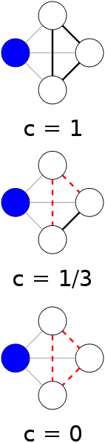
Network Analyses
Transform the weighted, directed connectivity matrix to binary (un)directed data sets
Network Analyses
  Clustering Coefficient: 0.42
  Sparseness: 0.12

Slide 42
Similarity in Connection Patterns
Similarity: correlations between -
  outgoing projections originating in two areas
  incoming projections ending in these two areas
The result suggests a tendency of regions to organize into clusters

Slide 43
The cortico-striatal-thalamic network

Slide 44
The cortico-striatal-thalamic network
Cluster the injections
Inter-group spatial relationships preserved in target domains
Construct the tractography
connections between major cortical regions and thalamic nuclei (based on previous chapter)

Slide 45
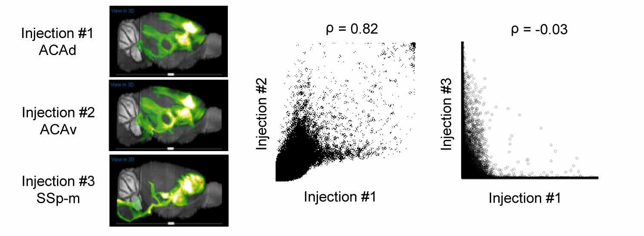

Cluster the injections
Spearman’s rank

Slide 46
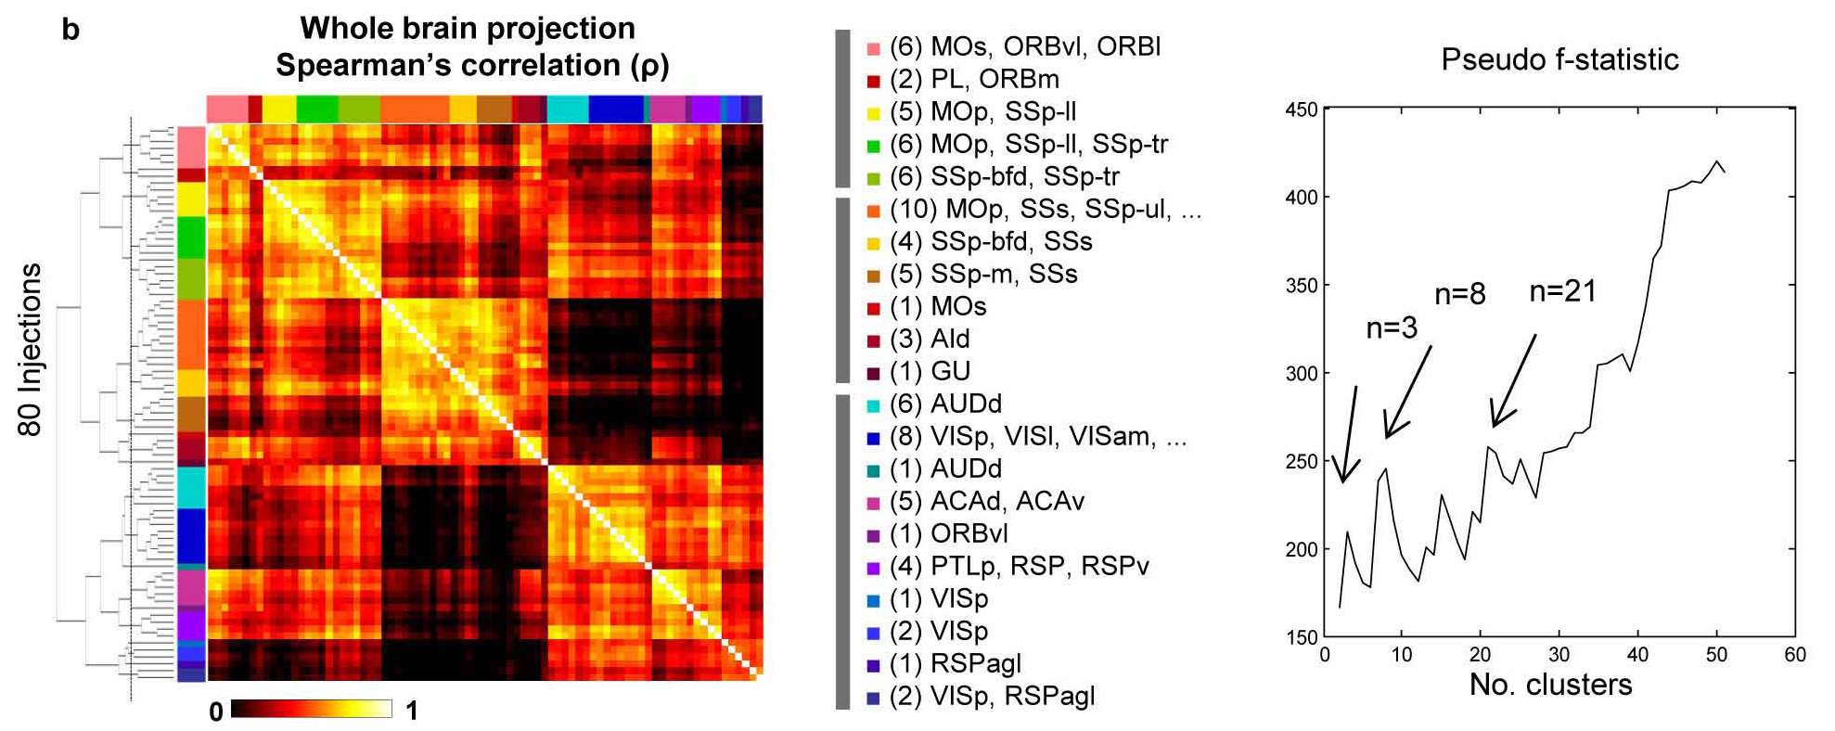
Cluster the injections

Slide 47
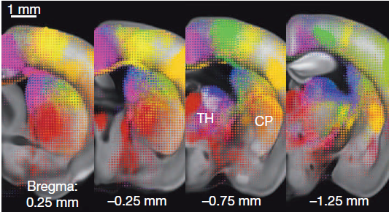
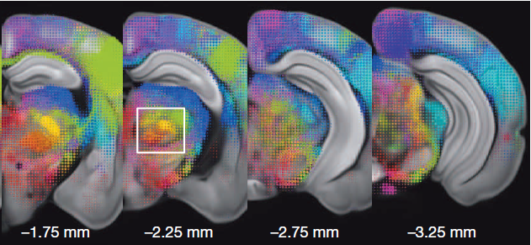
Cluster the injections

Slide 48
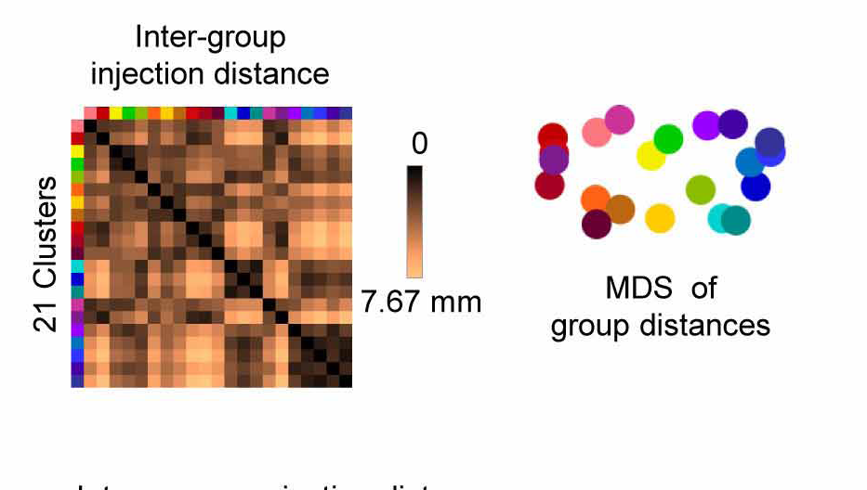
Inter-group spatial relationships preserved in target domains

Slide 49
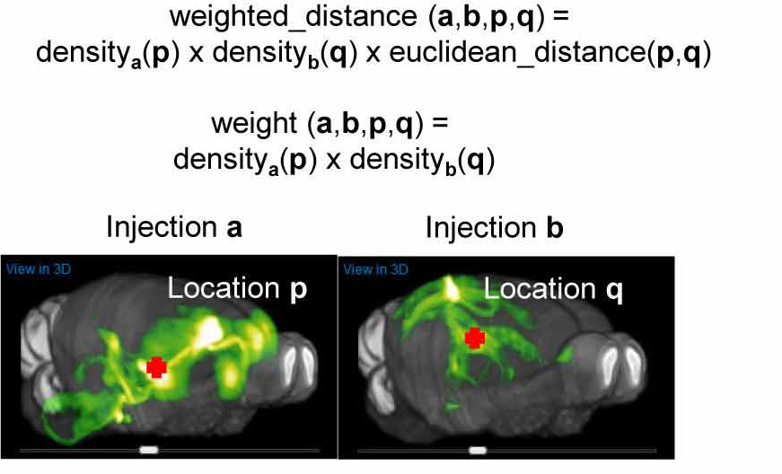
Inter-group spatial relationships preserved in target domains

Slide 50
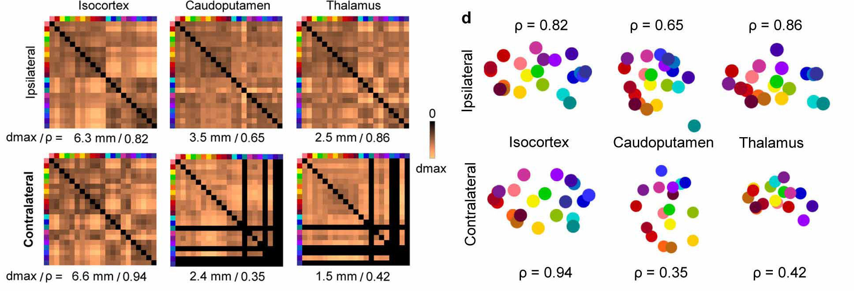
Inter-group spatial relationships preserved in target domains

Slide 51
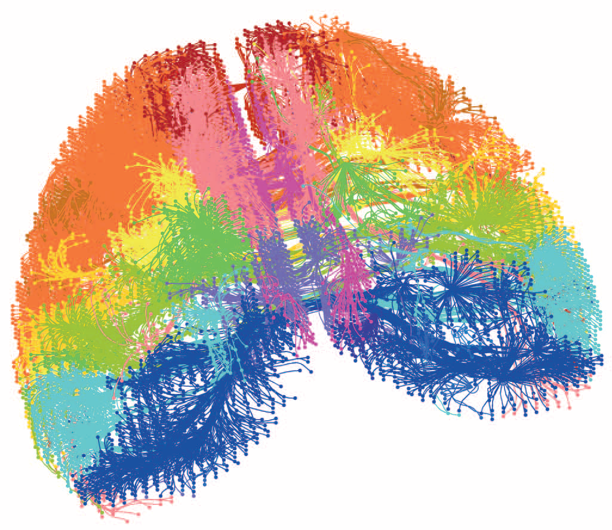
Construct the tractography
Isocortex

Slide 52

Construct the tractography
Caudoputamen

Slide 53
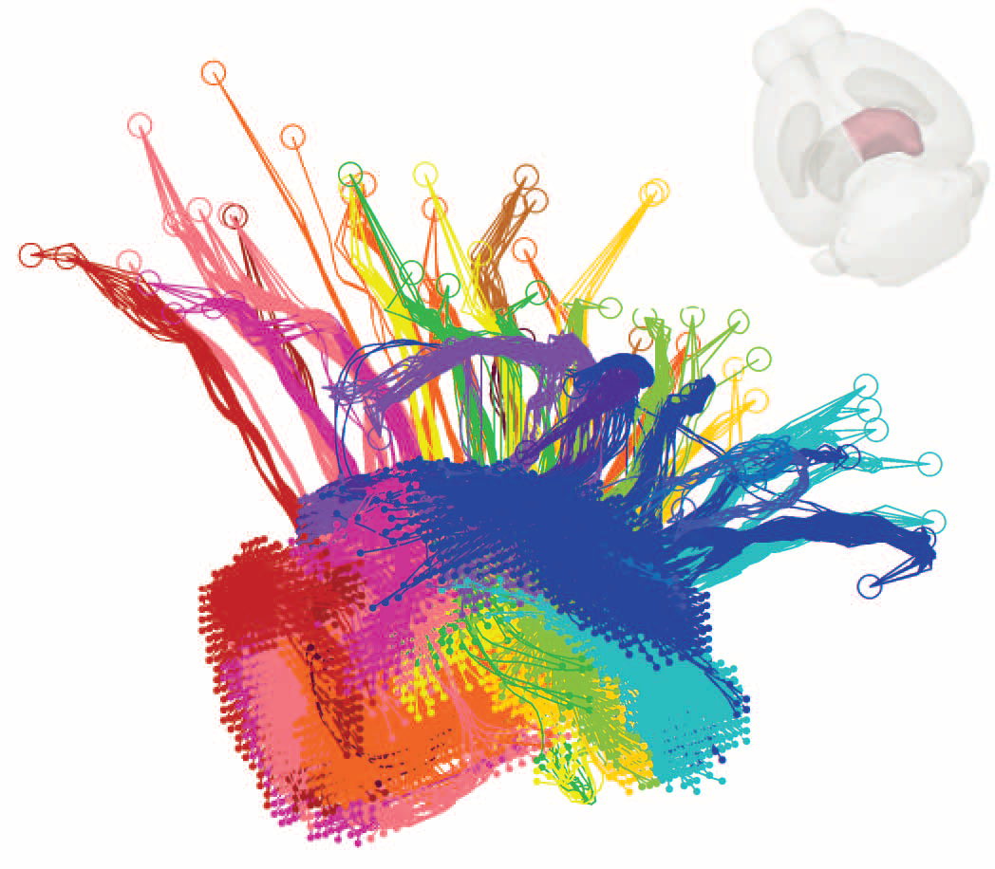
Construct the tractography
Thalamus

Slide 54
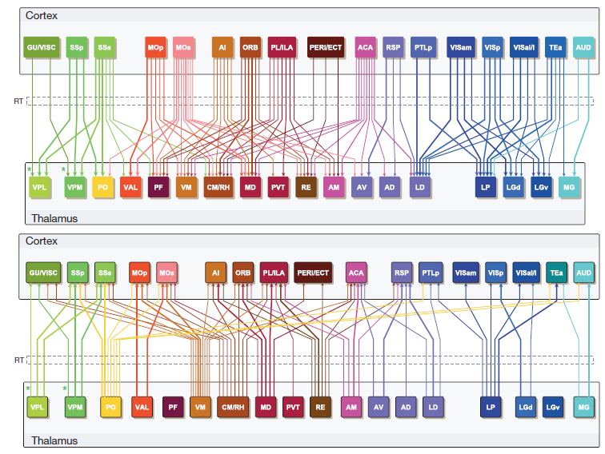
connections between major cortical regions and thalamic nuclei

Slide 55
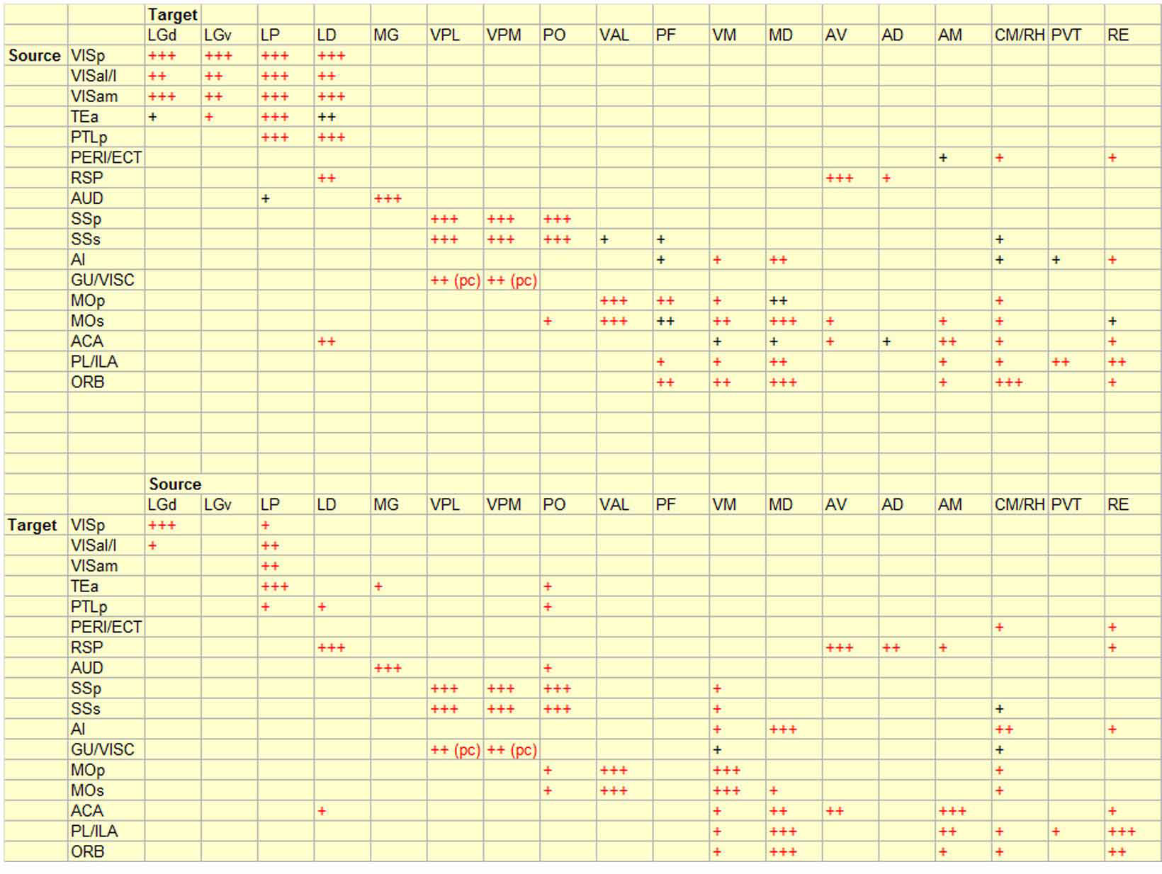
connections between major cortical regions and thalamic nuclei

Slide 56
Discussion

Slide 57
Features
Brain-wide
Detailed
Quantitative connectivity map

Slide 58
Features
Direct comparison between any image series
Systematic modelling
Computational analyses
Preserves the 3D spatial relationship of different domains

Slide 59
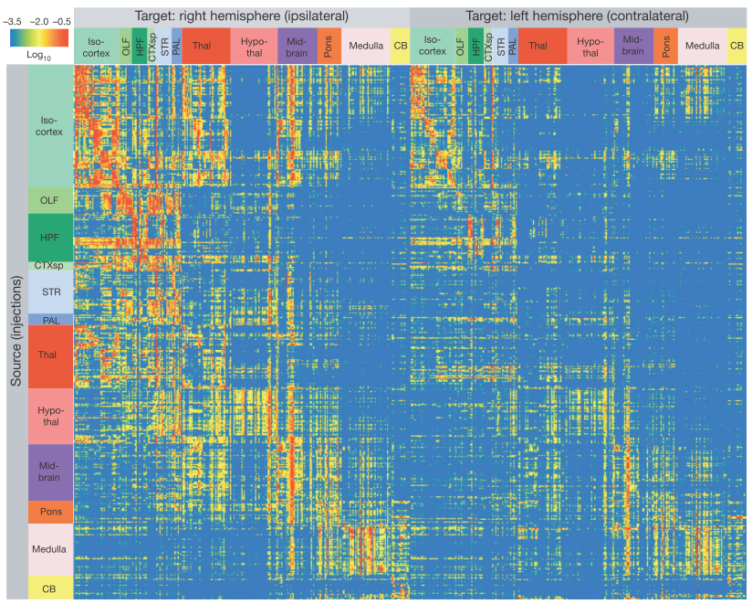
Pearson’s r = 0.595 → remarkably similar

Slide 60
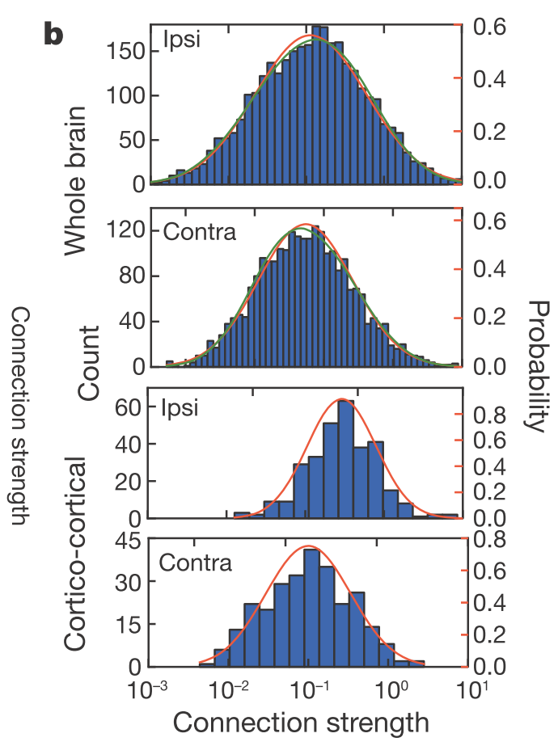
Lognormal distributions
It clusters and has hubs.

Slide 61
Limitations
Phase I data set
AAV tracer
False positive signals

Slide 62
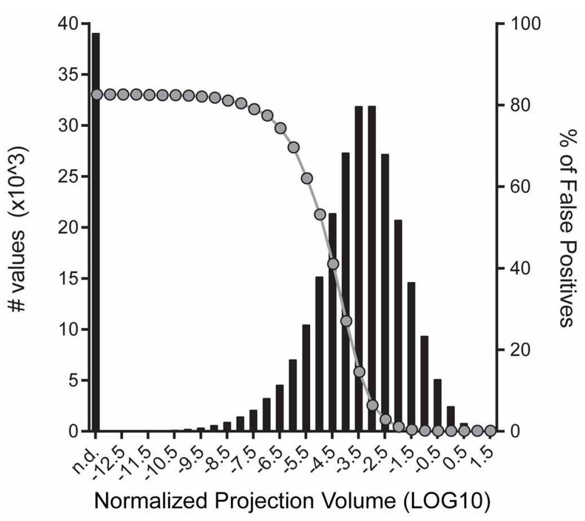
Extended Data Figure 7 | Distribution of log₁₀-transformed normalized projection volumes from the entire matrix presented in Fig. 3.

Slide 63
Discussion II
Still, synaptic-level details are missing.
Electrical connections are not revealed.
Mesoscale connectome provide a static structure connectivity map for further research.
Anatomical connection strength needs to be combined with physiological connection properties.
The Cre-driver dependent tracing here allowing the dissection of the neuronal type that are often intermingled.
This method can be further extended into identification of inter-connected pre- and postsynaptic cell types.

Slide 64

Nature method 2013
Combination with circuit data.
Build up a module that fit the brain function
In a larger network, this is still a challenge.

Slide 65
Thank you

