Slide 1
An Quick Introduction to R and its Application for Bioinformatics
Speaker:張家榮
Advisor: 趙坤茂老師

Slide 2
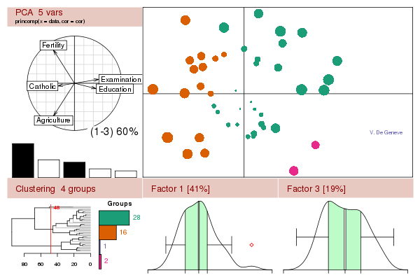
What is R?
A free software environment for statistical computing and graphics
A programming language
Useful websites:
http://www.r-project.org/
R學習筆記
中華R軟體學會
execute_r_online.php

Slide 3
Advantages of R
免費、開放、佔有率高、跨平台、彈性大、互動式
提供非常多的統計工具，包含線性與非線性模型（linear and nonlinear modelling）、統計檢定（statistical tests）、時間序列分析（time series analysis）、分類分析（classification）、群集分析（clustering）等相關工具。
From: R學習筆記

Slide 4
What Can We Do with R?
Matrix Operation
Visualization
Statistical Test
Machine Learning (clustering, classification, feature selection, prediction, etc.)
Image Processing
Necessary for Bioinformatics

Slide 5
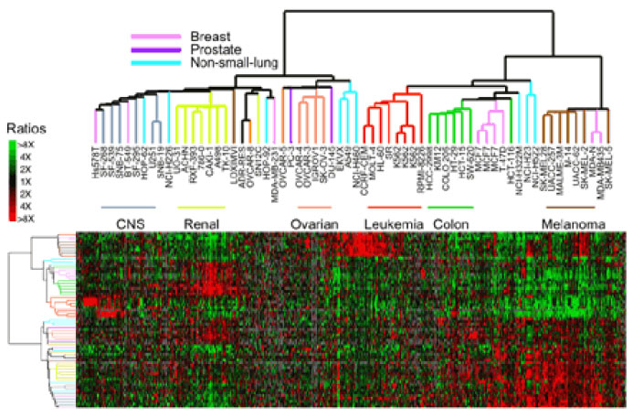
Microarray
From Wikipedia

