Slide 1
A Fault-tolerant Method for HLA Typing with PacBio Data
Speaker: Chia-Jung Chang
Advisors: Dr. Pei-Lung Chen and Prof. Kun-Mao Chao

Slide 2
Outline
Introduction
Simulation
Methods
Experiments
Discussion
Conclusion

Slide 3
Introduction
HLA genes
PacBio Sequencing Technology
HLA genotyping

Slide 4
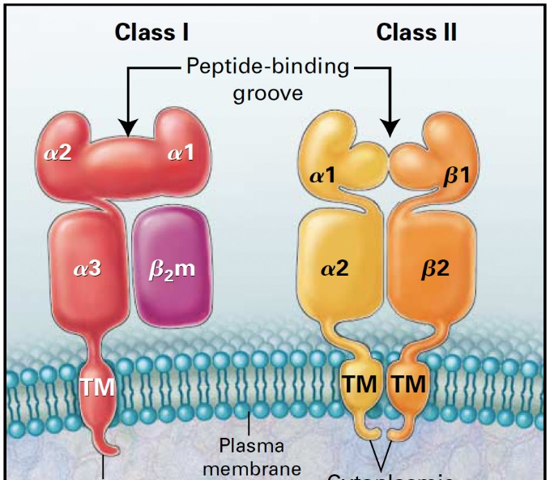
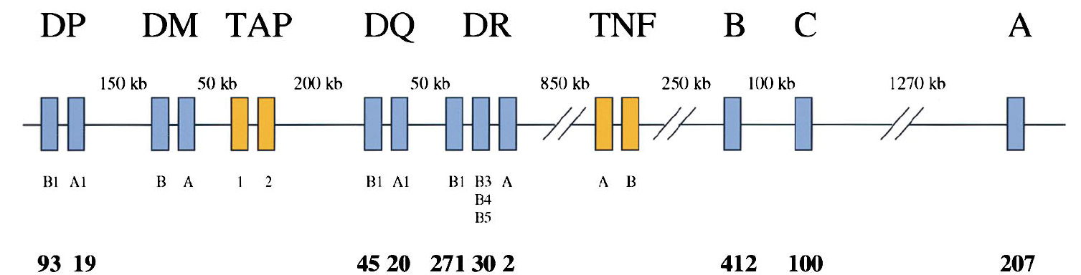
Classical HLA Genes
Mackay et al., N Engl J Med (2000)
Erlich et al., Immunity (2001)
Notes:
mediate interactions between white blood cells and body
Cells
immune system, autoimmune, transportations
of organs , infectious diseases

Slide 5
HLA Database
HLA Class I
Gene | A | B | C | E | F | G
Alleles | 2,579 | 3,285 | 2,133 | 15 | 22 | 50
Proteins | 1,833 | 2,459 | 1,507 | 6 | 4 | 16
Nulls | 121 | 109 | 63 | 0 | 0 | 2
HLA Class II
Gene | DRA | DRB | DQA1 | DQB1 | DPA1 | DPB1 | DMA | DMB | DOA | DOB
Alleles | 7 | 1,512 | 51 | 509 | 37 | 248 | 7 | 13 | 12 | 13
Proteins | 2 | 1,118 | 32 | 337 | 19 | 205 | 4 | 7 | 3 | 5
Nulls | 0 | 33 | 1 | 13 | 0 | 6 | 0 | 0 | 1 | 0

Slide 6
Regions of interest
Exons 2,3:
HLA-A, -B, -C
Exon 2
HLA-DRB1, -DQB1, -DPB1
Others

Slide 7
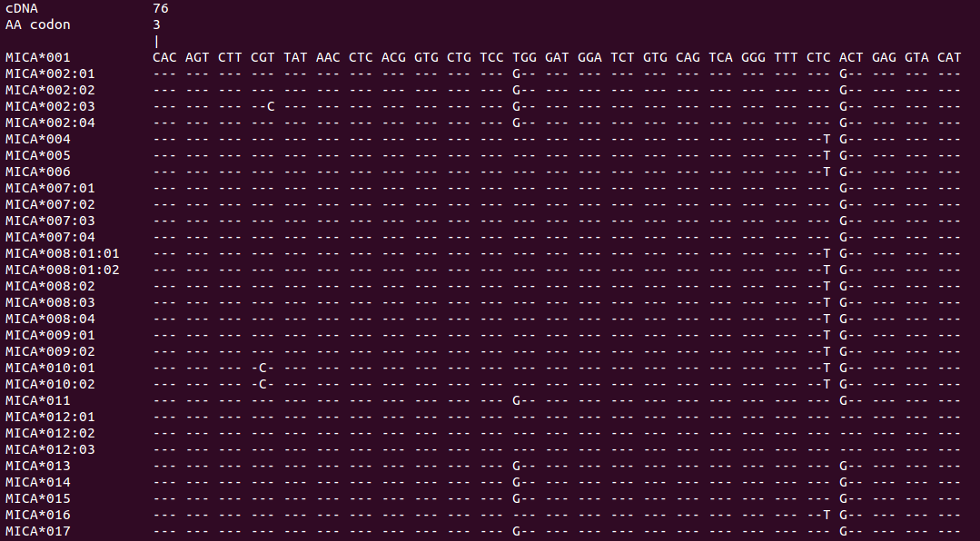
A Glimps

Slide 8
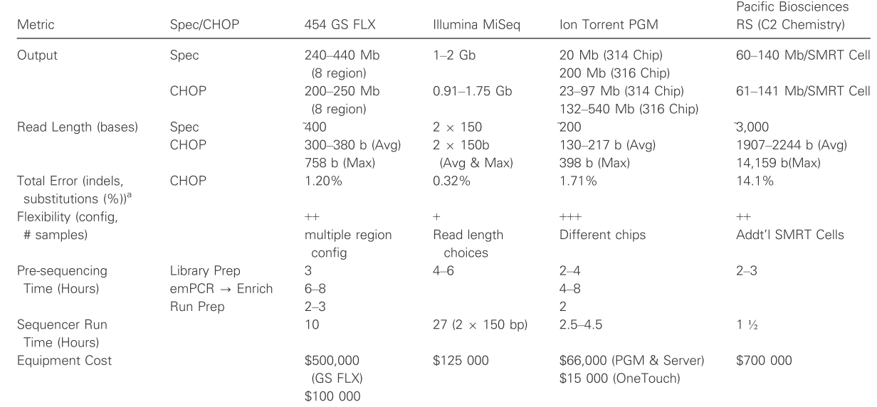
Comparison of NGS Technologies
From the University of Pennsylvania and The Children’s Hospital of Philadelphia

Slide 9
PacBio SMRT Sequencing
Developed by Pacific Biosciences
Single Molecule Real Time sequencing

Slide 10
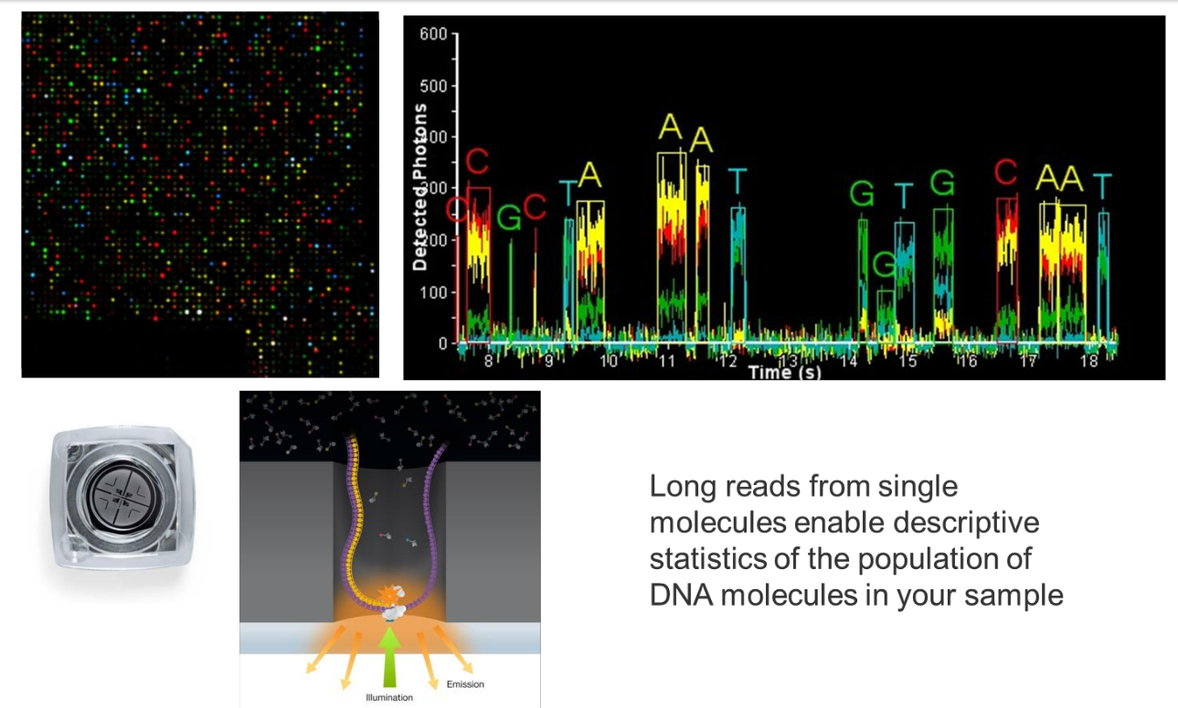
PacBio SMRT Sequencing

Slide 11
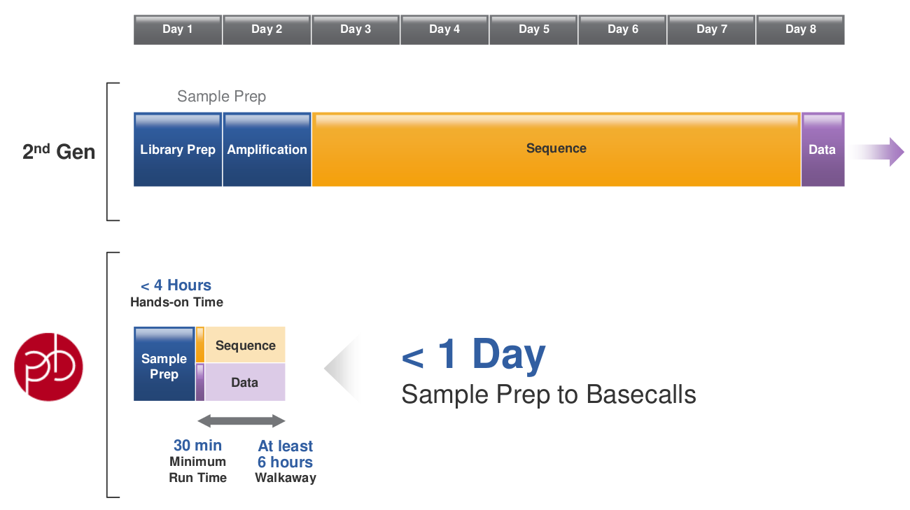
Time for PacBio

Slide 12
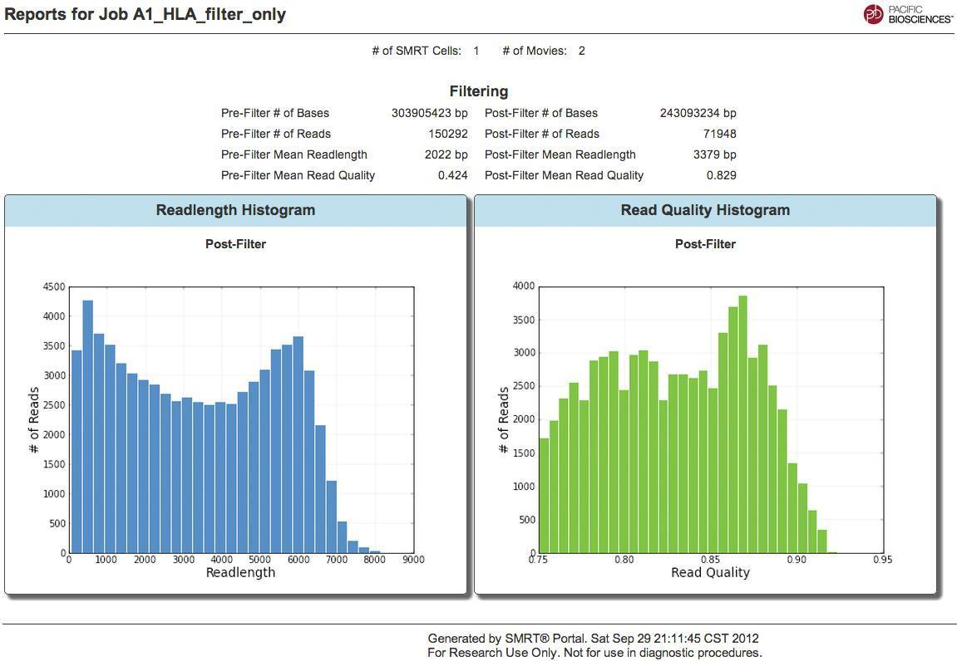
Rea Length

Slide 13
PacBio - Error Rate

Slide 14
PacBio - Error Profile

Slide 15
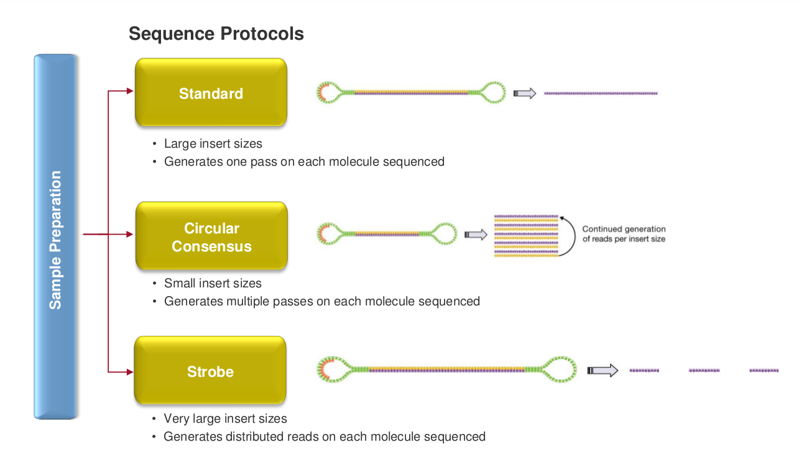
Sequencing Protocols

Slide 16
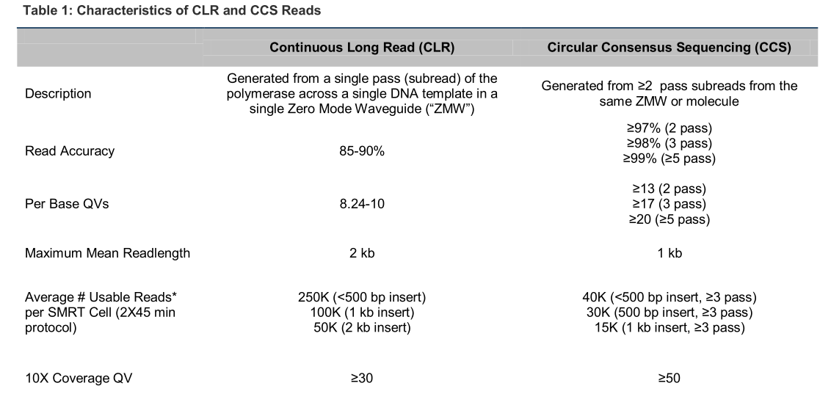
Two Types of Reads
From PacBio Technical Note

Slide 17
Targeted Sequencing
Sequencing specific areas of interest
v.s. Whole genome sequencing
Benefits
Compound Mutations and Haplotype Phasing
Repeat Expansions
Full-Length Transcripts and Splice Variants
Minor Variants and Quasispecies
SNP Detection and Validation
pdf

Slide 18
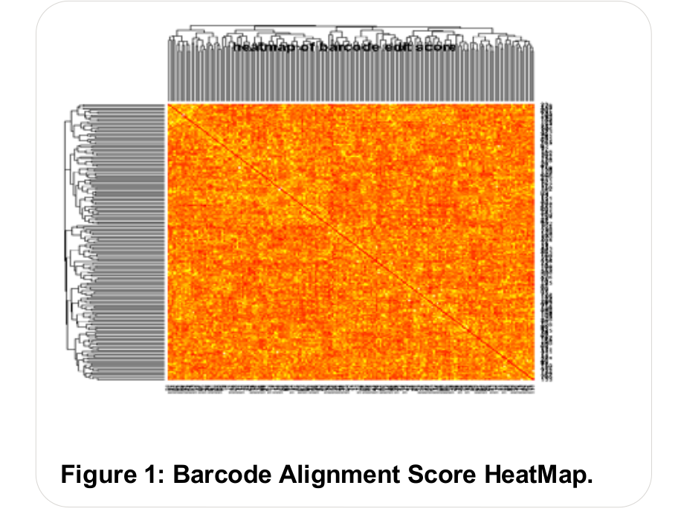
Barcode Technology
48 pairs of 16bp barcodes attached to targets
e.g. 48 samples can be sequenced parallelly
Primer
Primer
Barcode 5'
Barcode 3'

Slide 19
HLA Genotyping
HLA Matching before organ transportations
Serological (antibody based) approaches
Resolution is not enough
DNA-based
Sanger as the gold standard
NGS
Illumina
Roche 454
Ion Torrent
PacBio

Slide 20
Why Not and Why PacBio?
Why not PacBio?
High error rate
Sample identification error when multiplexing
Why PacBio?
Long enough to sequence exon 2 and exon 3 of class I HLA genes at the same time, which can solve the ambiguous allele combination problem

Slide 21
Why CCS instead of CLR?
Both are used to detect variants
CLR have more reads for consensus
How to identify samples?
Align barcode
CLR might lead to more barcode calling error

Slide 22
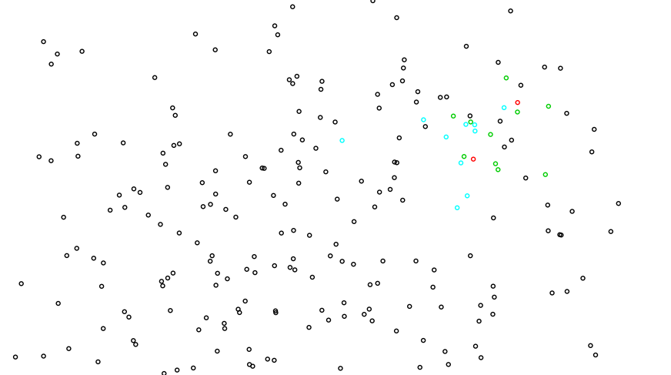
An illustration of the problem

Slide 23
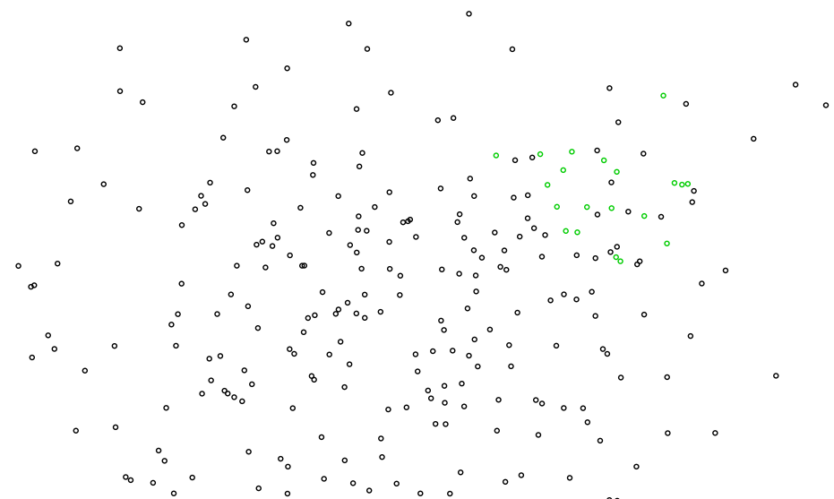
An illustration of the problem

Slide 24
Simulation
The target sequence for each allele
The samples in a multiplexing sequencing experiment
The pool of the reads in an experiment
Noise reads

Slide 25
The Target Sequence
HLA database only contains CDS sequences for most of the alleles

Slide 26
Three HLA Loci and Their Corresponding Reference Alleles
 | A | B | DRB1
reference | A*01:01:01:01 | B*07:02:01 | DRB1*01:01:01
start | 380 | 400 | 5400
length | 1100 | 950 | 600
#unique alleles | 2335 | 3075 | 1388

Slide 27
Samples in an Experiment
Alleles of a sample
Taiwan Minnan population
http://www.allelefrequencies.net
30% of homozygous samples
 | Type 1 | Type 2 | Type 3
#samples | 12 | 24 | 48
#reads/allele | 40 | 20 | 10
Notes:
48 pairs of barcodes
About 10000 ccs reads

Slide 28
The Pool of Reads
Produced by PBSIM
Ono, Y., Asai, K., Hamada, M.: PBSIM: PacBio reads simulator–toward accurate genome assembly. Bioinformatics 29(1) (January 2013) 119–121
CCS reads
length-mean=450
length-sd=170
accuracy-mean=0.98
accuracy-sd=0.02

Slide 29
Simulation of Correct Reads and Noise Reads

Slide 30
Pre-processing

Slide 31
Bays’ Theorem (BayesTyping0)
Denote the reads as r₁... r_{n} and a pair of alleles as a_{i}, a_{j}.

Slide 32
Bays’ Theorem (cont’d)

Slide 33
Bays’ Theorem (cont’d)

Slide 34
To Tolerate Noise Reads (BayesTyping1)
Assume there are m noise reads

Slide 35
Experiments
For Type 1 experiments (40 reads/allele), when typing HLA-A, NGSengine could only successfully predicted 274 pairs of alleles (22.83%).
On the other hand, BayesTyping0 successfully predicted 1193 pairs of alleles (99.42%).
 | Type 1 | Type 2 | Type 3
#samples | 12 | 24 | 48
#reads/allele | 40 | 20 | 10

Slide 36
Experiments without noise reads
 | A | B | DRB1
Type 1 | 99.92% | 99.92% | 100%
Type 2 | 99.50% | 99.21% | 100%
Type3 | 97.63% | 96.87% | 99.98%

Slide 37
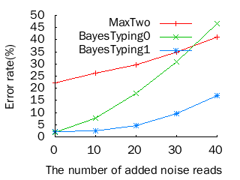
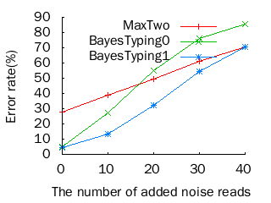
HLA-A

Slide 38
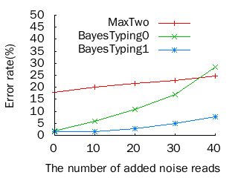
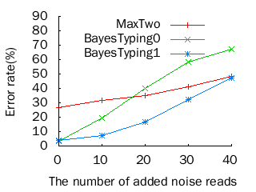
HLA-B

Slide 39
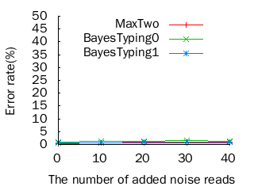
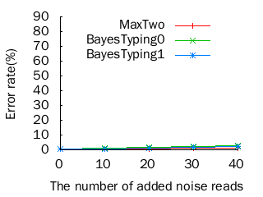
HLA-DRB1

Slide 40
Type 2 HLA with Different m

Slide 41
Noise Reads from Pools Containing Different Numbers of Samples

Slide 42
Homozygous and Heterozygous Samples
Fisher’s exact test

Slide 43
Conclusion
BayesTyping1 can tolerate sequencing errors, which are introduced by the PacBio sequencing technology, and noise reads, which are introduced by false barcode identiﬁcations to some degree.
It is better to multiplex12 or 24 samples instead of 48 samples to maintain a high accuracy

Slide 44
Thanks for your attention! Q & A

