Slide 1
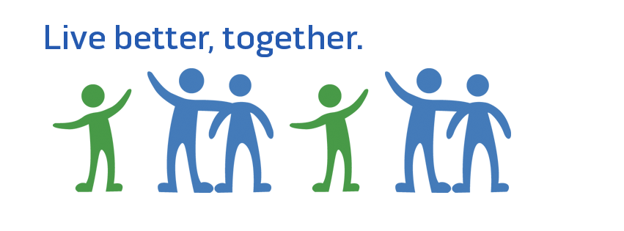
From patients to partners: participant-centric initiatives in biomedical research
楊沛東
李承翰
楊應甲
吳瑀涵
黃子豪
何亮融
林婷涵

Slide 2
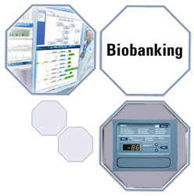
Medical research is increasingly analyzed by computing technology, so it generated a lot of biobanks.
楊沛東

Slide 3
Big data.
Data sharing initiatives.
Concern about the use of personal data.
Medical research is increasingly analyzed by computing technology, so it generated a lot of biobanks.
PCI
楊沛東

Slide 4
the tools to help build the long-term public trust that is needed for the new ways of carrying out medical research based on global networks of shared data and samples
Participant-Centric Initiatives
(PCI)
楊沛東

Slide 5
In medical research domain
allow beneficial research to proceed
protect the interests of research participants
Protecting individual interests
楊沛東

Slide 6
Participant's consent:
Traditional:
Reinforced by lots procedures, policies and legal requirements. (ex:IRB)
One-time consent.
Protecting individual interests
楊沛東

Slide 7
Participant's consent:
PCI:
Build the long term public trust.
global networks of shared data.
More efficient on research.
Protecting individual interests
楊沛東

Slide 8
Why?
1.No uniform standards of consent.
2.The requirements differ between jurisdictions at the regional or national level.
New trends in research demand new consent models.
李承翰

Slide 9
Why?
3.difficult to guarantee that individuals can remain anonymous.
4.More data applies to the current studies but also to participation in a biobank or a longitudinal study.
New trends in research demand new consent models.
Board consent?
李承翰

Slide 10
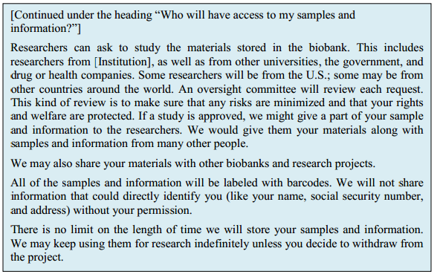
Broad consent
New trends in research demand new consent models.
ref:
http://www.genome.gov/Pages/PolicyEthics/InformedConsent/ConsentFormExample4.pdf
李承翰

Slide 11
Problems in broad consent:
1.For researchers: difficult to make consent forms future-proof.
2.For participants: Cannot express their preferences or protect their interests over time.
New trends in research demand new consent models.
李承翰

Slide 12
Problems in broad consent:
3.Secondary research may reduce the levels of trust between participants and researchers
4."One size fits all" approach also risks losing segments of the population.
New trends in research demand new consent models.
李承翰

Slide 13
From an ethical perspective: necessary for participants to give consent of new research possibilities on the same datasets.
The major challenge : develop ways to engage and to communicate with diverse groups over long periods of time.one way is through the use of social media technologies.
Giving research participants a greater choice.
李承翰

Slide 14
Aims:
Provide the basis to reshape the current relationships with participants and patients.
Less passive and more interactive.
Enormous benefits for biomedical research and clinical practice.
Giving research participants a greater choice.
李承翰

Slide 15
楊應甲

Slide 16
Participant-Centric Initiatives
Tools, programs and projects that empower participants to engage in the research process.
Participants⬄Participants
Participants⬄Clinicians/Researchers
What is PCI?
楊應甲

Slide 17
Participant-Centric Initiatives
Patients and research participants are located at the centre of decision making as equal partners in the research process.
Distinguish from PEI
(Public Engagement Initiatives)
What is PCI?
楊應甲

Slide 18
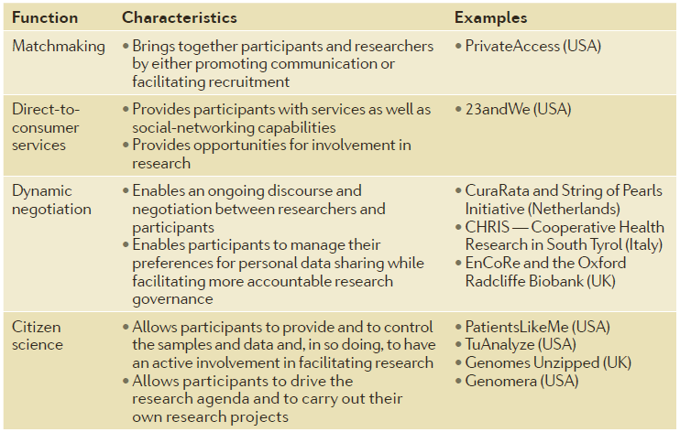
Key Functions of PCI
楊應甲

Slide 19
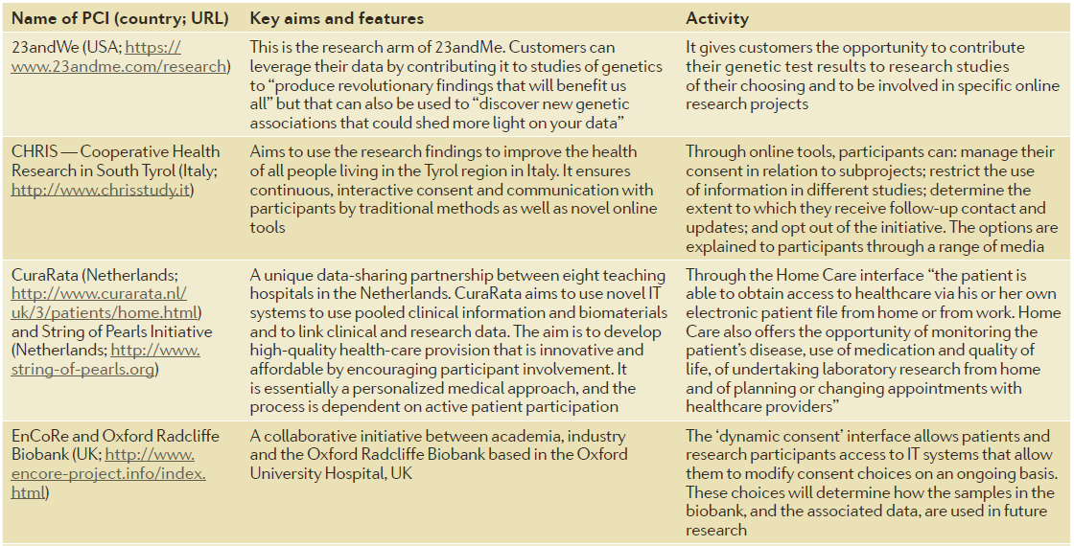
PCI Used for Research Purposes
What is PCI?
楊應甲
* The first 4 of 10 PCIs in the table are shown.

Slide 20
Placing participants in control.
Need to place the individual at the center of decision making is embedded in the design of the IT interface for PCIs.
Purely voluntary
Empowering participants.
Features of PCI
吳瑀涵

Slide 21
2. Using social media technology
Use social media technology and approaches
Allows participants to record all of their research activity.
Features of PCI
吳瑀涵

Slide 22
3. Promoting active participation
ongoing active interaction between participants and researchers
transparency and veracity in all interactions
Participants must commit themselves to research and to acting altruistically for others
Features of PCI
吳瑀涵

Slide 23
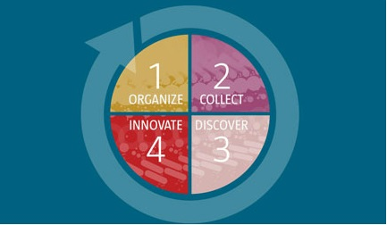
3. Promoting active participation
Features of PCI
吳瑀涵

Slide 24
4. Facilitating communication
Individual participant interfaces.
Blogs/Online experts/Webcasts
PCIs can inform participants and keep in regular contact.
Features of PCI
吳瑀涵

Slide 25
吳瑀涵

Slide 26
吳瑀涵

Slide 27
5. Facilitating communication
Through various social media tools, such as individual participant interfaces, blogs, online experts and webcasts, PCIs can inform participants and keep in regular contact.
Features of PCI
吳瑀涵

Slide 28
Streamlining the consent process.
Removing the need for anonymized data.
Facilitating participant recruitment.
Facilitating participant retention.
Benefits of adopting a PCI approach
黃子豪

Slide 29
5.Promoting the delivery of better quality and more cost-effective health care.
6.Sustaining public confidence in research.
7.Improving the quality of research.
Benefits of adopting a PCI approach
黃子豪

Slide 30
黃子豪

Slide 31
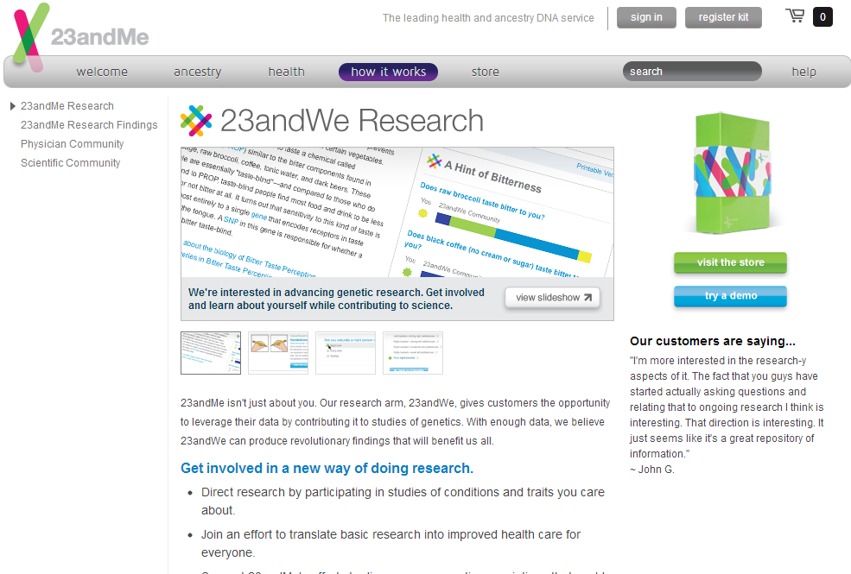
黃子豪

Slide 32
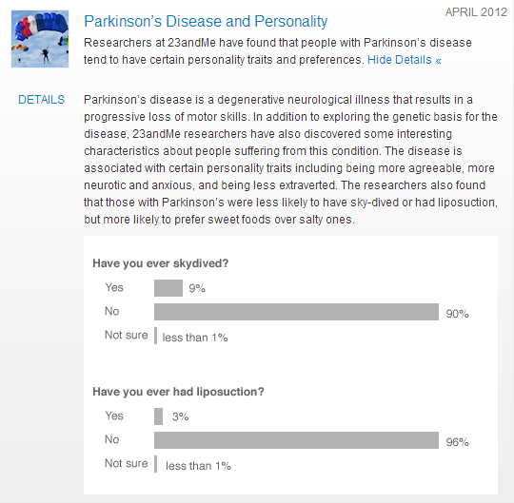
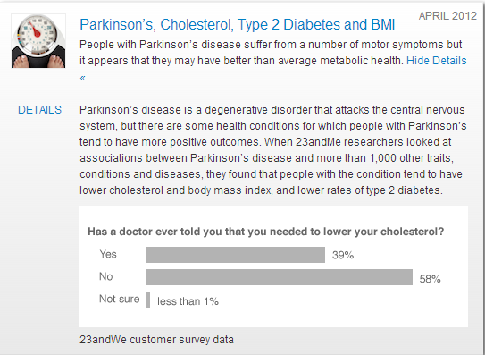
黃子豪

Slide 33
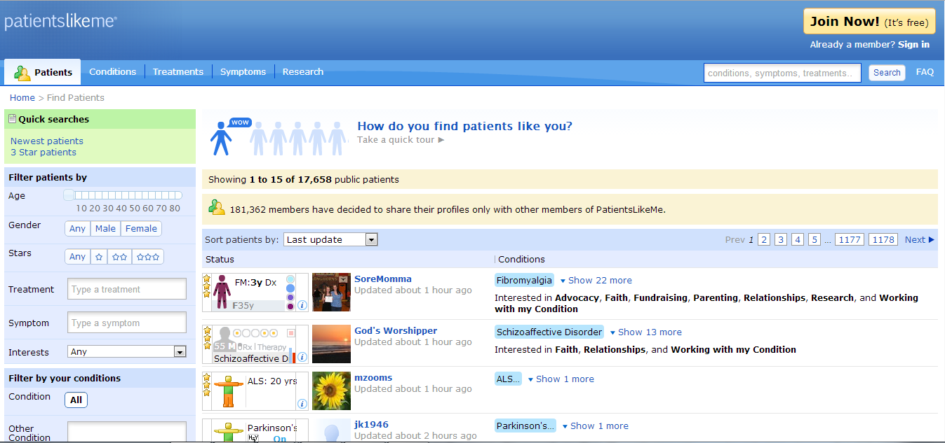
黃子豪

Slide 34
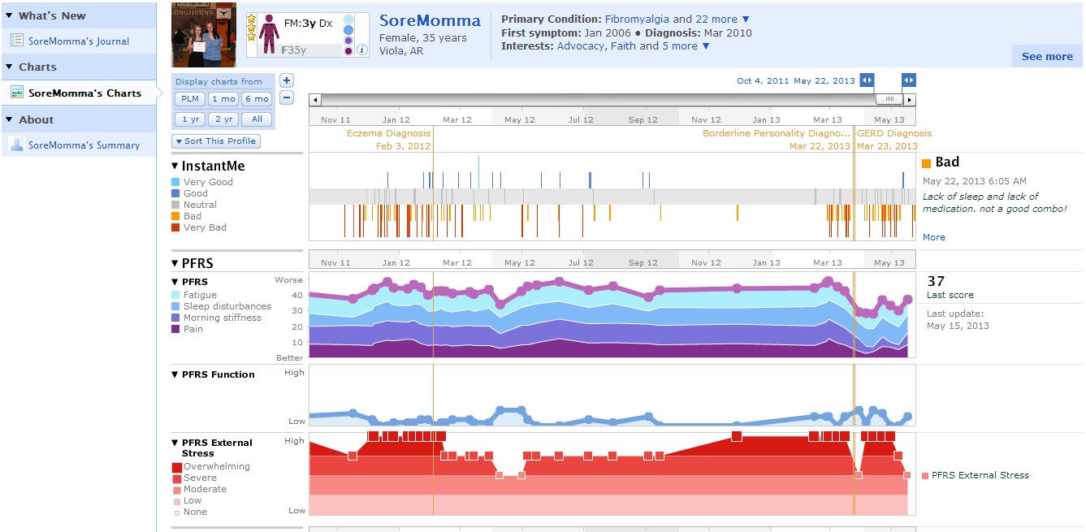
黃子豪

Slide 35
客戶提供訊息
得到醫療數據
幫助病患
進行分析
招攬更多
使用者
獲得客戶
信任
客戶
研究
效益
P C I
黃子豪

Slide 36
1. Requires a shift in current attitudes and approaches towards patients and research participants
Challenges to the wide-scale adoption
→respect research participants as partners in the research rather than to see them as patients or passive providers of information and sample
何亮融

Slide 37
2. Bulk of consent efforts are still paper-based, but transition to effective electronic consent models is difficult to managed online
Challenges to the wide-scale adoption
→need considerable support from institutional leadership and the investment of resources.
何亮融

Slide 38
3. broader implementation in research will be hampered by the lack of a common reference ontology
Challenges to the wide-scale adoption
何亮融

Slide 39
4.Implementation of PCIs also requires a change for research participants ,care needs to be taken to ensure that the use of PCIs does not prohibit or discourage certain groups from involvement in research,
Challenges to the wide-scale adoption
→ applications for mobile phones and the use of interactive screens using videos — instead of text — located in waiting rooms and public areas may help
何亮融

Slide 40
5. greater use of PCIs may lead to greater empowerment of participants, certain lines of research may not be possible if many participants opt out
Challenges to the wide-scale adoption
→research is needed to determine how best to introduce PCI approaches while still allowing expedited research to continue.
何亮融

Slide 41
Not only do PCI return data to research participants, but they play an active role in the research process. .
23andMe Partnering with Patients
“it is fascinating to learn about myself, my own biology. This is me, my chromosomes, my DNA, and it helps me to make better choices for myself.”said Cheryl-Anne.
http://blog.23andme.com/news/inside-23andme/23andme-partnering-with-patients//
林婷涵
Notes:
以PCI的方式跟傳統的方式來看，確實有很大的不同，除了要把蒐集到的資料回饋給病人外，病人也在研究中扮演很重要的角色
cheryl是一位有參與23andMe的癌症患者，她在全國種流防治研究宣傳月的時候說
"最有趣的就是了解我自己，我自己的生物，這就是我，我的染色體，我的DNA，她有助於我為自己作出更好的選擇"
能夠找出自己的風險，並且跟醫生共享訊息，可以免於更多更大的風險

Slide 42
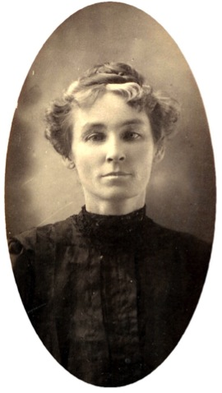
Usually been mistaken for a Jewish person despite having no known Jewish ancestors.
She joined 23andMe's Ancestry Finder in 2010, and noticed a cluster on her 7th chromosome that appeared to contain a significant number of matches with self-declared Ashkenazi ancestry.
Discovering Unknown Jewish Ancestry with 23andMe
http://blog.23andme.com/23andme-customer-stories/ashkenazi-and-me-discovering-unknown-jewish-ancestry-with-23andme/
By CeCe Moore
林婷涵
Notes:
很常被誤認為猶太人，儘管沒有已知的猶太祖先
在2010年 23andMe推出祖先搜索,她發現她與一些自我認定是德系猶太人的DNA在第七號染色體上有出現一蹴包含相當數量匹佩的DNA相同
近一步調查，發現媽媽沒有跟這些游太血統相同
由於爸爸去世，所以用父親的叔叔的資料進行測色
收到結果後，一清二楚的發現她的第七號染色體上有著相同的德系足群
而且她的叔叔的資料比她的更清楚，在23andMe上面搜索還列出了她的遠親+祖先有猶太人，
雖然這個德系猶太人的血統非常遙遠，但是肯定是相當正宗的
她猜測與作結論:由於她父親的家庭數應該是相當完整的，沒有明顯的犯罪嫌疑人
但是她祖母 珍妮 的父親是位知的，所以她猜測她的猶太血統是從珍妮那邊來的

Slide 43
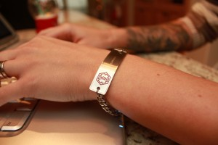
she and her doctors were unaware of her sensitivity to the drugs used to temporarily relax a patient's muscles before anesthesia is administered.
The Genetic Tests for Drug Response
she noticed that her tests showed she had the variants that are associated with pseudocholinesterase deficiency in 23andMe’s drug response report, now she wears medical ID bracelet.
http://blog.23andme.com/23andme-customer-stories/the-genetic-tests-for-drug-response/
By Renae
林婷涵
Notes:
Reanae在五年前進行扁桃腺切除手術時，使用了一種讓患者進行肌肉放鬆的藥物"膽鹼酯"，通常在五分鐘的時候就會起作用，但是對於某些患者卻會影響很常的時間
Ranae就是這樣，她的手術已經完成，呼吸管已經被移除，但是她還沒恢復肌肉的控制
但是醫生跟護士都沒有發現她有出現神麼不對近，Ranae只能努力的嘗試告訴周圍的人她無法呼吸
才知道原來她有 鹼酯酶缺乏，
她會知道23andMe是因為她的好奇心，還有她的老公在醫院上班
經過分析之後，她看到她的報告
發現23andMe可以看到大部分已知疾病的各種風險，還有各種藥物反應後的訊息
，如她的鹼酯酶缺乏 其實也有可能會導致她長期癱瘓
發現她是屬於其實這也會增加她長期癱瘓的風險
之後她就會帶著她的醫療ID手鐲，在手鐲上註明她有神麼樣的症狀需要醫生留意
所以以後就不會再發生同樣的事情

Slide 44
PatientsLikeMe: share about your experience with the disease and sell it to their partners
23andMe: offer consumers the ability to get their genes sequenced for $99.
How does PCI make money?
“for a consumer it still seems to have such marginal utility, especially at that price.”as science policy wonk Jonathan Gitlin wrote on Twitter.
林婷涵
Notes:
幾乎都是營利公司，所以PCI的功能也會因她們營利方式不同
PatientsLikeMe:將你分享的經驗，訊息，疾病等資料，賣給他們的合作夥伴(正在開發貨是銷售產品給病人的公司，這些產品可能包含藥品 醫療機械 醫療服務 設備 等)
除了你再輸入註冊帳號時的部分個人資訊不會給他們外 其他都會賣給他們
PatientsLikeMe也堅持透明度:會告訴他們的會員他們在作什麼 與哪些數據會被共享
透過出售這些數據，幫助病人了解真正醫療是借的產品價值並改善，幫助企業快速發展新的解決方案，改善病人的護理與生活質量
23andme:由google投資的23andMe是透過消費者支付99美金，就可以得到他們的基因測序
雖然這個價格非常驚人，在2011年時是999美元 雖然低訝格讓人跌破眼鏡，但是有一個科學政策的專家在twitter寫到:
"消費者對於這個價格來說,還是有一點邊際效益"
如果有真正醫療上的需要，23andMe公司可能不是最好的方式說服使用者參與。

Slide 45
PCI requires a cultural shift in current research.
Some systems have demonstrated that individuals are sufficiently motivated to engage in novel ways.
Conclusion
林婷涵
Notes:
對於目前的一些研究或是臨床實驗來說，PCI的概念以傳統觀念來說是非常衝擊的，且在實驗中套用PCI可能也會是不恰當或是不實際的。然而對於某些研究中已經證明，病人個體是可以透過PCI裡各種新穎的方式，而變成研究中的"積極的夥伴"。

Slide 46
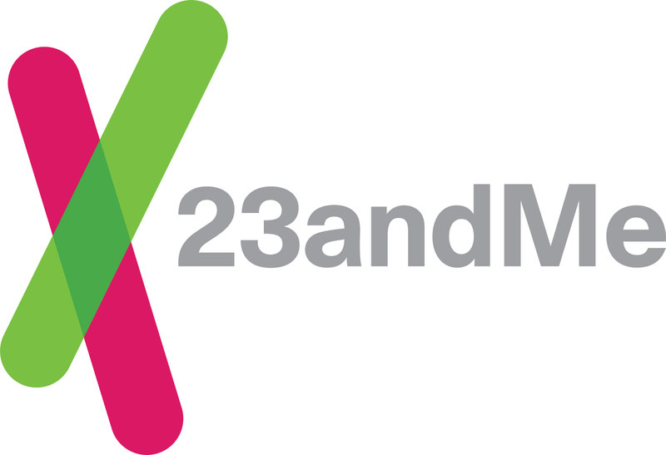
Conclusion
more Intuitive and Dynamic
林婷涵
Notes:
現在的PCI幾乎都是營利公司，所以PCI的功能也會因她們營利方式不同
主要的四個功能在前面楊應甲同學中報告有介紹
跟已前相比，主流的PCI系統在"同意過程"跟""通知過程"跟以前相比更加的直觀跟動態，(過去可能都會卡在開始時間，互相等來等去讓執行時間延長)，PCI可以讓這些過程變得精簡，且高效率~所以PCI很適合成為進行醫學研究的新途徑。

Slide 47
From patients to active partners
PCI:
obstacles of research?
Conclusion
facilitate innovative research
safeguard public trust.
林婷涵
Notes:
因此!PCI並不應該被視為研究的障礙，應該是要當成一種能夠促使創新研究以及保障公眾信任的方法。

Slide 48
THANKS FOR ATTENTION
林婷涵

