Slide 1
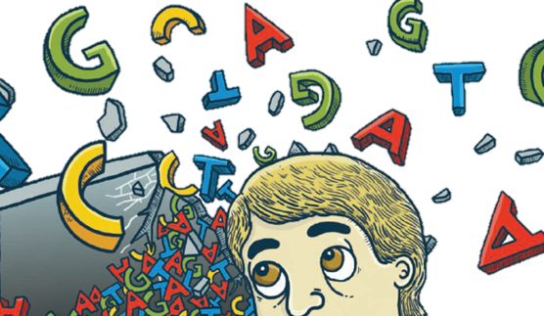
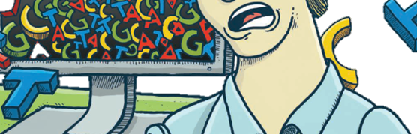
Will Computers Crash Genomics
SCIENCE VOL 331 11 FEBRUARY 2011
R01945014 黃博強
R01945037 林彥伯
R01945039 蘇醒宇
R01945043 吳卓翰
R01945046 蘇煒迪
R01945017 陳維

Slide 2
Introduction

Slide 3


Slide 4
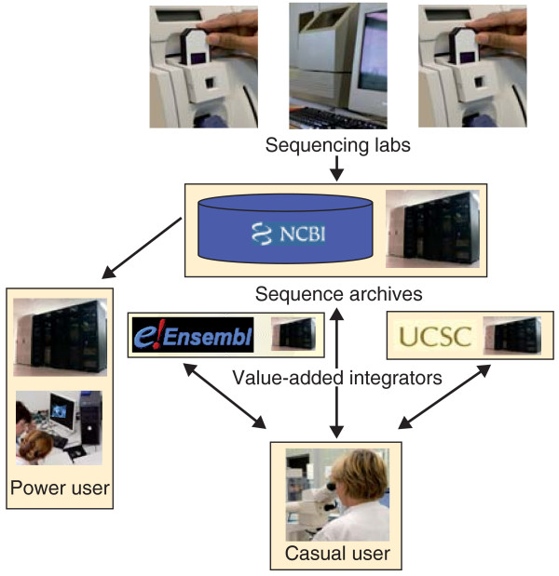
Old Genome Informatics

Slide 5
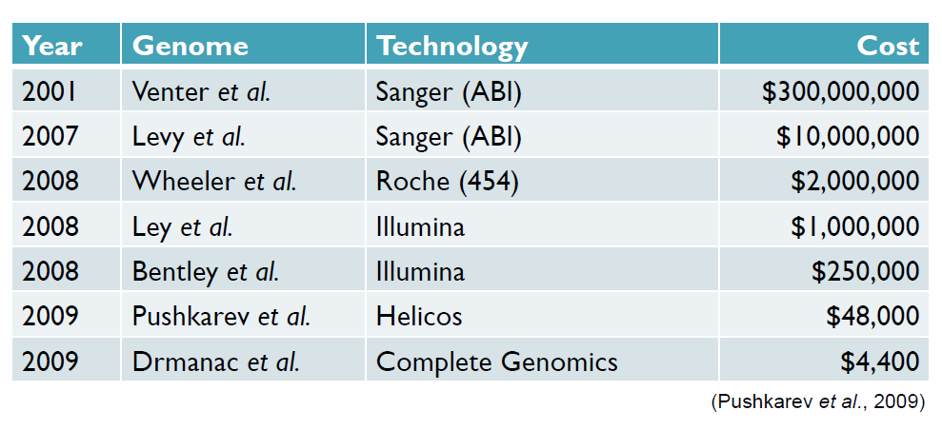
The Evolution of DNA Sequencing

Slide 6
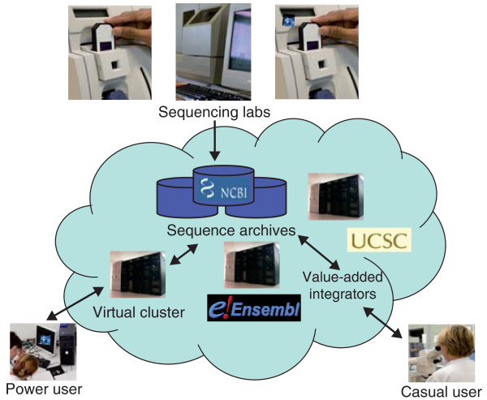
New Genome Informatics

Slide 7
Dizzy with data

Slide 8
Dizzy with data
Human Genome Project
  Planned for 15 years
Celera Genomics
  Shotgun Sequencing Method

Slide 9
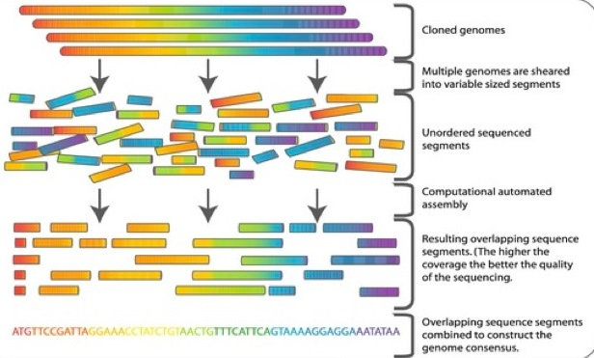
  Shotgun Sequencing Method

Slide 10
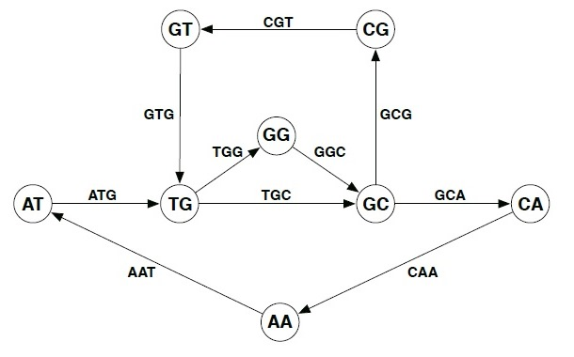
  Assemble fragments

Slide 11
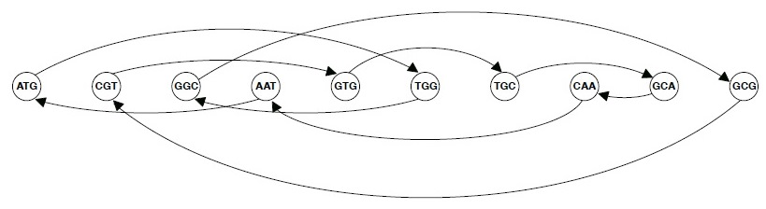
  Assemble fragments

Slide 12
  Dizzy with data
After 2005
  Sequence generation
  Ability to handle the data
“Next-generation” machines
  Cheaply
  Faster
Computer
  Memory
  Processing

Slide 13
  Dizzy with data
Genome Project
  More
Third generation machines
  Smaller

Slide 14


Slide 15
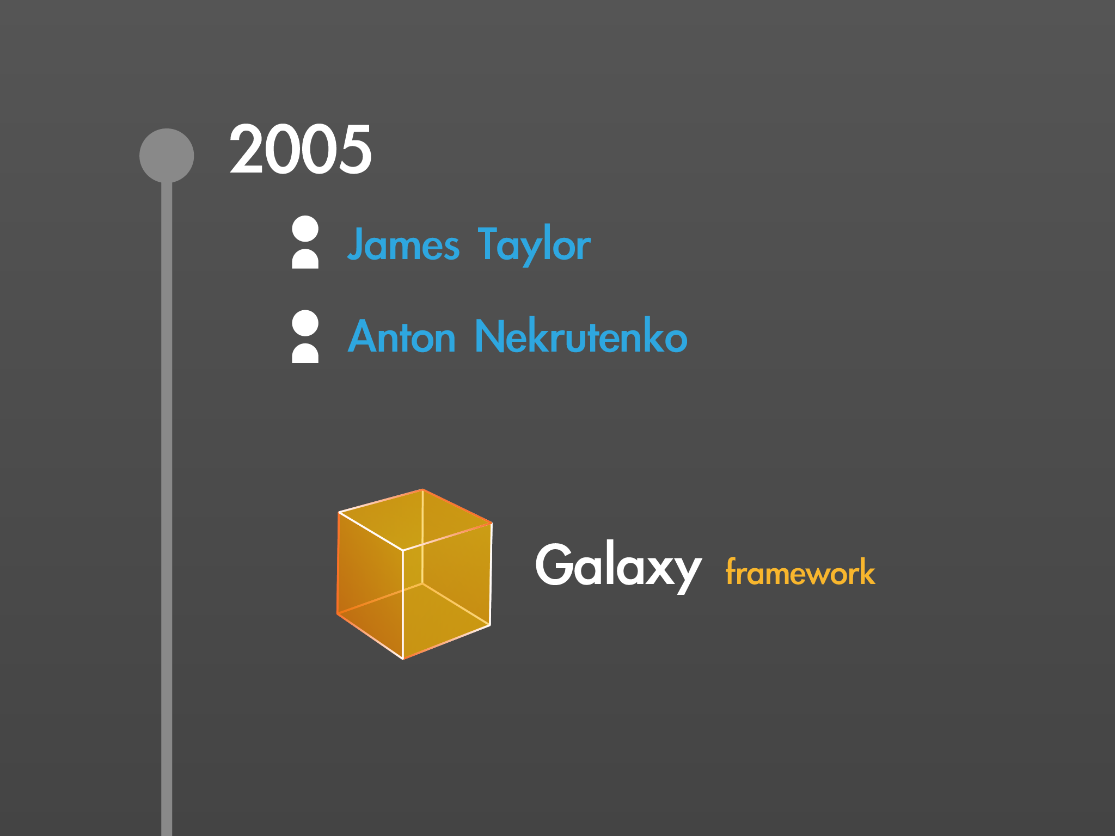

Slide 16
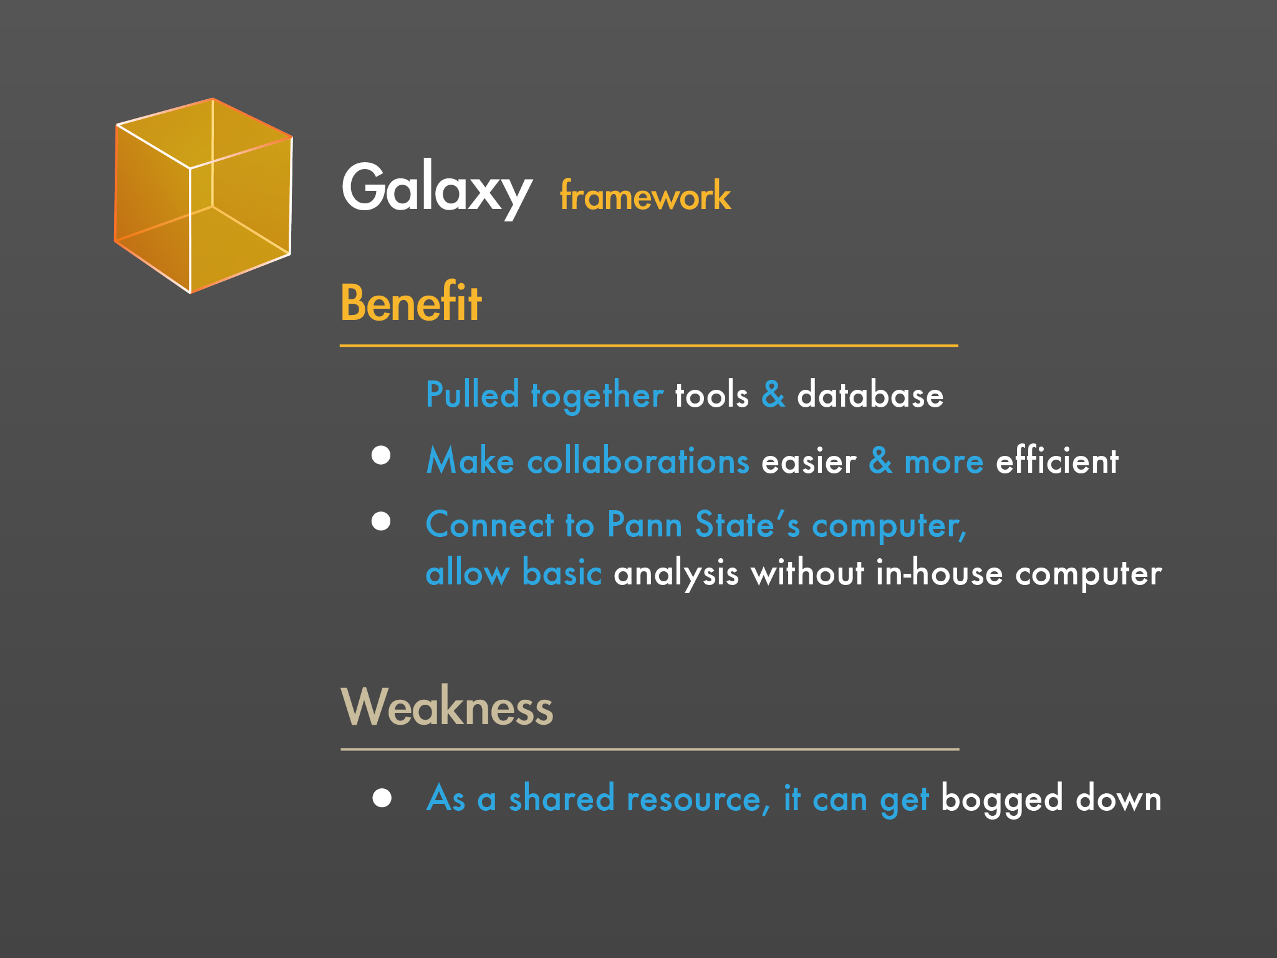

Slide 17
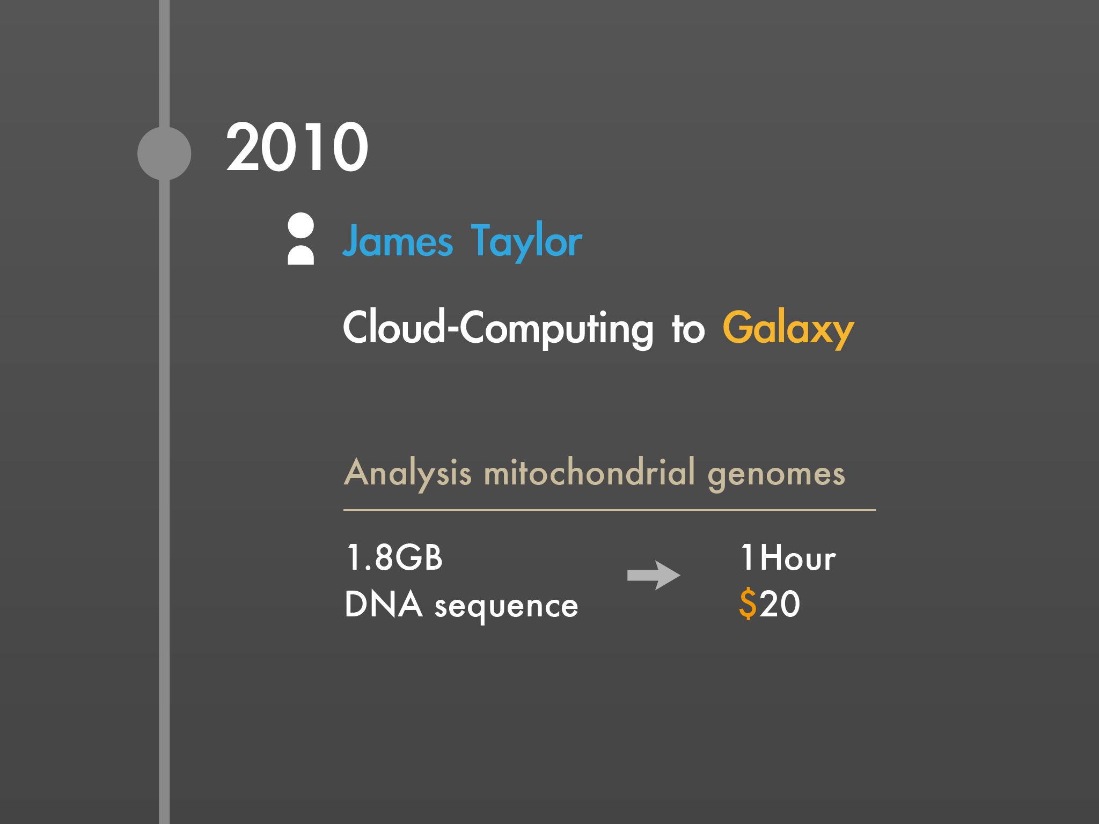

Slide 18
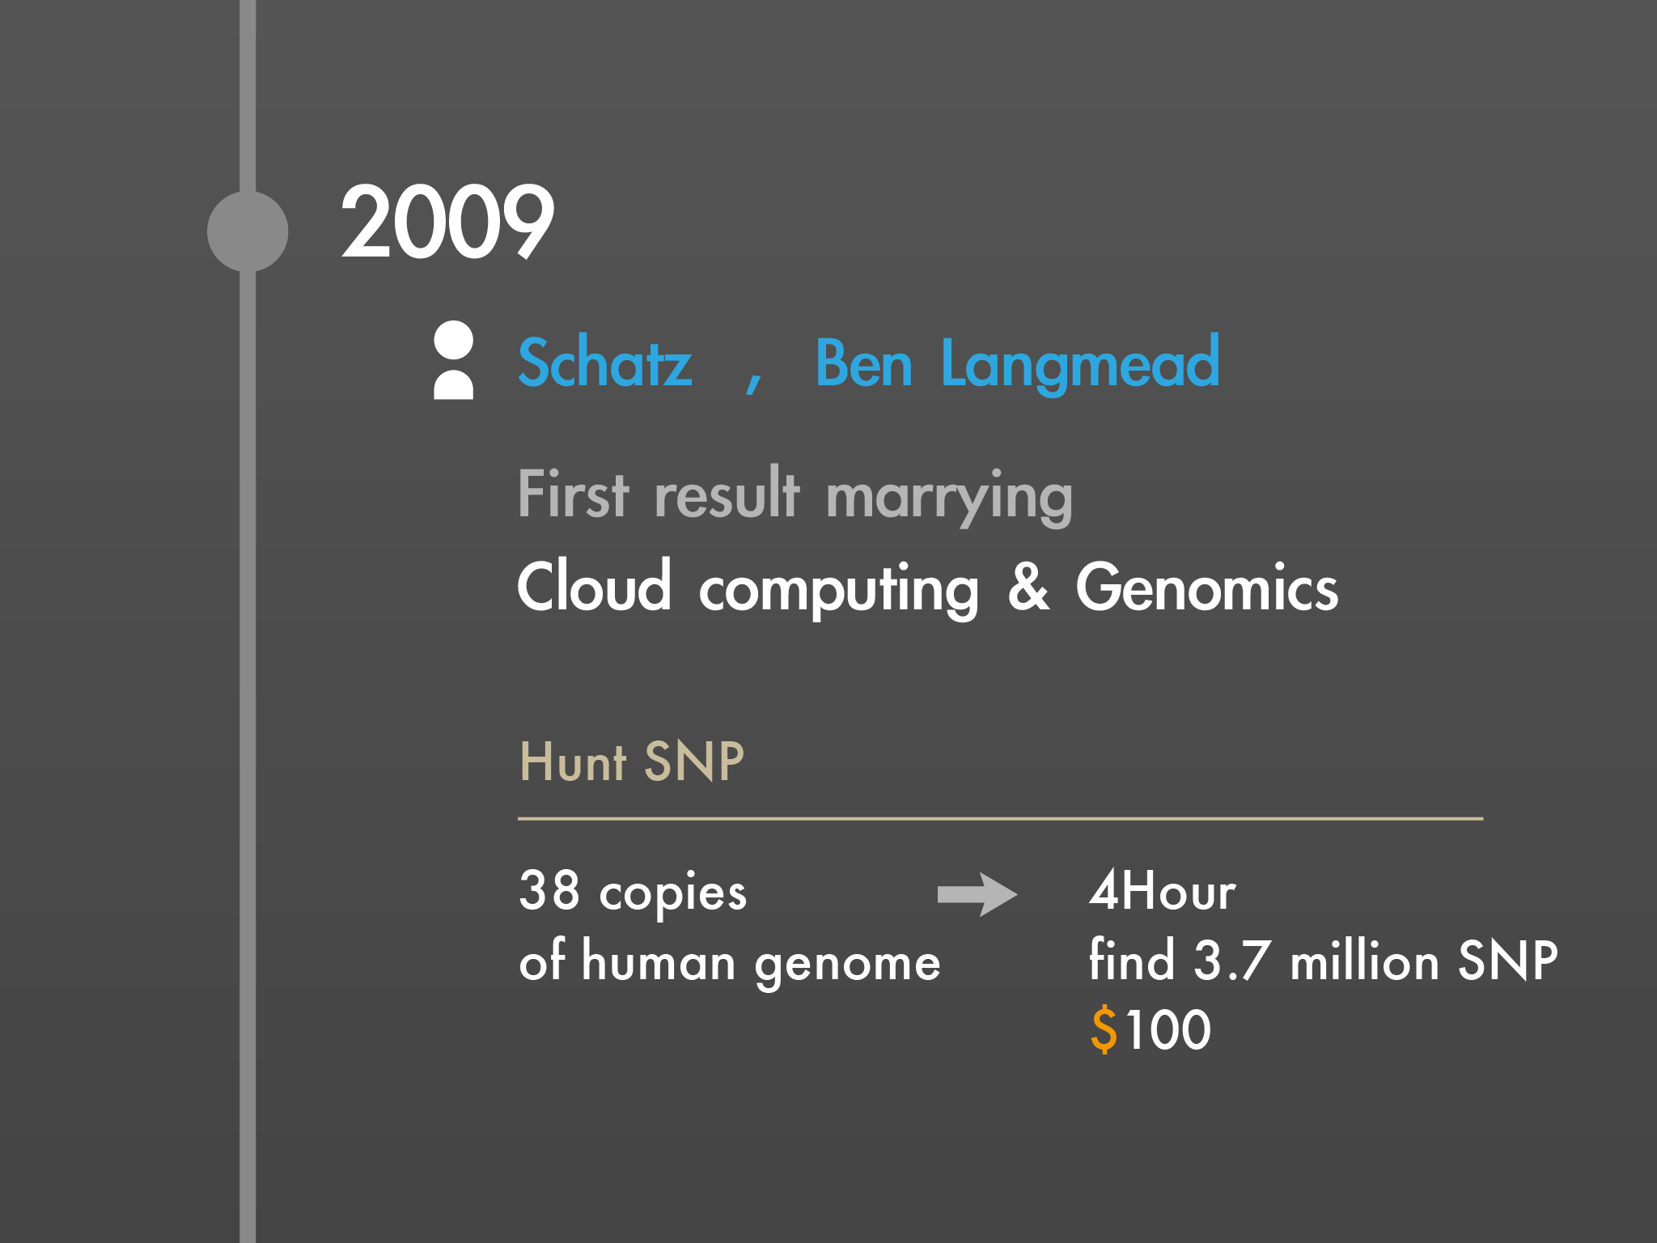

Slide 19
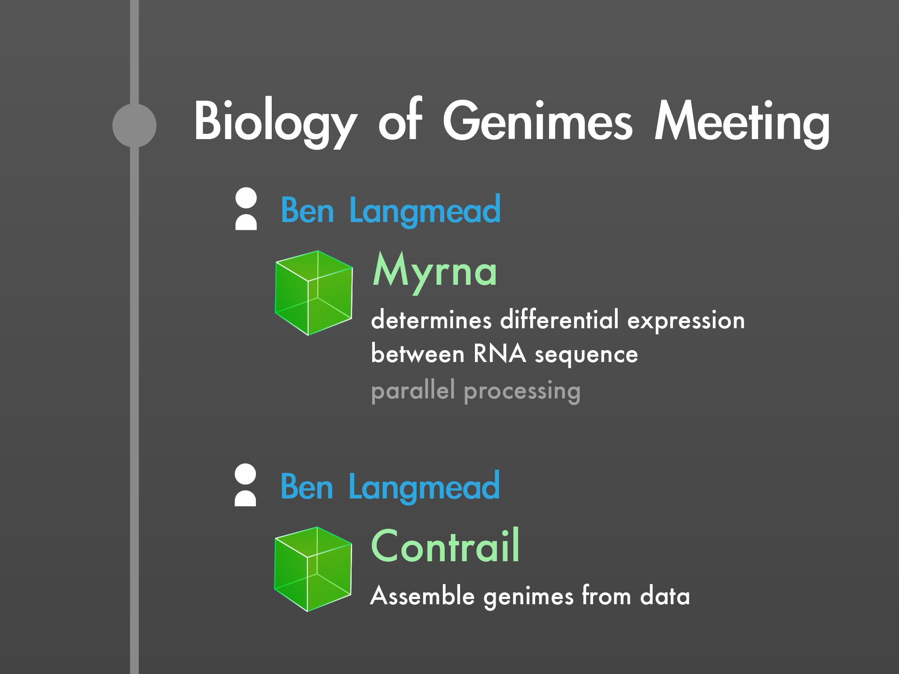

Slide 20
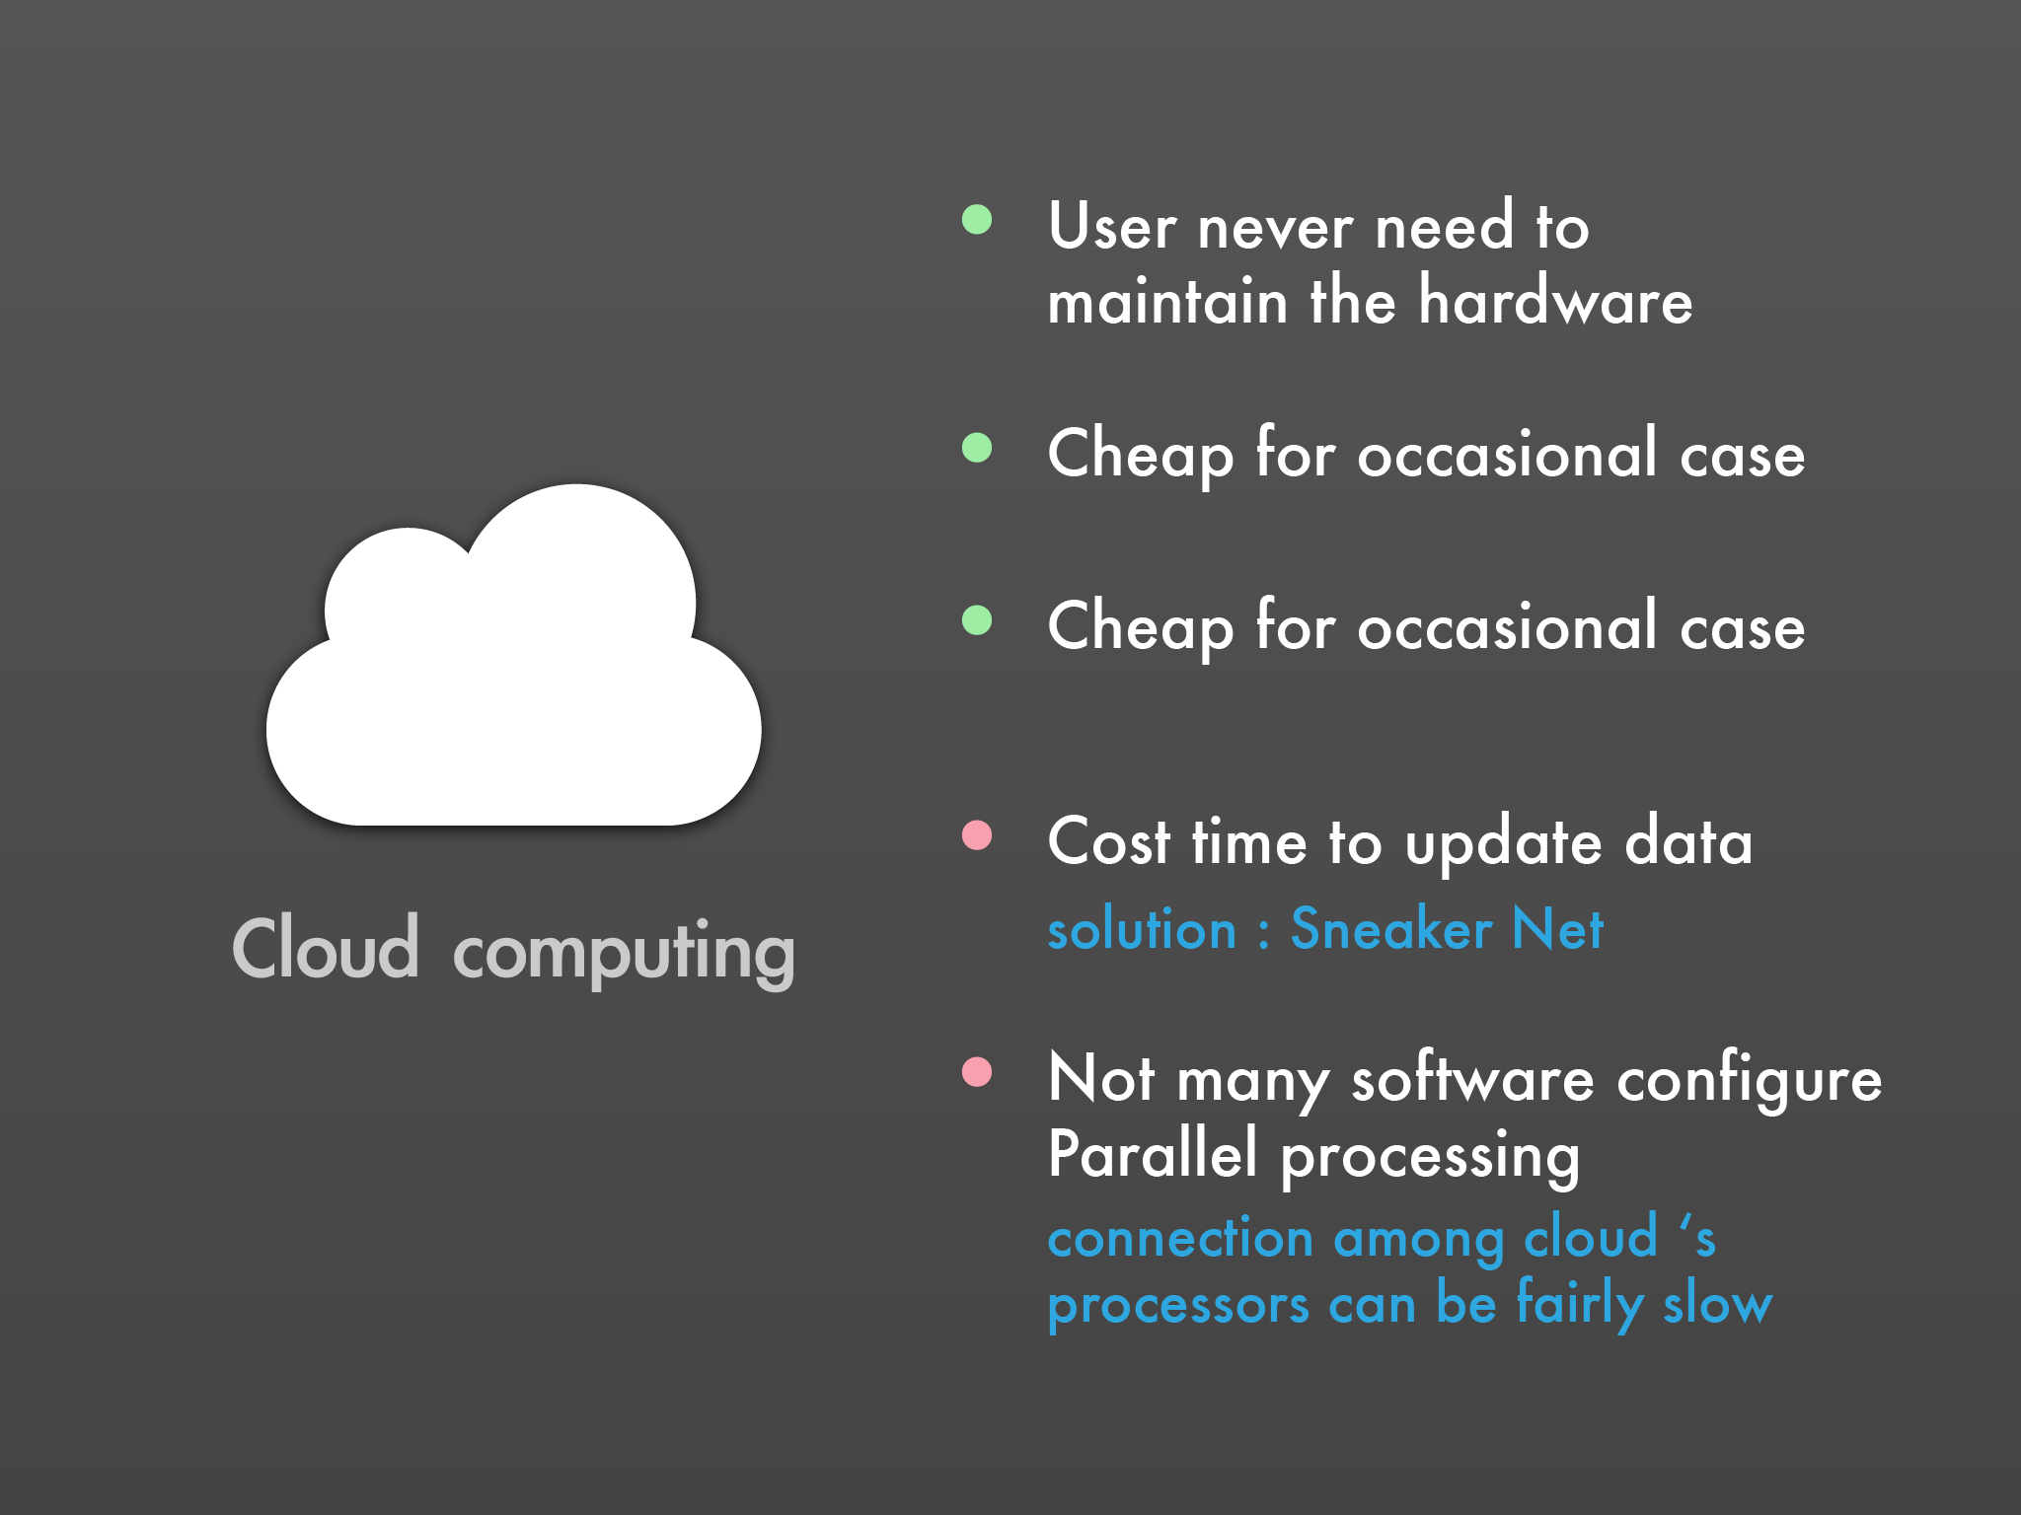

Slide 21


Slide 22
  Storage Issues

Slide 23
  Cost v.s.Data
3.2 billion base pairs X 1,000 X 10,000 = USD$ 32,000,000
USD$ 3,200

Slide 24


  Problems facing Bioinformatic
Data storage
Data transfer
Notes:
http://www.123rf.com/photo_5361166_data-storage-abstract-computer-technology-information-concept-illustration.html
http://findicons.com/icon/84805/data_transfer

Slide 25
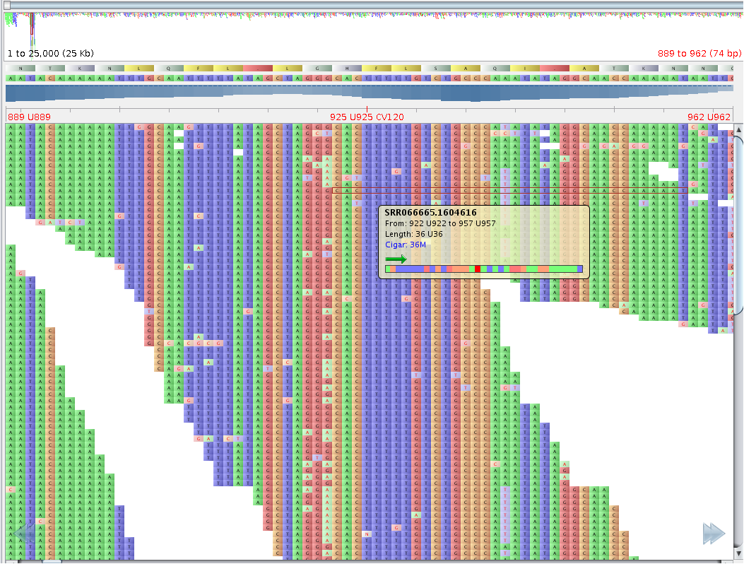
  Data Storage
Bioinformatics field tend to archive all raw sequence data.
More than 90 GB
Notes:
Because the raw material from next-generation machines is in the form of high-resolution images, it soaks up huge amounts of computer storage
進行Human whole genome sequencing時的每個樣本可有約30X以上的coverage（約90 GB以上）。
http://bioinfo-portal.cdac.in/research.html

Slide 26
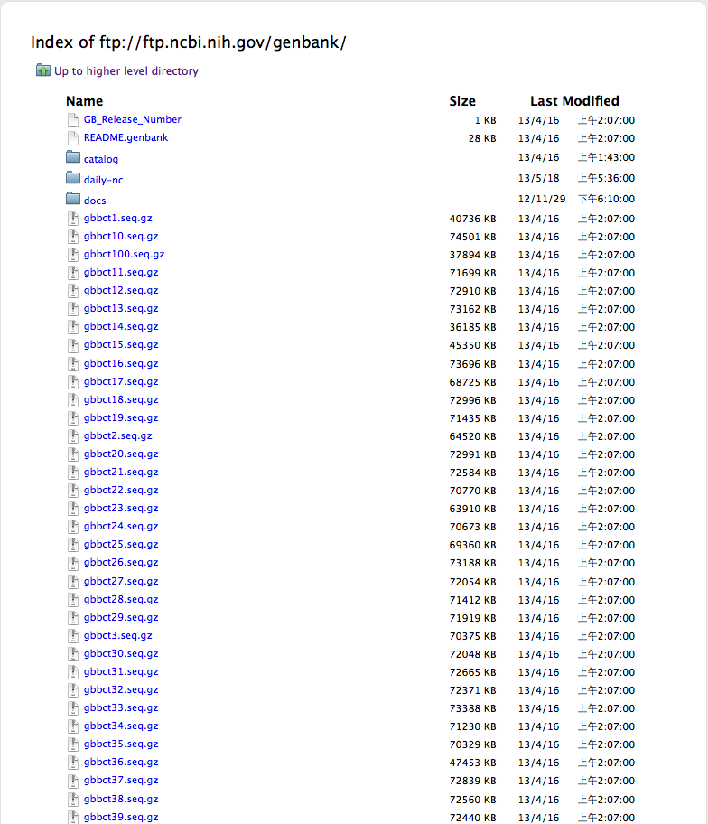
  Data Transfer
Want to analyze a genome?
More than 594 GB
Notes:
Uncompressed, the Release 195.0 flatfiles require roughly 594 GB (sequence files only) or 594 GB (including the *.txt files).
From Genbank Release Note!!!
Get larger because of the technology growing
Local file may be out of date, so it needs to be download again

Slide 27
  Solving the problem (storage)
Discard the original image files , and only keep the sequence data.
If necessary, just re-sequence the sample.
Notes:
Discarding the original image files once they produce the preliminarily processed sequence data, which is more easily kept.
it may be more economical to save no raw data and just rese- quence a DNA sample if necessary

Slide 28

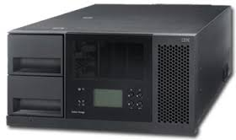
  Solving the problem (storage)
Putting the data in an off-site facility.
$0.095 per GB-month of data stored (Singapore)
$0.100 per GB-month of data stored (Tokyo)
$0.500 - $1.000 per GB
of data stored
Notes:
Storage costs at the Amazon Web Server top off at 14 cents a gigabyte per month
it commonly costs 50 cents to $1 per gigabyte for high-end storage on a local system
場地維護 設備折舊 電費 臨時要做大量的分析 有彈性

Slide 29
  Solving the problem (transfer)
Put one copy of the data in the common cloud which everyone uses.
Encouraged by the genomics community
  NCBI
    has put a copy of the data from the pilot project of the 1000 Genomes effort into off-site storage.
  Ensemble, the EBI sequence database
    are automatically funneled into a cloud environment as part of a test of the strategy.
Notes:
“you have one copy of the data located in this common cloud that everyone uses” and it won’t be necessary to download or upload the data between computers for processing.
EBI European Bioinformatics Institute

Slide 30
Worries about security
Data involving the health of human subjects, which is being linked more and more to genome information
The Health Information Protection Regulations came into force on July 22, 2005.
  The Health Information Protection Act is designed to improve the privacy of people’s health information while ensuring adequate sharing of information is possible to provide health services.

Slide 31
Going To the Cloud
National Human Genome Research Institute(NHGRI) hosted several meetings on cloud computing and on informatics and analysis in 2010.
“One thing that is clear is that as computation becomes more and more necessary through- out biomedical research, the way these [infrastructure] resources are funded will have to change to be more efficient,” says James Taylor, a bioinformaticist at Emory University
Notes:
Lincoln Stein
bioinformaticist at the Ontario Institute for Cancer Research (OICR) in Toronto, Canada,

Slide 32
Growing Exponentially of Data

Slide 33
The primary goal of bioinformatics is to increase the understanding of biological processes
But “We live in the post-genomic era, when DNA sequence data is growing exponentially“
Miami University (Ohio) computational biologaist Iddo Friedberg

Slide 34
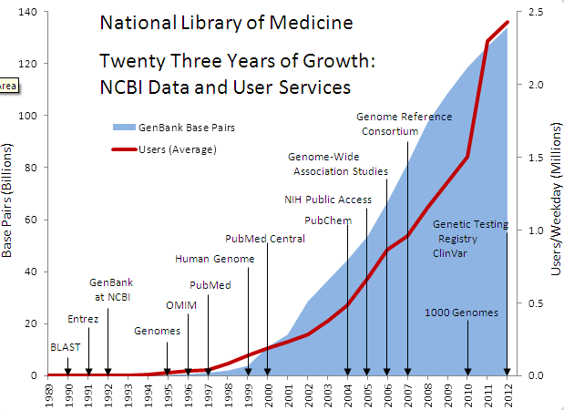
NCBI Data Growth

Slide 35
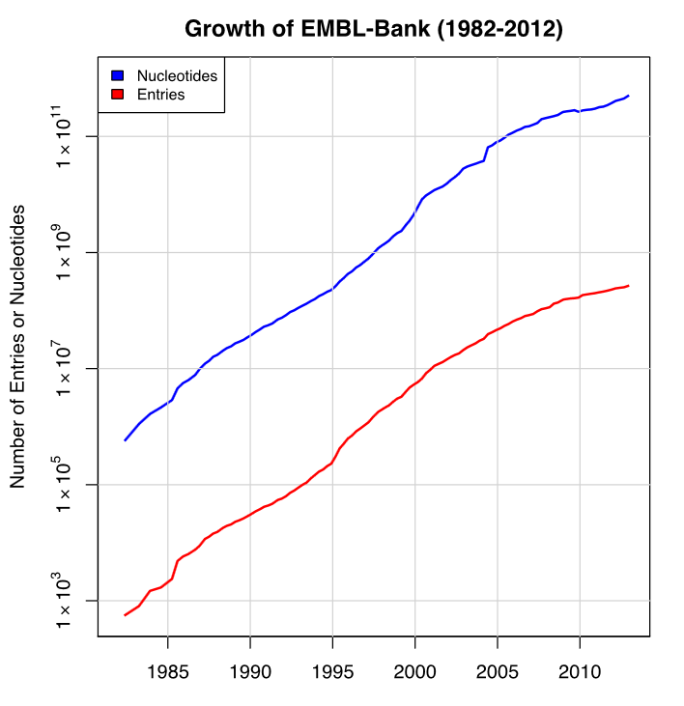
EMBL Data Growth

Slide 36
grand area of research
Sequence analysis
Genome annotation
Analysis of gene expression
Analysis of protein expression
Analysis of mutations in cancer
Protein structure prediction
Comparative genomics
Modeling biological systems
High-throughput image analysis
Protein-protein docking

Slide 37
Sequence analysis
  most primitive operation in computational biology
Genome annotation
  the process of marking the genes and other biological features in a DNA sequence
Analysis of gene expression
  The expression of many genes can be determined by measuring mRNA levels

Slide 38
Analysis of protein expression
  Gene expression is measured in many ways including mRNA and protein expression
Analysis of mutations in cancer
  to identify previously unknown point mutations in a variety of genes in cancer
Protein structure prediction
  important for drug design and the design of novel enzymes

Slide 39
Comparative genomics
  the study of the relationship of genome structure and function across different biological species
Modeling biological systems
  a significant task of systems biology and mathematical biology

Slide 40
High-throughput image analysis
  Computational technologies are used to accelerate or fully automate the processing, quantification and analysis of large amounts
Protein-protein docking
  predict possible protein-protein interactions based on 3D shapes

Slide 41
Obstacles in Computing Technology

Slide 42
Two Ways to Approach higher Computing Ability
One Computer Computing Ability
Cloud Computing

Slide 43
One Computer Computing Ability
TSMC 20nm manufacture procedure
No direct co-relation of bus observed data with the internal CPU activity
Multi-core processor : record and replay (R&R) system
Intel Corporation:
Virtues and Obstacles of Hardware-assisted Multi-processor Execution Replay
(2010)

Slide 44
Cloud Computing
Availability of a Service
Data Lock-in
Data Confidentiality and Auditability
Data Transfer Bottlenecks
Performance Unpredictability
Scaling Quickly
“10 Obstacles To Cloud Computing” By UC Berkeley & How GoGrid Hurdles Them

Slide 45
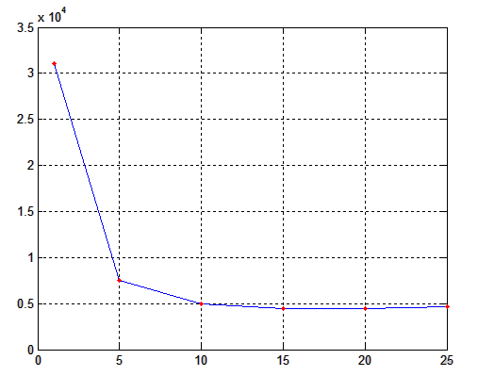
Cloud Computing

Slide 46
Conclusion
Development takes time, effort and money.
Computer is still developing fast, without comparing to bio-information.

Slide 47
Thanks for your attention !

