Slide 2
Recent Explosive Human Population Growth Has Resulted in an Excess of Rare Genetic Variants.
Science-2012-Keinan-740-3
҉林廷儒҉梁維元҉許芳瑋҉
҉陳慶安҉黃怡君҉劉耘非҉
҉謝弘柏҉

Slide 3
Introduction
By 陳慶安!!

Slide 4
Introduction
Introduction
Recent explosive
10,000 years ago Today
－population genetic equilibrium & complex disease risk
Earlier studies small amounts of data
Recent studies
However
They didn’t take account of accelerated explosive growth

Slide 5
Term Specification
By 謝弘柏!!

Slide 6
Exome
Term Specification
Gene → Genome Exon → Exome
The exome is a part of genome form by exons
What is an “exon”?
RECALL THE CENTRAL DOGMA

Slide 7
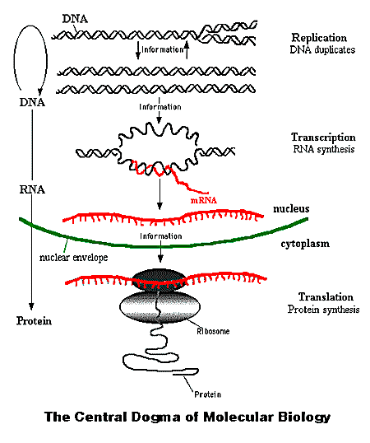
Central Dogma
RNA Splicing
So What’s An Exon?
Term Specification
Consist of roughly 180,000 exons, about 1% of total genome, 30 megabases of DNA
Mutations in the exome are thought to harbor 85% of disease-causing mutations
Not only for mRNA!!!!!
For tRNA, rRNA as well~
http://www.accessexcellence.org/

Slide 8
Hapmap (Haplotype Map)
Term Specification
International Hapmap Project
Started from 2002 Phase I : ~2005 Phase II : ~2007 Phase III : ~2009
11 global ancestry groups been assembled (Phase III)
We have over 99.5% of our genome in common. The other 0.5% consist of SNPs and mutations
To investigate the cause of many known genetic diseases, emphasizing on SNPs is a cost-effective way
Tag SNPs are selected from millions of well-defined SNPs

Slide 9
Site Frequency Spectrum (SFS)
Term Specification
For a sample of size k under the inﬁnitely many sites mutation model, write Mj(k) for the number of sites at which exactly j individuals carry a mutation. The vector (M1(k),M2(k),... ,Mk(k)) is called the site frequency spectrum of the sample.

Slide 10
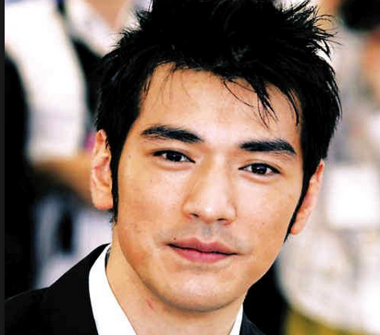
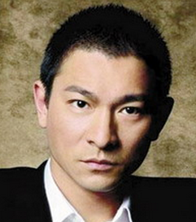
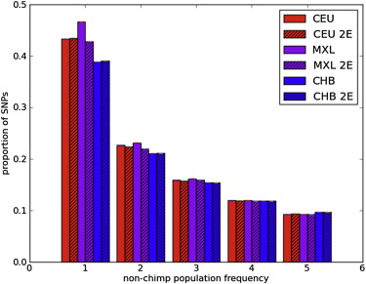
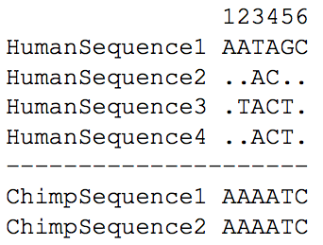
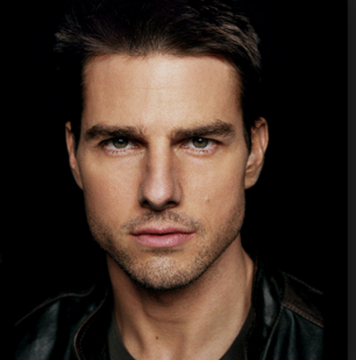
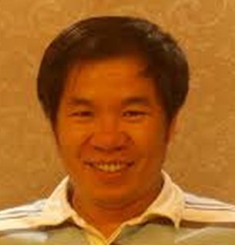
SFS Example
Term Specification
Unfolded Spectrum
Folded Spectrum

Slide 11
Term Specification
By 許芳瑋!!

Slide 12
Genotype Call Rate
Term Specification
$$= \frac{NumGenotypes(score≥threshold)}{NumGenotypes}$$

Slide 13
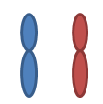
Wright-Fisher Model
Term Specification
Consider a gene with two alleles A and B.
In diploid population, N individuals will have 2N copies of genes.
N individuals
A B
2N copies of genes

Slide 14
Wright-Fisher Model
Term Specification
To calculate
We set the frequency of one allele is p and the other is q.
Then we assume …
Generations don’t overlap. For example, annual plants have exactly one generation per year.

Slide 15
Wright-Fisher Model
Term Specification
The probability of obtaining k copies of an allele that had frequency p in the last generation is
$$\frac{\left(2N\right)!}{k!\left(2N−k\right)!}{ p}^{k}q^{2N−k}$$

Slide 16
Population Genetics Theory
Term Specification
The study of allele frequency distribution and change under the influence of four main evolutionary processes: natural selection, genetic drift, mutation and gene flow.
It attempts to explain such phenomena as adaptation and speciation.

Slide 17
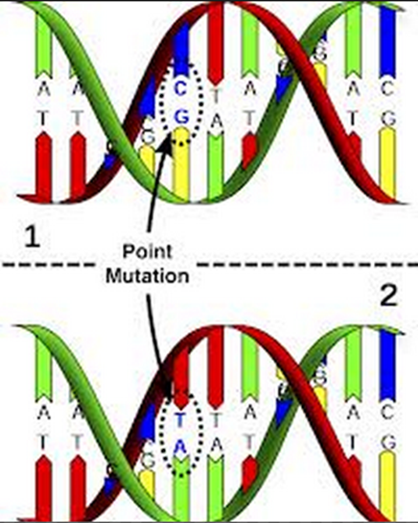
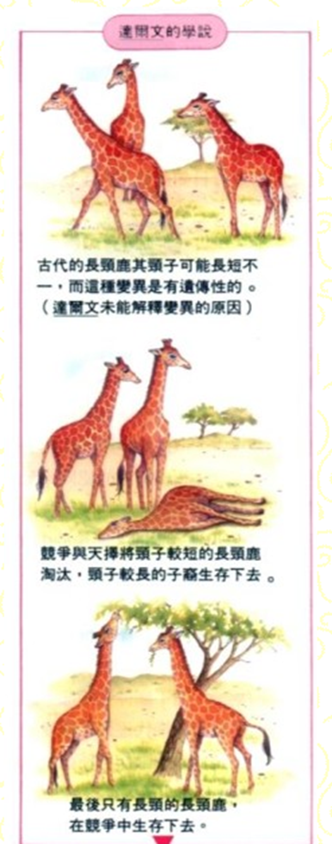
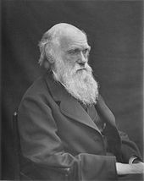
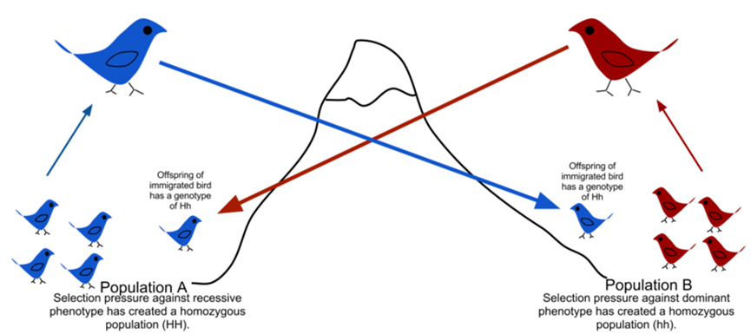
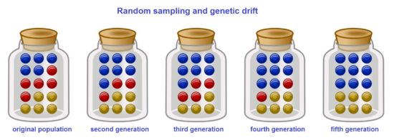
Population Genetics Theory
Term Specification
Charles Darwin(1809~1882)

Slide 18
Term Specification
By 劉耘非!!

Slide 19
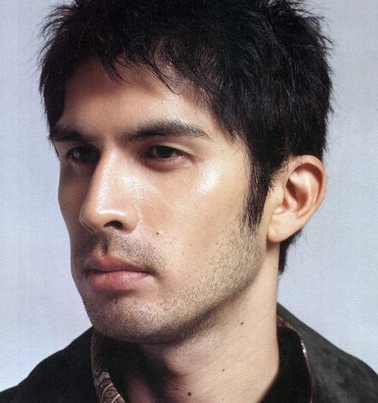
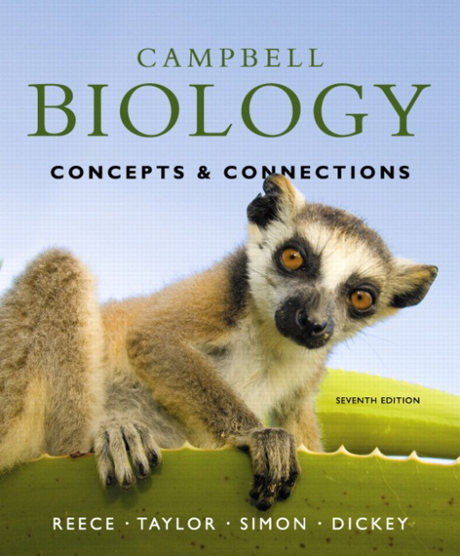
Bottleneck Effect/Genetic Drift
Term Specification
Genetic drift:
Chance events can cause allele frequencies to fluctuate unpredictable from one generation to the next.
→Bottleneck effect:
Drastic reduction in pop. Size
→Founder effect:
A few individuals colonize a new environment.
<<
>>

Slide 20
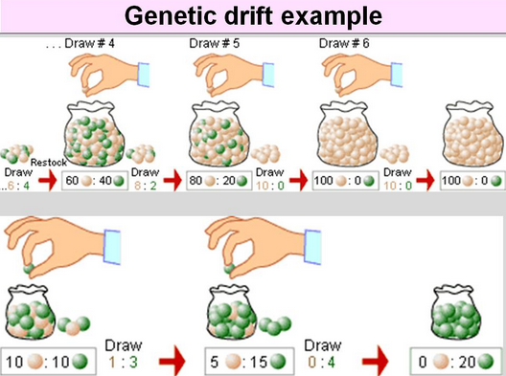
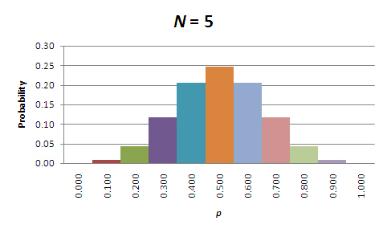
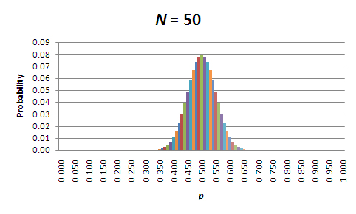
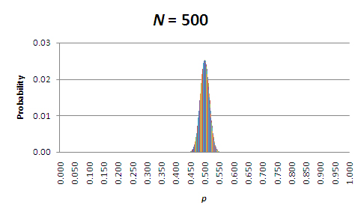
Genetic Drift
Term Specification
$$\operatorname{Pr}\left(k \right|p,n)= \left({n \atop k}\right)p^{k}{(1−p)}^{n−k}$$

Slide 21
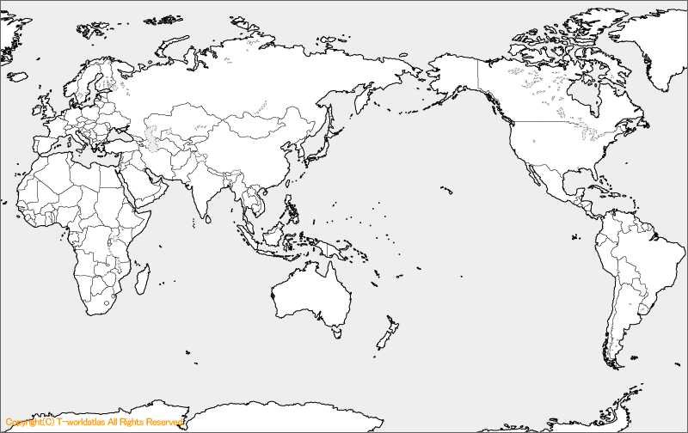
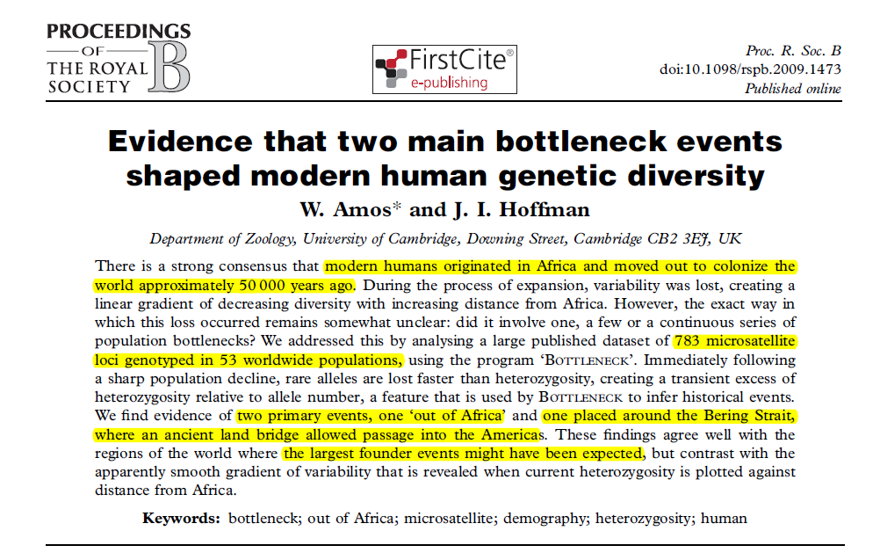
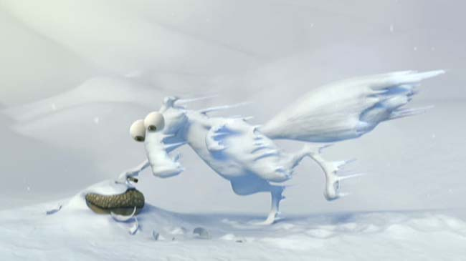
Two Major Bottleneck Events
Genetic Drift
25000 B.C.
Bering Strait
Bottleneck Effect
50000 B.C.
Out of Africa
Founder Effect

Slide 22
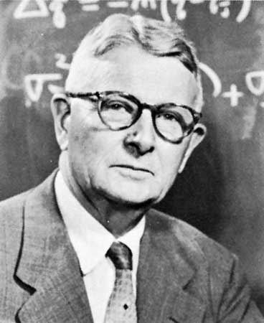
Effective Population Size N_{e}
Term Specification
E. Population Size = Real Population Size IF
Equal numbers of males and females, all are able to reproduce.
All are equally likely to produce offspring, and the number of offspring that each produces varies no more than expected by chance.
Mating is random.
The number of breeding individuals is constant from one generation to the next.
The size of an ideal population that experiences genetic drift at the rate of the population in question.
$$\frac{1}{N_{e}}=\frac{1}{t}\sum_{i=1}^{n}{\frac{1}{N_{i}}}$$
Sewall Green Wright
(1889 –1988)

Slide 23
Singleton (in this paper)
Term Specification
!!

Slide 24
This Paper: the Models
By 黃怡君!!

Slide 25
Population History Models
This Paper: the Models
Constant Population Size
European History with No Growth
European History with Recent Growth → Advocated in this paper

Slide 26
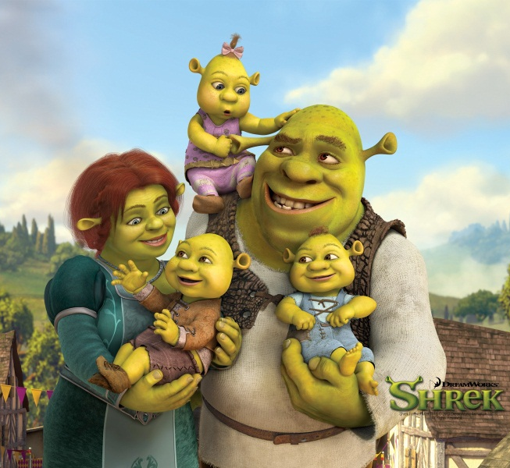
1. Constant Population Size
This Paper: the Models
Population of constant size throughout history
1989
2004
2010

Slide 27
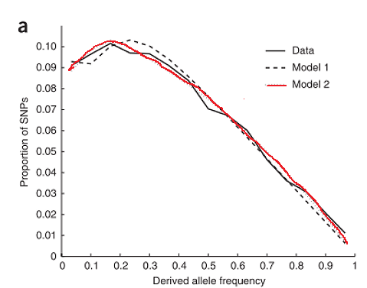
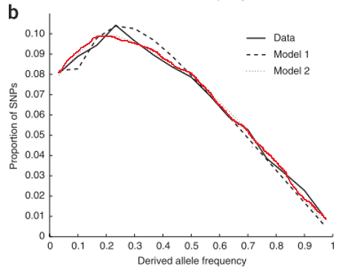
2. European History with No Growth
This Paper: the Model
Model 1 : w/ 1 bottleneck
Model 2 : w/ 2 bottlenecks
CEU CHB+JPT
With 2 Possible Population Bottlenecks
Measurement of the human allele frequency spectrum demonstrates greater genetic drift in East Asians than in Europeans
A. Keinan, J. C. Mullikin, N. Patterson, D. Reich, Nat. Genet. 39, 1251 (2007).
剛剛介紹過囉!

Slide 28
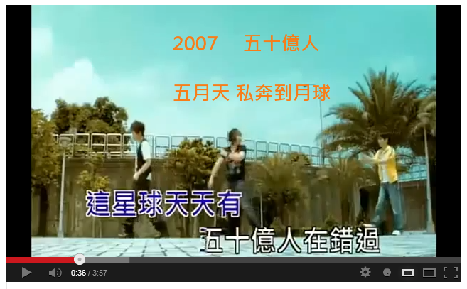
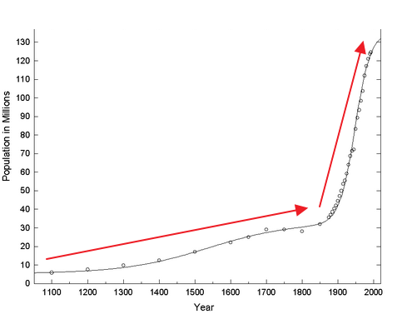
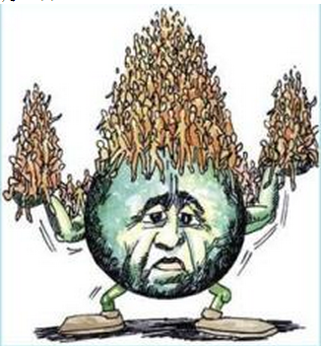
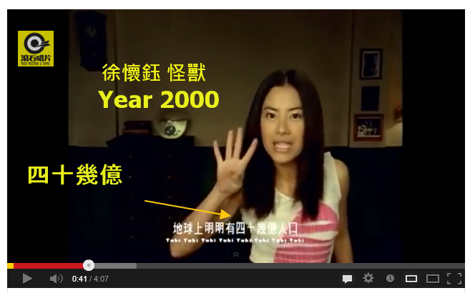
3. European History with Recent Growth
This Paper: the Model
Variant of 2nd model
Add recent exponential growth

Slide 29
Population History Models
This Paper: the Models
Constant Population Size
European History with No Growth
European History with Recent Growth (this paper)
Effects on SFS
Recent Explosive Growth
Sample Size

Slide 30
This Paper: the Graphs
By 林廷儒!!

Slide 31
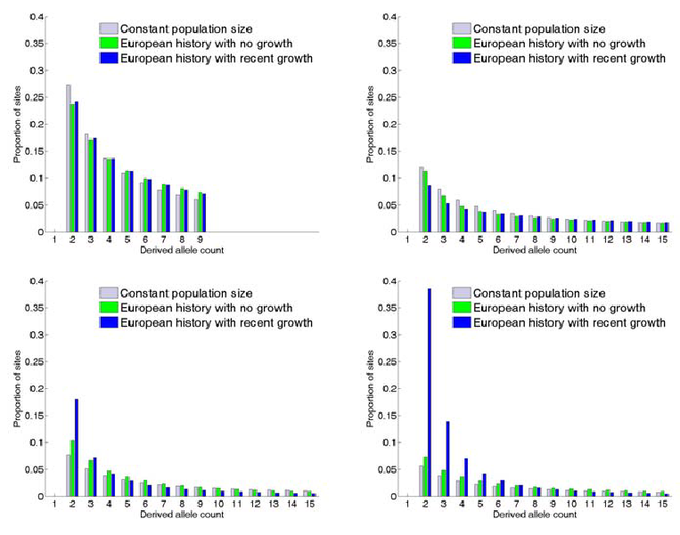
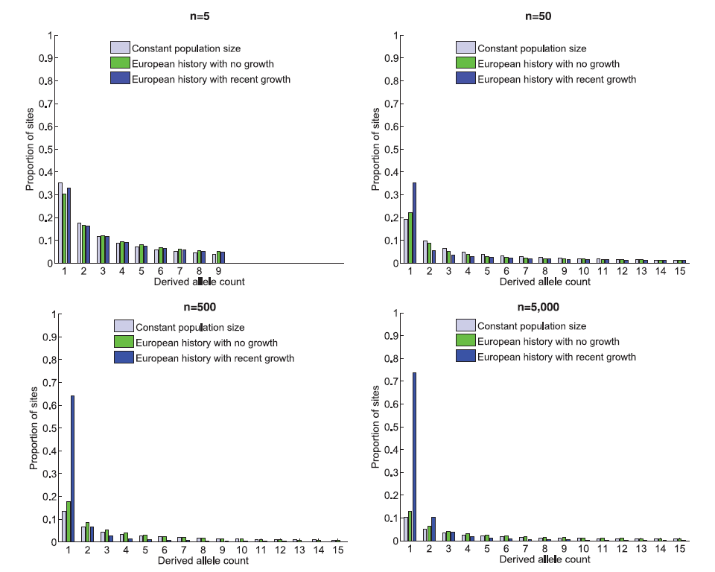
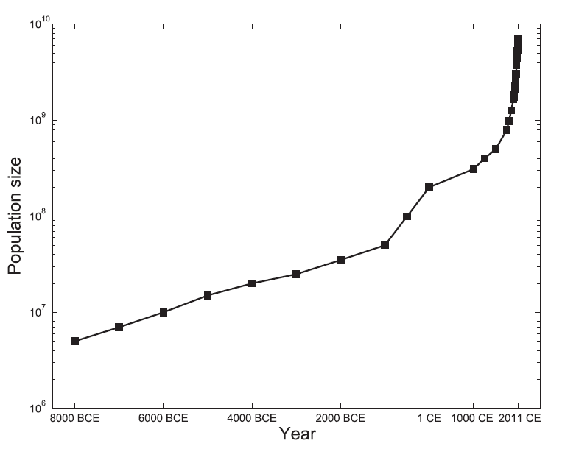
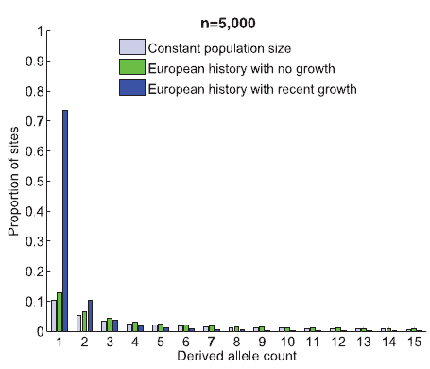
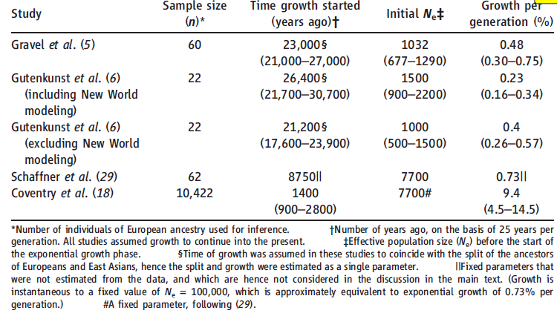
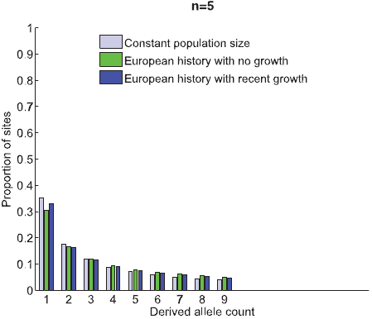
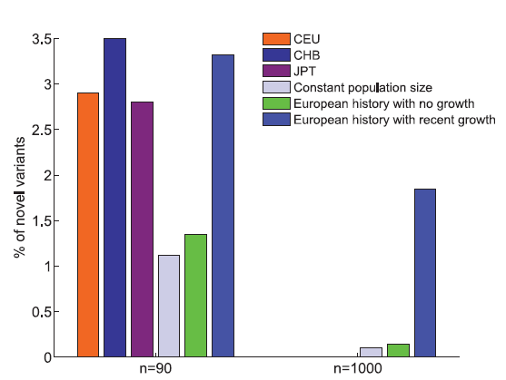
The Graphs
Population Growth
Estimation of Growth
Percentage of Novel Variants
Site Frequency Spectrum
This Paper: the Graphs
Figure 1
Figure 2
Figure 3
Table 1
Singleton

Slide 32
Conclusion
By 梁維元!!

Slide 33
Conclusion
Conclusion
劇烈成長 => 偏離平衡 => 累積基因變異直到達成新平衡
打從一萬年前冰河時代以來，人口爆炸加快了人類基因變異的速度
世界各地人類只會隨著進化越變越不同，和過去的人類並不相同
物競天擇的速度逐漸加快，人類再過幾個世代會進化到一定程度，甚至產生對某些疾病的抗體

Slide 34
Introduction to Biomedical Informatics Final Presentation
Music & Clips:
<Attack on Titan> Guren no Yumiya
<Fairy Tail> Happy’s Theme
<Mist of Pandaria> Stormstout Brew
<Mosaic> Brewfest!
<Fate/Zero> The Legend
<Exodus> Theme of Exodus
<Wrath of the Lich King> Howling Fjord
<World of Warcraft> Tavernˋ
<怪獸> 怪獸
<離開地球表面> 私奔到月球
Job Distribution – Presenting
Intro :梁維元
Key Words :謝弘柏、許芳瑋、劉耘非
Content :黃怡君、林廷儒
Conclusion :陳慶安
Slide Everyone
Slide Editing & Art Design
劉耘非
Reference
W. Amos, J. I. Hoffman, Proceedings of the Royal Society B-Biological Sciences 277, 131 (Jan 7, 2010).
J. B. Reece, M. R. Taylor, R. M. Liebaert, E. J. Simon, J. L. Dickey, Study Guide for Campbell Biology: Concepts and Connections. (Benjamin-Cummings Publishing Company, 2011).
R. Kliman, B. Sheehy, J. Schultz. (Nature Education, 2008).
Alon Keinan, James C Mullikin, Nick Patterson & David Reich; Measurement of the human allele frequency spectrum demonstrates greater genetic drift in East Asians than in Europeans
Alan R. Rogers; Lecture Notes on Gene Genealogies1
Wikipedia; en.wikipedia.org
Thank you for your attention.
Based on the paper
Science-2012-Keinan-740-3
Job Distribution – Reading
謝弘柏→陳慶安→許芳瑋→黃貿鍾
劉耘非→林廷儒→梁維元→黃怡君
Chief
黃怡君
Instructor
Kun-Mao Chao

