Slide 1
Integrating Genome
D. R. Zerbino, B. Paten, and D. Haussler Science 13 April 2012: 179-182.
劉恕維 洪士堯 李宗燁
林修竹 田耕豪 廖奎達

Slide 2
Outline
Introduction
Obtaining genome sequence
Modeling the evolution of genotype
From genotype to phenotype
Looking ahead to application

Slide 3
Introduction
劉恕維

Slide 4
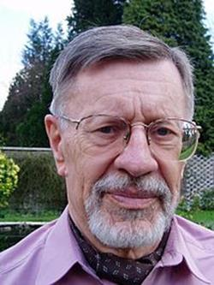
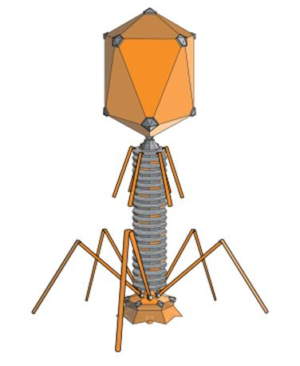
History – The Pioneer
1970 Walter Fiers
http://en.wikipedia.org/wiki/Walter_Fiers
W. Fiers, et al., Complete nucleotide sequence of bacteriophage MS2 RNA: primary and secondary structure of the replicase gene. Nature 260, 500-507 (1976)
Notes:
1970這位先生研究噬菌體的的RNA序列，是最先開始利用電腦去分析基因序列的人

Slide 5
History – The technique
Notes:
但是真正廣為應用的技術必須要到1980年，也就是史密斯和水先生所提出的方法，這個大家上課都已經學過了~
用GOOGLE查REFERENCE赫然發現~在這20年中，這篇PAPER已經被引用了將近7000次，每年被引用將近300次啊!!!!

Slide 6
History – Hardware
10000
16
Notes:
隨著電腦演進越來越發達
Moor’s law 每18個月~

Slide 7
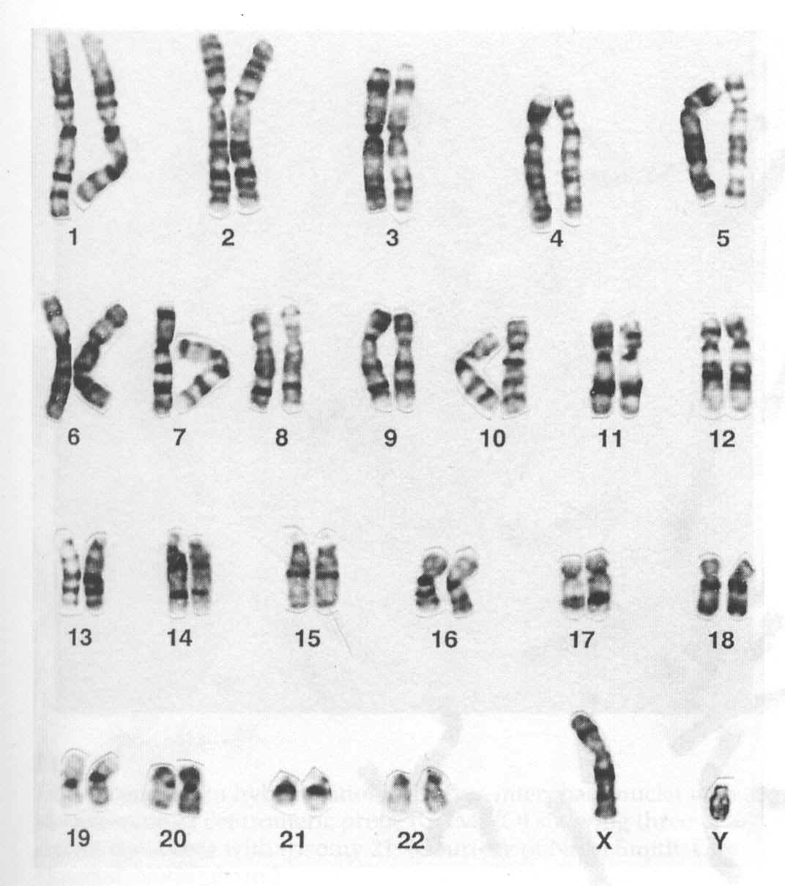
Genotype & Phenotype
Autism
http://big5.ifeng.com/gate/big5/baby.ifeng.com/yuer/special/detail_2011_01/27/4481382_0.shtml
http://www.chiang-ivf.com.tw/y-deletion.htm

Slide 8
Genotype & Phenotype
Phenotype
A A
B B
A B
A O
B O
O O
Genotype
http://www.eslite.com/product.aspx?pgid=1001110932064739

Slide 9
Challenge research
Genome evolution
Model molecular phenotype as consequence of genotype
Predict organismal phenotype

Slide 10
Obtaining Genomic Sequences
洪士堯
Notes:
大家好，今天我要介紹的是Obtaining Genomic Sequences的部分，我是洪士堯

Slide 11
Genome assembly
Process of reconstructing an entire genome from relatively short random DNA fragments, called reads.
Detect read overlaps and thereby progressively reconstitute most of the genome sequence.
Notes:
基因的重組簡單說就是從一堆隨機的DNA片段，也就是所謂的reads，中找出重疊的部分並且重組成一整段完整的genome，
這之前上課就有提到過，這問題可以類比成將一整捆同樣的報紙，爆炸之後
從片段中將整份報紙拼回去一樣

Slide 12
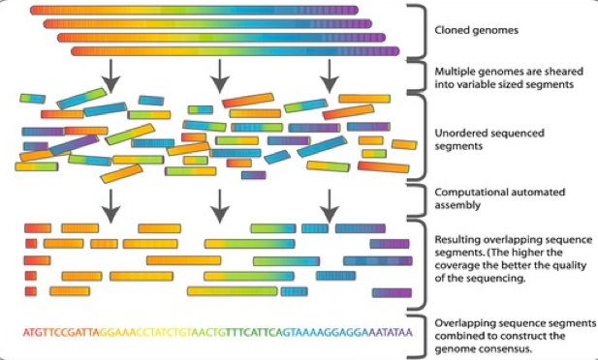
Genome assembly
Notes:
這張就是一張Genome assembly的過程簡圖，首先我們會有許多複製好的相同genomes，
接著我們將這一長條genome隨機切成許多不同大小的片段
之後再將每一段分別其他段進行比對看是否有重疊的部分，有的話就可以建立出頭尾關係
最後我們就可以拼出一段完整的genome
接下來我們會對genome assembly會使用上的一些基因處裡的方法做介紹

Slide 13
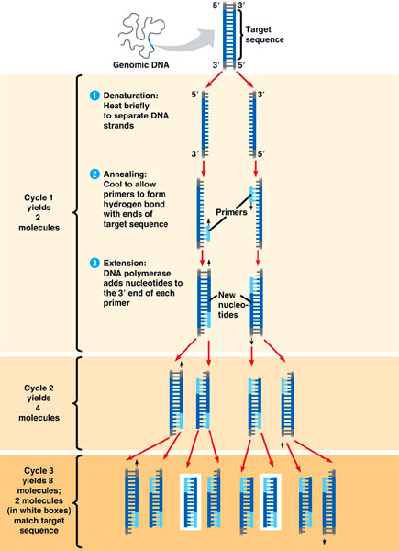
PCR
PCR：Polymerase Chain Reaction.
Procedure：
Denaturation step
Annealing step
Extension/elongation step
Notes:
PCR是一種基因放大的技術，其可以快速地將我們需要的基因大量複製
主要由以下三個步驟組成：
(1)變性反應(denaturation), 此階段會加熱到90度，使DNA的兩股分離。
(2)緩冷配對反應(annealing)，這個階段會降溫的55度，並且插入目標的引子，使引子與目標DNA配對。
在此圖中即是兩段淡藍色的變段，其標出我們需要DNA的起點與終點。
(3)延長反應(extension)，此階段再加熱到70度，DNA聚合酶開始加入新的ATCG合成新的DNA股。
的循環操作每次可使DNA的量添加一倍，若重複操作多次，以數學公式計算，DNA增加的量將會是2n，n是代表重複操作的次數。在理想的聚合酵素鏈鎖反應條件下，DNA是以幾何級數增加。理論上 ，一個DNA分子若重複操作 PCR 25次，那麼DNA的分子數將會擴增到225 = 106 個分子。這個DNA的量已足夠在Agarose凝膠電泳中觀察到

Slide 14
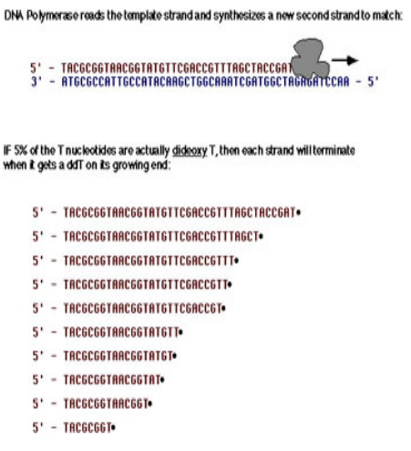
Chain-termination method
DNA replication in the presence of both dNTPs and ddNTPs will terminate the growing DNA strand at each base.
In the presence of 5% ddTTPs and 95% dTTPs Taq polymerase will incorporate a terminating ddTTP at each ‘T’ position in the growing DNA strand.
Notes:
不知道大家這門課上了這麼久以後，是不是都有跟我一樣的疑問，那就是到底我們是怎樣從一條DNA鍊得到那些ATCG的資訊然後得以分析?
這邊介紹的就是一種能分析ATCG的方法。
首先在做DNA複製的時候，我們不丟入一般的ATCG，而是丟入一般的ATCG混入少量的終止子
在複製的時候，DNA聚合酶會將這些終止子當成一般的ATCG放入DNA練中，但這些終止子無法在之後在接上更多的ATCG，因此這段DNA練就聚合中止
這邊的圖以T終止子為例，可以看出由於DNA混入了T終止子因此DNA鍊最後就會以T做結尾。
最後因為T的位置都固定，所以我們會有許許多多多以T為結尾，長短不一的片段

Slide 15
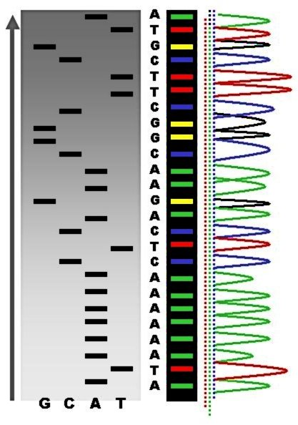
Chain-termination method (cont)
Gel Electrophoresis separates DNA by fragment size. The larger the DNA piece the slower it will progress through the gel matrix toward the positive cathode.
Notes:
有了那些片段之後，我們就可以對那先片段進行電泳
電泳是對微小粒子施加電場後小粒子因帶電而移動的現象
物體移動的速度與帶電量、重量有關，因此較輕的會移動較快，而較重的會留在後面
由於剛剛提到，我們會有許許多多相同重量的片段，因此這些相同重量的片段就會累積在一起
在電泳膠上形成條紋，最後加上終止子上都有做螢光標記
因此我們只要利用螢光標記即可判斷出終止子是為ATCG之中的哪一種
這樣一來我們即得到了reads的值
在利用這堂課教的alignment的方法，我們即可將重疊的部分找出，最終還原成一條完整的genome

Slide 16
Problems
genomes commonly contain large redundant regions (repeats).
regions where the statistical distribution of bases is significantly biased (lowcomplexity DNA)
Notes:
然而這樣的作法也不代表完全沒有問題，可能的問題會發生在當genome本身重複性高時
也有可能發生在當genome本身複雜度低，就是ATCG分布偏向某幾種時
我們的alignment就有可能產生錯誤的重疊，造成某些區域的不確定
但這些問題可以利用較長的read解決，避免錯誤的重疊產生

Slide 17
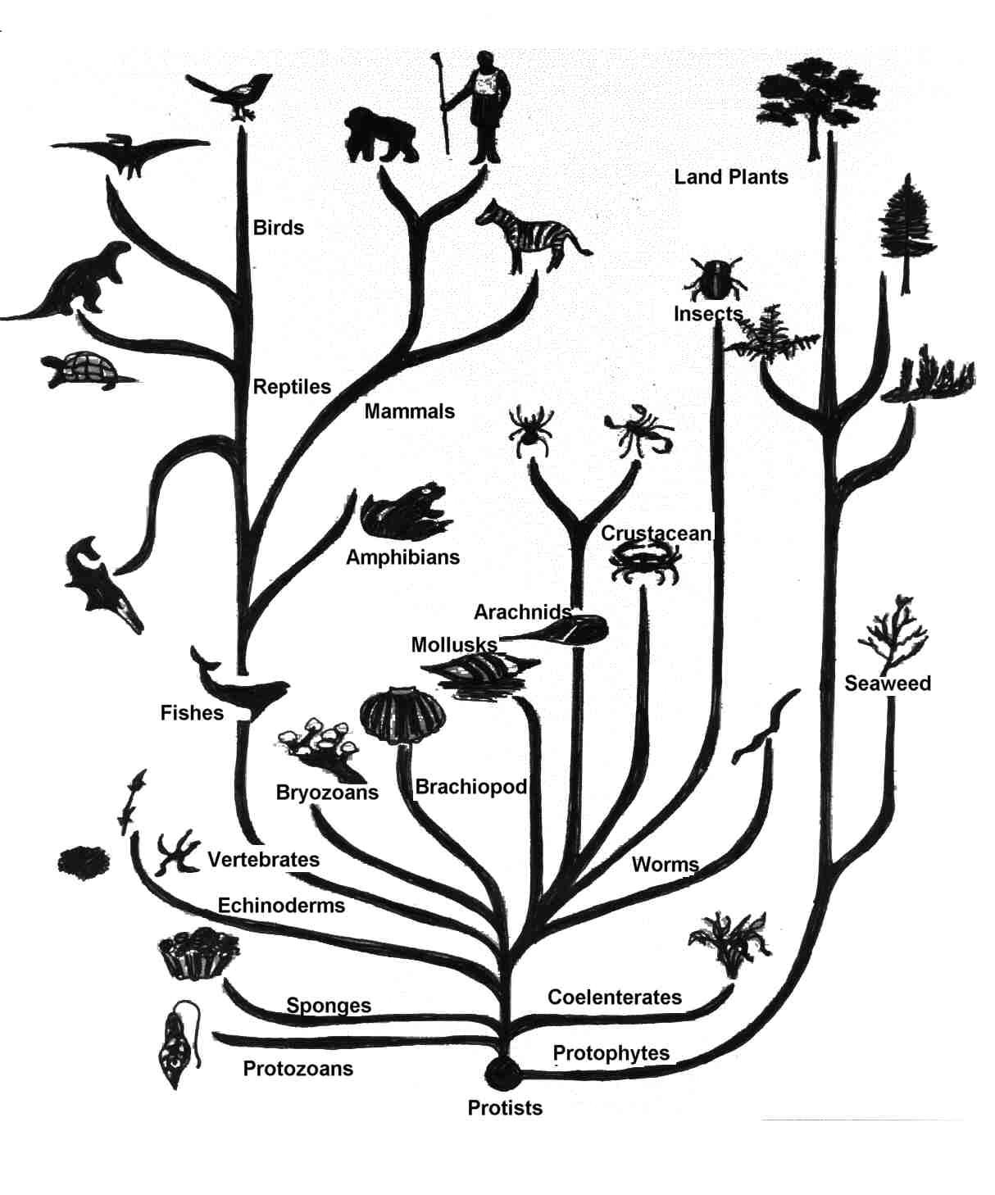
After the first complete
new genomes from that species or closely related species are generally not assembled de novo.
Using the reference genome as a template.
Notes:
再重組完第一個genome之後的genome就不需要從頭到尾重組一遍了
之後就可以拿第一次重組的結果當作參考值，再進行重組
這樣的重組除了可以對同物種，對相近的物種也可以利用這種方式，較快速的進行重組

Slide 18
Modeling the evolution of genotype
李宗燁

Slide 19
Modeling the Evolution of Genotype
Alignment and Assembly
Phylogenetic analysis
Evolutionary relationships between DNA

Slide 20
Alignment and Assembly
Genomes are compared by alignment
Large scale
Indicate changes in segment order and copy number
Small scale
Indicate specific base substitutions

Slide 21
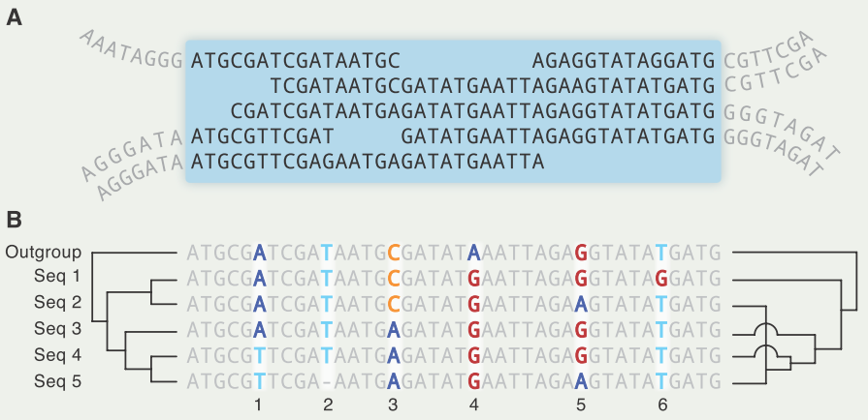
Alignment and Assembly
Alignment
Notes:
outgroup
外類群
維基百科，自由的百科全書
在分支系統學裡，當三個或更多個單系群被相比較時，若到最後，除了其中的一個之外，其他所有的類群之間的關係都比和其之間的關係要來得接近的話，此一類群便被稱之為外類群。這在演化上的意義是，外類群從母群分支出去的時間要早於其他類群相互分支出去的時間。
下面舉出一些例子，其外類群標示在右邊：
人屬、黑猩猩屬；大猩猩屬
真獸下綱、有袋下綱；單孔目
四足動物總綱、輻鰭魚綱；板鰓亞綱
脊索動物門、棘皮動物門；軟體動物門

Slide 22
Alignment and Assembly
Assembly
Primary challenge
Distinguish spurious sequence similarities from those due to common ancestry
Notes:
Genome assembly 組序
Spurious 假的
Linear assembly?
With the assembly optimiser, optimisation for loops can be made very simple.
Linear assembly takes care of the pipeline structure and generates highly parallel assembly code automatically.
The performance of the assembly optimiser can easily reach the performance of hand written assembly code.

Slide 23
Alignment and Assembly
Regions of genomes
Subject to purifying selection
Similarity of sequence is conserved
Orthologous protein-coding regions
Reliably aligned across great evolutionary distances
Between vertebrates and invertebrates
Neutrally drifting
Diverge much more quickly
Can be reliably aligned only if they diverged recently

Slide 24
Alignment and Assembly
Regions of genomes
Therefore, common to distinguish alignments of subregions
Local alignment
Used between conserved functional regions of more distantly related genomes
Full genome alighnments
Be practical when comparing genomes from closely related species

Slide 25
Phylogenetic analysis
Applied to
more than two species
or to multiple gene copies within a species
NP-hard.
Considerable effort has been devoted
Notes:
When applied to more than two species or to multiple gene copies within a species
Finding the optimal phylogeny under probabilistic or parsimony models of indels/substitutions is NP-hard.
Considerable effort has been devoted to obtaining efficient and accurate heuristic solutions.
https://zh.wikipedia.org/wiki/%E7%B3%BB%E7%BB%9F%E5%8F%91%E7%94%9F%E5%AD%A6
phylogenetic analysis 親緣關係學，是指在地球歷史發展過程中生物種系的發生和發展。
Phylogenetics，簡稱為譜系學

Slide 26
Phylogenetic analysis
Complicated by homologous recombination
Creates DNA molecules whose parts have different evolutionary histories
Notes:
在同源的觀念中，常常見到這三個專有名詞"homologous、paralogous、orthologous" 其差異為: Homologous (同源) = paralogus (旁系同源) + orthologous (直系同源) Orthologous (直系同源) : 不同物種間負責相同功能的構造(可以指基因、蛋白質或構造) Paralogus (旁系同源) : 同一物種 (或不同物種)內負責類似功能的兩構造 (可以指基因、蛋白質或構造) 例子: 1. 人的血紅蛋白包括四種 : 血紅蛋白A，血紅蛋白A2，血紅蛋白S和胎兒血紅蛋白，彼此間為旁系同源 ；
免子與人類的血紅蛋白A 彼此間為直系同源

Slide 27
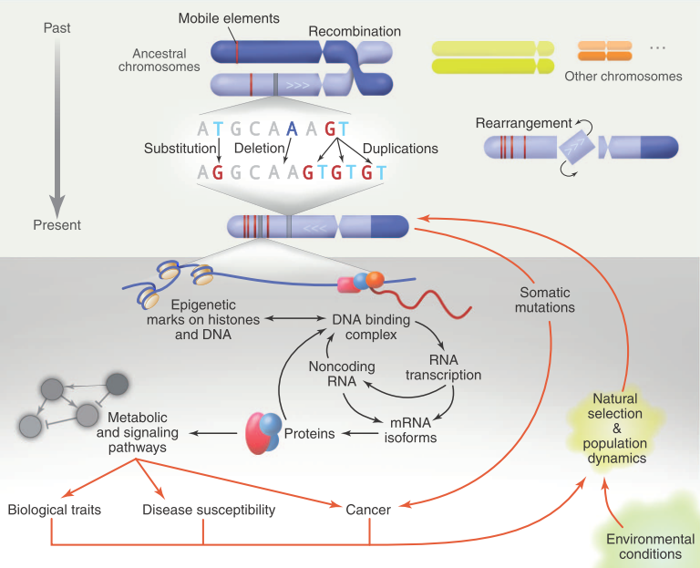
Notes:
Homologous recombination - Wikipedia, the free encyclopedia
同源重組（英語：Homologous recombination）是遺傳重組的一種類型，指兩股具有相似序列的DNA的重新排列，使遺傳物質發生交換。可發生於自然界中，或應用於人工的分子生物學技術。
真核生物體內的同源重組過程中發生於減數分裂時期，是染色體互換所造成的結果。除此之外，同源重組也能使遭受損害的染色體，得以利用與自身相似，且未受傷害的另一條染色體，來進行DNA修復作用[1]。細菌的同源重組，則發生於細菌進行接合（conjugation）、導入（transduction）或是轉型（transformation）的過程中。
許多技術利用重源重組將基因導入生物個體中，形成重組DNA[2]，方法又稱基因標的（gene targeting）。

Slide 28
Evolutionary relationships between DNA
Balanced structural rearrangements
Change the order and the orientation of the bases in the genome
substitutions
Segmental duplications/gains/losses
Alter the number of copies of homologous bases
Short indels
Unfortunately, there process are usually modeled and treated separately
Notes:
Indel
molecular biology term for the insertion or the deletion of bases in the DNA of an organism

Slide 29
Evolutionary relationships between DNA
Construction of a mathematically and algorithmically tractable unified theory
remains a major challenge for the field.
Notes:
Indel
molecular biology term for the insertion or the deletion of bases in the DNA of an organism

Slide 30
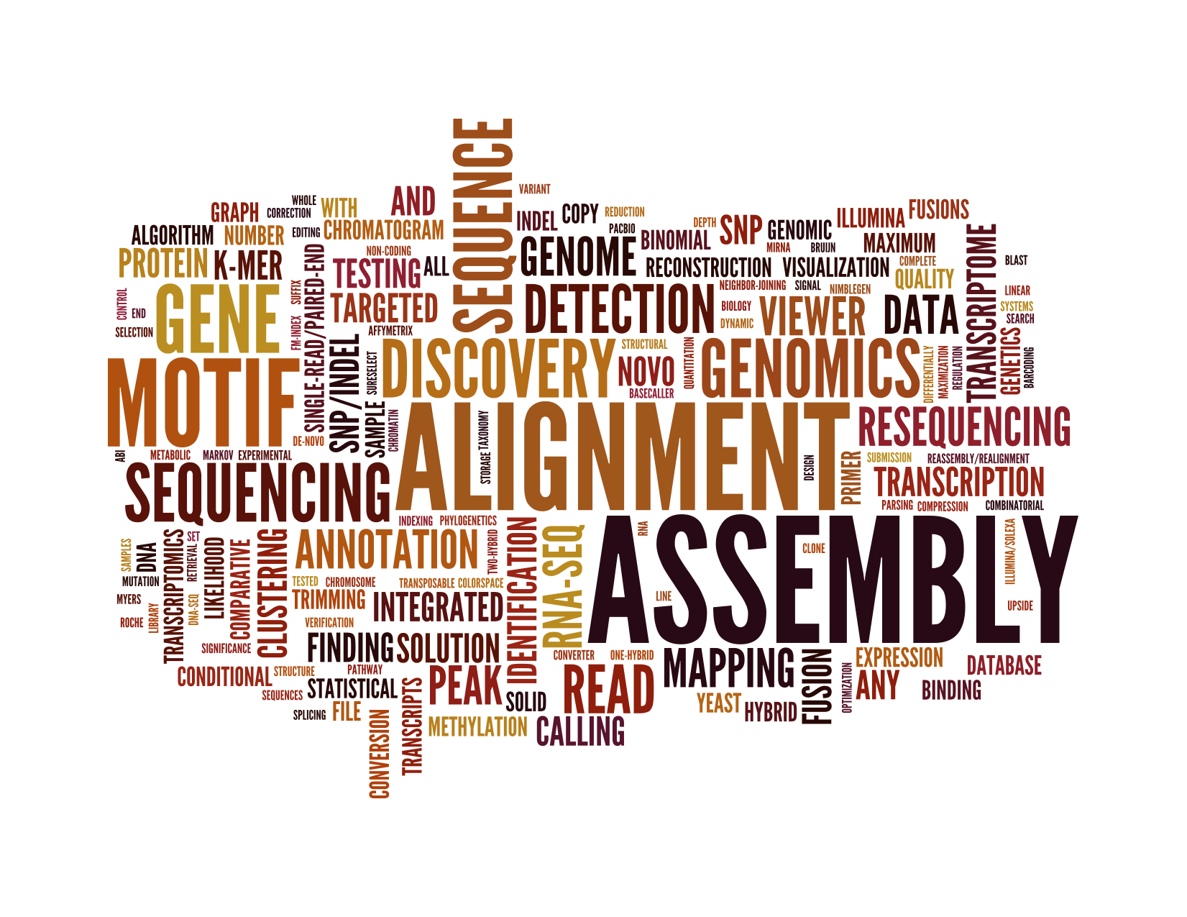
From genotype to phenotype
R01945042
林修竹

Slide 31
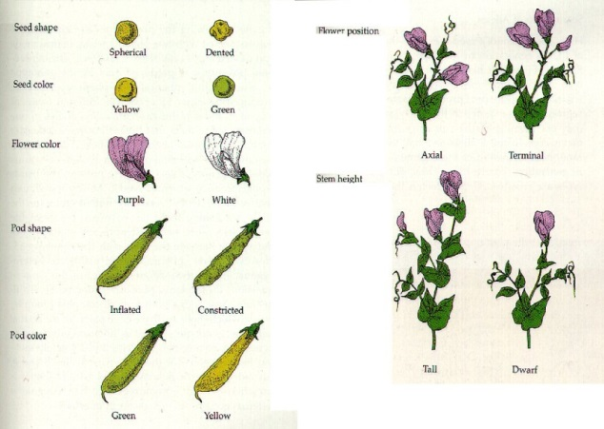
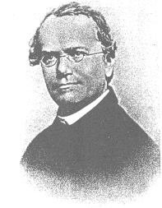
Gregor Mendel
Austrian Monk who experimented with pea plants
He noticed that not all peas are the same:
Green vs. yellow
Tall vs. short
Round vs. wrinkled
He discovered that crossing peas depended on the genes of the plant rather than only the outward appearance of the plant
Unless otherwise noted, all pictures come from Mr. Henne’s genetics powerpoint

Slide 32
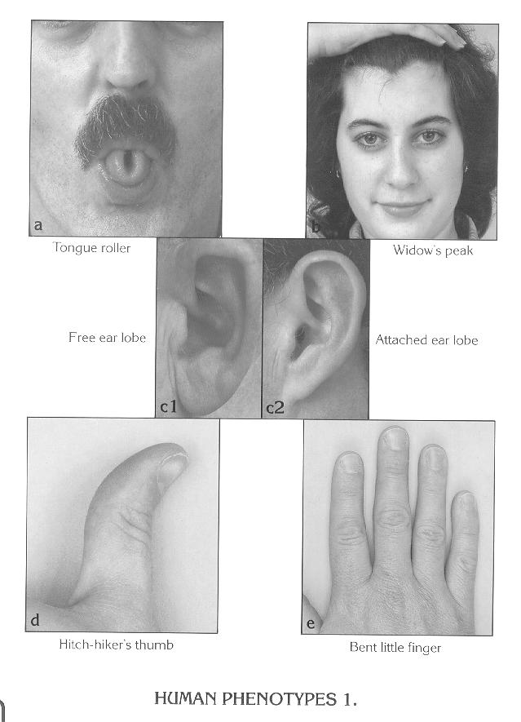
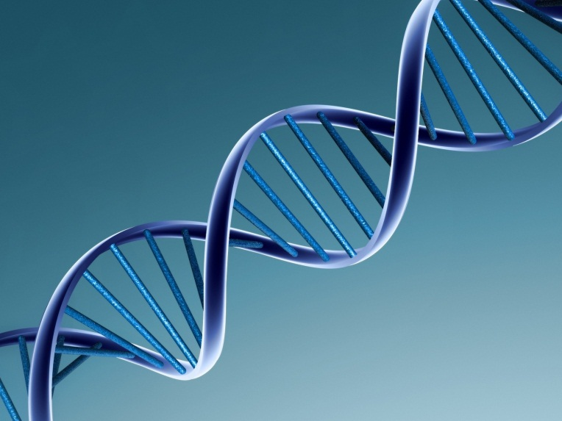
Phenotype vs. Genotype
Phenotype: the physical appearance of a plant or animal because of its genetic makeup (genotype)
Genotype: genetic constitution (makeup) of an individual
www.ansi.okstate.edu/breeds/swine/

Slide 33
The Punnett Square
A way for determining the genotype and phenotype of offspring
Capital letters are assigned to dominant genes and lower-case letters are assigned to recessive genes

Slide 34
Using the Punnet Square
Purebred (homozygous) dominant – the genes only have the dominant trait in its code.
Example – Dominant Tall -- TT
Purebred (homozygous) recessive – the genes only have the recessive trait in its code.
Example – Recessive short – tt
Hybrid (heterozygous) – the genes are mixed code for that trait.
Example – hybrid Tall -- Tt
T
T
t
Tt
Tt
t
Tt
Tt

Slide 35
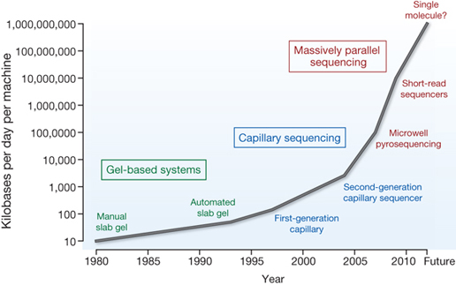
Massive increase in Sequencing Speed
Macmillan Publishers Ltd: Nature 458, 719-724 (2009).

Slide 36
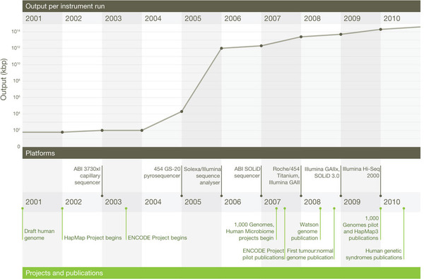
A decade’s perspective on DNA sequencing technology
Elaine R. Mardis
Nature 470, 198–203 (10 February 2011) doi:10.1038/nature09796Published online 09 February 2011

Slide 39
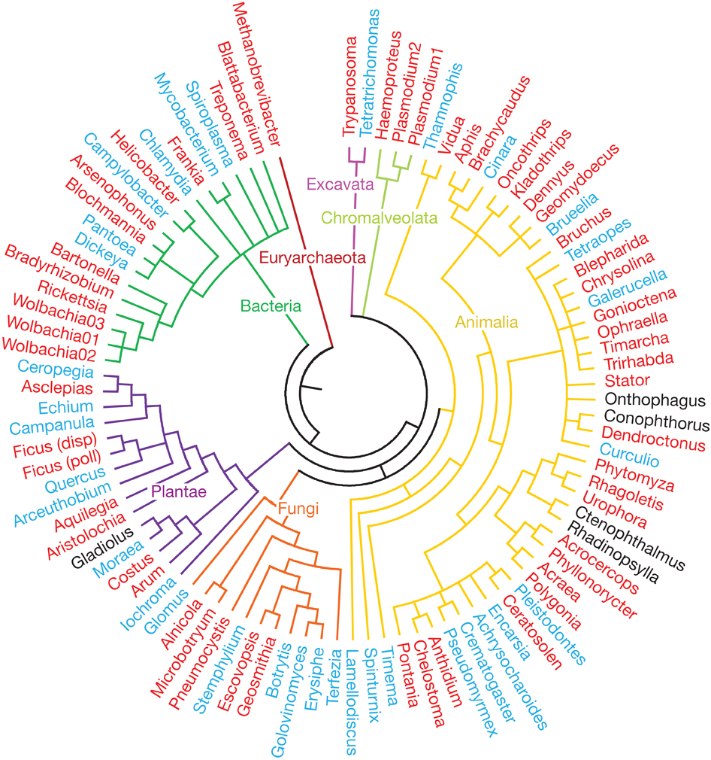
New Methods of Exploring
Cross Species
History and diversity of life
Climate, competitor, disease
Ecological interactions are evolutionarily conserved across the entire tree of life
José M. Gómez,
Miguel Verdú
& Francisco Perfectti
Nature 465, 918–921 (17 June 2010) doi:10.1038/nature09113

Slide 40
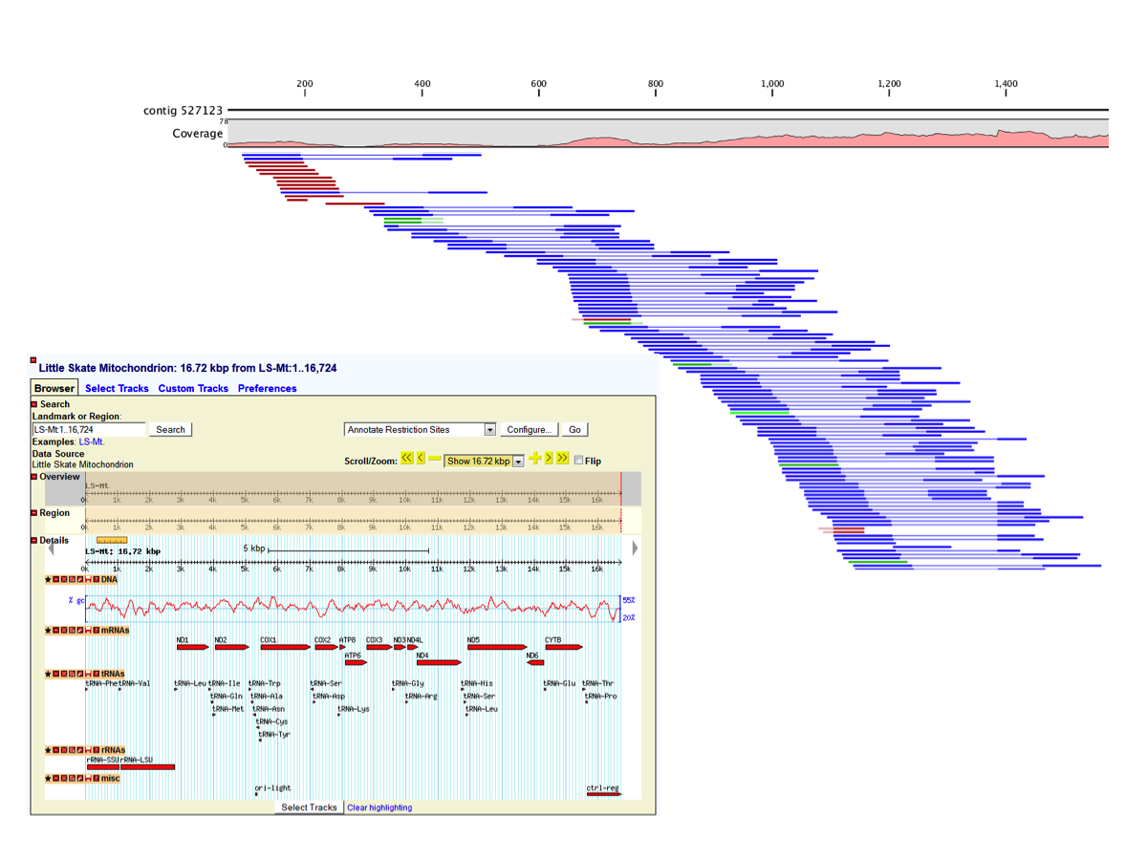
More Studies will be Derived From Experimental Data

Slide 41
Single Specie Human Genome Studies
Mendelian
Complex
Number of Genes | Single | Multiple
Frequency of genetic defects | Rare (< 1%) | Common (> 1%)
Effect Size | Large | Small
Type of Study | Linkage Analysis | Association Studies

Slide 42
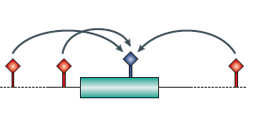
Association studies are critical to the study of complex diseases
Association
Tag, or genotype, SNPs on the basis of Linkage Disequilibrium patterns.
Select tags to provide as much information about surrounding region based on association with untagged SNPs.
Even if causal polymorphism is not tagged, it will be captured by proxy with an associated SNP that is tagged.
Source: Hirschhorn and Daly (2005)

Slide 43
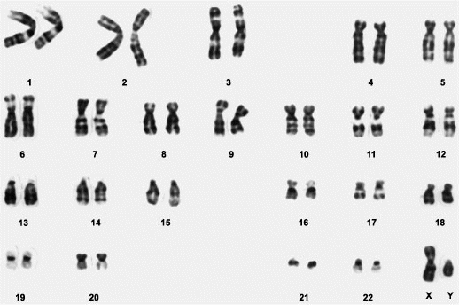
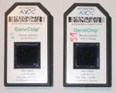
Genome-Wide Association (GWA) addresses some of these issues.

Slide 44
GWA has multiple advantages
Discovery
Studies not limited to current biological knowledge
Quantitative
Better characterize complex, quantitative traits

Slide 45
GWA has multiple advantages
Discovery
Studies not limited to current biological knowledge
Coronary Heart Disease (CHD)
Type 2 Diabetes
Recent GWA studies discovered:
Associated regions containing no annotated genes
Tagged SNPs not associated with any established
risk factors

Slide 46
GWA has multiple advantages
Quantitative
Better characterize complex, quantitative traits
Cardiac Arrhythmias
Identification of polymorphism accounting for variance of quantitative trait

Slide 47
Going forward
Association Studies
Cannot provide unambiguous identification of causal genes
But
can highlight pathways and mechanisms of particular interest.

Slide 48
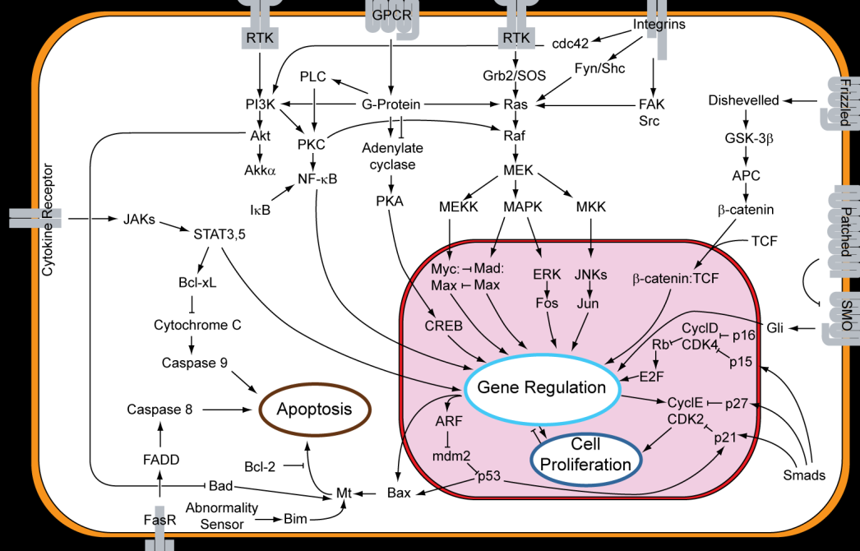
Leading to systems-level understanding of genetics and disease
Source: Wikipedia

Slide 49
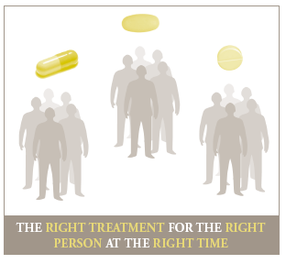
And Better Medicine!
Source: PMC 2006

Slide 50
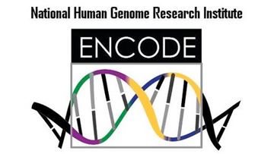
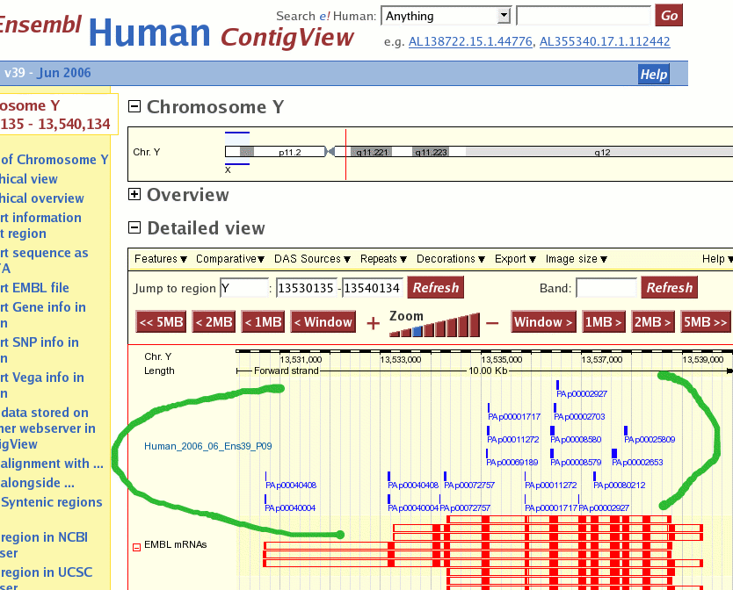
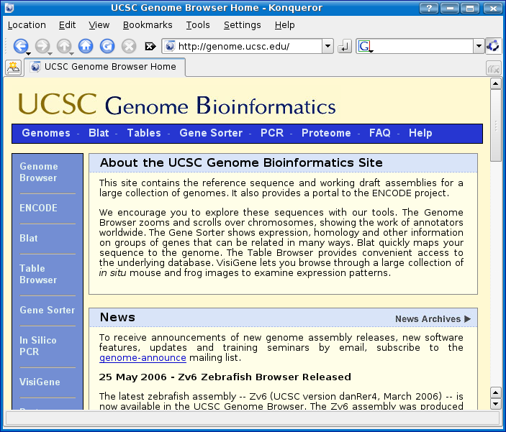
Databases
ENCODE
Epigenetics roadmap
modENCODE
EMSEMBL
UCSC Gene Browser
Notes:
The Encyclopedia of DNA Elements (ENCODE) Consortium is an international collaboration of research groups funded by the National Human Genome Research Institute (NHGRI). The goal of ENCODE is to build a comprehensive parts list of functional elements in the human genome, including elements that act at the protein and RNA levels, and regulatory elements that control cells and circumstances in which a gene is active.

Slide 51
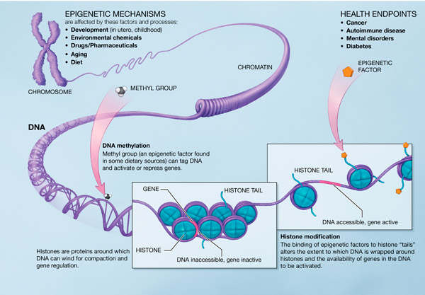
Epigenetics, RNA, Protein

Slide 52
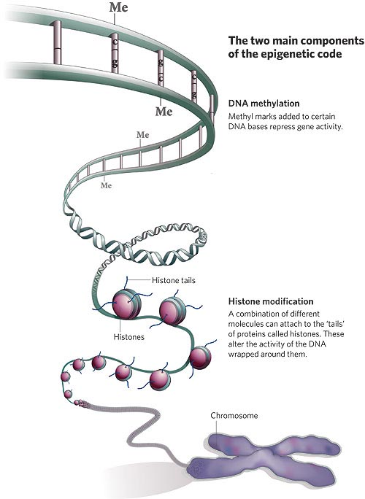
Epigenetics, RNA, Protein
Can’t be directly measured
Inferred by mathematical model
Markov Models
Factor Graphs
Bayesian Networks
Markov Random Fields

Slide 53
Example: Bayesian Networks Framework for testing association of untyped genotype to phenotype
Step 1
Step 2
Estimate, or impute, the genotypes of unmeasured SNPs using known patterns of correlation with tagged SNPs
Assess association between phenotype and genotypes, tagged and untagged
Greater power to detect associations
Better explanations of detected associations

Slide 54
Step 1 of the Analysis: Linking Genotype to Genotype
Use PHASE algorithm* to calculate Linkage Disequilibrium probabilities
Use these probabilities to impute untyped SNPs
*Stephens, M., Smith, N., and Donnelly, P. (2001). A new statistical method for haplotype reconstruction from population data. American Journal of Human Genetics, 68, 978--989.

Slide 55
Step 2 of the Analysis: Linking Genotype to Phenotype
Bayesian Regression Model
Regress on genotypes to arrive at estimates of phenotype

Slide 56
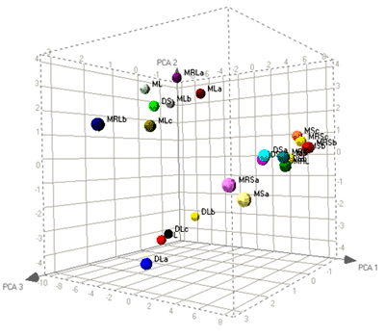
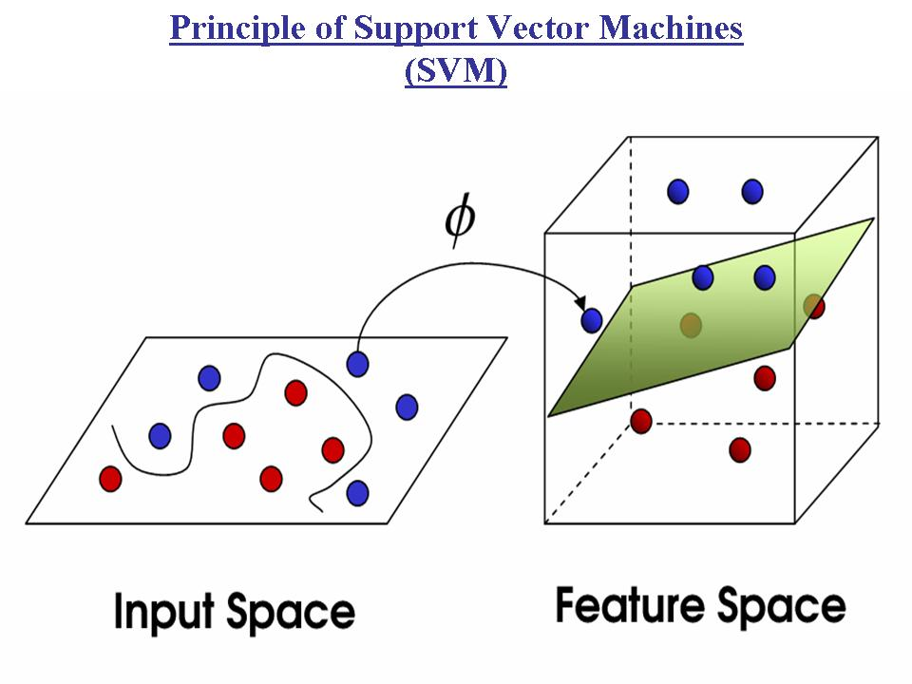
Classification and Regression model
Classification of Epigenetic, Transcripitional, Proteomic state to predict phenotype to genotype

Slide 57
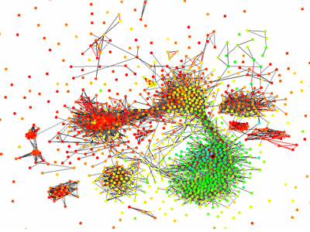
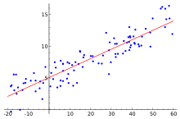
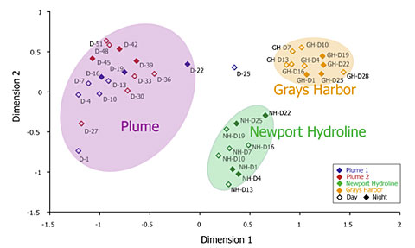
MDS

Slide 58
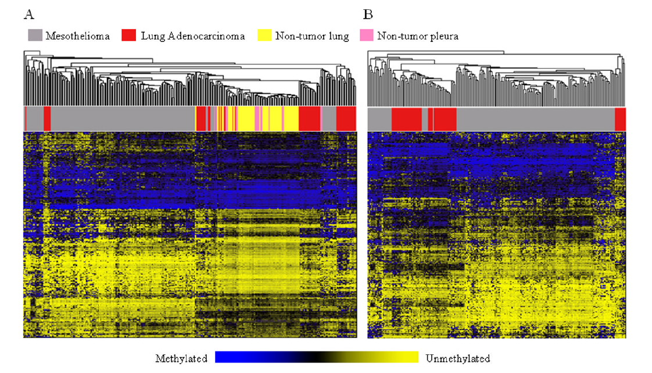
Clustering analysis

Slide 59
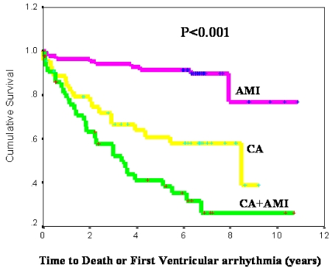
Cox Regression

Slide 60
Looking ahead to application
田耕豪 廖奎達

Slide 61
Applications
Medicine
Cancer
Vaccine
Stem cell
Agriculture
Human Prehistory

Slide 62
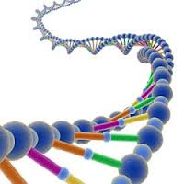
Applications
Cancer
Genomic modifications are the source of nearly all cancers.
圖片來源：http://www.easyoops.com/how-dna-mutations-are-fixed

Slide 63
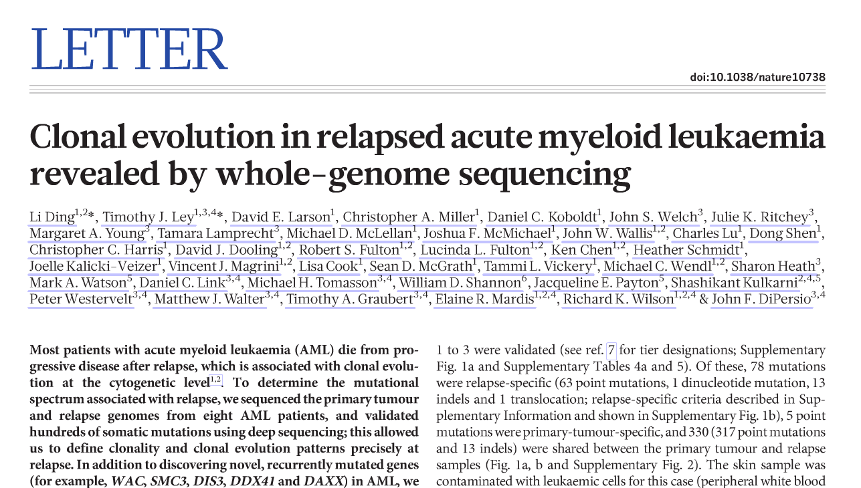
Applications

Slide 64
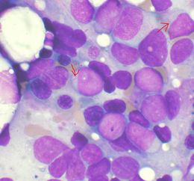
Applications
Acute Myeloid Leukemia (急性骨髓性白血病)
骨髓性造血芽細胞異常增殖的血液惡性腫瘤
圖片來源：wiki (http://zh.wikipedia.org/wiki/%E6%80%A5%E6%80%A7%E9%AA%A8%E9%AB%93%E6%80%A7%E7%99%BD%E8%A1%80%E7%97%85)

Slide 65
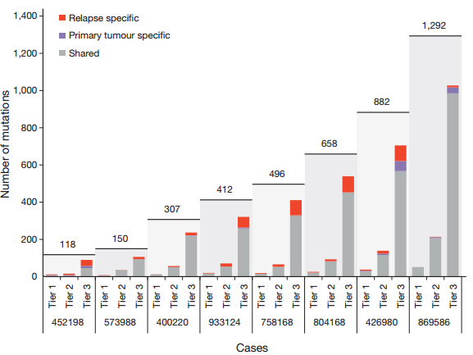
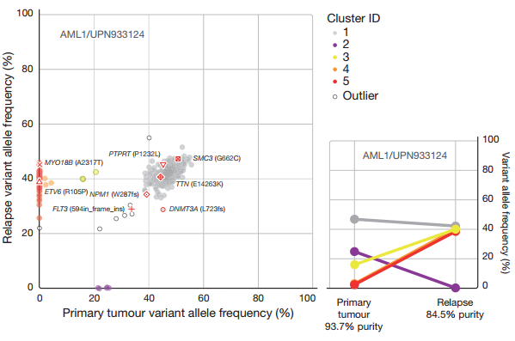
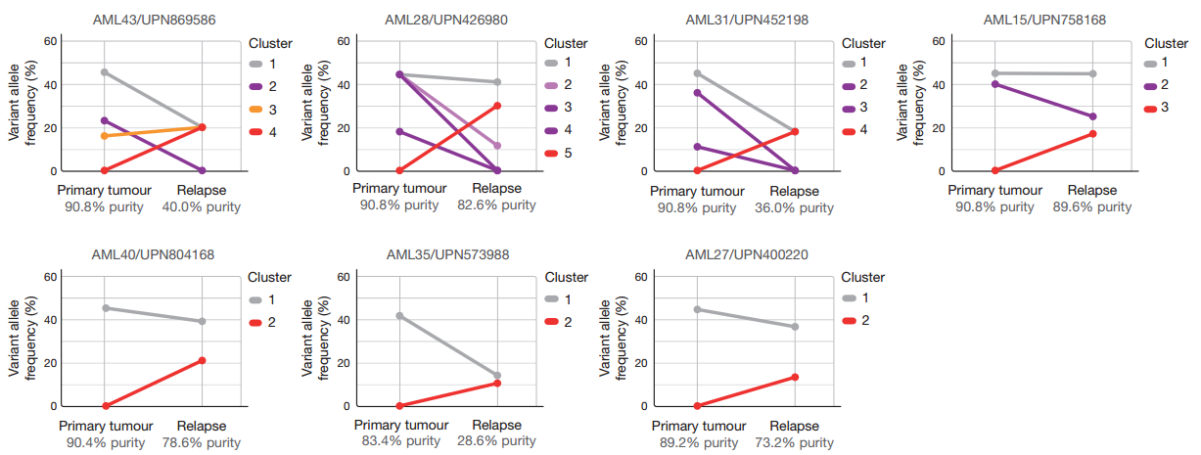
Applications

Slide 66
Applications
Coding mutations identified in eight primary tumor–relapse pairs

Slide 67
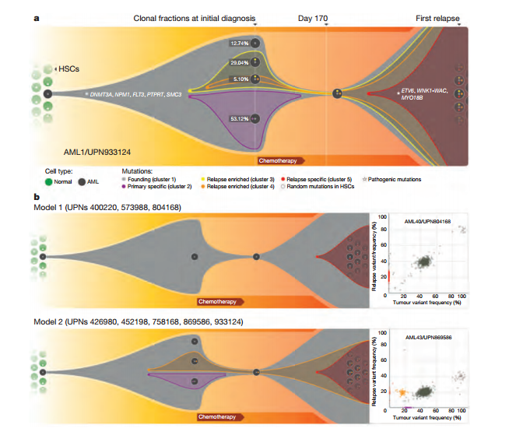
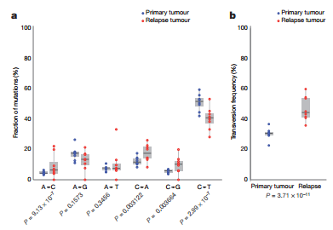
Applications

Slide 68
Applications
High-throughput genomics data
Vaccine design
Treatment of disease
Infectious disease
Autoimmune diseases
Immunodeficiency

Slide 69
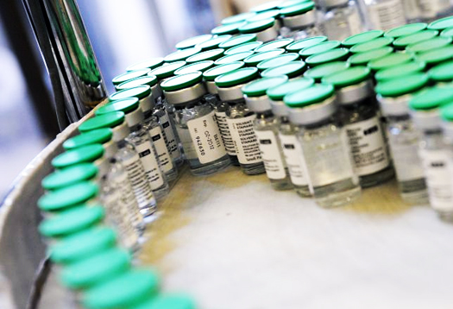
Applications
Vaccine
http://www.futurity.org/wp-content/uploads/2012/08/vaccine_factory_1.jpg

Slide 70
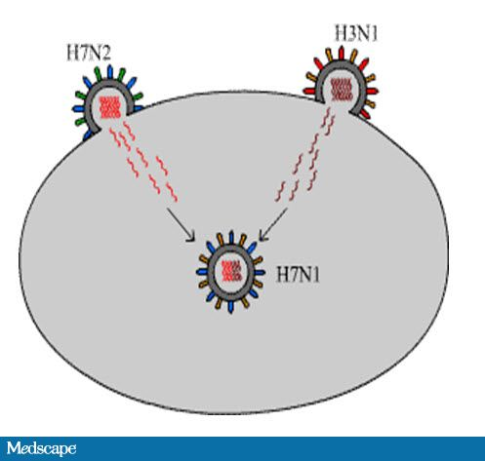
Applications
Vaccine
Every year in February…
http://www.medscape.org/viewarticle/727475

Slide 71
Application
Stem-cell
Genomic variants
Epigenetic state
Expression pattern
Induced pluripotent stem (iPS) cells and lineage-specific directly reprogrammed cells
Mutation is assessed with whole-genome analysis

Slide 72
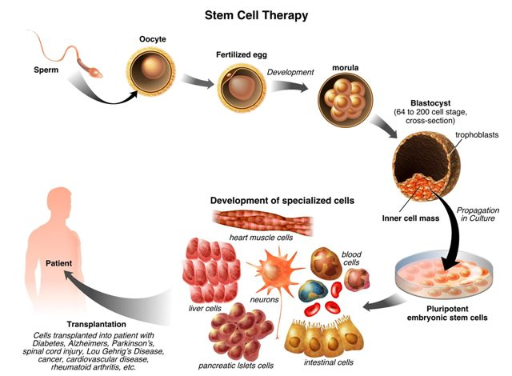
Application
http://www.stemcellsforhope.com/Stem%20Cell%20Therapy.htm

Slide 73
Application
Next step…
Integrating advances of different research fields
Combining above into mathematical models
Build comprehensive and computable models
So we can…
Explore and exploit the genome structures and processes lying at the heart of life

Slide 74
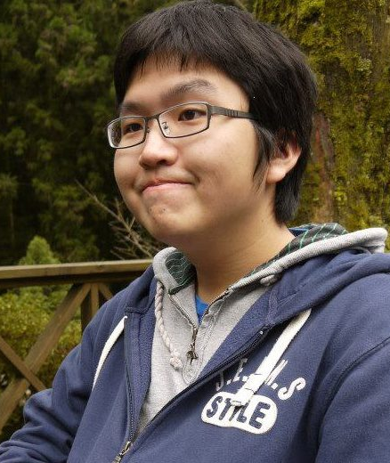
Thank You for
Your Attention!!!!!!

