Slide 1
Big Data: The future of biocuration

Slide 2
First of all, let’s make some sense of biocuration

Slide 3
What is biocuration?
Biocuration involves the translation and integration of information relevant to biology into a database

Slide 4
Why I need to sit here for 50 minutes to listen to your presentation??

Slide 5
Let me share some stories first…

Slide 6
Shinya Yamanaka

Slide 7
An Interesting And Successful example Galaxy Zoo

Slide 8
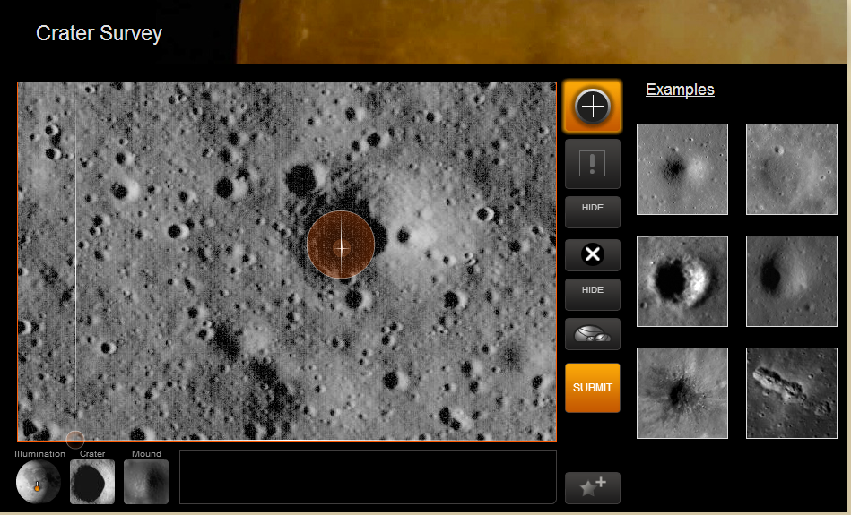

Slide 9
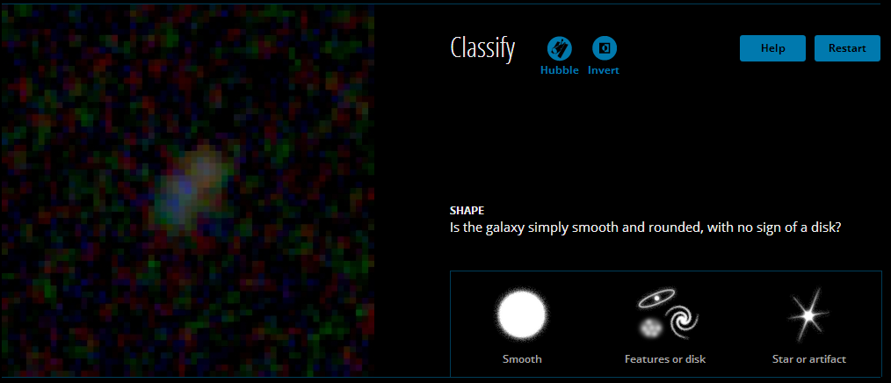

Slide 10
Three urgent actions
Immediately begin to work together to facilitate the exchange of data between journal and databases

Slide 11
2. In the next five years, curators, researchers and university administrations should develop an accepted recognition structure

Slide 12
3. Curators, researchers, academic institutions and funding agencies should, in the next 10 years, increase the visibility and support of scientific curation as a professional career

Slide 13
Data avalanche
Biology is in an era of accelerated information accrual and scientists increasingly depend on the availability of each others’ data.
By July 2008, more than 18 million articles
had been indexed in PubMed
Nucleotide sequences from more than 260,000 organisms had been submitted to GenBank.
GenBank ® is the NIH genetic sequence database, an annotated collection of all publicly available DNA sequences
The recently announced project to sequence 1,000 human genomes in three years to reveal DNA polymorphisms (www.1000genomes.org)

Slide 14
Goal of the 1000 Genomes Project is to find most genetic variants that have frequencies of at least 1% in the populations studied.
The 1000 Genomes Project is the first project to sequence the genomes of a large number of people, to provide a comprehensive resource on human genetic variation.
Recent improvements in sequencing technology have sharply reduced the cost of sequencing.
Data from the 1000 Genomes Project will be made available quickly to the worldwide scientific community through freely accessible public databases.

Slide 15
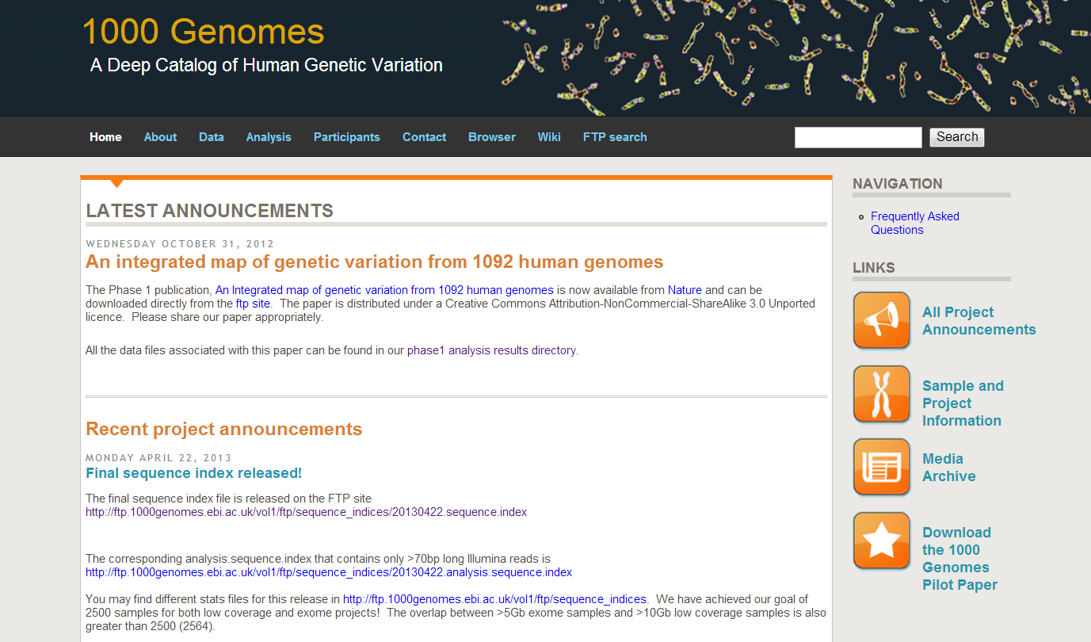

Slide 16
幕後英雄 Biocurators

Slide 17
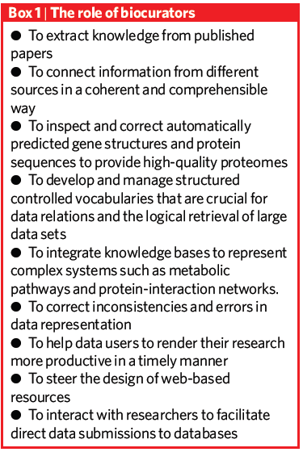
The role of biocurators
Manage raw biological data
Extract information from published literature
Develop structured vocabularies to tag data
Make the information available online

Slide 18
Between Biocurators
Goals
To exchange ideas and methods
To facilitate collaborations and training
Ways
more than 150 biocurators met at two international conferences
created a mailing list and a website (www.biocurator. org).

Slide 19
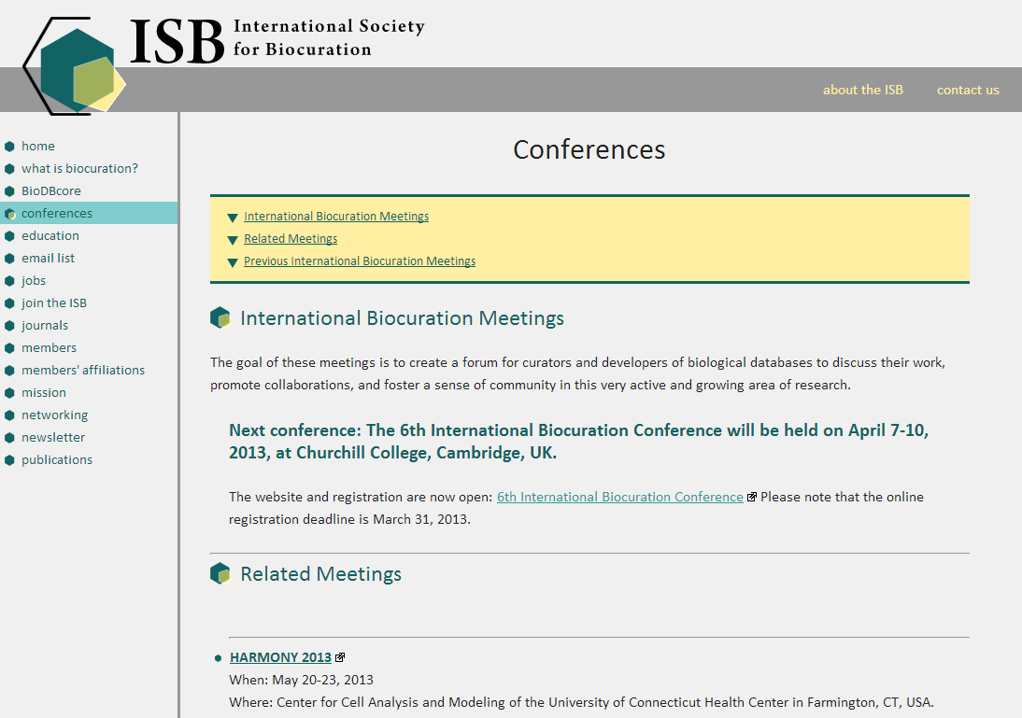

Slide 20
Information Identify
How information is presented in the literature greatly affects how fast biocurators can identify and curate it
The entities discussed in a paper, including species, genes, proteins, genotypes and phenotypes must be unambiguously identified during curation.
Benefits: save time、avoid errors
HUGO Gene Nomenclature Committee resource

Slide 21
It is necessary to provide a unique symbol for each gene so that we and others can talk about them, and this also facilitates electronic data retrieval from publications and databases.
For each known human gene we approve a gene name and symbol
Each symbol is unique and each gene is only given one approved gene symbol.
All approved symbols are stored in the HGNC database.

Slide 22
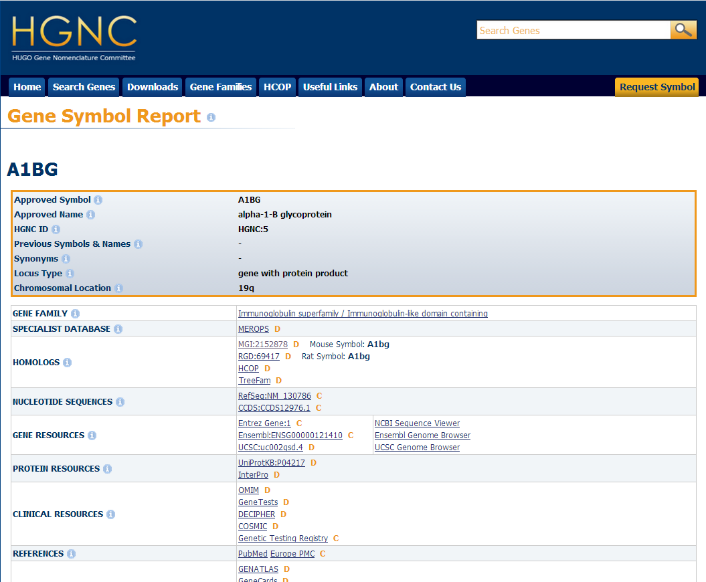

Slide 23
Community Curation

Slide 24
Community Curation (1)
Emerging standards of data reporting is promising
Data generation rate is faster and faster
Need to do annotation effort to scale up to the rate of data generation or the research speed will be slow down by un-annotated data
>50% time is used to gather & handle inconsistent data formats

Slide 25
Community Curation (2)
Annotation tools & Tool development
Standardized methods
Oversight by expert curators
Maintain consistency & accuracy
Social infrastructure
Training & Feedback

Slide 26
Lack of incentive
Not so much research communities are doing biocuration
Need a mechanism tied to career or research advancement

Slide 27
Incentive for researchers
New information or insight for their research interest
Improvement in academic reputation or impact
Career advancement and better funding chances

Slide 28
Consortium-based publication mechanism
Suitable for communities that lack funding for dedicated curators
Reward structure
Share consortium publication authorship
Subsequent satellite papers

Slide 29
Wiki-based mechanism
Provide a infrastructure for contributors to be recognized
But no standard practice for them the be cited like a publication
Need to develop a standard mechanism for citing data sets

Slide 30
Curators can be …
Researcher
General Public
Is that possible!?

Slide 31
Public-based(?) mechanism
Need to develop a way to allow general public to participate in biocuration
Ex: show user an image of in situ hybridization and ask them to grade it as “not expressed”, “restricted” or “ubiquitous expression”
Provide user basic knowledge and much of easy work can be done as first-pass annotation

Slide 32
Consortium-based publication mechanism
Suitable for communities that lack funding for dedicated curators
Reward structure
Share consortium publication authorship

Slide 33
Example 1
Daphnia Genomics Consortium(consists of over 475 scientists)
https://wiki.cgb.indiana.edu/display/DGC/Home

Slide 35
Example 1
Daphnia Genomics Consortium(consists of over 475 scientists)
Sequencing the genome at Joint Genome Institute in Walnut Creek, California

Slide 36
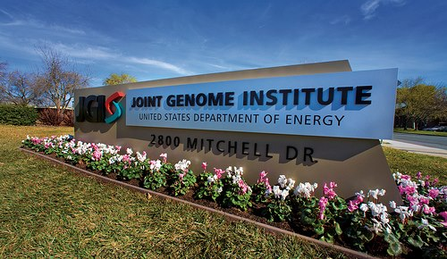

Slide 37
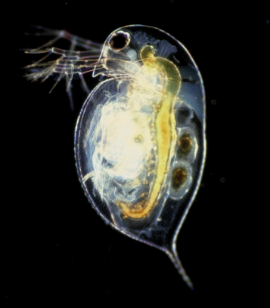
Daphnia (Water flea)

Slide 38
Daphnia 水蚤
生活在水中的浮游生物
約150種
介於0.2 ~ 5 mm
身上有半透明的殼
對於生存環境的變化很敏感，適應力強
子代基因中的變化，可用來理解基因體對於環境壓力的反應(因此可用來理解生態環境與基因體的關係)

Slide 39
Example 1
Daphnia Genomics Consortium(consists of over 475 scientists)
Sequencing the genome at Joint Genome Institute in Walnut Creek, California
Genome is annotated by contributors
Share publication authorship as a consortium

Slide 40
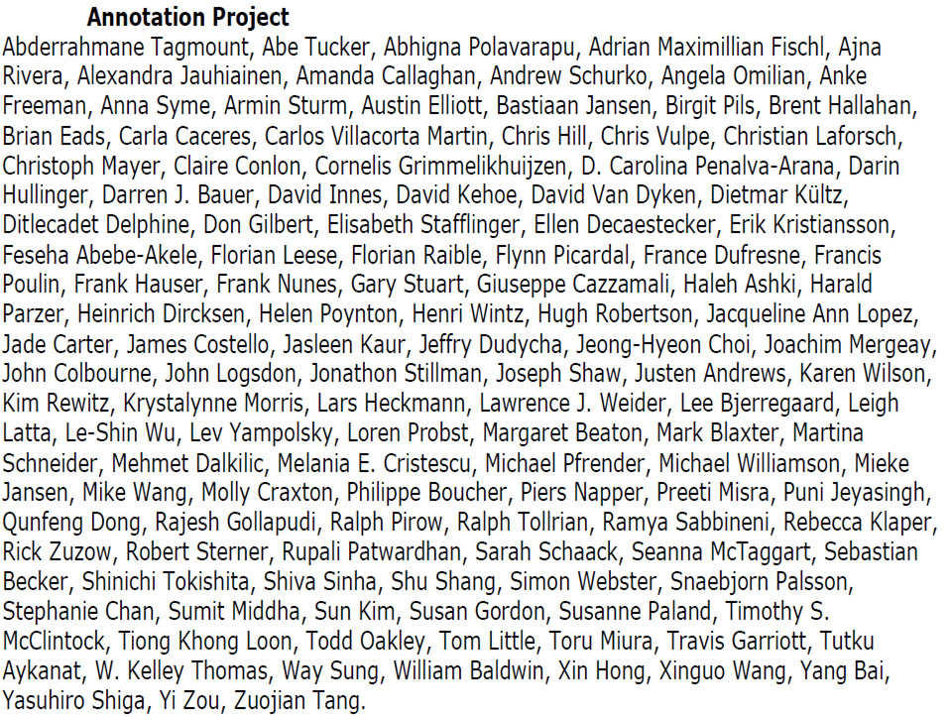
Fifty + published Daphnia Genome Project manuscripts

Slide 41
Example 2
Gene Wiki Project
http://en.wikipedia.org/wiki/Portal:Gene_Wiki#Editing_FAQ
Applying community intelligence to the annotation of gene and protein function
Editors? Students? Professionals? Academics?
Let’s browse around!!

Slide 42
Current status of Biocuration

Slide 43
GMOD
Generic Model Organism Database project
http://www.gmod.org/wiki/Main_Page
Notes:
create a small laboratory database of genome annotations, or a large web-accessible community database.

Slide 44
Model Organism Databases
FlyBase flybase.org Drosophila Database
The Generic Model Organism Project (GMOD) gmod.org/wiki/Main_Page A Toolkit for Creating New Community Databases of Biology
Gene Ontology Consortium www.geneontology.org Controlled Vocabularies for Gene Product Attributes
SGD www.yeastgenome.org Saccharomyces Genome Database
UCSC Genome Bioinformatics genome.ucsc.edu A Portal for Genomic Data
UniProt KnowledgeBase www.uniprot.org A Portal for Curated Information of Protein Sequence, Classification and Function
Notes:
生物學家在過去十年已經很習慣上網取得需要的資料來做分析和整合，這裡是一些公開的資料庫，根據統計，每個月有超過75萬個不同ip的使用者在使用這些資料庫。

Slide 45
Model Organism Databases
MGI www.informatics.jax.org The Mouse Genome Database
Reactome www.reactome.org A Curated Resource of Core Pathways and Reactions in Human Biology
RGD www.rgd.mcw.edu The Rat Genome Database
WormBase www.wormbase.org The C. elegans Genome Database
zfin.org http://zfin.org/cgi-bin/webdriver?MIval=aa-ZDB_home.apg The Zebrafish Information Network
Notes:
生物學家在過去十年已經很習慣上網取得需要的資料來做分析和整合，這裡是一些公開的資料庫，根據統計，每個月有超過75萬個不同ip的使用者在使用這些資料庫。

Slide 46
IDs
Approved gene symbols (which are inherently unstable)
Model-organism database IDs for genes (which do not change)
GenBank or Uniprot ID for nucleotide or protein
National Center for Biotechnology Information (NCBI) Taxon IDs
the Gene Ontology (GO) IDs
Enzyme Commission (EC) numbers.
Notes:
公認的基因資料編號方式，在論文或期刊裡提到基因序列的時候。

Slide 47
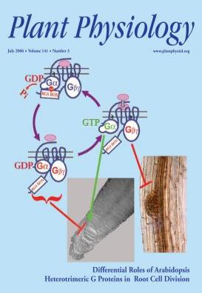
Journals
Notes:
FEBS 讓作者提供一些機器可讀的 XML 檔案以供分析，Plant Physiology跟 tair 合作讓作者上傳資料庫到tair(臺灣學術機構典藏)上

Slide 48
circurrium for biocuration

Slide 49
skill
advanced scientific research
competence in database management systems
multiple operating systems
scripting languages

Slide 50
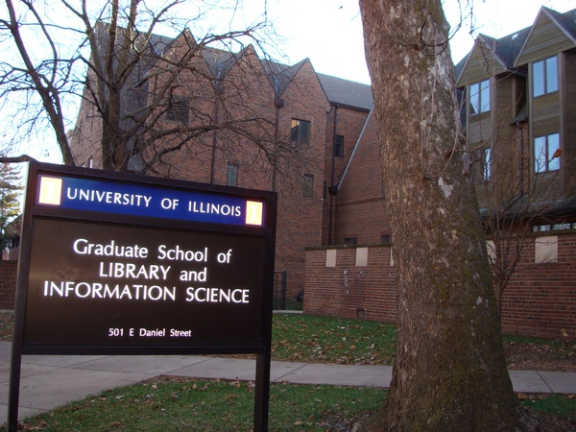
Graduate School of Library and Information Science (GSLIS)

Slide 51
Area of research
History, economics, policy
Information organization and knowledge representation
Information resources, uses, and users
Information systems
Management and evaluation
Social, community, and organizational informatics
Youth literature and services

Slide 52
Target areas for doctoral student
cross-disciplinary data sharing and reuse potentials
ontology of datasets, formats, provenance, identity conditions
metadata for description, discovery, interpretation, integration
interoperability, provenance, , preservation, and reuse
research data in the scholarly communication continuum
trust, security, confidentiality, ownership, quality, attribution

Slide 53
Target areas for master student
understanding of clients' information needs and content
ability to critically evaluate, select, and filter data resources
ability to find, evaluate, and synthesize relevant data sources
ability to manage many aspects of the data lifecycle
understanding of how to manage the diversity, size, and complexity of current and future data sets.

Slide 54
必修課程
Information Organization and Access
Libraries, Information and Society

Slide 55
其他選修學分
LIS456 Information Storage and Retrieval LIS490MU Museum Informatics LIS503 Use and Users of Information LIS522 Information Sources and Services in the Sciences LIS530B Health Sciences Information Services and Resources LIS530I Bio Informatics Problems and Resources LIS581 Administration and Use of Archival Materials LIS582 Preserving Information Resources LIS590BDI Biodiversity Informatics LIS590DE Design of Digitally Mediated Information Services LIS590DH Digital Humanities LIS590DP Document Processing LIS590EP Electronic Publishing LIS590II Interfaces to Information Systems LIS590OH Ontologies in Humanities OR LIS590ON Ontologies in the Natural Sciences LIS590SD Digital Social Sciences LIS590TR Information Transfer and Collaboration in Science

Slide 56
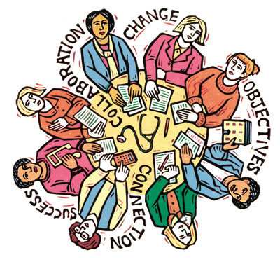
Roundtable

Slide 57
internship

Slide 58
National Snow and Ice Data Center (NSIDC)

Slide 59
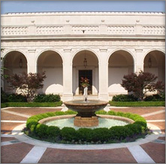
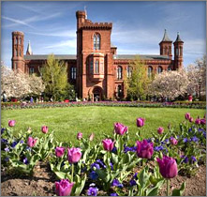
Smithsonian Institution, Digital Services Division

Slide 60
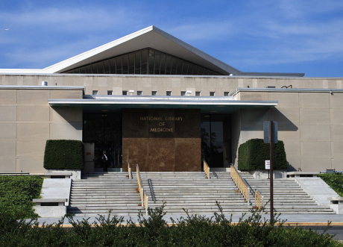
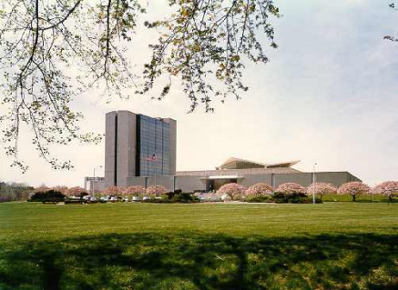
National Library of Medicine

Slide 61
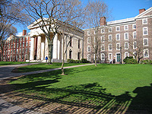
Brown University Women’s Writers Project

Slide 62
Occupation of Biocuration

Slide 64
National Human Genome Research Institute
www.genome.gov

Slide 65
Others
Protein data bank - Biochemical
Information & Annotation Specialist
Swiss Institute of Bioinformatics – Scientific Biocurator
Scientific Data – Editorial Biocurator
Genetics Society of America - Research Scientist

Slide 66
Thank you
Questions?

