Slide 1
DNA Nanotechnology:
Geometric sorting boards
David W. Grainger
Nature Nanotechnology 4, 543 - 544 (2009)
doi:10.1038/nnano.2009.249
呂昶諄 許祐程 梁閎鈞 邵明偉
謝政佑 魏偉峰 林雨澤 吳柏均

Slide 2
Outline
Overview
Materials with DNA
DNA Origami and surface placement
Applications of DNA Origami

Slide 3
Overview
呂昶諄

Slide 4
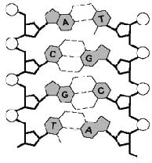
Overview
DNA nanotechnology
  the design and manufacture of artificial nucleic acid structures for technological use.
Why we use DNA
  Nature-born nano-scale
  Self-assembly
    Spontaneously form functional devices

Slide 5
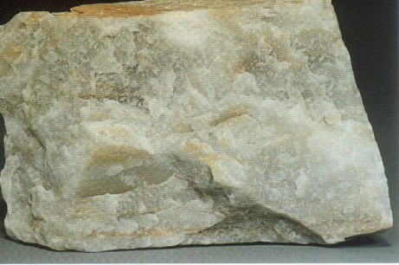
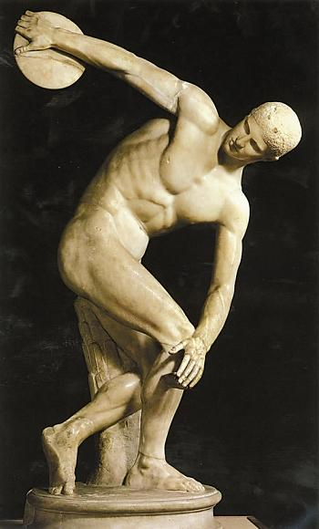
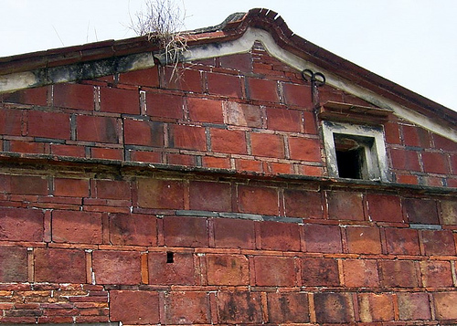
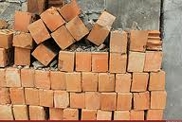
Overview
Top-down v.s. bottom-up approach of nanotechnology
DNA nanotech

Slide 6
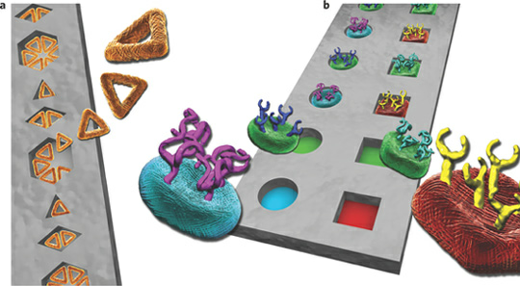
Overview
This presentation is about
a. DNA tiles building and surface
placement
b. DNA tiles decorated with different functional
reagents are used to create a variety of
functional devices

Slide 7
Materials with DNA
許祐程 梁閎鈞

Slide 8
Constructing novel materials with DNA
Thom H. LaBean
Hanying Li

Slide 9
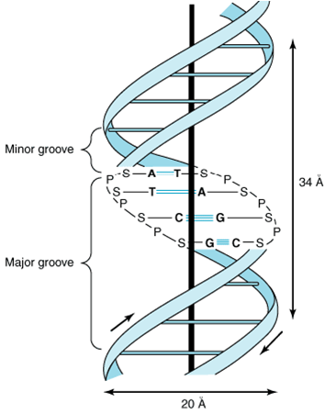
DNA
double helix
  diameter 2nm
  helical repeat length 3.4nm
nanoscale

Slide 10
Linear DNA for conducting nanowires
insulating
semiconducting
  AND, OR, XOR, NAND, NOR, INHIBIT, IMPICATION, XNOR
  Logic Gates: Simple and Universal Platform for Logic Gate Operations Based on Molecular Beacon Probes
superconducting
Notes:
半導：金跟碳；KAIST：2012/7、光當IO；超導：低溫

Slide 11
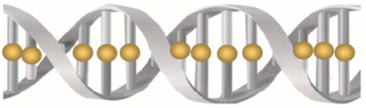
M-DNA
‘M’ stands for divalent metal ions
the imino proton of the DNA base-pairs is replaced by a Zn²⁺, Ni²⁺, or Co²⁺ ion.
behaves like a molecular wire
Notes:
傳導率；這邊的M跟mRNA的m不一樣，這邊的M是代表二價的金屬離子。

Slide 12
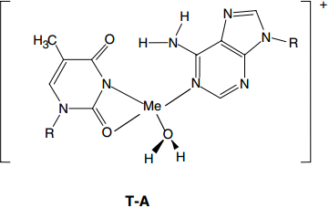
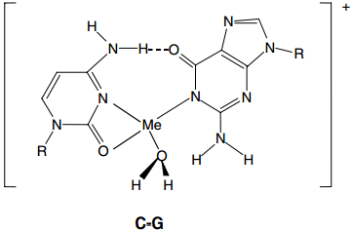
M-DNA

Slide 13
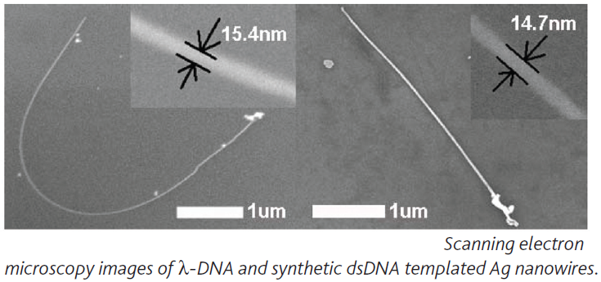
DNA templated nanowires
Ag ions were loaded onto DNA and reduced to form Ag nanoparticles (AgNPs) and fine wires
Pd, Au, Pt, Cu
Notes:
ㄅㄚˇ；寬度

Slide 14
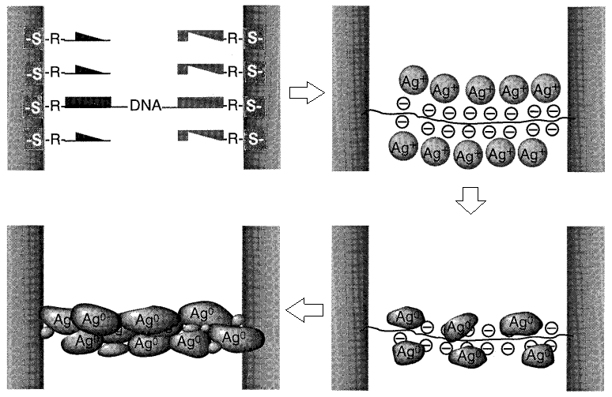
DNA templated nanowires

Slide 15
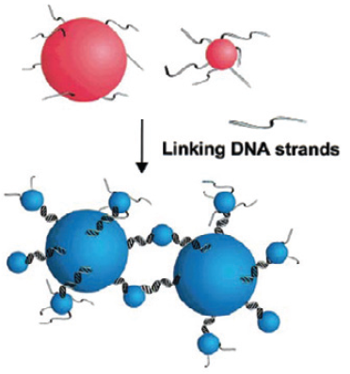
Linear DNA as smart glue
Notes:
自動黏、可控制強度

Slide 16
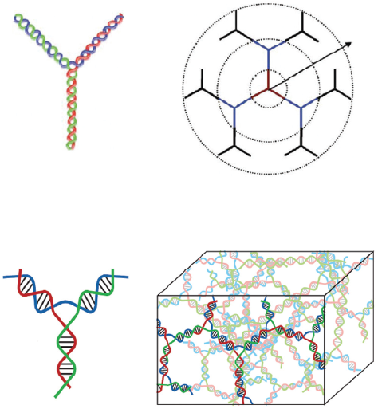
Branching DNA motifs

Slide 17
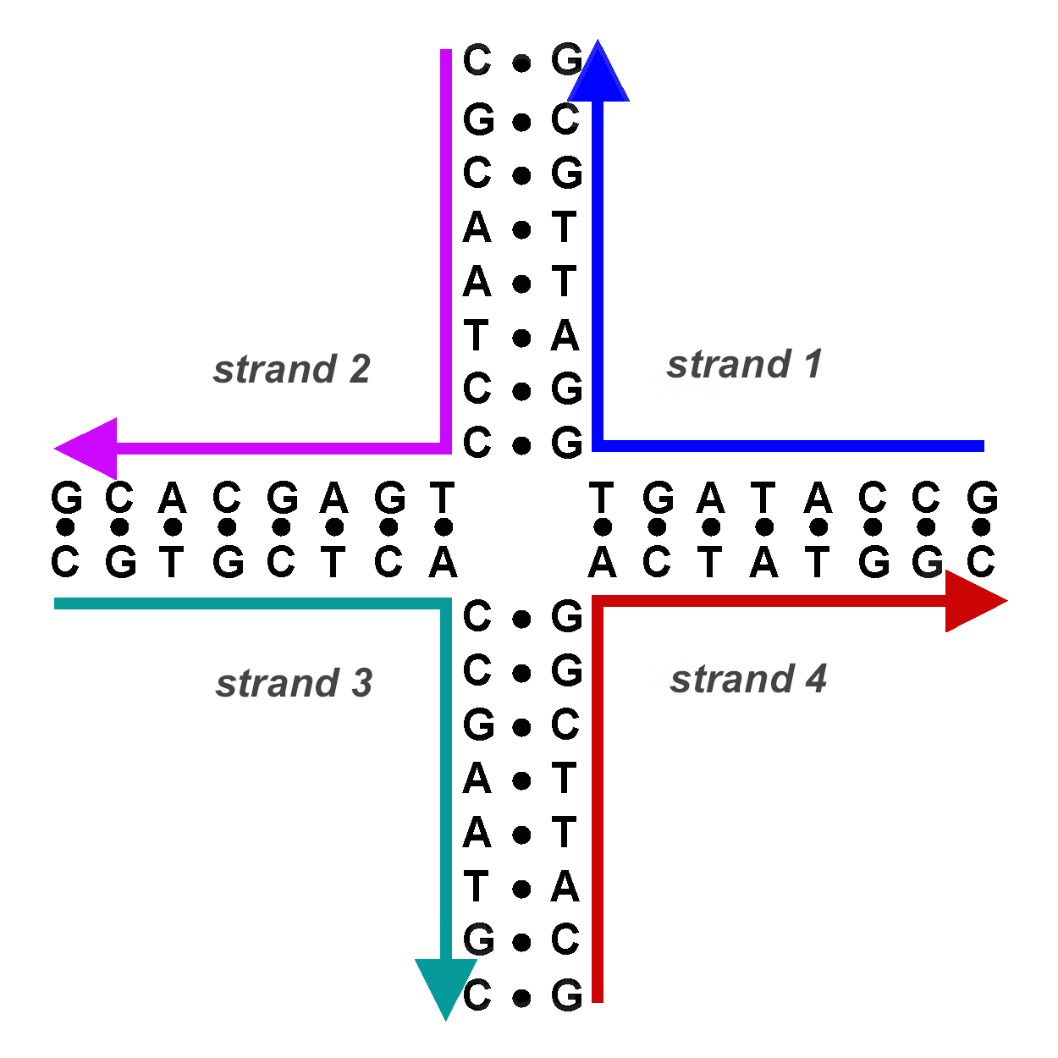
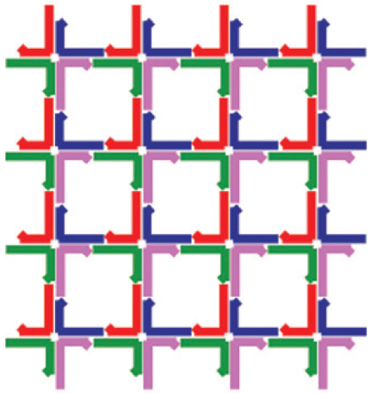

Slide 18
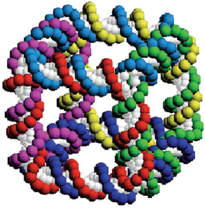

Slide 19
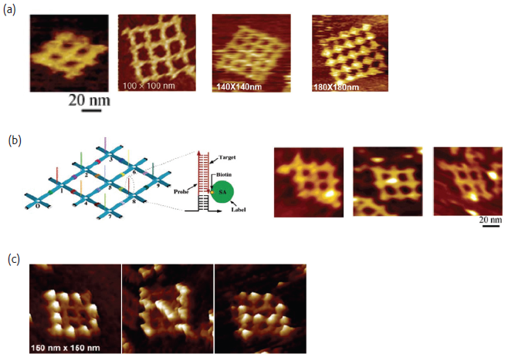
Notes:
當模板長東西

Slide 20
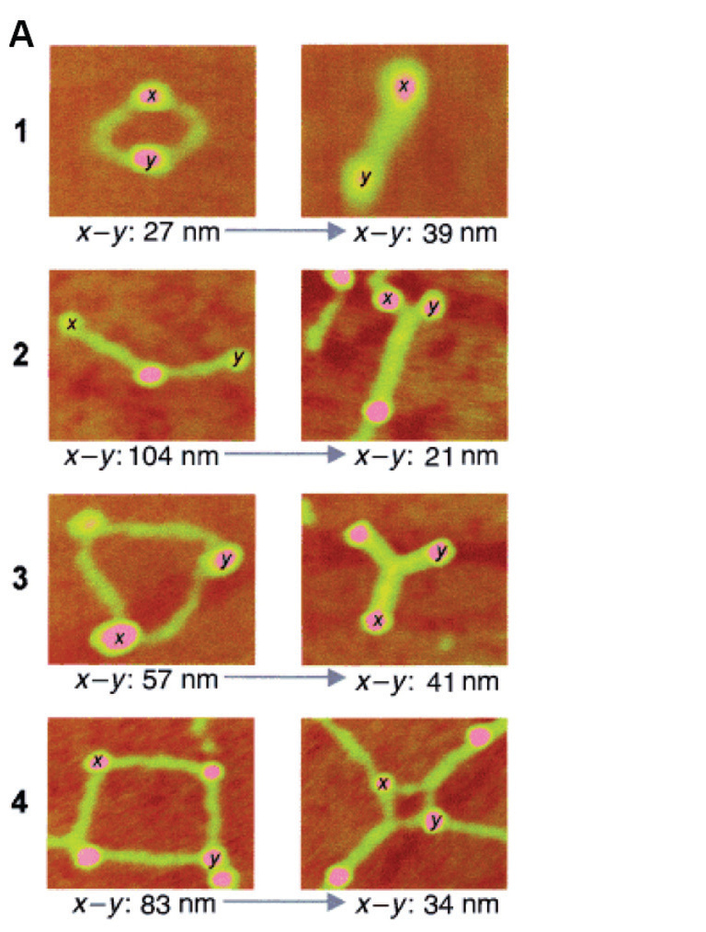
DNA-programmed assembly of biomolecules
Streptavidin, noncovalent
biotin/avidin interaction =>
complex DNA-STV networks can
be built, such as supramolecular
nanocircles and supercoiling
mediated STV networks.

Slide 21
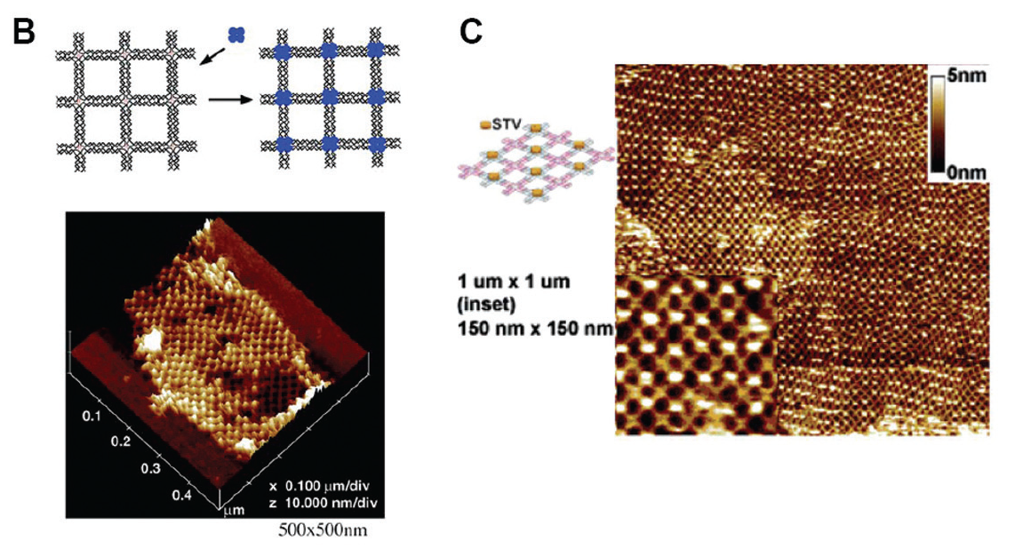
self-assembled DNA tiling systems have been used to organize biomolecules into patterns.

Slide 22
DNA binding proteins
E.g. use aptamer to direct the assembly of thrombin onto sites on arrays.
the protein molecules can dictate the shape of the DNA tile lattices.
E.g. if RuvA binds to the building blocks, the lattice shows a square-planar configuration rather than the original kagome lattice.

Slide 23
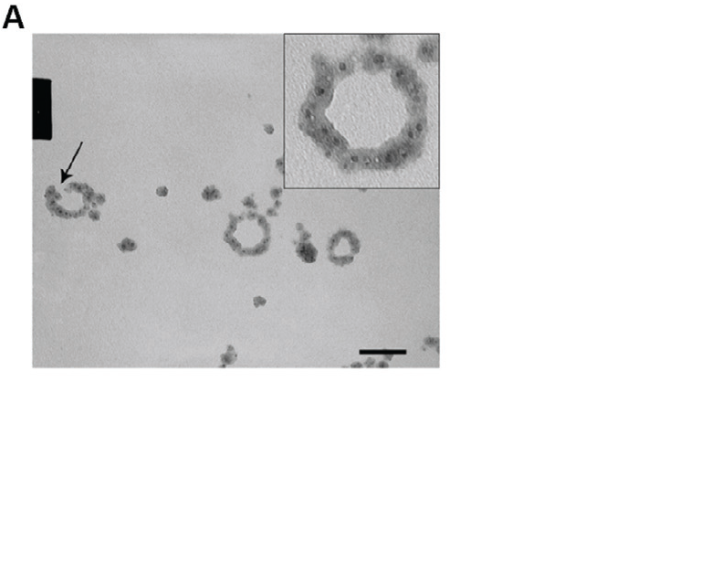
Combination strategies –
DNA, DNA binding protein, and inorganic nanomaterials.
Nanorings by DNA, helicase, and Cu₂O NPs
Organized self-assembly and functional units can be inserted

Slide 24
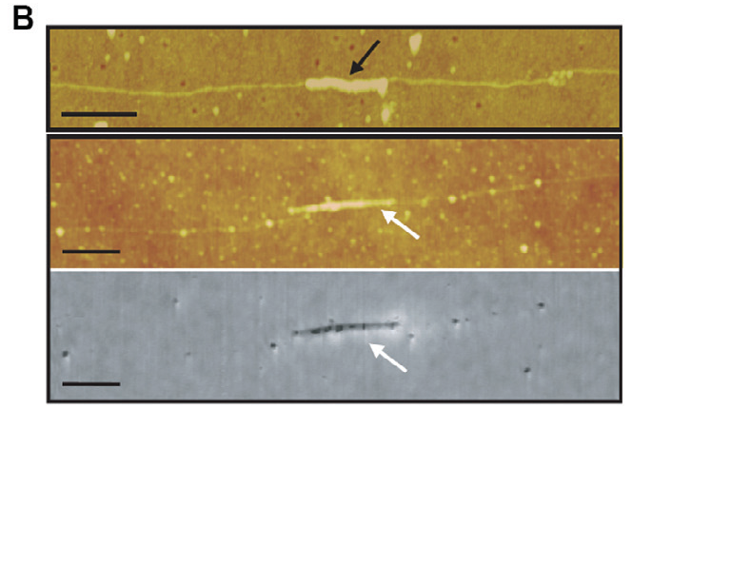
RecA can be used to localize a SWNT at a desired position along the dsDNA template
The RecA also serves to protect the covered DNA segment against metallization thereby creating an insulating gap

Slide 25
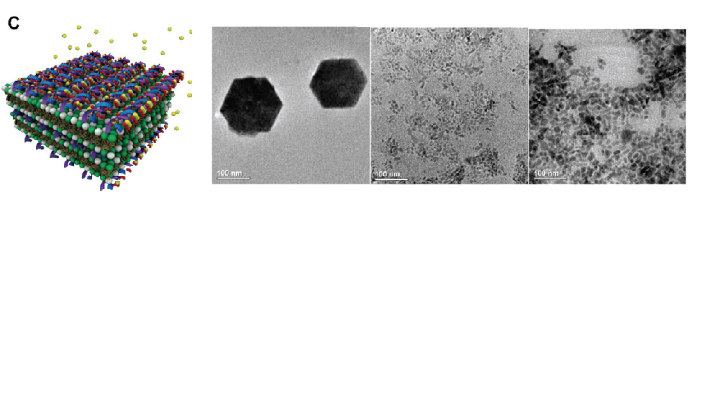
a multilamellar structure composed of anionic DNA and cationic lipid membranes has been used to achieve Cd²⁺ ion condensation and growth of CdS nanorods

Slide 26
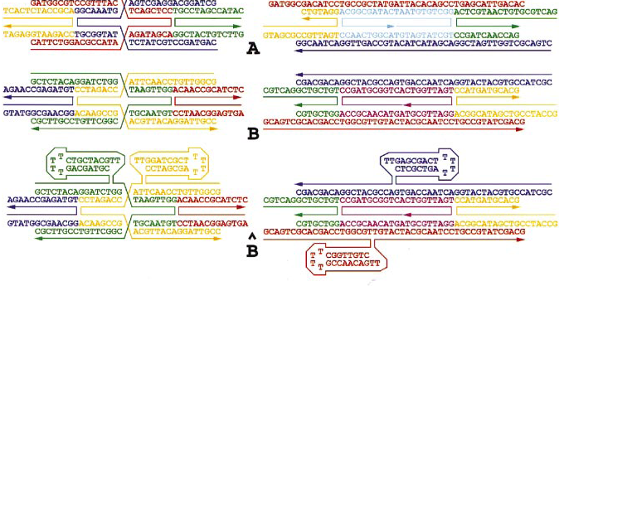
Design and self-assembly of two-dimensional DNA crystals

Slide 27
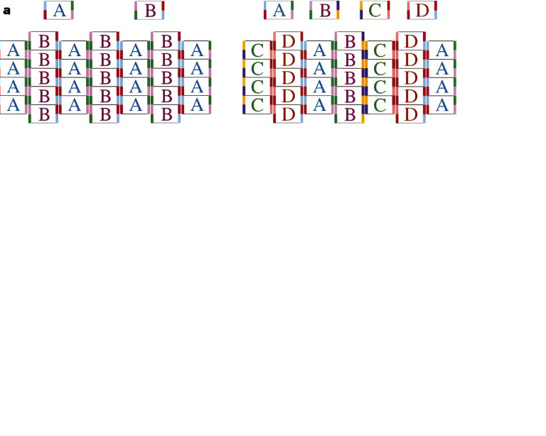
use either two or four distinct unit types to produce striped lattices.

Slide 28
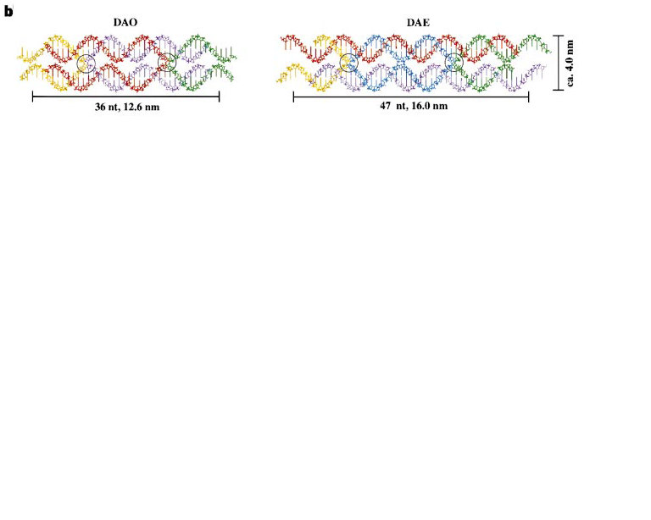
The antiparallel DX motif─
analogues of intermediates in meiosis
two are stable in small molecules: DAO(double crossover, antiparallel, odd spacing) and DAE

Slide 29
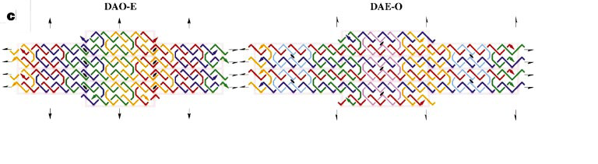
woven fabric：DAO-E and DAE-O
(verticals and horizontals)

Slide 30
DNA Origami and surface placement
邵明偉 謝政佑

Slide 31
Placement and orientation of individual DNA shapes on lithographically patterned surfaces
Kershner, R. J. et al. Nature Nanotech.

Slide 32
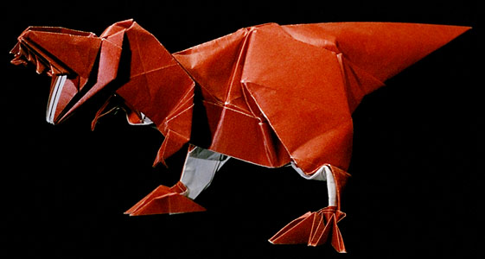
DNA Origami
What is origami?
  Folding.
  Not self assembly.
    http://tinyurl.com/q7olds9

Slide 33
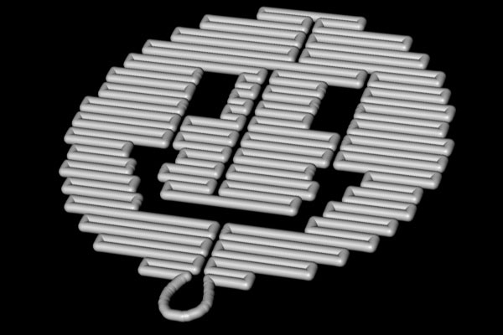
DNA Origami
What is DNA origami?
  Folding of DNA to create specific rigid shapes.
  Self assembly.
  http://tinyurl.com/q7olds9

Slide 34
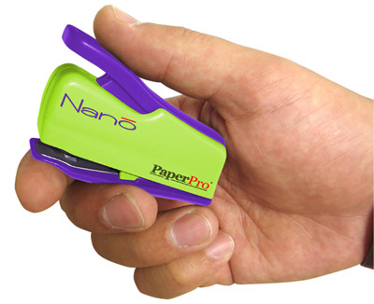
DNA Origami
How to “fold” the DNA ?
  DNA sequence composed of the ‘A’, ‘G’, ’C’, ’T’ binds most strongly to its perfect complement.
    A – T
    C – G
  Use single long strand with multiple short strands.
    Short strand like a stapler.

Slide 35
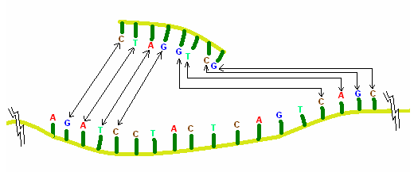
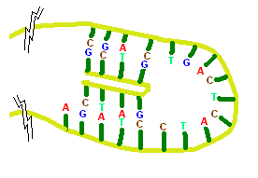
      http://tinyurl.com/q7olds9

Slide 36
DNA Origami
Application
  Nanoelectronic.
    Nano-circuit.
    Nano-computer.

Slide 37
DNA Origami
Uncontrolled deposition in random arrangement.
  Difficult to measure and integrate.
  This paper introduce the way to improve it.

Slide 38
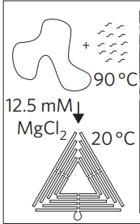
Synthetic scheme for DNA origami triangles

Slide 39
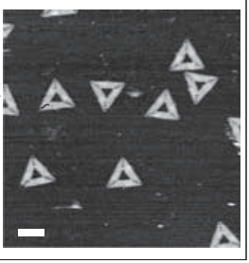
atomic force microscopy height image

Slide 40
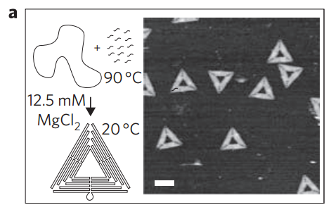

Slide 41
atomic force micrograph
The idea is to create sticky patches
Chemically differentiating lithographic feature

Slide 42
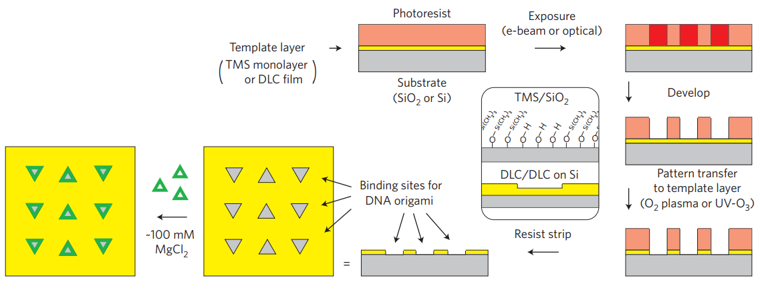
atomic force micrograph(AFM) of their random deposition on mica

Slide 43
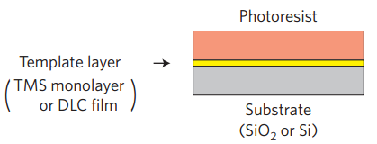
Template layer

Slide 44
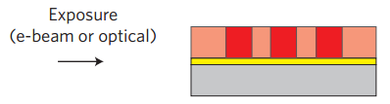
Exposed

Slide 45
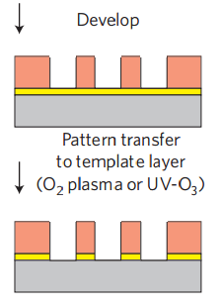
Dry oxidative etch
Differentiate the template layer
Render it sticky for DNA origami

Slide 46

Photoresist strip

Slide 47
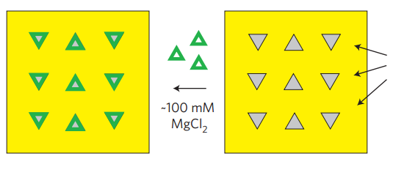

In buffer with ${MgCl}_{2}$

Slide 48
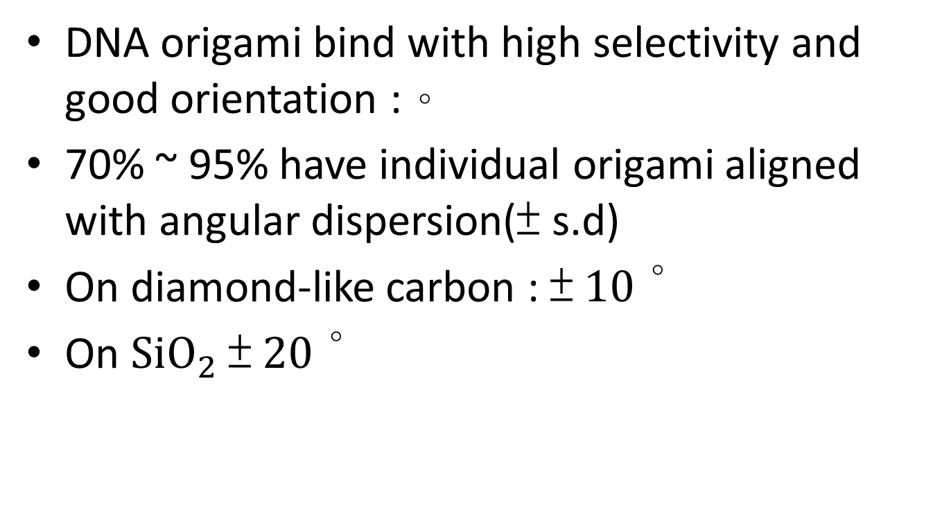
result
DNA origami bind with high selectivity and good orientation :。
70% ~ 95% have individual origami aligned with angular dispersion(± s.d)
On diamond-like carbon : ±${ 10}^{\text{。}}$
On ${SiO}_{2}$ ± ${20}^{\text{。}}$

Slide 49
Applications of DNA Origami
魏偉峰 林雨澤 吳柏均

Slide 50
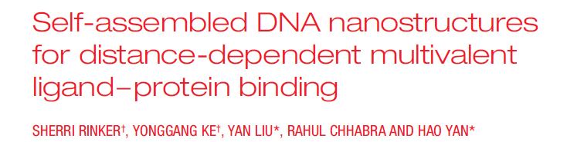
魏偉峰
林雨澤
吳柏均

Slide 51
Introduction
An important goal of nanotechnology is to assemble multiple molecules while controlling the spacing between them.
Of particular interest is the phenomenon of multivalency.
The effects of inter-ligand distances on multivalency are less well understood.

Slide 52
Methods
Distance-dependent multivalent binding
  multiple-affinity ligands
  precise nanometre spatial control.
Atomic force microscopy
  high-affinity bivalent ligands being used as pincers to capture and display protein molecules on a nanoarray.

Slide 53
Material
A multi-helix DNA tile
Two different protein-binding short oligonucleotide sequences—aptamers
Precise control over the distance between them.

Slide 54
Protein binding
The two aptamers bind to thrombin
  Aptamer A (red)
  Aptamer B (green)
  acoagulation protein involved as a key promotor in bloodclotting.

Slide 55
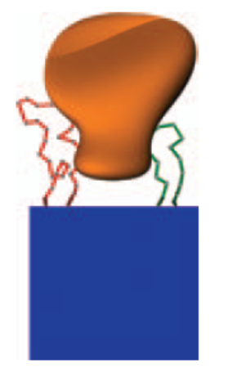
Protein binding
Varying the length of a rigid spacer
  An optimal inter-aptamer distance
  the two aptamers displays a stronger binding affinity to the protein than the individual aptamers does alone.

Slide 56
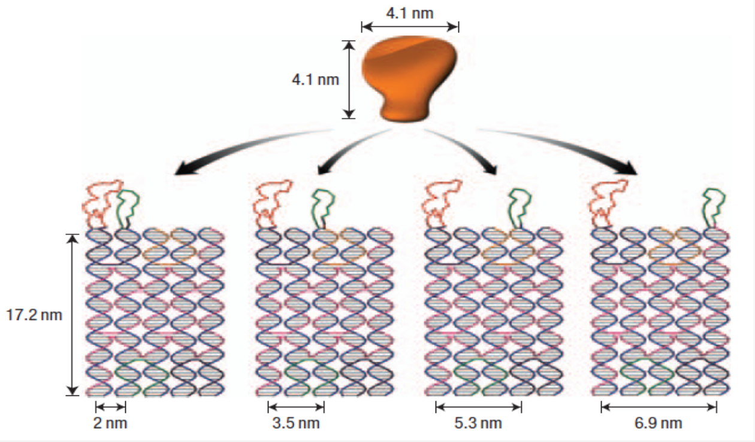
Protein binding

Slide 57
gel-mobility shift assays

Slide 58
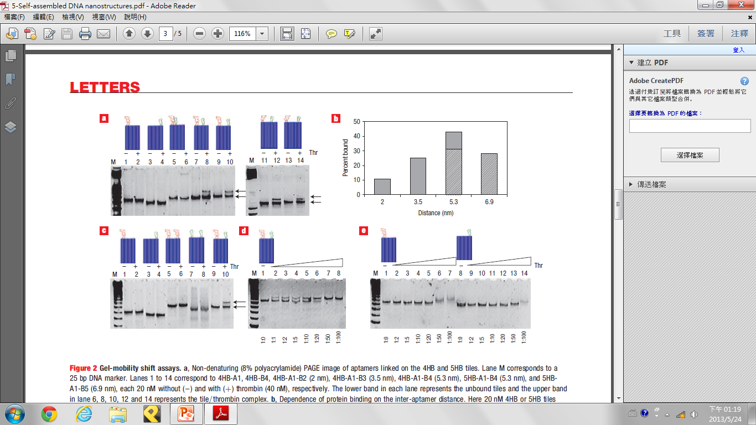

Slide 59
the 4HB-tile-based bivalent aptamers give a more obvious mobility shift during gel electrophoresis when bound with thrombin compared with that of the 5HB tiles.
The 4HB tile containing only apt-A on helix 1 (4HB-A1) and the 4HB tile containing only apt-B on helix 4 (4HB-B4) served as controls; both show no slower migrating band when incubated with thrombin (Fig. 2a, lanes 1–4) at this concentration.
When tiles are incubated with thrombin and carry two differing aptamers at a distance of 2 nm (4HB-A1-B2), a very faint significantly slower migrating band can be seen, representing a small population of the DNA structure binding to thrombin (Fig. 2a, lanes 5 and 6).
At a distance of 3.5 nm (4HB-A1-B3), We propose that this band is due to the binding of one thrombin molecule by the two different aptamers on the same DNA tile (Fig. 2a, lanes 7 and 8).
At a distance of 5.3 nm (4HB-A1-B4), the relative intensity of this band increases, and 40% of the structure is bound with thrombin (Fig. 2a, lanes 9 and 10).

Slide 61
we used 5HB to generate a 6.9 nm spacing between the aptamers. The gel mobility shift assay (Fig. 2a lanes 11–14) showed a decreased binding at 6.9 nm spacing (5HB-A1-B5) compared to 5.3 nm spacing (5HB-A1-B4).
Because the size of the thrombin protein is 4 nm, we did not expect to see improved binding at any distances greater than 6.9 nm.

Slide 63
for the same distance arrangements (5.3 nm), the thrombin-binding affinity of the bivalent aptamers on 5HB was slightly lower than that on 4HB.This difference is possibly due to the effect of the extra helix on the 5HB tile, which might limit the rotational freedom of the aptamer on the 4th helix. Overall, the inter-aptamer distance at 5.3 nm was determined to be optimal for bivalent binding (Fig. 2b).
The percentage of protein-bound DNA tiles at the different spacings were estimated based on the gel shift assay in Fig. 2a, and plotted in Fig. 2b.

Slide 64
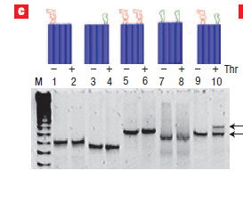

Slide 65
As a control experiment to show that only hetero-aptamers can give such bivalent binding capability, we compared the binding of the tile containing two identical aptamers arranged at the same 5.3 nm distance, 4HB-A1-A4 and 4HB-B1-B4, with the tile containing two different aptamers (4HB-A1-B4). As shown in Fig. 2c,

Slide 66
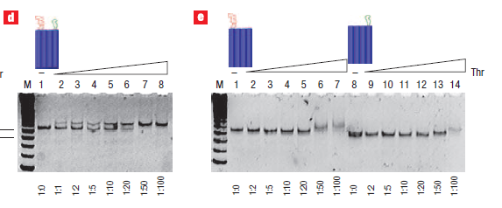

Slide 67
A rough estimate of the binding affinity of 4HB-A1-B4 to thrombin was obtained by titration of the thrombin concentration in the gel mobility shift assay (Fig. 2d lanes 1–8)
These titration results confirmed that the bivalent binding of the hetero-aptamers placed at an optimized distance can have a binding affinity better than the values for any of the monovalent binding arrangements.

Slide 68
Atomic force microscopy (AFM)

Slide 69
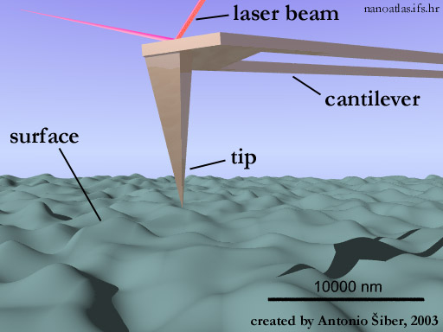
Atomic force microscopy (AFM)

Slide 70
DNA Origami Tiles
DNA Tiles: 60*90 nm
Rule out positional effect
  two type of DNA tiles.
Add a 1:4 ratio of Thrombin to the total number of aptamers
  no or low binding is expected on the lines that are further apart, but stronger binding is expected on the bivalent dual-aptamer lines

Slide 71
AFM Images
thrombin preferred to bind to the dual-aptamer lines

Slide 72
Result
The dual-aptamer line shows an approximately tenfold better protein binding than the single aptamer lines, consistent with the gel assay results.
(observed by 60 arrays)

Slide 73
Summay
This study represents the first example of using the spatial addressability of self-assembled DNA nanoscaffolds to control multi-component biomolecular interactions and to visualize such interactions at a single-molecule level.
It may be possible to use on enzymes and motor protein.

Slide 74
Thanks!

