Slide 1
Common Cold, Uncommon Variation
生醫電資所 碩士班 楊謹榕, M.D.
Instructor: Prof. 趙坤茂

Slide 2
Common Cold, Uncommon Variation
Gregory A. Poland, M.D., and Michael A. Barry, Ph.D.
New England Journal of Medicine 2009;360(21): 2245-6

Slide 3
Whole life, 80 years
Common cold, 5 years (6.3%)

Slide 4
Who is the enemy?

Slide 5
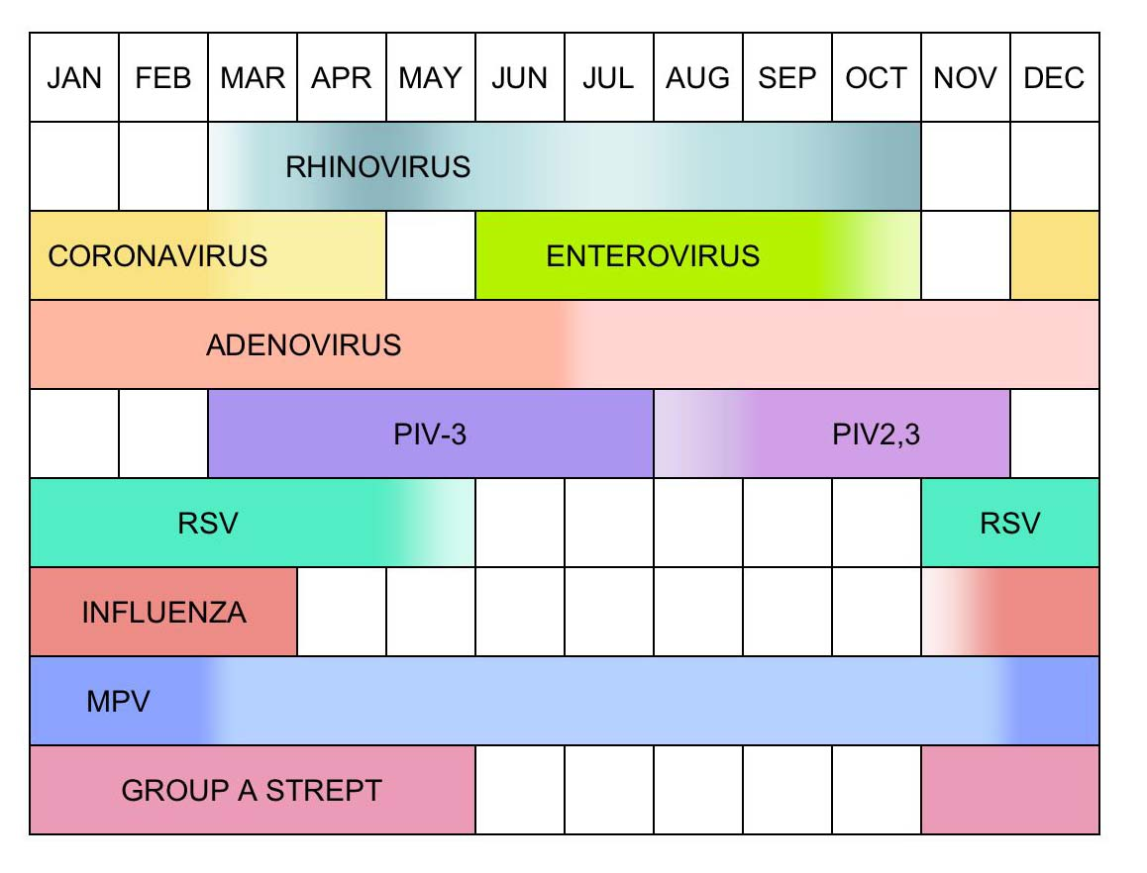
Common Pathogens of Common Cold
Rhinovirus 鼻病毒 50-80%
PIV: parainfluenza virus, RSV: respiratory syncytial virus, MPV: metapneumovirus, Group A Strept: group A streptococcal disease.

Slide 6
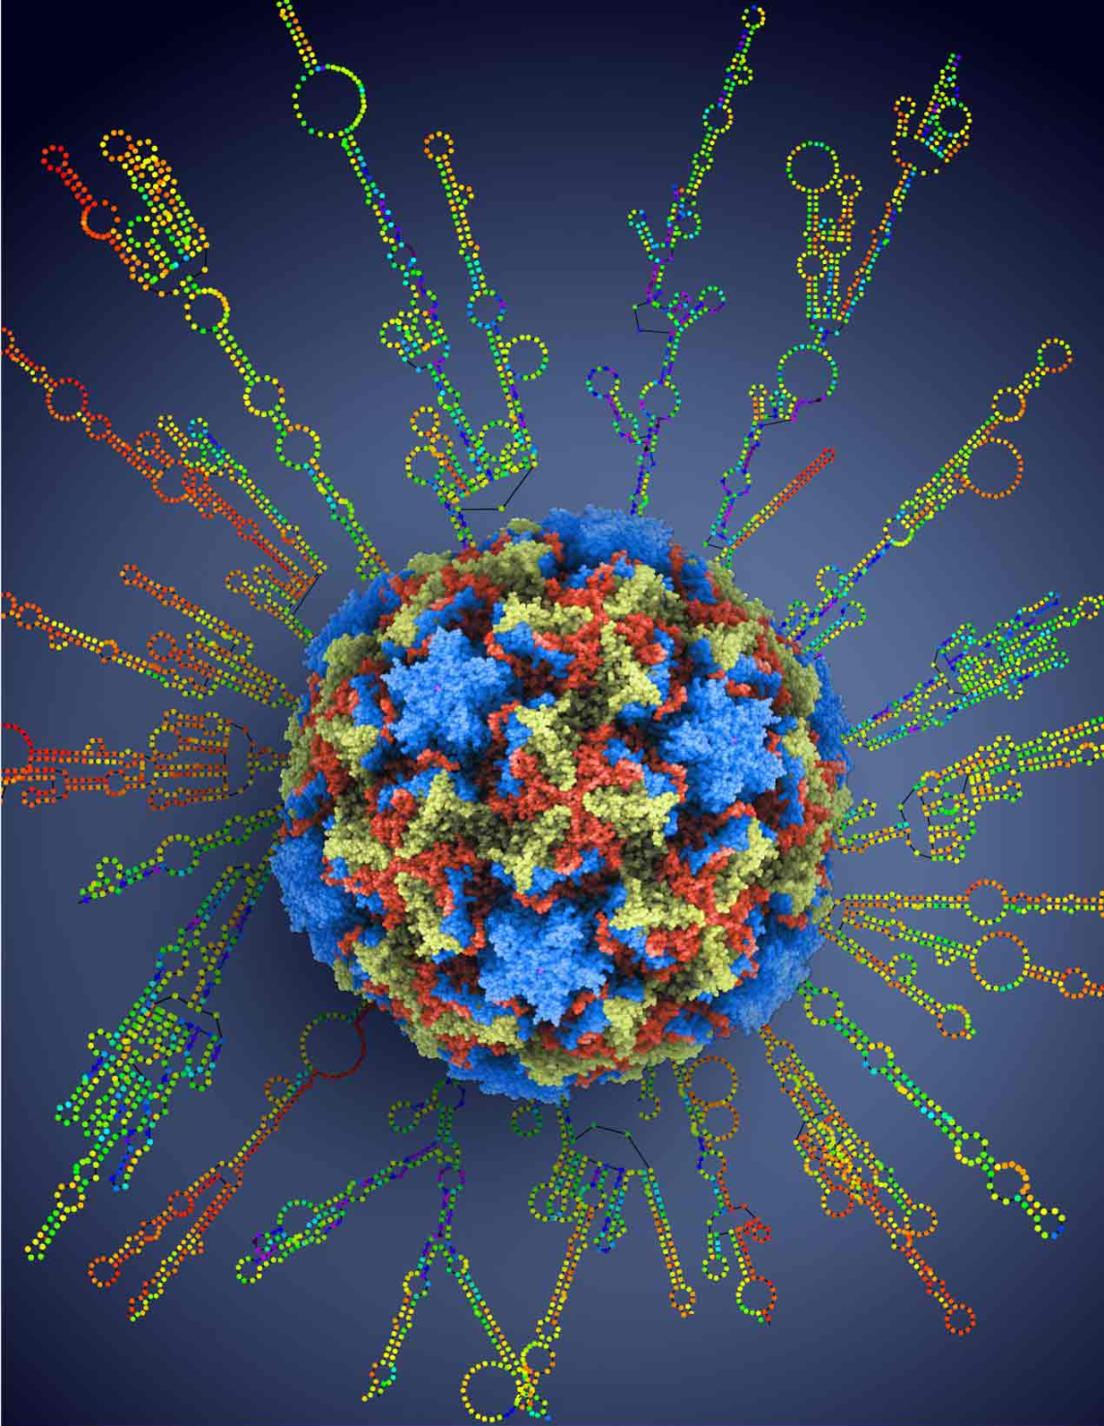
Rhinovirus
Science, 27th March, 2009, Vol. 324, Issue 5923 Cover
Blue: vp1
Green: vp2
Red: vp3

Slide 7
Rhinovirus
Discovered in the 1950s
Single-stranded, positive-sense RNA
30 nm
Notes:
enteroviruses in the Picornaviridae family

Slide 8
Against Influenza Virus
There is NO vaccine against Rhinovirus! 目前並沒有抗鼻病毒的疫苗

Slide 9
Genome of HRV (1)
製作外殼
其他功能
VP: viral protein
PRO: proteinase
POL: polymerase

Slide 10
Serotype 血清型
Genotype 基因型

Slide 11
Palmenberg et al. 2009 Sequencing the full genomes of 99 HRV serotypes

Slide 12
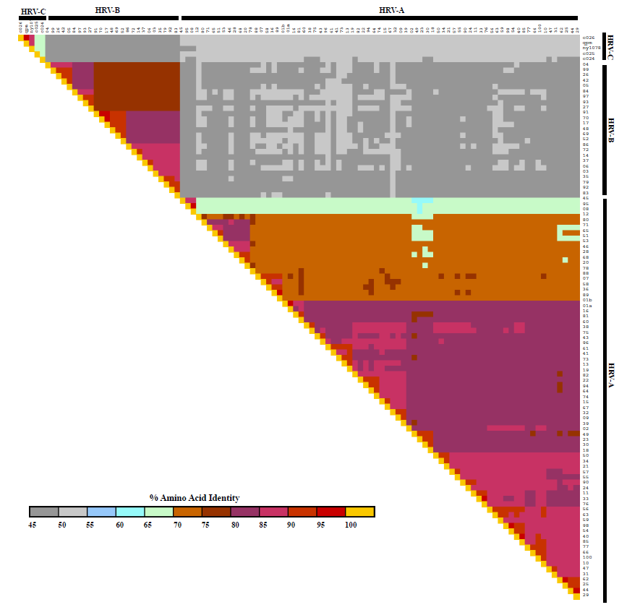
HRV-C
HRV-B
HRV-A
HRV-C
HRV-B
比較不同血清型的鼻病毒的胺基酸序列
HRV-A
Palmenberg et al. 2009 Whole genome amino acid sequence identity comparison

Slide 13
將所有已知的鼻病毒定序，排列出Genome Tree

Slide 14
PRT: pyrimidine-rich tract
IRES: internal ribosome entry site
UTR: untranslated region

Slide 15
“Uncommon Variation” Pyrimidine-rich tract
Different code in different HRV species
Different code among isolates within the same serotype

Slide 16
Highly conserved region
Highly variable region: may be associated with pathological potential

Slide 17
Moreover

Slide 18
Recombination between HRV species
相似程度
Hrv-53
Hrv-80
Hrv-46
Palmenberg AC, J Allergy Clin Immunol. 2010 Jun;125(6):1190-9

Slide 19
Recombination between HRV species
Huang T, et al. PLoS One. 2009 Jul 27;4(7):e6355

Slide 20
Recombinations between HRV species
Variations in nasal-wash isolates from patients with the same serotype HRV infection
Prolonged course
Poor therapeutic efficacy of antiviral drug

Slide 21
Applications: Vaccine
Influenza: trivalent vaccine (2A1B) 三價流感疫苗：對抗兩種A型流感病毒，一種B型流感病毒
Rhinovirus: multivalent vaccine? 鼻病毒：多價疫苗，一次對抗多種病毒？

Slide 22
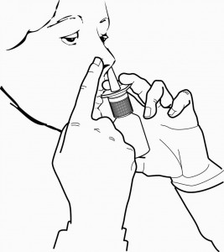
Applications: Gene therapy?
HRV target upper-airway mucosa
Generally, low comparative pathogenicity
Broad antigenic diversity

Slide 23
Take Home Message
Rhinovirus is the major pathogen of common cold.
Pyrimidine-rich tract is highly variable among rhinovirus.
Recombination increases the variability of rhinovirus.
Genome variation increases the pathogenic potential of rhinovirus.

Slide 24
The End 2013/06/03

