Slide 1
Discovery From Data Repositories H Craig Mak Nature Biotechnology 29, 46–47 (2011) 2013 /06 /10 吳柏誠 陳孝銓 朱唐廷 謝煒騏 李峻霆 徐振庭 葉騰遠

Slide 2
Introduction
Electronic Health Records(EHR)
Improve care coordination
Reduce healthcare disparities
Engage patients and their families
Improve population and public health
Ensure adequate privacy and security

Slide 3
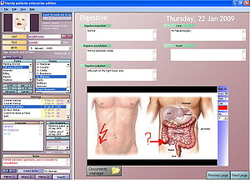
Electronic Health Record Systems

Slide 4
Health Information Technology for Economic and Clinical Health Act (HITECH)
The Health Information Technology for Economic and Clinical Health (HITECH) Act seeks to improve American health care delivery and patient care through an unprecedented investment in Health IT (HIT).
Meaningful use The main components of Meaningful Use are:
The use of a certified EHR in a meaningful manner, such
as e-prescribing.
The use of certified EHR technology for electronic
exchange of health information to improve quality of
health care.
The use of certified EHR technology to submit clinical
quality and other measures.

Slide 5
Standardized Administrative Billing Codes

Slide 6
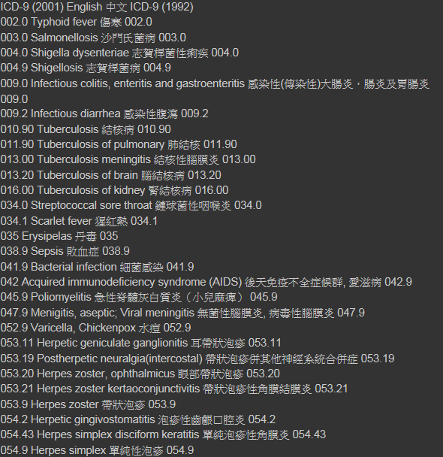
ICD9
database

Slide 7
ICD10

Slide 8
ICD
International Classification Of Diseases
WHO(1940)
Pathogen、Pathology、 Clinical、 Anatomical location
Latest version is ICD10
http://icd9cm.chrisendres.com/index.php

Slide 9
Genome-wide Association Study
Notes:
間單 準確的CSM

Slide 10
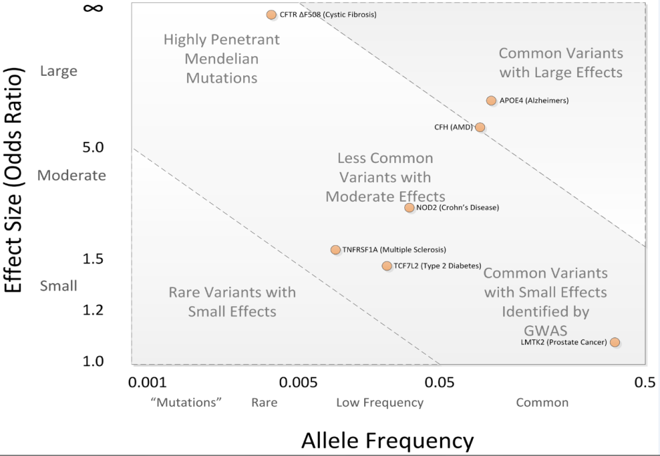
Genome-wide association study
Basic idea: Screen and test the whole genome for associations with a disease
Use genotyping technologies to assay100,000s of SNPs and relate them to disease
GWAS rely on ”common disease, common variant (of SNP)
Basic idea: A variant (of SNP) has to be common in order to
cause a common disease
However, many important disease-
causing variants may be rarer than
this,and are thus unlikely to be
detected with the GWAS approach
GWA studies typically identify common variants with small effect sizes
(“common” means >1-5% of population must have the genetic variant )

Slide 11
GWAS has typically 4 steps
1. Selection of large number of individuals with disease, and a
comparison group
2. DNA genotyping and quality control (QC) of assays and
data, check for genotyping errors
3. Statistical tests for association between the SNPs (those
passing the quality control) and the disease (one test for
each SNP, multiple testing…)
4. Replication of identified associations in an independent
population sample and examination of functionality of
identified SNPs

Slide 12
Limitations to GWAS
False-positive results (false associations found)
False-negative results (true associations missed)
Insensitivity to rare SNP variants
Requirement for large sample sizes
Genotyping errors

Slide 13
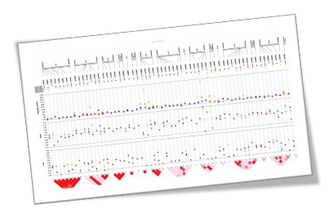
PheWAS
( Phenome-wide association scan )
● What disease associations can we make with a given gene?
⬅➔ GWAS
● Main information sources are genomic databases
and electronic medical records (EMR)
● <20 susceptibility genes variants are responsible for
>50% of the disease
● Potential gene-disease associations
could be dicovered
Notes:
What gene is associated with a given disease?(GWAS)
Scientists believe that human disease results from complex interactions between genes and environmental risk factors, and that variants from a few (<20) susceptibility genes variants are responsible for >50% of this disease burden. Hence, given a specific limited set of genes (or polymorphisms) scientists can determine the associations with phenomic markers such as, CPT codes, medications, ICD-9 codes.

Slide 14
Introduction
PheWAS use readily available billing code to replicate several known genotype-phenotype association and suggests novel possible association.
Typical EMR system contain diverse data sources, including billing data , laboratory and imaging result, medication records and clinical documentation.
Structured data V.S. Unstructured data.

Slide 15
Method
Selected 5 SNPs which are associated with 7 conditions:
atrial fibrillation, coronary artery disease, carotid artery stenosis, multiple sclerosis, Crohn’s disease, rheumatoid arthritis, and systemic lupus erythematosus.
Using ICD-9 coding to link genetic data to the phenome.
Notes:
coronary artery disease冠狀動脈疾病
atrial fibrillation心房顫動
carotid artery stenosis頸內動脈狹窄
multiple sclerosis多發性硬化症
Crohn’s disease克羅恩病
rheumatoid arthritis類風濕關節炎的
systemic lupus erythematosus系統性紅斑狼瘡

Slide 16
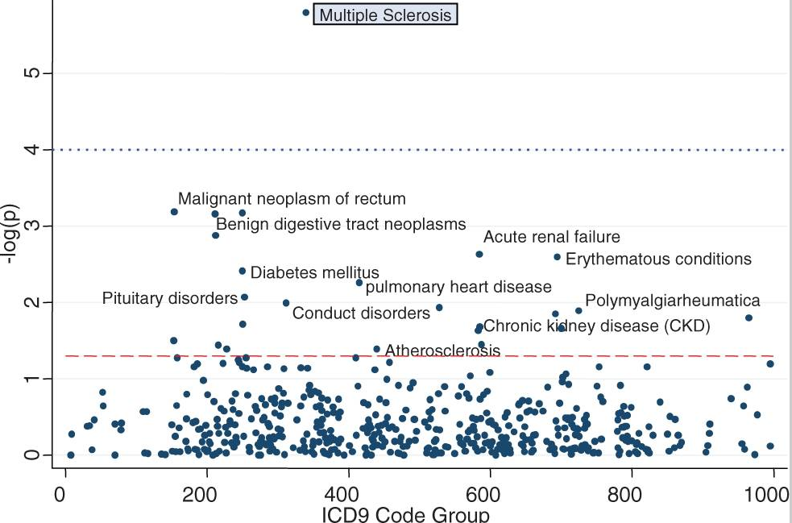
Null hypothesis(Ho): 擁有基因型’rs3135388’和擁有’MS’,’SLE’ 疾病的是不同組人
5.558 (p-value=2.77*10^-6)
P-value = 0.05
Notes:
P-value(MS多發性硬化症)=2.77*10^-6 , P-value(SLE紅斑性狼蒼)=0.51(圖為0.29)
先行chi square test，再做假設檢定，設p-value=0.05，選擇可能情況中p-value最小的，
連結到MS，但卻無法連結到SLE，表示PheWAS並非一定成功。
藍虛線為bonferroni correction，是多重比較時為避免type1 error過高，而做的修正。

Slide 17
Result
The PheWAS was able to detect 4 out of the 7 known SNP-disease associations (p<0.05).
The PheWAS picked up an additional 19 unknown associations between the SNPs and diseases
Notes:
1.預計從5個SNP找到7個已知的相對應疾病，但卻只成功找到四個。
2.有趣的是用phewas方式竟找到19個意料之外的答案，證明用此方法比起重統的GWAS更能找出新的SNP和disease對應關西。

Slide 18
EMR
(ICD-9)
regrouping
analysis
Notes:
The ICD9 coding system describes diseases, signs and symptoms, injuries,poisonings, procedures and screening codes
Since the ICD9 terminology was designed primarily for billing and administrative functions, we developed custom ‘case groups’ of ICD9 codes
to better allow for large-scale genomic research involving ICD9 codes.
we combined three-digit codes that represented common etiologies
e.g. creating a single ‘arrhythmias’ code group

Slide 19
‘arrhythmias’ code group
427.0 Paroxysmal supraventricular tachycardia
427.31
Atrial fibrillation
427.32
Atrial flutter
427.2
Tacycardia, proxysmal
427.9
Cardiac dysrhythmia
Notes:
All distinct ICD9 billing codes from each of the individuals’ records were captured and translated into corresponding case groupings

Slide 20
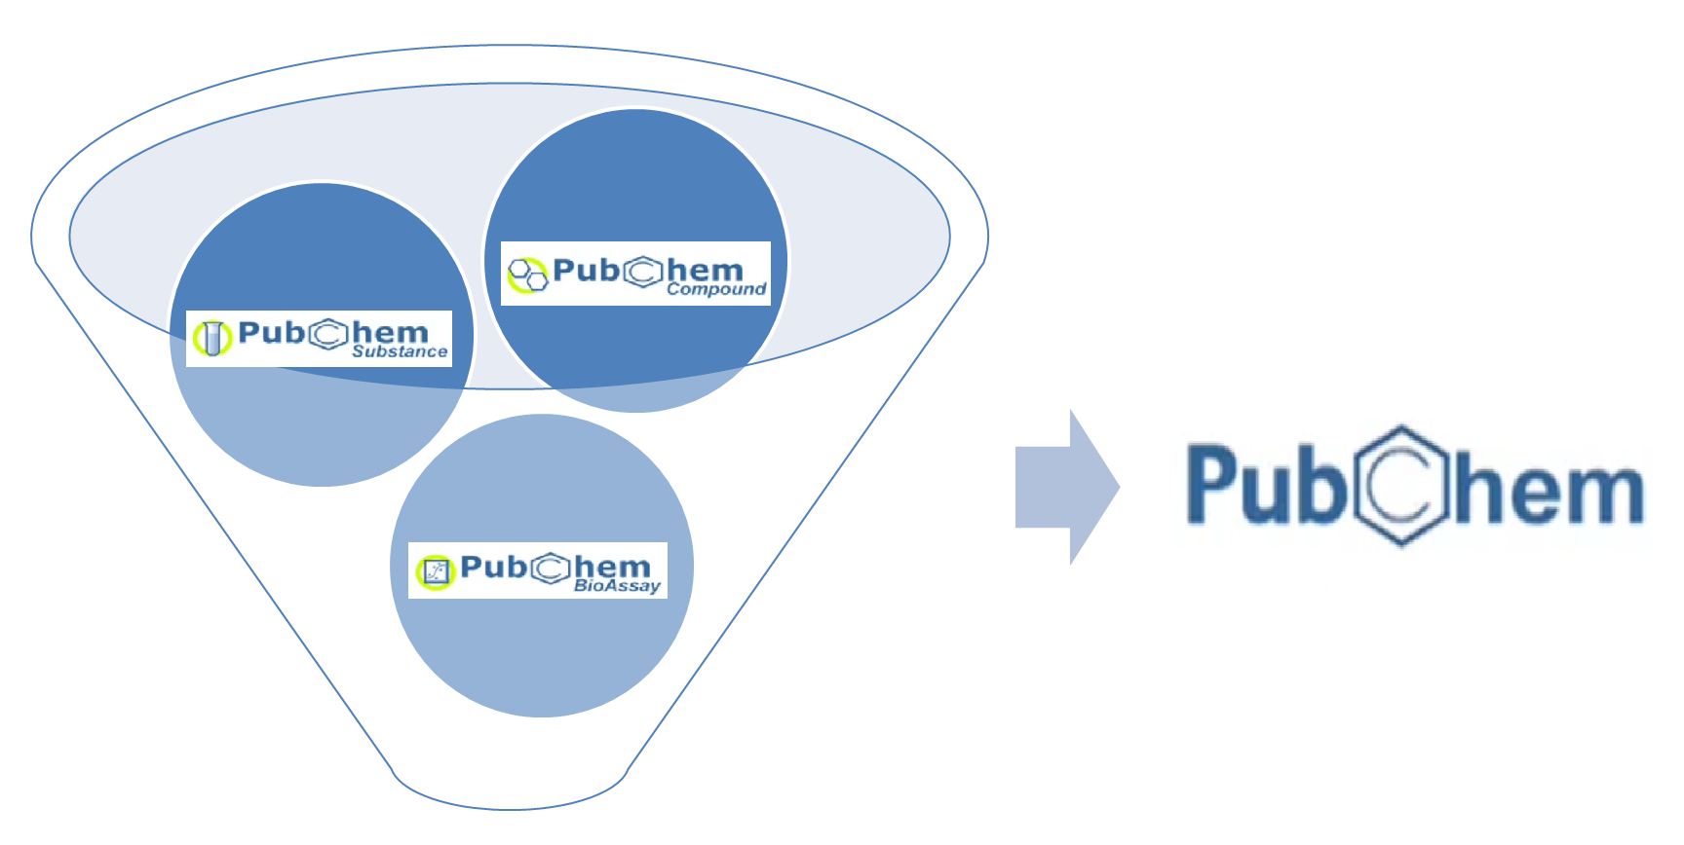
PubChem
3 databases
Substance：record of small molecules
Compound：database of unique chemical structures
BioAssay：biological activity testing results

Slide 21
Thank You for
Your Attention!!!!!!

