Slide 1
Waiting for the Revolution
Having the complete human DNA sequence hasn’t yet produced big advances in primary medicine, prompting some to ask what’s delaying the genomic revolution in health care
Author: Eliot Marshall
Source：Human Genome 10th Anniversary | NewsFocus 4 February 2011
Member:
Ming-Ru Chuang
Yun-Chieh Lee
Wei-Po Lin
Po-Wei Cheng

Slide 2
Author
Eliot Marshall
Science’s news staff.
He previously covered topics including radiation health risks, space policy, and genome sequencing.
Editing stories on medical research topics in Washington, D.C.; and writing about patents and other science policy issues.

Slide 3
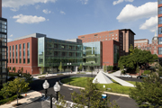
Introduction
The school of medicine at Johns Hopkins University

Slide 4
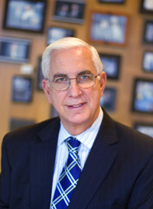
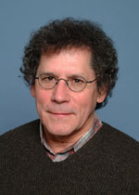
Introduction
Edward Miller
David Valle
James Evans

Slide 5
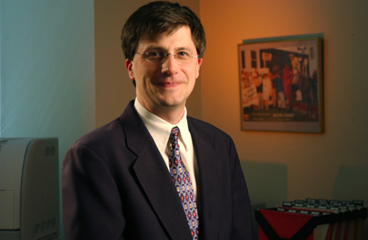
Greg Feero introduction
Work at the National Human Genome Research Institute(NHGRI) as a adviser
His job at NHGRI is to integrate genomics into medicine
Building up networks of like-minded medical leaders
http://www.genome.gov/pressDisplay.cfm?photoID=20019

Slide 6
Three elements of integration
Organizations represent nurses and physician’s assistants are quickly embracing genetic competency testing
Specialist groups in cancer and cardiovascular disease have been ramping up training
Primary care physicians have to engage

Slide 7
Why doctors don't join
Doctors already have too many obligations
The scarcity of data shows that gene-based methods actually protect or improve patients’ health
That may be true ,but the revolution will take decades

Slide 8
Speed up revolution : EGAPP establish
Its seal of approval would speed new ideas into clinical use
But most of EGAPP’s reviews have been unfavorable or neutral
Panel didn’t see evidence of a health benefit
In favor of a test for Lynch syndrome
Not help the patient but to alert relatives of those who test positive that they have 50% risk of being affect

Slide 9
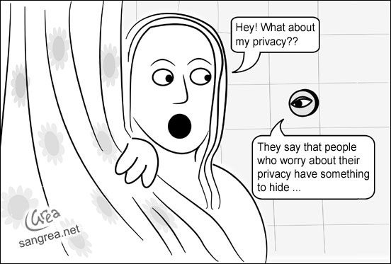
Moral problem
Privacy
What if the patient doesn’t want their test results to spread around?
http://ebizlawyer.wordpress.com/2011/03/31/privacy-general/

Slide 10
Who should pay
Can not link the gene test to the treatment
Hospital should pay
The tests “return money” in the long run
Health care by having a polyp removing
4000~5000 detected of screening 150000 people for Lynch syndrome(遺傳性非息肉型癌） assays

Slide 11
Making Medicine Precise
Topol: series of important DNA-based technologies
Sequence DNA from tumors
Research -> clinical approach

Slide 12
Making Medicine Precise
Gleevec to target tumor cells of chronic myeloid leukemia(慢性脊髓血友病) -> target other some cancers
DNA mutations affecting how patients respond to medicines in cardiovascular(心血管) therapy
Exome(外顯子)_sequencing: find high-genetic-risk drug
Clopidogrel(Plavix): high risk for patients with poor CYP2C19 metabolization

Slide 13
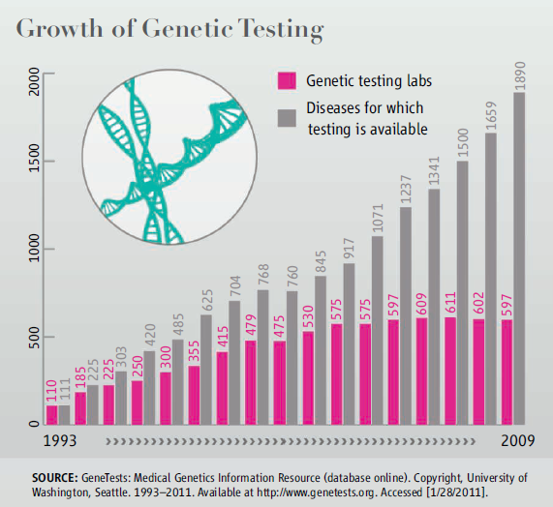
Growth of Genetic Testing
Many Diseases for which testing is available then before
Since 2008, health plan, insurers, and unions, are signed up for 65 million individuals

Slide 14
Like balloons

Slide 15
Puncture It

Slide 16
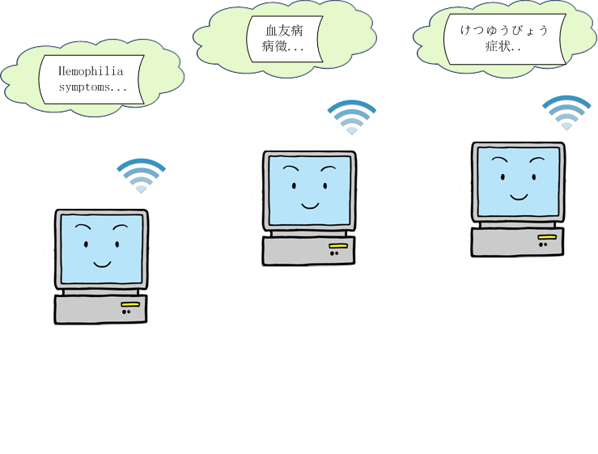
Connect the World

Slide 17
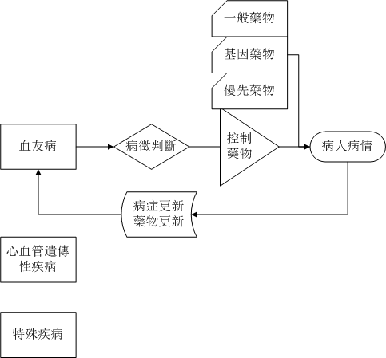
In the Future

Slide 18
Reference
https://myhealth.intermountainhealthcare.org/web/user/our-family-health
http://www.ncbi.nlm.nih.gov/projects/GeneTests/static/concepts/conceptsindex.shtml

