Slide 1
A reference ontology for biomedical informatics: the Foundational Model of Anatomy
Cornelius Rosse, , José L.V. Mejino Jr.
J Biomed Inform. 2003 Dec;36(6):478-500.
R00945016 任立容 R00945025 何泓毅
R00945023 許自程 R00945001 陳禹恆
R00922085 張翔竣 R00945004 陳郁文
R00945007 潘建豪 R00945013 許逸堯
2012/6/11

Slide 2
Introduction
Part 1 .任立容
R00945016

Slide 3
Background
New biomedical ontologies appear without well relating to traditional biology vocabulary database
Gene Ontology
Built up for collecting, combining new biology information together with basic biomedical information and make a systematic coordination

Slide 4
Background
New biology field
Molecular biology, Genetic biology, Bioinformatics, Systems biology ...,etc.
Classical biomedical field
Anatomy, Pathology, Physiology...,etc.

Slide 5
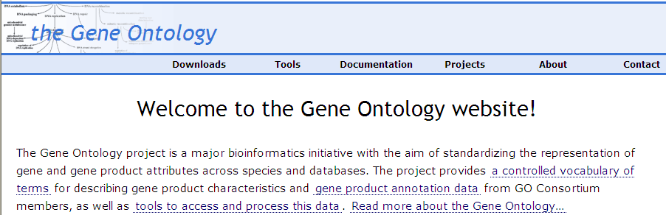
Introduction – Gene Ontology
In Unified Medical Language System (UMLS)
  Provide gene product annotation data
  Set of three structured vocabularies
    Cellular component, Molecular function, Biological process

Slide 6
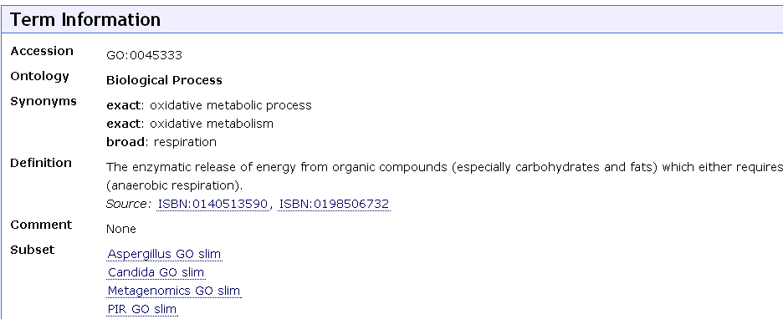
Gene Ontology Vocabularies
Cytochrome c
molecular function : oxidoreductase activity
biological process : oxidative phosphorylation , cellular respiration
cellular component terms :mitochondrial matrix

Slide 7
The Foundational Model of Anatomy(FMA)
An ontology based on Anatomy
Use anatomy for classification of all biology terms
Try to construct the relations of existing ontologies
Foundational means anatomy is fundamental to all biomedical domains

Slide 8
Organization of FMA
3 Components
Anatomy Taxonomy
Structural concept
Developmental biology
Typographies
Courier New font : name of concept
-italics- font : relationship
Bold: abbreviations

Slide 9
Purpose of FMA
Not an end-user application as other ontologies
But a reusable and generalizable resource of deep anatomical knowledge and other biology knowledge

Slide 10
Currently
70,000 anatomical concepts
ranging in size from macromolecules and cell components to major body parts
More than 110,000 terms
Related to other by more than 1.5 million instantiations of over 170 kinds of relationships
By Disciplined modeling

Slide 11
Disciplined modeling
Part 2. 何泓毅
R00945025

Slide 12
Foundational model
a symbolic model
non-graphical symbols
a conceptualization of a domain
including concepts and relationships
serve as a reference in terms of which other views (contexts) of the domain can be correlated.

Slide 13
Foundational model anatomy
Foundational model of the physical organization of the human body
anatomy (structure)—and its coherent knowledge domain is anatomy (science).

Slide 14
Disciplined modeling
a set of declared foundational principles
a high level scheme for representing the referents of concepts and relationships in the anatomy domain
Aristotelian definitions
a knowledge modeling environment

Slide 15
Foundational principles

Slide 16
1. Unified context principle.
strictly structural context
serve as a reference ontology for correlating other (e.g.,functional, clinical) contexts

Slide 17
2. Abstraction level principle
Should model canonical anatomy [ anatomy (structure) ]
provide a framework for anatomical variants
exclude instantiated anatomy [ anatomy (science) ]

Slide 18
3. Species specificity principle.
The initial iteration of the abstraction should model the anatomy of Homo sapiens
but at the same time it should serve as a framework for the anatomy of other species.

Slide 19
4. Definition principle.
Aristotelian definitions

Slide 20
5. Dominant concept principle.
An ontology’s dominant class = the class in reference to which other classes in the ontology are defined.
Anatomical structure (defined in Section 3.2) shall be the dominant class in the FMA (see Section 3.2.2.2).

Slide 21
6. Organizational unit principle.
The abstraction shall have two units in terms of which subclasses of Anatomical structure are defined: Cell and Organ.
Other subclasses of Anatomical structure shall constitute cells or organs, or be constituted by cells or organs.

Slide 22
7. Content constraint principle.
The largest anatomical structure represented shall be the whole organism
the smallest Biological macromolecule.
molecules not synthesized through the expression of the organisms own genes shall be represented in separate ontologies.

Slide 23
8. Relationship constraint principle.
Abstraction shall model three types of relationships
  class subsumption relationships
  static physical relationships
  transformation of anatomical entities during the ontogeny of an organism

Slide 24
9. Coherence principle.
The abstraction shall have one root, Anatomical entity, which subsumes all entities relating to the structural organization of the body;

Slide 25
10. Representation principle.
modeled as an ontology of anatomical concepts
accommodate all naming conventions associated with these concepts.

Slide 26
High level scheme
Anatomy Taxonomy
Anatomical Structural Abstraction
Anatomical Transformation Abstraction
Metaknowledge

Slide 27
High level scheme

Slide 28
Disciplined modeling
Part 3.許自程
R00945023

Slide 29
3.1.3 Aristotelian definitions
the purpose of definitions is to align all concepts in the ontology’s domain in a coherent inheritance type hierarchy or taxonomy
the essence of an entity is constituted by two sets of defining attributes:
the genus & the differentiae

Slide 30
3.1.4 Knowledge modeling enviroment
Protégé-2000 ontology editing and knowledge acquisition environment
frame-based architecture
compatible with the Open Knowledge Base Connectivity (OKBC) protocol

Slide 31
3.1.4.1 Frames, slots, slot values, and facets
Anatomical concepts are represented as frames, a data structure that contains all the information including the properties of the entity to which that concept refers and also the relationships of that entity to other entities

Slide 32
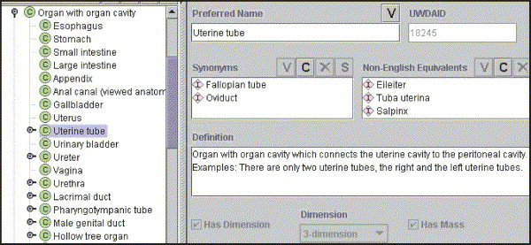
Attributes (properties) and relationships of the entity associated with the concept are expressed as slots of the frame

Slide 33
3.1.4.2 Classes and instances
A class in the AT is a collection of anatomical entities or collections of collections
Instance is the technical solution for enabling the selective inheritance of attributes
all concepts in the AT are subclasses of a superclass and also an instance of a metaclass

Slide 34
3.1.4.3 Selective inheritance of attributes
It is necessary to distinguish between the attributes that should and should not be propagated
每筆資料不一定所有內容都需要被傳到下一級，因此都有兩種屬性class與instance。前者的資訊會被傳遞到下一級，而上一級的template slot被傳遞到下一級後，被該級的instance當作own slot，定義出該級的slot與限制條件，比較像是每一級的規格定義檔，而own slot顧名思義，是自己的所以不會被傳播到下一級。

Slide 35
Disciplined modeling
Part 4.陳禹恆
R00945001

Slide 36
Attributed relationships
FMA is particularly rich in relationships.
It is not sufficient to state:
Ex:
  the esophagus(食道) is
  continuous with the pharynx(咽)
  and stomach(胃).

Slide 37
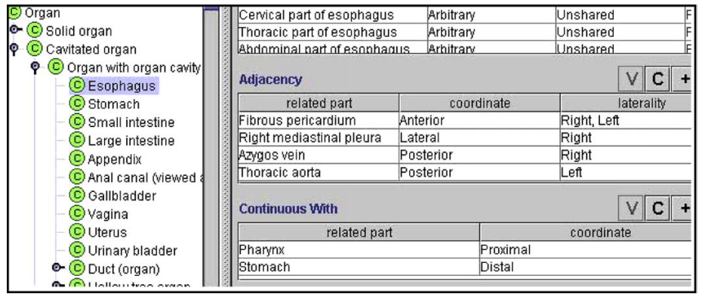
Attributed relationships
Knowledge-modeling environment is a challenge.
The solution is a to attach to a slot.
Ex: A-continuous with-B
C-adjacency-D

Slide 38
Anatomy taxonomy
The taxonomy in educational, research and clinical context is a leaf structure.
educational
clinical
research
Notes:
Chief among these shortcomings is the lack of abstract classes that could subsume more speciﬁc collections of anatomical.
bioinformatics have no choice but to establish their own scheme for aligning anatomical concepts in a computable representation

Slide 39
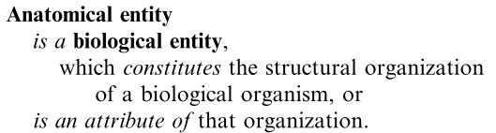
Root of the AT
A more restricted concept than entity will not subsume these concepts.
-has part- slot , and its inverse, -part of-, are introduced at the root of the AT.

Slide 40
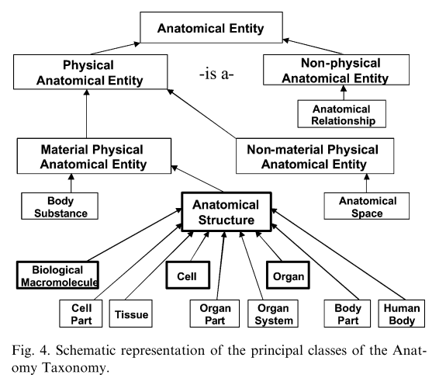
Principal classes

Slide 41
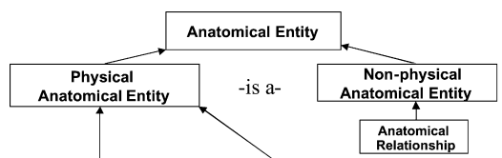
High level classes
volumes, surfaces, lines or points
spatial dimension:

Slide 42
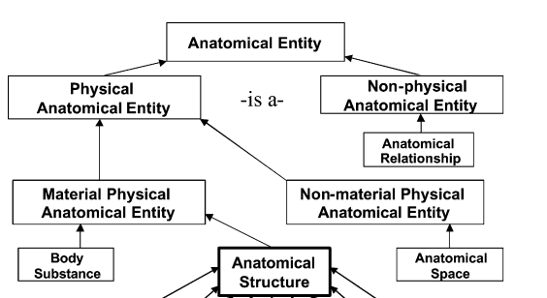
High level classes
Anatomical space, Anatomical surface,
Anatomical line, and Anatomical point
Mass

Slide 43
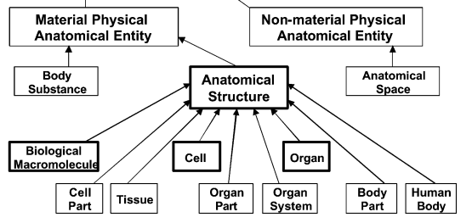
Metaclass and dominant concept
Divide by inherent 3D shape.
Exclude foreign and abnormal structures.

Slide 44
Disciplined modeling
Part 5.張翔竣
R00922085

Slide 45
Units of structural organization
Cell and Organ: organizational units of the FMA
These are two of the subclasses of Anatomical structure
All but two of the other subclasses of Anatomical structure are conceptually deriver from cell or organ
Notes:
也就是說在解剖學結構裡面, 其他subclass為cell和organ衍生出來的

Slide 46
Exceptions
Acellular anatomical structure
Biological macromolecule
Include these macromolecules in the FMA
Notes:
這種分子他們在有部分的cells存在著關聯 , 而在body substances的cells是independent的
將他們也include在FMA的目的是1.link to other ontologies,升在cell parts和body substances的分子構成和關聯的時候

Slide 47
Cell
A microscopic structure
Is an anatomical structure
Consists of cytoplasm surrounded by a plasma membrane
May find up 10 different implied classifications of cells in the literature
Most consistent scheme: proposed by Lovtrup
Notes:
Human body和其他後生動物體都符合這個制定

Slide 48
Organ
Is an anatomical structure
Consists of the maximal set of organ parts
Not only liver or thymus but hand or knee

Slide 49
Organ part
Is an anatomical structure
Consists of two or more types of tissues
Spatially related to one another
In patterns determined by coordinated gene expression

Slide 50
Tissue
Is an anatomical structure
Consists of similarly specialized cells and intercellular matrix

Slide 51
Function system
Organ system
  Constituted by organs
  Musculoskeletal system
    Skeletal system
    Articular system
Notes:
musculoskeletal system(肌肉系統)由肌肉 , 骨頭 , 關節 , 韌帶組成
再細分這個system成骨骼系統 , 關節系統
根據這個規則訂出來的這些系統並不符合anatomical(解剖學) structure .但是因為這種概念很廣泛的用在解剖學和臨床上面

Slide 52
Anatomical cluster
Do not fit any of Anatomical structure subclasses we describe so far
Do not constitute the whole or a subdivision of organ system
Like lung and the renal pedicle

Slide 53
Anatomical set
Which represent a collection of anatomical structure that are members of one class
Indirect connections exist between the members
Notes:
是members概念而不是parts , 這些member是用相同神經支配組成 .也就是說它裡面的members不一定直接有關聯可能是間接有關聯,

Slide 54
Anatomical junction
Subsume such anatomical structures as suture
The commissure of the mitral valve
Gastroesophageal junction
Anastomosis
Nerve plexus
Notes:
Gastroesophageal junction胃和食道接合處
Anastomosis(血管的接合處)
Nerve plexus神經接合處

Slide 55
Disciplined modeling
Part 6.陳郁文
R00945004

Slide 56
3.2.3 Derivation of terms
Make anatomical information available in computable form.
Generalizes to all application domains of anatomy.
Include in the FMA all terms that currently designate anatomical entities

Slide 57
Source of terms
Honored English language scholarly textbooks of anatomy.
Original journal articles from the anatomy and clinical literature.

Slide 58
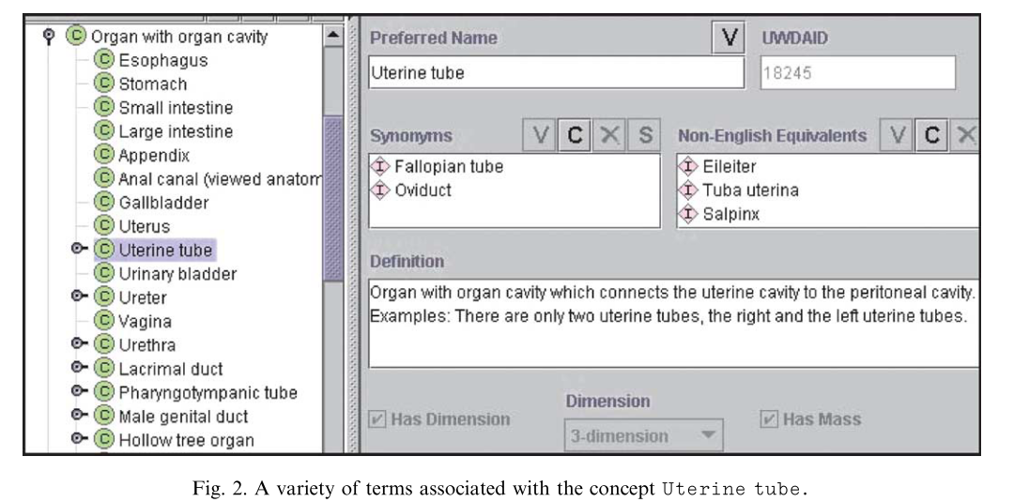
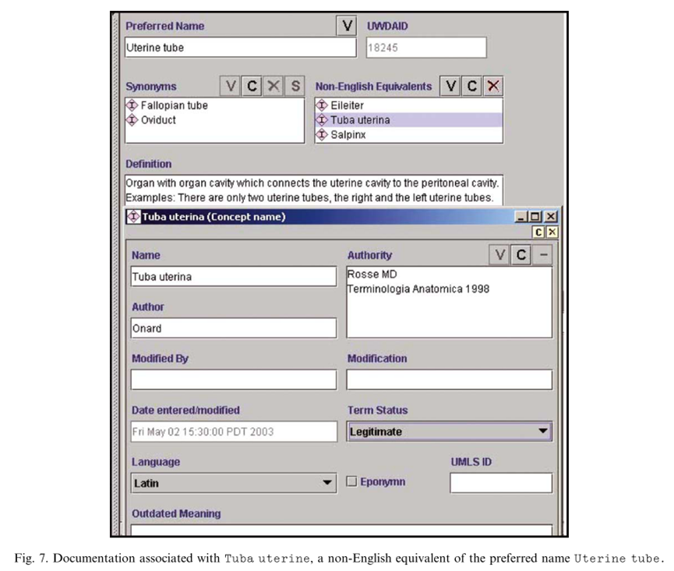




Slide 59
Naming convention
Singular form
Conjunctions and homonyms are not allowed
Anatomical sets (Set of spinal nerves)
Muscle (tissue) and Muscle(organ)
Macroscopic parts of the body that have not previously been named (Upper uterine segment)
“Left ﬁfth intercostal space”

Slide 60
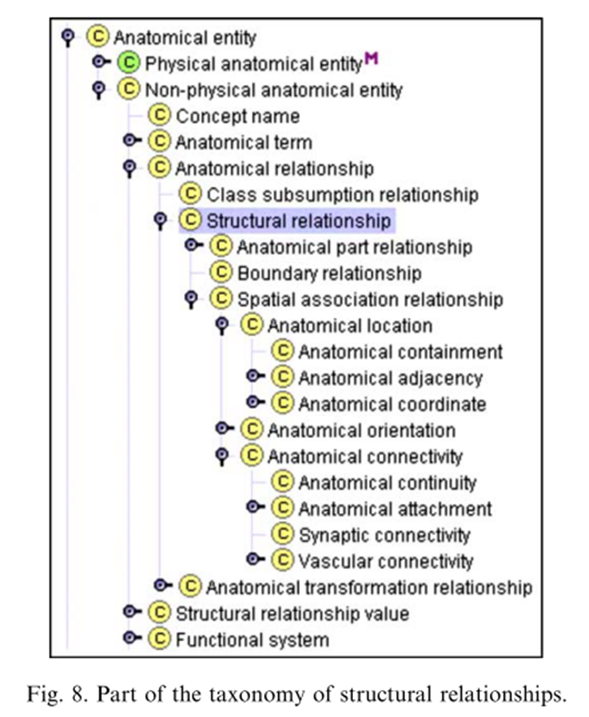
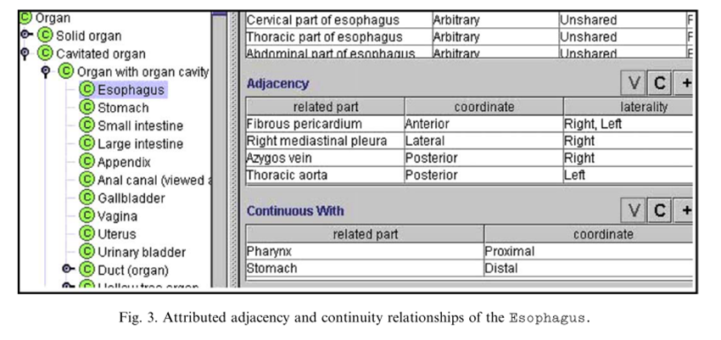
3.3 Anatomical Structural Abstraction
ASA is an aggregate
of the structural
relationships that
exist between the
entities.

Slide 61
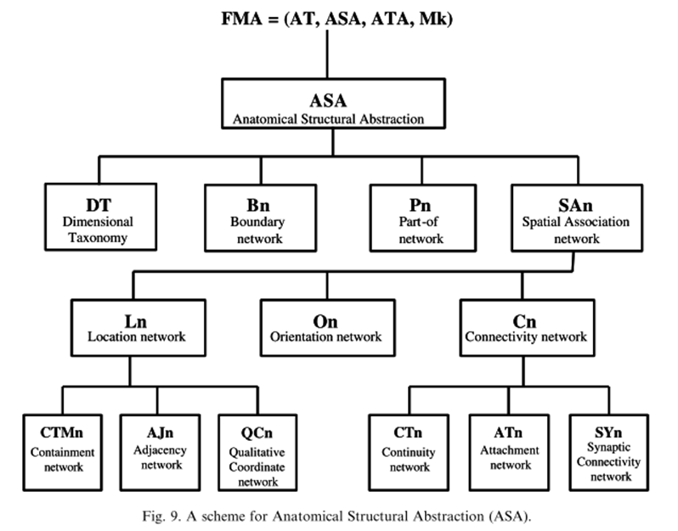
ASA are sets of interacting networks

Slide 62
Example
The surface of the heart forms the boundary of the heart in the boundary network (Bn) (not Pn)
the diaphragmatic surface of the heart is a part of the surface of the heart (Pn)
- also part of the boundary of the heart (Pn)
- also boundary of right ventricle (Bn)

Slide 63
Disciplined modeling
Part 7.潘建豪
R00945007

Slide 64
Anatomical Transformation Abstraction
Definition
  Anatomical Transformation Abstraction describes the time-dependent morphological transformations of the concepts represented in the taxonomy during the human life cycle, which includes prenatal development, postnatal growth and aging
ATA scheme
  Scheme for prenatal development, not for the morphological transformations associated with the processes of growth and aging
  Associated with an anatomical entity in order to comprehensively conceptualize and symbolically represent its development starting from the fertilized egg.

Slide 65
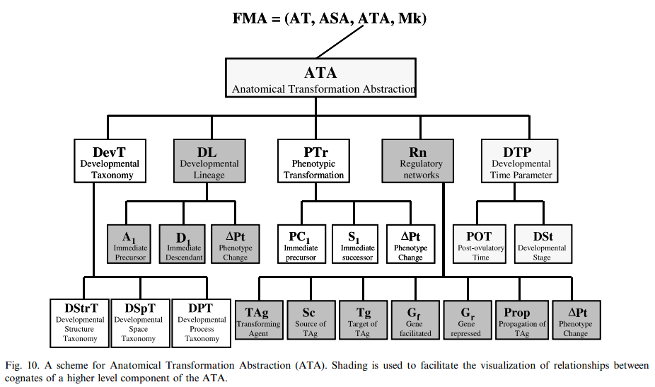
ATA Scheme

Slide 66

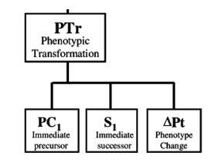
Phenotypic transformation
Phenotypic transformation(PTr)
  developmental states of one individual
  Precursor, successor, a change in phenotype
For example:
Mesodermal primordium of humerus > Cartilaginous primordium of humerus >
Ossifying humerus with primary ossification center > Ossifying humerus with secondary ossification center > Fully formed humerus

Slide 67
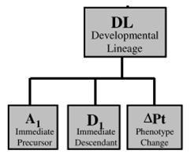

Developmental Lineage
Developmental lineage (DL)
  an ancestor replicates itself and gives rise to two or more descendants, each of which is phenotypically distinct from its immediate ancestor
  ancestor, descendant, change in phenotype

Slide 68

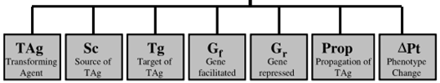
Regulatory networks
Transforming agent (TAg)
  Gene product, effect the expression of a new phenotype(ΔPT)
  ΔPT depends on the activity of G_{f} (facilitated ) or G_{r} (repressed) within its source(Sc)
  TAg must be propagated (Prop) from the source to the target, which may occur within cells

Slide 69
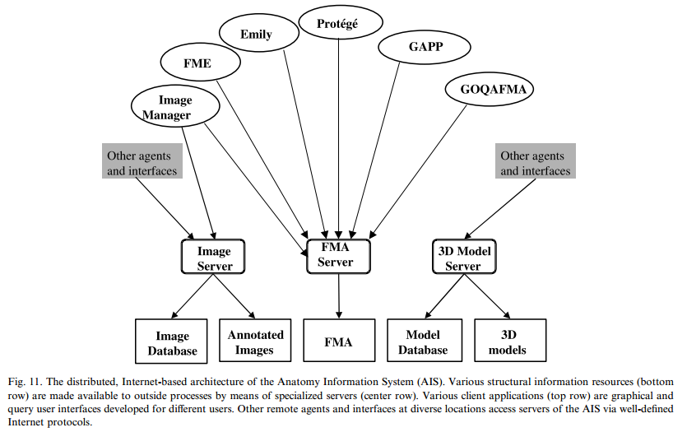
Accessing FMA

Slide 70
Evaluating and current usage
Low level
  Internal consistency
  Comprehensiveness
High Level
  Evaluated for its generalizability and usefulness to other projects in knowledge representation and application development

Slide 71
Evaluating and current usage
Comprehensiveness seems a relatively trivial problem compared to evaluating the FMA’s overall semantic structure and the extensive modeling of relationships.
  Difficulties: mapping of large symbolic models to one another, taking into account their structure as well as their terms
GALEN’s common reference model
  there are surprisingly few homologies
Conclusion
  the FMA has a strictly structural orientation
  We hope that the development of knowledge-based
  applications calling for anatomical knowledge will be
  stimulated by access to the comprehensive FMA, pro-viding opportunities for its higher level evaluation

Slide 72
Scaling of FMA
Part 8.許逸堯
R00945013

Slide 73
6. Scaling of FMA
FMA is to fulfill its potential as a reference ontology, it should be feasible to readily align other existing and evolving biomedical ontologies with it.
1. macroscopic anatomy and…
histology and the representation of cells, subcellular entities, and biological macromolecules
2. development of the neuroanatomical component of the
FMA
Instantiation of neuroanatomical relationships is in progress

Slide 74
3. using the FMA as a template for the representation of the
anatomy of non-human species as experimental models of
human disease
The challenge is to formally represent interspecies similarities and differences at the various levels of structural organization

Slide 75
7. Discussion
FMA expresses a theory of anatomy that provides a view of the domain consonant with the requirements of formal knowledge and also accommodates traditional views of the domain
The FMA’s theory of anatomy is articulated by its high level scheme:
the semantic structure of the AT ***
the schemes of the models ASA and ATA components

Slide 76
7. Discussion
7.1. Salient features of the AT
Anatomy Taxonomy
  incorporate all concepts that relate to the structure of body
  including those first identified in the contemporary literature and those that are newly discovered.

Slide 77
7. Discussion
7.1. Salient features of the AT
specific attributes that are shared by anatomical structures are propagated from the root of the taxonomy to its leaves.
semantic structure of the AT assures that all anatomical entities are encompassed by one attributed graph.
The structure of the AT is a dynamic abstraction that is modified as a result of new insights gain into the structure of anatomical knowledge.

Slide 78
7. Discussion
7.2. Relevance to bio- and biomedical informatics
The FMA is a domain ontology that represents deep knowledge of the structure of the human body
  large number and specificity of the structural relationships between these concepts.

Slide 79
7. Discussion
7.2. Relevance to bio- and biomedical informatics
continuous conceptual and implementation framework
  FMA anatomical entities down to the cell level and provide a framework for linking to the FMA ontologies and other data repositories.
adheres in its modeling to one context
  FMA is intended to meet the needs of diverse user groups
  designed as a reusable reference ontology rather than an application ontology.

Slide 80
7. Discussion
Such context-specific modeling results in a number of benefits:
obviates duplication and redundancy in ontology development, since the FMA’s contents can be reused
provides for consistency among independent ontologies that rely on the FMA’s contents
serves as a template for the development of other ontologies

Slide 81
8. Conclusions
Anatomical knowledge represented in the FMA parallels in its complexity and depth the knowledge.
FMA’s contents are processable by computers and provide for machine-based inference, which is a prerequisite for the development of knowledge-based applications.
Serving as a reference ontology for bioinformatics, the FMA may facilitate such a process.

Slide 82
Thanks for your attention

