Slide 1
Final Presentation
Fast and Accurate Short Read Alignment with Burrows-Wheeler Transform
Group 1
(1)陳伊瑋
(2)沈國曄
(3)唐婉馨
(4)吳彥緯
(5)魏銘良

Slide 2
Outline
Introduction & Background review
Prefix trie and Burrows-Wheeler transform
Exact Matching
Inexact Matching
Result & Conclusion
Reference

Slide 3
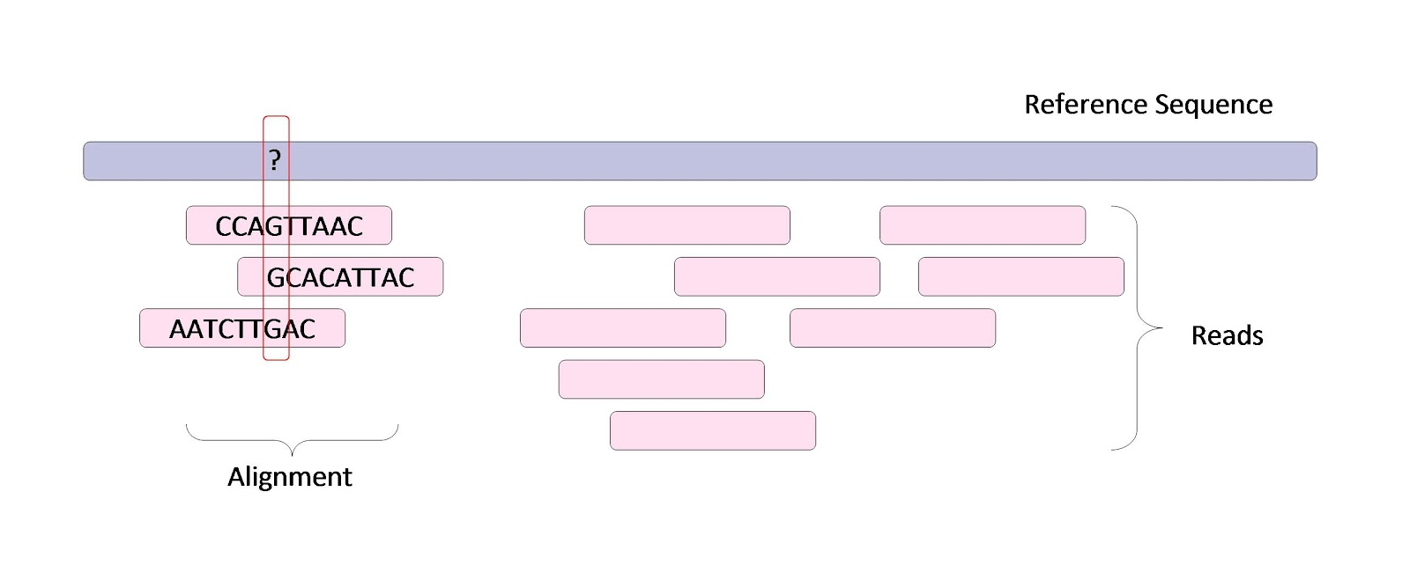
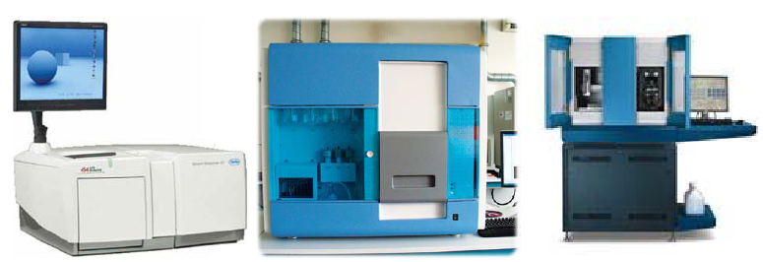
Introduction (1/3) [1]
Motivation:
  Much reads: 50~200 million 32-100 bp reads
  Reference sequence determined

Slide 4
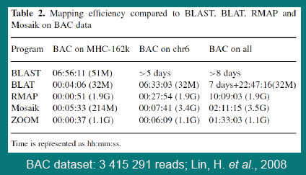
Introduction (2/3) [2]
BLAST/BLAT
Suffix array:
  Requires 12GB for human genome
※ Requires New Alignment Algorithm

Slide 5
Introduction (2/3) [1]
Four category of algorithms for this problem
Category | Representative | Pros | Cons
Hash the read sequence | MAQ | Flexible memory footprint | No multi-threading
Hash the genome | ReSEQ | Easy multi-threading | Large memory
Merge-sorting sequences | Malhis | *** | Hard for pairing
Burrows-Wheeler Transform | Bowtie | Relative small memory footprint | ***

Slide 6

Comparison
Feature | Speed | memory
Hash read sequence | No multi-threading | Memory footprint
Hash genome | Multi-threading | large
Merge sorting | fast | (no pairing)
BWT | fast | Smaller memory footprint
Basing BWT, inexact matching algorithm proposed
Notes:
改進，找圖

Slide 7
Outline
Introduction & Background review
Prefix trie and Burrows-Wheeler transform
Exact Matching
Inexact Matching
Result & Conclusion
Reference

Slide 8
Prefix of string ‘GOOGOL’
G
GO
GOO
GOOG
GOOGO
GOOGOL

Slide 9
2.1 Prefix trie and string matching
dashed line shows the route of the brute-force search for a query string ‘LOL’, allowing at most one mismatch
Suffix array interval
^ mark start of the string

Slide 10
Testing whether a query W is an exact substring of X can be done in O(|W|) time.
To allow mismatches, we can exhaustively traverse the trie.
We will show later how to accelerate this search by using prefix information of W.

Slide 11
Suffix of string ‘GOOGOL’
GOOGOL
OOGOL
OGOL
GOL
OL
L

Slide 12
2.2 Burrows-Wheeler transform (BWT)

Slide 13
Define some variables
A string X = a0a1 : : : an-1 is always ended with symbol $.
X[i] = ai,
X[i; j] =ai….. aj, a substring of X
Xi = X[i, n-1], a suffix of X
Suffix array S, S(i) is the start position of the i-th smallest suffix.
B[i] = $ when S(i) = 0 and B[i] = X[S(i) - 1] otherwise.

Slide 14
In practice, we usually construct the suffix array first and then generate BWT. Most algorithms for constructing suffix array require at least bits of working space, which amounts to 12GB for human genome.
Hon et al. (2007) gave a new algorithm which will only require less than 1GB memory at peak time for constructing the BWT of human genome.
This algorithm is implemented in BWT-SW (Lam et al., 2008). We adapted its source code to make it work with BWA (this paper).[3][4]

Slide 15
2.3 Suffix array interval and sequence alignment
is called the Suffix array interval of W
the set of positions of all occurrences of W in X is

Slide 16
For example the SA interval of string ‘go’ is [1; 2].
The suffix array values in this interval are 3 and 0 which give the positions of all the occurrences of ‘go’.
Sequence alignment is equivalent to searching for the SA intervals of substrings of X that match the query.
For the exact matching problem, we can find only one such interval.
For the inexact matching problem, there may be many.

Slide 17
Outline
Introduction & Background review
Prefix trie and Burrows-Wheeler transform
Exact Matching
Inexact Matching
Result & Conclusion
Reference

Slide 18
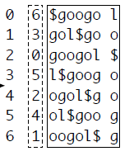
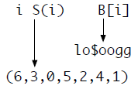

Review
X = googol$
$\underline{R}(W)$ min { k : W is the prefix of X_{S(k)} }
$\overline{R}(W)$ max { k : W is the prefix of X_{S(k)} }
$\underline{R}(go)$ = 1
$\overline{R}(go)$ = 2

Slide 19
Definition
X = googol$
C(a) The number of symbols in X[0,n-2] that are lexicographically smaller than a ∈ ∑
C(g) = 0
C(l) = 2
C(o) = 3

Slide 20
Definition
X = googol$
O(a,i) The number of occurrences of a in B[0,i]
0 , i = 0
1 , i = 1,2
2 , i = 3
3 , 4 <= i <= 6
O(o,i) =
0 , 0 <= i <= 4
1 , i = 5
2 , i = 6
O(g,i) =
O(l,i) = 1 , 0 <= I <= 6

Slide 21

Definition
X = googol$
$\underline{R}\left(aW\right)$ $\text{C}\text{(}\text{a}\text{) + }\text{O}\text{(}\text{a}\text{, }\text{R}\text{(}\text{W}\text{) − 1) + 1}$
$\overline{R}\left(aW\right)$ C(a) + O(a, $\overline{R}\left(W\right)$)
W = go aW = ogo
g
$
o
l
o
o
g

Slide 22

Meaning
X = googol$
$\underline{R}\left(aW\right)$ $\text{C}\text{(}\text{a}\text{) + }\text{O}\text{(}\text{a}\text{, }\text{R}\text{(}\text{W}\text{) − 1) + 1}$
$\overline{R}\left(aW\right)$ C(a) + O(a, $\overline{R}\left(W\right)$)
W = go aW = ogo
C(o) = 3

Slide 23
Meaning
X = googol$
$\underline{R}\left(aW\right)$ $\text{C}\text{(}\text{a}\text{) + }\text{O}\text{(}\text{a}\text{, }\text{R}\text{(}\text{W}\text{) − 1) + 1}$
$\overline{R}\left(aW\right)$ C(a) + O(a, $\overline{R}\left(W\right)$)
W = go aW = ogo

Slide 24
Meaning
X = googol$
$\underline{R}\left(aW\right)$ $\text{C}\text{(}\text{a}\text{) + }\text{O}\text{(}\text{a}\text{, }\text{R}\text{(}\text{W}\text{) − 1) + 1}$
$\overline{R}\left(aW\right)$ C(a) + O(a, $\overline{R}\left(W\right)$)
W = go aW = ogo

Slide 25

Meaning
X = googol$
$\underline{R}\left(aW\right)$ $\text{C}\text{(}\text{a}\text{) + }\text{O}\text{(}\text{a}\text{, }\text{R}\text{(}\text{W}\text{) − 1) + 1}$
$\overline{R}\left(aW\right)$ C(a) + O(a, $\overline{R}\left(W\right)$)
W = go aW = ogo
If $\overline{R}\left(aW\right)$ – R(aW) >= 0, then aW is a substring of X

Slide 26

Example
X = googol$
$\underline{R}\left(aW\right)$ $\text{C}\text{(}\text{a}\text{) + }\text{O}\text{(}\text{a}\text{, }\text{R}\text{(}\text{W}\text{) − 1) + 1}$
$\overline{R}\left(aW\right)$ C(a) + O(a, $\overline{R}\left(W\right)$)
W = go aW = ogo
C(o) = 3

Slide 27
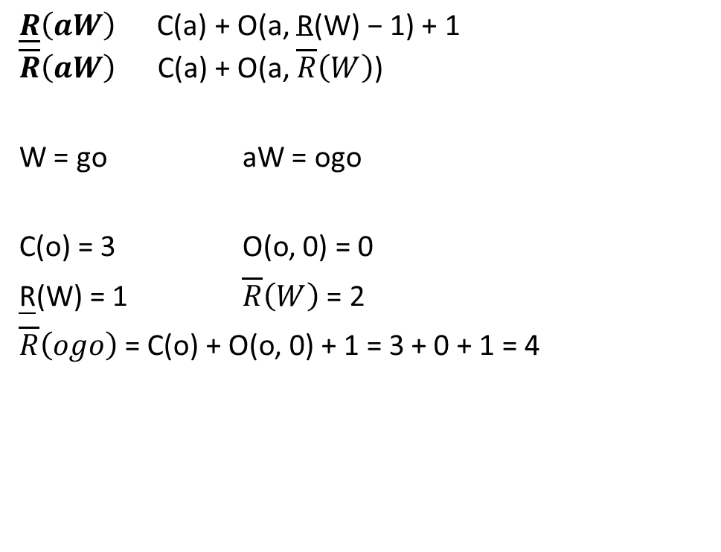
Example
X = googol$
$\underline{R}\left(aW\right)$ $\text{C}\text{(}\text{a}\text{) + }\text{O}\text{(}\text{a}\text{, }\text{R}\text{(}\text{W}\text{) − 1) + 1}$
$\overline{R}\left(aW\right)$ C(a) + O(a, $\overline{R}\left(W\right)$)
W = go aW = ogo
C(o) = 3 O(o, 0) = 0
R(W) = 1 $\overline{R}\left(W\right)$ = 2
$\overline{R}\left(ogo\right)$= C(o) + O(o, 0) + 1 = 3 + 0 + 1 = 4

Slide 28
Example
X = googol$
$\underline{R}\left(aW\right)$ $\text{C}\text{(}\text{a}\text{) + }\text{O}\text{(}\text{a}\text{, }\text{R}\text{(}\text{W}\text{) − 1) + 1}$
$\overline{R}\left(aW\right)$ C(a) + O(a, $\overline{R}\left(W\right)$)
W = go aW = ogo
C(o) = 3

Slide 29
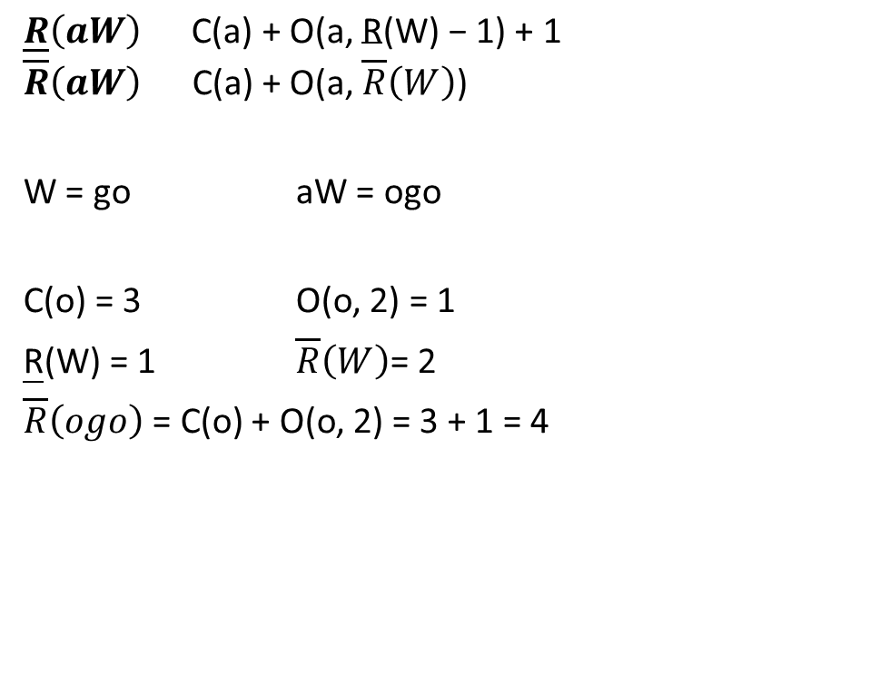
Example
X = googol$
$\underline{R}\left(aW\right)$ $\text{C}\text{(}\text{a}\text{) + }\text{O}\text{(}\text{a}\text{, }\text{R}\text{(}\text{W}\text{) − 1) + 1}$
$\overline{R}\left(aW\right)$ C(a) + O(a, $\overline{R}\left(W\right)$)
W = go aW = ogo
C(o) = 3 O(o, 2) = 1
R(W) = 1 $\overline{R}\left(W\right)$= 2
$\overline{R}\left(ogo\right)$ = C(o) + O(o, 2) = 3 + 1 = 4

Slide 30

Example
X = googol$
$\underline{R}\left(aW\right)$ $\text{C}\text{(}\text{a}\text{) + }\text{O}\text{(}\text{a}\text{, }\text{R}\text{(}\text{W}\text{) − 1) + 1}$
$\overline{R}\left(aW\right)$ C(a) + O(a, $\overline{R}\left(W\right)$)
W = go aW = ogo
$\overline{R}\left(aW\right)$ – R(aW) = 4 – 4 = 0
ogo is a substring of X
S(4) = 2

Slide 31
Outline
Introduction & Background review
Prefix trie and Burrows-Wheeler transform
Exact Matching
Inexact Matching
Result & Conclusion
Reference

Slide 32
Between Exact & Inexact Matching
Exact
  Find all exact substrings (get positions)
Inexact
  Find all similar substrings (get positions)
    Bounded differences (insertion/deletion/mismatch)
Reference string: X
Bob spent all his money
on a game called “monkey money”
money
Query string: W

Slide 33
An artificial example
Reference string: X
TTAACGTTTATTACGTTTAAGTTTAACCTT
Query string: W
AACG
Allowed differences: 2

Slide 34

Straightforward ideas
Reference string: X
TTAACGTTTAACTTGTTTAAGTTTAACCTT
Query string: W
AACG
Allowed differences: 2
To follow the procedures of exact matching, we’ll scan W from right to left
We have a budget of $2 from the beginning
Minus 1 when one difference occurs
Stop when bankrupt occurs or W is fully scanned

Slide 35

Straightforward ideas
Reference string: X
TTAACGTTTAACTTGTTTAA-GTTTAACCTT
AACTTG
Query string: W
AACG
Allowed differences: 2

Slide 36
Straightforward ideas
Reference string: X
TTAACGTTTAACTTGTTTAA-GTTTAACCTT
AACTTG
Query string: W
AACG
Allowed differences: 2

Slide 37
Straightforward ideas
Reference string: X
TTAACGTTTAACTTGTTTAA-GTTTAACCTT
AACTTG
Query string: W
AACG
Allowed differences: 2

Slide 38
Straightforward ideas
Reference string: X
TTAACGTTTAACTTGTTTAA-GTTTAACCTT
AACTTG
AACTTG
Query string: W
AACG
Allowed differences: 2

Slide 39

Straightforward ideas
Reference string: X
TTAACGTTTAACTTGTTTAA-GTTTAACCTT
AACTTG
AACTTG
Query string: W
AACG
Allowed differences: 2

Slide 40
Straightforward ideas
Reference string: X
TTAACGTTTAACTTGTTTAA-GTTTAACCTT
AACTTG
Query string: W
AACG
Allowed differences: 2

Slide 41
Straightforward ideas
Reference string: X
TTAACGTTTAACTTGTTTAA-GTTTAACCTT
AACTTG
Query string: W
AACG
Allowed differences: 2

Slide 42
Straightforward ideas
Reference string: X
TTAACGTTTAACTTGTTTAA-GTTTAACCTT
?
Query string: W
AACG
Allowed differences: 2

Slide 43

Straightforward ideas
Reference string: X
TTAACGTTTAACTTGTTTAAGTTTAACCTT
Query string: W
AACG
Allowed differences: 2

Slide 44
Straightforward ideas
Reference string: X
TTAACGTTTAACTTGTTTAA-GTTTAACCTT
Query string: W
AACG
Allowed differences: 2

Slide 45
Straightforward ideas
Reference string: X
TTAACGTTTAACTTGTTTAA-GTTTAACCTT
Query string: W
AACG
Allowed differences: 2

Slide 46
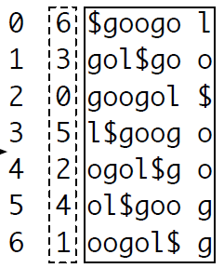
Before illustrating
Something we knew in Exact-Matching
  In O(|W|) time, we can find all positions
    X: googol$ W:go
  In O(1) time, we find all updated positions
    X: googol$ W:ogo
Magic
  “2 numbers” can show all positions

Slide 47

Algorithm
INEXRECUR(W,i,z,k,l)
A Recursive function
  W: query string
  Handle W[i] in this recursion
  z: the remaining budgets
  (k,l) represents the previous interval
Query string: W
AACG

Slide 48
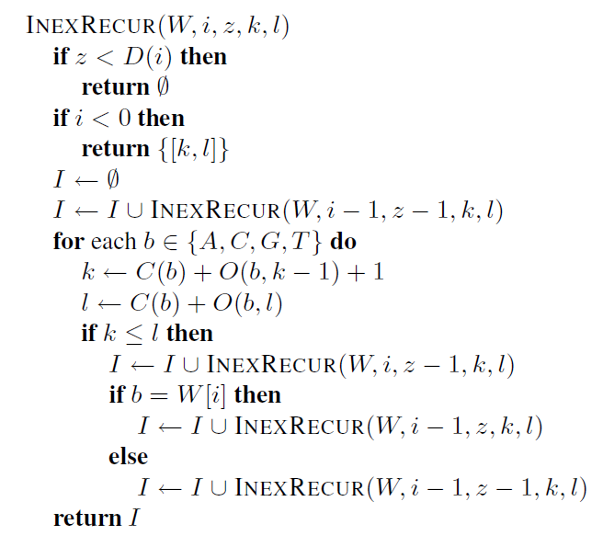
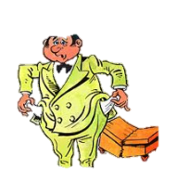
INEXRECUR(W,i,z,k,l)
0
Fully scanned
Return the acceptable interval

Slide 49

INEXRECUR(W,i,z,k,l)
0
TTAACGTTTAACTTGTTTAA-GTTTAACCTT
AACG → AACG
I is ready to collect all similar intervals
Insertion to X

Slide 50
TTAACGTTTAACTTGTTTAA-GTTTAACCTT
AACG → AACG
0
TTAACGTTTAACTTGTTTAA-GTTTAACCTT
AACG → AACG
TTAACGTTTAACTTGTTTAA-GTTTAACCTT
AACG → AACG
deletion from X

Slide 51
0
TTAACGTTTAACTTGTTTAA-GTTTAACCTT
AACG → AACG
match

Slide 52
0
TTAACGTTTAACTTGTTTAAGTTTAACCTT
AACG
mismatch

Slide 53
Inexact Matchings
INEXRECUR(W,|W|-1,allowed_diff,1,|X|-1) gives the inexact-matching intervals

Slide 54
Outline
Introduction & Background review
Prefix trie and Burrows-Wheeler transform
Exact Matching
Inexact Matching
Result & Conclusion
Reference

Slide 55
Implementation
Implemented BWA：to do short read alignment based on the BWT of the reference genome.
BWA is freely available at the MAQ website: http://maq.sourceforge.net.
Format：SAM (Sequence Alignment/Map format).
SAMtools：extract alignments in a region, merge/sort alignments, get SNP/indel calls and visualize the alignment. (http://samtools.sourceforge.net)

Slide 56
Evaluated programs
BWA
MAQ
  (Li et al., 2008a)
SOAPv2
  SOAP-2.1.7 (http://soap.genomics.org.cn)
Bowtie
  Bowtie 0.9.9.2 (Langmead et al., 2009)

Slide 57
Evaluation on simulated data
Human genome with 0.09% SNP mutation rate, 0.01% indel mutation rate and 2% uniform sequencing base error rate.
CPU time in seconds on a single core of a 2.5GHz Xeon E5420 processor (Time)
percent confidently mapped reads (Conf)
percent erroneous alignments out of confident mappings (Err)

Slide 58
Bowtie-32bp：151 sec, Err 6.4%
SOAP-2.1.7：longer than 35bp.
SOAP-2.0.1：is better with 32bp.
SOAPv2：5.4GB.
Bowtie、BWA：2.3GB～3GB
MAQ：1GB.
MAQ：for 128bp

Slide 59
Evaluation on real data
Human genome ：12.2 million read pairs European Read Archive (AC:ERR000589)
CPU time in hours on a single core of a 2.5GHz Xeon E5420 processor (Time),
percent confidently mapped reads (Conf),
percent confident mappings with the mates mapped in the correct orientation and within 300bp (Paired)
Notes:
European Read Archive (AC:ERR000589)：12.2 million pairs of 51bp.These reads were produced by Illumina for NA12750, a male included in the 1000 Genomes Project (http://www.1000genomes.org).

Slide 60
slower -BWA： 6.3 hr 89.2% 99.2%
Notes:
Wrong with human-chicken hybrid
Bowtie：2,640
BWA ： 2,942
MAQ ： 3,005
SOAPv2 ： 4,531
BWA ： 0.06% (=2942*4/12.2M/0.889).

Slide 61
DISCUSSION
Implemented BWA.
BWA outputs alignment in the SAM format to take the advantage of the downstream analyses implemented in SAMtools.
Evaluation on simulated data and real data.
BWA is faster than MAQ (similar alignment accuracy).

Slide 62
Outline
Introduction & Background review
Prefix trie and Burrows-Wheeler transform
Exact Matching
Inexact Matching
Result & Conclusion
Reference

Slide 63
Reference
[1] Heng Li and Richard Durbin, “ Fast and Accurate Short Read Alignment with Burrows-Wheeler Transform” The Wellcome Trust Sanger Institute, 2009.
[2] Bioinformatics for High-throughput sequencing
http://www.bioconductor.org/help/course-materials/2009/EMBLJune09/Talks/NGS_Overview_Simon_Nicolas.pdf
[3] Hon, W.-K., Lam, T.-W., Sadakane, K., Sung, W.-K., and Yiu, S.-M. (2007). A space and time efficient algorithm for constructing compressed suffix arrays. Algorithmica, 48:23–36.
[4] Lam, T. W., Sung, W. K., Tam, S. L., Wong, C. K., and Yiu, S. M. (2008). Compressed indexing and local alignment of DNA. Bioinformatics, 24(6):791–797.

